Slide 1
Phase 7
CAST
Deterministic Scenario Tool:
1 set of loads for 1 set of inputs
Cast/CalCast/DM
Phase 7 Model Structure
Average Load + Inputs * Sensitivity
Land Use Acres
BMPs
Land to Water
Delivery to Tidal Bay
*
*
*
Direct Loads
*
Load by land-river segment and land use

Slide 2
Cast/CalCast/DM
Phase 7 Model Structure
Average Load + Inputs * Sensitivity
Land Use Acres
BMPs
Land to Water
Delivery to Tidal Bay
*
Phase 7
CalCAST
Tool for finding parameters that best match observations
Specified by WQGIT
*
*
Calibrated with estimated priors
Direct Loads
*
Load by land-river segment and land use

Slide 3
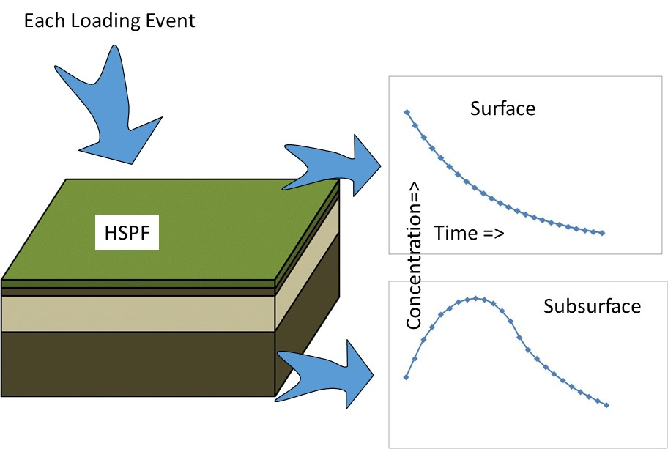
Cast/CalCast/DM
Phase 7
Dynamic Model
Tool for
loading estuarine models
Comparing against observations
Other potential collaborative projects

Slide 4
Watershed Model Plan – Year 2 - 2023
Continue development of CalCAST (Isabella)
  Test improved input data sets
  Fully build out
Continue development of the Dynamic Watershed Model (Gopal)
  Segmentation
  Reservoirs
  Observed Data
Investigate and incorporate new load sources (Gary +)
Help on the way
ORISE watershed modeler
to join team this year

Slide 5
New or revised direct load sources
Boat Discharges
Tidal shoreline erosion
Tidal flooding
CSOs
Grey Infrastructure
Did you like how streambank was explicitly handled in P6?

Slide 6
Observed Stream Data
CBPO will download this year and again in 2025
From USGS NWIS / EPA WQ Portal
Will develop automated QA checks
Make sure that any data you want us to use is in the Portal

Slide 7
Fields we’ll be looking for in Water Quality Portal
Field Name | Field Description | Example Value
Lat/Long*
OrganizationIdentifier | Id of organization performing sampling | «MDDNR»
MonitoringLocationIdentifier* | Id of sampling station | «01491000»
CharacteristicName*ª | Measured parameter/analyte | «Total suspended solids»
USGSPCode*ª | Measured parameter/analyte | «80154»
CharacteristicType | Broad category of environmental measurement | «Nutrient»
ActivityMediaName | Environmental medium where sample was taken | «Water»
MonitoringLocationTypeName* | Type of sampling station | «Stream»
*Mandatory Fields (other fields are helpful if any of the mandatory fields are entered incorrectly)
ªEither provide CharacteristicName or USGSPCode

