Slide 1
CAST Updates
Helen Golimowski
helen@devereuxconsulting.com
April 24, 2023

Slide 2
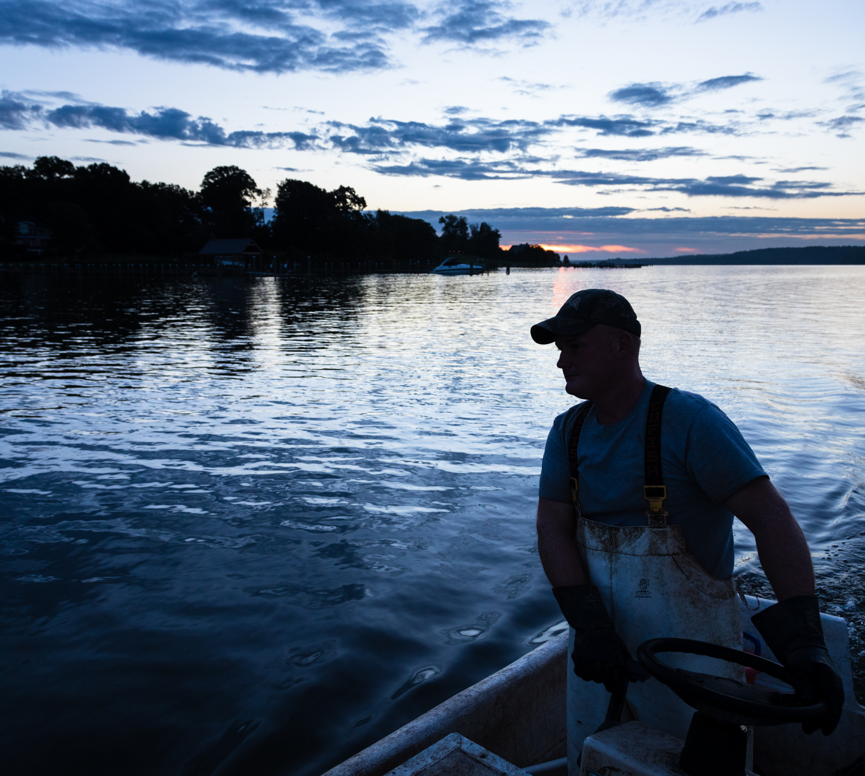

Good News for the Chesapeake Bay!
The aquatic life was restored in roughly 400 miles of rivers and streams and 2,000 acres of lakes in the Chesapeake Bay watershed
Recreation was restored in roughly 350 miles of rivers and streams and 400 acres of lakes in the Chesapeake Bay watershed
Fish consumption use was restored in roughly 60 miles of rivers and streams and 800 acres of lakes in the Chesapeake Bay watershed
While not conclusive evidence of a causal relationship, we hope that CAST helped planners reach these goals

Slide 3
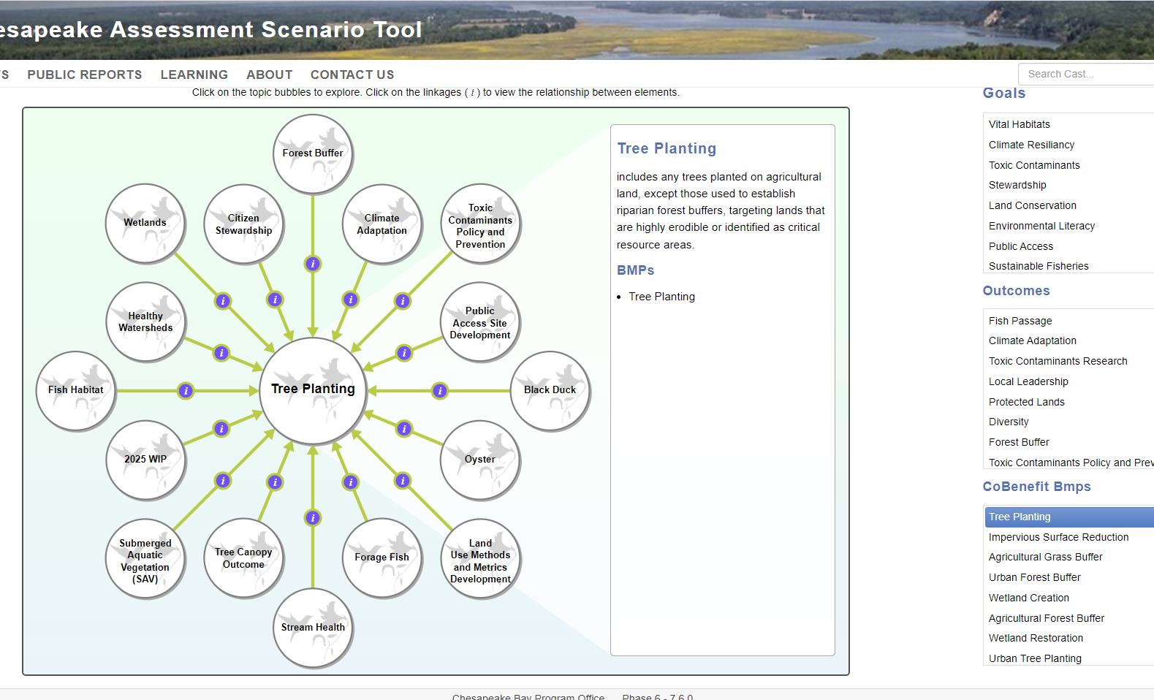
Ecosystem Benefits Browser
The Chesapeake Bay Program developed the Ecosystem Benefits Browser, an interactive tool that visualizes and summarizes the Goals, Outcomes, and Co-benefits associated with CAST BMPs
It was reviewed at the STAC Ecosystem Services workshop and at the GIT Co-Chairs meeting on March 22, 2023. Overall, feedback has been positive!
The link to the Browser can be found on the Ecosystem Benefits page
Please reach out to Olivia and Helen via CAST Contact Us to let us know how you are using the new tool
https://cast.chesapeakebay.net/ecohealth/index

Slide 4
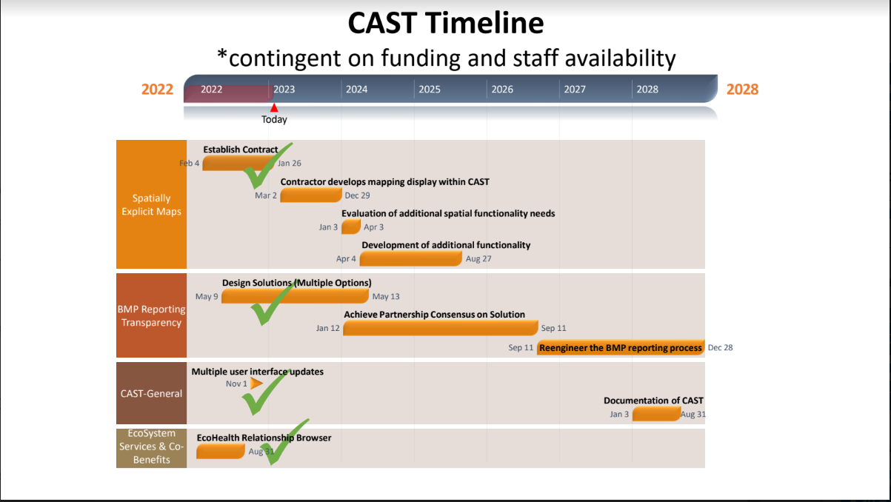

Slide 5
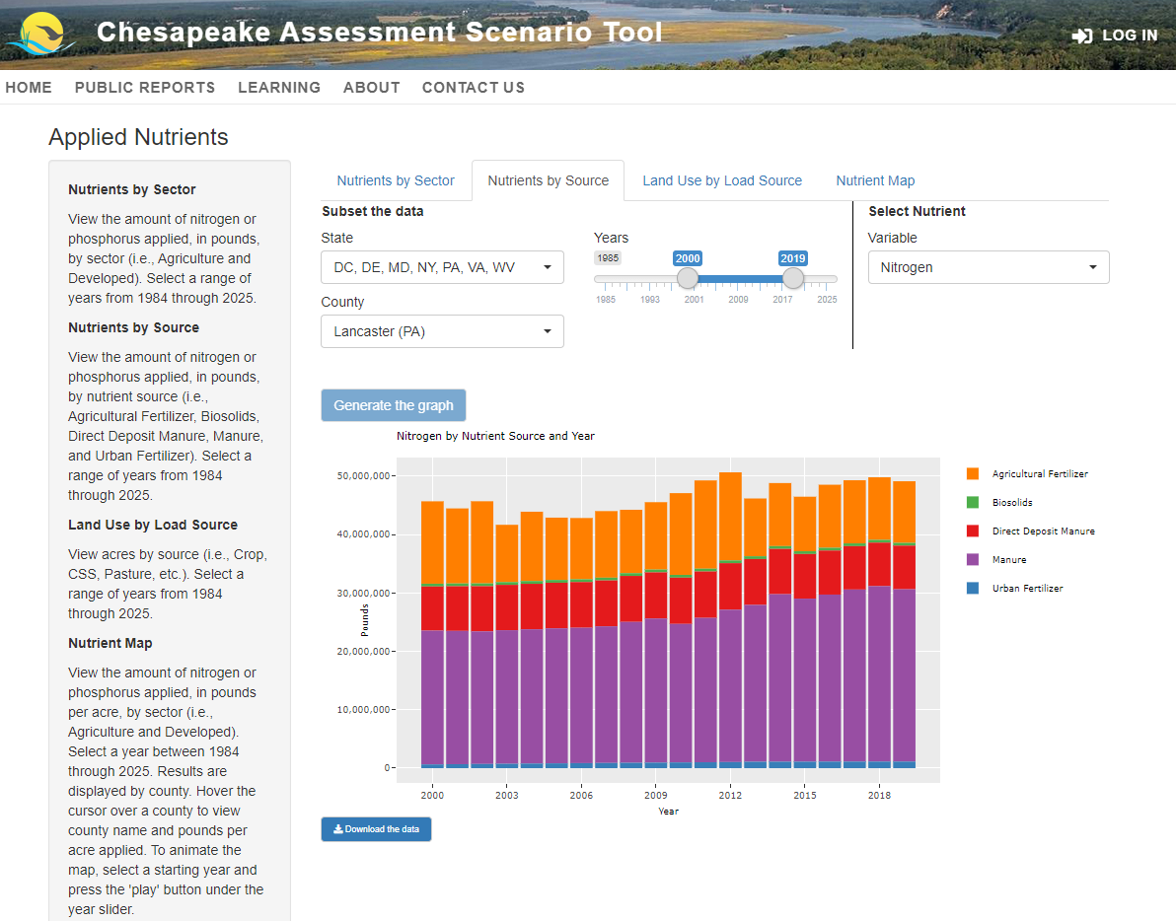
Maps: Integrate the land use with the planning and assessment functionality
Seeking contractor support for the following:
  Develop a new API service specific to the Chesapeake 1-meter dataset
  Use zonal algorithms that are easily parallelizable and can manage large queries through a distributed data processing cluster
  To work in an online tool, develop an algorithm using the number of vertices of an area of interest, as opposed to area dependent
  The Fast-Zonal Statistics (FZS) API is labeled “fast” because to determine the zonal sum for a polygon over a raster surface, only the cells which intersect the boundary of the polygon must be traversed rather than all the interior cells. This means that computationally the approach scales much better with increased data resolution as the FZS algorithm is constant in relation to the length (meters) of the polygon perimeter rather than its area (meters square). (Haag et al. 2020, https://www.sciencedirect.com/science/article/pii/S0098300419306697)

Slide 6
Maps: Integrate the land use with the planning and assessment functionality
Seeking contractor support for the following:
  Develop a new API service specific to the Chesapeake 1-meter dataset
  Use zonal algorithms that are easily parallelizable and can manage large queries through a distributed data processing cluster
  To work in an online tool, develop an algorithm using the number of vertices of an area of interest, as opposed to area dependent
  The Fast-Zonal Statistics (FZS) API is labeled “fast” because to determine the zonal sum for a polygon over a raster surface, only the cells which intersect the boundary of the polygon must be traversed rather than all the interior cells. This means that computationally the approach scales much better with increased data resolution as the FZS algorithm is constant in relation to the length (meters) of the polygon perimeter rather than its area (meters square). (Haag et al. 2020, https://www.sciencedirect.com/science/article/pii/S0098300419306697)
Approach decreases the processing time to seconds.
Visualization of the 1-meter data could be achieved through a separate map tiling service

Slide 7
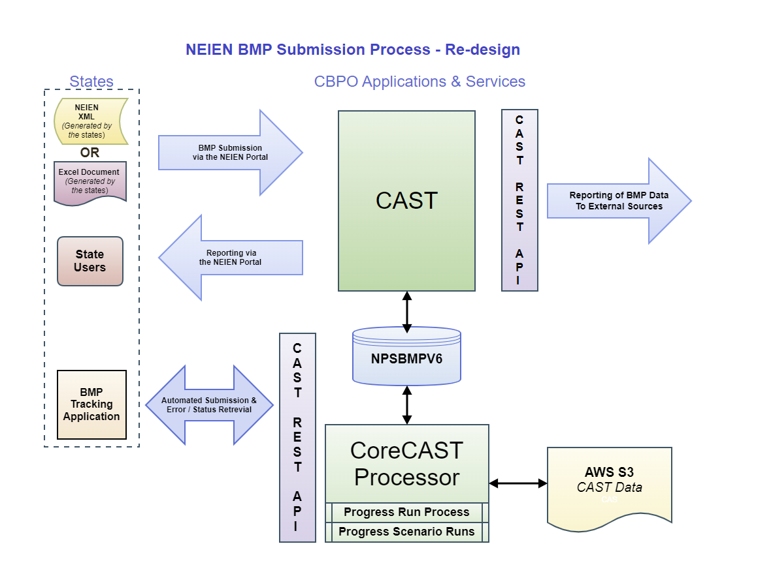
Future Update
We are moving forward with CAST improvements that were planned as part of the WQGIT priorities
One updates is to improve transparency in reporting BMPs annually
This includes updates to the software used in annual reporting
  Re-design NPSBMPV6 database to meet CBPO database standards and best practices.
  Design and build processes to upload XML and Excel files via CAST including data validation and error reporting. This could be another application but would make sense to include it in the NEIEN Portal on CAST.
  Design and build the Progress Run Process. This process pulls BMPs from the NPSBMPV6 database and loads them into CAST including error reporting. Developing this as a process on the CoreCAST Process would be faster and more efficient.
  Longer Term: Develop RESTful API services for automated submission and reporting of submitted BMPs and for consumption of BMP and Scenario-related data.
No changes to the current NEIEN schema or requirements to change the xml format
Updates will take more than a year to implement, and will therefore not affect 2023 progress

Slide 8
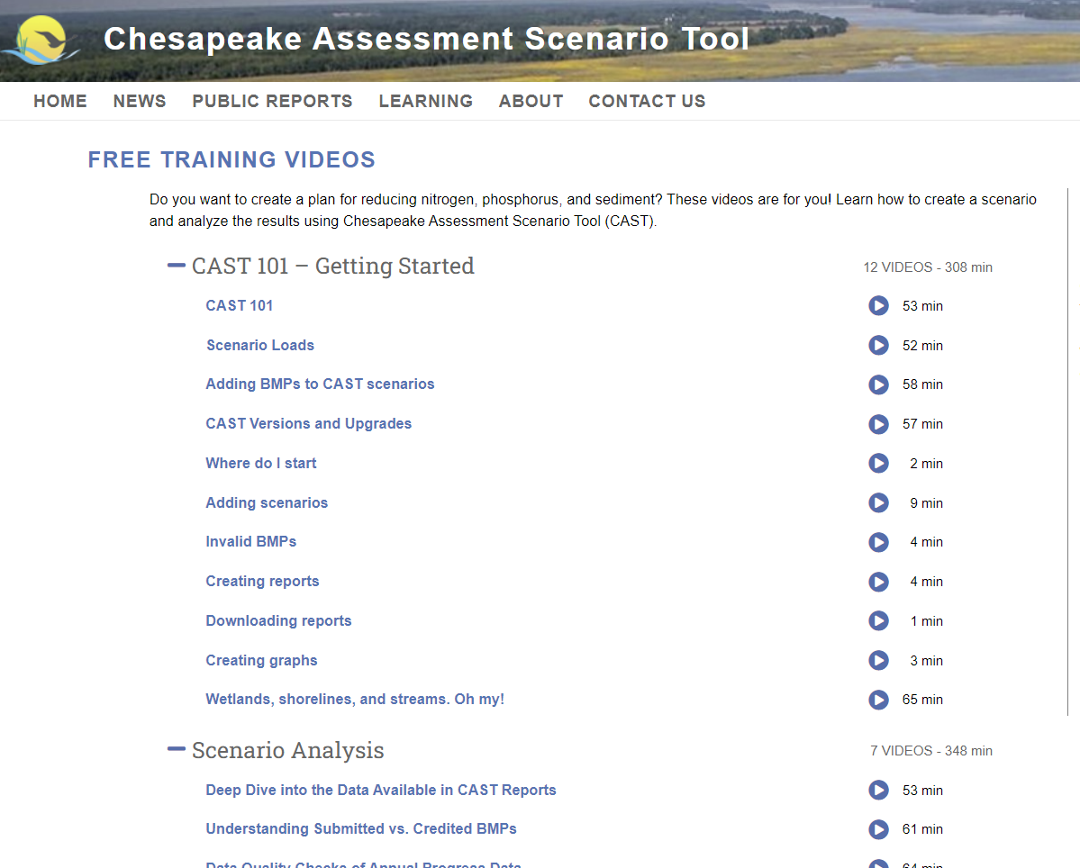
March CAST Webinar
Conowingo and Climate Change WIPs
  Last month’s CAST webinar highlighted the Conowingo WIP and climate change. We first defined and dove into the background of the Conowingo WIP. Then, we discussed how climate change impacts the TMDLs and how it is addressed in the WIPs. Finally, we demonstrated how to use tools in CAST to quantify the differences between the Conowingo WIP and Climate Change WIP scenarios.
A recording of the webinar is available on the Free Training Videos page, under Scenarios Analysis
In total, there are 32 videos ranging from 2 minutes to an hour available to all
https://cast.chesapeakebay.net/Learning/FreeTrainingVideos

Slide 9
April CAST Webinar
BMP Targeting Maps
  This month’s webinar will highlight the BMP targeting maps. We will explain how to read the maps and use the BMP pounds reduced and costs by county tool. Then, we will walk through the steps to create a planning scenario based on this BMP targeting information, and how to read the results of the scenario. Finally, we will circle back and share the CAST resources that were used to create the targeting maps and tools.
Thursday, April 20th at noon EST
Information will be included in the CAST Newsletter and posted to the Free Training Videos

