Slide 1

So, You Want to Have a Meeting?
Applying Meeting Science to Improve your Meetings
Sherry Witt, Senior Facilitator, GDIT

Slide 2
What makes a good meeting?

Slide 3
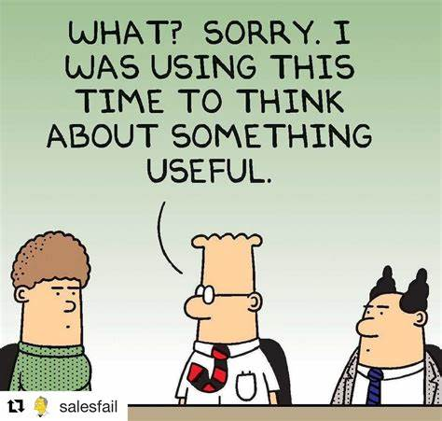
What makes bad meetings
No agenda
Too many people, too few people
No purpose/objectives/goals/meeting outcomes
Wasting individual times
No positive, actionable results
No value added
Facilitator allows dysfunction to happen
Meeting invite doesn’t have enough information
Lack of logistics planning/correction
Late start
Lack of structure; disorganized; poor planning
Miscommunication
Negative feedback
Inconclusive
Uncomfortable environment

Slide 4
Meetings Matter!
Inclusion
Innovation
Return on Investment
Engagement
Building of Trust
Teamwork/ Collective Brainpower
Connection
Communication
Collaboration
Cooperation
Consensus Building
More Perspectives

Slide 5
Types of Meetings
Status Update Meetings
Information Sharing Meetings
Decision Making Meetings
Problem Solving Meetings
Innovation Meetings
Team Building Meetings

Slide 6

When a Meeting is Necessary
Topic is complex
Topic spans multiple functions, expertise, persons/departments/organizations
Allows persons/departments/organization to be apart of the decision making and next steps for buy in and better results
Helpful to gain feedback and perspectives from different persons
Best to collect information “face-to-face” and in real time
Collaboration and communication is necessary in advance of developing documentation or messages
When in doubt, ask others!

Slide 7
AND when it’s not….
Meeting has no clear purpose or outcomes.
Reoccurring meeting outlives its purpose.
Critical participants are not available.
Participants don’t have enough information to fully participate or adequate time to prepare.
Feedback or information is better received in other ways.
Friday afternoon before holiday weekend. ☹
Monday morning after holiday weekend. ☹

Slide 8
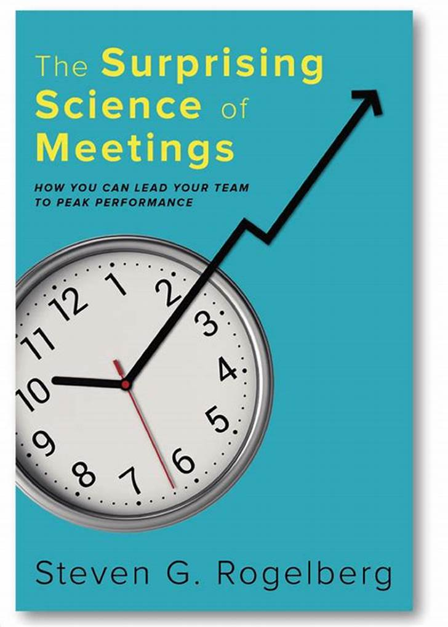
U.S. employees endure 55 million meetings/day
50% of meeting time is not effective
68-100% of employees complain about being in meetings
Only 2% of Fortune 500 companies are employing engagement surveys about meeting effectiveness
Bad meetings impact employee engagement, but so do good meetings
Meetings that start late had meaningful consequences
The data on agendas is not impressive, but the way they are facilitated and managed is
Silent brainstorming yields better results
Making your meetings better result in tremendous financial and engagement gains
Meetings can be vastly improved by leveraging evidence-based paths and strategies

Slide 9

Have a steward mindset.
Don’t default to 1-hour meetings.
Manage meeting size.
Start and end your meetings well.
Frame your agenda topics as questions.
Try alternative formats.
Evaluate your meetings periodically.

Slide 10
Problem: A few dominate the conversation Solution: Build engagement in your design
Be intentional in your agenda design.
Speak to participants in advance of meeting (ask for engagement from your non-talkers).
Establish norms/ground rules.
Consider dyadic work, work in pairs first to get everyone engaged.
Collect and synthesize information from participants in advance of meeting.
Brainstorm in silence (anonymous input may be more effective)
Use meeting apps for voting.

Slide 11
Cultural Changes Around Meetings
Offer meaningful training on running meetings.
Package agendas with meaningful change.
Require approval for large meetings.
Get groups talking about meetings. Make a plan
Uphold meeting free time (e.g., Finish it Fridays).
Endorse meeting guidance/principles/chief meeting officer.
Assess on engagement and pulse surveys around meetings.

Slide 12
Meeting Preparation
Meeting Conduct
Post Meeting
Designing Effective Meetings

Slide 13
Meeting Preparation
What type of meeting are you having?
Define the purpose and expected outcomes
Identify who needs to come to fulfill the purpose and outcomes
Prepare your agenda, have good questions, consider group dynamics and techniques
Get documentation in order - let people prepare before the meeting. Set folks up for success. Think about the timing to send that out.
Send out meeting invitations with the appropriate information needed. Make connections to persons in advance if it helps to fulfil the purpose.
Prepare your meeting kit (sticky notes, sharpies, dot voting stickers, markers, name tents) what you need to conduct your meeting effectively
Determine if you need help (e.g., registration, technology, breakout support)

Slide 14
Adriana Girdler’s Ground Rules
You are responsible for our success
One person speaks at a time
Be supportive of all opinions
Be on time when returning from breaks
Think process not personality
Think how it CAN be done, not how it can’t
Be flexible in your thinking – out of box thinking is required
What is said here stays here
Phone and computers off
Details, details, details

Slide 15
Developing the Purpose & Outcomes
What problem might it help solve?
What will people get out of the meeting?
What will be different after this meeting?
What do you want the participants to leave the meeting having accomplished or determined?
How will people feel when they leave this meeting? What will people leave this event talking about?
At the end of the meeting, what needs to happen for all to feel it was worthwhile.
What would a successful outcome look like? How might it be measured? What is the outcome you most expect? What is the one you most desire?
What is the purpose of your meeting? What else? What else? What else?

Slide 16
Who Gets In, Who Stays Out
Who helps to fulfill the purpose?
Who threatens the purpose?
If the list is getting out of control, you need to ask – who was this meeting for first?

Slide 17
Validating Your Meeting Design
Are we getting to the outcomes as quickly as possible?
What will it feel like?
Do I have a balance of energy?
Is it confusing or clear?
Am I over-committing the time?
Can I reframe the agenda topic as a question?
Have I clearly defined the meeting purpose and expected outcomes?
Do topics affect the entire group and does the whole group need to solve them?
Do I have the right people to fulfill the meeting purpose and outcomes?
Does the design make the connections you want to create? (Connections just don’t happen on their own)

Slide 18
Meeting Conduct
Arrive early to set up your meeting (e.g., avoid technical issues)
Use specific tools so participants know what to expect from them (Ground Rules, Parking Lot, Time Outs)
Start meetings well – greet them, make introductions
Manage the conversations, work with group dynamics
Ensure everyone has the opportunity to participate
Summarize agreed upon action items with due dates
End meetings well – end on a high note, be grateful for their time

Slide 19
Post Meeting
What will post-meeting activity look like? How do you capitalize in the work done in your meeting for the future?
Determine what follow up looks like and communicate it with your participants and their role in fulfilling to it.
Send everything collected during the meeting within 24 hours to participants.
Evaluate meetings periodically (how are you as a meeting leader, how to improve meetings, evaluate feedback)

Slide 20

Ichi-go iche-e
“One meeting, one moment in your life that will never happen again.”
“….praise this moment because [the next time we meet], we’ll have a new experience, and we will be different people and will be bringing new experiences with us, because we are also changed.”
What will make this meeting different from all the others?

