Slide 1
Phase 7 Land Use: Update
Peter Claggett¹, Labeeb Ahmed¹, Elliot Kurtz², Sean MacFaden³, Patrick McCabe², Sarah McDonald¹, Jarlath O’Neill-Dunne³, Katie Walker²
¹ Lower Mississippi-Gulf Water Science Center, U.S. Geological Survey
² Chesapeake Conservancy’s Conservation Innovation Center
³ University of Vermont’s Spatial Analysis Laboratory
Water Quality Goal Implementation Team Meeting
April 24, 2023

Slide 2
Chesapeake Bay 1-meter Land Use/Cover Classification (64 classes)
Water and Water Margins (6)
10 Tidal Waters
Lentic
11 Lakes & Reservoirs
12 Riverine Ponds
13 Terrene Ponds
Lotic
14 Streams and Rivers (visible water)
15 Bare Shore
Development (18)
Impervious
    20 Roads
    21 Structures
    22 Other Impervious (Parking lots, driveways)
    23 TC over Roads
    24 TC over Structures
    25 TC over Other Impervious
    31 Extractive Impervious
32 Solar Field Panel Arrays
Pervious
26 Tree Canopy over Turf Grass
27 Turf Grass
28 Bare Developed
    30 Extractive Barren
33 Solar Field Barren
34 Solar Field Herbaceous
35 Solar Field Shrubland
36 Suspended Succession Barren
37 Suspended Succession Herbaceous
38 Suspended Succession Shrubland
Natural Lands (25)
Tree Canopy
40 Forest
41 Tree Canopy, Other
Open Space
42 Natural Succession Barren
43 Natural Succession Herbaceous
44 Natural Succession Shrubland
45 Harvested Forest Barren
46 Harvested Forest Herbaceous
Riverine Wetlands
50 Riverine Wetlands Barren
      51 Riverine Wetlands Herbaceous
      52 Riverine Wetlands Shrubland
      53 Riverine Wetlands Tree Canopy
      54 Riverine Wetlands Forest
      55 Riverine Wetlands Harvested Forest
      Terrene Wetlands (isolated)
60 Terrene Wetlands Barren
      61 Terrene Wetlands Herbaceous
      62 Terrene Wetlands Shrubland
      63 Terrene Wetlands Tree Canopy
      64 Terrene Wetlands Forest
      65 Terrene Wetlands Harvested Forest
      Tidal Wetlands
70 Tidal Wetlands Barren
      71 Tidal Wetlands Herbaceous
      72 Tidal Wetlands Shrubland
      73 Tidal Wetlands Tree Canopy
      74 Tidal Wetlands Forest
      75 Tidal Wetlands Harvested Forest
Agriculture (15)
Productive Lands
80 Cropland Barren
81 Cropland Herbaceous
82 Orchards and Vineyards Barren
83 Orchards and Vineyards Herbaceous
84 Orchards and Vineyards Shrubland
85 Pasture Barren
86 Pasture Herbaceous
87 Hay Barren
88 Hay Herbaceous
Agricultural Facilities
90 Agricultural Structures
91 Animal Operation Impervious
92 Animal Operation Barren
93 Animal Operation Herbaceous
94 TC over Agricultural Structure
95 TC over Animal Operation Impervious

Slide 3
Phase 6 Roll-up of High-Res Land Use Classes
Impervious, Roads (1)
20 Roads
2. Impervious, Non-Roads (6)
    21 Structures
    22 Other Impervious (Parking lots, driveways)
31 Extractive Impervious
32 Solar Field Panel Arrays
90 Agricultural Structures
91 Animal Operation Impervious
3. Tree Canopy Over Impervious (5)
    23 TC over Roads
    24 TC over Structures
    25 TC over Other Impervious
94 TC over Agricultural Structure
95 TC over Animal Operation Impervious
4. Turf Grass (1)
27 Turf Grass
5. Tree Canopy over Turf Grass (1)
26 Tree Canopy over Turf Grass
6. Forest (6)
40 Forest
41 Tree Canopy, Other
53 Riverine Wetlands Tree Canopy
54 Riverine Wetlands Forest
63 Terrene Wetlands Tree Canopy
64 Terrene Wetlands Forest
Mixed Open (14)
15 Bare Shore
28 Bare Developed
30 Extractive Barren
33 Solar Field Barren
34 Solar Field Herbaceous
35 Solar Field Shrubland
36 Suspended Succession Barren
37 Suspended Succession Herbaceous
38 Suspended Succession Shrubland
42 Natural Succession Barren
43 Natural Succession Herbaceous
44 Natural Succession Shrubland
45 Harvested Forest Barren
46 Harvested Forest Herbaceous
8. Wetlands, Riverine Non-forested (4)
50 Riverine Wetlands Barren
      51 Riverine Wetlands Herbaceous
      52 Riverine Wetlands Shrubland
55 Riverine Wetlands Harvested Forest
9. Wetlands, Terrene Non-forested (4)
60 Terrene Wetlands Barren
      61 Terrene Wetlands Herbaceous
      62 Terrene Wetlands Shrubland
      65 Terrene Wetlands Harvested Forest
10. Cropland (5)
80 Cropland Barren
81 Cropland Herbaceous
82 Orchards and Vineyards Barren
83 Orchards and Vineyards Herbaceous
84 Orchards and Vineyards Shrubland
11. Pasture / Hay (6)
85 Pasture Barren
86 Pasture Herbaceous
87 Hay Barren
88 Hay Herbaceous
92 Animal Operation Barren
93 Animal Operation Herbaceous
12. Water (4)
11 Lakes & Reservoirs
12 Riverine Ponds
13 Terrene Ponds
14 Streams and Rivers (visible water)
Other Classes (7)
10 Tidal Waters
70 Tidal Wetlands Barren
71 Tidal Wetlands Herbaceous
        72 Tidal Wetlands Shrubland
        73 Tidal Wetlands Tree Canopy
        74 Tidal Wetlands Forest
        75 Tidal Wetlands Harvested Forest
Notes:
General classification with 18 classes.

Slide 4
Tidal forests: a Watershed model land use or Water Quality model input?
Impervious, Roads (1)
20 Roads
2. Impervious, Non-Roads (6)
    21 Structures
    22 Other Impervious (Parking lots, driveways)
31 Extractive Impervious
32 Solar Field Panel Arrays
90 Agricultural Structures
91 Animal Operation Impervious
3. Tree Canopy Over Impervious (5)
    23 TC over Roads
    24 TC over Structures
    25 TC over Other Impervious
94 TC over Agricultural Structure
95 TC over Animal Operation Impervious
4. Turf Grass (1)
27 Turf Grass
5. Tree Canopy over Turf Grass (1)
26 Tree Canopy over Turf Grass
6. Forest (6)
40 Forest
41 Tree Canopy, Other
53 Riverine Wetlands Tree Canopy
54 Riverine Wetlands Forest
63 Terrene Wetlands Tree Canopy
64 Terrene Wetlands Forest
Mixed Open (14)
15 Bare Shore
28 Bare Developed
30 Extractive Barren
33 Solar Field Barren
34 Solar Field Herbaceous
35 Solar Field Shrubland
36 Suspended Succession Barren
37 Suspended Succession Herbaceous
38 Suspended Succession Shrubland
42 Natural Succession Barren
43 Natural Succession Herbaceous
44 Natural Succession Shrubland
45 Harvested Forest Barren
46 Harvested Forest Herbaceous
8. Wetlands, Riverine Non-forested (4)
50 Riverine Wetlands Barren
      51 Riverine Wetlands Herbaceous
      52 Riverine Wetlands Shrubland
55 Riverine Wetlands Harvested Forest
9. Wetlands, Terrene Non-forested (4)
60 Terrene Wetlands Barren
      61 Terrene Wetlands Herbaceous
      62 Terrene Wetlands Shrubland
      65 Terrene Wetlands Harvested Forest
10. Cropland (5)
80 Cropland Barren
81 Cropland Herbaceous
82 Orchards and Vineyards Barren
83 Orchards and Vineyards Herbaceous
84 Orchards and Vineyards Shrubland
11. Pasture / Hay (6)
85 Pasture Barren
86 Pasture Herbaceous
87 Hay Barren
88 Hay Herbaceous
92 Animal Operation Barren
93 Animal Operation Herbaceous
12. Water (4)
11 Lakes & Reservoirs
12 Riverine Ponds
13 Terrene Ponds
14 Streams and Rivers (visible water)
Other Classes (7)
10 Tidal Waters
70 Tidal Wetlands Barren
71 Tidal Wetlands Herbaceous
        72 Tidal Wetlands Shrubland
        73 Tidal Wetlands Tree Canopy
        74 Tidal Wetlands Forest
        75 Tidal Wetlands Harvested Forest
Notes:
General classification with 18 classes.

Slide 5
Potential Shifts in the Roll-up for Phase 7
Impervious, Roads (1)
20 Roads
2. Impervious, Non-Roads (6)
    21 Structures
    22 Other Impervious (Parking lots, driveways)
31 Extractive Impervious
32 Solar Field Panel Arrays
90 Agricultural Structures
91 Animal Operation Impervious
3. Tree Canopy Over Impervious (5)
    23 TC over Roads
    24 TC over Structures
    25 TC over Other Impervious
94 TC over Agricultural Structure
95 TC over Animal Operation Impervious
4. Turf Grass (1)
27 Turf Grass
5. Tree Canopy over Turf Grass (1)
26 Tree Canopy over Turf Grass
6. Forest (6)
40 Forest
41 Tree Canopy, Other
53 Riverine Wetlands Tree Canopy
54 Riverine Wetlands Forest
63 Terrene Wetlands Tree Canopy
64 Terrene Wetlands Forest
Mixed Open (14)
15 Bare Shore
28 Bare Developed
30 Extractive Barren
33 Solar Field Barren
34 Solar Field Herbaceous
35 Solar Field Shrubland
36 Suspended Succession Barren
37 Suspended Succession Herbaceous
38 Suspended Succession Shrubland
42 Natural Succession Barren
43 Natural Succession Herbaceous
44 Natural Succession Shrubland
45 Harvested Forest Barren
46 Harvested Forest Herbaceous
8. Wetlands, Riverine Non-forested (4)
50 Riverine Wetlands Barren
      51 Riverine Wetlands Herbaceous
      52 Riverine Wetlands Shrubland
55 Riverine Wetlands Harvested Forest
9. Wetlands, Terrene Non-forested (4)
60 Terrene Wetlands Barren
      61 Terrene Wetlands Herbaceous
      62 Terrene Wetlands Shrubland
      65 Terrene Wetlands Harvested Forest
10. Cropland (5)
80 Cropland Barren
81 Cropland Herbaceous
82 Orchards and Vineyards Barren
83 Orchards and Vineyards Herbaceous
84 Orchards and Vineyards Shrubland
11. Pasture / Hay (6)
85 Pasture Barren
86 Pasture Herbaceous
87 Hay Barren
88 Hay Herbaceous
92 Animal Operation Barren
93 Animal Operation Herbaceous
12. Water (4)
11 Lakes & Reservoirs
12 Riverine Ponds
13 Terrene Ponds
14 Streams and Rivers (visible water)
Other Classes (7)
10 Tidal Waters
70 Tidal Wetlands Barren
71 Tidal Wetlands Herbaceous
        72 Tidal Wetlands Shrubland
        73 Tidal Wetlands Tree Canopy
        74 Tidal Wetlands Forest
        75 Tidal Wetlands Harvested Forest
Notes:
General classification with 18 classes.

Slide 6
Potential for Double-Counting Reported Acres: Construction, Harvested Forest, Feeding Space
Impervious, Roads (1)
20 Roads
2. Impervious, Non-Roads (6)
    21 Structures
    22 Other Impervious (Parking lots, driveways)
31 Extractive Impervious
32 Solar Field Panel Arrays
90 Agricultural Structures
91 Animal Operation Impervious
3. Tree Canopy Over Impervious (5)
    23 TC over Roads
    24 TC over Structures
    25 TC over Other Impervious
94 TC over Agricultural Structure
95 TC over Animal Operation Impervious
4. Turf Grass (1)
27 Turf Grass
5. Tree Canopy over Turf Grass (1)
26 Tree Canopy over Turf Grass
6. Forest (6)
40 Forest
41 Tree Canopy, Other
53 Riverine Wetlands Tree Canopy
54 Riverine Wetlands Forest
63 Terrene Wetlands Tree Canopy
64 Terrene Wetlands Forest
Mixed Open (14)
15 Bare Shore
28 Bare Developed
30 Extractive Barren
33 Solar Field Barren
34 Solar Field Herbaceous
35 Solar Field Shrubland
36 Suspended Succession Barren
37 Suspended Succession Herbaceous
38 Suspended Succession Shrubland
42 Natural Succession Barren
43 Natural Succession Herbaceous
44 Natural Succession Shrubland
45 Harvested Forest Barren
46 Harvested Forest Herbaceous
8. Wetlands, Riverine Non-forested (4)
50 Riverine Wetlands Barren
      51 Riverine Wetlands Herbaceous
      52 Riverine Wetlands Shrubland
55 Riverine Wetlands Harvested Forest
9. Wetlands, Terrene Non-forested (4)
60 Terrene Wetlands Barren
      61 Terrene Wetlands Herbaceous
      62 Terrene Wetlands Shrubland
      65 Terrene Wetlands Harvested Forest
10. Cropland (5)
80 Cropland Barren
81 Cropland Herbaceous
82 Orchards and Vineyards Barren
83 Orchards and Vineyards Herbaceous
84 Orchards and Vineyards Shrubland
11. Pasture / Hay (6)
85 Pasture Barren
86 Pasture Herbaceous
87 Hay Barren
88 Hay Herbaceous
92 Animal Operation Barren
93 Animal Operation Herbaceous
12. Water (4)
11 Lakes & Reservoirs
12 Riverine Ponds
13 Terrene Ponds
14 Streams and Rivers (visible water)
Other Classes (7)
10 Tidal Waters
70 Tidal Wetlands Barren
71 Tidal Wetlands Herbaceous
        72 Tidal Wetlands Shrubland
        73 Tidal Wetlands Tree Canopy
        74 Tidal Wetlands Forest
        75 Tidal Wetlands Harvested Forest
Notes:
General classification with 18 classes.

Slide 7
Potential New Classes (with unique loading rates) for Phase 7
Impervious, Roads (1)
20 Roads
2. Impervious, Non-Roads (6)
    21 Structures
    22 Other Impervious (Parking lots, driveways)
31 Extractive Impervious
32 Solar Field Panel Arrays
90 Agricultural Structures
91 Animal Operation Impervious
3. Tree Canopy Over Impervious (5)
    23 TC over Roads
    24 TC over Structures
    25 TC over Other Impervious
94 TC over Agricultural Structure
95 TC over Animal Operation Impervious
4. Turf Grass (1)
27 Turf Grass
5. Tree Canopy over Turf Grass (1)
26 Tree Canopy over Turf Grass
6. Forest (6)
40 Forest
41 Tree Canopy, Other
53 Riverine Wetlands Tree Canopy
54 Riverine Wetlands Forest
63 Terrene Wetlands Tree Canopy
64 Terrene Wetlands Forest
Mixed Open (14)
15 Bare Shore
28 Bare Developed
30 Extractive Barren
33 Solar Field Barren
34 Solar Field Herbaceous
35 Solar Field Shrubland
36 Suspended Succession Barren
37 Suspended Succession Herbaceous
38 Suspended Succession Shrubland
42 Natural Succession Barren
43 Natural Succession Herbaceous
44 Natural Succession Shrubland
45 Harvested Forest Barren
46 Harvested Forest Herbaceous
8. Wetlands, Riverine Non-forested (4)
50 Riverine Wetlands Barren
      51 Riverine Wetlands Herbaceous
      52 Riverine Wetlands Shrubland
55 Riverine Wetlands Harvested Forest
9. Wetlands, Terrene Non-forested (4)
60 Terrene Wetlands Barren
      61 Terrene Wetlands Herbaceous
      62 Terrene Wetlands Shrubland
      65 Terrene Wetlands Harvested Forest
10. Cropland (5)
80 Cropland Barren
81 Cropland Herbaceous
82 Orchards and Vineyards Barren
83 Orchards and Vineyards Herbaceous
84 Orchards and Vineyards Shrubland
11. Pasture / Hay (6)
85 Pasture Barren
86 Pasture Herbaceous
87 Hay Barren
88 Hay Herbaceous
92 Animal Operation Barren
93 Animal Operation Herbaceous
12. Water (4)
11 Lakes & Reservoirs
12 Riverine Ponds
13 Terrene Ponds
14 Streams and Rivers (visible water)
Other Classes (7)
10 Tidal Waters
70 Tidal Wetlands Barren
71 Tidal Wetlands Herbaceous
        72 Tidal Wetlands Shrubland
        73 Tidal Wetlands Tree Canopy
        74 Tidal Wetlands Forest
        75 Tidal Wetlands Harvested Forest
Notes:
General classification with 18 classes.

Slide 8
Evaluating Potential New Land Use Classes for Phase 7
CalCAST
SPARROW
Chesapeake Healthy Watershed Assessment 2.0
Various ongoing USGS, STAC, and academic studies evaluating the hydrologic and nutrient/sediment effects of specific land uses

Slide 9
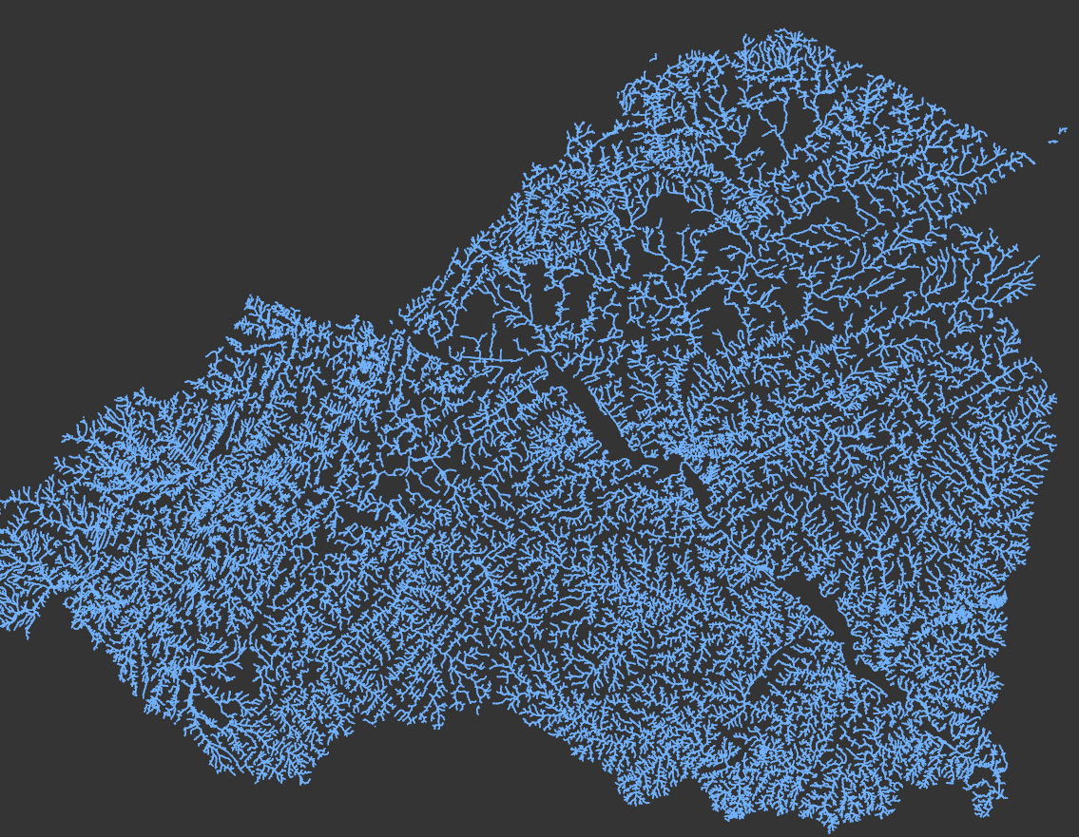
Hyper-Res Hydrography (separate from land use)
Lower Susquehanna Example
CBP Hyper-Resolution Streams, 1:2000
(Lower Susquehanna Example)
Attributes:
Channel type probability (gully, ditch, stream, etc.)
Bank height
Channel width
Floodplain width (TBD)
Entrenchment ratio (TBD)
Flow permanence probability (TBD)
Stream order
Drainage area

Slide 10

Phase 7 Land Use History: 1985 - 2012
SPATIAL
DATA
LCMAP / NLCD (30m)
LANDFIRE
High-Resolution Land Use
Parcel and Road Segments
1987
1990
1992
1997
2000
2001
2002
2004
2006
2007
2008
2010
2011
2012
2013/14
2017/18
2020
2021/22
TABULAR
DATA
USDA Census of Agriculture
Decennial Census of Population and Housing
American Community Survey
LCMAP: Land Change Monitoring, Assessment, and Projection; CBLCD: Chesapeake Bay Land Cover Data series; NLCD: National Land Cover Database

Slide 11
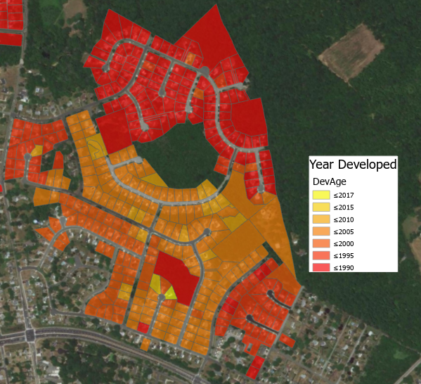
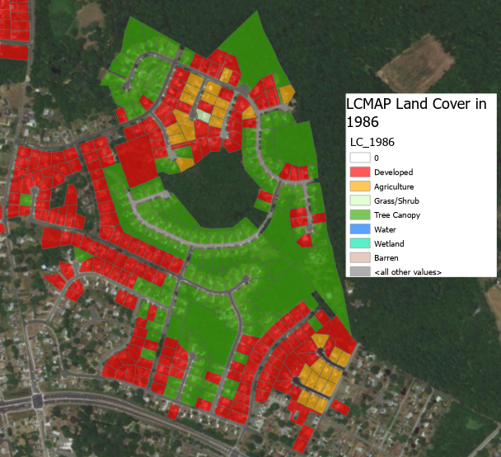
Back-Casting Development Example
Year Developed (LCMAP)
Land Cover 1986 (LCMAP)

Slide 12
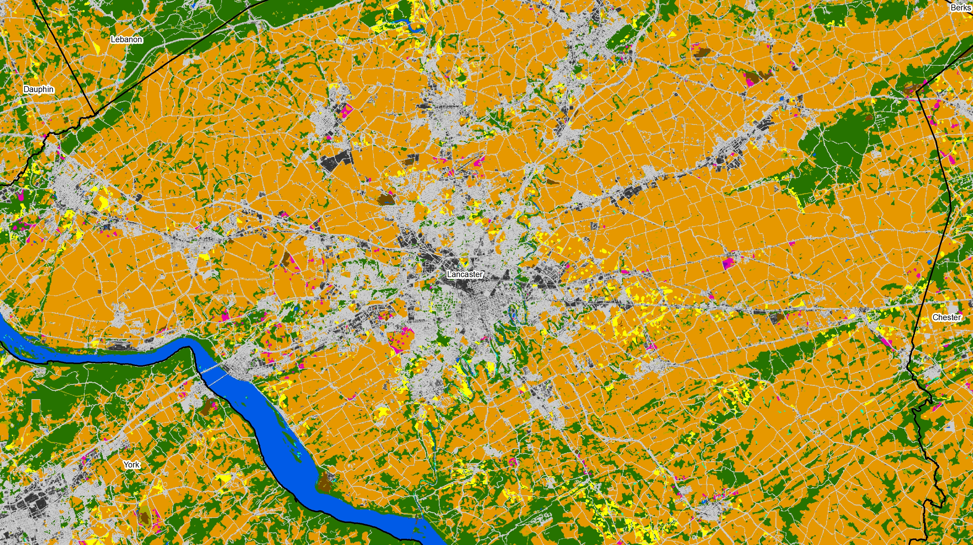
Forecasting Future Land Use Change
Use the Chesapeake Bay Land Change Model to:
Forecast land use change from 2020 through 2075 in 5-year increments;
  Simulate residential, commercial, mixed-use, solar fields, and land conservation;
  Parameterize model using 1-meter land use change from 2013/14 to 2021/22;
  Improve the predictive power of the CBLCM through use of machine learning;
  Revisit the purpose and effectiveness of Land Policy BMPs.

Slide 13

Contact Information
(i.e., how to get a copy of the SCFM Toolbox?)
Peter R. Claggett
Research Geographer
pclaggett@usgs.gov
443-370-5724

