Slide 1
RISING WATER TEMPERATURES:
Ecological Implications and Management Recommendations from the STAC Workshop
Katie Brownson (U.S. Forest Service)
&
Julie Reichert-Nguyen (NOAA/Climate Resiliency Workgroup)
Water Quality Goal Implementation Team Meeting - April 24. 2023

Slide 2
Watershed Acknowledgements
Synthesis Element #1 Paper (Water Temperature Effects on Fisheries and Stream Health in Nontidal Waters): Stephen Faulkner, Kevin Krause, Rosemary Fanelli, Matthew Cashman, Than Hitt and Benjamin Letcher, USGS; Frank Borsuk and Greg Pond, EPA
Synthesis Element #1 Addendum (Temperature Criteria in CBP Jurisdictions' Water Quality Standards and Information on Warmwater Species): Rebecca Hanmer, EPA-retired; Jonathan Leiman, Maryland Department of the Environment; Daniel Goetz, Maryland Department of Natural Resources; Robert Breeding, Virginia Department of Environmental Quality; and Matthew Robinson, DC Department of Energy and Environment
Synthesis Element #4 Paper (Watershed Characteristics and Landscape Factors Influencing Vulnerability and Resilience to Rising Stream
Temperatures): Renee Thompson, USGS; Nora Jackson, CRC/CBP; Judy Okay, J&J Consulting; Nancy Roth, Tetra Tech; Sally Claggett, USFS
Synthesis Element #5 Paper (Trends): Rich Batiuk, CoastWise Partners; Nora Jackson, CRC/CBP; John Clune, USGS; Kyle Hinson, VIMS; Renee Karrh, Maryland Department of Natural Resources; Mike Lane, Old Dominion University; Rebecca Murphy, University of Maryland Center for Environmental Science/CBP; and Roger Stewart, Virginia Department of Environmental Quality
Synthesis Element #6 Paper (Model Projections): Rich Batiuk, CoastWise Partners; Gopal Bhatt, Pennsylvania State University/CBP; Lewis
Linker, U.S. EPA CBP; Gary Shenk, USGS/CBP; Richard Tian, University of Maryland Center for Environmental Sciences/CBP; and Guido Yactayo, Maryland Department of the Environment
Synthesis Element #7/8 Paper (Impacts of BMPs and Habitat Restoration on Water Temperatures): Katie Brownson and Sally Claggett, USFS; Tom Schueler, CSN; Anne Hairston-Strang and Iris Allen, Maryland Department of Natural Resources-Forestry; Frank Borsuk and Lucinda Power, EPA; Mark Dubin, UMD; Matt Ehrhart, Stroud; Stephen Faulkner, USGS; Jeremy Hanson, VT; Katie Ombalski, Woods & Waters
Consulting
Synthesis Element #10 Paper (Monitoring): Peter Tango, Breck Sullivan, John Clune, and Scott Phillips, USGS
Thank you to all the contributors and workshop participants!

Slide 3
Tidal Acknowledgements
Synthesis Element #2 Paper (Tidal Fisheries and Habitat Impacts): Bruce Vogt, Jay Lazar, and Emily Farr, NOAA; Mandy Bromilow, NOAA Affiliate; Justin Shapiro, CRC
Synthesis Element #3 Paper (SAV Impacts): Brooke Landry and Becky Golden, Maryland DNR; Marc Hensel and Chris Patrick, VIMS; Dick Zimmerman and Rhianne Cofer, Old Dominion University; Bob Murphy, TetraTech
Synthesis Element #5 Paper (Trends): Rich Batiuk, CoastWise Partners; Nora Jackson, CRC/CBP; John Clune, USGS; Kyle Hinson, VIMS; Renee Karrh, Maryland Department of Natural Resources; Mike Lane, Old Dominion University; Rebecca Murphy, University of Maryland Center for Environmental Science/CBP; and Roger Stewart, Virginia Department of Environmental Quality
Synthesis Element #6 Paper (Model Projections): Rich Batiuk, CoastWise Partners; Gopal Bhatt, Pennsylvania State University/CBP; Lewis Linker, U.S. EPA CBP; Gary Shenk, USGS/CBP; Richard Tian, University of Maryland Center for Environmental Sciences/CBP; and Guido Yactayo, Maryland Department of the Environment
Synthesis Element #9 Paper (Indicators): Julie Reichert-Nguyen and Bruce Vogt, NOAA; Mandy Bromilow, NOAA Affiliate; Ron Vogel, UMD for NOAA Satellite Service; Breck Sullivan, USGS; Anissa Foster, NOAA-CRC Internship Program
Synthesis Element #10 Paper (Monitoring): Peter Tango, Breck Sullivan, John Clune, and Scott Phillips, USGS
Thank you to all the contributors and workshop participants!

Slide 4
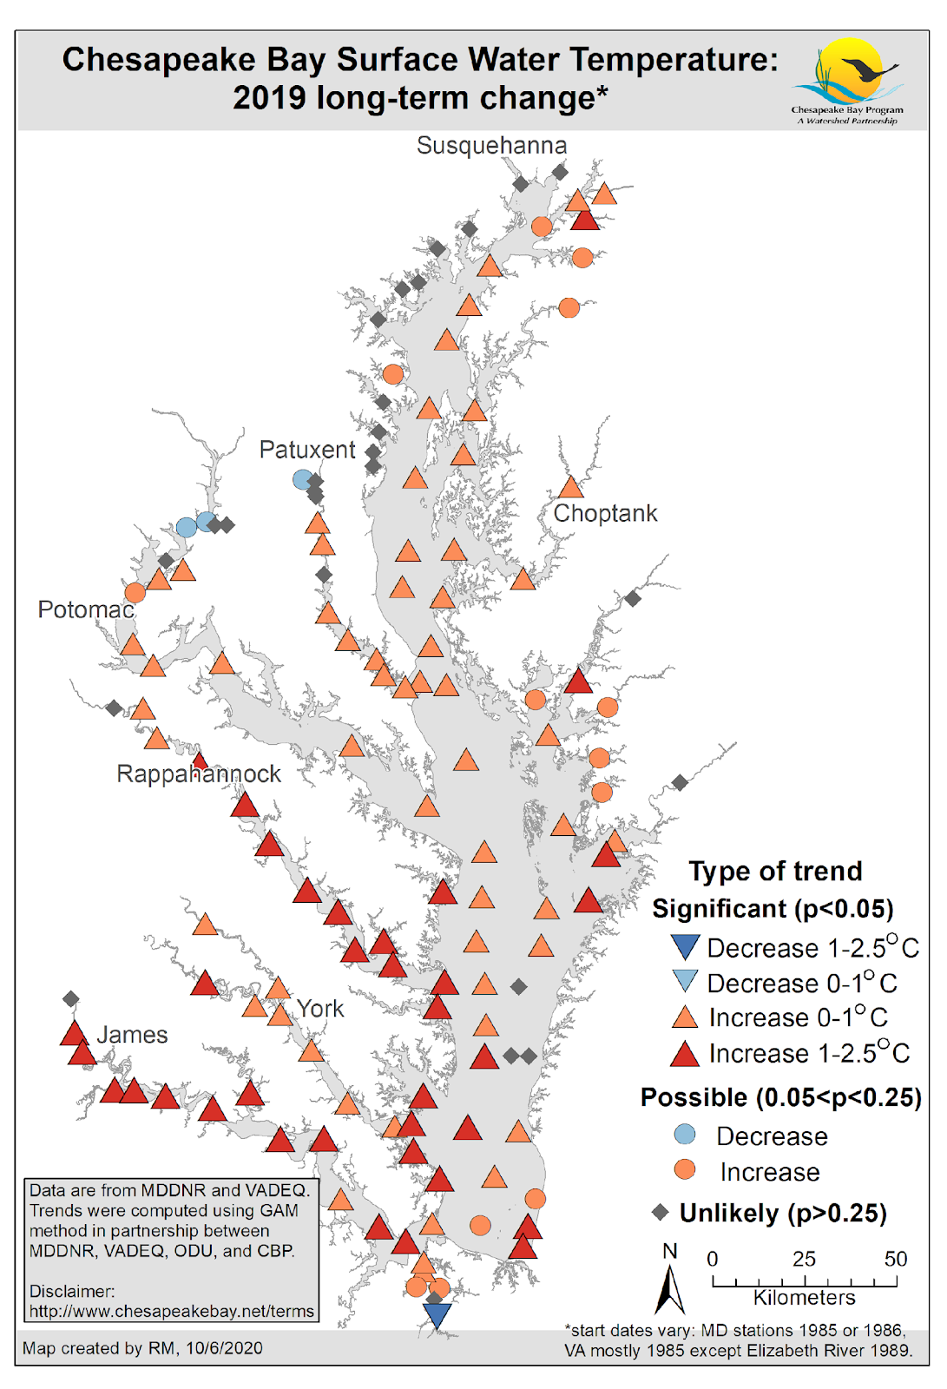
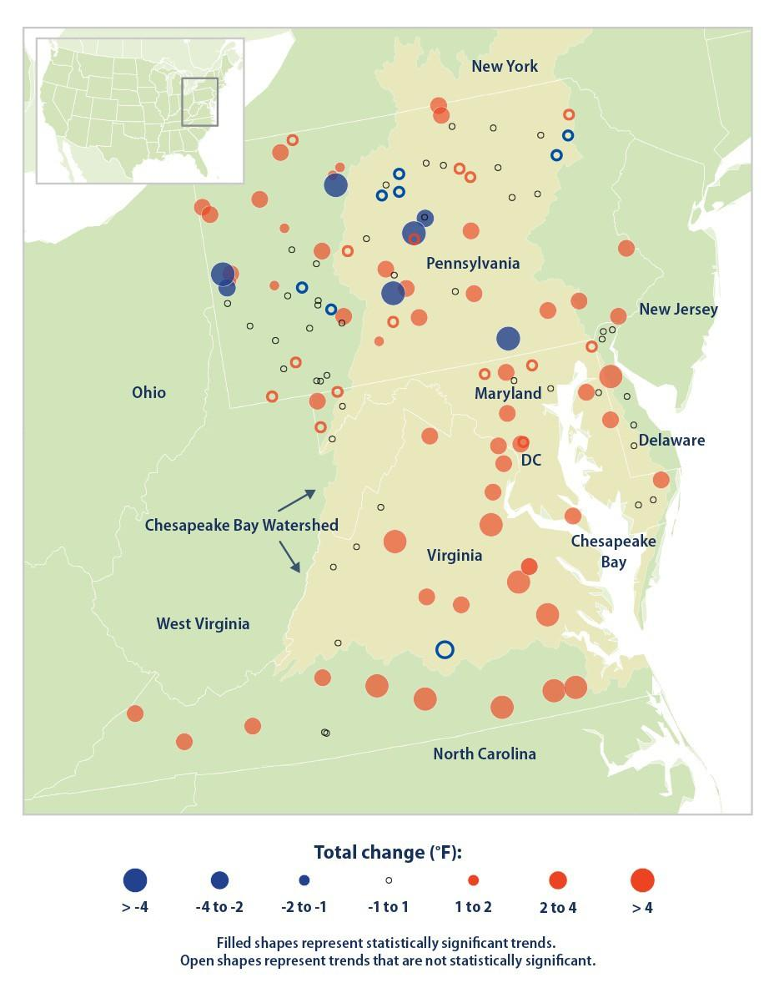
Chesapeake Bay tidal and non-tidal water temperatures have been increasing.
(Rice and Jastram, 2015)

Slide 5
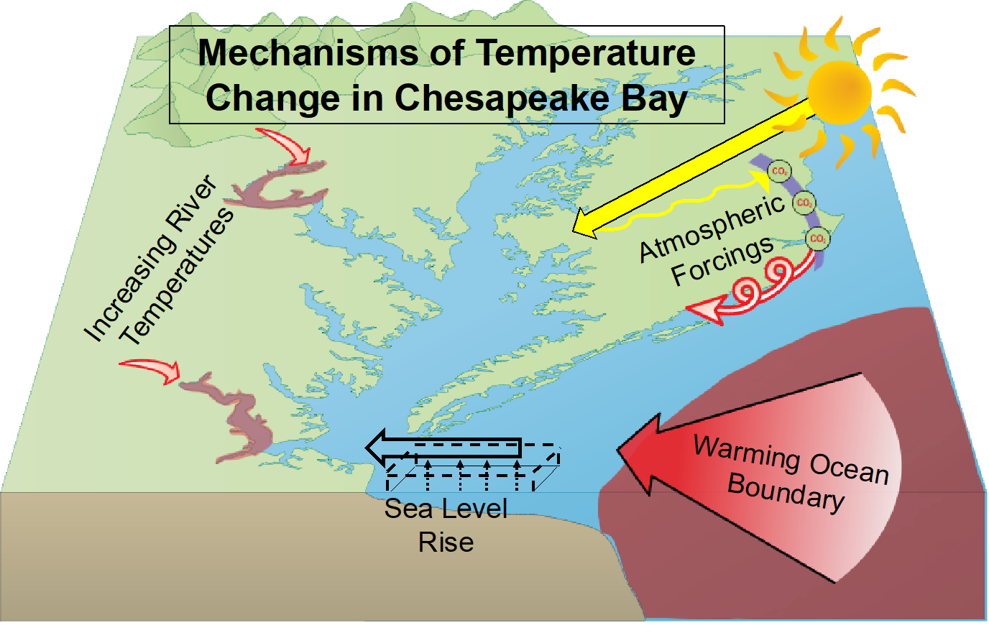
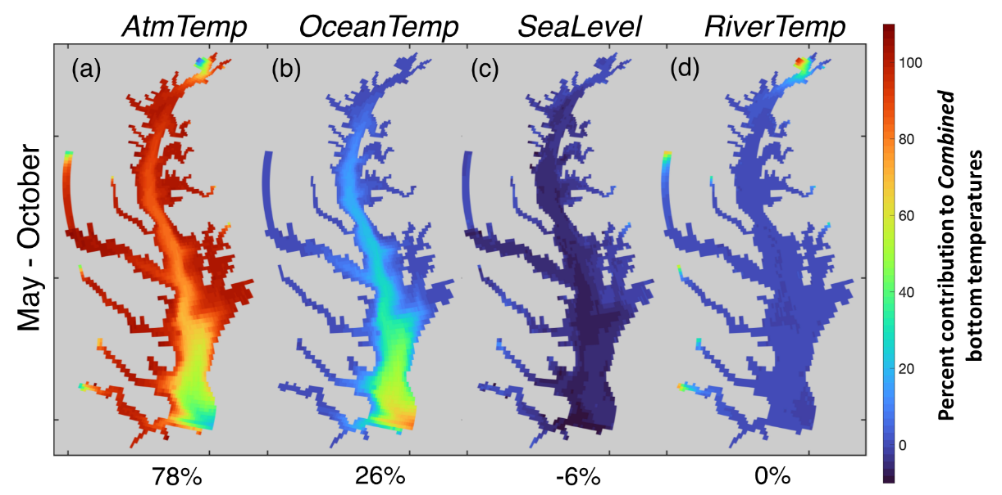
Increasing tidal water temperatures have been driven largely by atmospheric forcings
and the warming ocean boundary
Air temperatures
Ocean temperatures
Sea level rise
River temperatures
Source: Hinson at el. 2021
Notes:
But the mechanisms driving warming water temperatures vary between tidal and non-tidal waters
Increasing tidal water temperatures have been driven largely by atmospheric forcings and the warming ocean boundary and are therefore not likely able to be mitigated through watershed restoration strategies.

Slide 6
Increasing stream and river temperatures have been driven by rising air temperatures, but other drivers have a strong influence
Heat transfer from channel substrate
  Substrate composition (bedrock vs. gravel)
  Hyporheic exchange
  Residence time in hyporheic zone
Groundwater inputs
  Hyporheic exchange
  Groundwater temperature
  Degree of infiltration
  Groundwater residence time
  Legacy sediment
  Underlying geology
Runoff temperature
  Sources of water (farm ponds, municipal, mining and industrial discharge, snowmelt, etc.)
  Upstream and riparian land use
  Degree of infiltration
Channel temperature buffering capacity
  Surface area: volume ratio
  Channel form
  Large woody debris
  Instream vegetation
  Water clarity
  Stream size
Streamflow
  Baseflow
  Withdrawals (from surface or groundwater)
  Local hydrology (presence of dams, floodplain connectivity, etc.)
  Hydraulic resistance
  Upstream and riparian land use
  Groundwater inputs
  Degree of infiltration
  Rainfall
Non-tidal water temperature
Air temperature
  Direct solar radiation
  Canopy cover
  Ambient air temperature
Notes:
In nontidal waters, the story is more complex.
There are also multiple factors influencing water temperature, including whether there are groundwater inputs, runoff temperature, which can be heavily influenced by upstream land use, and whether a stream is shaded.
These drivers will vary in importance over space and time – some may be more relevant than others in different seasons and in different parts of the watershed.

Slide 7
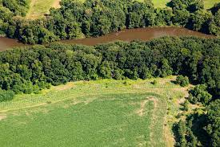
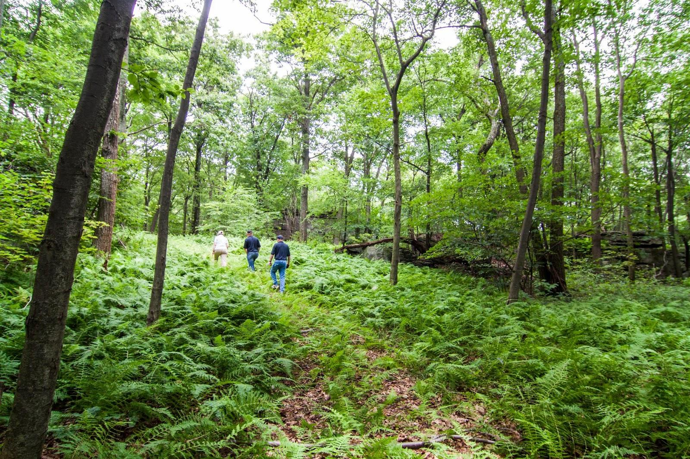
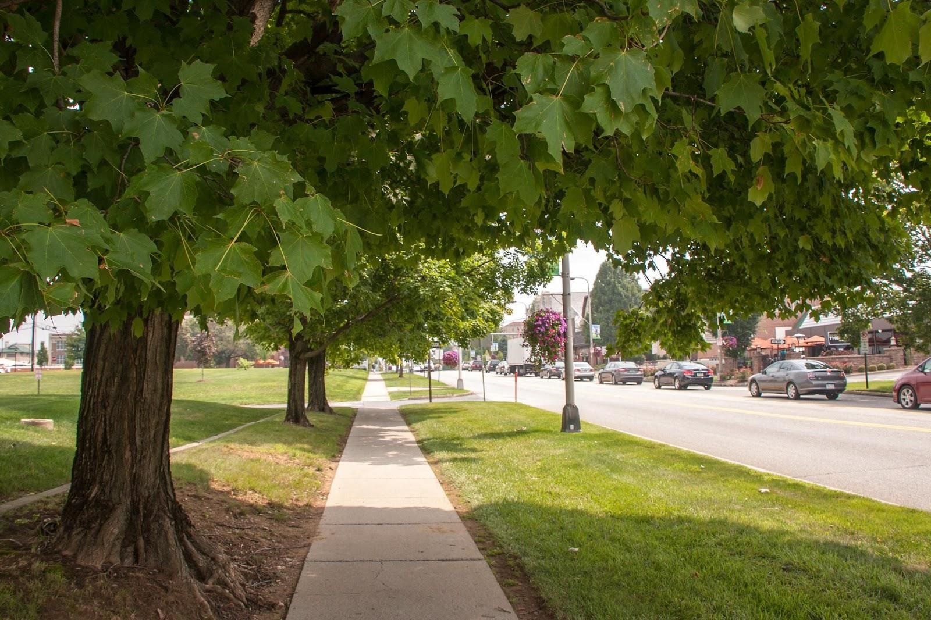
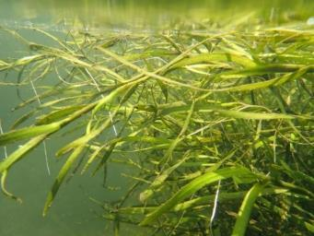
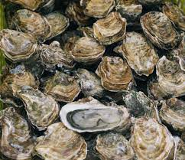
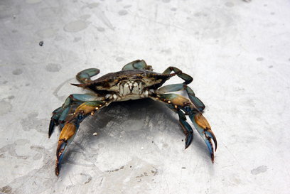
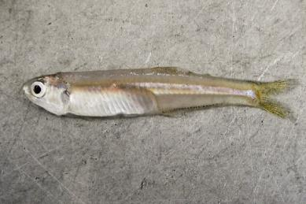
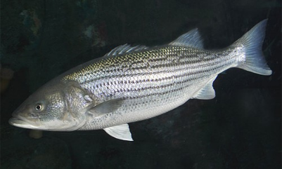
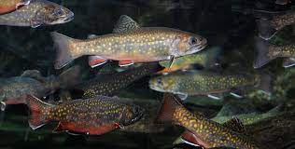
BMPs
Conservation
Land use practices
Mitigation
Lowering of Water Temps
Watershed
Tidal & Watershed
Adaptation
Minimize Impacts & Adjust
Submerged Aquatic Vegetation (SAV)
Oysters
Blue Crabs
Forage
Striped Bass
Brook Trout
(Menhaden, Bay anchovy, benthic invertebrates)
Notes:
Given these important differences between the drivers of rising water temperatures between tidal and nontidal waters, we divided the workshop effort into two sub-groups. The watershed, or non-tidal subgroup looked at opportunities to both mitigate and adapt to rising water temperatures. Mitigation efforts focus on what we can do on the land to directly cool water temperatures or minimize the extent to which heated runoff is entering waterways.
- Adaptation approaches tend to be focused on restoration or management activities that can help minimize impacts on particular species or habitats. The tidal group primarily focused on adaptation approaches, given that tidal water temperatures are more driven by global forces

Slide 8
Watershed
Ecological Impacts and Recommendations
Leads: Katie Brownson, U.S. Forest Service & Rebecca Hanmer, Forestry Workgroup Chair

Slide 9
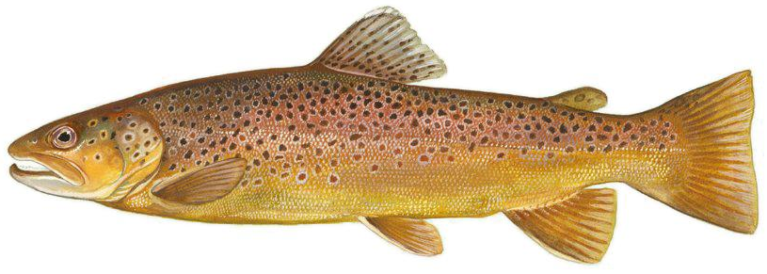
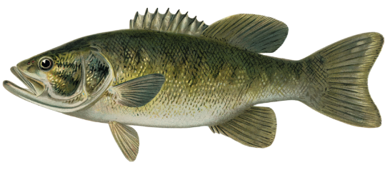
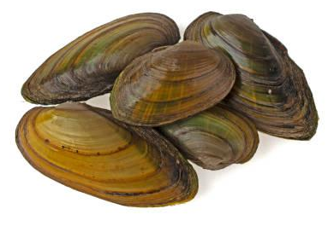
Ecological Impacts - Species
Strongest negative impacts on coldwater species (e.g., trout, sculpin) and their habitats (esp. where streams aren’t driven by groundwater )
Watershed-wide, warmwater aquatic species are most common. Although more tolerant to temperature increases, they are sensitive to extreme temperatures including rapid changes and to indirect effects (e.g., invasives, pathogens) from higher temps.
More study needed of temperature effects on lower foodweb
    Algae, biofilms, zooplankton
    Macroinvertebrates
    Freshwater mussels & host species

Slide 10
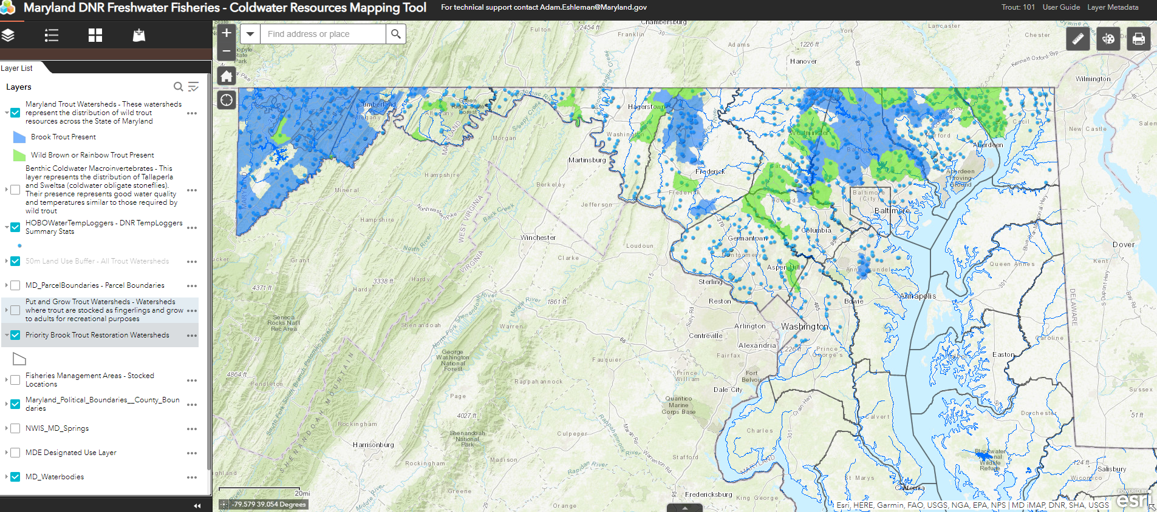
Coldwater Fisheries and Habitat Recommendation
Chesapeake Bay Program partners need to accelerate conservation to protect the coldwater streams now supporting healthy aquatic life, especially native brook trout, which are extremely sensitive to rising water temperatures, and continue resiliency analyses and mapping to focus coldwater habitat restoration efforts.

Slide 11
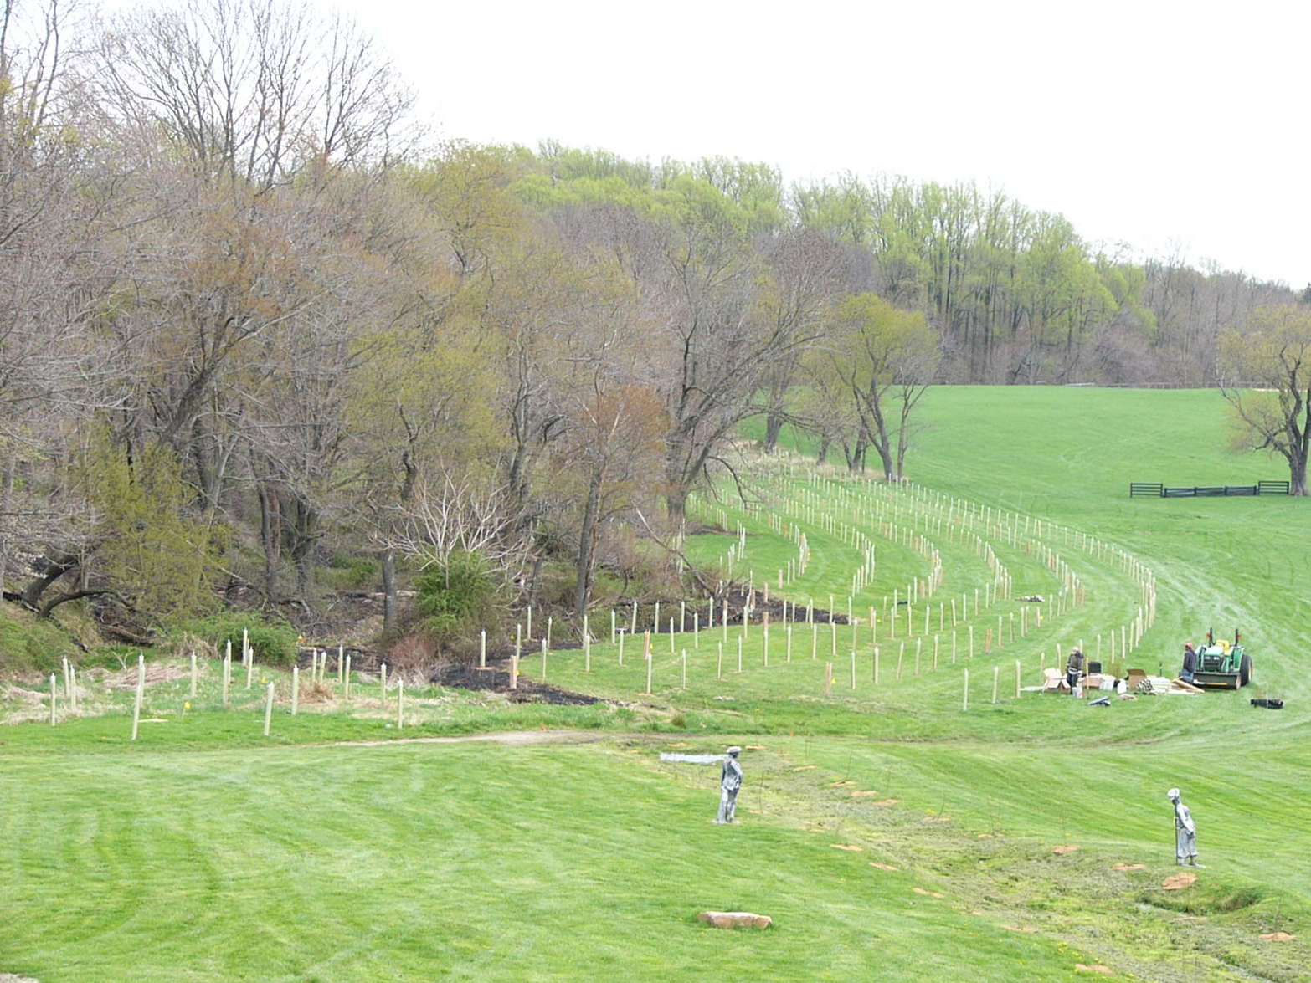
Rural Waters and Habitats Recommendation
In rural areas, CBP partners should work to strategically restore forests and aquatic habitats while promoting good agricultural stewardship practices that can reduce the amount of heated runoff being generated by farms

Slide 12
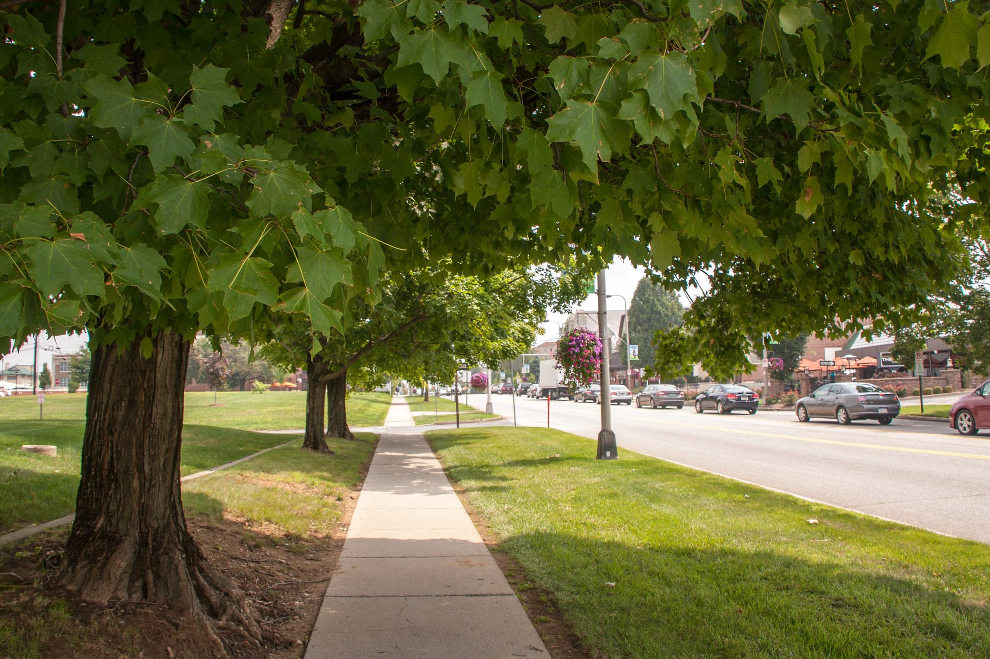
Urban Waters and Habitats Recommendation
In urban areas, the CBP partners should increase tree canopy, vegetation and practices favoring infiltration to reduce the amount of heated runoff entering waterways, paying attention to underserved urban areas which historically suffer the worst heating and human health outcomes.
Photo Credit: Leslie Robertson, NASF

Slide 13
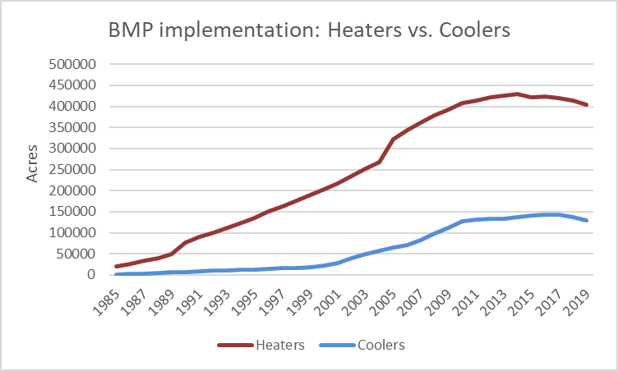
Best Management Practices (BMPs) Recommendation
The CBP partners should work to minimize the extent to which water quality BMPs are further heating waterways and strategically use cooling BMPs to counteract the warming effects of climate change and land use where possible

Slide 14
State Temperature Water Quality Standards Recommendation
Given the vital role of Clean Water Act water quality standards (WQS) in focusing federal, state, local and private actions to protect water quality and aquatic life, the states and EPA should review and modernize the components of current WQS systems that would strengthen their capability to address climate-related rising water temperatures and drive area-targeted protection and restoration strategies.

Slide 15
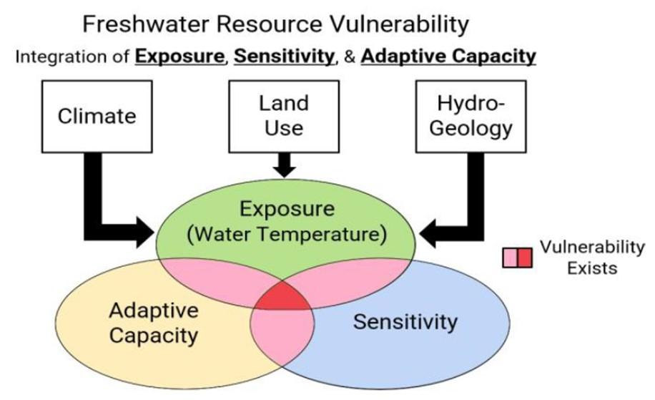
Overarching Recommendation for Research
The CBP partners should enhance and facilitate partnership efforts to collect data and develop tools needed to fill critical knowledge gaps, improve understanding of the impacts of rising temperatures on aquatic ecosystems, and inform management decisions.
Potential role for WQGIT: Conduct a robust assessment of which BMPs are heaters and coolers
Notes:
Role for WQ GIT: Evaluate BMPs, extent of impact, and to identify any landscape characteristics influencing the temperature impacts of BMPs

Slide 16
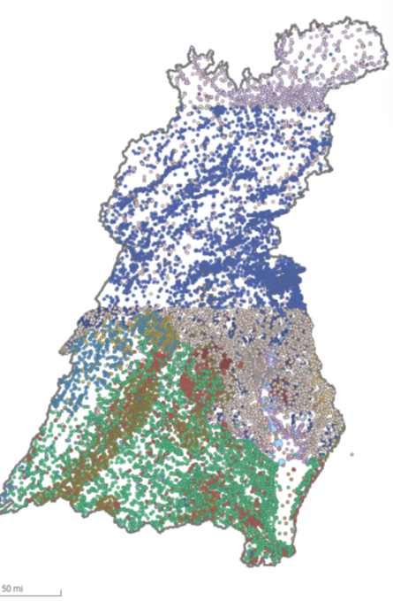
Overarching Recommendation for Monitoring and Analysis
The CBP partners should increase monitoring of water temperature in smaller streams, and further analyze existing data from larger streams and rivers, to improve understanding of the effectiveness of restoration and conservation of stream communities and fisheries in the face of land-use and climate change.
Source: John Clune, Tammy Zimmerman, James Colgin, Charlie Sandusky, USGS

Slide 17
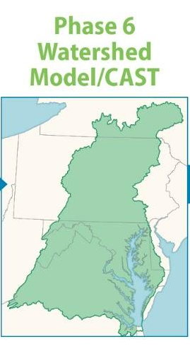
Overarching Recommendation for Watershed Modeling
The CBP partnership should develop new modeling tools and expand the use of CAST and the Chesapeake Healthy Watershed Assessment to better inform the management of watershed fisheries and ecosystems.
Potential role for WQ GIT/Modeling/CAST Teams:
  Develop fine-scale, process-based local models in selected areas that better simulate the influence of land use and groundwater on local stream temperatures
  Develop CAST scenario outputs related to temperature, fisheries and biota
Notes:
Additional CAST scenario outputs could help inform managers on the aggregate effects of their land use and land management decisions related to the Chesapeake TMDL.

Slide 18
TIDAL
Ecological Impacts, Science Needs &
Recommendations
Leads: Julie Reichert-Nguyen (NOAA), Bruce Vogt (NOAA), Brooke Landry (MD DNR), Rich Batiuk (Coastwise Partners) & Jamileh Soueidan (CRC/NOAA)

Slide 19
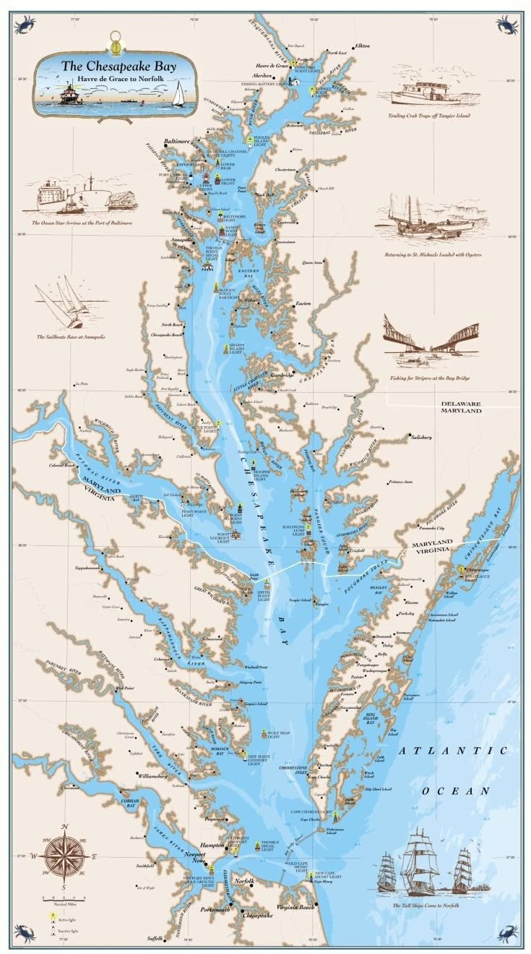

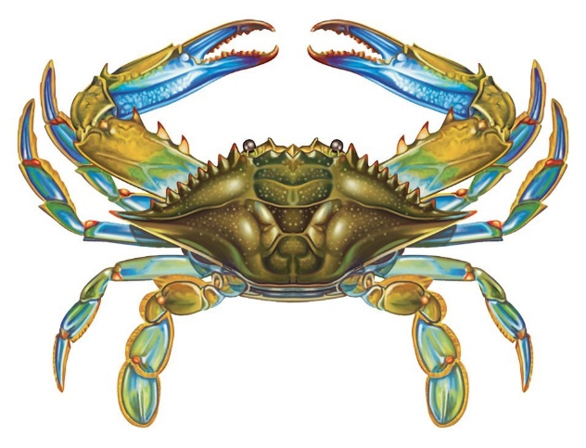
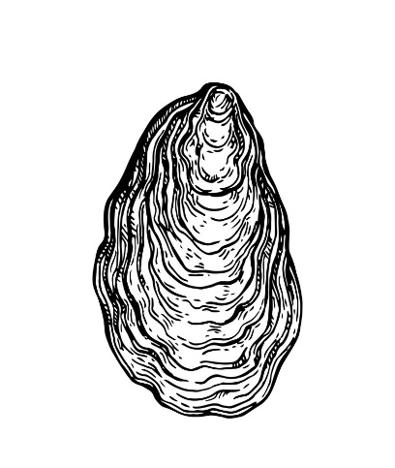
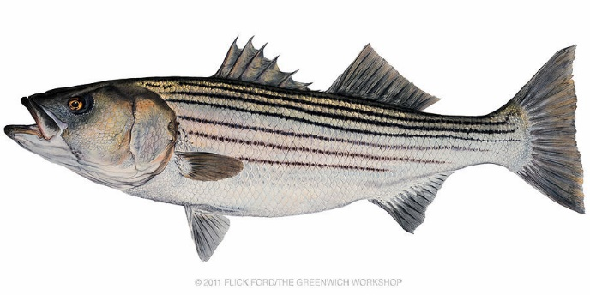
Rising Tidal Water Temperatures:
Ecological Impacts to Living Resources and Habitats
Changes in habitat suitability for vulnerable species (e.g., striped bass, eelgrass) from multiple stressors and extreme events
Impacts to fisheries from rising water temperature may be positive or negative depending on species, life stage, habitat requirements, and occurrence of other stressors.
Eelgrass is negatively affected by rising water temperature, while other species (e.g., widgeongrass, freshwater species) may be more heat tolerant.
Northward shifts in species range and habitats. Species from the south are becoming more prevalent.
Species | Impacts
Blue Crab
Eastern Oyster
Striped Bass
Higher productivity; reduced winter mortality
Reduced eelgrass and marsh habitat; increased predation
Longer spawning season; more algae/food
Multiple climate and other stressors on already depressed populations
Increased growth rates
Seasonal shifts–mismatch in spawning/prey availability; unsuitable water temp; reduced habitat
Notes:
Rising water temperatures in the Chesapeake Bay present a wide range of ecological considerations, impacting fisheries
A review of regional species climate vulnerability scores and bay-specific research revealed both positive and negative responses to this rising water temperature
Positive impacts are likely for blue crabs and some forage species, as warmer temperatures support higher productivity and increased habitat range
While oysters can thrive in higher temperature regimes, they are highly vulnerable to other climatic impacts such as ocean acidification and salinity driven by precipitation. Negative impacts are predicted for oysters due to their already depressed populations as a result of disease, overfishing, and habitat loss
Striped bass may experience both negative and positive impacts at different life stages and habitat use (e.g., rivers and estuaries to marine). There is the potential for localized impacts, which leads to higher uncertainty in evaluating striped bass vulnerability
With the warming tidal water trends occurring within the Chesapeake Bay, species are undergoing range shifts in distribution and population.
Some Bay species’ populations are shifting north while other species from the south are becoming more prevalent in the Bay
These range shifts can result in changes to habitats and species affecting abundance and distributions, food web dynamics, and fishing behavior
Likewise, habitats required by fish and shellfish species are shifting in range and experiencing impacts that lead to changes in fish abundance, distribution, and reproductive success.
Concerns of future climate conditions allowing for new pathogens
Lastly, there is evidence that climate drivers including temperature are allowing range expansion for cobia, brown shrimp, and red drum. The impacts of southern species moving into the Bay are not fully understood. However, the increased abundance of brown shrimp has led to a new fishery in the Bay and some scientists have pointed to red drum increasing predation pressure on species such as blue crab.
Rising water temperatures in the Chesapeake Bay present a wide range of ecological considerations, impacting fisheries
A review of regional species climate vulnerability scores and bay-specific research revealed both positive and negative responses to this rising water temperature
Positive impacts are likely for blue crabs and some forage species, as warmer temperatures support higher productivity and increased habitat range
While oysters can thrive in higher temperature regimes, they are highly vulnerable to other climatic impacts such as ocean acidification and salinity driven by precipitation. Negative impacts are predicted for oysters due to their already depressed populations as a result of disease, overfishing, and habitat loss
Striped bass may experience both negative and positive impacts at different stages of life (larval to adult) and habitat use (rivers and estuaries to marine)
The range of responses and potential for localized impacts (for example changes in habitat quality and reproductive success within specific tributaries) leads to higher uncertainty in evaluating Striped bass vulnerability
Bullet Four
For SAV,
Viable populations of eelgrass are likely to be extirpated as a result of the warming temperatures, since the species has poor heat tolerance. Research shows that acute warming from summertime heat waves has triggered shoot mortality and population declines.
Conversely, research has shown widgeon grass, certain ecotypes of freshwater SAV, and possibly other subtropical seagrasses to be more tolerant to temperature increases.

Slide 20
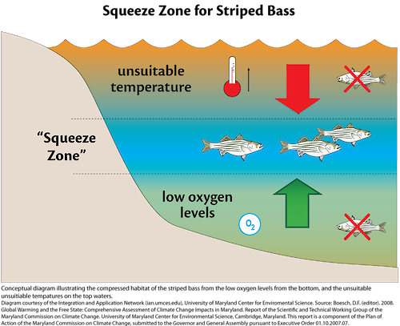
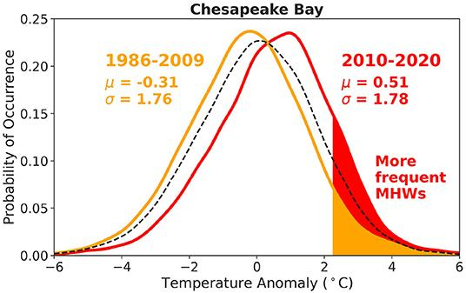
Rising Water Temperatures: Compounding Stress
Increases in water temperature → increases in organic matter → decreases in bottom dissolved oxygen.
Reduced habitat for fish; e.g., squeeze zone, loss in SAV and marshes.
Reduced water clarity and salinity from nutrient pollution and increases in precipitation → negative effects on SAV and oysters on top of increases in water temperature.
Increases in the intensity and frequency of prolonged extreme warming events; i.e., marine heat waves (MHW).
Boesch 2008
Mazzini and Pianca 2022
Notes:
Key species such as striped bass and certain types of SAV are particularly vulnerable to the compounding stress of rising water temperatures and other stressors such as low dissolved oxygen, increased nutrient pollution, increased precipitation, and marine heat waves. These multiple stressors have the potential to impact habitat suitability for these species. An example of this being an increased habitat squeeze on striped bass, who can only thrive in certain regions of the water column, as the higher portions of the water column are too warm, and the lower portions have low dissolved oxygen levels.
Additionally, evidence shows extreme events such as marine heat waves negatively impact both habitat and species survival. Heat waves are associated with harmful algal blooms, increase in bacteria such as vibrio, mortality of SAV and other organisms, shifts in species composition, increased risk during recreational activities and impacts to fishing and aquaculture
Heatwave figure- Probability of occurrence of sea surface temperature anomalies in the Chesapeake Bay. The stations used in this analysis were: Tolchester Beach (TB), Thomas Point (TP), Solomons Island (SI), Lewisetta (LW), Goodwin Island (GI), and Kiptopeke (KP). Yellow corresponds to years between 1986 and 2009, red corresponds to the most recent decade, 2010–2020, and black dashed line refers to all years combined, 1986–2020. Shaded regions show the area above the 90th percentile threshold, estimated from the entire time series. Mean (μ) and standard deviation (σ) values in °C are indicated. The enhanced red shaded area indicates an increase in likelihood of MHWs in the last decade.
Pull script from CWF presentation

Slide 21
Themes for Actionable Recommendations
Ecosystem-Based Management
Nearshore Habitats
Multiple/ Extreme Stressors
Future Climate Conditions
Notes:
There were four main themes emerged from day one of the workshop and that guided the second day of the workshop when identifying management recommendations.
Ecosystem-Based Management

Slide 22
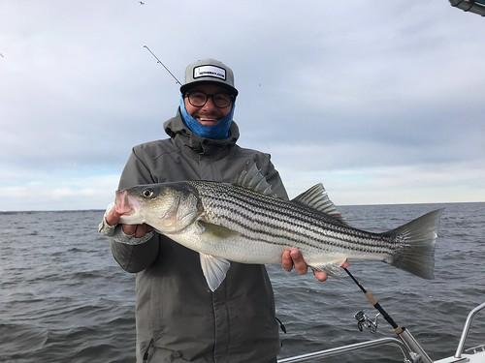
Recommendations: Ecosystem-Based Management
Establish fishing guidance based on temperature and dissolved oxygen and habitat condition thresholds to reduce catch and release mortality during periods of poor environmental condition.
Hold workshop with fishery stakeholders to explore long-term strategies to advance ecosystem approaches that incorporate climate change considerations; include discussions on potential new fisheries and adaptation needs.
Photo: Eric Packard
Notes:
Climate TMDL and WIPs - compare with fish and sav habitat requirements
Rationale:
o Higher water temperatures put more stress on multiple fish species. Low oxygen conditions are worsened by high water temperatures.
Combined high water temperature and low oxygen reduce the area of suitable habitat for Striped bass and other species.
o This stress can be minimized by notifying anglers of days when habitat conditions are poor and discourage fishing that could result in catch and release mortality.
o Increasing air and water temperatures along with other climate change drivers are already leading to changes in the abundance and distribution of coastal and Chesapeake Bay fisheries.
o At the same time southern species are moving northward and showing up in greater abundances in the Chesapeake Bay and in some cases creating new fishery opportunities and adapting current fisheries strategies.
Implementation Actions:
o Host focused meetings to review existing science on temperature and oxygen thresholds, application of the science to develop bay wide thresholds and guidance.
The desired outcome of these meetings is to establish temperature and oxygen thresholds for striped bass and other key species based on best available science
o Convene discussions meetings with managers and anglers to:
To discuss the utilization of temperature and oxygen thresholds findings from focused meetings to help develop and communicate guidance to anglers on the environmental thresholds and ways to modify fishing practices to reduce mortality when fish are most vulnerable
o Hold forum to identify the changes that are occurring and develop scenarios for how the Bay and fisheries will change over the next 20 years.
o Convene fishery survey experts to discuss if changes are needed on how we conduct fish stock surveys under changing climate conditions.

Slide 23
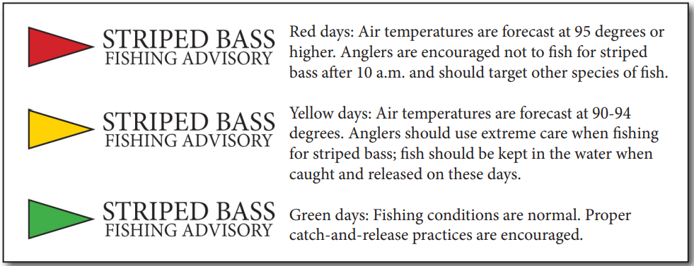
Recommendations: Multiple/Extreme Stressors
Convene an interdisciplinary team of scientists, resource managers, meteorologists, and communicators to design and create a publicly available marine heat wave alert system.
Connect alert system with habitat preferences of key species and guidance on fishing behavior; consider incorporating other key parameters (e.g., dissolved oxygen, salinity).
Example from Maryland Department of Natural Resources
Notes:
Review current definitions of heat waves and conduct research to determine an appropriate definition for Chesapeake Bay (or tributaries as appropriate).
Explore real time monitoring of marine heat waves and need for forecast products.
Link heat waves to living resources by analyzing heat waves and fishery survey data such as ChesMMAP.
Incorporate dissolved oxygen and link to habitat preferences of key species such as striped bass, blue crabs, oyster, and SAV.
Development of the warning system
Outreach to public, and to partners in development
Rationale:
o Heat waves in the Chesapeake Bay are increasing in frequency, number of days per year and yearly cumulative intensity (Mazzini and Pianca, 2022).
o And as stated before, heat waves are associated with a myriad of negative impacts to species and habitat
harmful algal blooms, increase in bacteria such as vibrio, mortality of SAV and other organisms, shifts in species composition, increased risk during recreational activities and impacts to fishing and aquaculture.
o During a marine heat wave, it’s important to change how/when/where fishing and aquatic recreation is occurring to minimize impact on both people and aquatic life.
Implementation Actions
• Convene CBP partners and relevant subject-matter experts such as NOAA’s weather service and Climate program office to review the state of the science and scope out a conceptual design for the alert system through a workshop.
• Some issues to consider in the design are the degree of focus on human health and/or living resource risk, the scale (Bay-wide, or tributary specific, which agency would issue alerts (MDDNR/VADEQ, NWS, etc. Incorporate human health risks associated with heat waves and guidance on mitigating impacts.

Slide 24
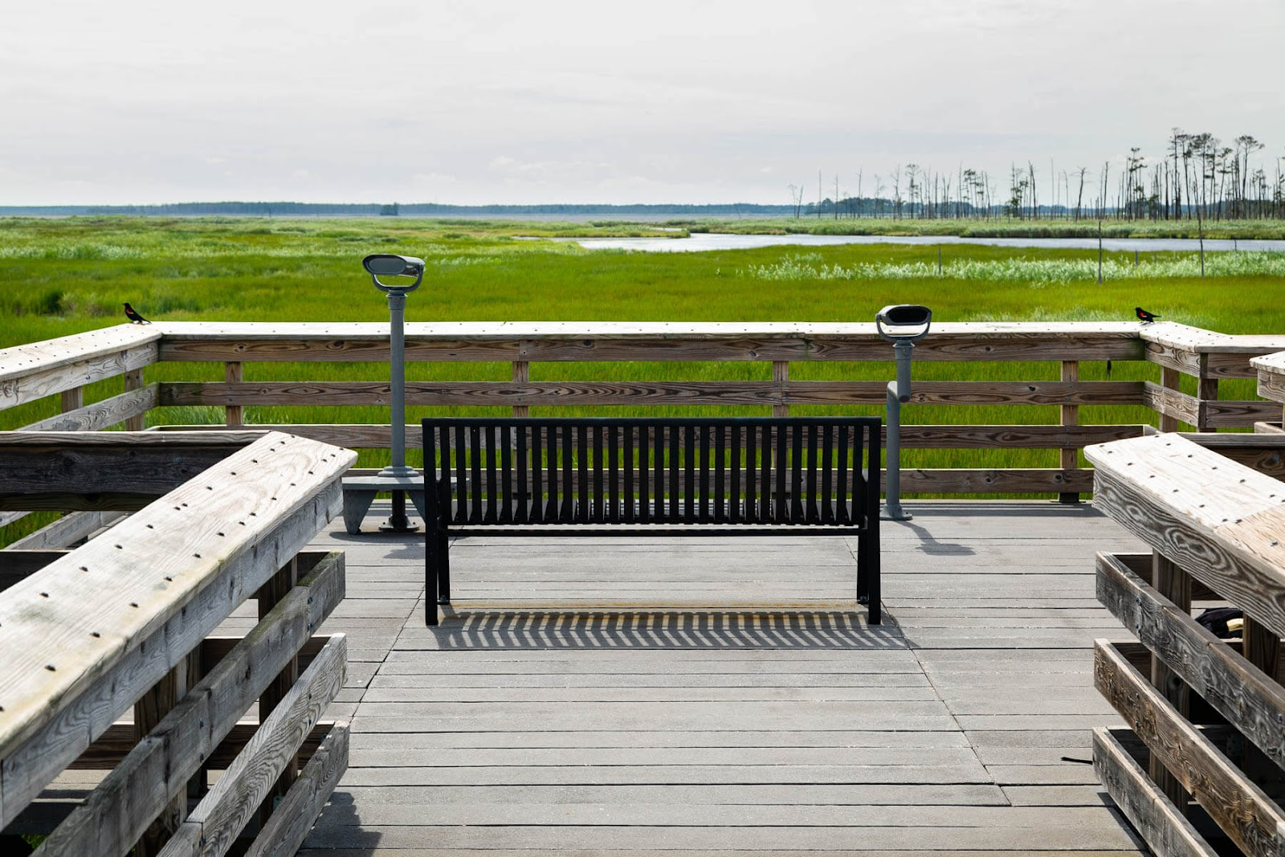
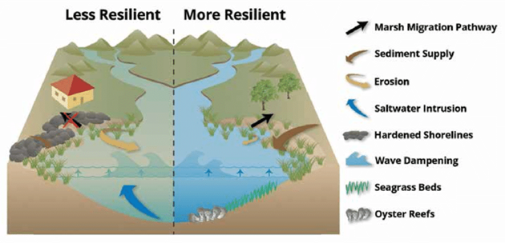

Recommendations: Nearshore Habitat
Develop common criteria/metrics to help target, site, and design natural infrastructure projects, such as living shorelines, where communities and ecosystems can benefit.
Support research on how to group natural resource restoration strategies (e.g., seagrass, marshes, oyster reefs) to maximize resilience from climate change impacts.
Photo: Will Parsons, CBP
Notes:
Point out that many of these natural infrastructure projects are also approved BMPs.
Rationale:
o Shoreline hardening along the coastlines of the Bay continues despite regulations in Maryland and Virginia to promote natural infrastructure
o Hardened shorelines adversely impact organisms and ecosystems including fish habitat, SAV, water fowl, and water quality
o Natural infrastructure provides ecosystem services in the face of a changing climate, including shoreline erosion protection, refuge for many fish and shellfish species from multiple stressors, protection from rising water temperatures, sedimentation mitigation, and improved water quality.
Implementation Actions
o Develop siting criteria and targeting tools to facilitate development of more project designs and project implementation proposals.
o Conduct outreach to homeowners. Review current studies on behavioral drivers behind shoreline hardening decisions and summarize findings to develop effective communication strategies for homeowners to increase the use of natural infrastructure over hardened structures.
Develop a Chesapeake Bay specific guide with a menu of living shoreline options
o Explore development of a funding proposal for a proof of concept project that integrates SAV and oysters

Slide 25
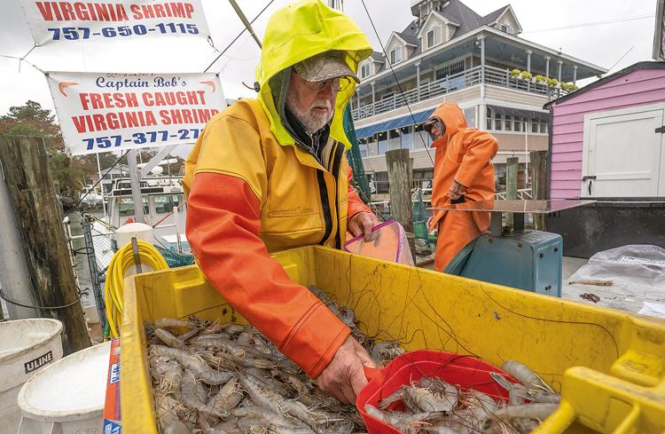
Recommendations: Future Climate Conditions
Develop and implement strategy to improve communications on expected future scenarios for existing species and information on emerging species from the south.
Support social science research and develop targeted communication for specific audiences (policymakers, managers, residents, local partners).
Photo: Dave Harp, Bay Journal
Notes:
Rationale:
o It is clear the Chesapeake Bay is undergoing an ecosystem regime shift driven by climate change and other factors. New species and new fisheries are emerging in the Bay, and existing species and fisheries are undergoing change. Some will no longer be in the Bay. There is a need to better communicate the impacts of rising water temperatures to manage the public’s expectations of what the Bay will look like.
This strategy should be tailored to focus on various audiences- policy-makers, managers, and residents, as each stakeholder group has their own unique perspectives in regard to this changing system

Slide 26
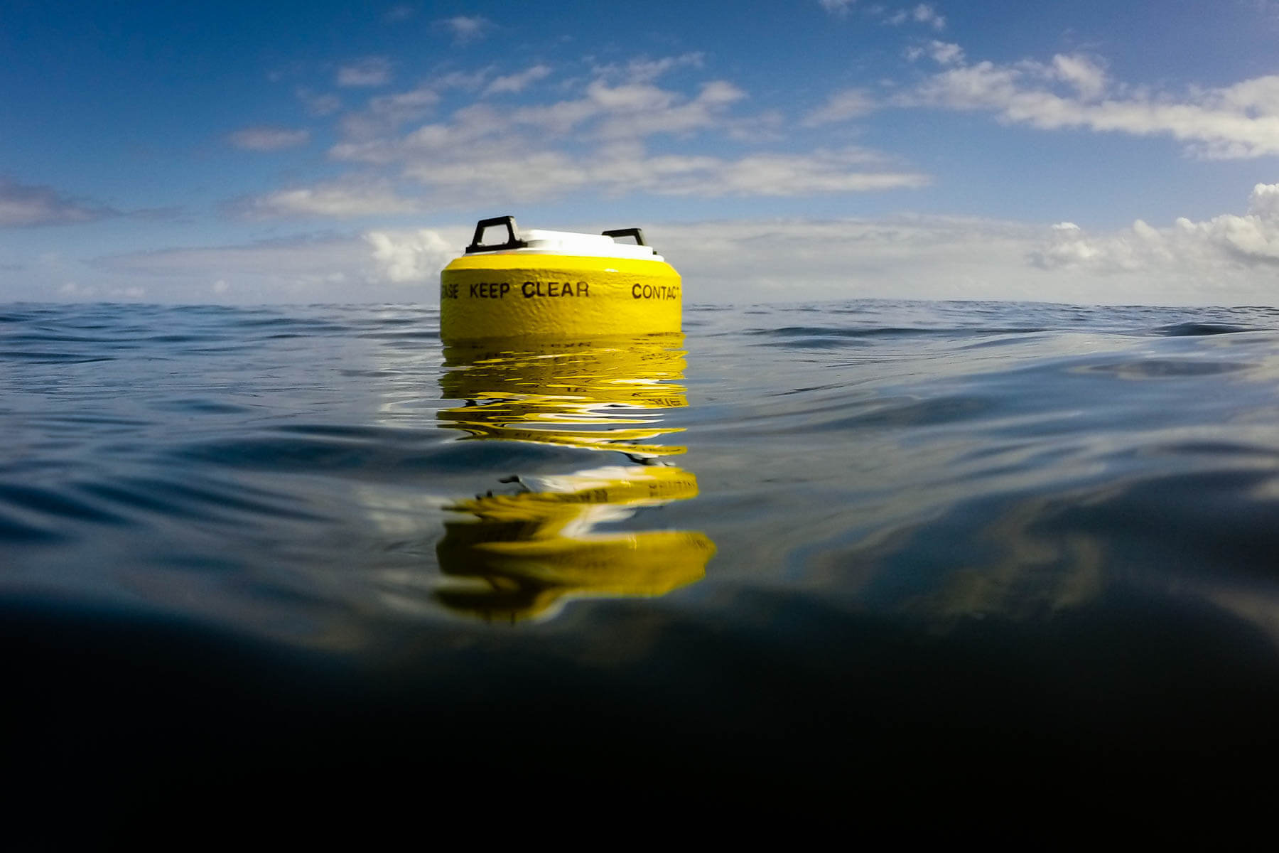
Science Needs: Ecosystem-Based Management
Improve environmental and biological (predator/prey) monitoring to assess changes in fish habitat conditions.
Consider establishing long-term water quality and biological monitoring where there are significant fisheries habitat and spawning grounds.
Develop habitat suitability models and indicators for key fisheries resources that incorporates information on extreme stressors, such as marine heat waves, and other stressors (e.g., dissolved oxygen).
Research how loss of late-winter/spring eelgrass habitat will affect blue crab populations.
Photo: Doug Wilson
Notes:
Mention tributary scale models and focus on shallow water environments (CESR) for informing monitoring strategies.
For ecosystem-based management, there were monitoring, modeling, and analysis science needs identified that included improvements to our monitoring of environmental parameters like dissolved oxygen and temperature as well as biological and living resource parameters, like changes in prey availability. Addition participants recommended establishing monitoring stations where there are significant fisheries habitat and spawning grounds. While the Chesapeake Bay area has well established monitoring of water quality parameters, we are lacking long-term biological monitoring, which will be needed to better understand how shifts in temperature ranges and seasons will affect both predator and forage fish and availability of food resources. Modeling and analyses related needs included the development of habitat suitability models and indicators of change, which would assist in defining areas where there is suitable habitat during critical life stages and corresponding seasonal changes and inform fisheries managers in decision making. Lastly, there is research needed to understand how loss of eelgrass habitat during the late-winter and spring will impact blue crab populations, who rely on this habitat.

Slide 27
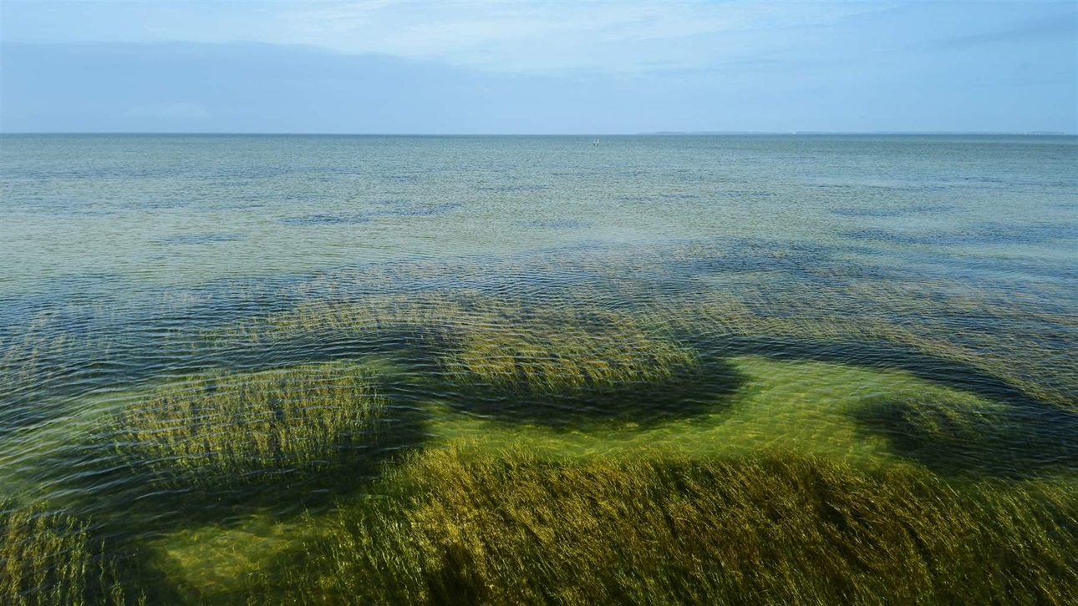
Science Needs: Strategic Nearshore Restoration
Improve understanding of watershed practices (e.g., cooling BMPs) and tidal habitat restoration (e.g., marshes) to minimize localized warming of nearshore tidal waters to reduce warming and provide thermal refugia for vulnerable SAV and fisheries.
Use models to increase understanding of habitat change from sea level rise to inform restoration strategies.
Photo: Peter McGowan, USFWS
Notes:
This slide shows the some of the identified science needs related to strategic restoration for nearshore habitats. These include understanding ecological impacts or benefits that could occur from natural infrastructure implementation and developing criteria for targeting nearshore restoration where multiple benefits and ecosystem services can be optimized, including fish and bird habitat, shoreline protection, erosion control, flood reduction to nearby communities, and water quality. These types of studies can help inform the best strategies for maximizing suitable habitat and minimizing other stressors. The participants also highlighted that we need to increase our understanding of watershed practices that can reduce local warming effects in nearshore tidal environments. While rising water temperatures in the tidal waters of the Chesapeake Bay are mainly driven by global forces related to increasing air temperatures, there could be cooling benefits at a local scale in some tidal tributaries by implementing strategies, such as forest buffers or reducing impervious surfaces, that reduce warming of nontidal waters that discharge into the tidal waters. However, we need targeted research to better understand the overall effect of this strategy in reducing vulnerability of living resources utilizing these nearshore tidal habitats. The participants also suggested using models to increase our understanding of habitat change from sea level rise to inform restoration strategies. While sea level rise has been projected to have a cooling effect, it also puts important marsh habitat at risk. It will be important to better understand how we can implement marsh, submerged aquatic vegetation, and oyster restoration to be adaptable to sea level rise to maximize quality habitat availability for fish and leverage change where we can related to marsh migration and subtidal versus intertidal oyster restoration.

Slide 28
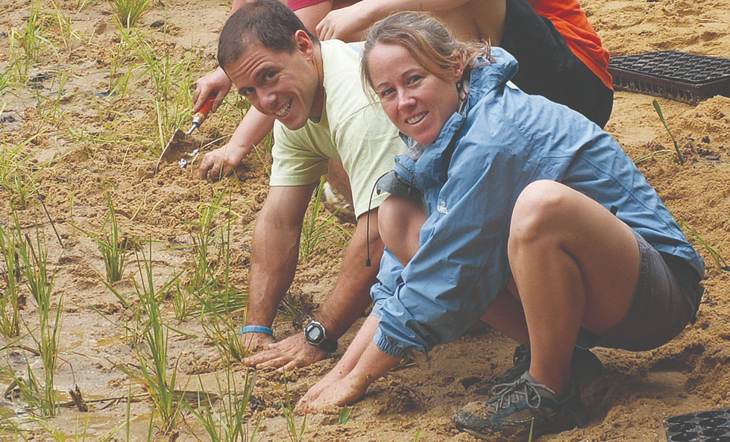
Common Themes Across the Workshop:
Implementation
Comprehensive Jurisdictional and Land Use Plans
  E.g., ensure that land-use planning decisions and county comprehensive plans incorporate science and evidence-based practices in regard to water temperature.
Targeting
  E.g., incorporate water temperature considerations when planning, siting, and implementing restoration and conservation efforts.
Nature-Based Features
  E.g., restore nature-based and natural features on land and in the water to help moderate or build resilience to rising water temperatures.
  Support efforts to implement living shorelines, cooling BMPs, and natural infrastructure where appropriate and feasible (e.g., on public land or develop incentive programs for private land).
Communication
  E.g., ensure open communication with stakeholders (e.g., communities, decision makers, scientists, practitioners) to ensure that rising water temperatures are taken into consideration.
(Marcy Damon, Chesapeake Bay Foundation)

Slide 29
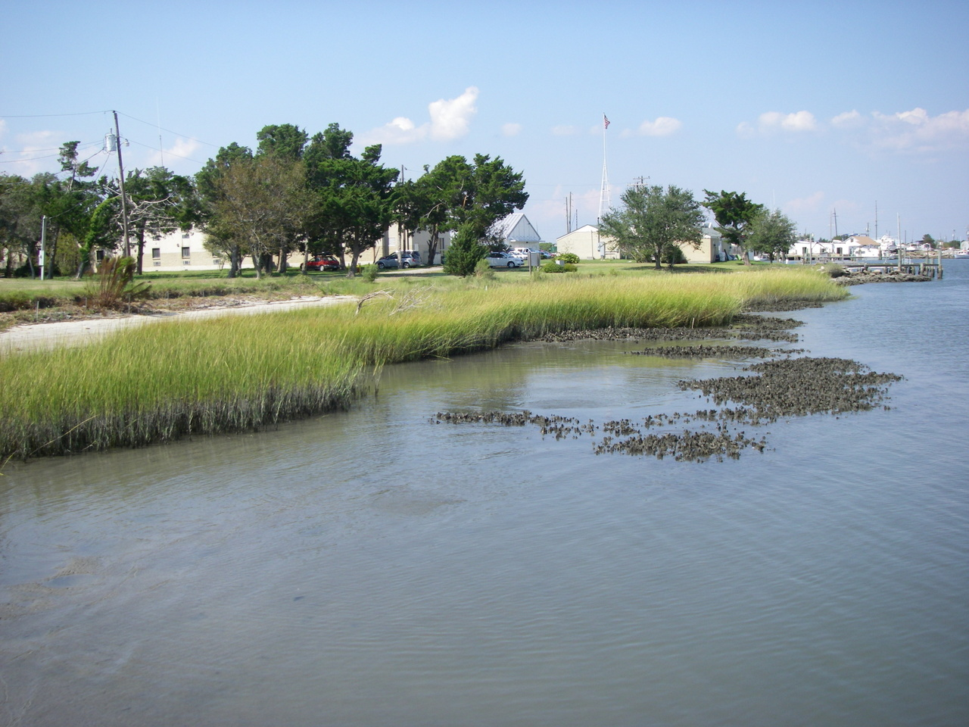
Common Themes Across the Workshop:
Science & Research
Modeling tool improvements
  E.g., finer-scale modeling, incorporating temperature change, improving connections between modeling and monitoring living resources.
Expanded Monitoring
  E.g., expanding monitoring networks to collect data necessary to track water temperature and ecological change; improve the ability to pair air temperature trends with water temperature trends.
Thresholds
  E.g., understanding environmental condition and habitat thresholds and communicating the implications of rising water temperatures for living resources.

Slide 30
Role for Water Quality GIT
How can the WQGIT help implement the report’s recommendations?
What can the Bay Program do to support jurisdictions in the implementation of these recommendations?
Are there programs in place at the state governments that are already supporting these recommendations?
Contact Information:
Katie Brownson
  Katherine.brownson@usda.gov
Julie Reichert-Nguyen
  julie.reichert-nguyen@noaa.gov
Find the report here:
www.chesapeake.org/stac/document-library/rising-watershed-and-bay-water-temperatures-ecological-implications-and-management-responses/
Notes:
We are happy to take questions for you and also would love to hear your thoughts on these recommendations!

