Slide 1
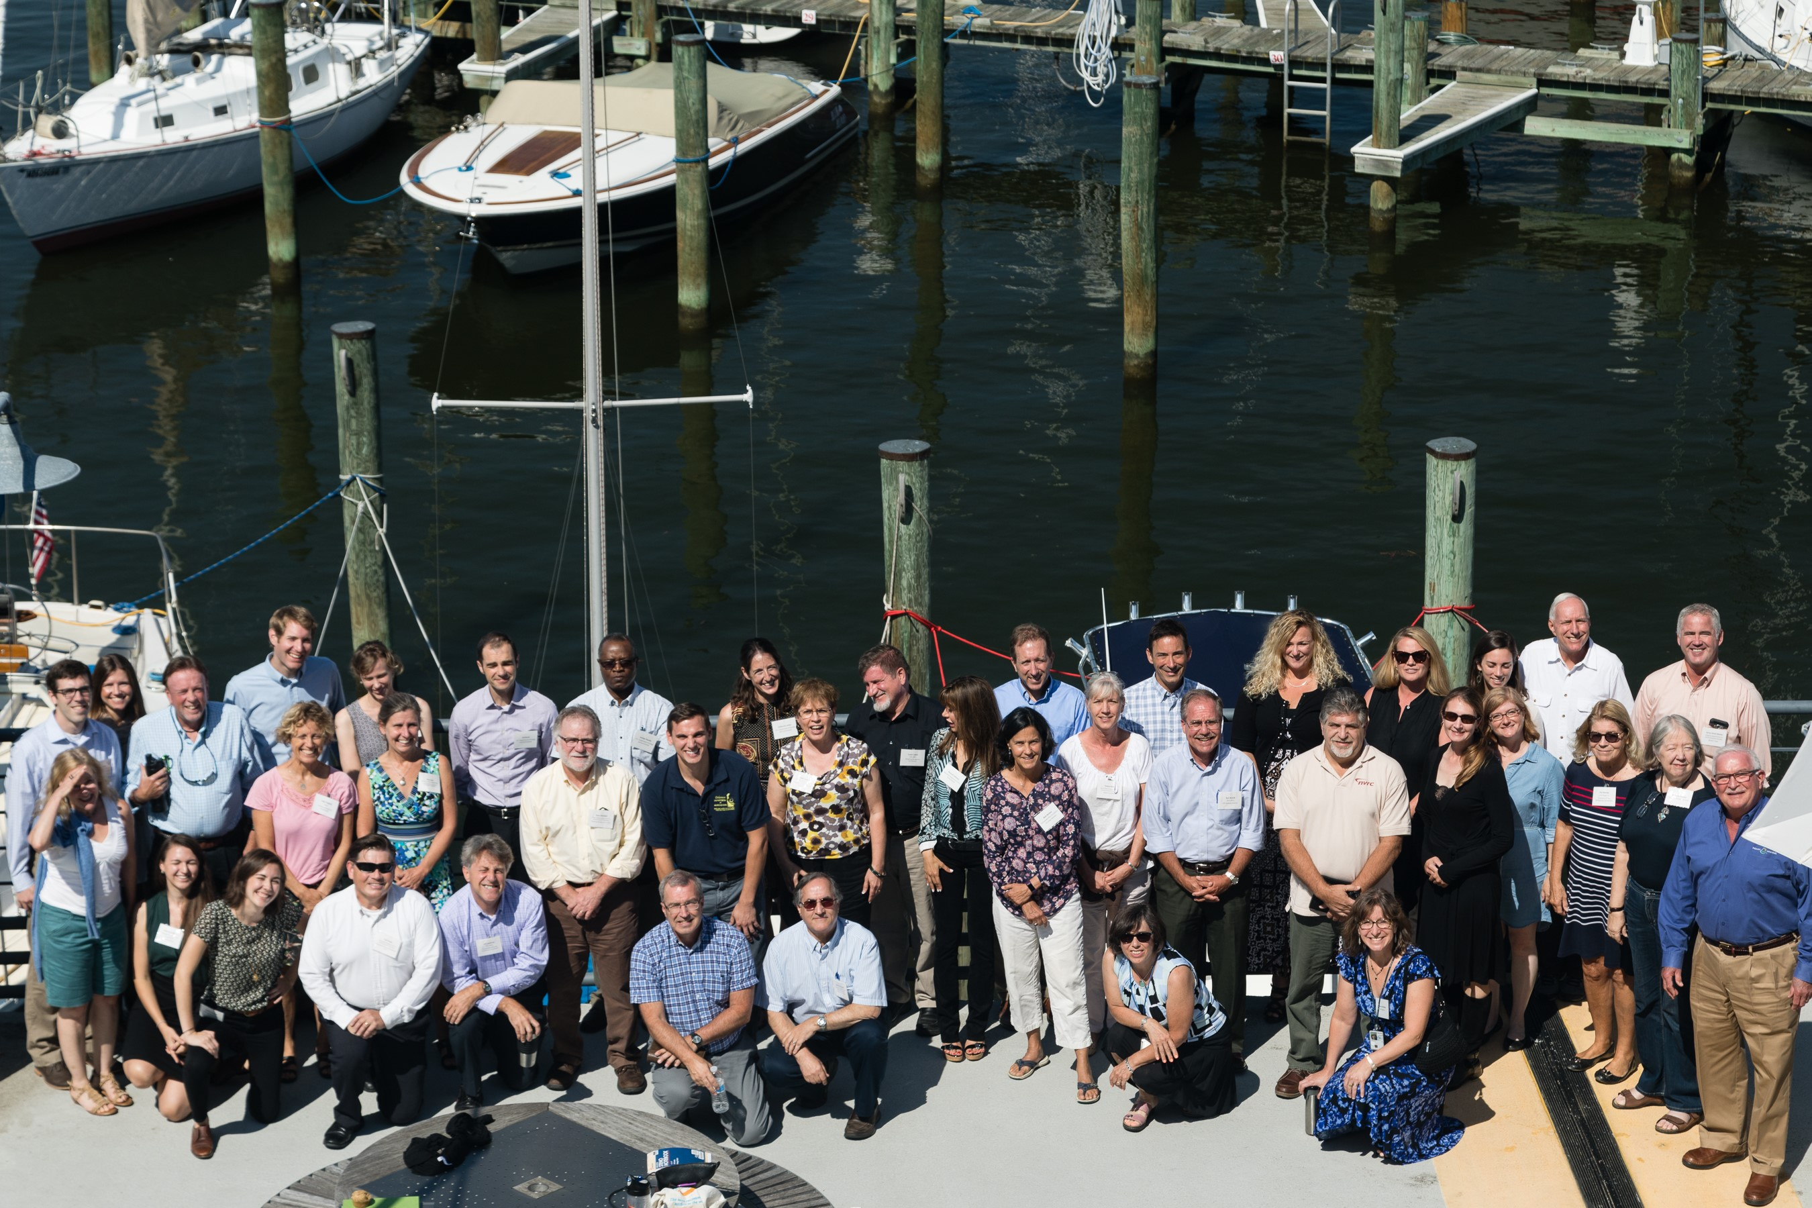
2017 Midpoint Assessment: Year of Decision
October 5, 2017 Local Government Advisory Committee Meeting

Slide 2
Today’s Objectives
Highlight of key midpoint assessment policy decisions to be considered by the PSC
Solicit LGAC feedback on local relevance of these decisions

Slide 3
Draft Phase III WIP Planning Targets, Final Phase 6 Modeling Tools, and Final Policy Decisions Will Not Be Ready Until December 2017

Slide 4
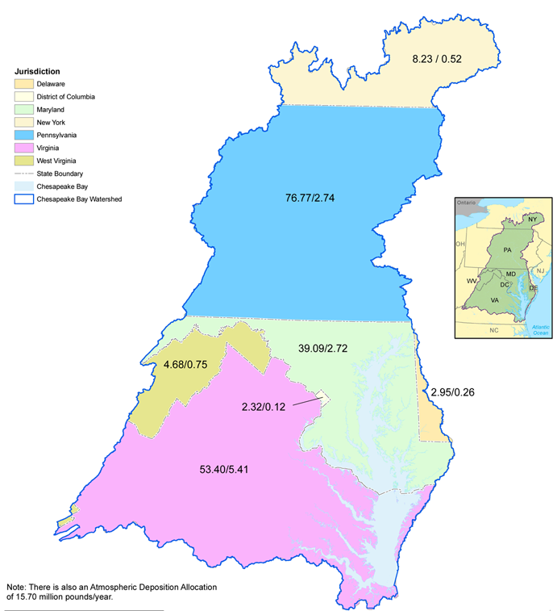
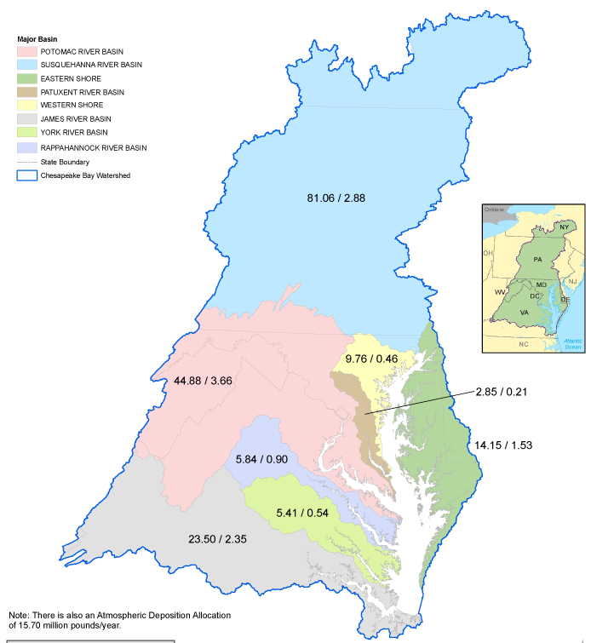
Planning Targets by Jurisdiction and Major River Basin

Slide 5
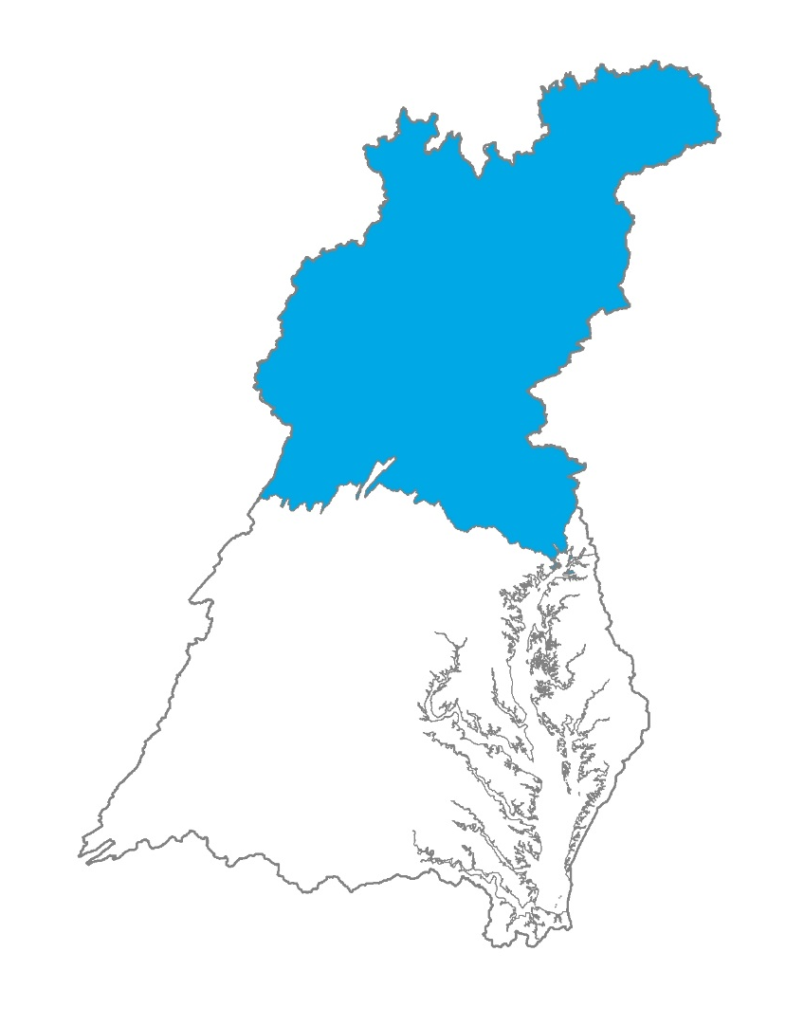
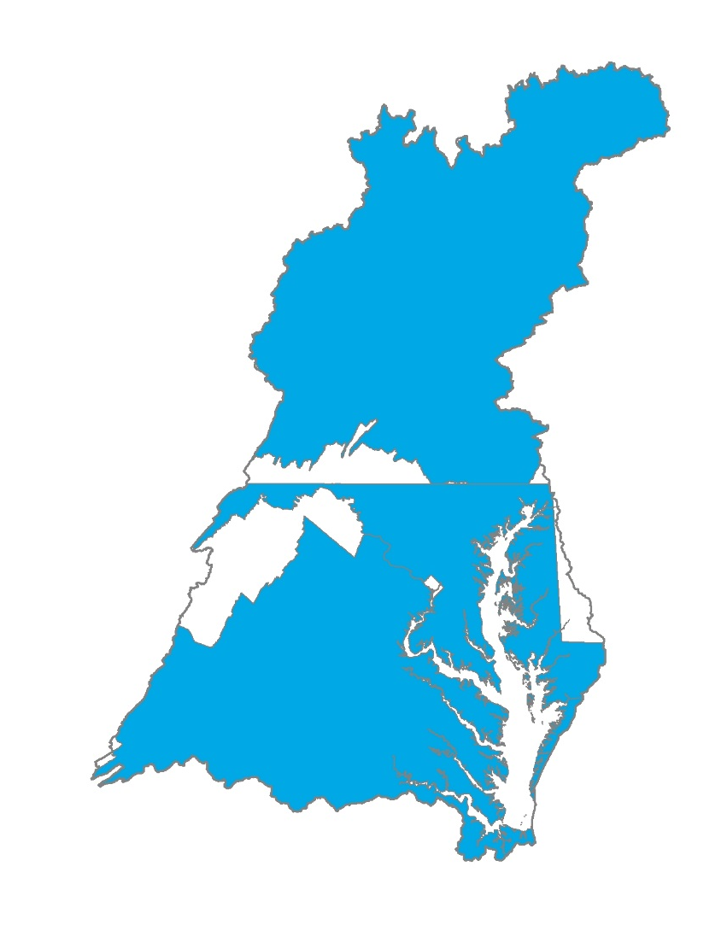
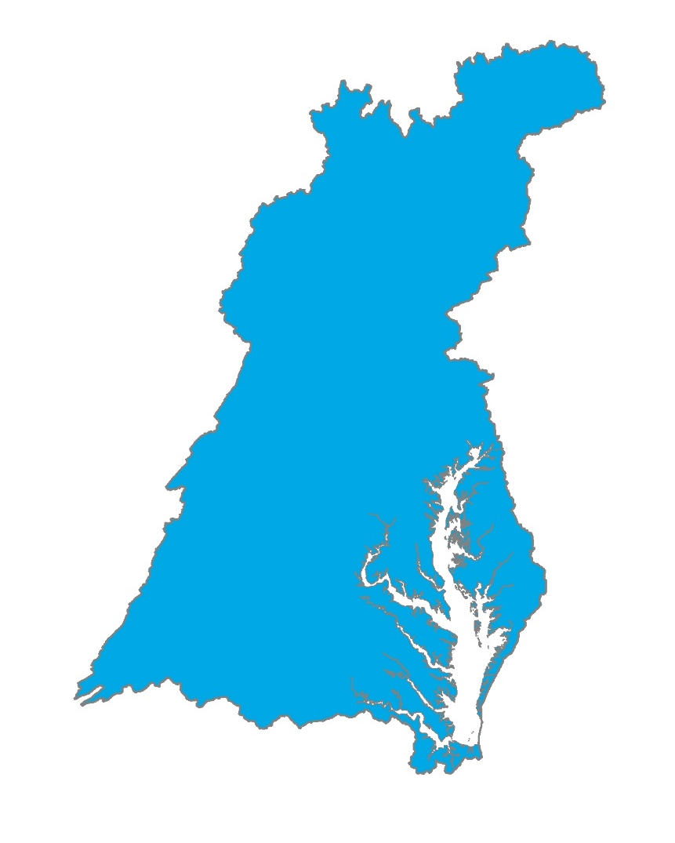
Conowingo Dam Infill
Recap of Policy Decisions
Who?
How?
Allocation equity rules used in the Bay TMDL
Most cost effective practices and locations
When?
By 2025
Beyond 2025
Post 2025

Slide 6
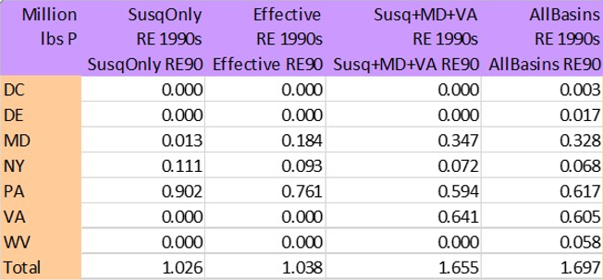
Susquehanna Options

Slide 7
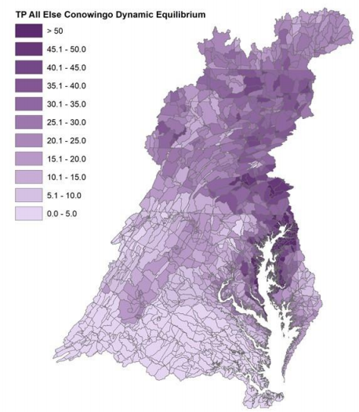
Conowingo Dam Infill
October 3, 2017 PSC Decisions
PSC agreed to add the “Susquehanna + most effective basins” option for final PSC decision.

Slide 8
Draft - Most Effective Basins

Slide 9
Conowingo Dam Infill
October 3, 2017 PSC Decisions
PSC agreed to draft a letter on expectations for the role in Exelon in addressing increased loads associated with Conowingo infill, as part of the Clean Water Act 401 certification.
  The letter will likely be addressed to Exelon.
PSC will review a draft of the letter at one of their upcoming meetings.

Slide 10
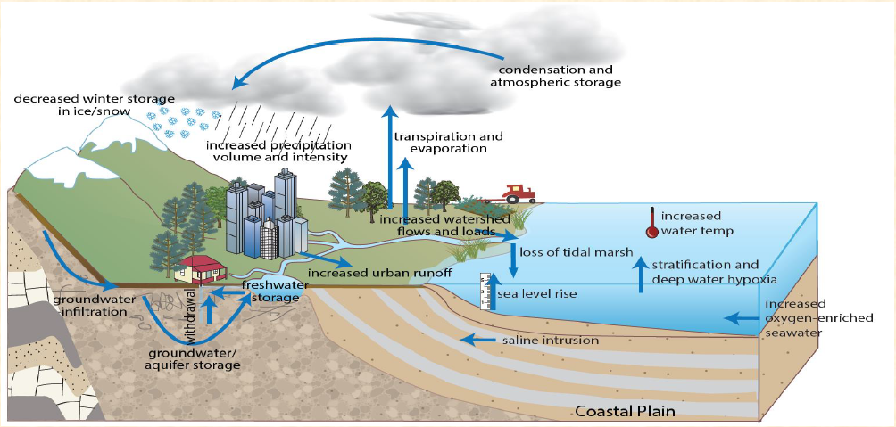
Climate Influence on the Bay Watershed

Slide 11
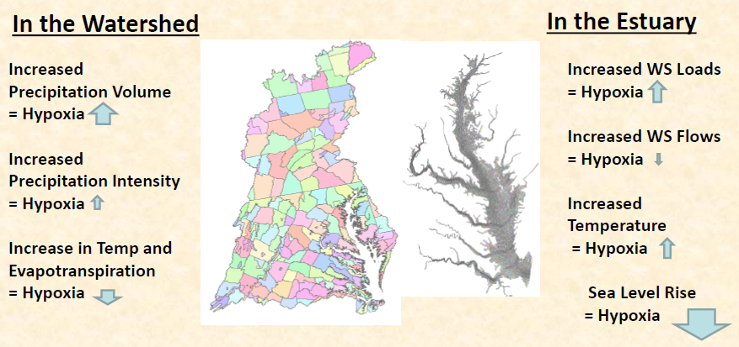
Keeping Score for 2025

Slide 12
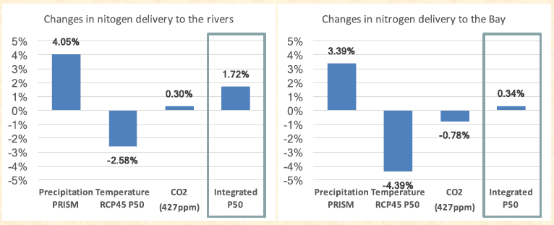
DRAFT Model Results: Nitrogen to Rivers and the Bay

Slide 13
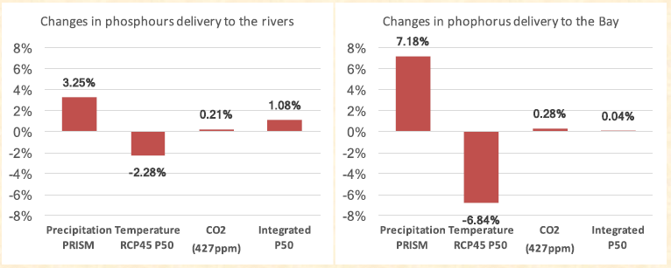
DRAFT Model Results: Phosphorus to Rivers and the Bay

Slide 14
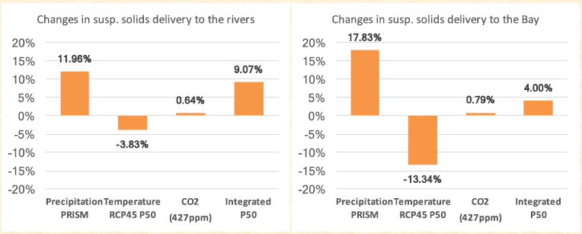
DRAFT Model Results: Sediment to Rivers and the Bay

Slide 15
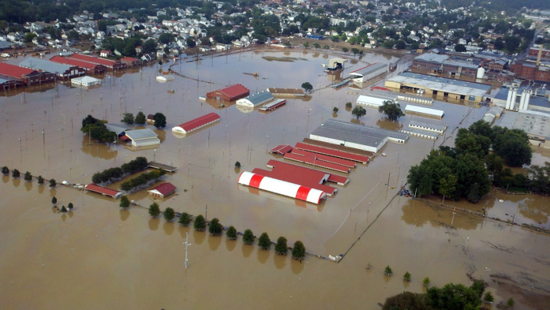
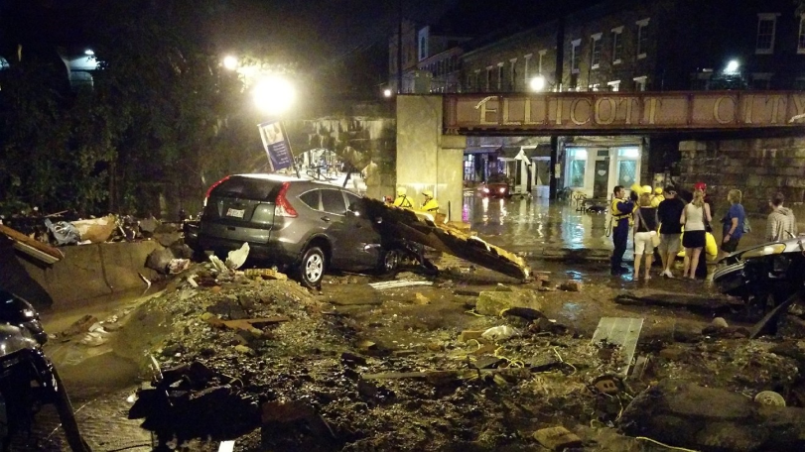
Climate Change
Recap of Policy Decisions
The Partnership will decide how to address climate change considerations in the Phase III WIPs:
  Quantitatively – accounting for additional loads due to climate change impacts projected through 2025 in the Phase III WIPs
  AND/OR
  Qualitatively – adaptively manage climate change considerations through the implementation of BMPs (with climate resilient characteristics) and other commitments through the Phase III WIPs and 2-year milestones

Slide 16
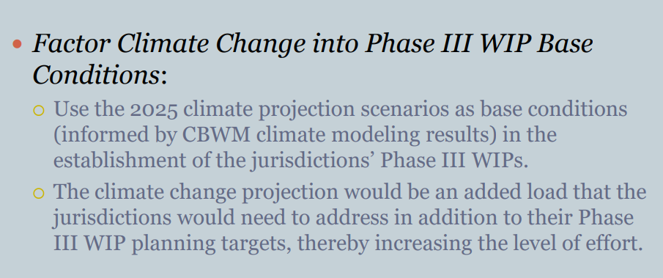
Climate Change
Quantitative Policy Options

Slide 17
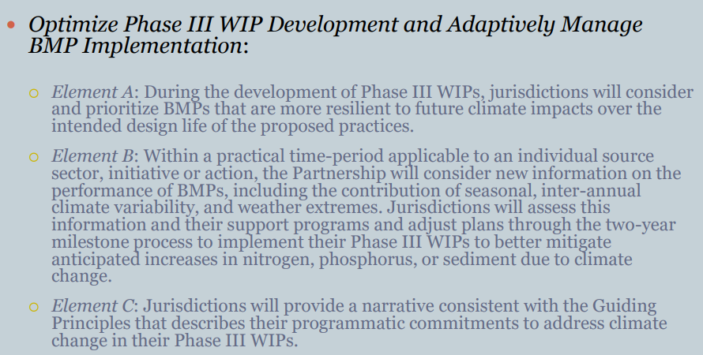
Climate Change
Qualitative Policy Options

Slide 18

Accounting for Growth
Recap of Policy Decision: Should 2025 Future Projections be Used to Account for Growth in the Phase III WIPs?
2025 growth projection
Load reductions necessary to meet the 2025 Phase III WIP Planning Target (lock box)

Slide 19
Accounting for Growth
WQGIT Recommendations to the PSC
Use 2025 growth projections as base conditions for the Phase III WIPs.
  This approach explicitly accounts for growth in the Phase III WIPs.
  2025 growth will be forecasted using zoning information from local governments.
Update the growth projections every 2 years with the best available data to inform the development of the two-year milestones.
  Allows for adaptive management to changing growth patterns and trends as we approach 2025.
  Allows state and local jurisdictions to report new data based on updated policies, ordinances, etc. that will change growth patterns.

Slide 20
Revised Midpoint Assessment Schedule
First week of December 2017
  Modeling Workgroup and WQGIT recommendations on (1) how to address Conowingo; (2) climate change in the Phase III WIPs; (3) Phase 6 suite of modeling tools; and (4) draft Phase III WIP planning targets.
December 19-20, 2017
  PSC meeting to make final decisions on how to address Conowingo Dam and climate change in the Phase III WIPs; approval of the Phase 6 suite of modeling tools; and release of the draft Phase III WIP planning targets for 4-month Partnership review.
December 22, 2017 – April 20, 2018
  Partnership review of the draft Phase III WIP planning targets.
May 7, 2018
  Release of the final Phase III WIP planning targets.
February 8, 2019
  Draft Phase III WIPs posted on jurisdictions’ websites for partner and public stakeholder review.
June 7, 2019
  Final Phase III WIPs posted on jurisdictions’ websites

Slide 21
Upcoming 2017 PSC Decisions
Decisions and Presentations for December 19-20, 2017 PSC Meeting
  Presentation of modeling results of Conowingo scenario options using final calibrated Phase 6 modeling tools, with a comparison of scenario options to the jurisdictions’ draft Phase III WIP planning targets.
  Decision Requested: (1) Who should be responsible for addressing the additional load due to Conowingo; (2) how should it be allocated; and (3) by when should this additional load be addressed?
  Presentation of modeling results of climate change impacts (precipitation change, temperature increase, and sea level rise) using final calibrated Phase 6 modeling tools, with a comparison of scenario results to the draft Phase III WIP planning targets to show any changes to levels of effort.
  Decision Requested: (1) how should climate change considerations and impacts be factored into the Phase III WIPs and (2) by when?

Slide 22
Upcoming 2017 PSC Decisions
Decisions and Presentations for December 19-20, 2017 PSC Meeting
  A presentation of each jurisdiction’s 2025 growth projection will be provided.
  Decision Requested: Does the PSC concur with the WQGIT recommendations to (1) use 2025 growth projections as base conditions for the Phase III WIPs and (2) update these projections every two years?
  Decision Requested: Approval of the final calibrated Phase 6 suite of modeling tools.
  Decision Requested: Approval and release of the draft Phase III WIP planning targets for Partnership review.

