Slide 1

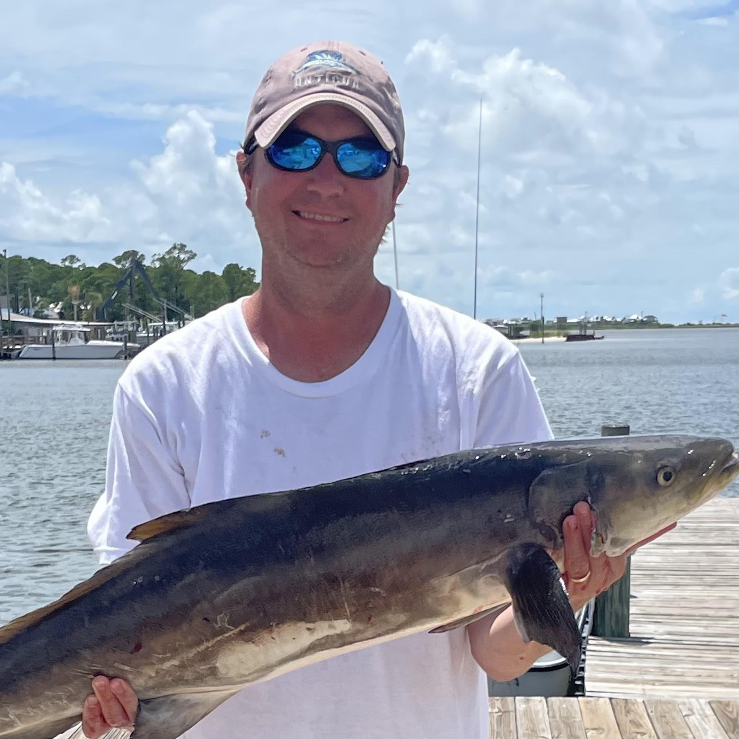
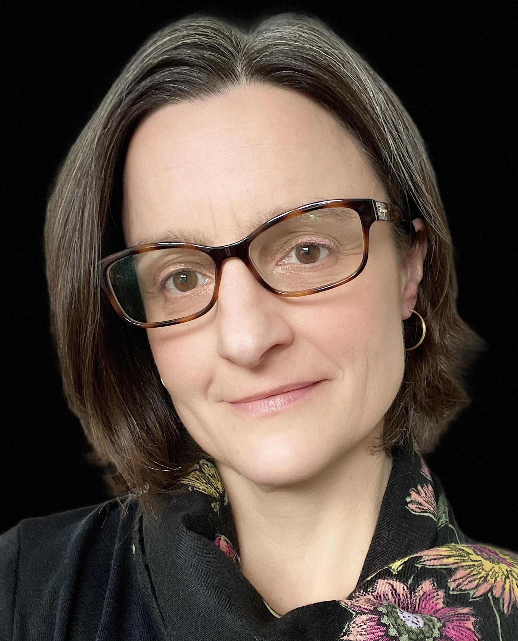
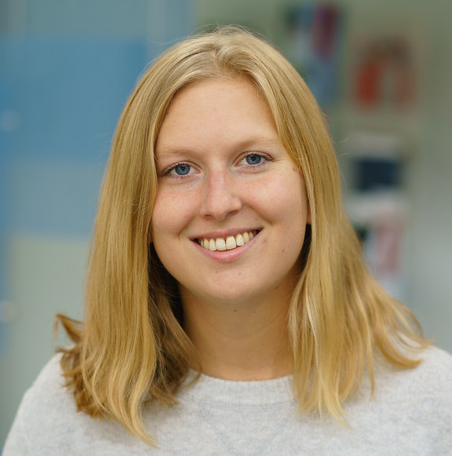





Integrating the functional importance of biodiversity in US marine ecosystem management
This project aims to ‘operationalize’ the functional roles of biodiversity in marine ecosystems
by identifying key components of biodiversity, resilience, and their interactions that can inform
practical decisions in U.S. marine management.
Emmett Duffy
Steven Scyphers
Gabrielle Canonico
Kelsi Furman
Notes:
Emmett:
Turning now to the next phases of this research:
A key reason for protecting spp is because of their ecological contributions to ecosystems and people.
Goal of phase 2 of MBD is to understand how biodiversity sustains healthy ecosystems
and benefits for people -- food, cultural value, etc
And specifically, how can we use that knowledge to improve management and conservation?

Slide 2
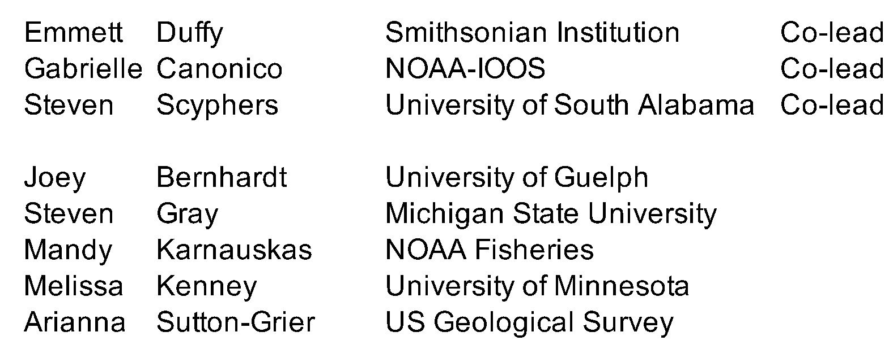
Project Collaborators
Notes:
Convene a task force of technical experts and managers to:
• synthesize evidence on how biodiversity affects marine ecosystem functioning and resilience,
• in a form that supports decision-making by managers of U.S. living marine resources

Slide 3
Research Questions
We seek to understand the decision needs of U.S. marine managers, and how key species, habitats, and interactions influence functioning of the ecosystems they manage.
1. What aspects of biodiversity, ecosystems, and their interactions do U.S. marine resource
managers and users consider important for making decisions, particularly those mandated
by law or program policy? Are important aspects missing? In short, what do they need?
2. What types of biodiversity (species, habitats, interactions) in what abundances are needed
to sustain functional, resilient U.S. marine ecosystems, based on best scientific evidence?
3. Do common themes emerge regarding how biodiversity affects ecosystem functioning
and resilience across U.S. marine management use cases, and across spatial scales?
4. Can stakeholders’ and managers’ conceptual models of biodiversity-function links be
integrated with scientific data in existing decision support processes, or are new
frameworks needed?

Slide 4

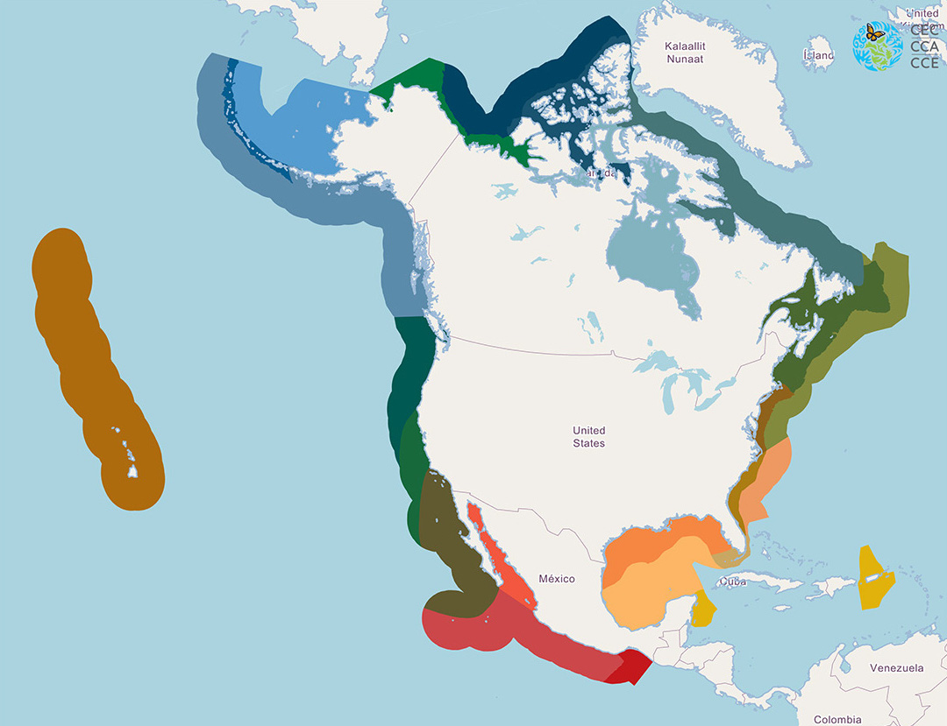


Case Studies
Canada
Salish Sea
Chesapeake Bay
Gulf of Mexico

Slide 5
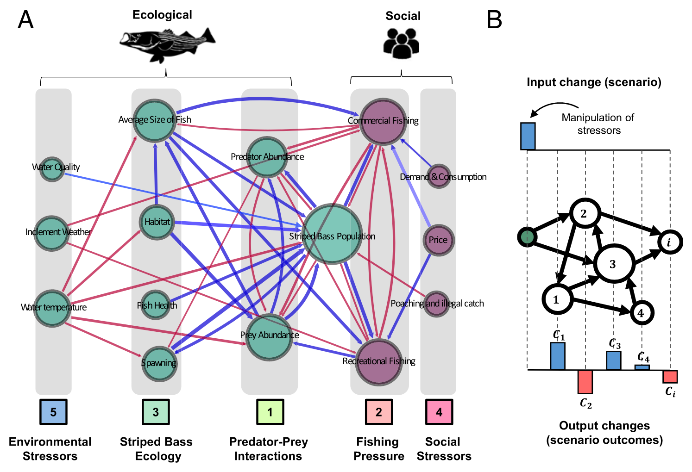
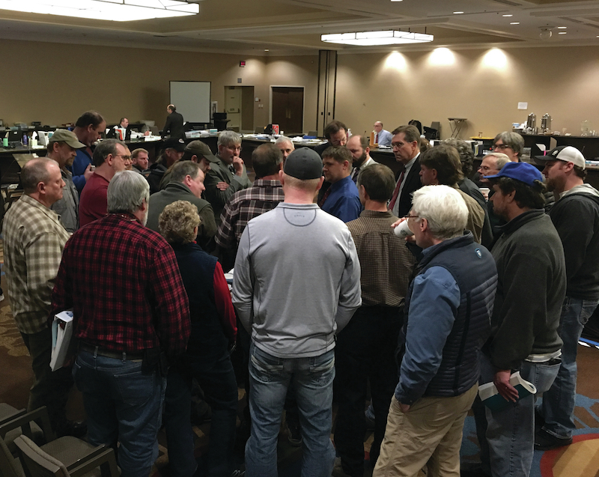
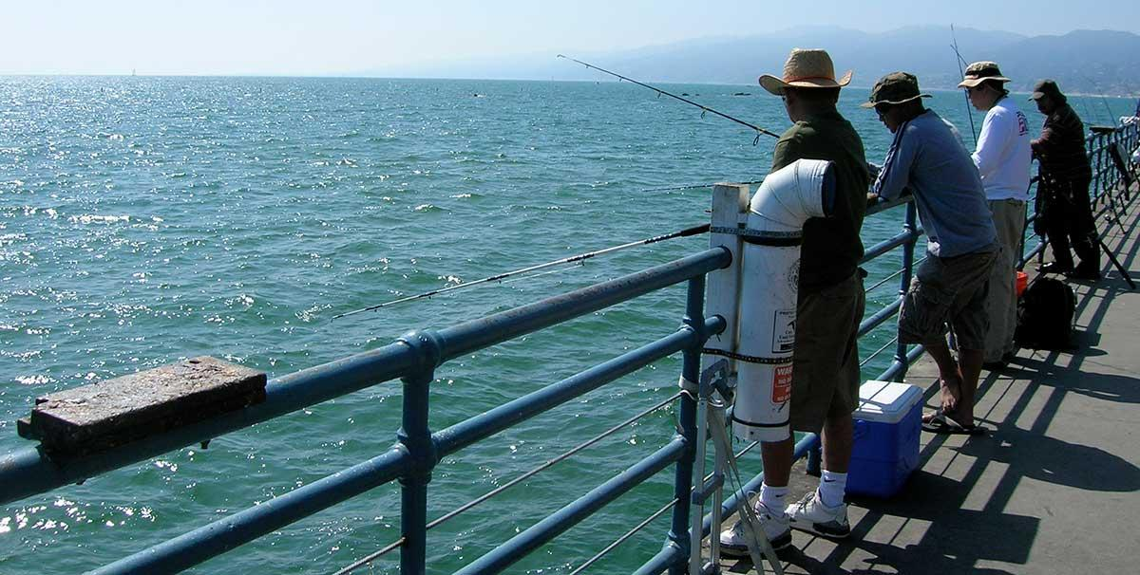
Our Approach - Collaborative Modeling
Interviews and analysis: How do stakeholders and managers see the system working?
Ecological
Social

Slide 6
Fuzzy Cognitive Mapping
“Does this component of the system (i.e., management) have an impact on this component of the system (i.e., biodiversity or resource users)?”
If they did see an impact, interviewees were asked to assign categorical weighting to the causal links drawn between the components.
Marine Resource Management
High Positive
Low Negative
Medium Positive
Marine Resource Users
Biodiversity
Medium Negative
Notes:
To demonstrate, I'm going to quickly walk through part of each interview. A hybrid approach was used with fixed concepts brought into each interview, and then the option for interviewees to bring in their own concepts that they saw as important to the SES of post-Irma Key West. The first 3 concepts in each model were Irma, People and environment. Each interviewee was asked "does this component of the system (Irma) have an impact on this component of the system (people). If they did see an impact, interviewees were asked to if the relationship was positive or negative, and to assign categorical weighting to the causal links drawn between the components. And then this process was continued for each component and potential relationship in the system.

Slide 7
1
Marine Resource Users
Marine Resource Management
-0.66
1
-1
-0.33
1
OPEN CONCEPT
0.33
Biodiversity
-1
OPEN CONCEPT
0.66
Notes:
Once this process was complete, the result is a complex model with diverse components with assigned weighted relationships. The scale of low, medium, and high impact was transformed to a numeric scale of 0.33, 0.66 and 1.

Slide 8
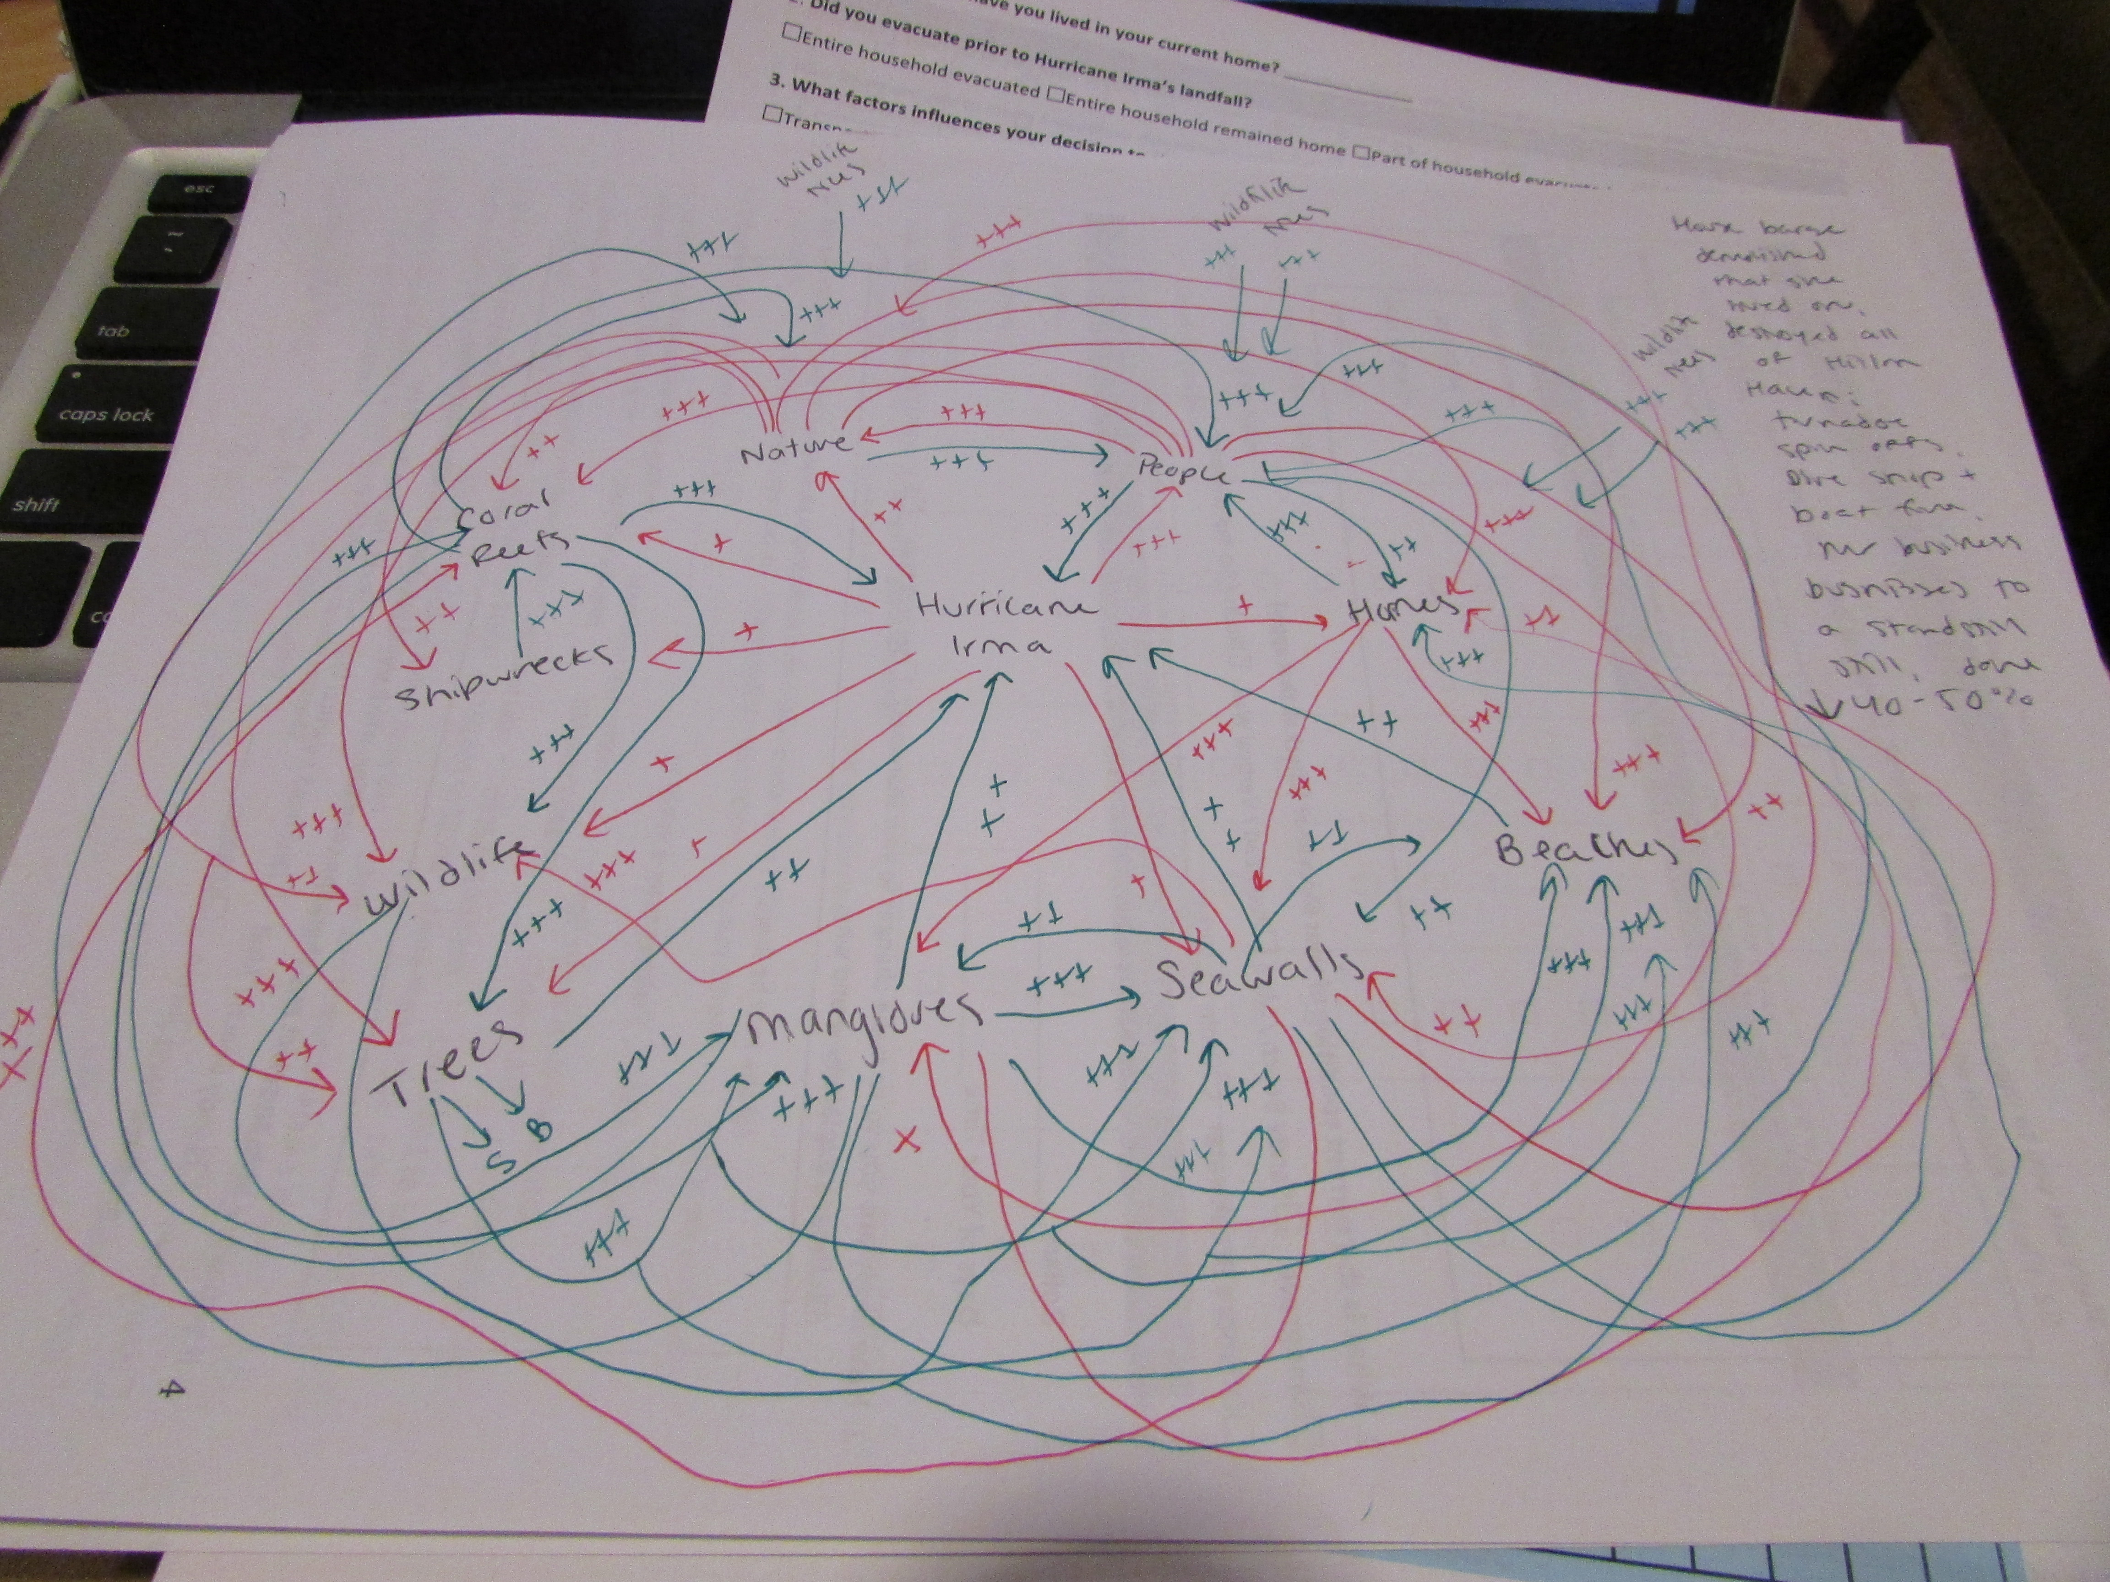
Notes:
An example fcm

Slide 9
Phase 1 - Individual Interviews
The term biodiversity can mean different things to different people and be measured in multiple different ways.
  How do you define biodiversity?
  What do you see as the key aspects of biodiversity?
What ecosystem services rely on biodiversity in your system?
What stakeholders rely on biodiversity in your system?
Is biodiversity explicitly considered in marine resource management? If so, in what management approaches or policies?
Are there approaches to managing biodiversity that would improve the delivery of the ecosystem services in this system?

Slide 10
What do you think?
1. What do you see as the key aspects of biodiversity?
2. What local or state policies manage for biodiversity?
3. What approaches are needed to better manage biodiversity?
Google Form:
https://forms.gle/2gu3D2UjCtp6pUrF6

Slide 11
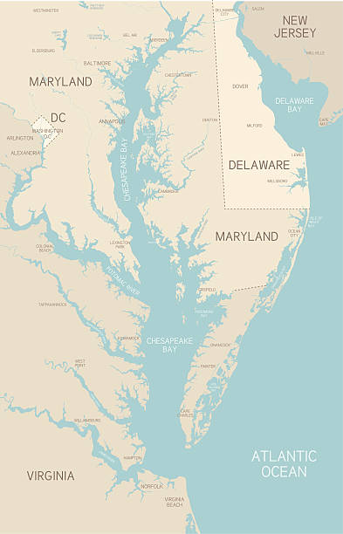
Phase 2 - Case Study Workshops - Chesapeake Bay
Notes:
Change - what can I put in for CB?

Slide 12
What do you think?
4. What is your current focus or top concern for the Chesapeake Bay?
5. What aspects of biodiversity are important in the Chesapeake Bay?
6. What stakeholders rely on biodiversity in this system?
Google Form:
https://forms.gle/2gu3D2UjCtp6pUrF6

Slide 13






Working to Build a Foundation for Evidence-Based Decisions
Science
Communities
Evidence-
Based Decisions
Governments
Notes:
We recognized when we began this work over three years ago the opportunity in focus on marine biodiversity, and not through the lens of any one specific management mandate, but rather to understand more holistically its role in fostering ecosystem health. Phase I started with understanding what we have and the data gaps and Phase II is deepening that by operationalizing that understanding and engaging with communities on what diverse species and habitat mean to us and to sustainability.
Now three years in, we are establishing the scientific foundation, the building blocks, to improve many different decisions across many mandates, to accelerate action on climate, advance objectives articulated in the US Ocean Climate Action Plan, fill significant data gaps, and to share information with many audiences the importance of managing for diverse species and habitats.
We’ve made great progress in terms of building on what we have – gathering existing data and coordinating across scientific disciplines – as well as working closely with agencies and engaging communities along the way. But there’s much more to do, especially to continue deepening engagement with many audiences as we continue to the work…
Next month, we will hold an event with the National Oceanographic Partnership Program where experts and managers will come together around needs and opportunities for biodiversity information to inform management, development, conservation, and our collective response to climate.
(Maybe you don’t want to say anything about this yet??) We hope to build towards a summit that helps to solidify ongoing collaboration with managers to more closely align this work with decisions.
In the case study regions, it provides the opportunity to deepen relationships with communities… and at the national level we will continue working with Lenfest to engage with all of you and more…
And to that point, this is not an initiative that falls solely to government at any level - rather we have the imperative to find shared, common ways to come together, to build linkages across diverse knowledge holders and opinions, and include the breadth of perspectives in this work to sustain these systems that we value. It requires ongoing conversation across sectors, communities all while incorporating the best available science as we go.

Slide 14
Thank You!
We want to hear more from you!
Would you be willing to participate in our study? If yes, please leave contact information in Google Form or feel free to contact me.
Contact Information:
Dr. Kelsi Furman
FurmanK@si.edu
Dr. Emmett Duffy
DuffyE@si.edu
Google Form:
https://forms.gle/2gu3D2UjCtp6pUrF6

