Slide 1


Urbanized Stream Source Ratio
October 20, 2015
Urban Stormwater Workgroup
Reid Christianson, PE, PhD
Neely Law, PhD
Bill Stack, PE

Slide 2
Background
Need identified to better represent headwater streams in the Phase 6 Bay Watershed Model
  Peculiarities of Perviousness STAC workshop (Nov. 2013)
    Called for consideration of stream corridor as a separate land use
Focus on urban watersheds below 60 square miles (0 to 3rd order)

Slide 3
Current representation of streams in
Phase 5 Chesapeake Bay Watershed Model
Edge-of-Field
Expected loads from one acre
Loads from headwater streams considered a part of upland areas
Some Watershed BMPs
Edge-of-Stream
60-100 sq miles
SDF
Scour/Deposition
In Stream Concentrations
Notes:
For any particular watershed, the single simulated acre is multiplied by the number of acres of that land use in the watershed.
The different types of land uses are added together to get the total load to the stream.
The stream then has some scour and deposition depending on the velocity of the water

Slide 4
Key Findings
NSQD database
  TSS concentrations from urban land uses lower than what is observed in urban streams, suggesting that other downstream sources are also responsible for the urban sediment budget
Research studies
  Urban stream channel erosion is a major component of the urban sediment budget; 20 – 60% on average
  Magnitude of stream channel erosion in any given urban watershed are strongly influenced by local factors, such as watershed impervious cover and the physical properties of the urban stream corridor

Slide 5
Previous Work
Phase I – Literature Review (CWP, 2013 & 2014a)
Phase II – MS4 Concentration Monitoring Data (CWP, 2014b)
Phase III – Watershed Flow-Concentration Relations (CWP, 2015)

Slide 6
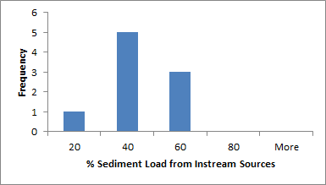
Previous Work
Phase I – Literature Review (CWP, 2013; CWP 2014a)
  38 entries; 16 included % sediment from in-stream; 9 met size criteria (<60 sq. mi.)
Histogram of the percentage of sediment load from instream two outliers and modeling studies removed.

Slide 7
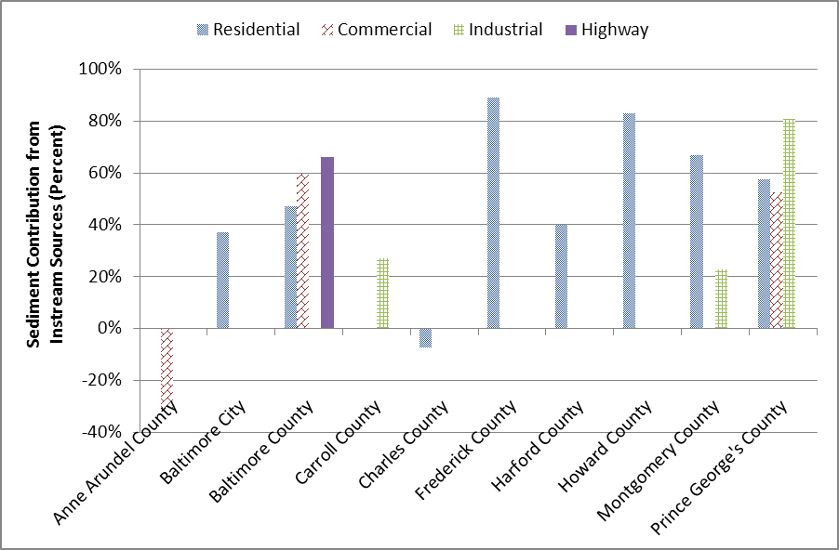
Previous Work
Phase II – MS4 Concentration Monitoring Data (CWP, 2014)

Slide 8
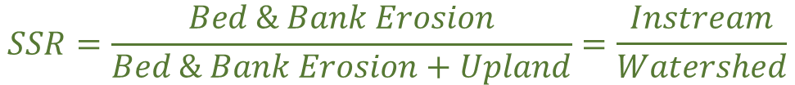
General Approach
Define a Stream Source Ratio (SSR) that quantifies the relative load attributed to in-stream sources (e.g. bed & bank erosion, resuspension)
$$SSR=\frac{Bed \& Bank Erosion}{Bed \& Bank Erosion+Upland}=\frac{Instream}{Watershed}$$

Slide 9
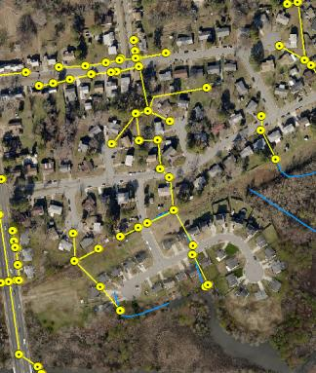
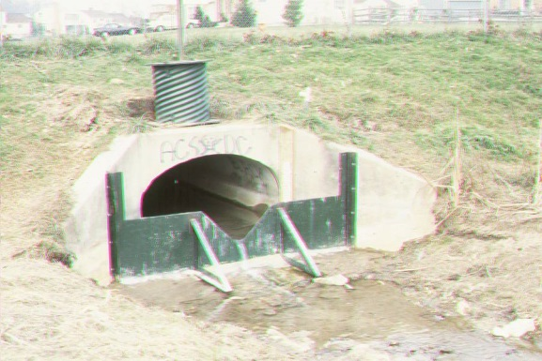
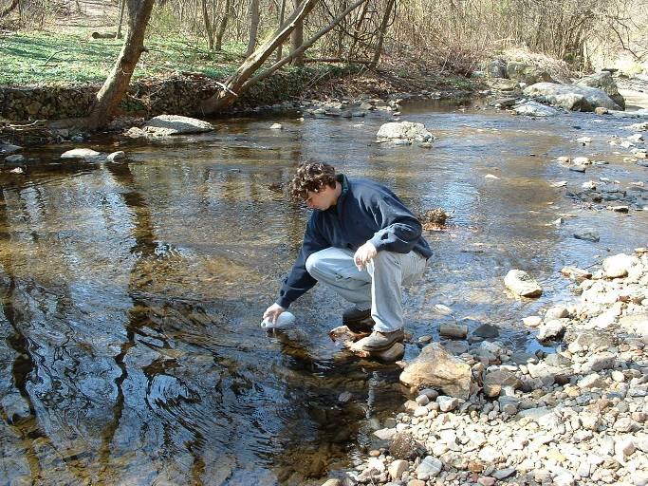
Urban streams
In densely developed areas where streams systems are heavily altered, the contribution of erosion* to sediment yield can be estimated based on a Stream Source Ratio (SSR) of observed sediment concentrations in outfalls vs streams.
* Including erosion from banks, beds, and resuspension of sediment.
Upland Sources
Watershed Sources

Slide 10
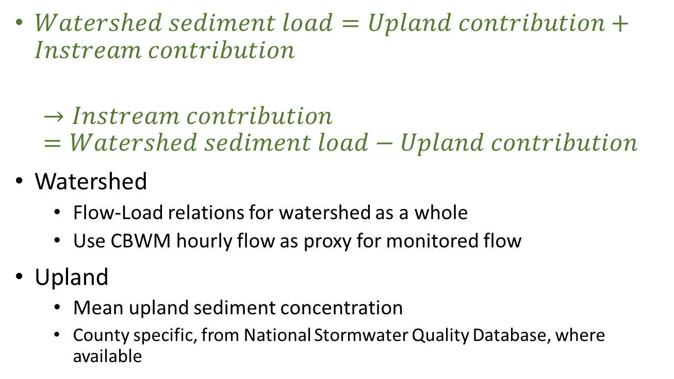
General Mass Balance Approach
$Watershed sediment load=Upland contribution+Instream contribution$
$$→Instream contribution=Watershed sediment load−Upland contribution$$
Watershed
  Flow-Load relations for watershed as a whole
  Use CBWM hourly flow as proxy for monitored flow
Upland
  Mean upland sediment concentration
  County specific, from National Stormwater Quality Database, where available

Slide 11
Analytical Process
SSR estimated as a result
  Monitoring data from small urban watersheds
  Event Mean Concentration from NSQD
Relate drainage area characteristics to SSR
  E.g. Impervious & Soil type
Final predictive regression based on 6 watersheds

Slide 12
Watershed Characteristics
Watershed Name | Drainage Area (sq. mi.) | Impervious Cover (fraction) | Forest Cover (fraction) | Fraction HSG C/D | Riparian Length Fraction of stream | SSR (Estimated)
Breewood | 0.10 | 0.331 | 0.181 | 0.729 | 1.00 | 0.820
Moores Run @ Radecke Ave | 3.52 | 0.300 | 0.070 | 0.895 | 0.750 | 0.579
Stony Run @ Linkwood | 2.20 | 0.694 | 0.306 | 0.438 | 0.385 | 0.909
West Branch Herring Run @ Idlewylde | 2.13 | 0.277 | 0.116 | 0.449 | 0.405 | 0.319
Scott's Level - 01 | 3.42 | 0.246 | 0.029 | 0.641 | 0.767 | 0.314
Powder Mill Run | 3.64 | 0.378 | 0.041 | 0.954 | 0.656 | 0.691

Slide 13
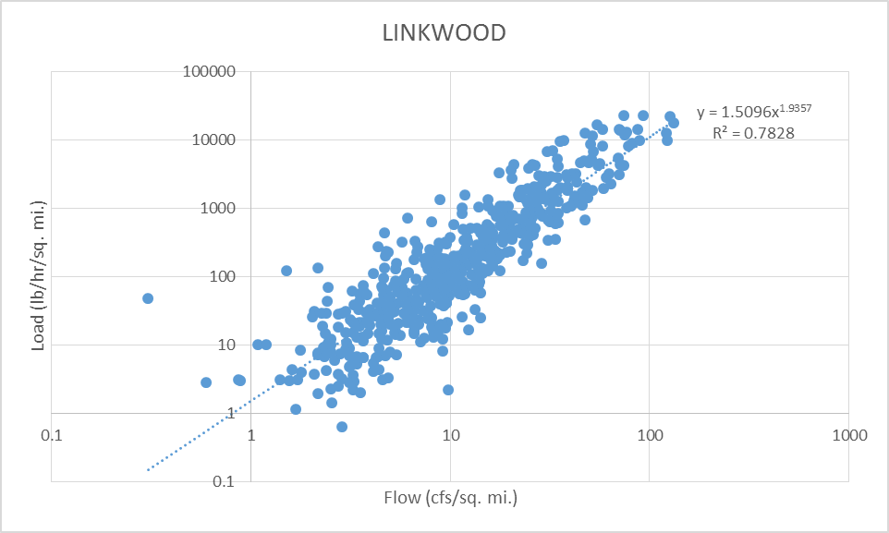
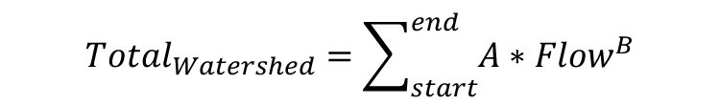
Flow-Load Relation
$${Total}_{Watershed}=\sum_{start}^{end}{{A∗Flow}^{B}}$$

Slide 14

Flow-Load Relation
$${Total}_{Watershed}=\sum_{start}^{end}{{A∗Flow}^{B}}$$
$$Watershed sediment load=Upland contribution+Instream contribution$$

Slide 15

SSR Estimation Example - Watershed
Flow-load relation used to estimate total watershed load
$$Watershed sediment load=Upland contribution+Instream contribution$$

Slide 16


SSR Estimation Example - Upland
Event Mean Concentration for county from NSQD represents upland
  $Outfall(upland) ={EMC}_{Storm}∗{Flow}_{Total}$
$$Watershed sediment load=Upland contribution+Instream contribution$$

Slide 17

SSR Estimation Example - Upland
Event Mean Concentration for county from NSQD represents upland
  $Outfall(upland) ={EMC}_{Storm}∗{Flow}_{Total}$
$$Watershed sediment load=Upland contribution+Instream contribution$$
Watershed | Upland TSS EMC (mg/l)
Breewood | 58.0
Moored Run @ Radecke Ave | 44.0
Stony Run @ Linkwood | 40.0
West Branch Herring Run @ Idlewylde | 40.0
Scott's Level - 01 | 32.4
Powder Mill Run | 40.0
Average | 42.4

Slide 18

SSR Estimation Example - Instream
$$Instream contribution=Watershed sediment load−Upland contribution$$
(Watershed)
(Instream)

Slide 19

SSR Estimation Example - Instream
$$Instream contribution=Watershed sediment load−Upland contribution$$
(Watershed)
(Instream)

Slide 20
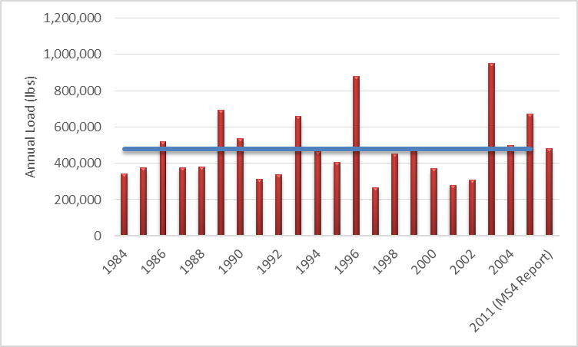
Scott’s Level
MS4 Report for 2011 = 480,183 lbs
Annual Average (flow-load) = 480,195 lbs

Slide 21
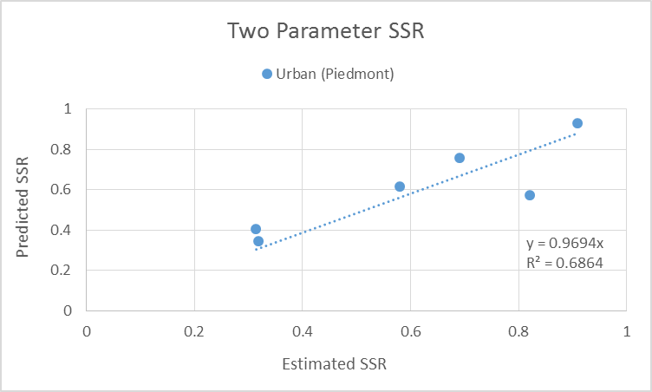

Final – Simplified Predictive Regression
$SSR=1.4085∗Impervious Cover \left(fraction\right)+0.5341∗HSG CD(fraction)−0.$2828
Watersheds with 25% impervious or more

Slide 22
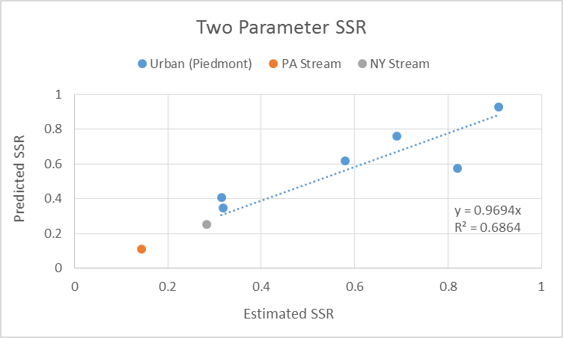
Final – Simplified Predictive Regression
$SSR=1.4085∗Impervious Cover \left(fraction\right)+0.5341∗HSG CD(fraction)−0.$2828
Trib. to Big Spring Run ~ 1.05 sq. mi. @17.6% Imp. & 27% HSG CD

Slide 23
Final – Simplified Predictive Regression
$SSR=1.4085∗Impervious Cover \left(fraction\right)+0.5341∗HSG CD(fraction)−0.$2828
Allen Creek ~ 27.27 sq. mi.
@13.7% Imp. & 64% HSG CD

Slide 24
Phase 6 Implementation
RUSLE based on work by USGS and Tetra-Tech represents upland load
  Impervious cover would contribute no sediment
  Apply the predicted SSR and “back-calculate” sediment from stream
Sediment EMCs
  Upland loads calculated on-the-fly with modeled flow
    Tetra Tech NSQD and Literature EMC (140.44 mg/l)
    CWP Maryland MS4 analysis EMC (92.21 mg/l)
    NSQD Bay States average (CWP, 2014) EMC (72.77 mg/l)
  Apply the predicted SSR and “back-calculate” sediment from the stream
Phase 5.3.2 total load (fallback)
  SSR to parse load into upland and stream

Slide 25
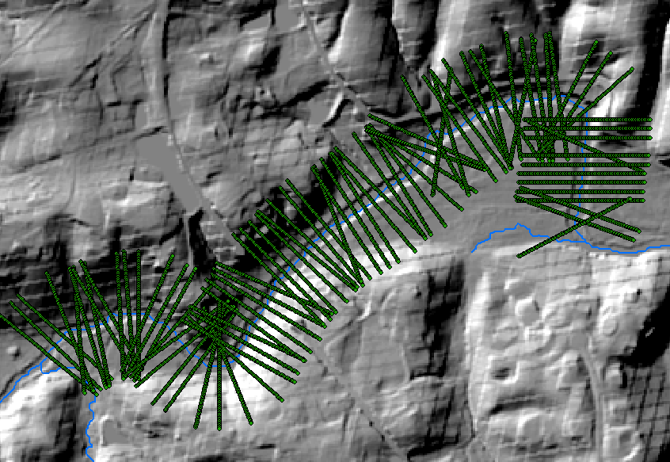
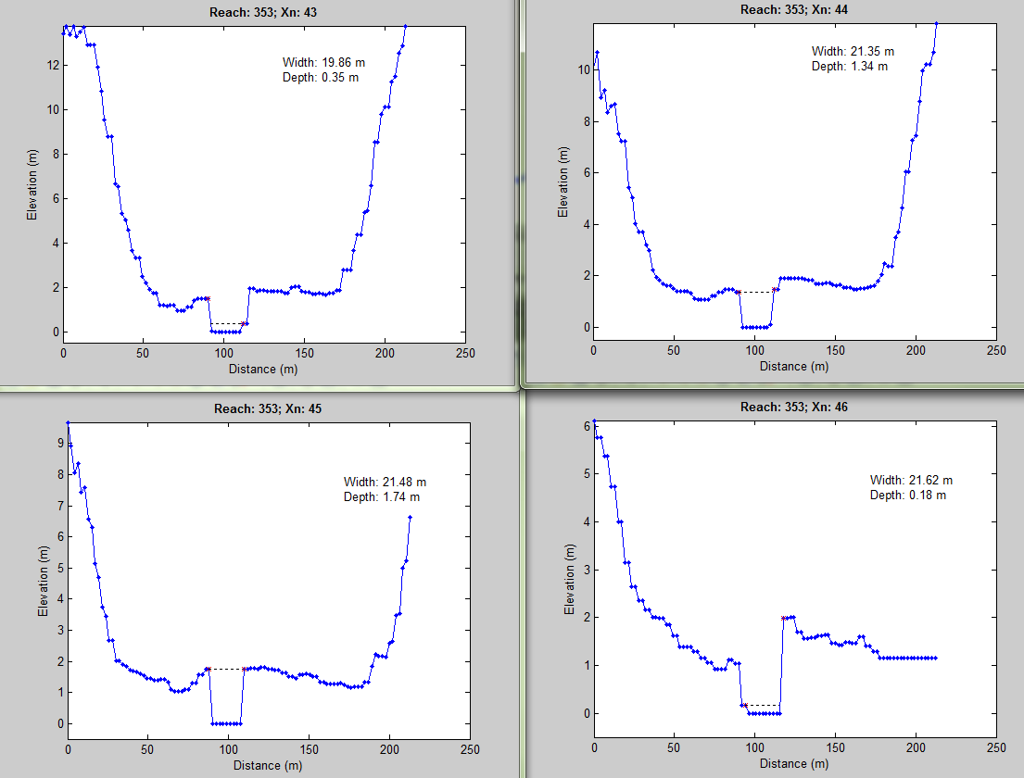
Rural Streams (<15% Imp.) - USGS
Spatial analysis estimating Stream Parameters
Sediment balance based on USGS monitoring data

Slide 26
Questions?
References
  Center for Watershed Protection. 2013. Technical Memorandum: Sediment Stream Loading Literature Review in Support of Objective 1 of the Sediment Reduction and Stream Corridor Restoration Analysis, Evaluation and Implementation Support to the Chesapeake Bay Program Partnership.
  Center for Watershed Protection. 2014a. Technical Memorandum: Stream Sediment Studies in Support of Objective 1 of the Sediment Reduction and Stream Corridor Restoration Analysis, Evaluation and Implementation Support to the Chesapeake Bay Program Partnership.
  Center for Watershed Protection. 2014b. Technical Memorandum: Analysis of Stream Sediment Monitoring in Support of Objective 1 of the Sediment Reduction and Stream Corridor Restoration Analysis, Evaluation and Implementation Support to the Chesapeake Bay Program Partnership.
  Center for Watershed Protection. 2015. Technical Memorandum: Analysis of Stream Sediment Monitoring to create a watershed characteristic regression in Support of Objective 1 of the Sediment Reduction and Stream Corridor Restoration Analysis, Evaluation and Implementation Support to the Chesapeake Bay Program Partnership.

Slide 27
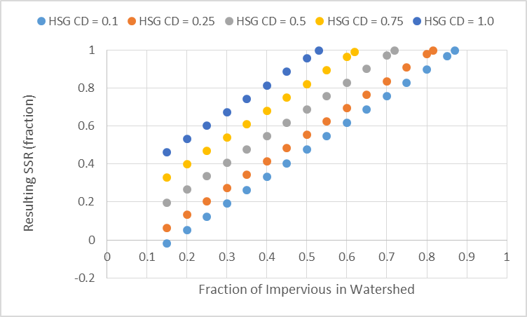
Predicted SSR for Small Urban Streams
General envelope of potential SSR results

