Slide 1
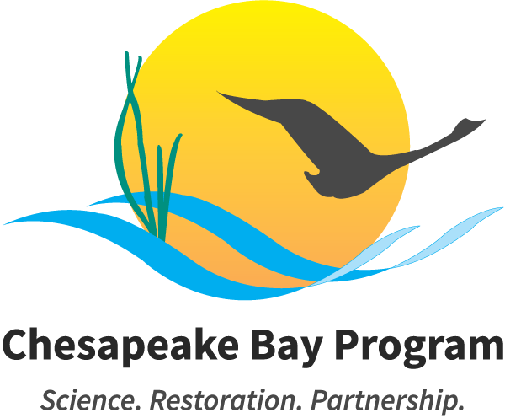
Chesapeake Bay Program 2025: Reaching and Beyond
Bruce Vogt
NOAA Chesapeake Bay Office
SFGIT Meeting 9/18-19/2023

Slide 2
Executive Council Charge
Charting a Course to 2025 and Beyond
October 11, 2022, directed to the Principals’ Staff Committee
Part 1: This report, Reaching 2025
Progress toward achieving the 2014 Outcomes by 2025
Additional focus on water quality/TMDL, emerging science and monitoring, climate and DEIJ, wetlands and forest buffers
Considerations for actions beyond 2025
Part 2: Beyond 2025
Process began in June

Slide 3
Reaching 2025 Conclusions
Roughly ⅔ of our outcomes are on track and represent significant accomplishments.
In spite of those successes, we have work to do on the remaining ⅓ of the outcomes:
Targeting, developing cost estimates, tracking, monitoring, and reporting are critical components of quantifiable outcomes.
Champions who take responsibility for leading/coordinating outcomes are critical. Often they include a federal representative along with a jurisdictional one, or in some cases an NGO. Champions often contribute and advocate for catalyzing funding, staff, and resources.
Developing networking systems to engage and incentivize private landowners and communities to address challenges such as nonpoint source pollution, living shorelines, forest buffers, and freshwater wetlands.

Slide 4
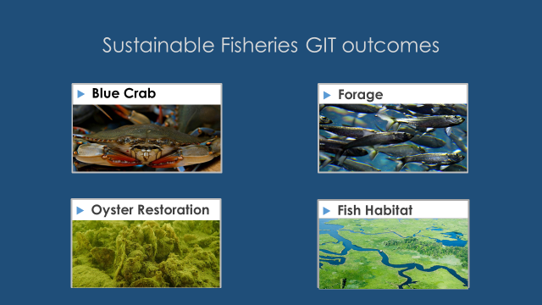
Fisheries GIT Outlook for 2025

Slide 5
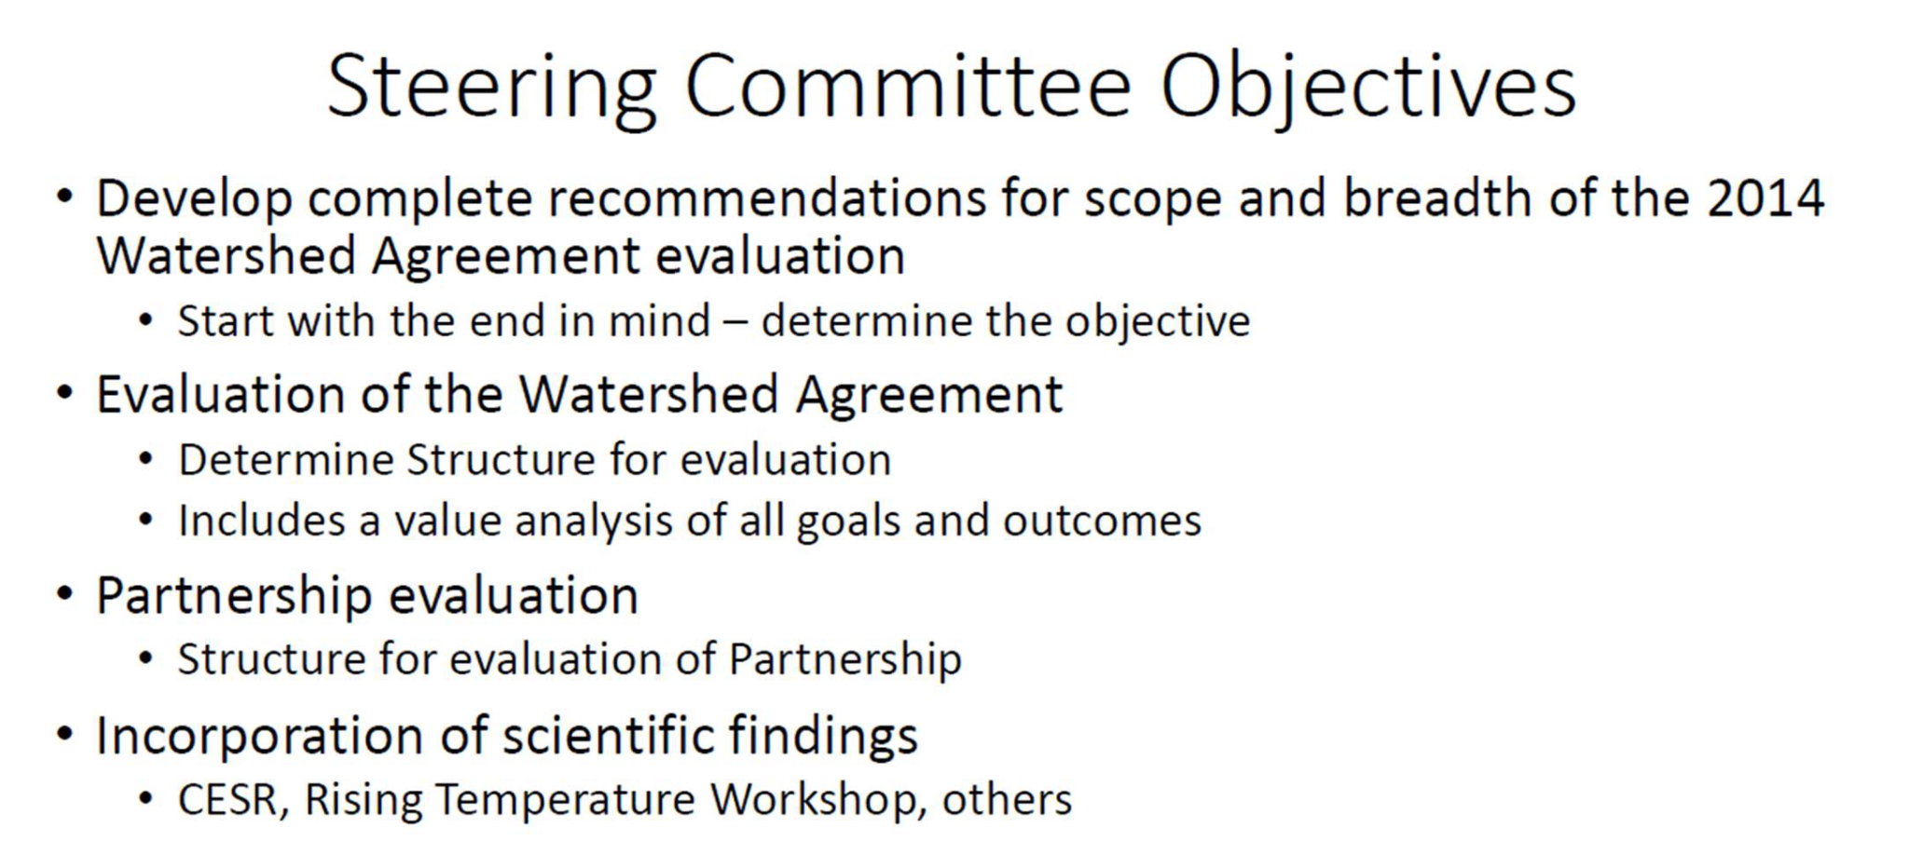
Beyond 2025

Slide 6
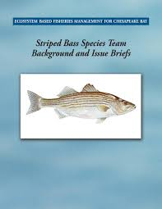
Fisheries GIT Strategy for 2025
Begin discussing what do we want the Fish GIT to focus on in the future
Identify key concepts we want to prioritize
Quantifiable and species specific goals
Advance ecosystem based management w/in Bay and regionally
Connect with other Goal Teams
Recognize changing climate and environmental conditions
Target places for higher impact

Slide 7
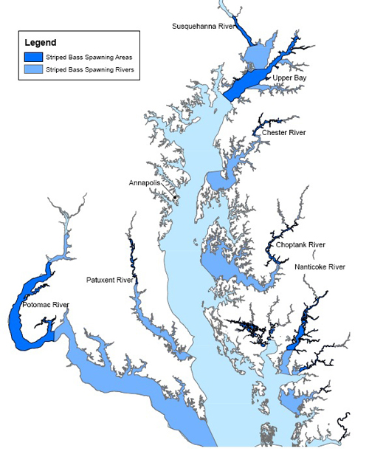
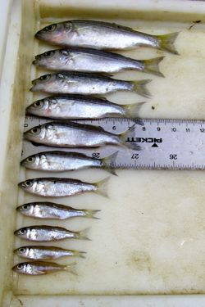
What it could look like…
Support/maintain Striped bass spawning success and recruitment in three priority tributaries
Protect and restore wetlands
Improve water quality
Limit shoreline hardening
Create diverse seascapes (oysters, sav, marshes)
Adapt to climate change and attempt to provide thermal refuge for fish
Advance science to measure fish response to system change and management actions

