Slide 1

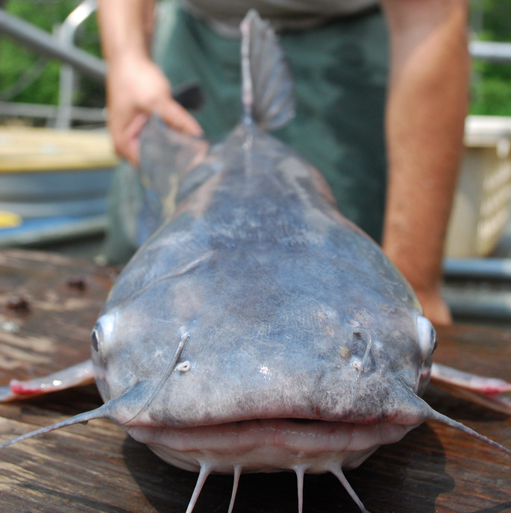
Invasive Catfish Workgroup Management Strategy Progress and Next Steps
Sustainable Fisheries Goal Implementation Team Meeting – Fall 2023
Bailey Robertory (CRC)
bailey.Robertory@noaa.gov
Photo Credit: Chesapeake Bay Program

Slide 2
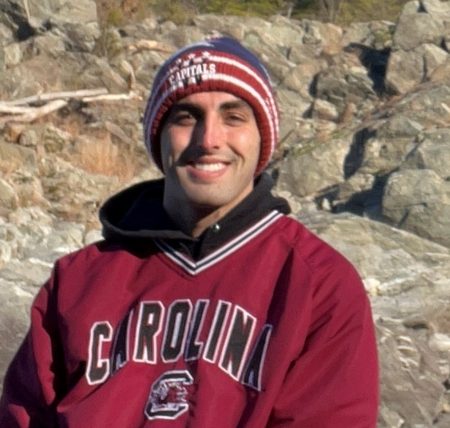



Introduction
Bailey Robertory
  CRC staffer with the Sustainable Fisheries Goal Implementation Team
  NOAA Chesapeake Bay Office
  Prior to CRC
    B.S Marine Science
    M.S Wildlife, Aquatic, and Wildlands Science and Management
Notes:
Bailey

Slide 3
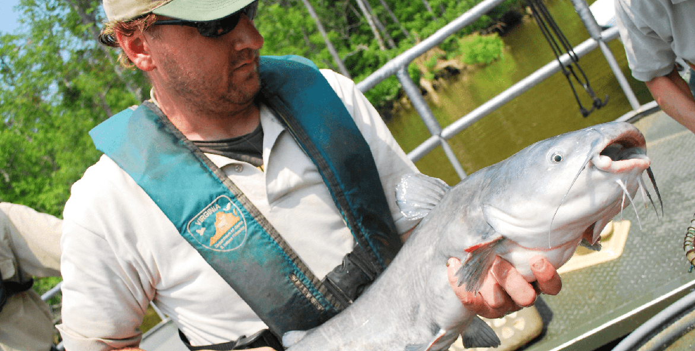
What is the Invasive Catfish Workgroup?
ICW
Group of different stakeholders tasked with planning the management of invasive catfish (mostly Blue catfish) throughout the Chesapeake Bay Watershed
Group includes state managers, government, scientists, recreational watermen, commercial watermen, and more
Met in 2020 to develop a management strategy
Photo Credit: Matt Rath, Chesapeake Bay Program
Notes:
Bailey

Slide 4
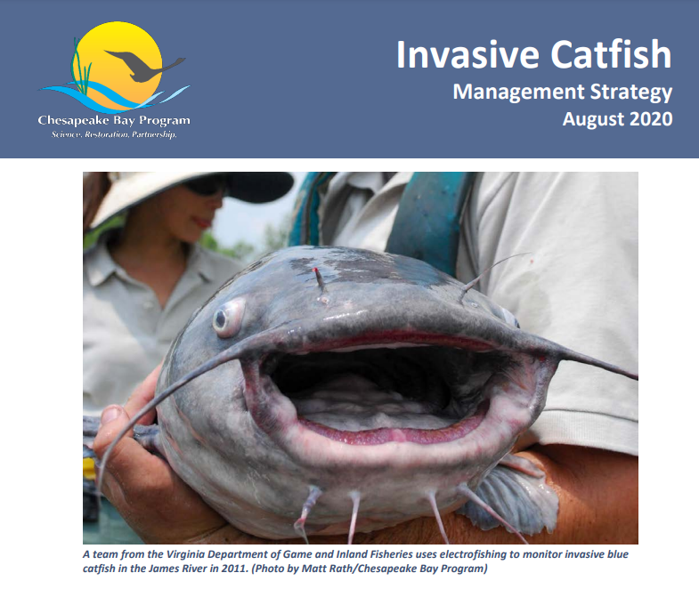
2020 Invasive Catfish Management Strategy
Link
Stated Outcome:
“Reduce the abundance and mitigate the spread and ecological impacts of invasive catfishes in Chesapeake Bay through increased public education and awareness and development of fishery management strategies that ensure ecosystem health and productivity.”
Notes:
Bailey

Slide 5
ICW Roles
2020 Invasive Catfish Management Strategy
Specific Roles within the ICW
  Catfish regulations, management plans, and public campaigns are the responsibility of the management jurisdictions
  Academic institutions, non-profits, and federal agencies support research efforts to better understand the impacts of invasive catfishes and to increase public awareness
  Commercial fishers, recreational anglers, processors, and marketing experts provide valuable insights on the interests of the public and seafood industry that may inform the development of effective fisheries management strategies
  Source: https://www.chesapeakebay.net/what/publications/2020-invasive-catfish-management-strategy
Notes:
Bruce

Slide 6
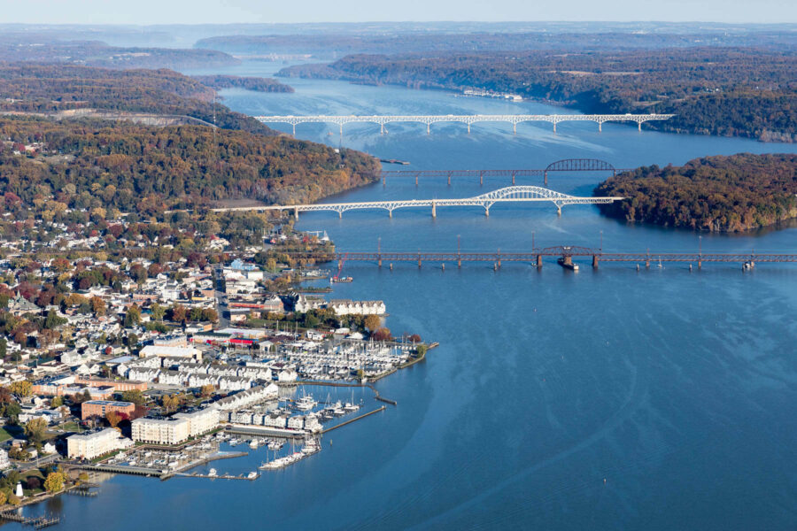
2023 Invasive Catfish Workgroup Meeting
Decision was made to reconvene ICW and assess the future of group
Meeting held on July 19th - virtual
Member questions prior to meeting
  What has gone well with the ICW in the past?
  What has not worked/needs to be improved?
Wide range of responses
  Common themes
Photo Credit: Chesapeake Bay Program
Notes:
Bailey

Slide 7
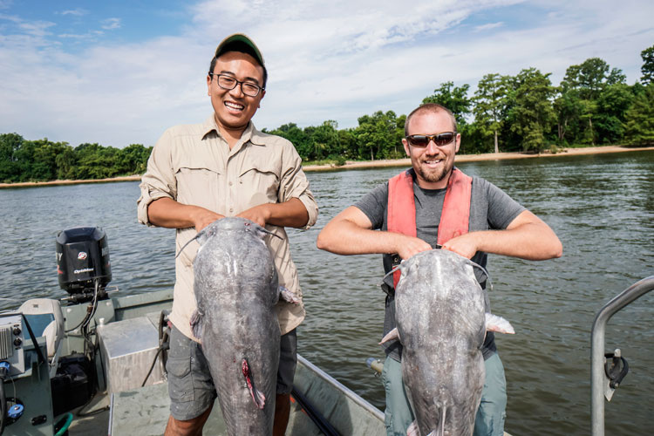
Pre-Meeting Responses - Good
ICW brings together a diverse group of stakeholders
Increased awareness of issues regarding invasive catfish
Space for collaboration
Photo Credit: NOAA Fisheries
Notes:
Bailey

Slide 8
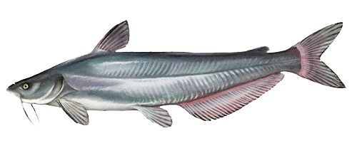
Pre-Meeting Responses –
Needs Improvement
Negative perception around catfish
Need for more meetings
  Strong push for in-person meetings
Need for clearer goals/get on same page
Need for a spokesperson for retailers
More communication between states, input from fishermen, and more unified message
Processor deficit
Strong displeasure with USDA requirements
Photo Credit: Maryland DNR
Notes:
Bailey

Slide 9
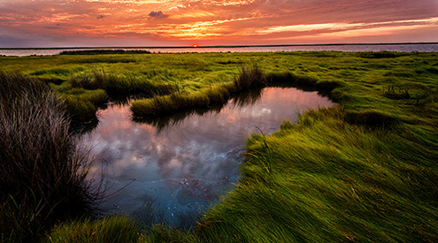
ICW Meeting Results
Asked members if the ICW should continue
  Overwhelming agreement
  Momentum
Desire to hold an in-person meeting soon (Winter 2023)
Request for more funding/advertisement for various aspects
Confusion by some on why Blue Catfish are not more readily available on menus
Desire to re-assess/find a common goal/plan that all can agree on
Still issue of conflicting opinions
Photo Credit: National Wildlife Federation (Bob Miller)
Notes:
Bailey

Slide 10
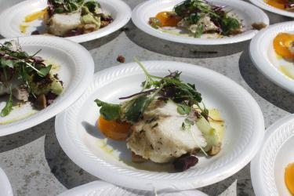
ICW – What is being done by members?
Members committed to in-person meeting
Member attempting to get Blue Catfish on the menu in Caroline County Public Schools
USGS looking for high priority science needs (possibly catfish needs as identified by group)
Member spoke at Farm Bill hearing to express frustration with USDA requirements
  Working with congressional leaders to get catfish language removed from bills
  Hoping to get more funding for research and processors
Photo Credit: NOAA Fisheries
Notes:
Bailey

Slide 11
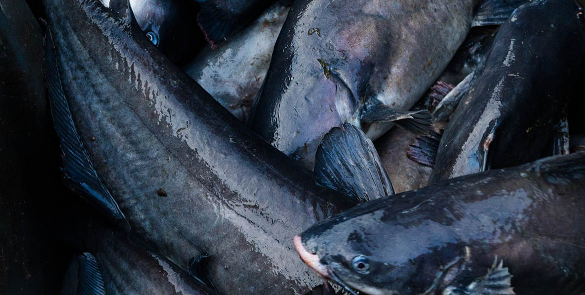
What suggestions does the Fish GIT have regarding the next steps and focus of the ICW?
Open to any and all feedback
Photo Credit: Will Parson, Chesapeake Bay Program
Notes:
Bailey

