Slide 1


Chesapeake Bay
Water-Column Hypoxia Monitoring
This is the Teal Title Slide, you can swap to the
Blue 1 Title Slide or Blue2 Title Slide in the Layout menu
An Update to the Chesapeake Bay Program Fisheries Goal Implementation Team
September 19, 2023
NOAA Chesapeake Bay Office

Slide 2
Deployments
Maintenance
Data Server Update
QC Protocols
Living Resources
Next Site Selection

Slide 3
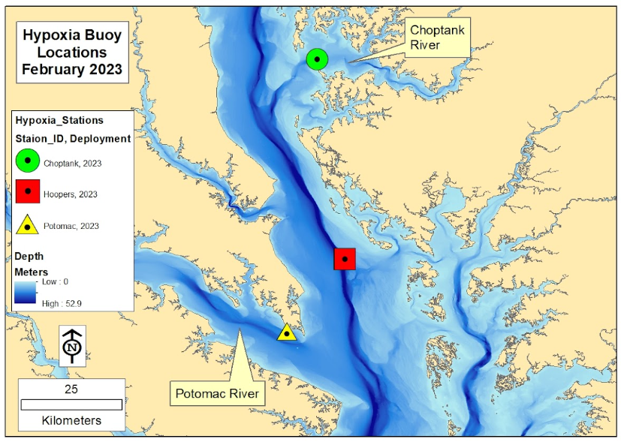
2023 Deployment Map
Lower Choptank River
Sensors at 1m, 5m, 8m
Deployed 4/26
Mid Bay
Sensors at 5m, 9m, 13m, 17m
Deployed 5/15
Lower Potomac River
Sensors at 3m, 7m, 10m
Deployed 5/25

Slide 4
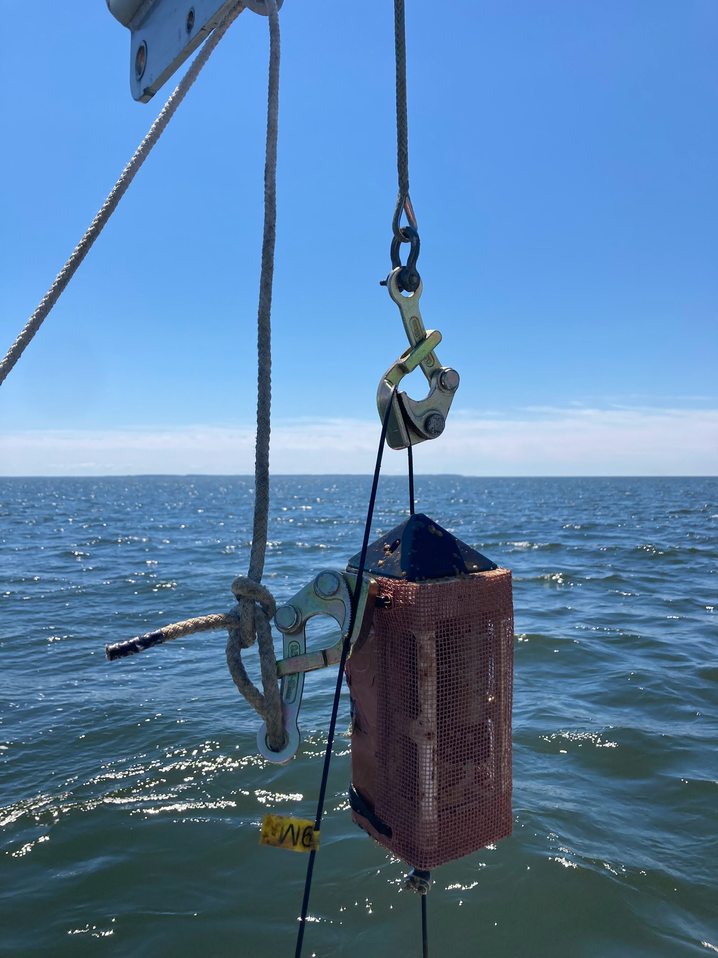
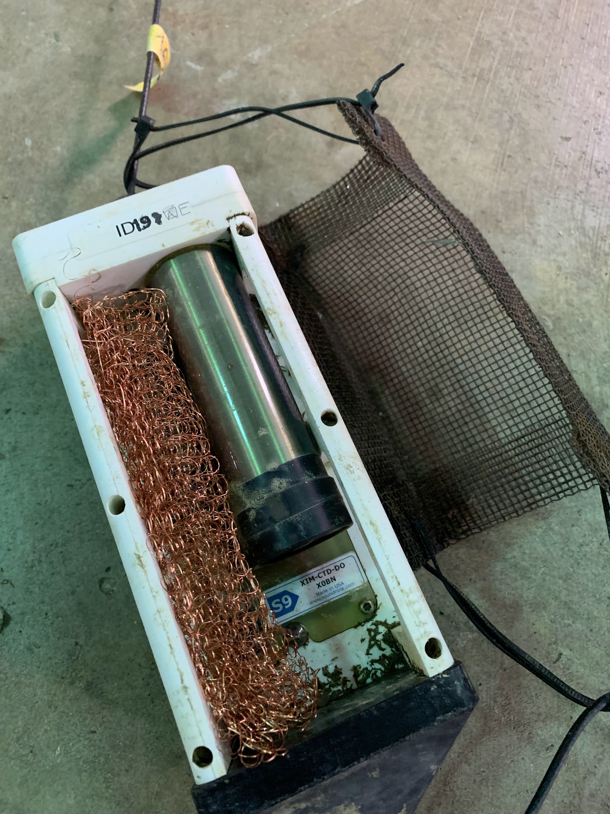
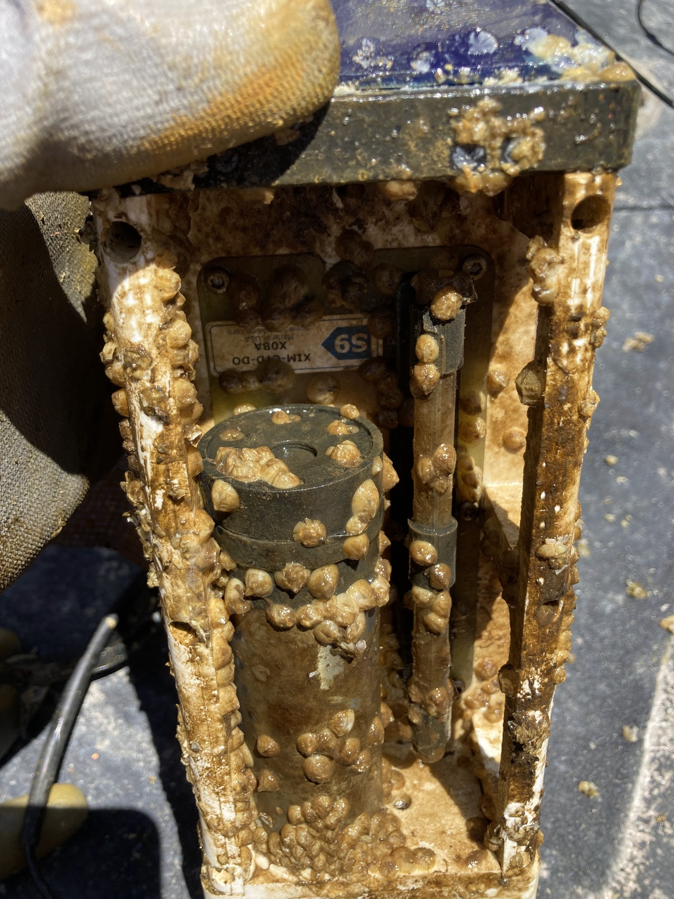
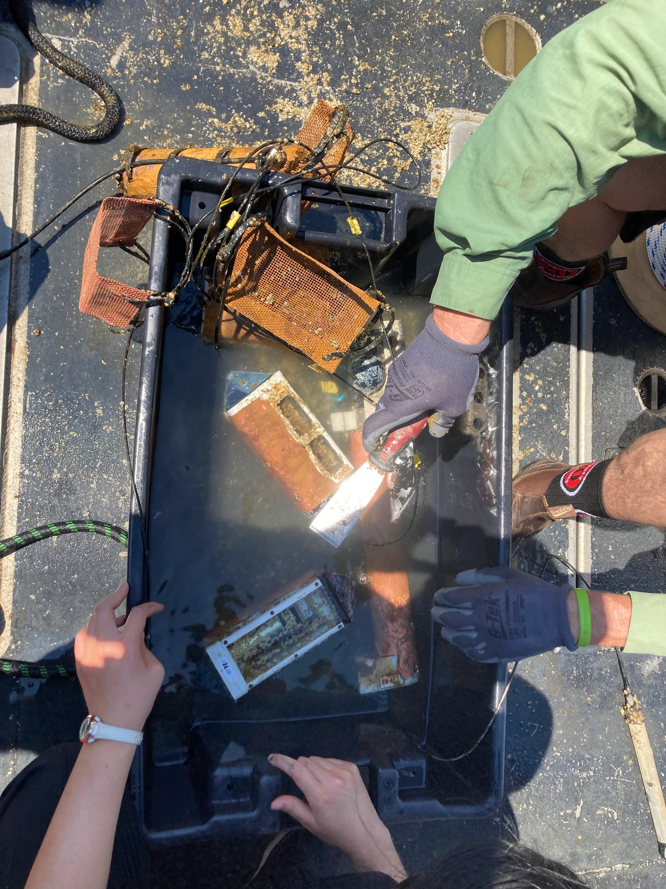
Maintenance Visits & Issues
Anti-Fouling
Copper wire mesh covering and copper tape initially
Barnacle season requires more frequent visits; vinegar baths
Short period gaps for recovering an array to dissolve the barnacles is OK
Additional copper mesh nested around sensors to add anti-fouling measures

Slide 5
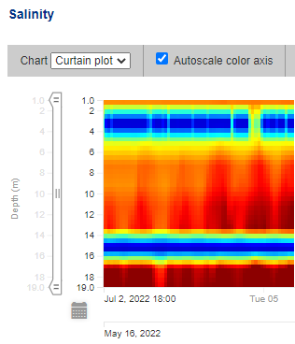
Layout: Minimal Logo Swoosh
Swap to other slide layouts in the Layout menu
Maintenance Visits & Issues
Bad Sensor Readings
Bad conductivity cells at 3m & 15m on East array (2022)
  15m conductivity cell became a problem on May 22, less than a week after deployment
  3m conductivity cell became a problem on July 1 likely due to barnacle fouling
  Eventual course of action will be to replace the sensors and either remove biofouling or return for maintenance
  NCBO display server will interpolate through the bad data at 3m & 15m (see ‘clean’ visualizations)
  Raw and QC’d data will be retrievable through IOOS pages

Slide 6
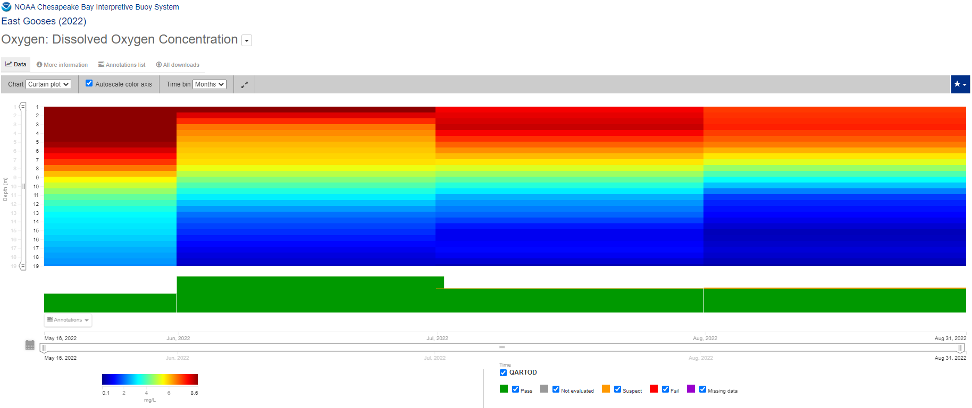
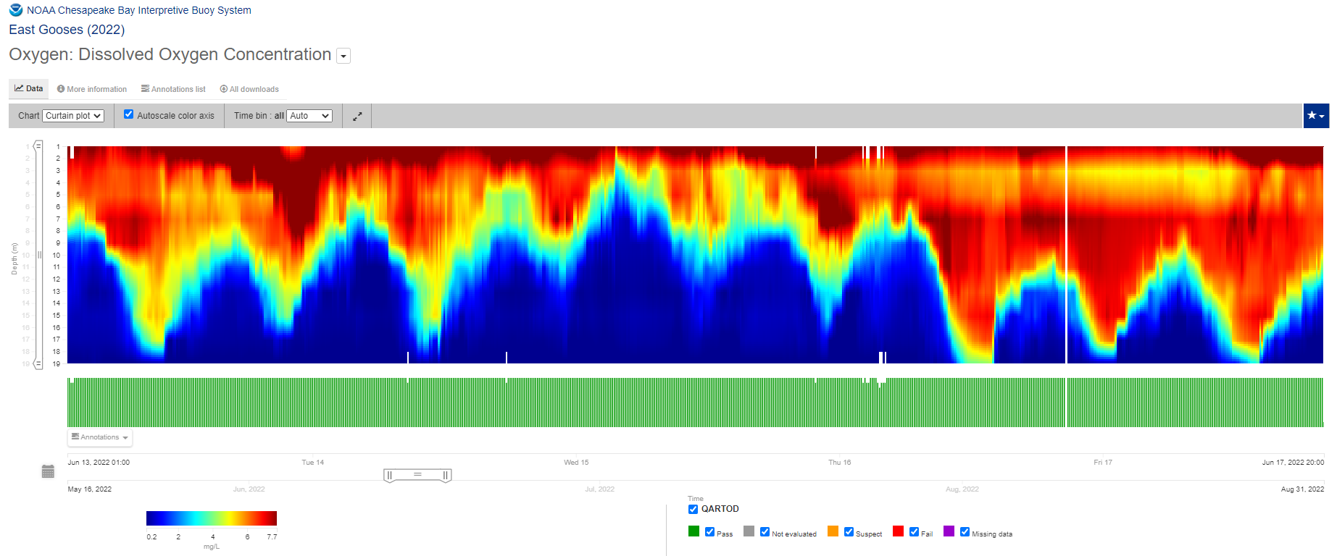
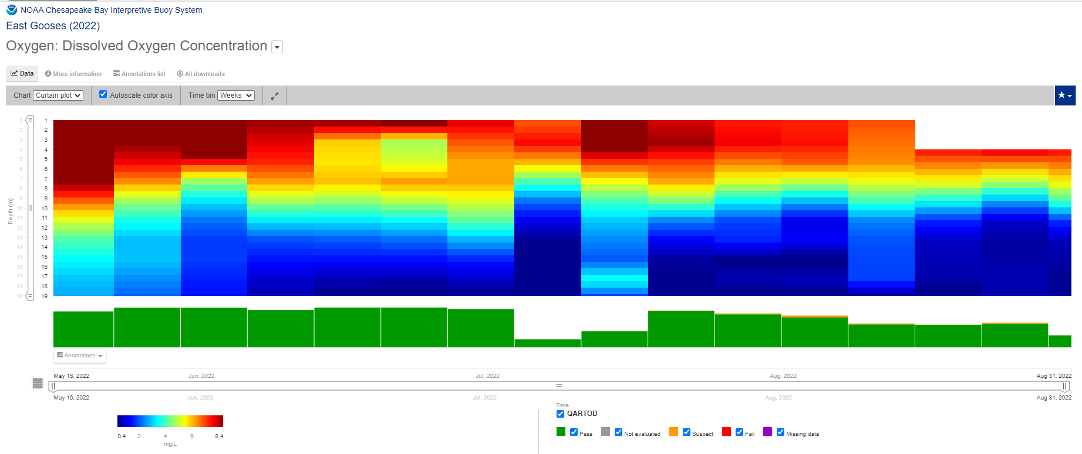
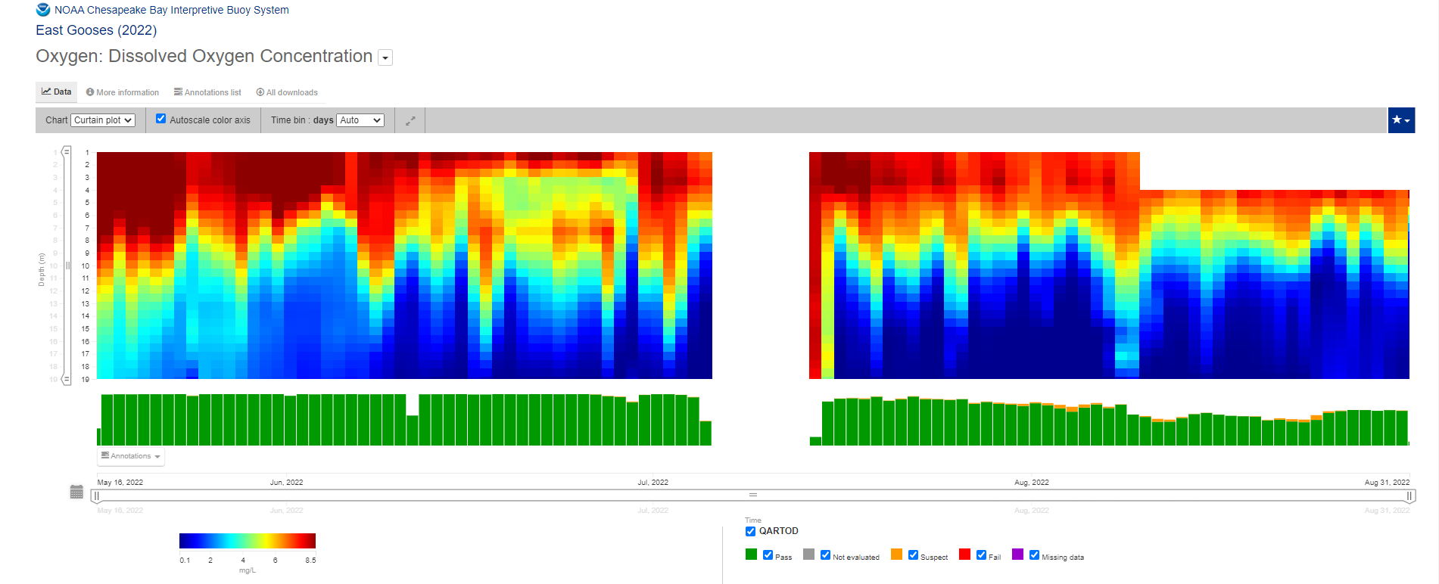
The Difference is Temporal Resolution
Monthly (top left), Weekly (middle left), Daily (bottom left), 10 min (middle right)
3.5 months (left plots) vs 5 days (right plot)
~2 mg/L threshold

Slide 7
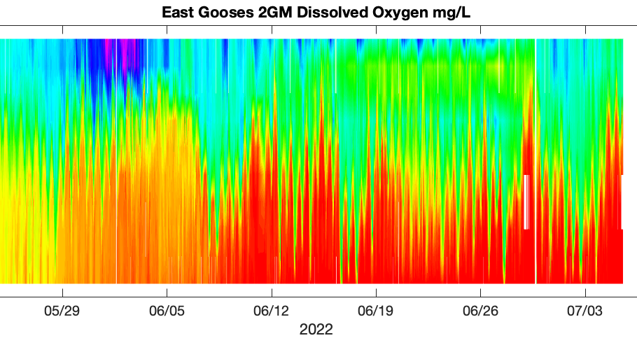
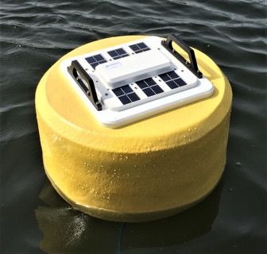

Data Servers and Visualizations
Axiom
Deliver Raw & QC Visualizations & Data
Axiom
Visual QC & Download Tool
S9
Raw Data
Buoy
NCBO
Raw Data & QC (flagged) Data
Notes:
Data is transmitted from the buoy to the S9 server. The NCBO server will take the raw data and create a duplicate display record that can interpolate between bad sensor data. Both sets of records are passed to the Axiom server for archiving and distribution with the display records the source of visualizations.

Slide 8
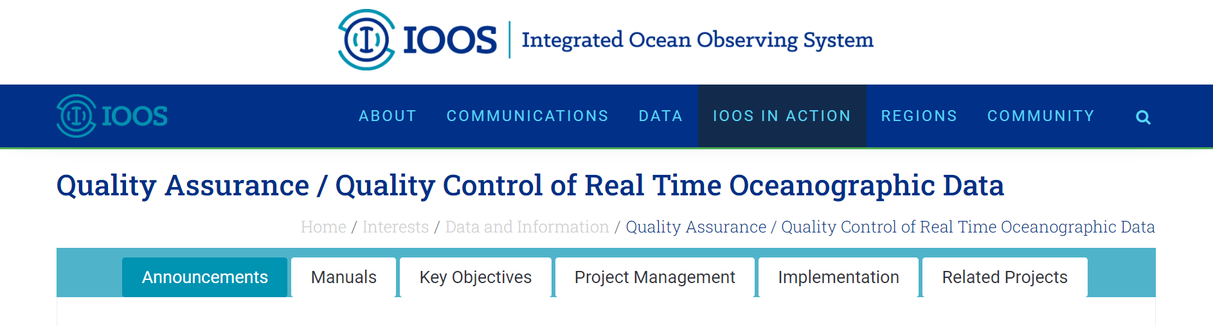
QA/QC Measures
Current Tests Evaluated- Sensor Variable Thresholds Under Review
Location Test
Spike Test
Gross Range Test
No Data Test
Flat Line Test
Rate of Change Test

Slide 9
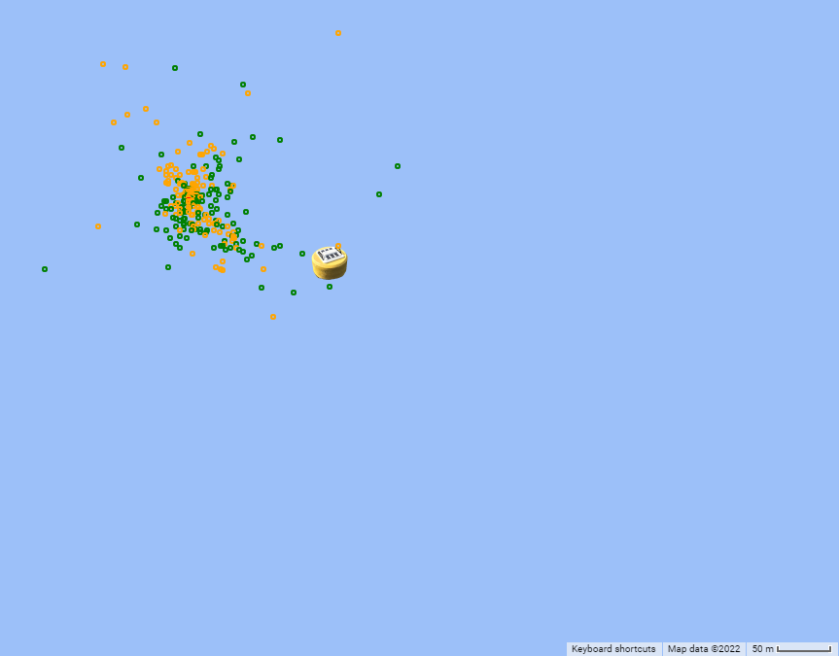
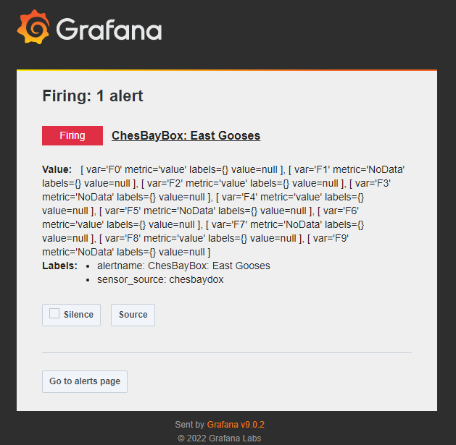
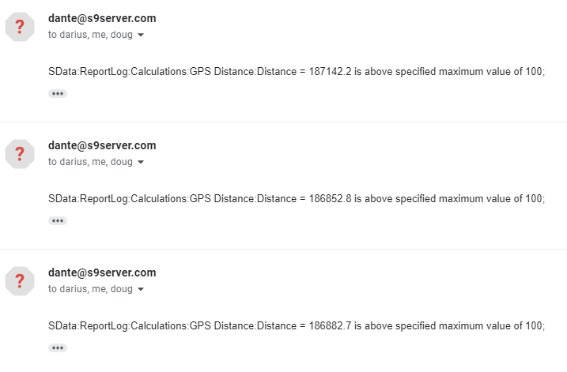
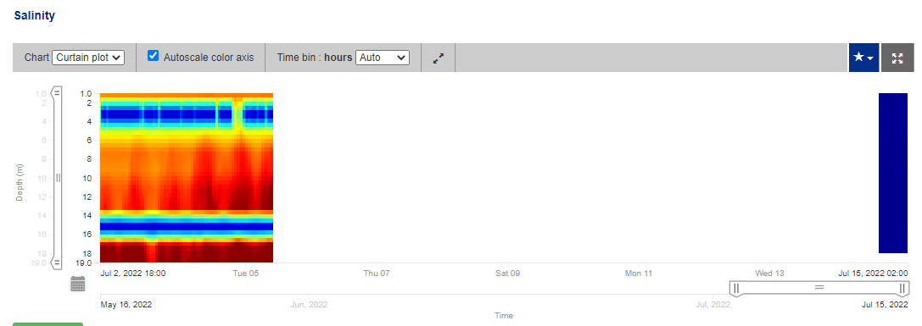
Layout: Minimal Logo Swoosh
Swap to other slide layouts in the Layout menu
Data Server Alerts
NCBO Server provides off-location alerts
Axiom Server provides “no data” alerts

Slide 10
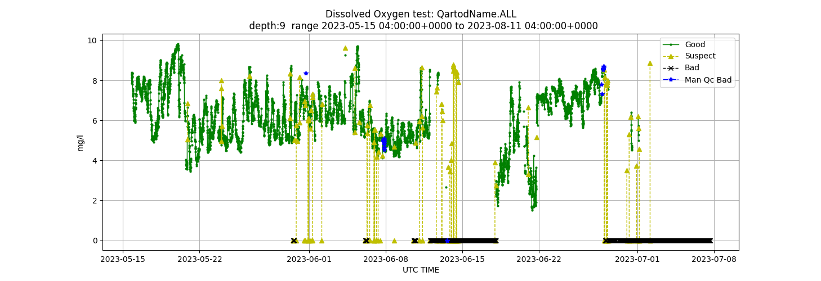
QA/QC
Flagging to Identify Questionable and Bad Data

Slide 11
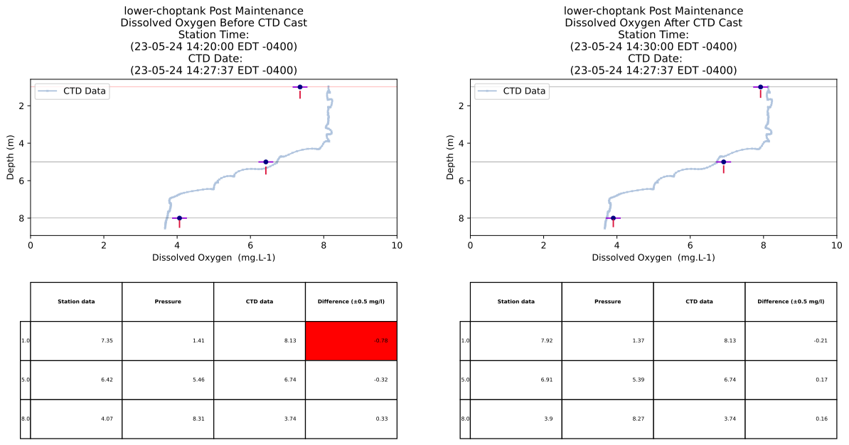
QA/QC
CTD-DO Validation Example

Slide 12

Observations & Living Resources
Acoustic telemetry receivers are a component of all CBIBS (small buoys and hypoxia arrays) platforms
Data is archived within the Mid-Atlantic Acoustic Telemetry Observation System (MATOS)
Opportunities exist to tie species presence data with continuous water column habitat (DO, Temp, Salinity) data

Slide 13
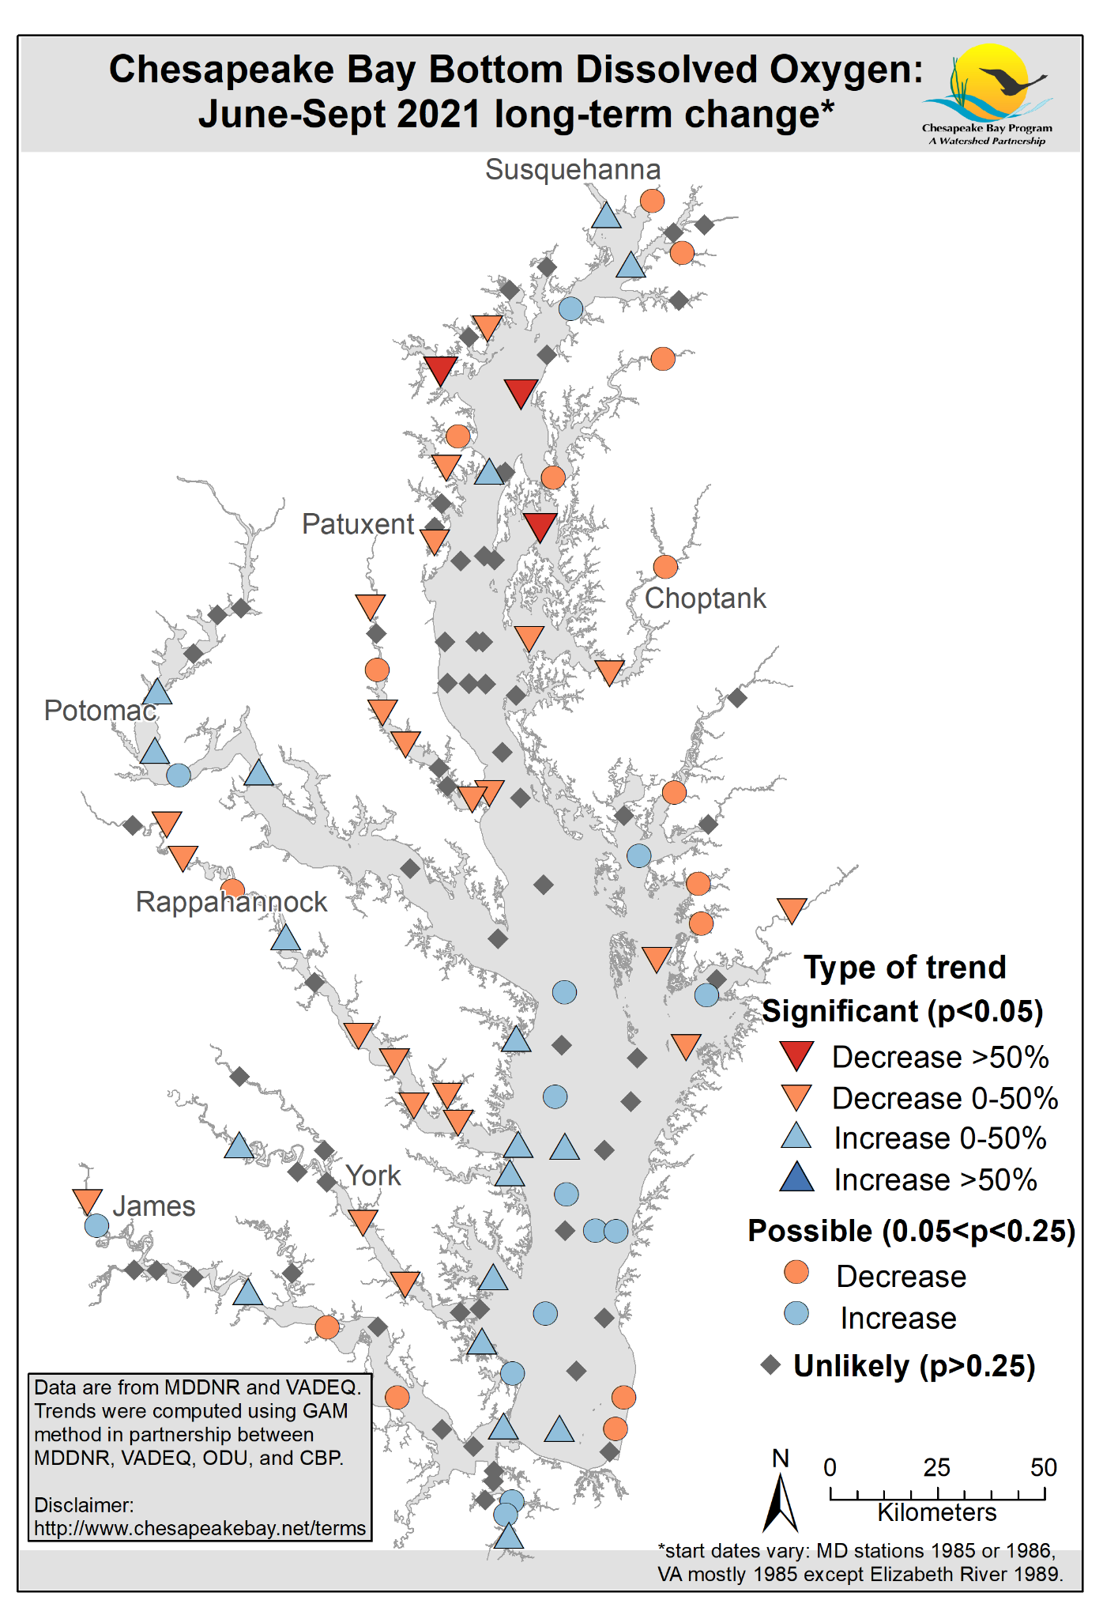
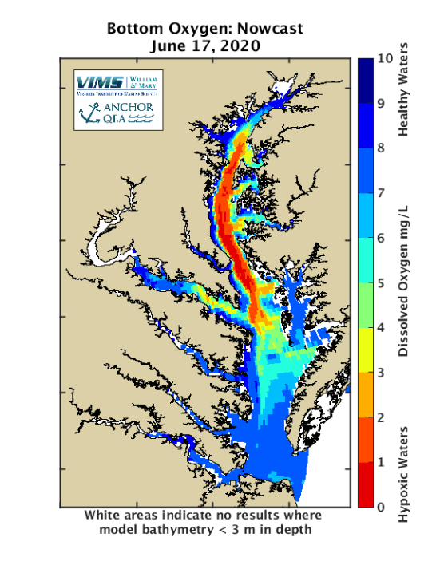
Expected Outcomes
Layout: Aqua footer sm
Swap to other slide layouts in the Layout menu
Increase understanding of temporal and spatial variability of dissolved oxygen in deep and shallow water
Improve validation for the models used in annual hypoxia reporting
Establish sampling design and monitoring needed to assess TMDL water quality attainment criteria
Provide data to develop improved habitat suitability models for multiple species (Striped bass, forage, blue crab)

Slide 14
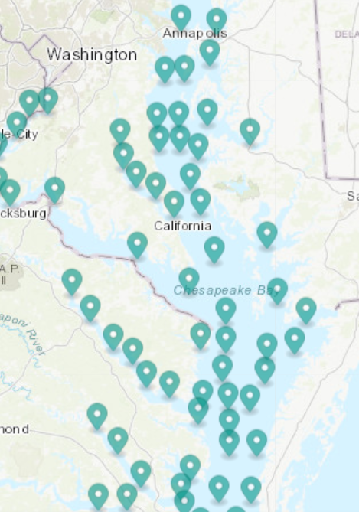
Planning & Budgeting for a Wider Array Network
EPA confirms 2 years of funding
NCBO provides overall project oversight and management
NCBO acquires equipment and supplies for a 10-array system this fall
Engage the Hypoxia Collaborative Workgroup to evaluate network expansion options
Operate and maintain a maximum of 7 arrays in the 2023 sampling season (March-Dec)

Slide 15
Questions?
Contact Jay.Lazar@NOAA.gov for additional information
Layout: Minimal Logo Swoosh
Swap to other slide layouts in the Layout menu

