Slide 1
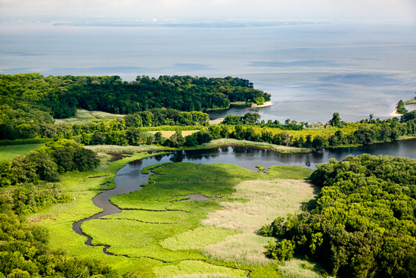
Incentivizing Forestland Retention in the Chesapeake Bay Watershed
The Healthy Watersheds Forest Project
Project Update
Photo by Will Parson
Chesapeake Bay Program

Slide 2
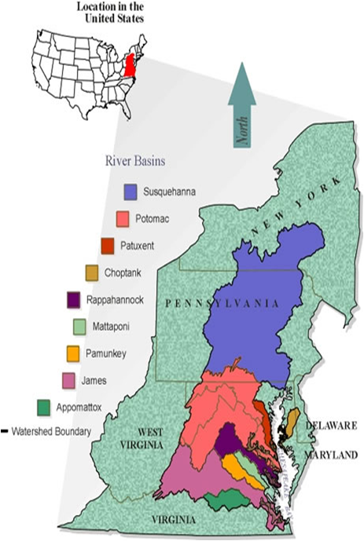
Project Objectives
Phase I: Built economic case for crediting land conservation in the Chesapeake. Bay TMDL Model
Phase II: VA/PA partnership – Worked with localities to identify needed policy tools and incentives to retain forestland
Phase III: Implement tools in the field and develop/test financing model to attract large scale private capital investment

Slide 3
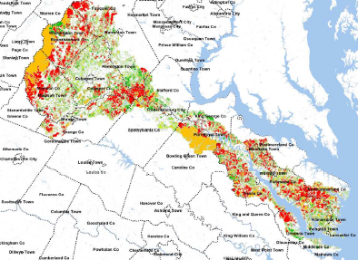
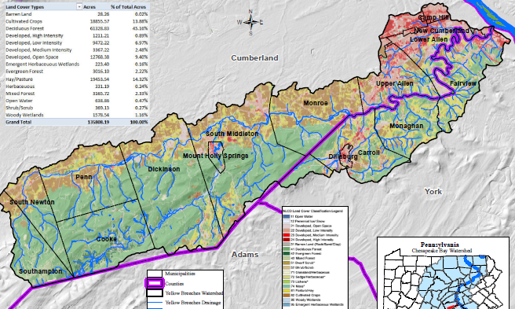
Phase II Project Study Areas:
Virginia
Pennsylvania
Rappahannock River Basin
Yellow Breeches Watershed
Notes:
Rappahannock River Basin
Geography: headwaters to coast
Land Use: forest, agriculture, urban, rural
Areas of high density development growth
Home of Rappahannock River Basin Commission (RRBC)
100 percent in Virginia so watershed issues outside of Virginia control are minimal (other than air)
Yellow Breeches Watershed
Empties into Susquehanna River
Varied land use including significant agriculture
Multiple local governments including west Harrisburg, the State Capital

Slide 4
Results To Date:
Phase 1- Proved $$ value of retaining forestland to meet Chesapeake Bay Goals.
CB jurisdictions approved crediting forestland as BMP in TMDL model in December 2017
Phase 2 – Partnered with localities and landowners to develop solutions
Developed a toolbox of policy actions and economic incentives to stimulate forestland retention
Phase 3 - In progress
Working with two counties as pilots (Orange and Essex) to implement phase 2 toolbox of incentives
Developing financial model designed to bring large scale private capital investment into conservation to incentivize landowners and localities to retain forestland

Slide 5

Phase II “Tool Box” Categories from Locality Engagement Discussions
Land Use Policies, Zoning and Regulations
Local Spending and Tax Polices
Voluntary Land Protection Techniques
Land Acquisition
Notes:
Virginia team members met with elected officials, senior planners, landowners, NGOs and others throughout the Rappahannock River Basin between June 2016 and June 2017. Those discussions focused on specifics within each of these categories.
Pennsylvania team members did the same.

Slide 6
Challenges Identified by Localities
Land Use Valuation Tax vs. Composite Index Formula
Balancing environmental and economic needs
Easements: Forever is a long time
Credit trading where the polluter is upstream
Creating incentives for both landowners & localities
TMDL not a major concern for non-MS4 jurisdictions

Slide 7
Phase III Tasks
TASK ONE: Work with two Virginia Counties(Orange and Essex) to revise policies & ordinances to incentivize retention of forest and agricultural lands.
TASK TWO: Create working financial model to incentivize private sector investment ($500M+) in conservation on a landscape scale and on a long-term sustainable basis.
TASK THREE: Coordinate with other Chesapeake Bay Program workgroups to integrate findings with those of other initiatives to institutionalize results across all Bay jurisdictions.

Slide 8
Phase III Project Status Overview: Task One
Pilot Communities Identified: Orange and Essex
Endorsement by elected and appointed leadership secured
Objective: build inventory of regulatory/voluntary land stewardship programs available to landowners
Programs include opportunity for revenue enhancement to landowners for BMPs for project specific conservation activities, and resulting from tax optimization.
Meetings with County leaders and property owners ongoing in Orange, beginning in Essex
Background policy, regulatory and financial analyses completed for Orange County, Recommendations to be submitted to full BOS in Aug/Sept. Now starting in Essex .

Slide 9
Lessons Learned from Local Engagement in Orange County
Initial Project Execution Strategy.
Move forward quickly with task one workshops -involve broad citizen participation
Build support for policy changes to incentivize land conservation
Follow up with task two in-depth financial discussions with individual landowners
What Local Elected Leadership Advised
Reverse our order
Start first by visiting with landowners about the task two objectives, e.g. demonstrating how landowners could add to their income stream by taking conservation actions
This was wise counsel and has resulted in the project receiving strong support

Slide 10
Lessons Learned from Local Engagement in Orange County con’t.
CALCULATE ECONOMIC BENEFIT FIRST
Step 1: Inventory and account for all existing land use programs and current tax programs including subsidies.
Step 2: Develop a compatibility matrix to identify the potential mix and match of those programs which work, or not, with the others.
Step 3: Consider real and perceived competition for funds and the interplay of the programs to characterize opportunity for private financing of HQ Forest retention, reforestation and HQ AG retention.

Slide 11
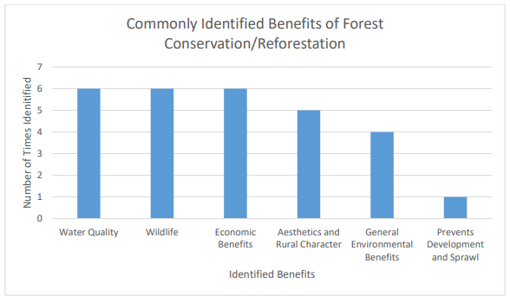
Most Commonly Identified Benefits of Forest Conservation and Reforestation*
* From Orange County Public Workshop

Slide 12
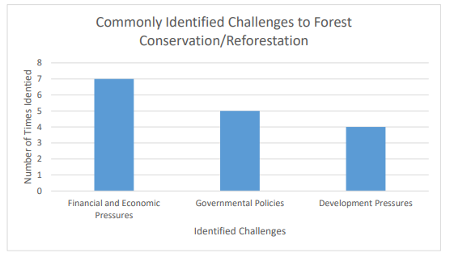
Most Commonly Identified Challenges to Forest Conservation and Reforestation*
* From Orange County Public Workshop

Slide 13
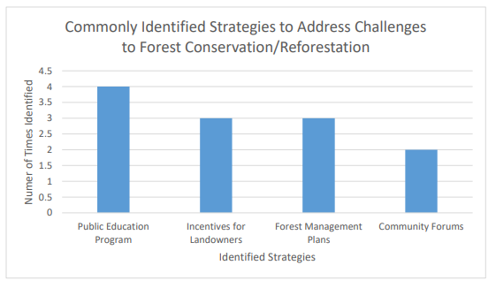
Most Commonly Identified Strategies to Address Challenges*
* From Orange County Public Workshop

Slide 14
Phase III Project Status Overview: Task Two
A key investment concern is risk management
For the landowner - what are the tradeoffs, the opportunity costs incurred with participation?
For the Counties, what are the legal liabilities, and the administrative costs involved – can these be managed and generate revenue?
For the private investor, what are the regulatory, market, and project risks – how can these be mitigated?
Carbon values were selected as water quality proxy to provide additional income streams and incentives for landowners and rural localities
Offers potential to aggregate individual landowner interests so they can be offered at scale and with the market convenience required to attract large-scale private capital investments.

Slide 15
Phase III Financial Mechanism Overview
Mechanism must be able to:
Aggregate individual landowner interests and offer them at a scale large enough to attract private capital (>$50MM) on an ROI rather than a philanthropic basis.
Provide alternative revenue source for rural localities to meet budget shortfalls stemming from reduced taxes on forest and agricultural lands
Provide market rates of return (ROI) by paying landowners acceptable value for land management practices via environmental ‘credits’ sold in regulatory and/or voluntary markets.

Slide 16
Phase III Financial Mechanism Overview
Aggregating Mechanism:
Focus is on Economic Development Authorities (EDAs).
Approach: Modify EDA statutory authority to allow it to represent landowner interests in carbon markets as a proxy for water quality.
This enables a role for counties, combined by choice, into a regional (watershed basin) entity to exercise the authorities granted within the EDA.
VA General Assembly passed this enabling legislation in 2019 legislative session

Slide 17

Success Outcomes – Ripple Effect
Empowered governments at local level
Governments empowered with planning tools and incentives to balance growth and forestland retention goals
Policies at all government levels provide incentives for forestland retention
Quality communities and healthy watersheds at reduced cost
Private sector financing on landscape scale sustainable basis
Notes:
By Project’s end :
Governments empowered with planning tools and incentives to balance growth and forestland retention goals
State and local regulations & statutes contain mix of incentives and requirements to promote forestland retention.
Policies at all levels provide incentives for forestland retention
Local decision-makers create quality communities and keep healthy watersheds while reducing costs associated with achieving clean water

Slide 18
For further information:
Greg Evans, Virginia Secretary of Agriculture and Forestry Office
greg.evans@governor,virginia.gov
Eldon James, Rappahannock River Basin Commission
ejames7@me.com
Darren Coffey, The Berkley Group
darren@bgllc.net
Kevin Byrnes, Regional Decision Systems
kfbyrnes@verizon.net
Dan Spethmann, Working Lands Investment Partners, LLC
dspethmann@working-lands.com
Chandler Van Voorhis, ACRE Investment Management, LLC
chandler@acre-investment.com
John Griffin, Chesapeake Conservancy
jgriffin@chesapeakeconservation.org

