Slide 1
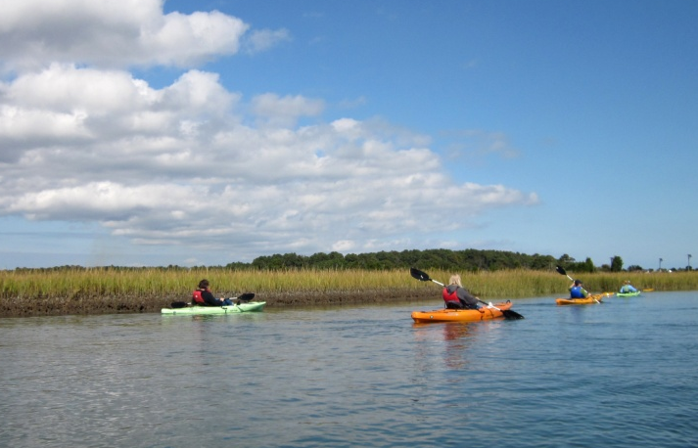

The Bay’s Health & Future: How it’s doing and What’s Next
Chesapeake Bay Program
2013/14 Funding
Citizen’s Advisory Committee /
Local Government Advisory Committee
Joint Meeting
December 5, 2013
Jim Edward, Deputy Director
Chesapeake Bay Program (EPA)

Slide 2
Fiscal Year 2013 Chesapeake Bay Program Funding
Region 2 | $233,000
Region 3 | $50,774,000
Philadelphia | $4,239,708
Annapolis | $46,534,292
Office of Water | $420,000
Office of Enforcement and Compliance Assurance | $1,386,000
Office of General Counsel | $255,000
Office of Environmental Information | $545,000
Office of Air and Radiation | $0
Total | $53,613,000

Slide 3
Fiscal Year 2013 Chesapeake Bay Program Office Funding
Intramural | $4,902,292
General Extramural | $7,612,000
Operational Support | $1,500,000
Partnership and Executive Order Support | $2,800,000
Data Management | $3,312,000
TMDL Implementation | $1,870,000
Reporting and Accountability | $663,000
Innovative Nutrient/Sediment Reduction Grants | $6,000,000
Small Watershed Grants | $2,000,000
Tidal Water Quality Grants | $1,600,000
Nontidal Water Quality Grants | $2,592,000
State Implementation Grants | $19,295,000
Total | $46,534,292

Slide 4
Chesapeake Bay Program Funding
(in millions)
E.O. 13508

Slide 5
2012/13 NFWF Targeted Grant Funding and Technical Assistance to Local Governments in the Chesapeake Bay Watershed
2012
  NFWF launched a new initiative targeting grant funding and technical assistance to local governments in the watershed.
  This new initiative was called the targeted Local Government Green Infrastructure Initiative.
  14 projects were funded to each locality for technical assistance valued at between $100,000 to $150,000. (approximately 1.8 million)
  To help overcome challenges to improving local rivers and streams and improving water quality
  There were 27 Technical Assistance projects, ranging in value from
  $6,000 to $40,000.

Slide 6
2012/13 NFWF Targeted Grant Funding and Technical Assistance to Local Governments in the Chesapeake Bay Watershed
2013
  14 projects were funded as investments that build local government capacity for green infrastructure and accelerate adoption of green infrastructure practices on private lands.
  These 14 projects range in value from $49,500 to $500,000.
  Also in 2013, there are 12 projects for the 1st cycle ranging from $15,000 to $40,000. A 2nd cycle is scheduled to open in December.

