Slide 1
Change of striped bass abundance in the Chesapeake Bay, an ecosystem-based evaluation
Josephine Oakley
Co-Authors: Yan Jiao, Eric Smith, Rob Latour, Tom Miller, Kevin Friedland, Mary Fabrizio, & Ed houde

Slide 2


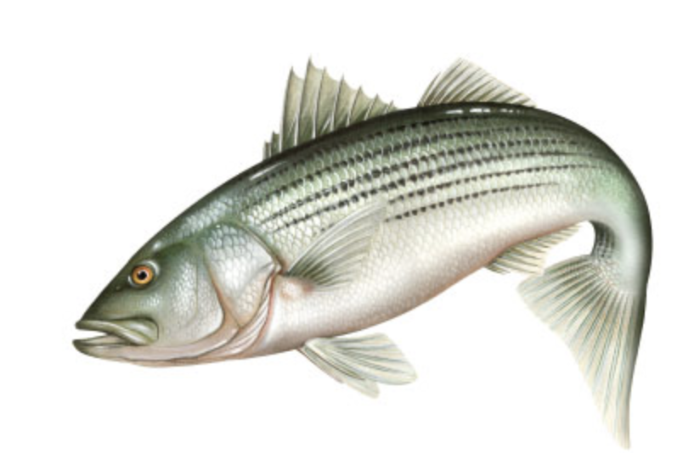
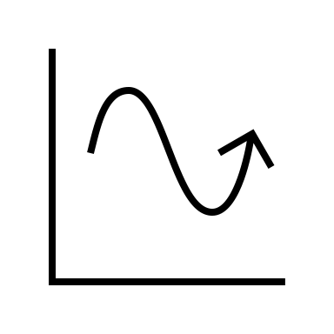


Introduction
Striped bass (Morone saxatilis) support a valuable fishery on the Atlantic coast
Populations have shown dynamic patterns
What conditions are contributing to abundance trends
Consider multiple species, and large-scale climate indices
ASMFC

Slide 3
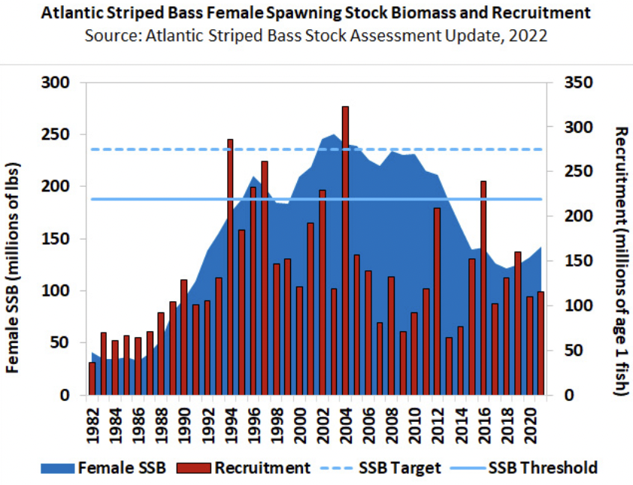
Atlantic Coast Stock
Overfished
Female spawning stock biomass was highest in 2003
Recruitment is variable
Overall, the population has been declining since 2010
ASMFC

Slide 4
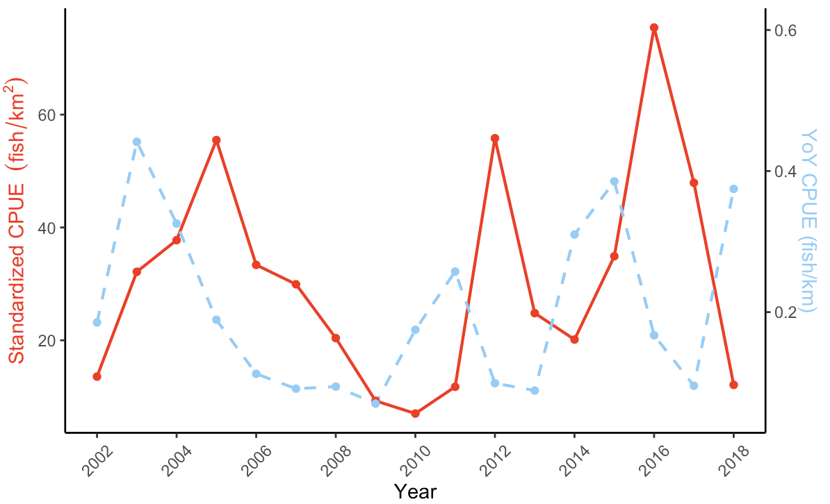
Trends in the Chesapeake Bay
Relative Abundance

Slide 5
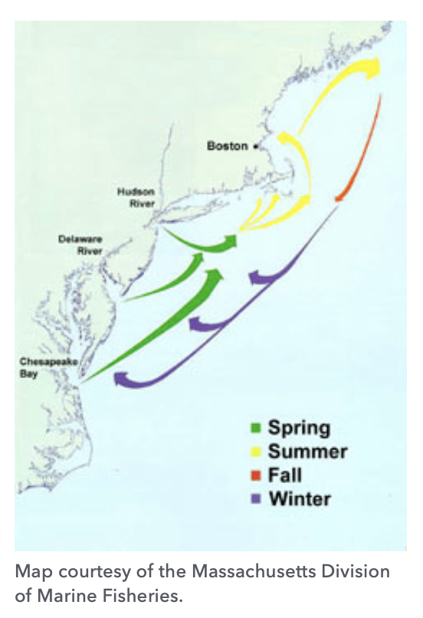
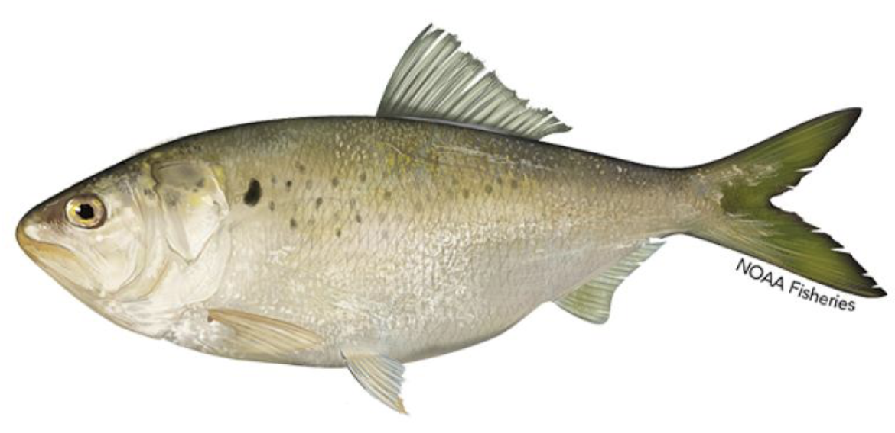
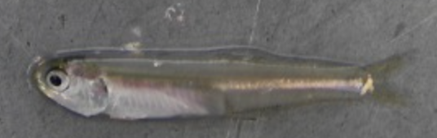
Striped Bass
Atlantic Menhaden
Long-lived migratory species
Anadromous
Live in estuaries for 2 to 4 years
Majority of the stock originates from the Chesapeake Bay
Piscivorous
Bay Anchovy
VIMS

Slide 6
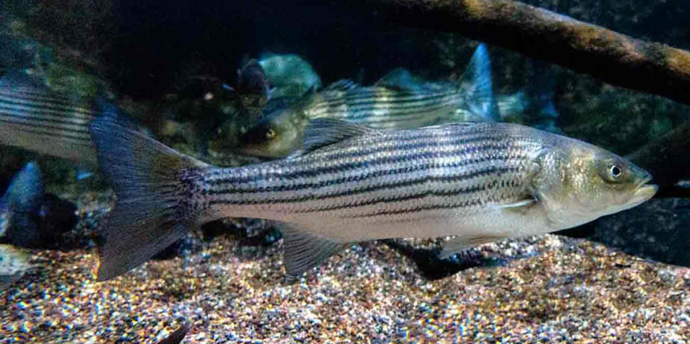
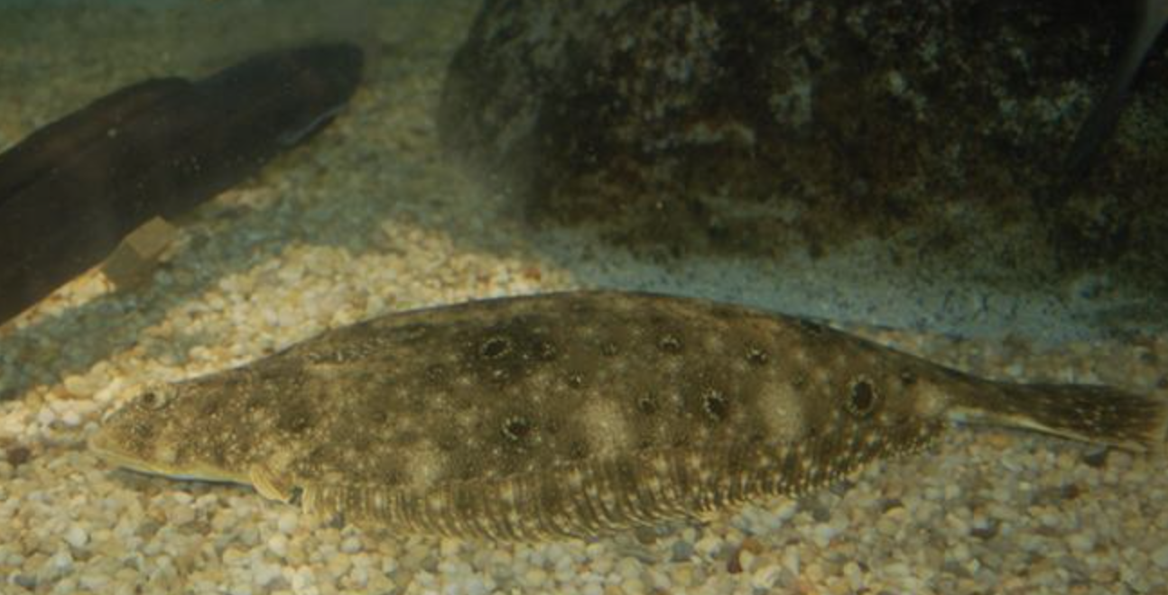
Life in the Bay
Species interactions
Estuarine-coastal ecosystems are changing which is affecting fish species
Responses of multiple species to environmental change can be similar
How are these factors contributing the abundance and productivity?
Chesapeake Bay Program
NOAA

Slide 7
Objectives
Notes:
We had three main objectives going into this

Slide 8
Objectives
1. Assess striped bass in the Chesapeake Bay to better understand the mechanisms of their change

Slide 9
Objectives
1. Assess striped bass in the Chesapeake Bay to better understand the mechanisms of their change
2. Assess how environmental variables affect striped bass abundance

Slide 10
Objectives
1. Assess striped bass in the Chesapeake Bay to better understand the mechanisms of their change
2. Assess how environmental variables affect striped bass abundance
3. Examine the temporal relationship between abundance and larger climate factors

Slide 11
Objectives
1. Assess striped bass in the Chesapeake Bay to better understand the mechanisms of their change
2. Assess how environmental variables affect striped bass abundance
3. Examine the temporal relationship between abundance and larger climate factors
4. Characterize the community response to environmental factors that affect the Bay

Slide 12
Methods

Slide 13
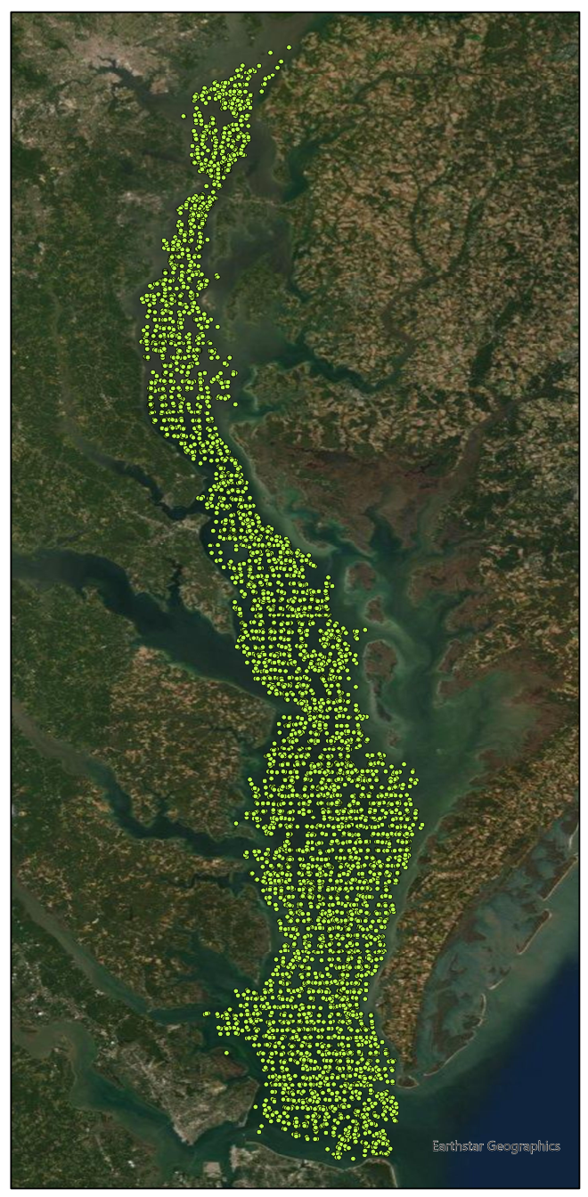
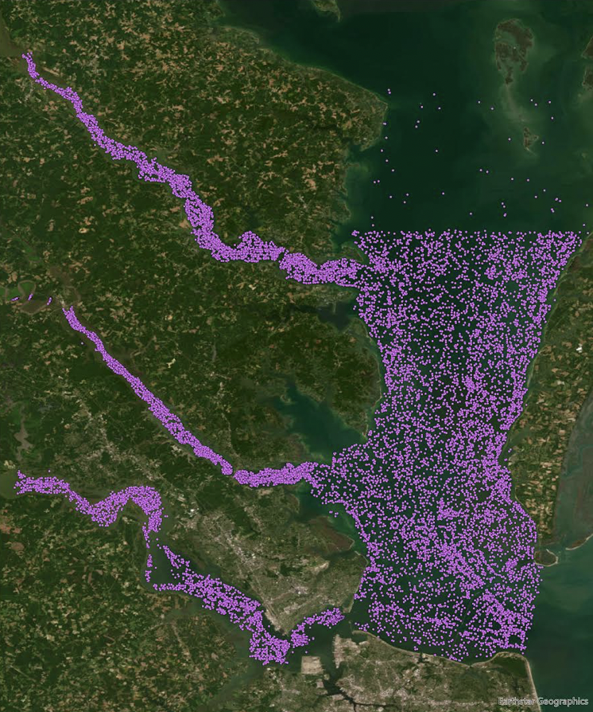


Data and Survey Locations
ChesMMAP
VIMS YoY
Chester
Potomac
Choptank
Rappahannock
Patuxent
Potomac
York
Rappahannock
James
York
James

Slide 14
Species catch data
Hurdle model
Factors recorded during trips

Slide 15

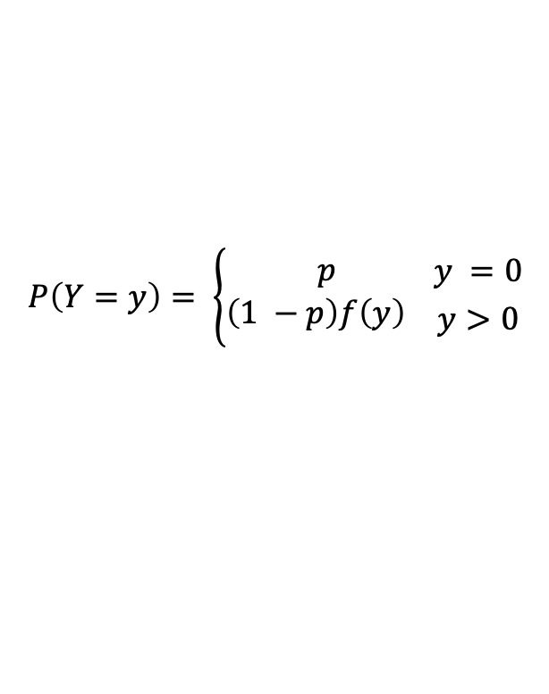
Catch-Effort Standardization
The data had a high percentage of zero catch
69% for striped bass
Hurdle model
Generalized linear models
Stepwise variable selection
AIC
$$P\left(Y=y\right)= \left\{\begin{aligned}p \\ \left(1 −p\right)f\left(y\right) \end{aligned}{y =0 \atop y>0}\right.$$

Slide 16
Annual Bay temperature
Species catch data
Hurdle model
Annual index of abundance
Factors recorded during trips
Large climate oscillations

Slide 17
Annual index of abundance
Species with correlated abundance trends
Life history traits
Mechanisms of change
Community assessment

Slide 18
Results
Notes:
Now for the results

Slide 19
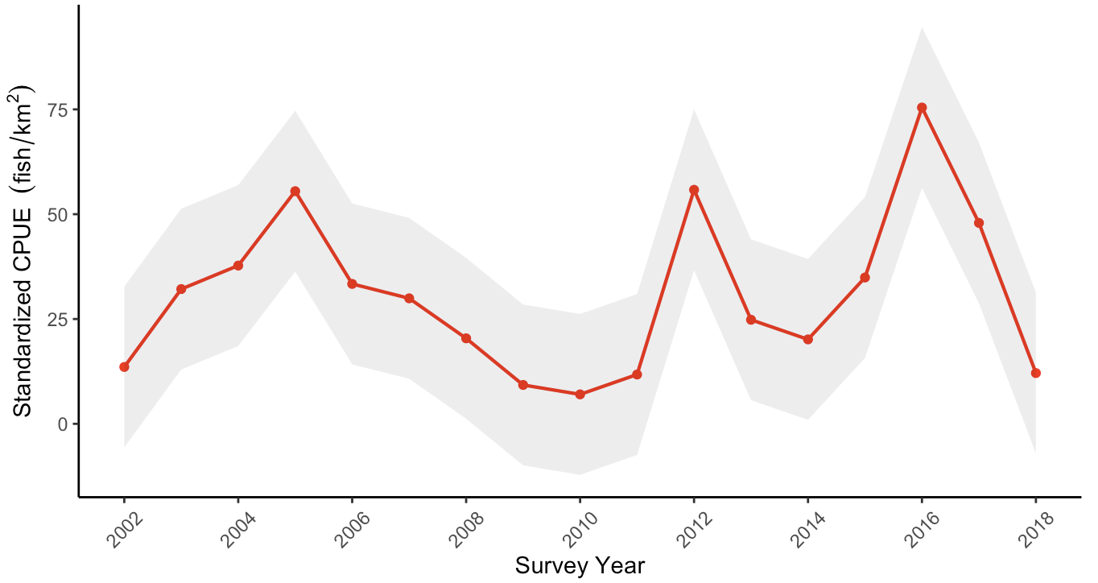
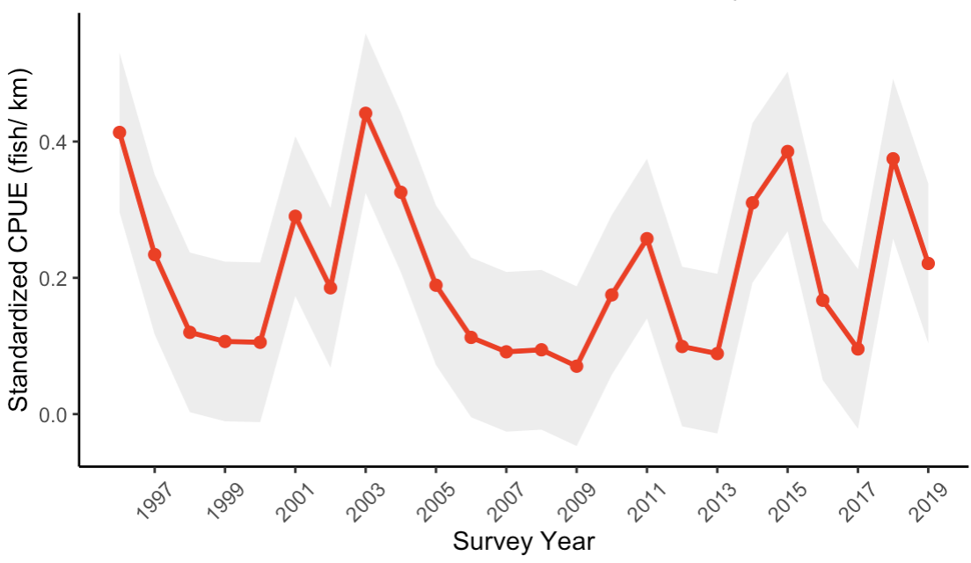
Striped Bass Standardized CPUE
ChesMMAP Relative Abundance
VIMSYoY Relative Abundance

Slide 20
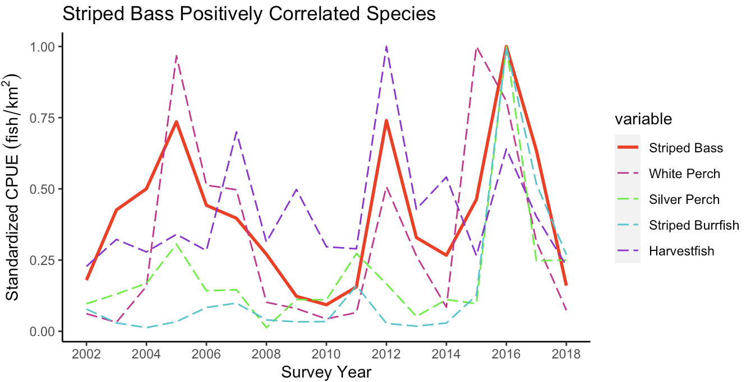

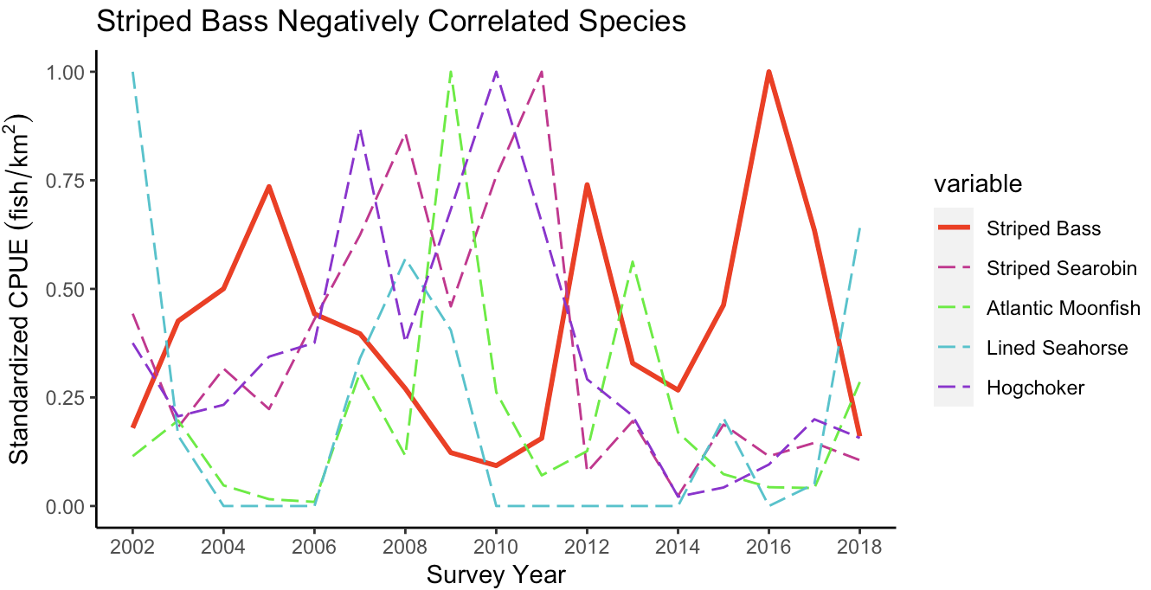
Abundance Correlation Analysis
Positive
ChesMMAP
Correlation Values
Species | Pearson
white perch | 0.7332
silver perch | 0.6617
striped burrfish | 0.5721
harvestfish | 0.4758
cownose ray | 0.4735
striped searobin | -0.5260
Atlantic moonfish | -0.4658
lined seahorse | -0.4586
hogchoker | -0.4525
spiny butterfly ray | -0.4406
Negative

Slide 21
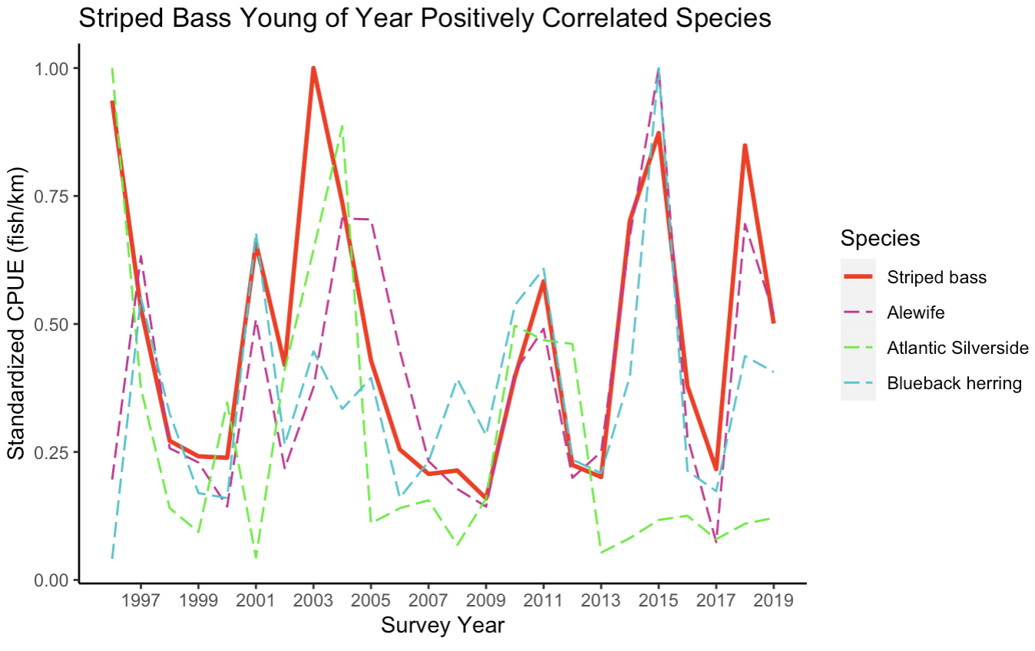
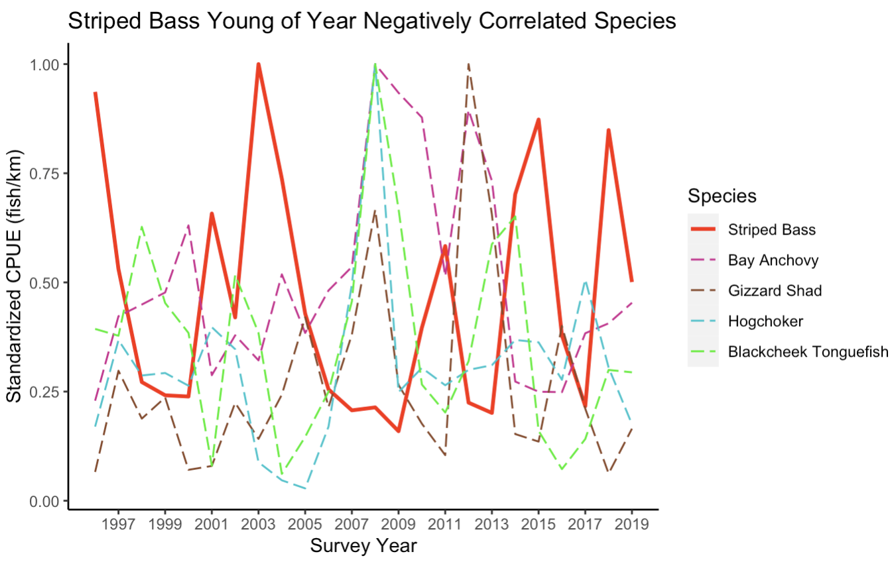
Abundance Correlation Analysis
Positive
VIMS YoY
Correlation Values
Species | Pearson
alewife | 0.6274
Atlantic silverside | 0.4723
blueback herring | 0.4691
Bay anchovy | -0.6144
gizzard shad | -0.5173
hogchoker | -0.3454
blackcheek tonguefish | -0.3312
Negative

Slide 22
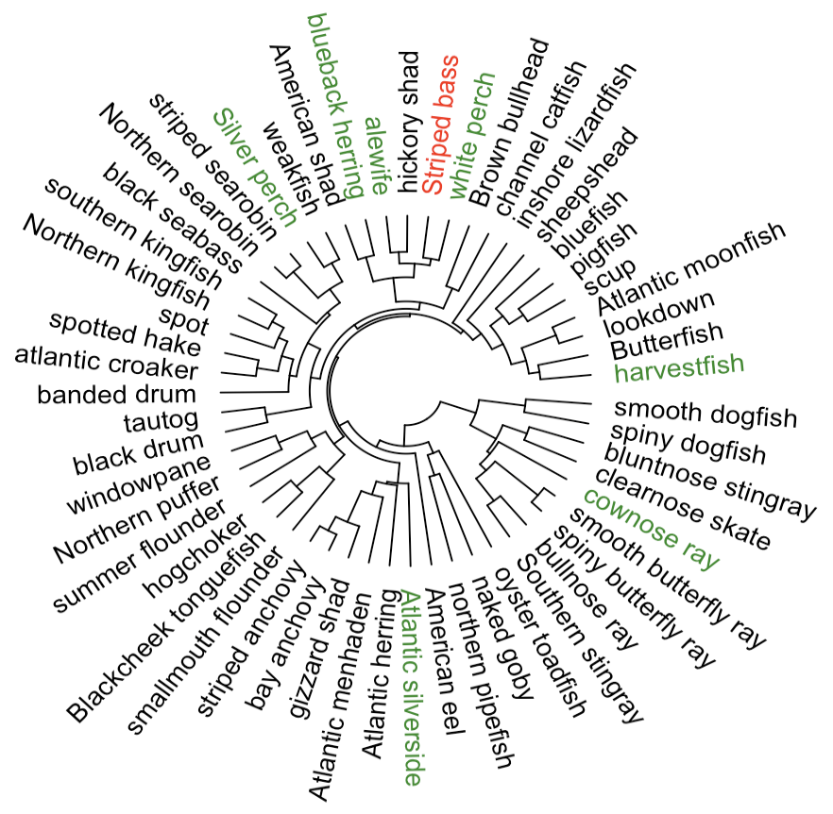
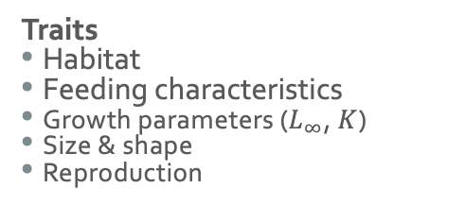
Life History Cluster Analysis
Traits
Habitat
Feeding characteristics
Growth parameters ($L_{∞}$, $K$)
Size & shape
Reproduction

Slide 23
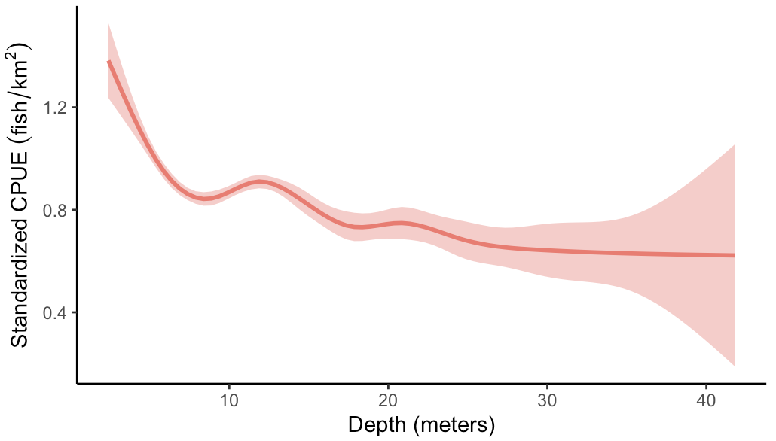
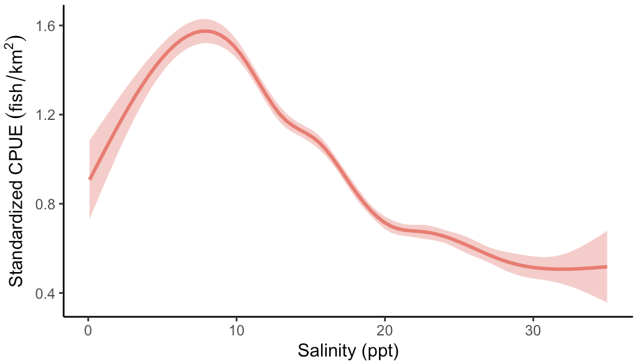
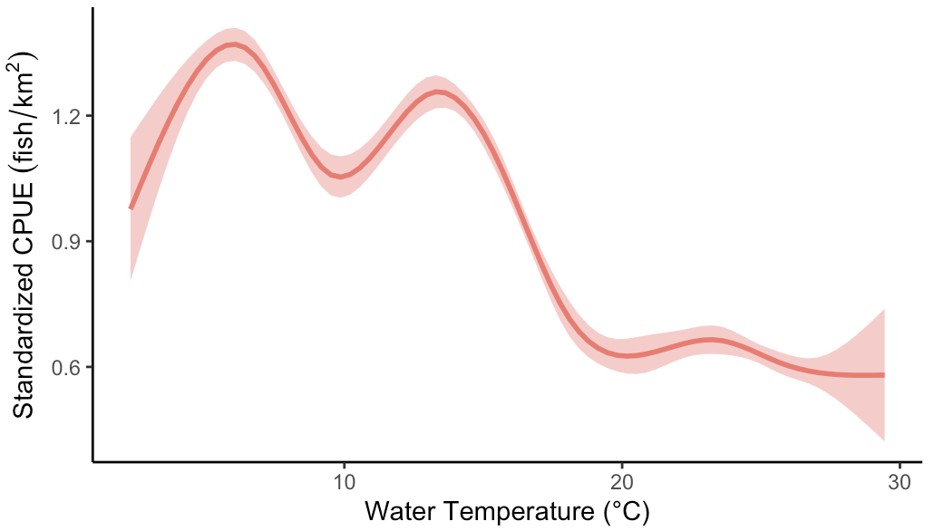
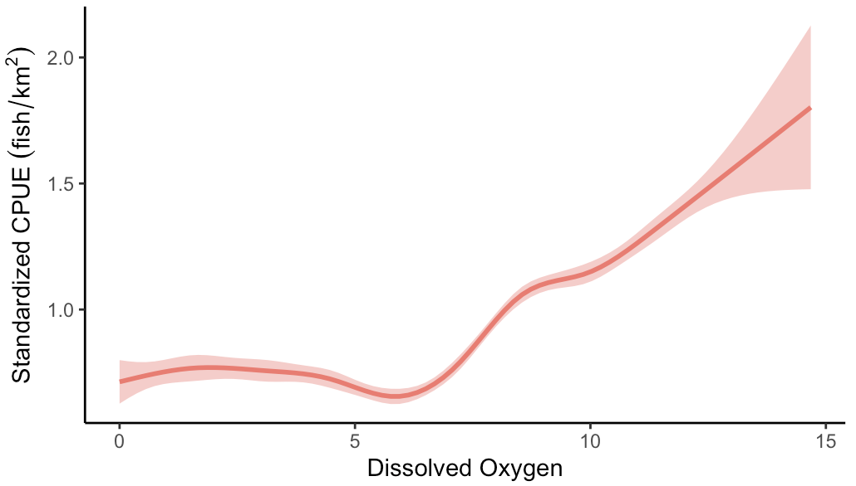
Effects of Environmental Factors
ChesMMAP

Slide 24
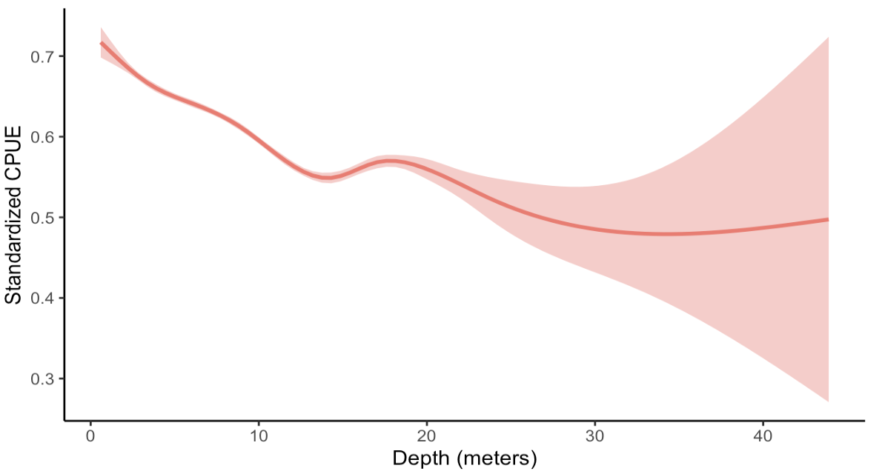
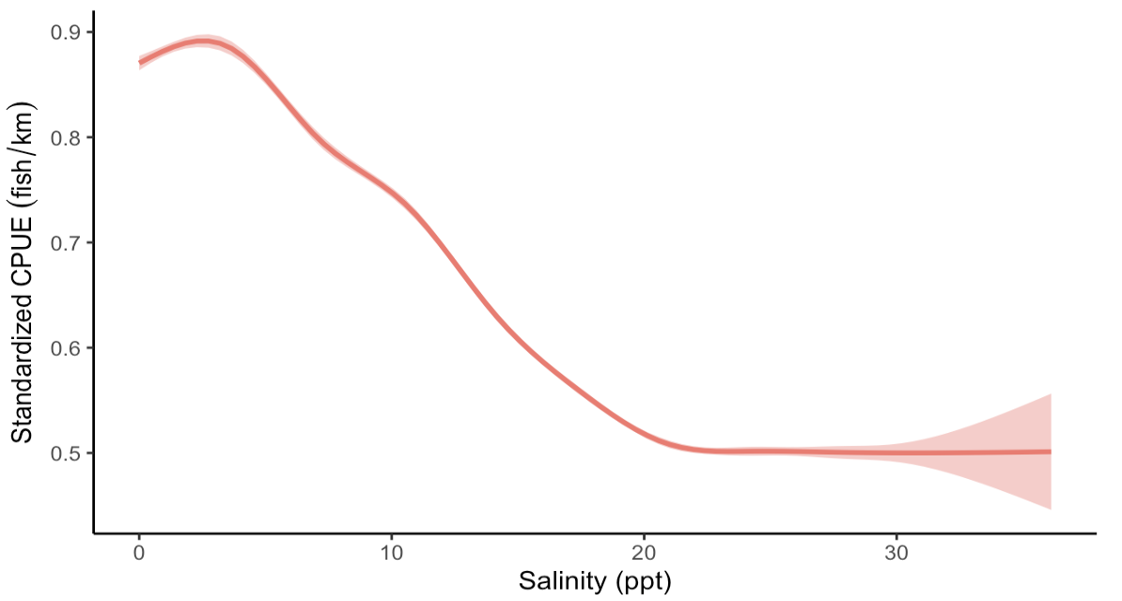
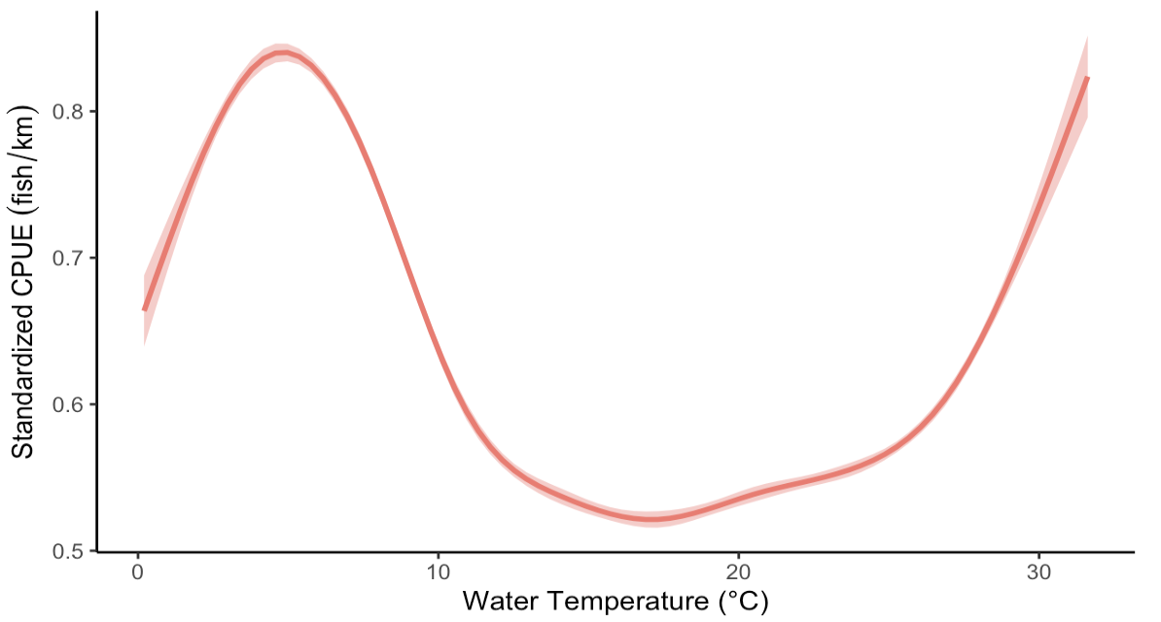
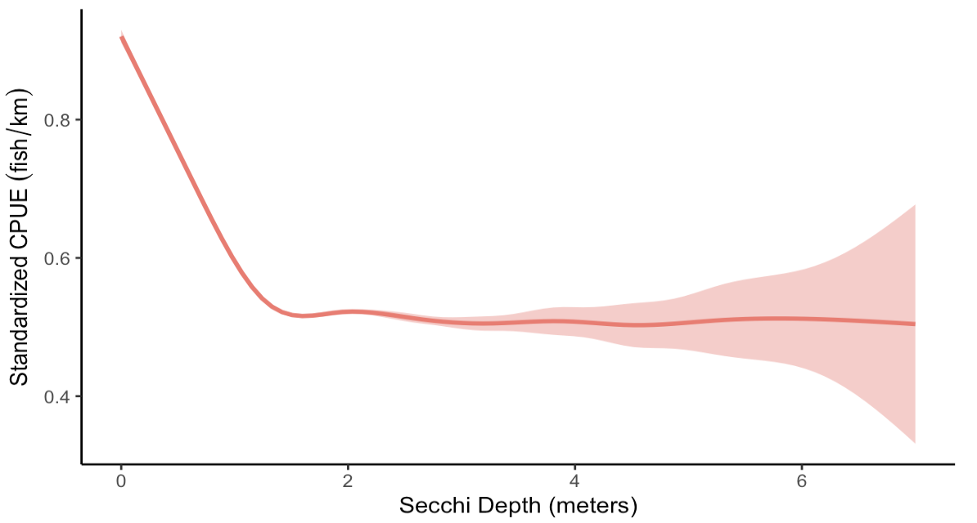
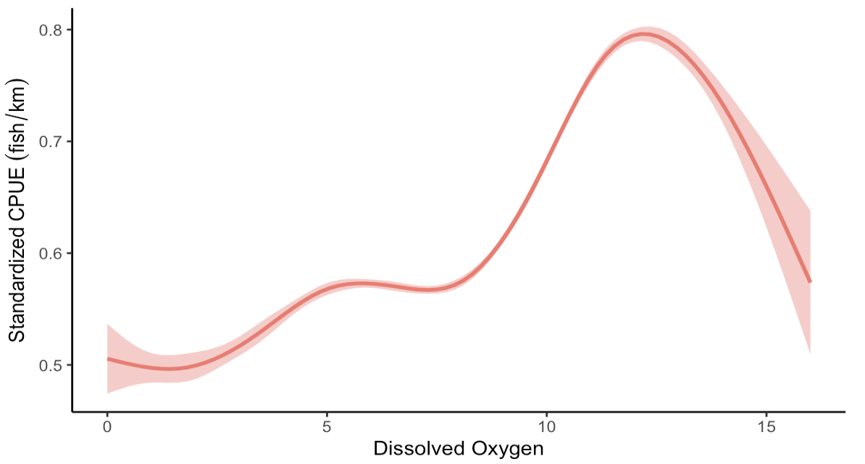
Effects of Environmental Factors
VIMSYoY

Slide 25
Bay & large-scale climate oscillations

Slide 26
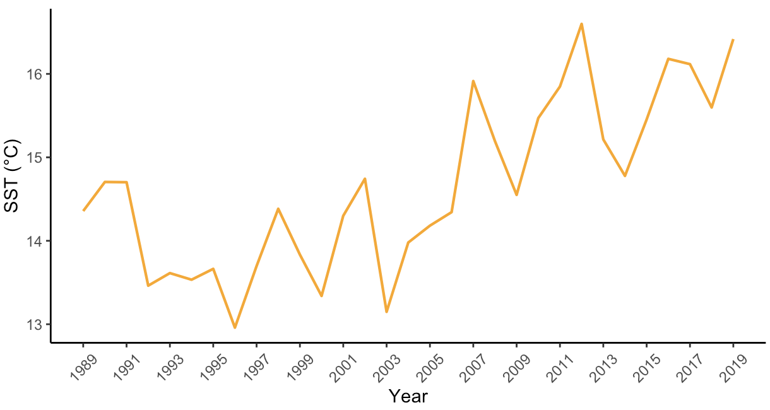
Bay Sea Surface Temperature (SST)
Average Annual SST
Increasing
Change point occurred in 2006
Marine heat waves (MHWs) have occurred more frequently in the Bay since 2010

Slide 27
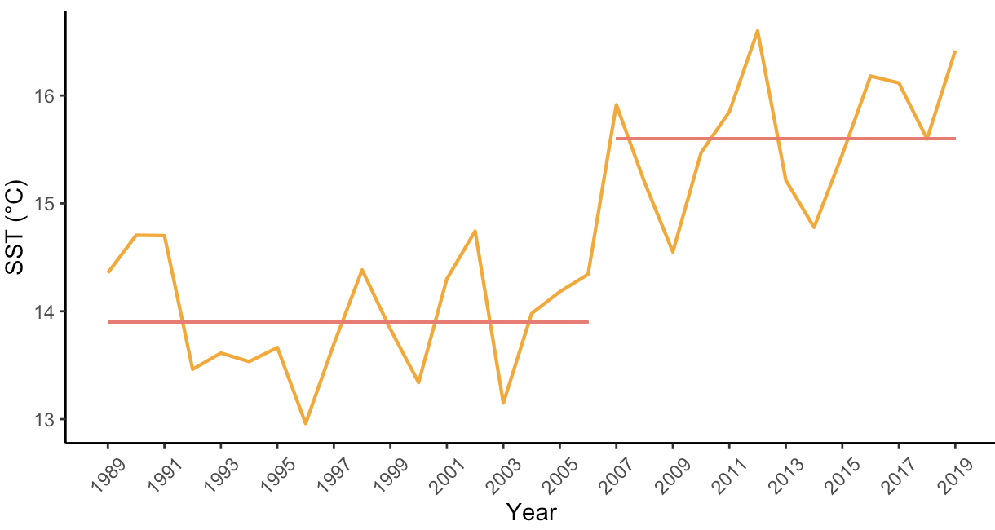
Bay Sea Surface Temperature (SST)
Average Annual SST
Increasing
Change point occurred in 2006
Marine heat waves (MHWs) have occurred more frequently in the Bay since 2010

Slide 28
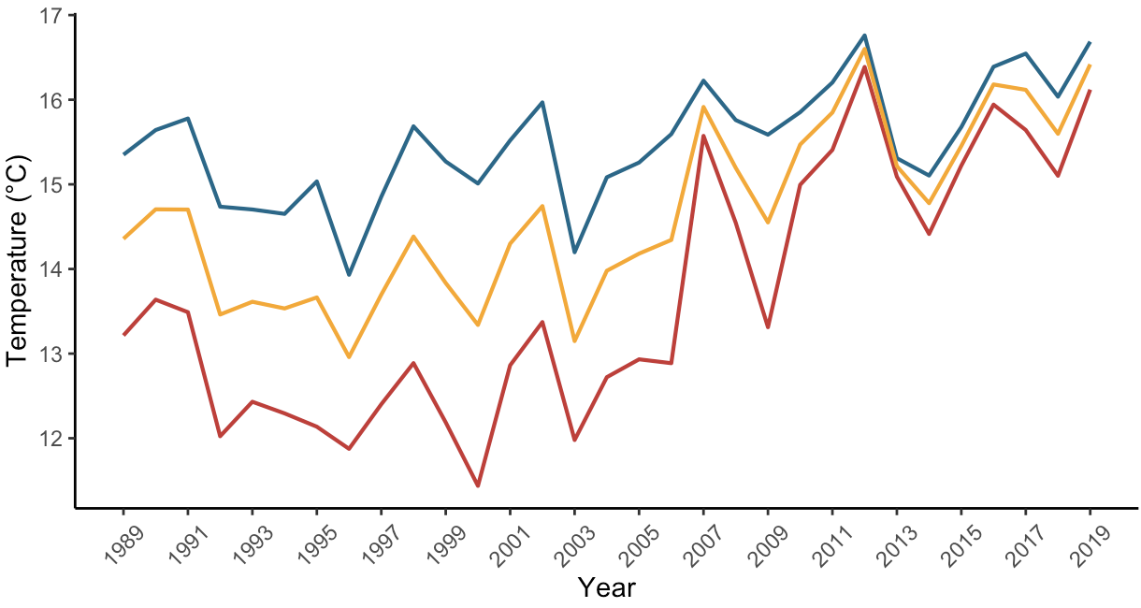
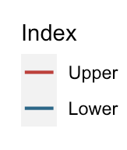
Bay Sea Surface Temperature (SST)
Average Annual Upper, Lower and Full Bay SST
Upper and lower bay SST increasing
Gradient has decreased
Range has decreased

Slide 29
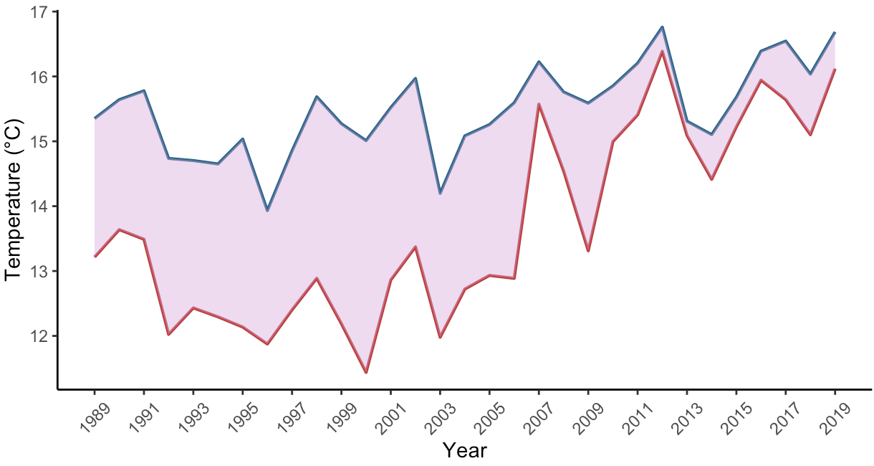
Bay Sea Surface Temperature (SST)
SST Gradient
Upper and lower bay SST increasing
Gradient has decreased
Range has decreased

Slide 30
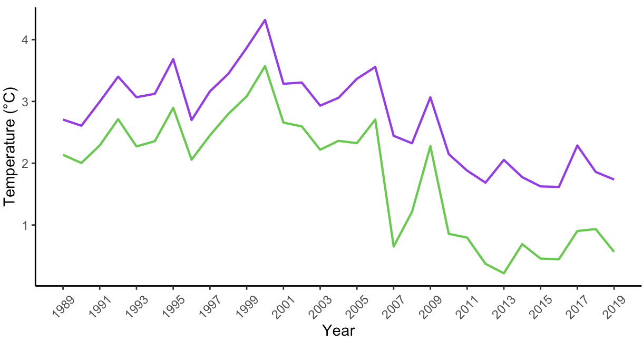
Bay Sea Surface Temperature (SST)
Average Annual SST Gradient and Range
Upper and lower bay SST increasing
Gradient has decreased
Range has decreased
Notes:
Gradient purple
Range green

Slide 31
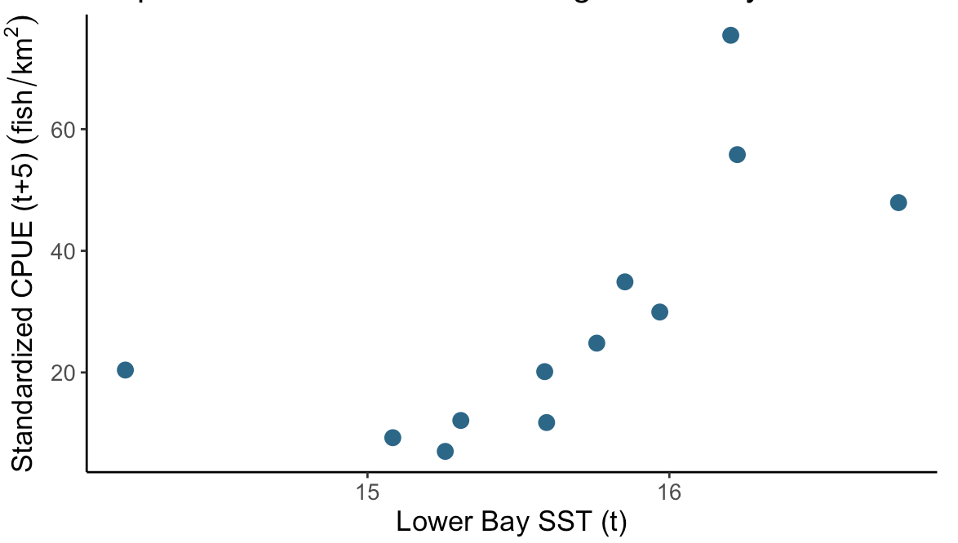
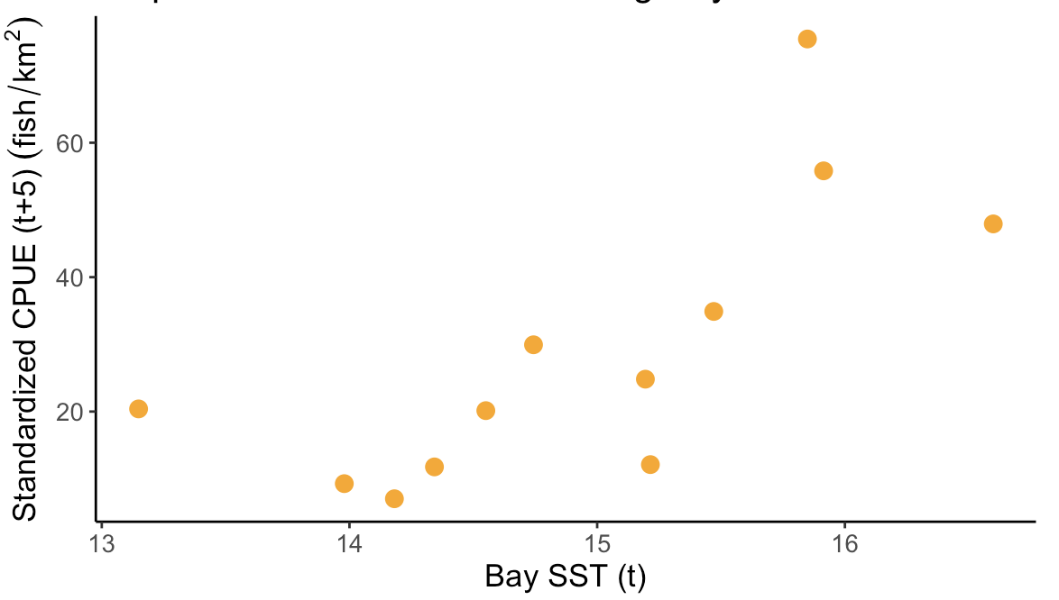
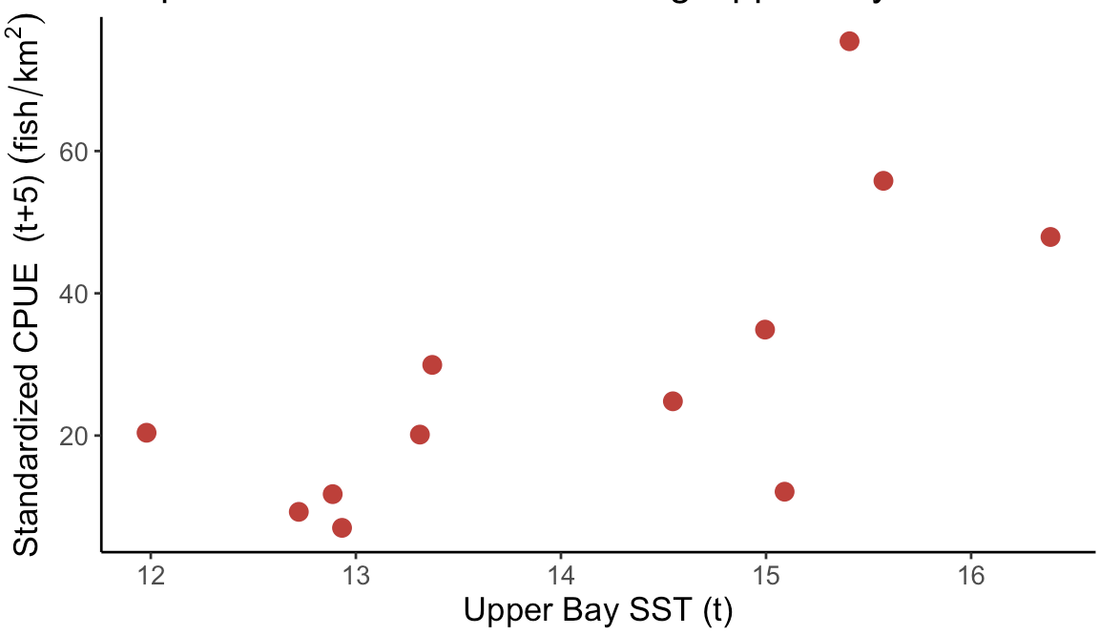
Bay SST Correlation
ChesMMAP
r = 0.538
r = 0.593
r = 0.583
Abundance positively correlates with increasing Bay SST
Abundance lags 5 years behind Bay SST

Slide 32
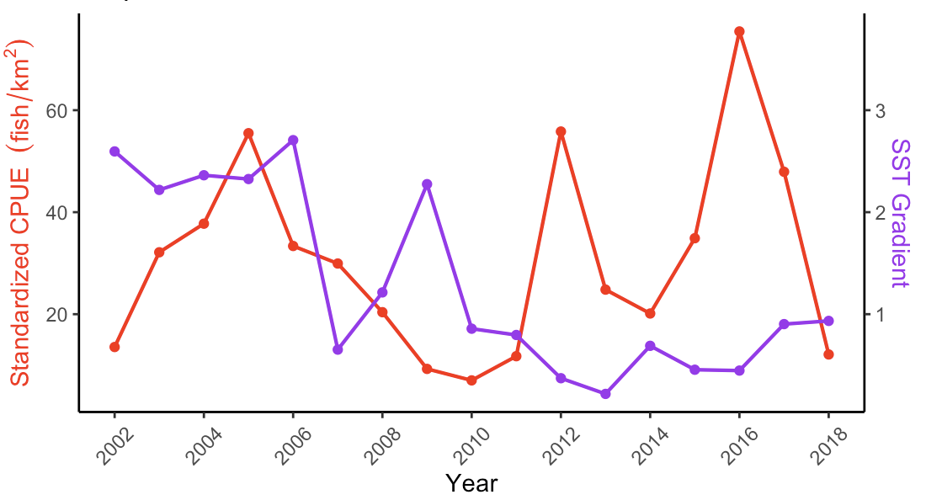
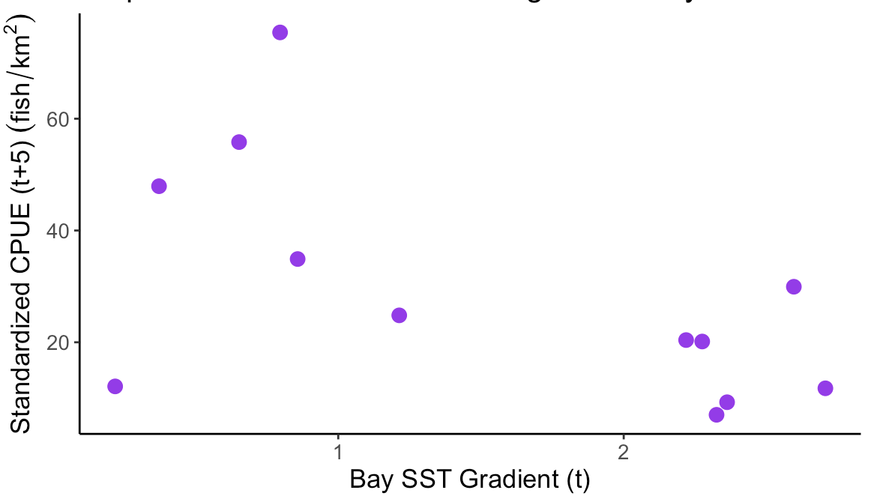
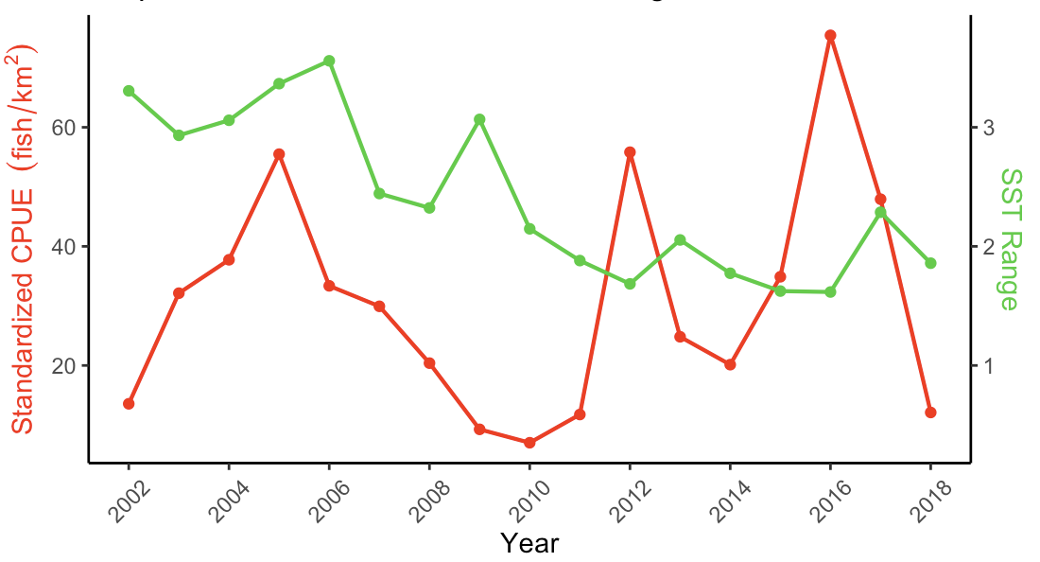
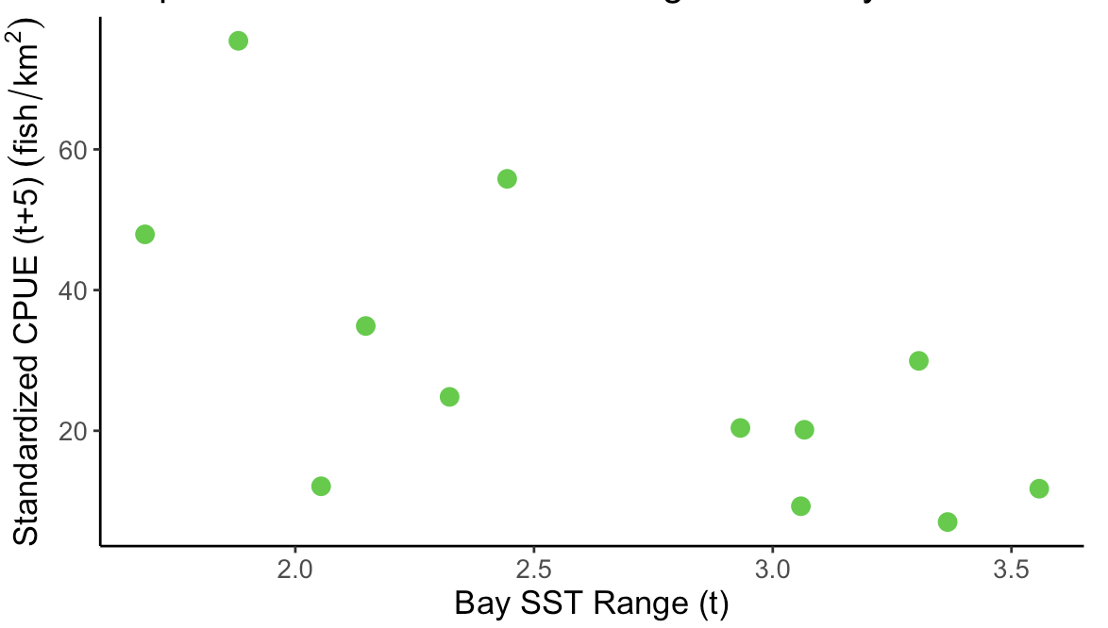
Bay SST Gradient
r = -0.478
SST Correlation with striped bass
Abundance negatively correlates with Bay SST gradient and range
Abundance lags 5 years behind gradient and range
Bay SST Range
r = -0.490

Slide 33
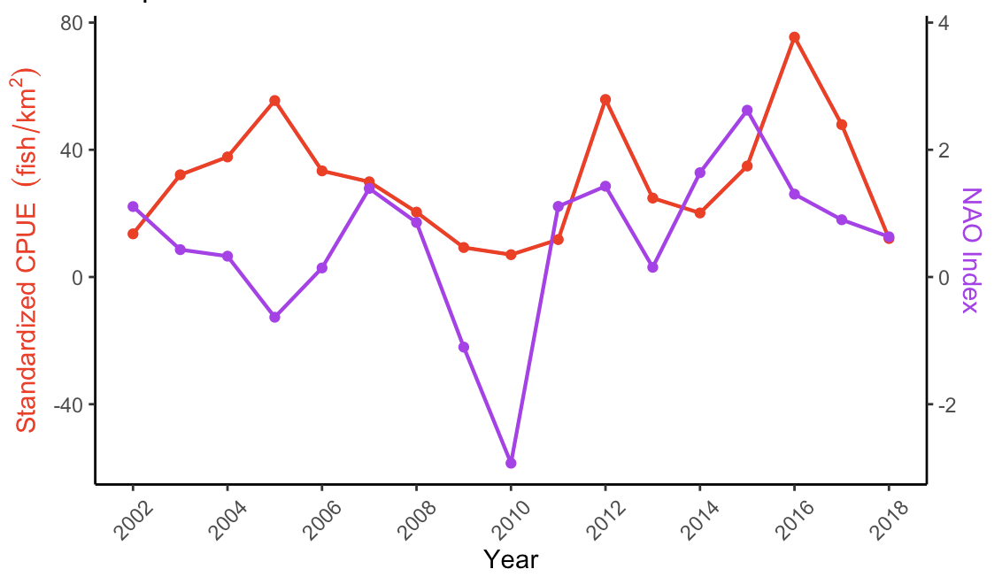
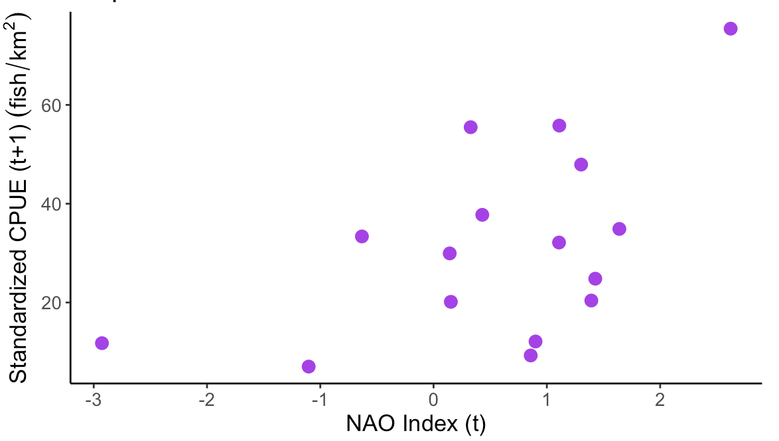
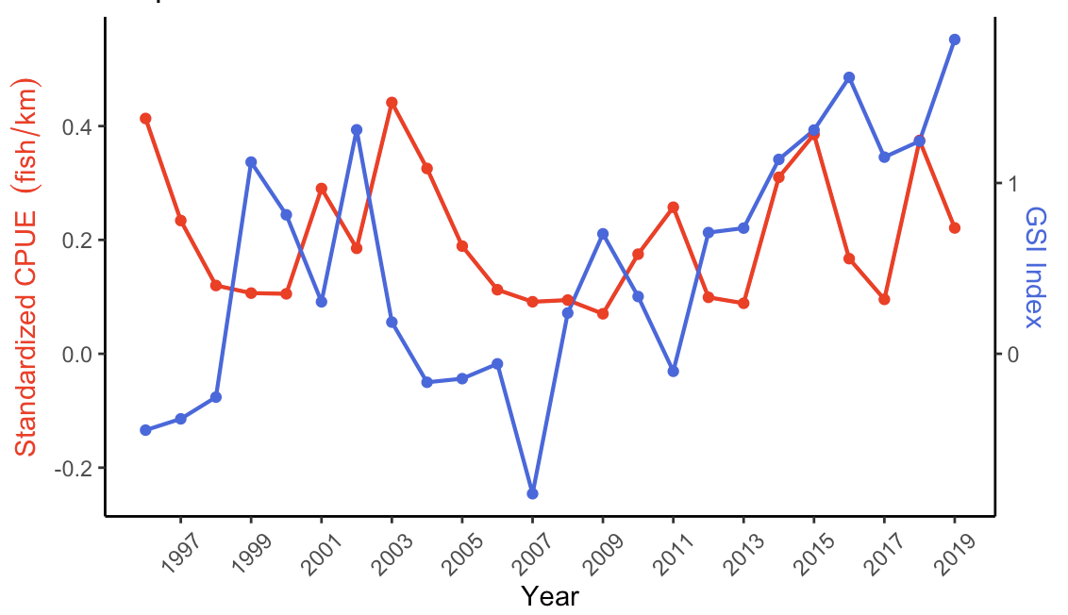
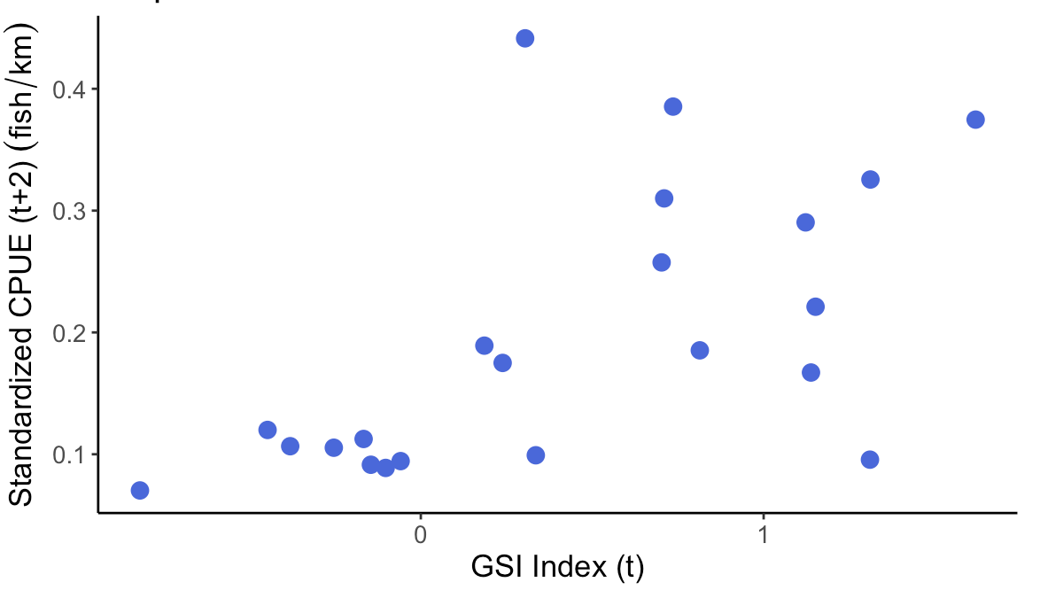
Abundance lags 1 year behind NAO index
r = 0.516
North Atlantic Oscillation - MMAP
Global Climate Oscillations
Gulf Stream Index - VIMSYoY
Abundance lags 2 year behind GSI index
r = 0.503

Slide 34
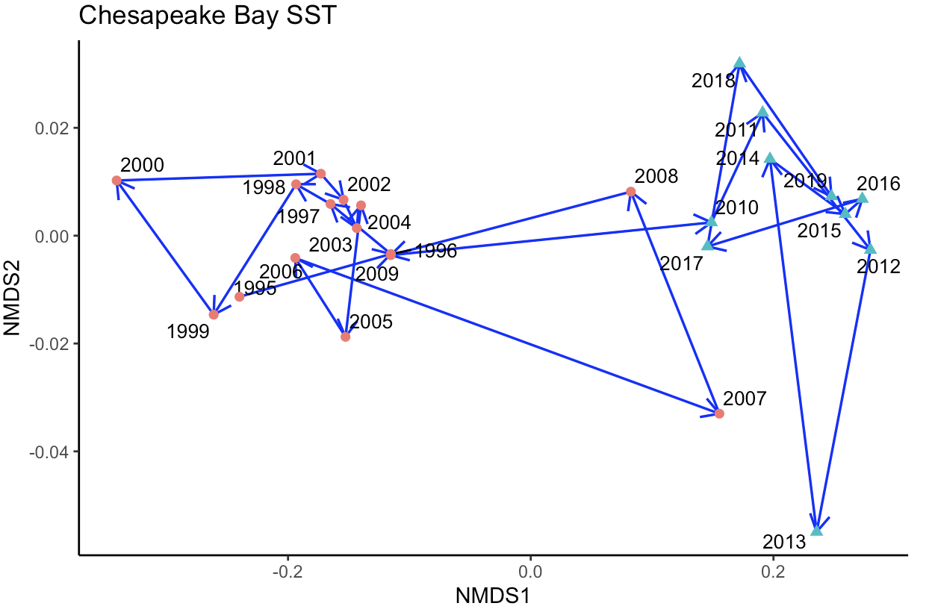
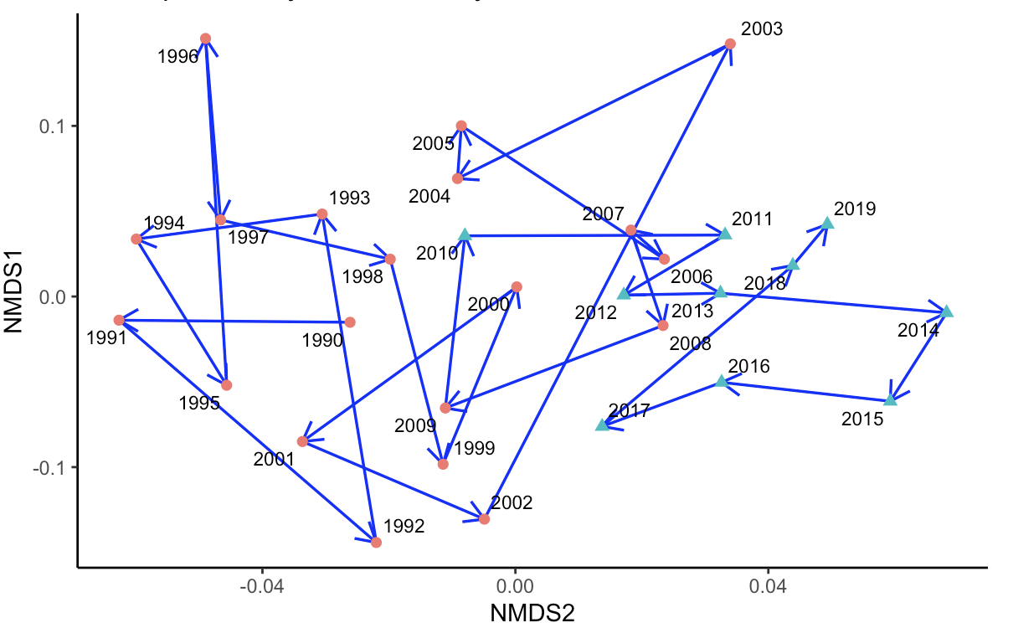
SST
Chesapeake Bay SST & Water Quality nMDS
Water Quality

Slide 35
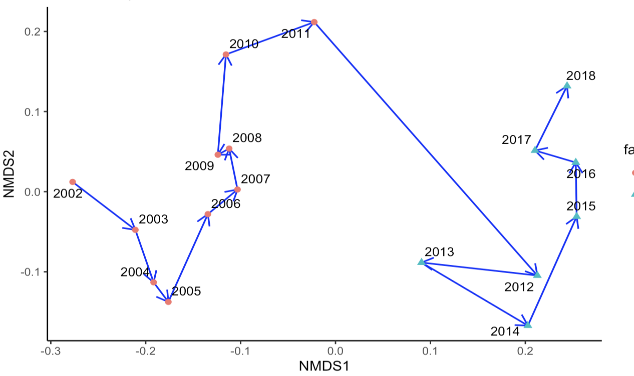
Chesapeake Bay Community
Fish Community Biomass
Species that contributed most to dissimilarity:
Atlantic croaker
Summer flounder
Spot
Weakfish

Slide 36
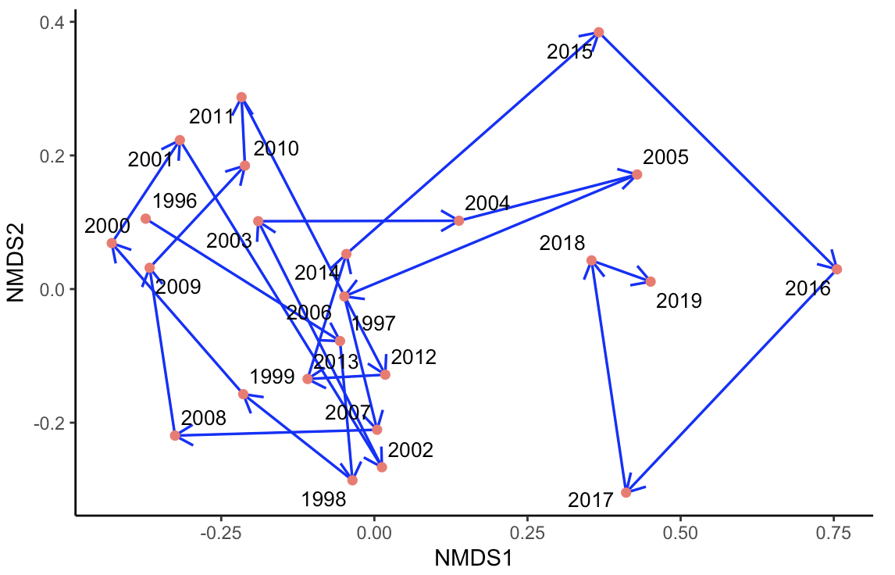
Fish YoY Abundance
Chesapeake Bay Community

Slide 37


Traits Based Community Assessment
6
5
4
3
2
1
Principle Response Curve
2002 - 2011
2012 - 2018

Slide 38
Traits Based Community Assessment
Principle Response Curve
Large maximum length (110-400 cm)
High maturation age (4-25 years)
Large offspring size (4.41-450 mm)
Bearers
Non-guarders
Demersal
Subtropical
Small offspring size (0.19-0.80 mm)
Small maximum length (30-46 cm)
Generalists

Slide 39
Conclusion
Local environmental factors influence relative abundance
Correlation with larger scale climate factors
Changing Bay environment ~2010
Species exhibited similar abundance trends that tend to belong to the same functional groups
In future include fishing effect
Fisheries management should reflect ecosystem changes

Slide 40


Acknowledgements
Supporters:
NOAA Chesapeake Bay Fisheries Research Program
Virginia Tech
Lab mates:
Jon Low
Chad Wong
Iman Pakzad

Slide 41
Questions?

