Slide 1
Update to the Management Board regarding
Developing Watershed Management Plans Indicator
November 2013
Nita Sylvester, EPA CBPO
Chair of STAR’s Indicators Workgroup

Slide 2
Restoration and Protection Efforts
Reducing Pollution
Reducing N Pollution
Restoring Habitats
Restoring Wetlands
Protecting Watersheds
Public Access Sites
Reducing P Pollution
Reducing S Pollution
Managing Fisheries
Fostering Stewardship
Blue Crab Fishery Management
Planting Forest Buffers
Developing Watershed Management Plans
Wastewater Treatment Plant Upgrades
Protected Land
Water Trails
Bay Gateways
K-12 Education (R)
Wetlands Enhance/ Rehab.
Reopening Fish Passage
Planting Bay Grasses (R)
Restoring Oyster Reefs (R)
Green: previously reported indicator already updated
Green w/ “(R)”: previously reported indicator already updated and revised
Black: previously reported indicator to be updated
Black w/ “(R)”: previously reported indicator to be replaced with new indicator
Black w/ strikeout: previously reported indicator no longer tracked or updated and removed
Black Italicized: previously reported indicator no longer tracked or updated; commitment met
Red: previously reported indicator no longer tracked or updated; commitment NOT met
Notes:
Restoration and Protection Effort indicators featured in “Track Our Progress” section of ChesapeakeBay.net
Wetlands Enhancement and Rehabilitation (supplemental indicator):
unable to update due to lack of cooperation from jurisdictions;
requested MB concurrence to remove from “Track the Progress” section of website
MB agreed
Indicator removed from “Track Our Progress” section
Water Trails and Bay Gateways (supplemental indicators):
were components of the old Public Access Index;
tracking discontinued after commitments were met;
Requested MB concurrence to remove from “Track the Progress”
MB decided to keep and revise text on webpages to indicate “Tracking has been discontinued since the goal was achieved”
Developing Watershed Management Plans: next slide

Slide 3
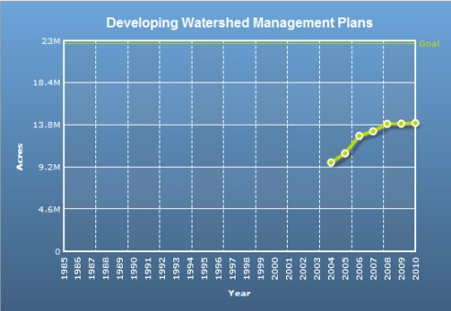
Developing Watershed Management Plans
MB decision: keep and revise text on webpage to indicate “Tracking has been discontinued since the goal was achieved.”
  pending provision of new data from PA in anticipation that it will show achievement of commitment
PA subsequently determined there were no new River Conservation Plans in the Bay watershed since 2008
Achievement remains at ~62%
Notes:
Developing Watershed Management Plans:
tracking discontinued;
not essential to support adaptive management of GITs' strategies
requested MB concurrence to remove from “Track the Progress”
MB decided to keep and revise text on webpage to indicate “Tracking has been discontinued since the goal was achieved (pending provision of new data from PA in anticipation that it will show achievement of commitment)

Slide 4
Options
Remove the page
Keep the page and say: “Tracking has been discontinued. The goal was not achieved.”

