Slide 1
Content Overview of the next Chesapeake Bay Ambient Water Quality Criteria Technical Addendum: Final needs/decisions.
Peter Tango
USGS@CBPO
April 3, 2014

Slide 2
Chapters 1-3
Relevant to the Criteria Assessment Framework
WBRTF bathymetry, volume developed
Open Water Designated Use Definition Review
SAV Goal Alignment

Slide 3
Chapters 4-6
Criteria Assessment Protocols
DO: Focus on Short duration Criteria assessment options
Interim rules for 303d listing status using the BIBI to support Aquatic Life Use assessment
Nontraditional Partner protocols for DO data

Slide 4
Chapter 7
Bay Health Tracking
Development of the new Multimetric Water Quality Standards Attainment Indicator

Slide 5
Chapter 1. Western Branch Patuxent River Tidal Fresh Segment Bathymetry and Volume
MDE provided river transect data.
Volume estimation was developed to support WQ Stds assessment
River grid representation developed to link with the Bay model
(I think this needs final concurrence from WQGIT)

Slide 6
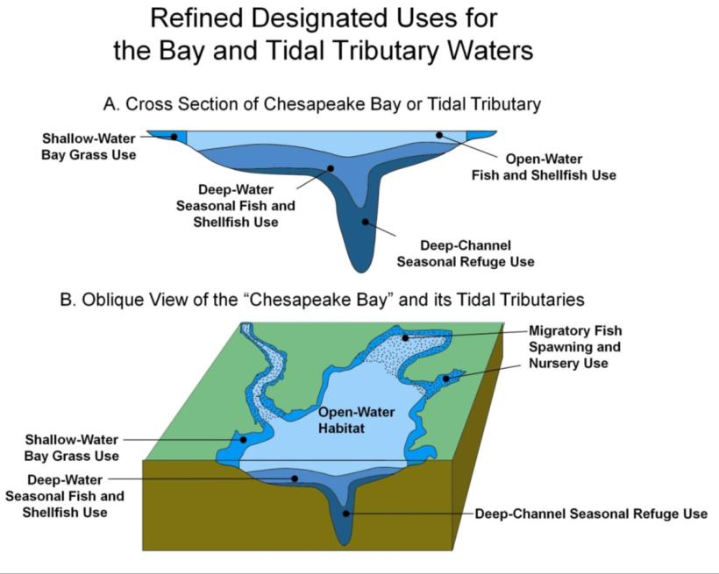
Chapter 2. Open Water Designated Use Definition Review
A lot of analyses showing general differences between nearshore and offshore DO behavior
UCAT recommended retaining Open Water DU shore to shore definition.
States have the right to request subsegmenting on a case by case basis.
WQGIT approved.

Slide 7
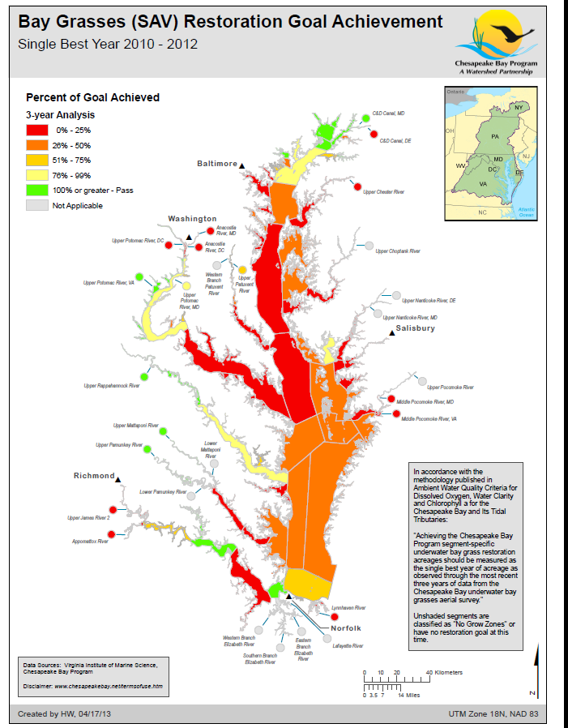
Chapter 3. Alignment of the Chesapeake Bay SAV Restoration Goals.
CBP 2003: 185,000 acre goal
Water Quality Stds in 2004/5: 192,000 acre goal.
SAV WG has sorted through history to illustrate the decisions supporting 192K goal. (Becky G! Howard W!)
Alignment is a work in progress within CBP in 2014.

Slide 8
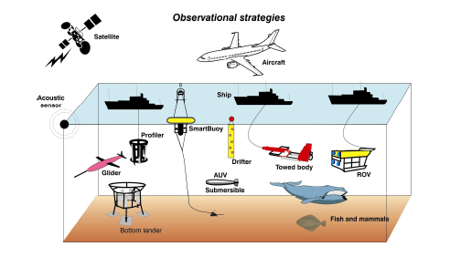

Chapter 4. Assessing Short-Duration Criteria in Chesapeake Bay: (Part 1).
Measure water quality
at high temporal frequency.
Apply CFD approach.
Use the Umbrella Criterion Approach defining the acceptable risk of nonattainment for the unmeasured criteria

Slide 9
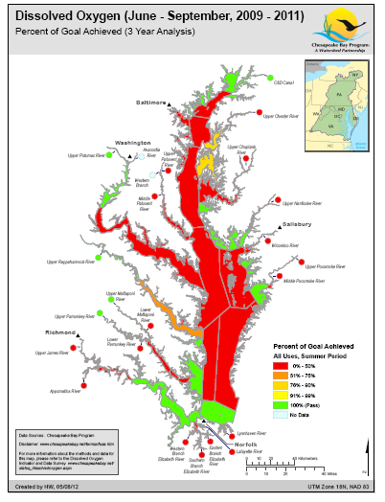

Water Quality Standards Attainment:
As we know it today.
“You’re either in…or you’re out!”

Slide 10
Enter Umbrella Criterion: Chesapeake Bay EMAP sensor data set was evaluated to compare criterion failure rates. Does passing the Open Water 30-day mean DO criterion (5.0 mg/L) provide an adequate measure of protection for passing the 7-day mean DO criterion?
Monthly Mean Dissolved Oxygen (mg/L) | Failure rate of the Open Water 7-day mean dissolved oxygen criterion | Failure rate of the OW Instantaneous minimum DO criterion
5.01 | 17.7% | 44.9%
?

Slide 11
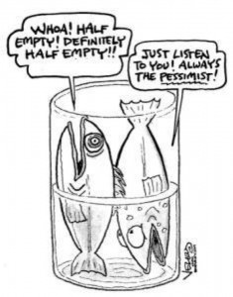
EPA Rule of Thumb level of protection with criterion assessments: 10% allowable exceedances. So, is our glass half full or half empty?
Half Empty:
We meet the 30-day mean DO criterion, but
we fail to meet the 7 day and instantaneous minimum criteria…
…even with a 10% allowable exceedance.
Half Full:
We meet the 30-day mean DO criterion,
Our short-duration criteria might be considered protected:
Protected IF our criteria or allowable exceedance for violations were different.
(Or, there might be another option….)

Slide 12

As the monthly mean dissolved oxygen concentration increases, the associated violation rate for short-duration criteria declines.
Suggestion: Instead of basing protection for short-duration criteria only on the pass-fail assessment, use the information on monthly means to understand the level of risk of violating short-duration criteria.
Short duration DO criterion violation rate (%)

Slide 13
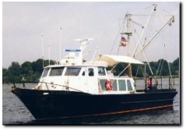
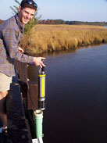
Our low frequency data (2x/month) requires that we achieve a higher monthly mean to establish a low risk of nonattainment for short-duration criteria compared with near real-time (15 min) assessments.
Risk of violating the 7-day mean when collecting 2 samples per month
Risk of violating the 7-day mean criterion
Near true risk of violating
the 7-day mean from Continuous Monitoring data
Monthly Mean Dissolved Oxygen (mg/L)

Slide 14
Chapter 4. Assessing Short-Duration Criteria in Chesapeake Bay
Measure water quality
at high temporal frequency.
Apply CFD approach.
Use the Umbrella Criterion Approach defining the acceptable risk of nonattainment for the unmeasured criteria
Recommendation needed in CAP WG:
For assessment purposes, when we apply the Umbrella Criterion with
something other than the instantaneous minimum:
Option 1: All DO surfaces must have
<10% risk to protect against nonattainment in each cell.
Option 2. All DO surfaces must have<10% average risk for the surface.

Slide 15
Chapter 4. Assessing Short-Duration DO Criteria in Chesapeake Bay: (Part 2).
3 Zones
of Assessment
Measure water quality
at high temporal frequency.
NEW Recommendation! Apply Zone approach to support partial delistings using Instantaneous minimum assessments.
Use the Umbrella Criterion Approach defining the acceptable risk of nonattainment for the unmeasured criteria
Offshore
Nearshore
Sub-
estuaries

Slide 16
3 DO Assessment Zones for Instantaneous minimum assessment recommendation
Caffrey (2004), VADEQ, Boyton (in progress)
Habitat adjacent to monitoring sites can explain general patterns of DO dynamics across sites.
Caffrey 2004: Adjacent habitat, estuarine area and salinity explained 58% of variation in Net Ecosystem Metabolism at NERR sites.
Nutrient loading can explain 68% of NEM variation
Blends understanding of regional and local geomorphology effects and management interest
Blends use of monitoring approaches and data abundance
Support for States when requesting cons

Slide 17
IM DO 3-Zone Assessment Recommendation to Support States in Partial Delisting Options to Promote Status and Incremental Progress Reporting
Offshore: Subject to Open Water Criterion Assessment
Nearshore of mainchannel Bay or primary tributary:
Zoned on a case by case basis.
Coordinated between the jurisdiction and EPA
Use 3 Full Seasons of one or more Con Mon data sets in the segment.
Apply 1% nonattainment rule: compensating for spatial resolution
Subestuary: Tribs of tribs, small waters.
3 years of synoptic sampling, 10+ samples per year, 10% rule of assessment applied to meet IM standard.
(We should probably discuss time of day as a factor in data collection rules here).

Slide 18
Chapter 4. Assessing Short-Duration DO Criteria in Chesapeake Bay: In Total
Measure water quality
at high temporal frequency.
Apply CFD.
Use the Umbrella Criterion Approach defining the acceptable risk of nonattainment for the unmeasured criteria
NEW Recommendation! Apply Zone approach to support partial delistings using Instantaneous minimum assessments.
Further Interpretation Note: Meeting IM represents an Umbrella for all other applicable DO Criteria
3 Zones
of Assessment
Offshore
Nearshore
Sub-
estuaries
Decision requested: Support for presenting the 3 Zone approach for EPA to consider
To make the best use of our understanding of the Bay system and the best available
Monitoring resources we have to support impairment assessments.

Slide 19
Chapter 5. Interim Rules for Using BIBI to support Aquatic Life Use Assessments
Classification Category for Water Quality Status | Description
Category 1 | All designated uses are supported, no use is threatened.
Category 2 | Available data and/or information indicate that some, but not all, designated uses are supported.
Category 3 | There is insufficient available data and/or information to make a use support determination.
Category 3a | VA: no data are available within the data window of the current assessment to determine if any designated use is attained and the water was not previously listed as impaired.
Category 3b | VA: some data exist but are insufficient to determine support of designated uses. Such waters will be prioritized for follow up monitoring, as needed.
Category 3c | VA: data collected by a citizen monitoring or another organization indicating water quality problems may exist but the methodology and/or data quality has not been approved for a determination of support of designated use(s). These waters are considered as having insufficient data with observed effects. Such waters will be prioritized by DEQ for follow up monitoring.
Category 3d | VA: data collected by a citizen monitoring or other organization indicating designated use(s) are being attained but the methodology and/or data quality has not been approved for such a determination.
Category 4 | Available data and/or information indicate that at least one designated use is not being supported or is threatened, but a TMDL is not needed.
Category 4a | A State developed TMDL has been approved by EPA or a TMDL has been established by EPA for any segment-pollutant combination.
Category 4b | Other required control measures are expected to result in the attainment of an applicable water quality standard in a reasonable period of time.
Category 4c | The non-attainment of any applicable water quality standard for the segment is the result of pollution and is not caused by a pollutant.
Category 5 | Available data and/or information indicate that at least one designated use is not being supported or is threatened, and a TMDL is needed.
For segments where “Impaired = No” identify those segments that have a breadth of confidence limits (Upper confidence Limit - Lower confidence Limit ≥ 0.5) of .5 or greater. Of that remaining subset of segments, those that have a Mean BIBI <2.7 would be classified as Category 3 (insufficient information) until more conclusive information is available.
WQGIT supported 2013

Slide 20
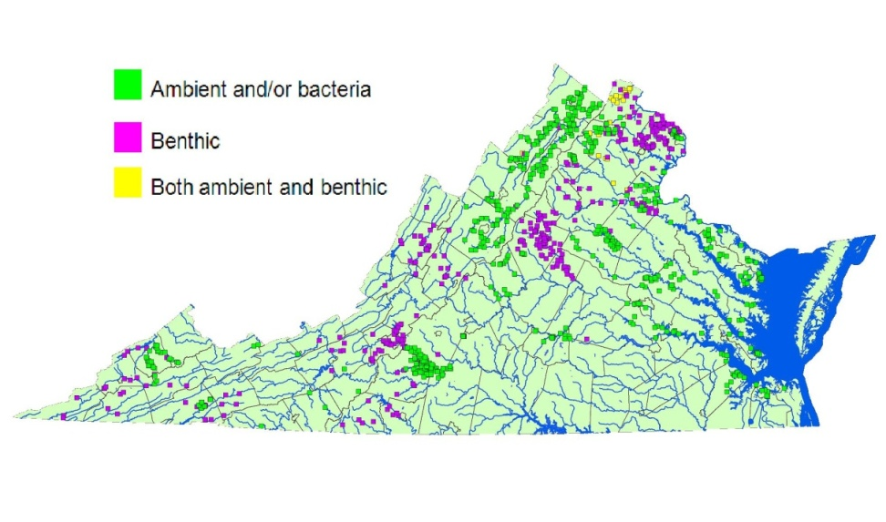
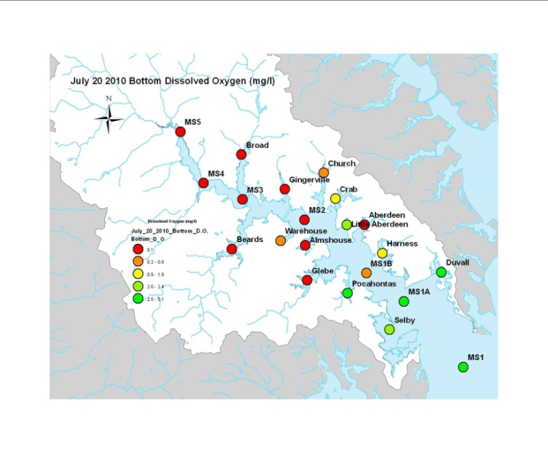
Chapter 6. Nontraditional Partner DO data collection and handling protocol
Documenting the need for nontraditional partner data to follow EPA protocol for inclusion of data in regulatory assessments.
Expecting to end the chapter with future directions that might include other data for informing decisions but not regulatory assessments.
E.g. Alliance for the Chesapeake: VA
E.g. South River Federation: MD

Slide 21
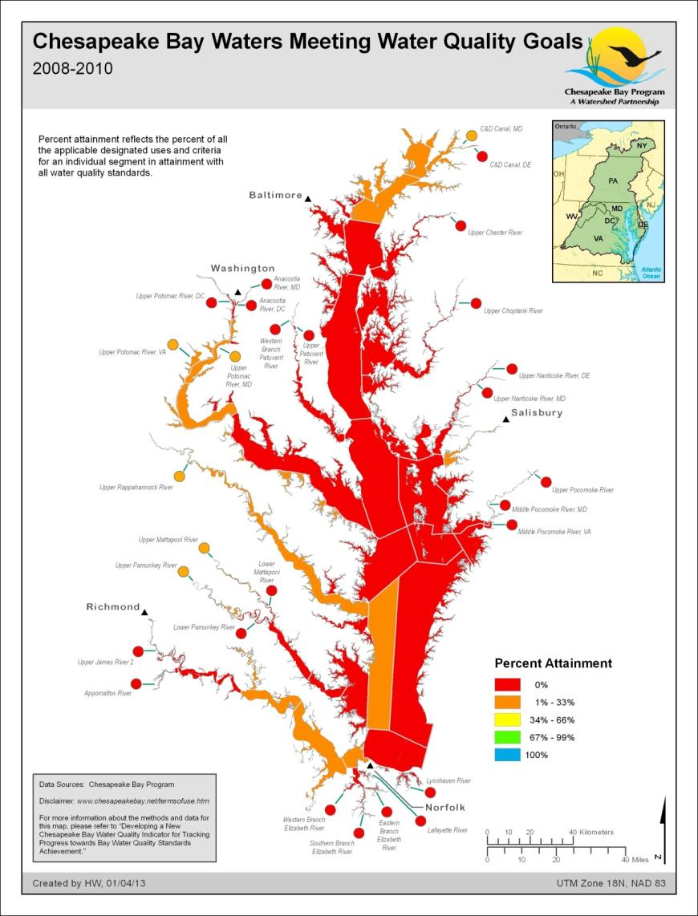
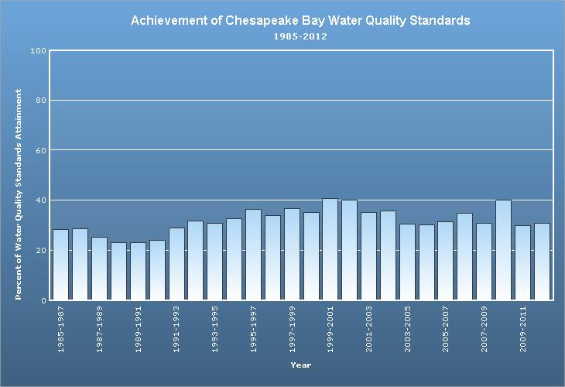
Chapter 7. Multimetric Water Quality Standards Indicator for Supporting Progress Tracking in Bay Restoration
Documents the use of DO + Water Clarity/SAV + CHLA standards attainment assessments in a multimetric assessment of progress. (Liza H, Lea R)
Approved by WQGIT (and Management Board I think) in 2013.

Slide 22
Needs/Decisions
Document is nearing ready as first complete draft for CAP WG review.
Questions and comments welcome on all chapters
Note WQGIT approvals that are already banked!
Decision points in next CAP WG meeting:
Umbrella Criterion application rule
3-Zone recommendation to address monitoring and management of segments.
Recognize Instantaneous minimum role in Umbrella applications with partial delisting options.
Review

