Slide 1
Agriculture:
Challenges and Progress in the Chesapeake Bay
Douglas Beegle, Distinguished Professor Emeritus of Agronomy
Dept. of Crop and Soil Sciences
Penn State University
Chesapeake Bay Citizens Advisory Council September 7, 2017

Slide 2
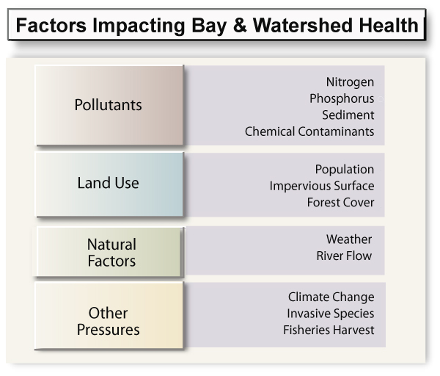
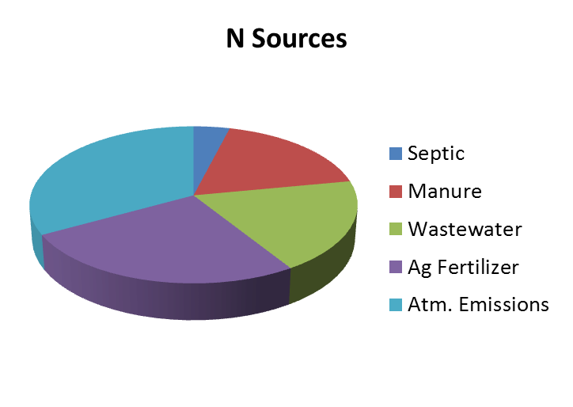
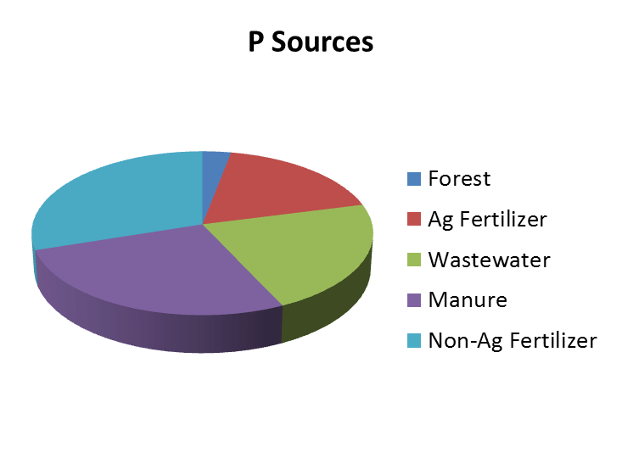
Bay Health
Chesapeake Bay Program

Slide 3
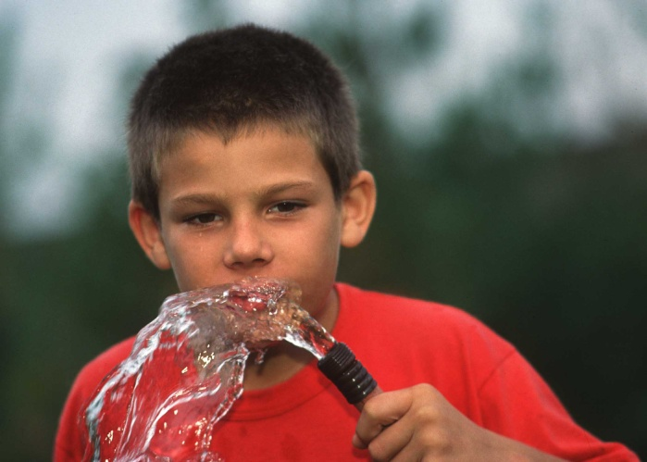
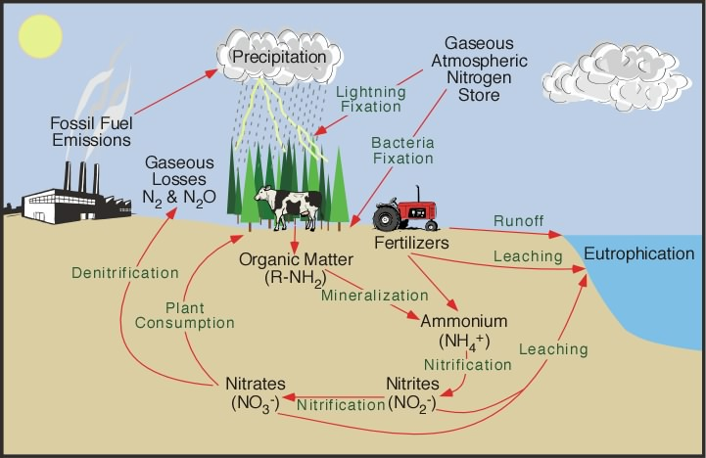
Nitrogen in the Environment
N is an essential element for plants and animals
  Often the most limiting nutrient for crop production
High N can be toxic to animals – especially infants
  PHS for drinking water:
  10 ppm NO₃-N
Very dynamic and mobile in the soil water system
  Very difficult to keep out of the environment – even with good management

Slide 4
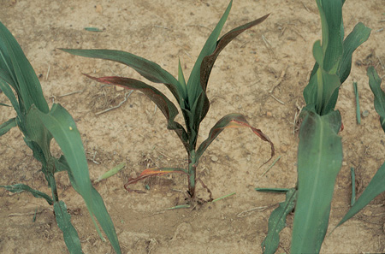
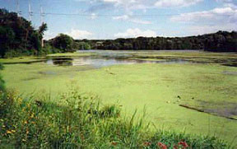
Phosphorus in the Environment
P is an essential element for plants and animals
  Relatively insoluble
High P is generally non-toxic to plants or animals
P causes accelerated eutrophication
  Excessive growth of algae and aquatic plants
  Decaying vegetation results in low oxygen
  Limits use of water for drinking, fishing, recreation, etc.

Slide 5
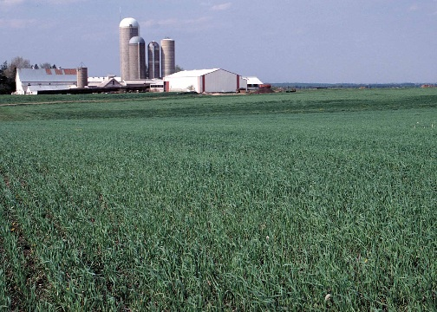
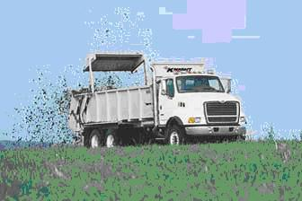
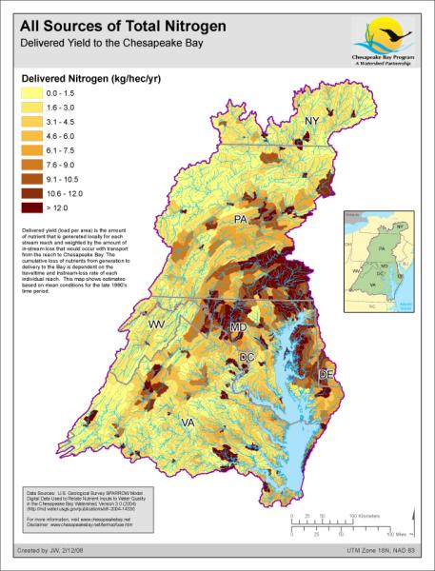
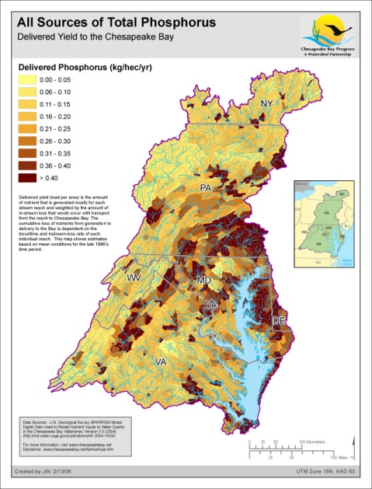
Ag Nutrient Management for Environmental Protection in the Chesapeake Bay
What is causing the problem?
  Management
    Economics
      Assumption: If farmers improve nutrient management they will make more money?
      Economics are driving the problem, not the solution!
    Stewardship ethic
    On the farm
  Systemic
    Structure of agricultural systems
    Regional nutrient imbalance
    Beyond the farm

Slide 6
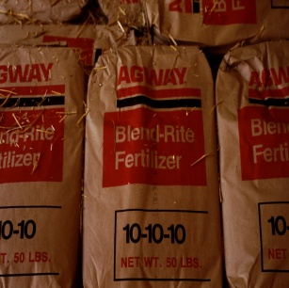


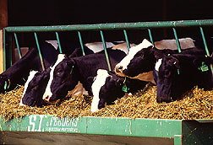
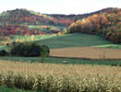
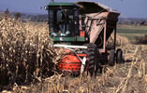
Traditional Animal Ag Nutrient Flows
¼
Fertilizer
Crops
Local
Animals
Soil
¾
At one time in PA, manure was considered part of the realty of the farm
$
Manure

Slide 7
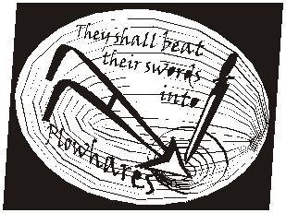
Why is there a pollution problem with nutrients?
Prior to WW II, most farms relatively feed self-sufficient traditional farms
  Main source of N was legumes and manure
  Internal cycling of nutrients was critical
Nitrate plants built for explosives in WW II
  Converted to fertilizer production after the war
  Enabled grain production on farms without animal manure and legumes to supply N
This lead to specialization
  Specialization
    Farms in the “corn belt” grew corn
    Farms in places like PA fed that corn to animals
  Economic synergy
  Concentration of ag industries in different areas

Slide 8
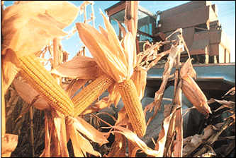
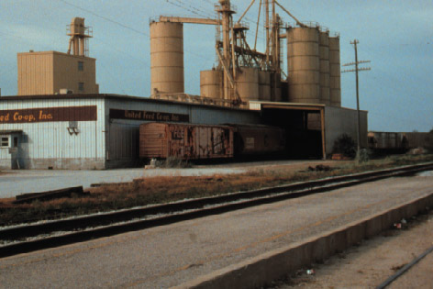
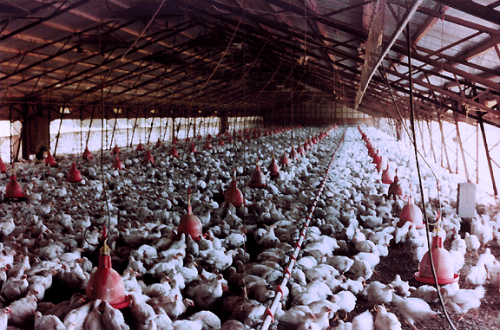
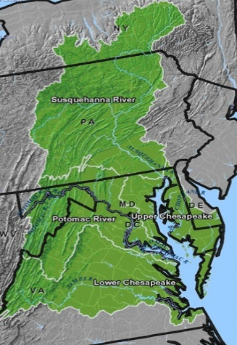
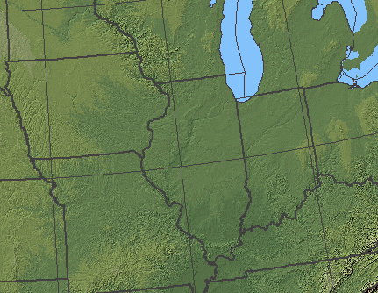
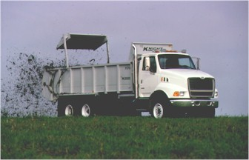

Contemporary Animal Ag Nutrient Flow
¼
Feed mill
Crops
Animals
$
$
-$
Soil
¾
Externality
~$900M/yr
-$
Manure
? ? ?

Slide 9
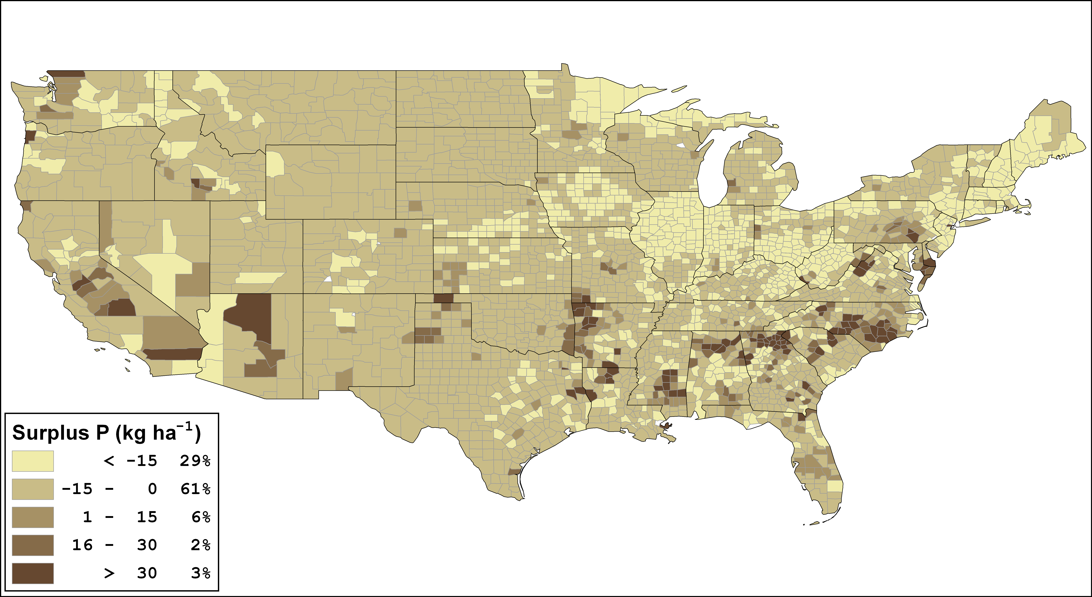
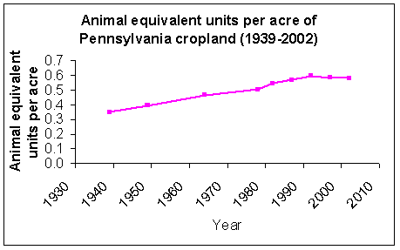
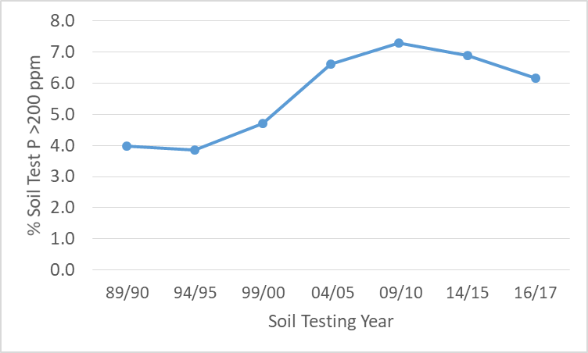
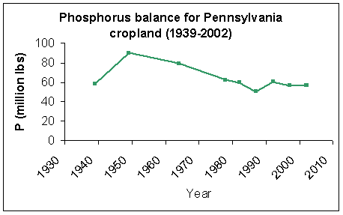
Nutrient Imbalance
MAWQ Program
Maguire et al., 2007
PA Very High Soil Tests
PSU AASL
MAWQ Program

Slide 10
Strategic Conflict Between Economic Production and the Environmental Protection
Some Public
Funding
Economic Forces
Food
Outputs
Market
Farm
Production
Decisions
Farm
Production
Decisions
BMPs
Env.
Non-Market
Current
Policy
Response
Social Pressure
Farmers must change the way they manage nutrients
Economic externality!
Adapted from Lanyon, 2000

Slide 11
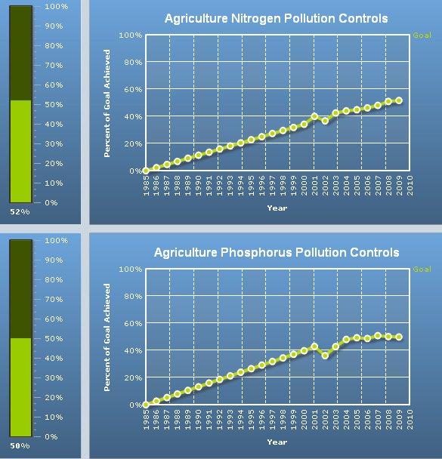
Progress in the Chesapeake Bay
BMP based programs
  significant progress. . . But not enough progress
  Relatively low hanging fruit
  Progress may be slowing
Strategic approaches
  Real progress requires strategic approaches that address the fundamental underlying systemic problem
    Nutrient Imbalance
Chesapeake Bay Program

Slide 12
Strategic Solution to Food Production and the Environment
Economic/Social Signals
Economic Power
Production
Decisons
Food
Outputs
BMPs
Market
Env.
We need to internalize the environmental costs of food production . . . Somehow?
Adapted from Lanyon, 2000

Slide 13
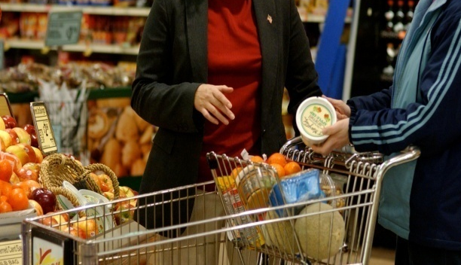

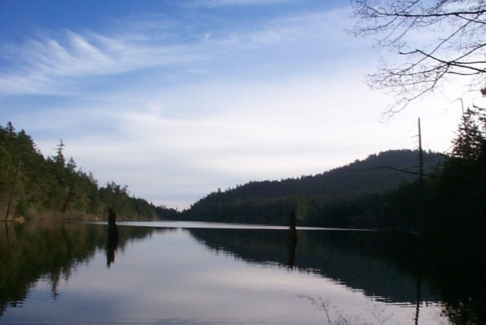
Addressing the Real Solution to the Nutrient Management Problem?
This is not an just agricultural issue, it is a food issue. . . Producing food in a way that causes less pollution is more expensive
How are we going to pay that cost?
  Common assumption is that it is simply mismanagement . . .
    Therefore, improved management will clean up the environmental problem and make the farmer more money Win – Win?
    However, generally the economic impact of nutrient management will be negative for farms with nutrient problems.
      Environmental cost must be internalized
    If there was additional profit in nutrient management we probably wouldn’t have the problem.

Slide 14
Recent Example: NPR 8/21-22/17
Walmart unveiled Project Gigaton, a plan to reduce emissions of greenhouse gases by a billion tons of carbon between now and 2030.
  Discovered that most of the carbon was in producing food
  This is beyond the direct control of the company…goes back to the suppliers
Other food companies are asking the same question. Many of them, including General Mills and Kellogg joined forces and set up an organization called Field to Market to measure and reduce the environmental impact of their operations.
“Just one crucial obstacle - relying on oats for your bacon* costs a little more money, and somebody would have to pay to make it happen, like Walmart and, in turn, American consumers.”
    *One example in the story was to substitute oats (~5%) as part of swine ration to reduce N
“Any real change could reshape the landscape of American farms.”

Slide 15
Current Policies
Federal Clean Water Act:
Animal Feeding Operations
  AFO/CAFO -Animal Feeding Operations
  NPDES Permits
  Comprehensive Nutrient Management Plans (CNMP)
Chesapeake Bay TMDL
  Tracking implemented management practices
  Supporting implementation of advanced technologies and nutrient trading
  Enhancing nutrient management compliance efforts
PA Nutrient Management Act
  Concentrated animal operations (CAO) - Farms over 2 AEU/A
  Implement an approved nutrient management plan
PA Clean Streams Law
  All farms must have a manure management plan or permit
MANAGEMENT
MANAGEMENT
MANAGEMENT
MANAGEMENT
MANAGEMENT
Focus on using BMPs to change on-farm management
Good but . . . Doesn’t address the underlying problem

Slide 16
Contemporary Nutrient Flow
¼
Feed mill
Contemporary Mgmt.
Crops
Animals
Yield
Traditional Mgmt.
Soil
¾
Agronomic Efficiency
Nutrients
Global
Manure
? ? ?

Slide 17
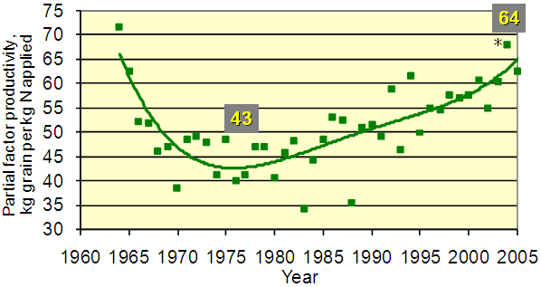
Improved Agronomic Efficiency
Integrated crop management systems
Better genetics
Better recommendation systems
Enhanced efficiency fertilizers
Improved application technologies
etc.
Impact on the Bay?
Potential to increase animal production with off-farm feed
Fixen, IPNI

Slide 18
Contemporary Nutrient Flow
Animal Production Efficiency
Feed mill
Crops
Animals
Soil
Global
Manure
? ? ?

Slide 19
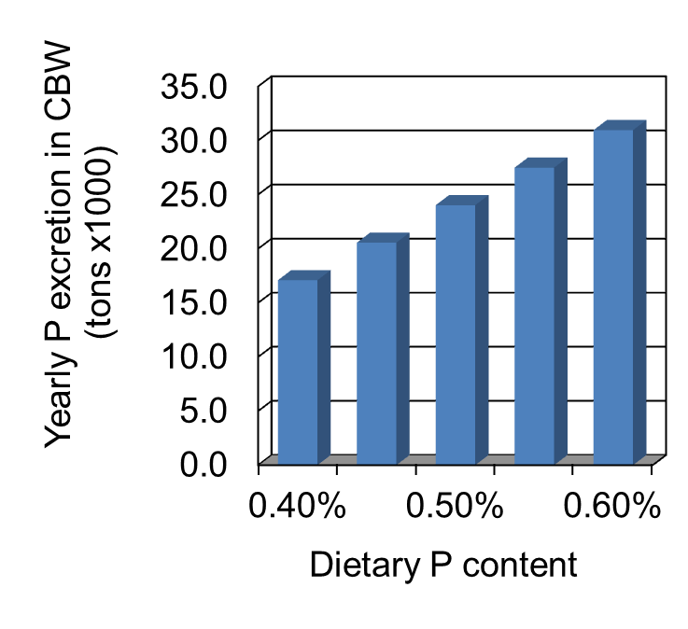
Improved animal production efficiencies
Dairy
  Impact on overfeeding P to dairy cows within Chesapeake Bay watershed?
  Excess P in dairy rations goes directly into manure
Knowlton et al., Va Tech

Slide 20
Improved animal production efficiencies
Swine and Poultry
  Adding phytase enzyme to Swine and Poultry rations
  ~30-40% Reduction in manure P
  Economical
Swine
Phytate
Major form of P in grain
Unavailable to monogastric animals
P
P
P
P
P
P
Baxter et al.

Slide 21
Contemporary Nutrient Flow
Feed mill
Crops
Animals
Soil
Nutrient Management
N-P
Global
Manure
? ? ?

Slide 22
Nutrient Management Planning
  Managing manure for maximum agronomic and economic benefit with minimum environmental impact
Inventory available nutrients and crop nutrient requirements
  Soil Testing
  Manure Analysis
Intelligently allocate manure to crops
  Most benefit from nutrients
  Least potential risk
Determine application management
  Application method
  Application timing
Determine balanced manure rate based on available N and P
  Available Manure N ≤ Crop N Requirement
  Adjusted based on P Index
Recommend manure and soil management BMPs
  Manure storage and handling
  Soil conservation practices
Deal with excess nutrients
  Manure export

Slide 23
Nutrient Management Systems
Nutrient Management Process – More than just a Nutrient Management Plan
  More emphasis on desired outcomes
    Too often the plan is the object of the exercise!
      One size fits all solution???
    The plan must be the means to an end, not the end itself
  Adaptive Management
    On-going process!
    Encourage innovation
  Farmer and regulators must buy into the process
Nutrient Management Process
Select Management Options
Assessment
Planning
Implementation and Record Keeping
Outcome
Economic Production & Environmental Protection

Slide 24
Eliminate Nutrient Management Planning Requirement!
Plans are by necessity speculative, a best estimate of what might happen
  Farmers are challenged to know what they might do in the future and feel locked-in to their plan
Require records instead of a plan
  Records could be entered into our planning software to see if nutrients were properly managed
This would make planning necessary, rather than required
  Planning would become an ongoing process
Would also help document management

Slide 25
Nutrient Management Challenges
Idealism ― Realism
  Limited Resources
  Achieving appropriate balance
  Cost/benefits
  Holistically
    Strategic conflict between Ag and Environment
    Agriculture and Society
  Targeting
Lots of variables and lots of uncertainty
  Realistically account for the important variables
  Reasonable estimates of uncertainty
    N Recs for corn are in 40 lb/A increments
    Plans are held to 1 lb/A tolerance
Continued emphasis on science and education
Benefits
Bay
Costs

Slide 26
Targeting CAOs in Pennsylvania
Very High Animal Density Farms (>2 AEU/A)
Manure nutrients in excess of crop requirements.
Not enough land for manure spreading.
  You will have to export some manure
  Maybe since you are already exporting, consider exporting a little more to avoid spreading in potential environmentally sensitive situations
High pollution potential.
Moving excess manure off the farm or reducing animal density.
Negative economic returns.
~10% of farms but, >50% of Manure
What about CAFOs – Very Large Farms?

Slide 27
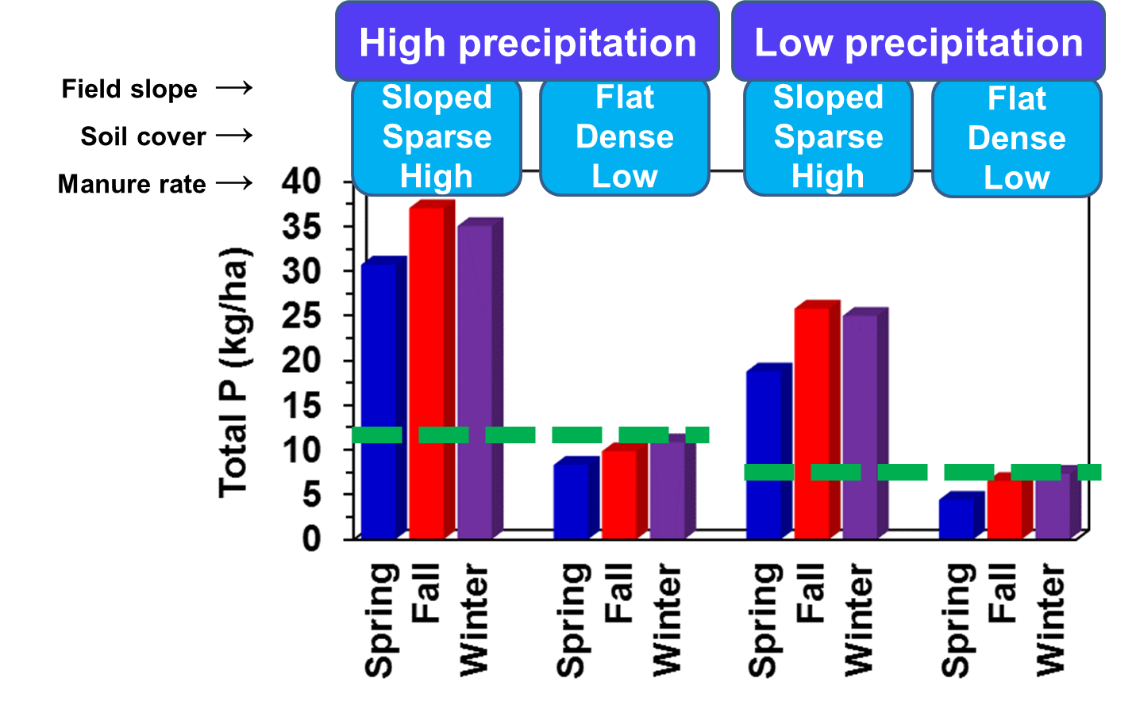
Winter Manure Application
~20 lb P₂O₅ reduction on avg. 200 A dairy
Saving ~$0,05/A, but cost >$400/ lb P₂O₅
Jian Liu et al. Penn State & USDA-ARS
SWAT Model

Slide 28

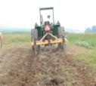
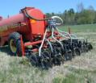
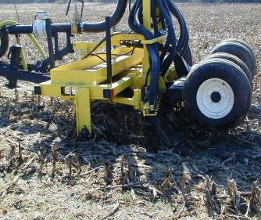
No-till Manure Injection
Surface Chisel Low Dist. Inj. Aerator
Taller bars are worse except for economics
Penn State & USDA-ARS PSWMRU
Rotz et al. USDA-ARS & Penn State

Slide 29
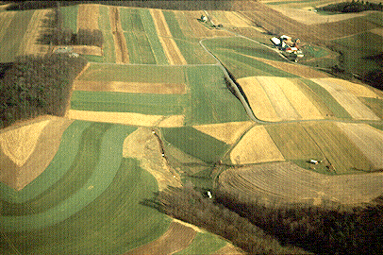
Phosphorus Index Targeting
Understand and manage the system
Critical Source Area
Sources
Transport
Source
Transport
Volatilization
N P K
Runoff
Erosion
Leaching
Tile flow
  Ex. 90% of the P comes from 10% of the area
Water Body
USDA-ARS PSWMRU
Subsurface
flow
Phosphorus Index
Identify and manage critical source areas for environmental protection from P losses
Hydrology

Slide 30
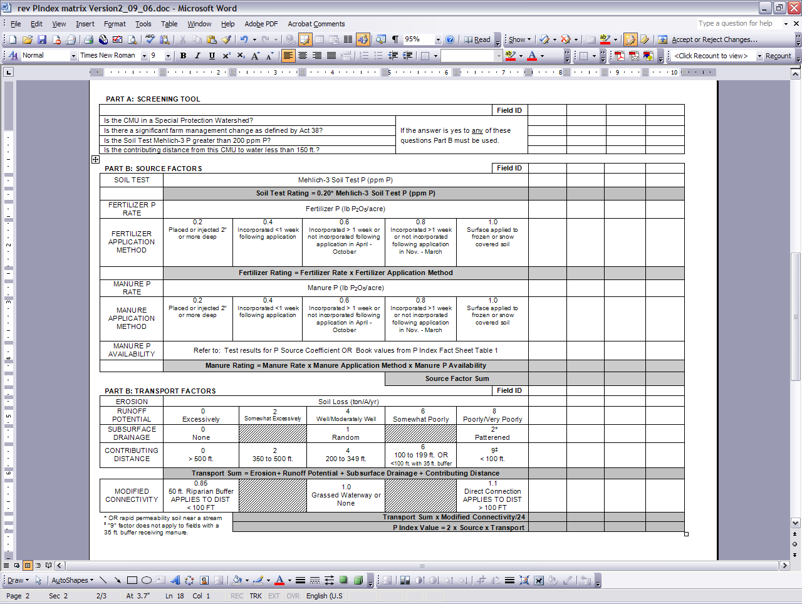
PA Phosphorus Index v. 2
(v. 3 in progress)
Field assessment of the risk of P loss. . .
Source and Transport

Slide 31
Contemporary Nutrient Flow
¼
Feed mill
Crops
Animals
Soil
¾
Achieve Nutrient Balance
Reconnect Nutrient Flow
Alternative uses for manure
New Technologies
New Policies
????
Manure
? ? ?

Slide 32
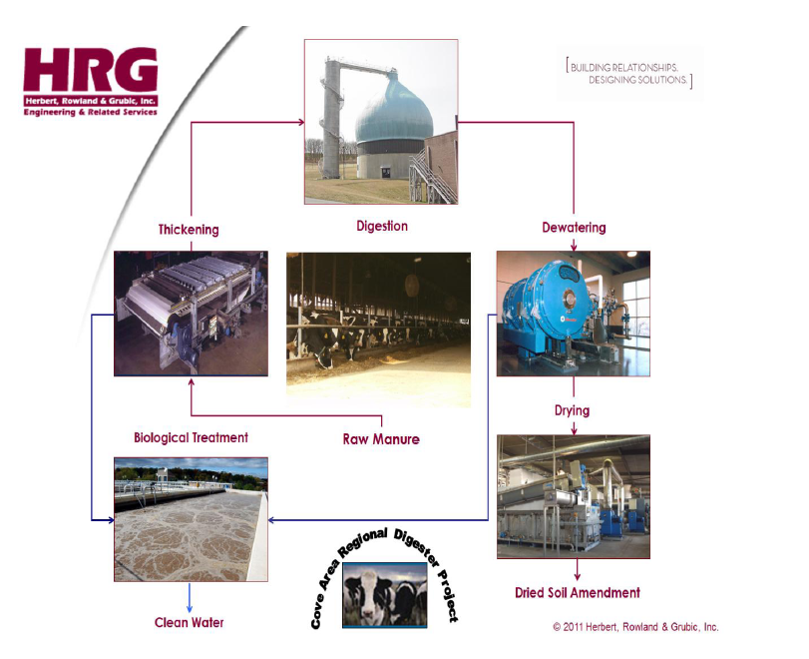
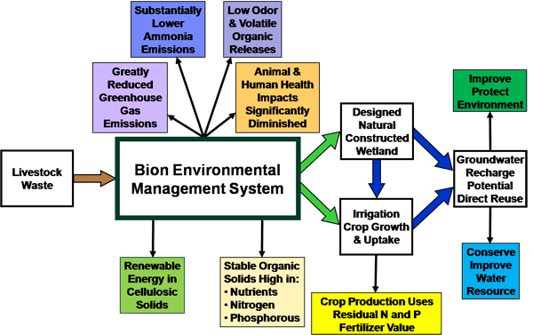
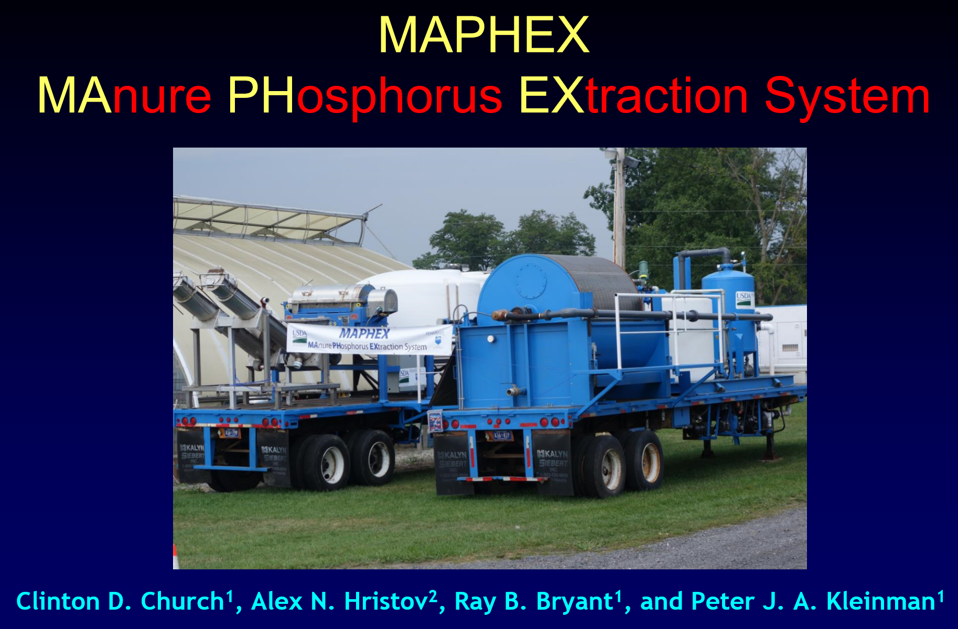
New Technologies
Research new technologies
Encourage innovation
Facilitate adoption
Silver bullet??

Slide 33
Contemporary Animal Ag Nutrient Flow
¼
Feed mill
Crops
Animals
$
¾
Soil
$
N-P
$
$
$900 M/yr
Nutrient Management
If we want food produced in a way that does not pollute, food will cost more.
$
$900 M/yr
Externality $?
Manure
? ? ?

Slide 34
Summary
Understand and address both the systemic and management issues with nutrients.
Major progress has been made in many segments of the food production system resulting in significant improvements in water quality
  Improved agronomic efficiency
  Improved animal production efficiency
  Improved nutrient management systems
Integrate nutrient management into systems focusing on outcomes not activities
  Set the objectives and give managers the freedom to come up with solutions
  Encourage individual innovation
  Don’t dictate practices, especially one size fits all prescriptions
Greater emphasis on solutions to the systemic issues
  Relieve the strategic conflict between production and the environment
  Encourage public and private strategic innovation

Slide 35

Douglas Beegle
  dbb@psu.edu
Pennsylvania Nutrient Management Program
  http://panutrientmgmt.cas.psu.edu
Penn State Extension Crop Management Team
  http://cmeg.psu.edu
Penn State Extension
  http://extension.psu.edu

