Slide 1



Pennsylvania’s Chesapeake Bay Program Progress and Challenges
Chesapeake Bay Program Citizen Advisory Council
September 8, 2017

Slide 2
Agenda
Progress Made and the Job Ahead of Us
Challenges
Pennsylvania’s Restoration Strategy
EPA Pennsylvania Specific Expectations
Phase 3 WIP Game Plan
Funding

Slide 3
Pennsylvania Nitrogen Loads: 2015-2025
113 M lbs.
(11 M lbs. reduced 1985-2015)
79 M lbs.
(34 M lbs. to reduce 2015-2025)
Where will the remaining Nitrogen reductions* come from?
78% Agriculture
20% Urban
2% Septic
2015
2025
*Based on jurisdictions’ Phase II WIPs

Slide 4
Pennsylvania Phosphorus Loads: 2015-2025
4.3 M lbs.
(1.7 M lbs. reduced 1985-2015)
3.6 M lbs.
(0.7 M lbs. to reduce 2015-2025)
Where will the remaining Phosphorus reductions* come from?
76% Agriculture
24% Urban
2015
2025
*Based on jurisdictions’ Phase II WIPs

Slide 5
Pennsylvania Sediment Loads: 2015-2025
2,477 M lbs.
(540 M lbs. reduced 1985-2015)
1,946 M lbs.
(531 M lbs. to reduce 2015-2025)
Where will the remaining Sediment reductions* come from?
70% Agriculture
30% Urban
2015
2025
*Based on jurisdictions’ Phase II WIPs

Slide 6
Pennsylvania’s Source Sector Challenges
Needs to reduce 19 million lbs. nitrogen by 2017 and a total of 34 million lbs. by 2025
Responsible for 69 percent of remaining basinwide nitrogen load reductions by 2025
Agriculture will likely be responsible for more than 80 percent of these nitrogen reductions by 2025
How do we put the technical assistance/compliance infrastructure and cost share funding in place to deliver on these needed reductions

Slide 7
Restoration Strategy: Six Elements
“Strategy is a mix of technical and financial assistance, technology, expanded data gathering, improved program coordination and, only when necessary, stronger enforcement and compliance measures.”
Address Pollutant Reduction
Quantify & Multiply BMPs
Improve Record-keeping
Identify Needed Changes
Seek New Resources
Establish a DEP Chesapeake Bay Office
Notes:
Address pollutant reduction by: a) meeting the EPA goal of inspecting 10 percent of farms and MS4s in the watershed annually, b) ensuring development and use of manure management and agricultural erosion and sediment control plans, and c) enforcement for non-compliance
Quantify undocumented Best Management Practices in watersheds impaired by agriculture or stormwater and put more high-impact, low-cost BMPs on the ground.
Improve reporting, record-keeping and data systems to provide better documentation and obtain maximum credit toward Bay goals.
Identify legislative, programmatic or regulatory changes to provide the additional tools and resources necessary to meet federal pollution reduction goals by 2025.
Establish a DEP Chesapeake Bay Office to coordinate development, implementation and funding of Pennsylvania’s Chesapeake Bay efforts.
Obtain additional resources for water quality improvement.

Slide 8
Agricultural Inspection Initiative
DEP began inspections August 29, 2016
Districts began inspections October 3, 2016
Successfully completed the first year
Over 2080 Inspections Completed
Over 1572 by Conservation Districts
Over 508 by DEP
Results of inspections to date
Total Acres Covered – 245,664 acres
Does not include existing Act 38 Inspection Program
Notes:
Administratively Complete Manure Management Plan = 65% (1099 out of 1692)
Acres covered by an administratively complete plan =
Administratively Complete Agriculture E&S Plan = 63% (1072 out of 1715)
Number referred to DEP for follow-up enforcement action due to lack of plan(s) = 14
Acres covered by an administratively complete plan == 57,000

Slide 9
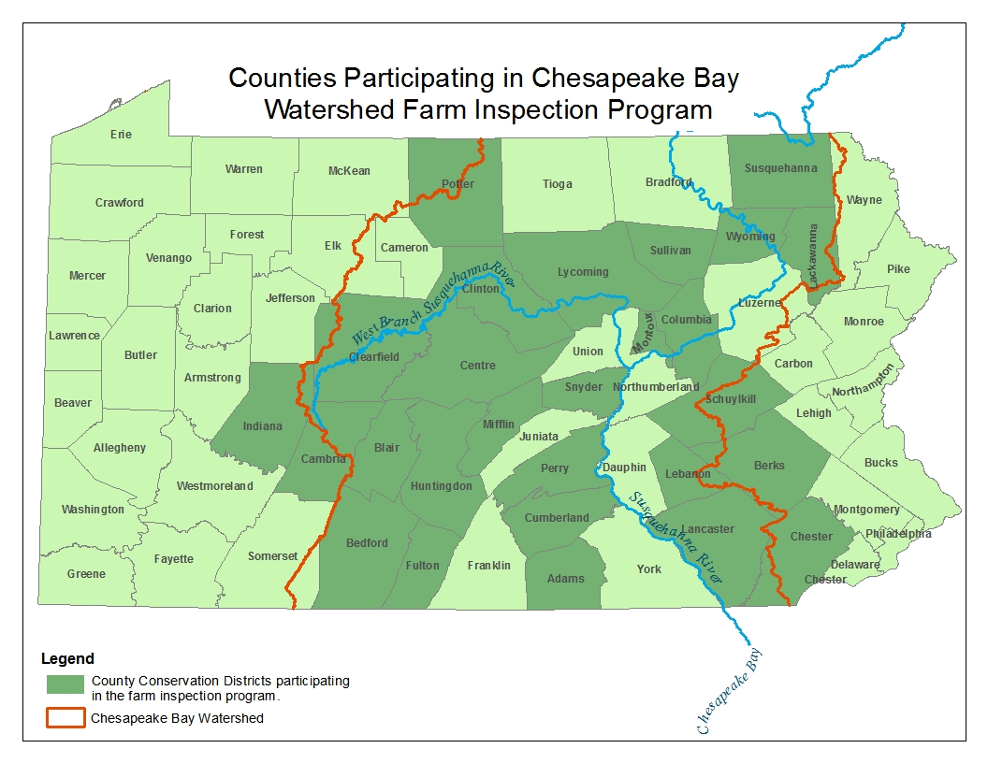
50
50
38
50
25
50
50
50
38
38
50
63
50
50
50
50
88
50
25
50
50
300
75
100
75
50
Notes:
This is the total amount of inspections that will be accomplished by each county conservation district annually.

Slide 10
Data Management Initiatives
Penn State Farmer Self-Reporting Survey Results (6700 surveys returned!)
475,800 acres of nutrient/manure management; 97,562 acres of enhanced nutrient management;
2,164 animal-waste storage units; 2,106 barnyard runoff-control systems;
55,073 acres of agricultural erosion and sedimentation control plans; 228,264 acres of conservation plans;
More than 1.3 million linear feet of stream-bank fencing; 1,757 acres of grass riparian buffers; and 5,808 acres of forested riparian buffers.
Total estimated reductions:
Nitrogen -- 1,047,704 lbs/year
Phosphorus -- 79,620 lbs/year
Sediment -- 10,395,906 lbs/year
NRCS Potomac Watershed Remote Sensing Project
Collected data on 26 conservation BMPs using a grid approach
Field verification “spot checks” were done by experienced NRCS staff using the standard USDA NRCS 5% quality assurance/quality control sample

Slide 11
Data Management Initiatives
Worldview Development
Used the existing database design that was created for five Pennsylvania county conservation districts and Virginia Department of Environmental Quality
Submitted 2016 Progress Data Using the new Database Software
PracticeKeeper Software Launch to ALL Districts in July, 2017
6 Modules – Nutrient Management, E & S Planning, Watershed Projects, Complaints and BMPs
DEP staff and 9 Districts pilot testing starting now
Hardware for PracticeKeeper
Funding Distributed for tablets for in-the-field data collection
Notes:
Districts doing the pilot testing include Clinton, Susquehanna, Cumberland, Adams, who do not have PracticeKeeper now and Lancaster, Allegheny, Chester, Berks and Juniata Counties who do have it.

Slide 12
Urban Stormwater Cost Share Program
Municipalities, MS4 Communities in Blair, Cumberland, Dauphin, Franklin, Lackawanna, Lancaster, Lebanon, Luzerne, Lycoming and York Counties
$200,000 maximum per grantee
Round #1 (Awarded July, 2016)
Over $2.2 million awarded to 19 projects
Round #2 (Announced June 29,2016)
Awarded $2.2 million for 17 projects:
Stream Restoration and Buffers, Retention Basin Retrofits and Bio-retention Basins, Rain Gardens, Permeable Pavement
Estimated reduction of 2,800 pounds of nitrogen, 396 pounds of phosphorus and 798,500 pounds of sediment

Slide 13
Agriculture BMP Special Projects
Support Implementation of the Restoration Strategy
BMP Implementation Projects in areas identified as part of the Agricultural Inspection Strategies
In impaired watersheds or priority watersheds identified by the County in their Implementation Plans
BMP verification and tracking, including the further documentation of voluntary practices
Awarded $2.9 million to conservation districts for 46 projects (2 years funding)
Streambank fencing and crossings, barnyard runoff controls and heavy use area protection, manure storage, rotational grazing, cover crops and no-till planting promotion
Estimated reduction of 84,000 pounds of nitrogen, 2400 pounds of phosphorus, and 3.5 million pounds of sediment
Extending completion date to September 30, 2019.

Slide 14
Funding
EPA Federal Funding (Approximately $40 million per year)
State Revolving Loan Fund (Wastewater Infrastructure and Nonpoint Source Projects)
Section 106 Water Pollution Control (Permitting, Monitoring and Assessment, Compliance and Enforcement)
Section 319 Nonpoint Source Program (Technical Assistance, Project Implementation)
Chesapeake Bay Regulatory and Accountability Grant and Chesapeake Bay Implementation Grant (Program Administration, Technical Assistance, Project Implementation)
State Funding (Approximately $75 million per year)
DEP (Match to Federal Money above, Growing Greener)
State Conservation Commission
Pennvest (Wastewater Infrastructure and Nonpoint Source Projects)
DCNR (Land Conservation, Riparian Buffers)
Projected to Need Another $80-$100+ million per year in Cost Share to Meet Target Reduction Goals

Slide 15
Unliquidated Obligations (ULO’s)– PA EPA Grants
RUMOR –Pennsylvania has large amounts of unspent money
In reality, every penny is accounted for
EPA tracks money only as it is spent
They don’t count monies allocated to:
Personnel (including salaries, benefits and indirects)
Contract and sub-award grant commitments
Conservation districts for ag inspections, technical assistance
Outreach and Education
BMP Installation
BMP Verification, Data Management, Verification
Notes:
Personnel: 12.5 FTEs in CBIG, 10 FTEs in CBRAP for Program Management, Ag Inspections, Assistance to Conservation Districts
Conservation District Staff: 33 Technicians for Inspections, + Partial funding for 39 more for Act 38 Program + 7 Engineers
BMP Installation is the Special Project money described earlier. These are two year projects. This money is tied up, but takes two years to be spent.

Slide 16
Phase 3 Watershed Implementation Plan (WIP)
Stakeholder Input and Outreach
Steering Committee/Workgroups
Website: www.dep.pa.gov/chesapeakebay/phase3
Communications Strategy:
Builds on One-Day Kick-Off Conference, Listening Sessions, Public Comment
Planning Targets & Implementation
Sector Specific
Local Area Goals
Priority Areas/Watersheds
Measurable Outputs, Milestones
Emphasis on Local Water Quality, Local Goals, Local Benefits
Notes:
Steering Committee is comprised of Secretaries of DEP, DCNR and PDA, Directors of SRBC and ICPRB, the Chesapeake Bay Commission, Pennvest and the co-chairs of the workgroups. There are six workgroups: Agriculture, Stormwater, Wastewater, Forestry, Local Planning Goals and Priority Practices, and Funding.

Slide 17
Agriculture Workgroup
Co-chairs:
Matt Royer, Penn State and Lead, PA in the Balance Initiative
Greg Hostetter, Deputy Secretary, Pennsylvania Department of Agriculture
Doug Goodlander, Program Manager, Department of Environmental Protection
John Bell, Government Relations, Pennsylvania Farm Bureau
Members:
Karl Brown, SCC
Bill Chain, CBF
Andrew Flinchbaugh, Producer
David Graybill, Producer
James Harbach, Producer
Jeff Hill, Lancaster Conservation District
James Junkin, Producer
Jennifer Reed-Harry, PennAg
Jennifer Schuler, Bell and Evans
Chris Sigmund, TeamAg
James Van Blarcom, Producer
Coordinator: Jill Whitcomb
Notes:
Of most interest to the group today is the Agriculture Workgroup. Good mix of producers across all types of production including crop and animal production, including all types of animals
Included industry associations and private consultants
Environmental group
Government representation
One role the CAC can play is to provide input through Jill the Coordinator
Comment on draft work products as this group develops them.

Slide 18
Phase 3 WIP Schedule
April, May, 2017 – Form Steering Committee and Workgroups
June 5, 2017 – Phase 3 WIP Kick-Off Conference, Radisson Harrisburg
June 3 – July 7, 2017 – Follow-up Written Comment Response to Conference
July 2017 through October 2017
Bay Program Partnership Works Through Issues
Workgroups Formed, Convened
Comments Compiled, Additional Information and Data Compiled
October 2017 through May 2018
Workgroups and Steering Committee develop the WIP
Additional Outreach Around Development of Local Planning Goals/Sector Specific Plans
August/September 2018 – Public Comment Period of Draft Phase 3 WIP
December 2018 – Submit to EPA for Partnership Review
January 2019 – Revise in Response to Partnership Review
March 2019 – Submit Final Phase 3 WIP

Slide 19
Local Planning Goals
Jurisdictional Boundaries (County, Township, Borough, Conservation District)
Federal or State Facilities
Regional Entity Boundaries (River Basin Commission, Planning Commission)
Watershed or sub-watershed
“Segment-shed” as defined in the TMDL
Area with a defined need for pollutant reduction (ex. MS4s)
Targeted area with high pollutant loadings
Notes:
One of the main Baywide Expectations is for the states to define local planning goals. A Task Force defined them as any of the above.
We are now in the process of creating a decision matrix to select these areas that is objective based on a set of criteria now being developed by our Local Planning Goal Workgroup. The final set could be any combination of this list.

Slide 20
EPA Pennsylvania Expectations
Programmatic, policy, legislative and regulatory changes needed
Demonstration of the staff, partnerships and financial resources needed
A dedicated and targeted annual state cost-share program
Next steps as we move forward:
Evaluate the expectations and define how the Commonwealth can meet these expectations or
Define a viable alternative to their expectations that achieves the same end result.
EPA Actions
Continue to target federal compliance and enforcement actions
Direct or withhold federal funding
Establish finer scale load allocations through a Pennsylvania-specific amendment to the TMDL
Require additional reductions from point sources
Promulgate nitrogen and phosphorus numeric water quality standards for Pennsylvania streams and rivers

Slide 21
PA in the Balance
Themes around A Culture of Stewardship
Four Priority Initiatives
Conservation Training
Soil and Stream Health
Ag Certification
Priority Watersheds
Integral Part of the Phase 3 WIP

Slide 22
Public Comment
240+ Attendees at Kick-Off Listening Session:
Academia – 17 (+4 Facilitators from University of Virginia)
Environmental Groups – 32
Federal and State Legislative Offices – 5
Individuals – 1
Industry Associations:
Agriculture – 7
Local Government, Redevelopment Authorities, Water Planning -- 9
Conservation Districts – 17
Government:
Local – 37
County – 11
State -- 43
Federal -- 14
Law Firms, Private Consultants, Engineering and Private Industry -- 41
Reporters, Media -- 4
Have Final Draft of Summary Report
Received Comments from 16 People through eComment and 40 through Facebook

Slide 23
Public Comment -- Future
Input on 33 Different Topics from the Kickoff Session Alone
Working Through All Comments Now with Workgroups
Incorporation into the Phase 3 WIP Sector Specific Sections
Incorporation into Local Planning Goals, Priority Areas or Practices
Common Themes that Should be Examined Further Across Multiple Workgroups or with the Steering Committee
Future Engagement, Local Focus – What Should That Look Like?
Additional Partners through Workgroup Members
Workshops, Focus Sessions
Industry Conference Presentations
Additional Written Comment Periods
Other
Notes:
The CAC can participate in any of these future events, the steering committee is open to the public
Nicki has made the commitment to meet separately with the Pennsylvania members on a regular basis, preferably before each CAC meeting, at least by conference call.

Slide 24
Other Resources
Chesapeake Bay Program Website
http://www.chesapeakebay.net
Chesapeake Bay Assessment Scenario Tool - CAST
http://www.casttool.org – County level scenario calculator
Chesapeake Bay Facility Assessment Scenario Tool - BayFAST
http://www.bayfast.org – Facility level scenario calculator
Phase 6 Model Data Visualization Tool – New Beta 4 Run
https://mpa.chesapeakebay.net/Phase6DataVisualization.html

Slide 25
Contact Information:
Katie Hetherington Cunfer
khethering@pa.gov
Veronica Kasi
vbkasi@pa.gov
717-772-4053
DEP Chesapeake Bay Program Website:
http://www.dep.pa.gov/ChesapeakeBay
Phase 3 WIP Website:
www.dep.pa.gov/chesapeakebay/phase3

