Slide 1
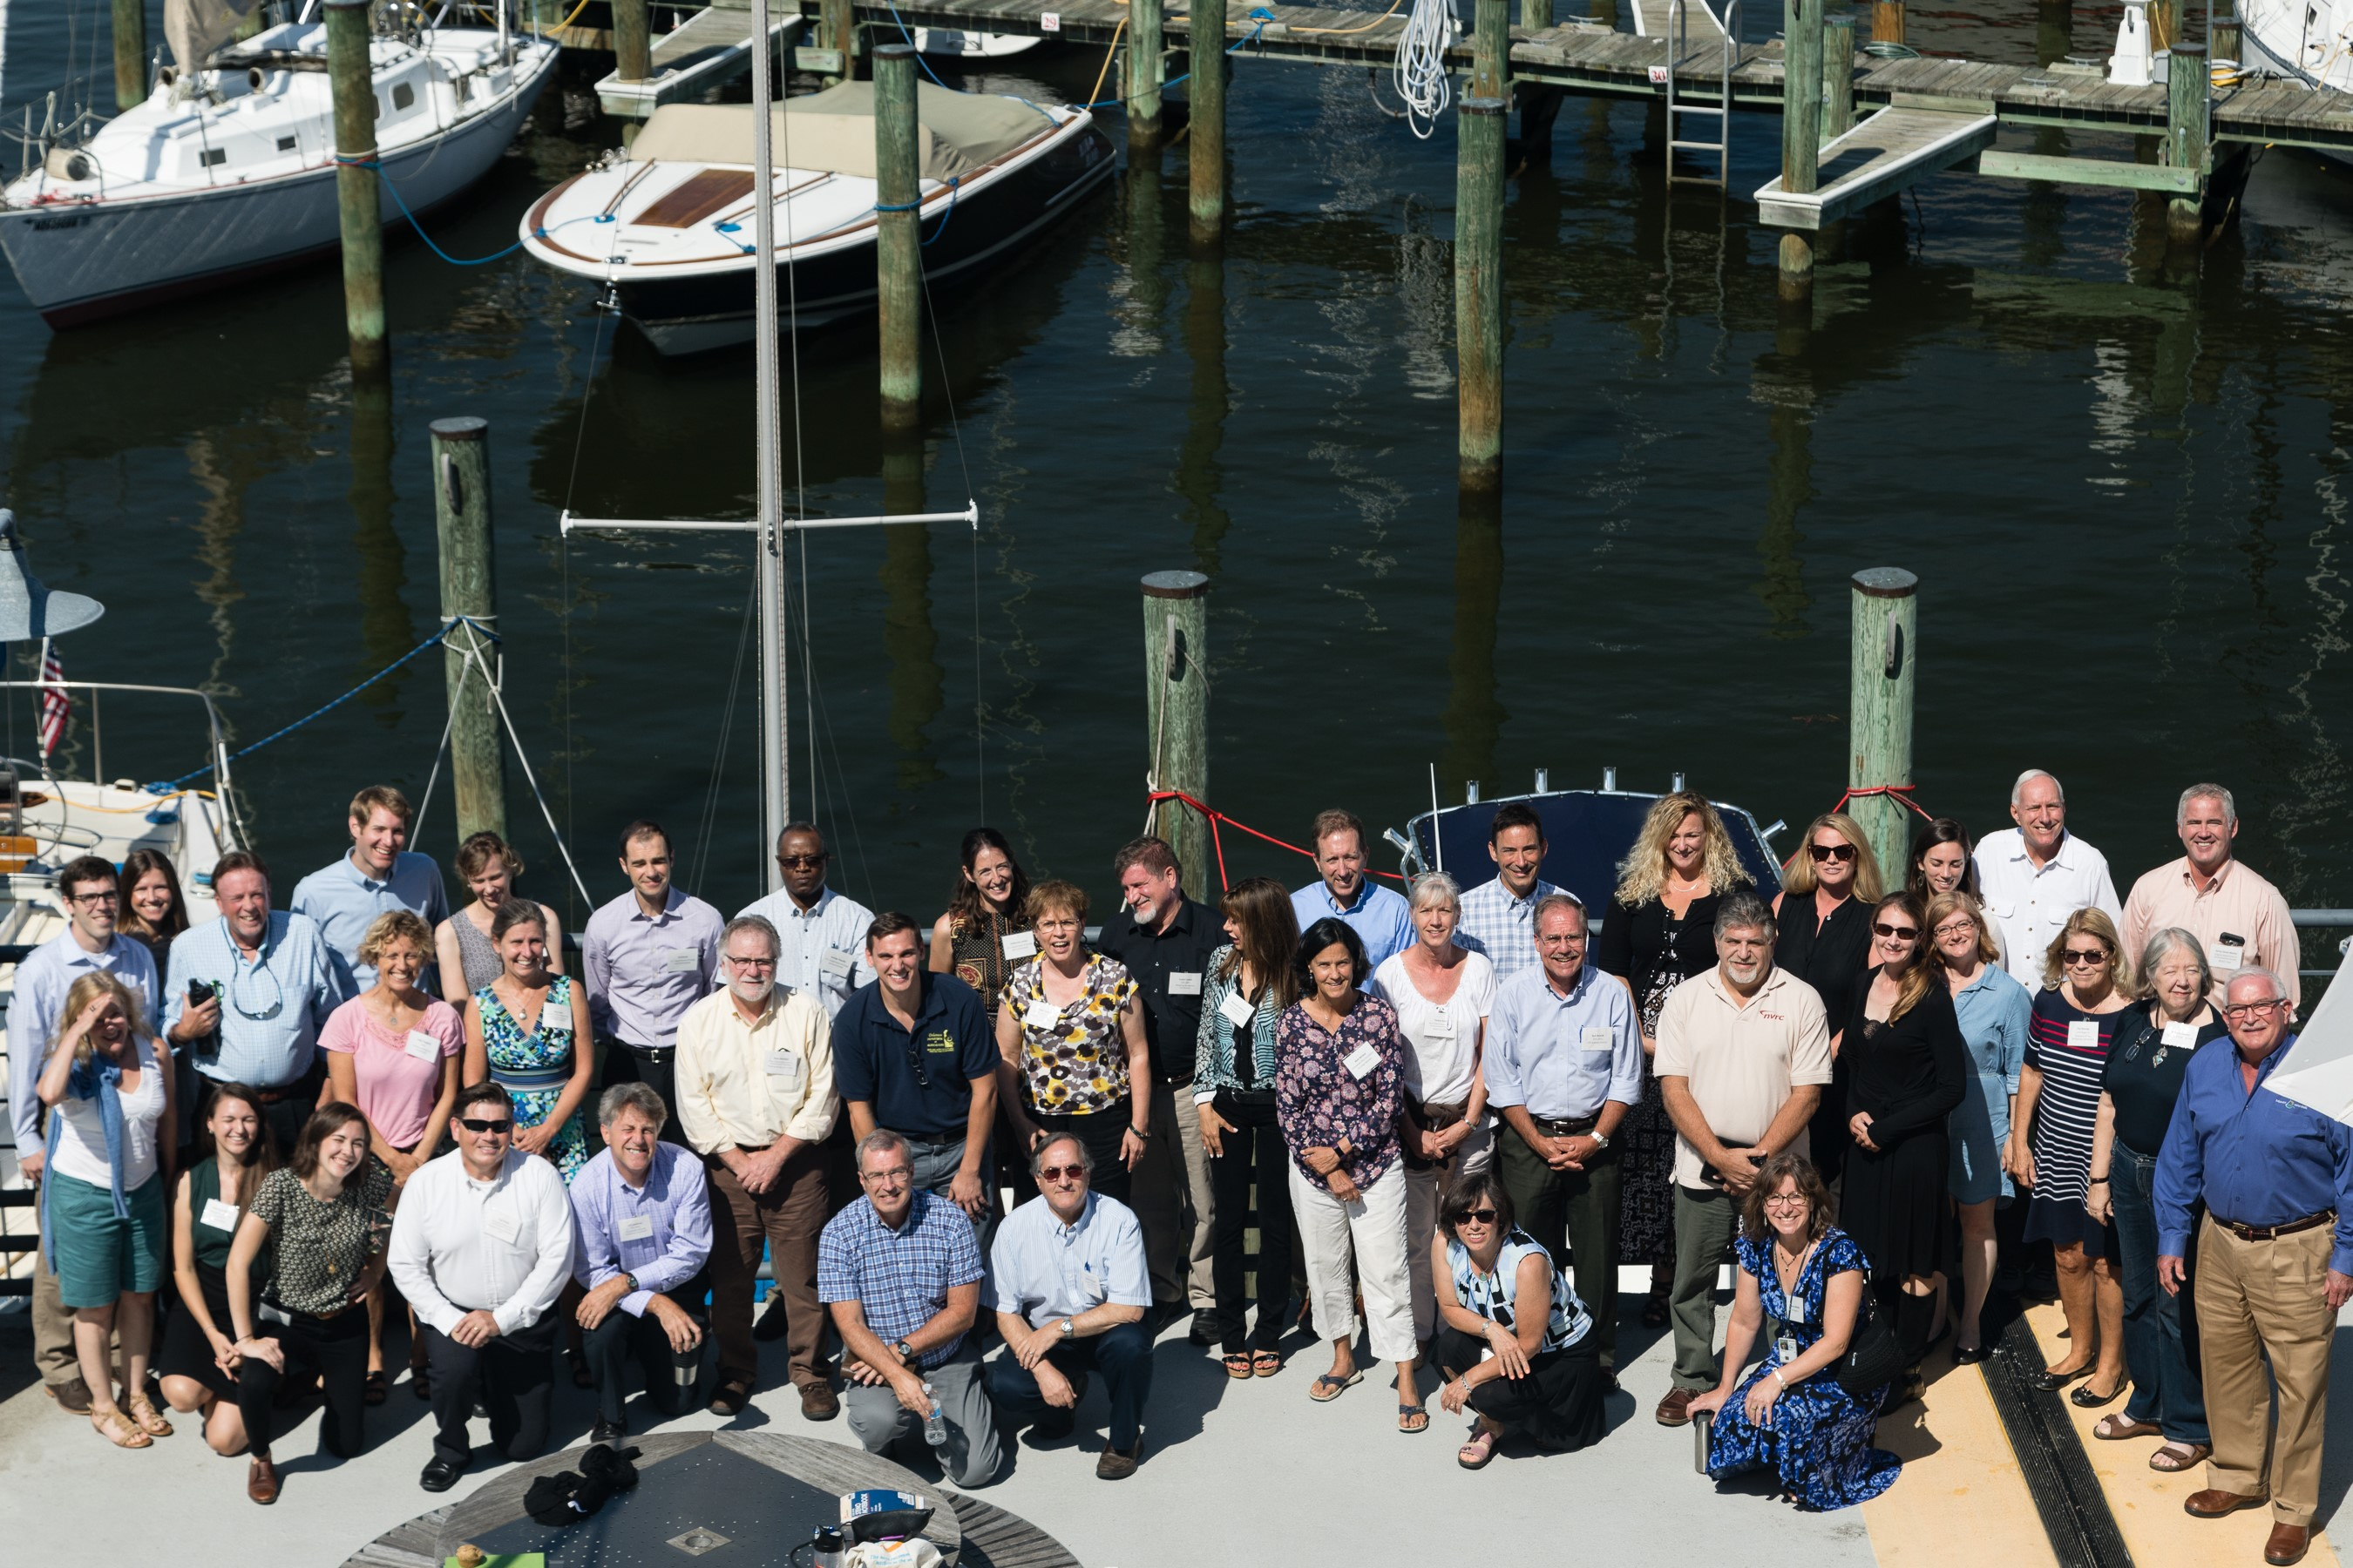
2017 Midpoint Assessment: Year of Decision
November 30, 2017 Citizens Advisory Committee Meeting

Slide 2
Today’s Objectives
Highlight of key midpoint assessment policy decisions to be considered by the PSC during their December 19-20, 2017 retreat
Solicit CAC feedback on local relevance of these decisions

Slide 3
Midpoint Assessment Policy Decisions
Adoption of Partnership’s Phase 6 models for management application
Approval of the proposed Bay assimilative capacity and adjustments to Maryland’s water quality standards regulations’ restoration variances
Approval of draft Phase III Planning Targets as the starting point for the 4-month review process
Approval of proposed process for the four-month review of the draft Phase III WIP planning targets

Slide 4
Midpoint Assessment Policy Decisions
Approval of using 2025 for accounting for growth in the Phase III WIPs
Approval of the approach to account for the additional loads delivered to the Bay due to the Conowingo infill
Approval of how to factor climate change into the Phase III WIPs

Slide 5
Improved Partnership Models
5 years of Partnership decision-making
STAC sponsored technical workshops from soil phosphorus to Conowingo
Independent scientific peer reviews of every Partnership model
Comprehensive fatal flaw review and issue resolution

Slide 6
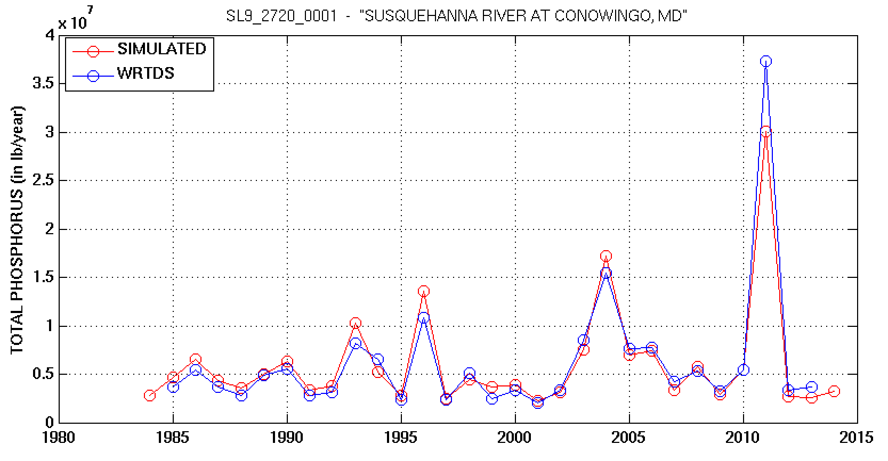
Best Match with Monitoring Data Ever!

Slide 7
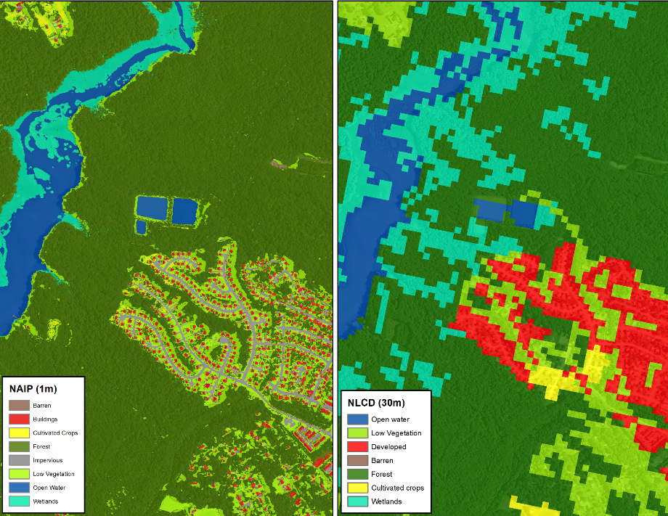
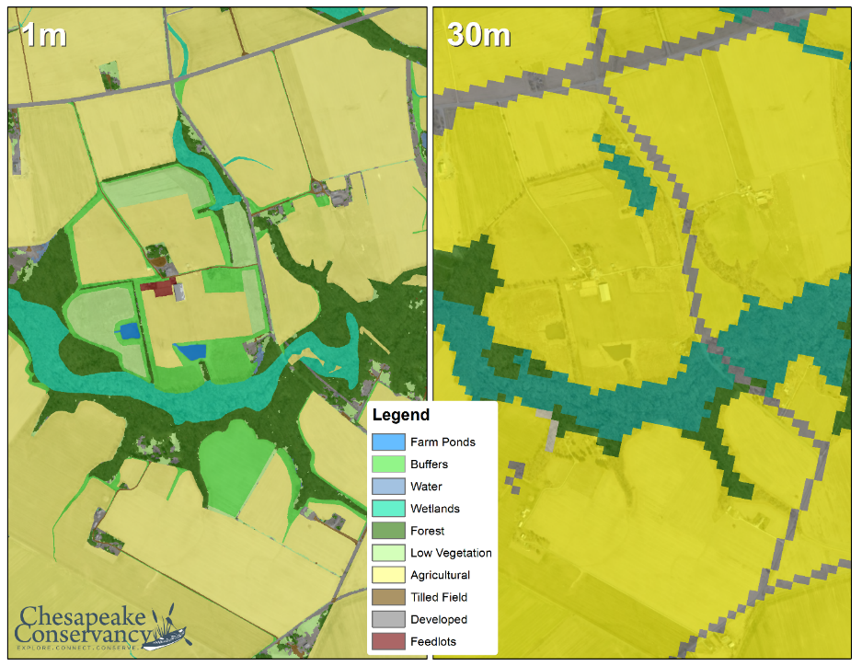
Phase 5
30-Meter Resolution Land Use/Cover Data
Phase 6
1-Meter Resolution Land Use/Cover Data

Slide 8
Hundreds More BMPs

Slide 9
Local Agricultural and Municipality Data
Municipal Separate Storm Sewer Systems
Combined Sewer Systems
Sewer Service Areas
Land Cover (produced from 1m NAIP imagery)
Land Use (derived from land cover + local data)
Parcels
Roads (NAVTEQ)
Beaches (NAVTEQ)
Institutional lands (NAVTEQ)
Federal lands
Golf courses (NAVTEQ)
Surface mines (USGS-NWALT)
Landfills (digitized from aerial imagery + elevation)
Protected lands
Streams (derived from topography)
Wetlands (including National Wetlands Inventory)
Tidal zones (derived from elevation)
Floodplains (FEMA)
Frequently flooded soils (USDA-SSURGO)
Cropland+Pasture (National Cropland Data Layers)
Livestock populations (USDA Agriculture Census)
Poultry populations (Annual USDA-NASS data supplemented with USDA Ag Census)
Crop, hay and pasture acreages (USDA Ag Census)
Crop yields (annual USDA-NASS data)
Soil P concentrations (state data)
BMPs (USDA NRCS + state data)

Slide 10
Establishing the Phase III Planning Targets:
Three Partnership Principals
Allocated loads must result in achievement of the states’ Bay water quality standards
Major river basins that contribute the most to Bay water quality problems must do the most to resolve those problems
All tracked and reported reductions in loads are credited toward achieving assigned loads

Slide 11
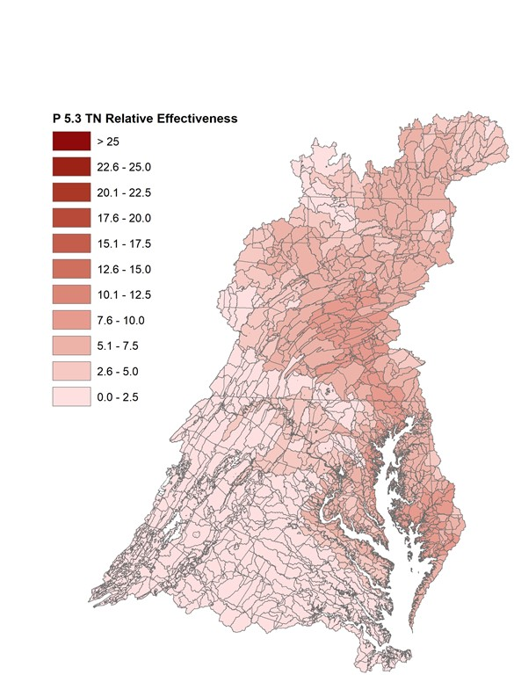
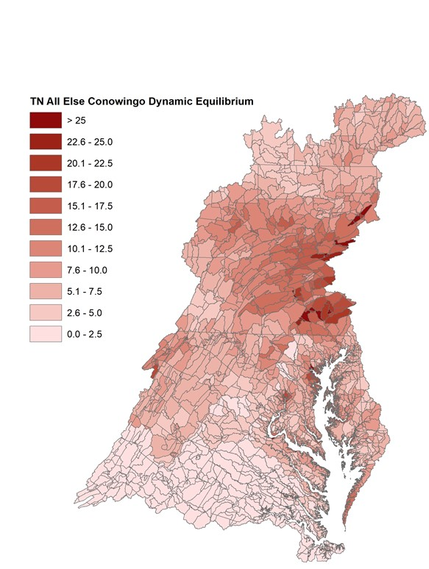
More Impact, Do More
Nitrogen
Phase 5
Phase 6

Slide 12
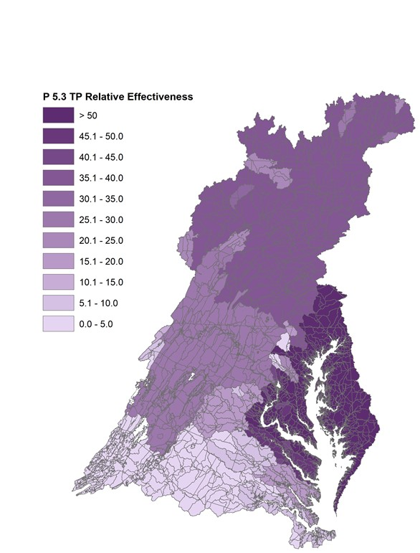
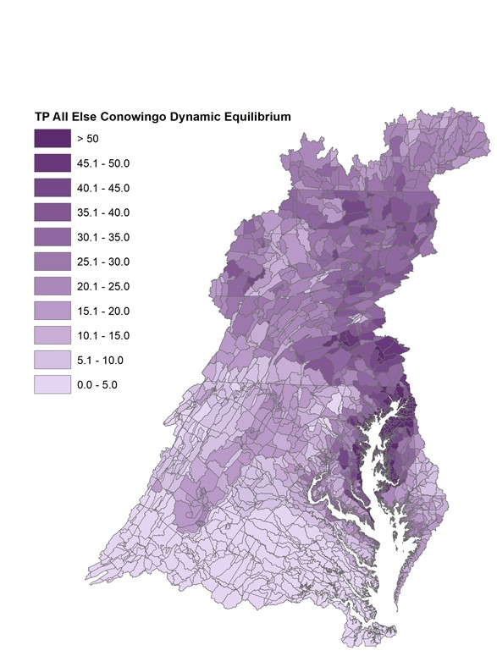
More Impact, Do More
Phosphorus
Phase 5
Phase 6

Slide 13
Determining the Bay’s Ability to Absorb Pollutants
(Note: Graphic reflects Phase 5 suite of modeling tools used to establish the 2010 Bay TMDL allocations)
Basin-wide load is
190 N and 12.7 P (MPY)
Notes:
13

Slide 14
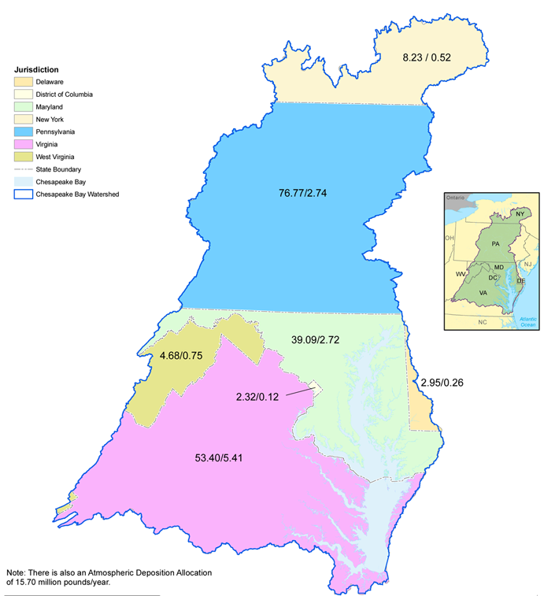
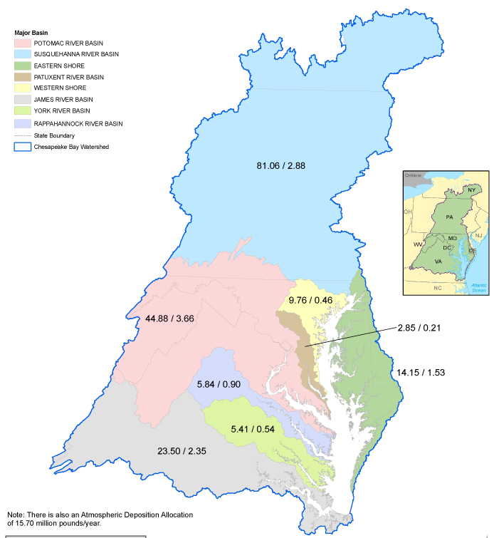
Planning Targets by Jurisdiction and Major River Basin

Slide 15
PSC Approved Schedule
December 19-20, 2017: PSC 2-day retreat and decision making
December 22, 2017: Release of draft Phase III WIP planning targets
December 22, 2017 – April 20, 2018: Partnership’s review of the draft Phase III WIP planning targets
Late April/Early May 2018: PSC approval of the final Phase III WIP planning targets with any agreed-to special cases
May 7, 2018: Release of the final Phase III WIP planning targets

Slide 16
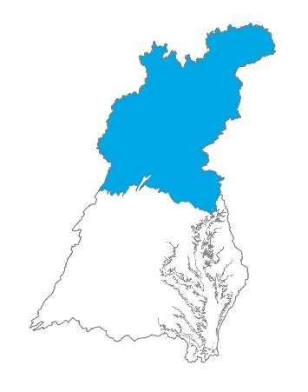
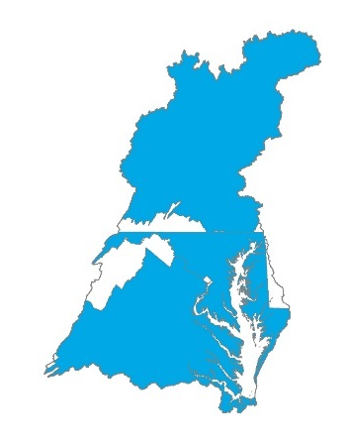
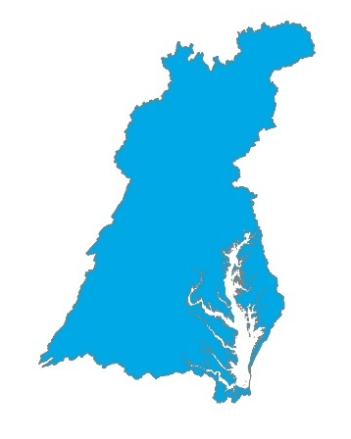
How to Offset the Additional Loads Due to Conowingo Dam Infill
How much?
Who?
How?
Allocation equity rules used in the Bay TMDL
Assign additional load as local planning goal
Post-2025 with agreed-upon date
Beyond 2025 – no future date identified
When?
By 2025

Slide 17

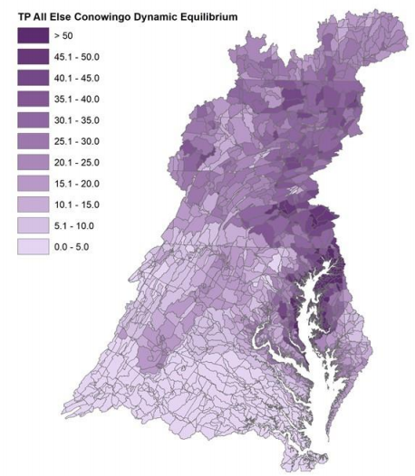
Conowingo Dam Infill
October 3, 2017 PSC Decisions
PSC agreed to add the “Susquehanna + most effective basins” option for final PSC decision.

Slide 18
Conowingo Dam Infill
October 3, 2017 PSC Decisions
PSC agreed to draft a letter on expectations for the role in Exelon in addressing increased loads associated with Conowingo infill, as part of the Clean Water Act 401 certification.
  The letter will likely be addressed to Exelon.
PSC will review a draft of the letter at one of their upcoming meetings.

Slide 19
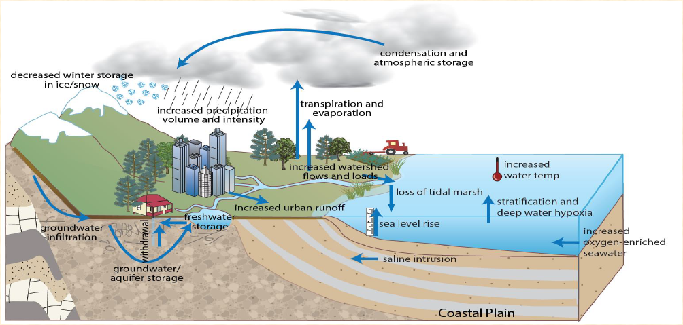
Climate Influence on the Bay Watershed

Slide 20
Relative Sea Level Rise
(2025 Projection: .17 meter/.6 feet)
Extreme (2.5m)
High Emission Scenario with
Max Contribution from Ice Sheets;
Low Probability, High Consequences
High (2.0m)
Intermediate High (1.5m)
Moderate to High Emissions
Intermediate (1.0m)
Intermediate Low (0.5m)
Low Emissions; Requires
Major Carbon Cuts and Removal
Low (0.3m)
The six Global Mean Sea Level (GMSL) scenarios in Sweet et al., 2017, identified by the height in meters in 2100 relative to MSL in 2000, span the range of scientifically plausible sea level rise scenarios. The shaded regions represent a central 80% probability range for each scenario. These curves have been adjusted to depict MSL relative to 1992.
The five scenarios described in Hall et al., 2016 correspond to GMSL of 2.0m, 1.5m, 1.0m, 0.5m, and 0.2m relative to MSL in 1992, and are indicated by thick black lines.
Graphic by E.T. Petruncio
Relative Sea Level Rise Scenarios for Annapolis
from Hall et al. (2016) and Sweet et al. (2017)
with Annapolis Monthly Mean Sea Level Data for 1930-2016
Notes:
MSL in 2000 = MSL in 1992 + .092957 ft (based on averages of monthly data)

Slide 21
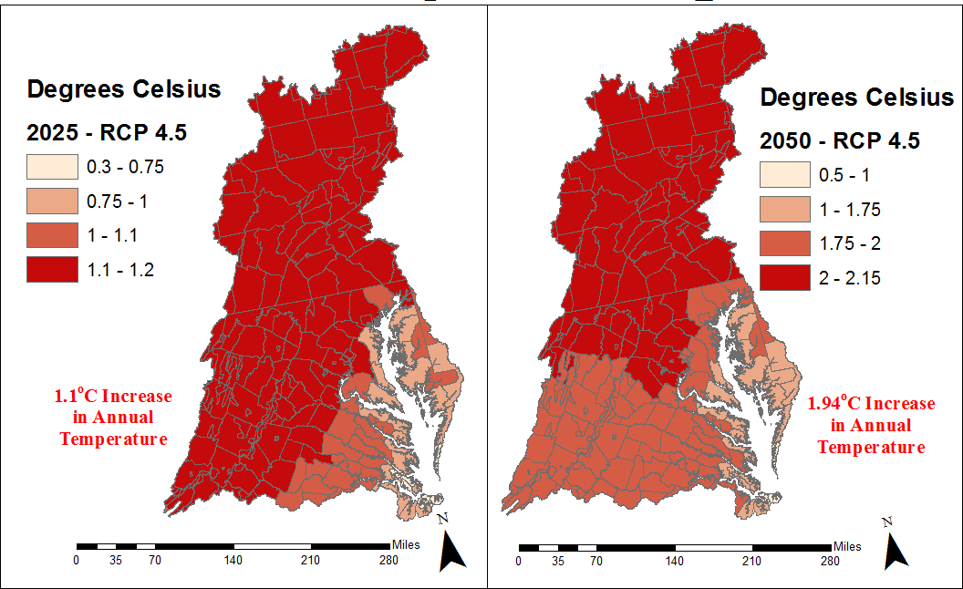
Temperature Change
2025/2050
Chesapeake Bay Watershed: Annual Change in Temperature (2025/2050)
Notes:
Note that the change is in degrees Celsius, it’s kind of a lot

Slide 22
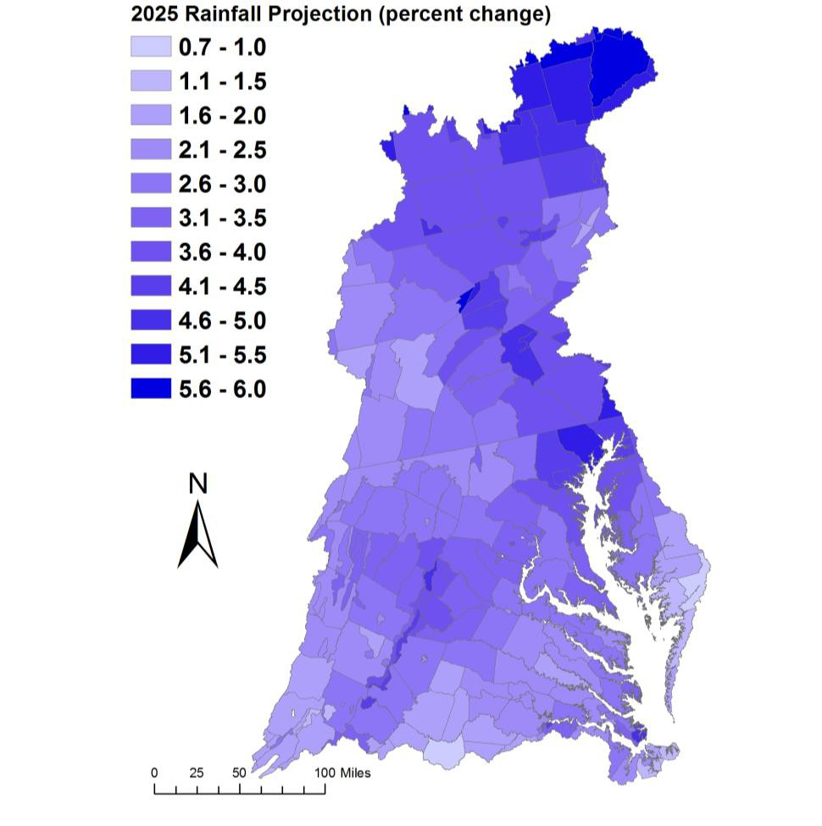
Precipitation Change
2025 Projection: Trends in 88-years of annual PRISM^{[1]} data
2050 Projection:
Change in Rainfall Volume 2021-2030 vs. 1991-2000
Major Basins | PRISM Trend
Youghiogheny River | 2.1%
Patuxent River Basin | 3.3%
Western Shore | 4.1%
Rappahannock River Basin | 3.2%
York River Basin | 2.6%
Eastern Shore | 2.5%
James River Basin | 2.2%
Potomac River Basin | 2.8%
Susquehanna River Basin | 3.7%
Chesapeake Bay Watershed | 3.1%
Kyle Hinson
[1] Parameter-elevation Relationships on Independent Slopes Model
11

Slide 23
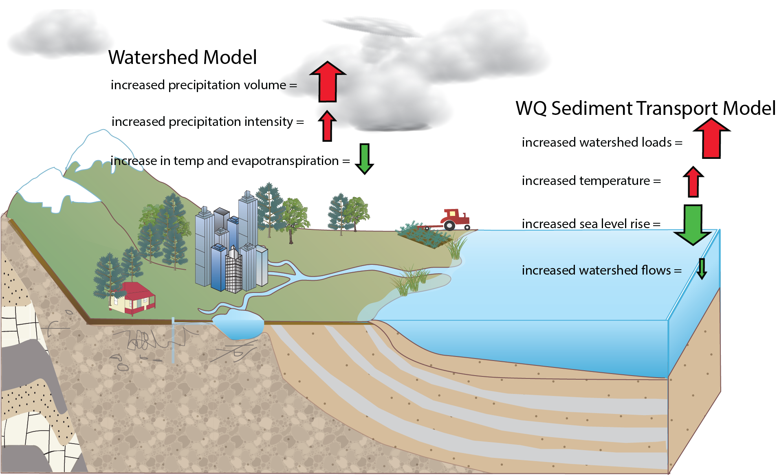
Accounting for Changing Conditions
Cumulative Hypoxic Impact

Slide 24
Estimated Changes in Watershed and Bay Loads by 2025 Due to Climate Change
Pollutant of Concern | Change in Delivery to Rivers | Change in Delivery to Bay
Nitrogen | +1.72% | +.34%
Phosphorus | +1.08% | +.04%
Sediment | +9.07% | +4%

Slide 25
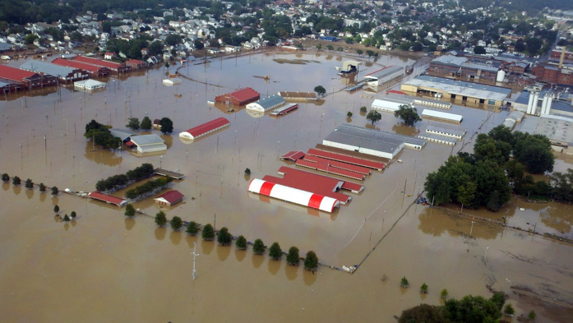
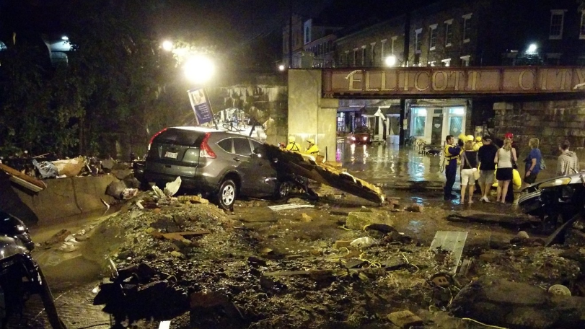
Climate Change
Recap of Policy Decisions
The Partnership will decide how to address climate change considerations in the Phase III WIPs:
  Numerically – accounting for additional loads due to climate change impacts projected through 2025 in the Phase III WIPs
  AND/OR
  Programmatically – adaptively manage climate change considerations through the implementation of BMPs (with climate resilient characteristics) and other commitments through the Phase III WIPs and 2-year milestones

Slide 26

Accounting for Growth
Recap of Policy Decision: Should 2025 Future Projections be Used to Account for Growth in the Phase III WIPs?
2025 growth projection
Load reductions necessary to meet the 2025 Phase III WIP Planning Target (lock box)

Slide 27

2010 population = 17.4 million
2025 population = 19.4 million (11.5% increase)

Slide 28
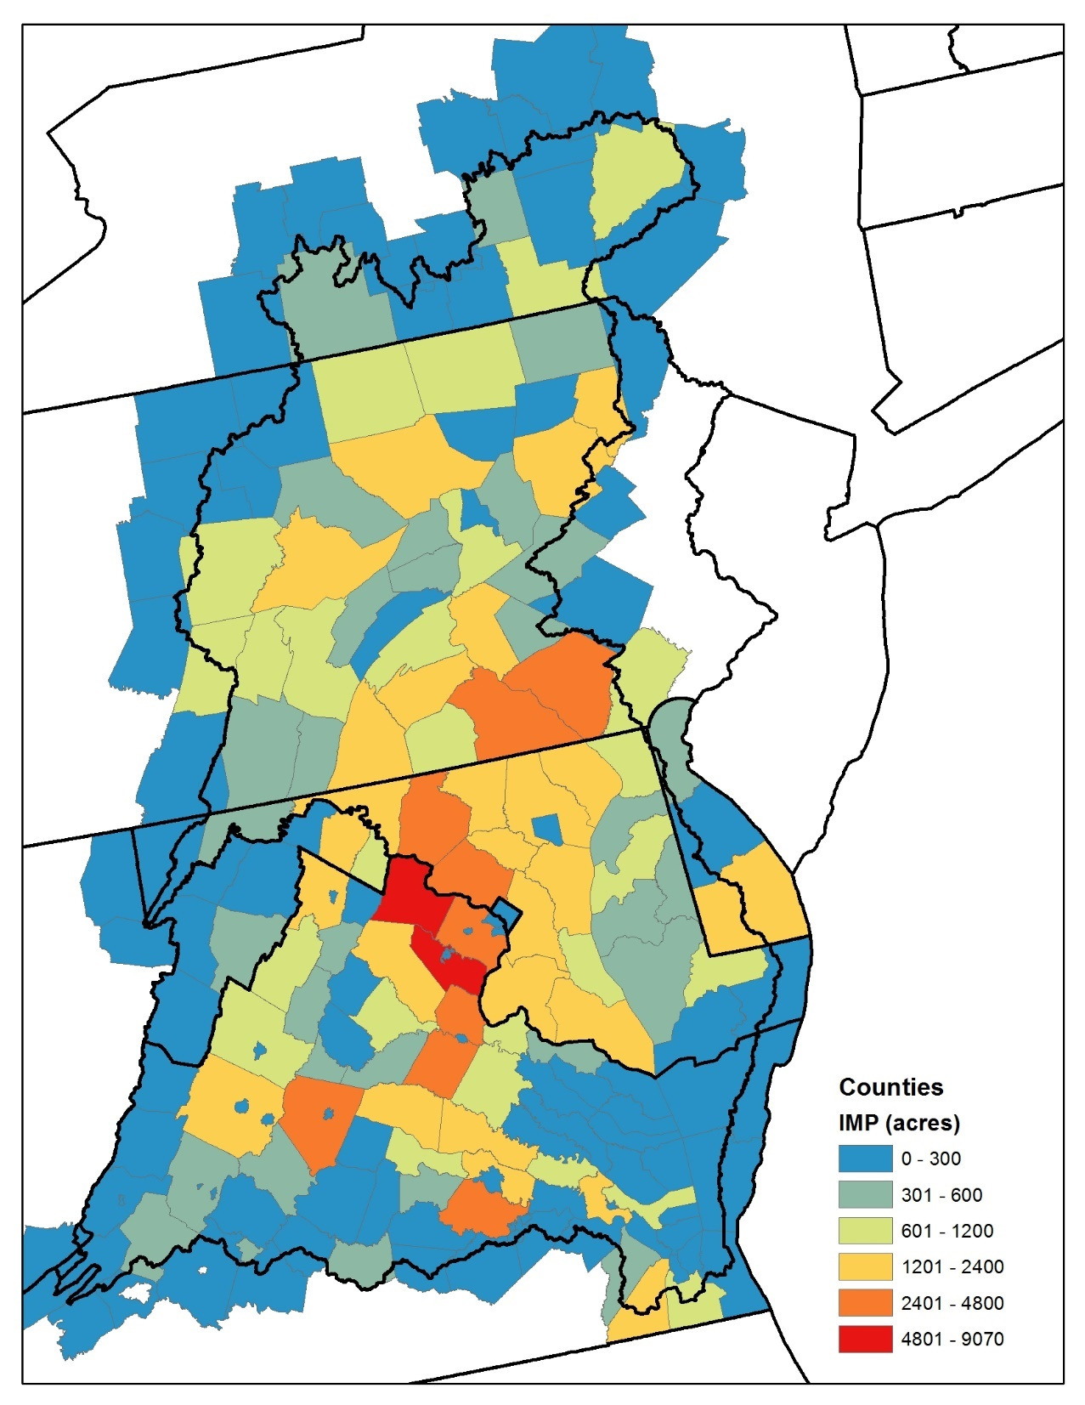
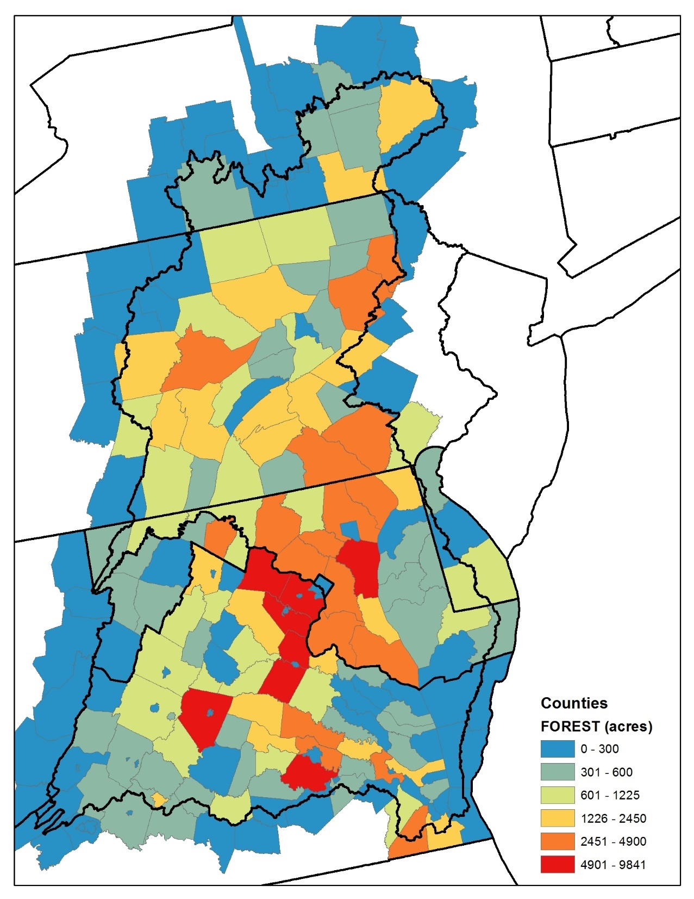
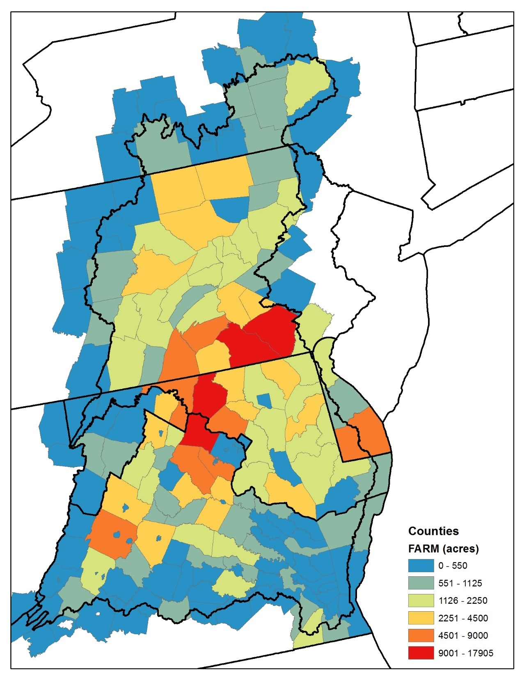
Estimated Growth in Loads under the
Current Zoning Scenario
Forecasted growth in impervious surfaces
Forecasted conversion of forests
Forecasted conversion of farms

Slide 29
Accounting for Growth
WQGIT Recommendations to the PSC
Use 2025 growth projections as base conditions for the Phase III WIPs.
  This approach explicitly accounts for growth in the Phase III WIPs.
  2025 growth will be forecasted using zoning information from local governments.
Update the growth projections every 2 years with the best available data to inform the development of the two-year milestones.
  Allows for adaptive management to changing growth patterns and trends as we approach 2025.
  Allows state and local jurisdictions to report new data based on updated policies, ordinances, etc. that will change growth patterns.

Slide 30
TBD: Summary of “All the Numbers”:
Nitrogen, Phosphorus, and Sediment
Jurisdiction | 1985 Baseline | 2016 Progress | Phase III WIP Target | Accounting for Growth | Conowingo Dam Infill | Climate Change | 2016 Progress + | Needed Reductions
NY
PA
MD
WV
DC
DE
VA
Basinwide

Slide 31
Revised Midpoint Assessment Schedule
December 4-5, 2017
  Modeling Workgroup and WQGIT recommendations on (1) how to address Conowingo; (2) climate change in the Phase III WIPs; (3) Phase 6 suite of modeling tools; and (4) draft Phase III WIP planning targets.
December 19-20, 2017
  PSC meeting to make final decisions on how to address Conowingo Dam and climate change in the Phase III WIPs; approval of the Phase 6 suite of modeling tools; and release of the draft Phase III WIP planning targets for 4-month Partnership review.
December 22, 2017 – April 20, 2018
  Partnership review of the draft Phase III WIP planning targets.
May 7, 2018
  Release of the final Phase III WIP planning targets.
February 8, 2019
  Draft Phase III WIPs posted on jurisdictions’ websites for partner and public stakeholder review.
June 7, 2019
  Final Phase III WIPs posted on jurisdictions’ websites

