Slide 1


Slide 2
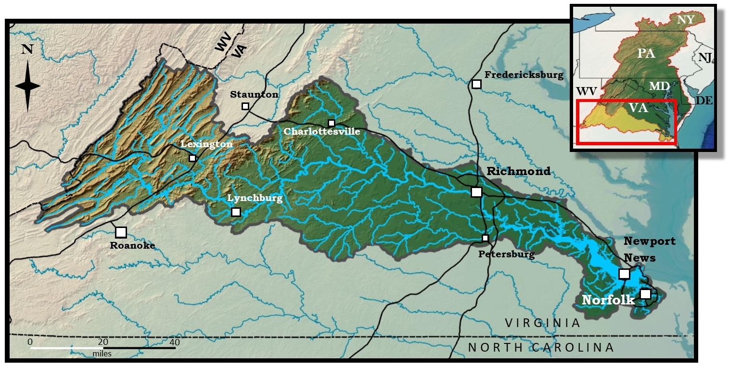
340 miles long
15,000 miles of tributaries
10,000 square miles of watershed
39 counties, 19 cities

Slide 3
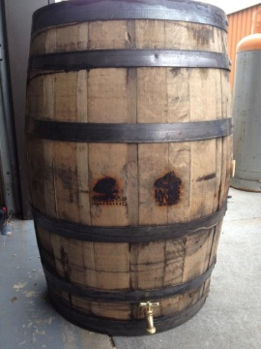
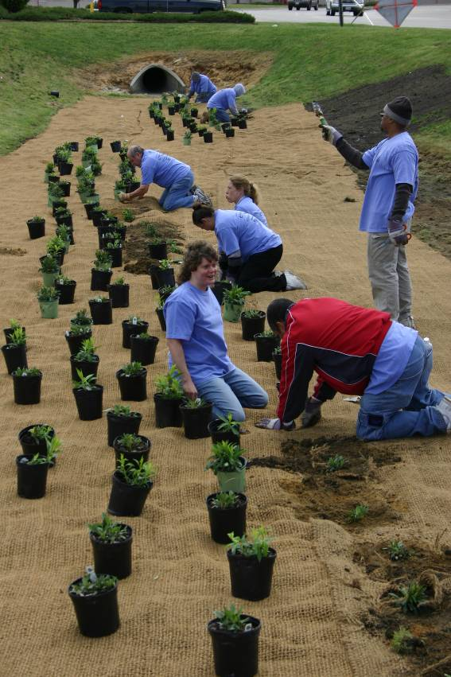
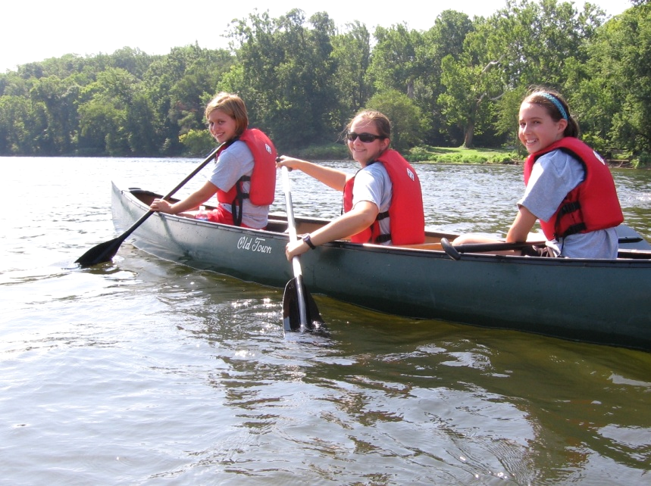
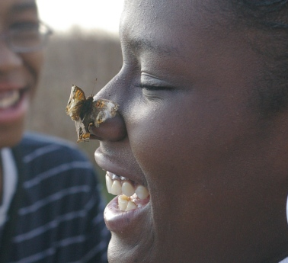
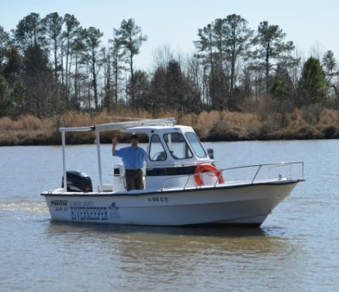
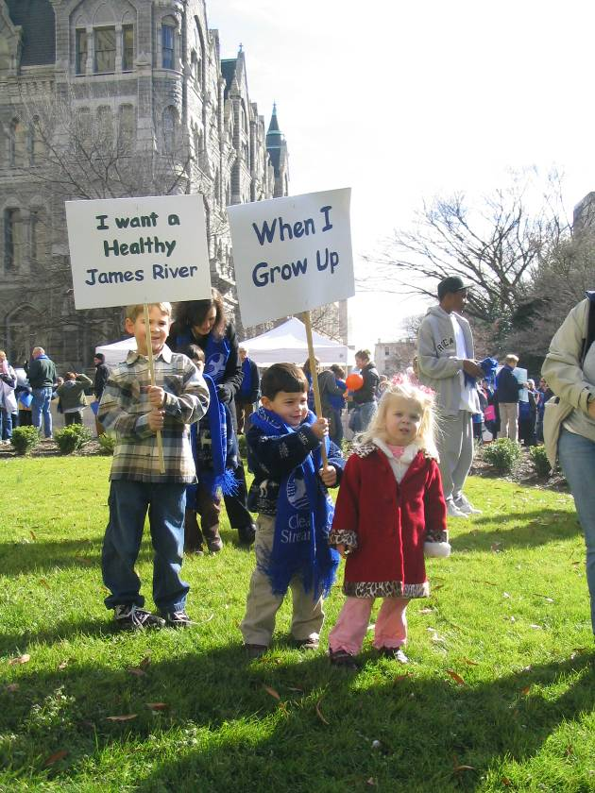
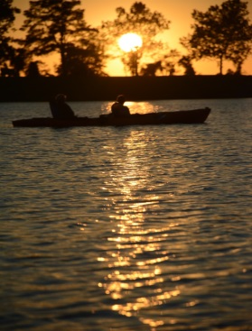

About the James River Association
501(c)(3) whose mission is to be guardian of the James River
We provide a voice for the river and take action to promote conservation and responsible stewardship of its natural resources
Core Programs: Watershed Restoration; Education; Community Conservation; River Advocacy/Riverkeeper

Slide 4
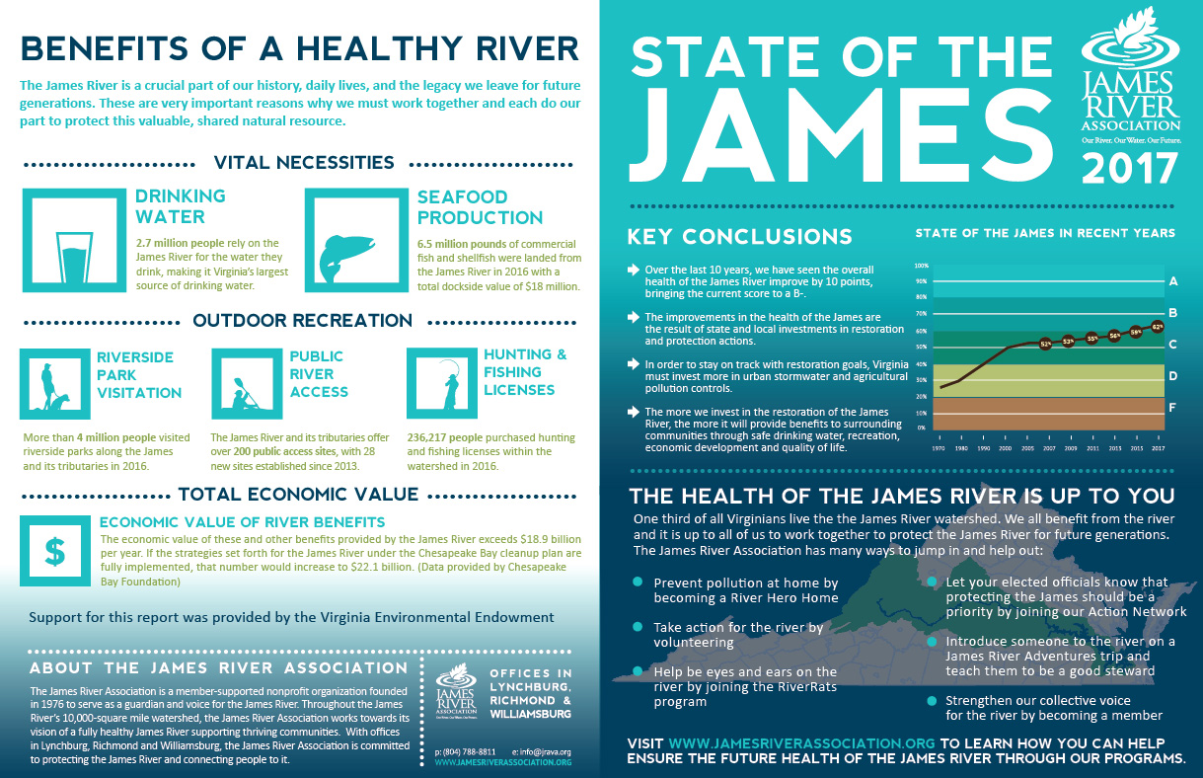
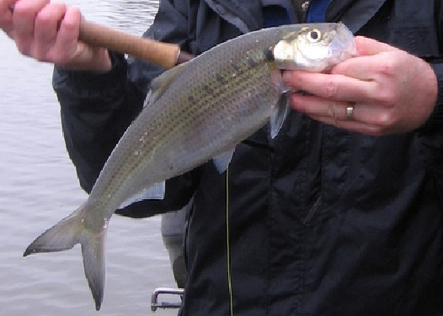
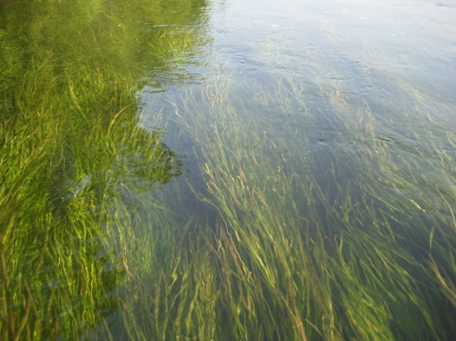
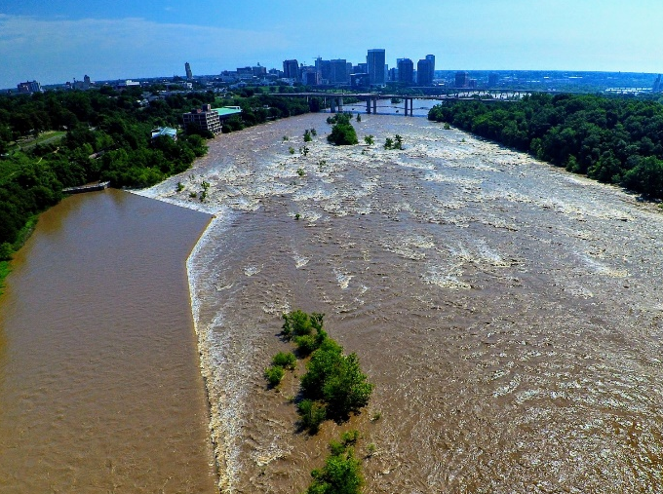
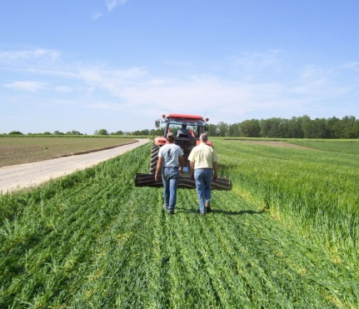
Fish and Wildlife
Habitat
Pollution Reductions
Protection & Restoration Actions
Report Card
Indicators & Benchmarks
Overall Score

Slide 5
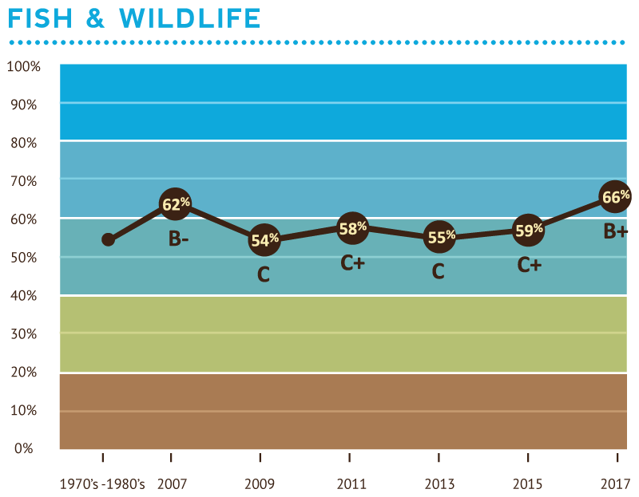
2017 Scores: 66%, B+
Bald Eagle 100%, +0
Striped Bass 59%, +0
Oysters 57%, +10
Smallmouth Bass 93%, +26
American Shad 11%, +7
Brook Trout 74%, +0

Slide 6
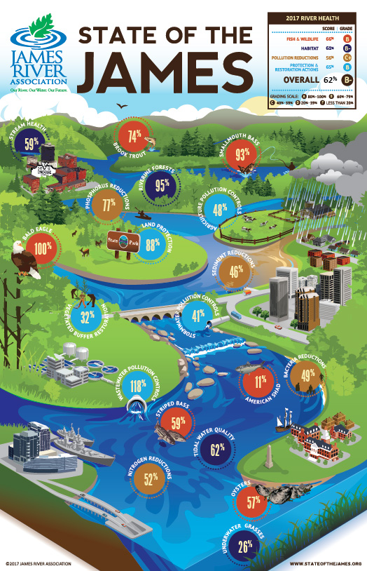
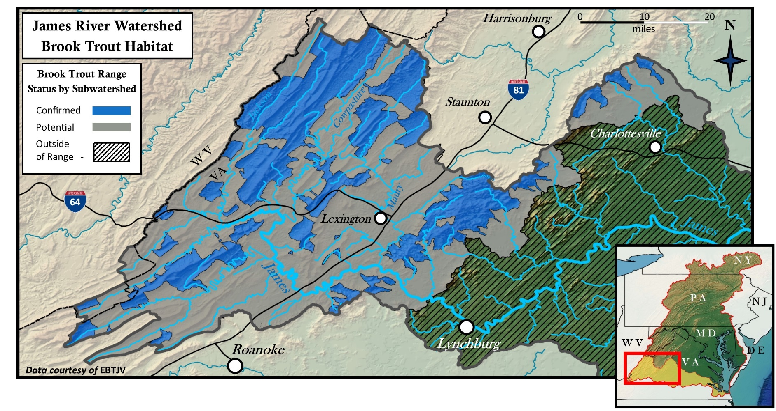
Fish and Wildlife
75%

Slide 7
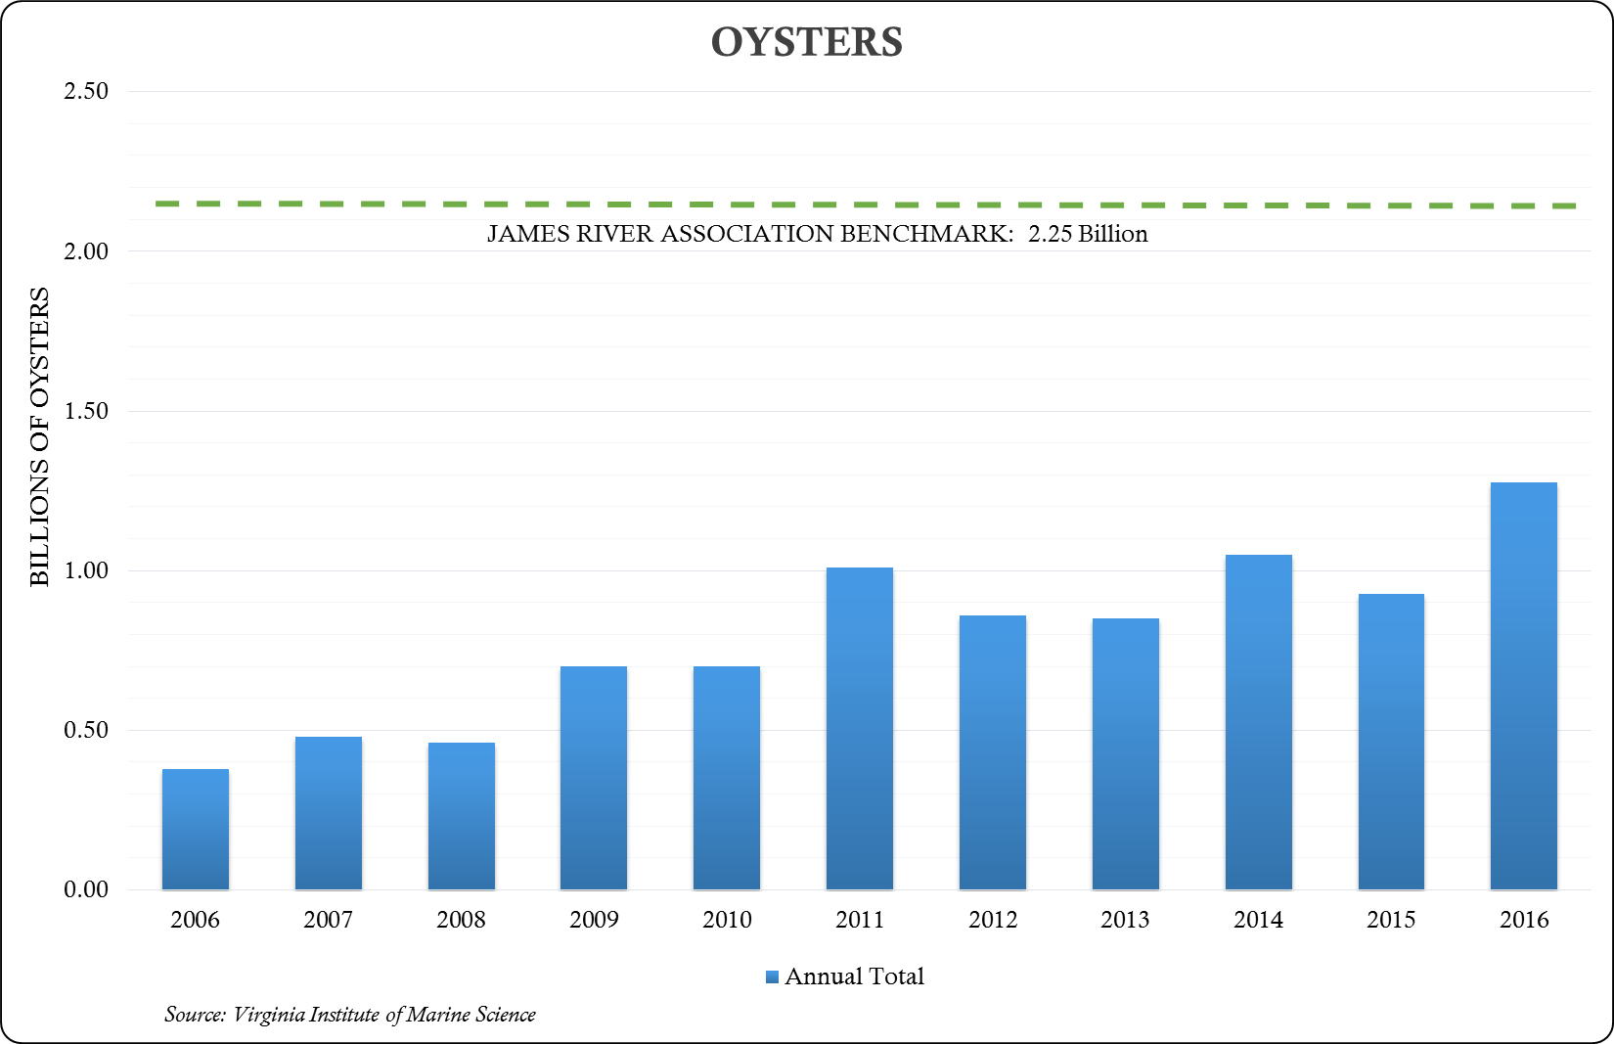
Fish and Wildlife
57%
+10

Slide 8
Fish and Wildlife
11%
+7

Slide 9
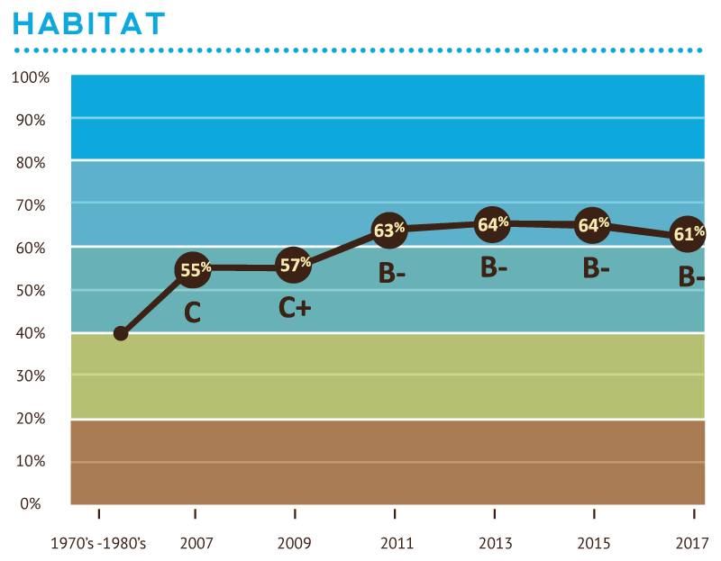
2017 Scores: 61%, B-
Underwater Grasses 26% -32
Riverine Forests 95% +1
Stream Health 59% +6
Tidal Water Quality 62% +11
HABITAT

Slide 10
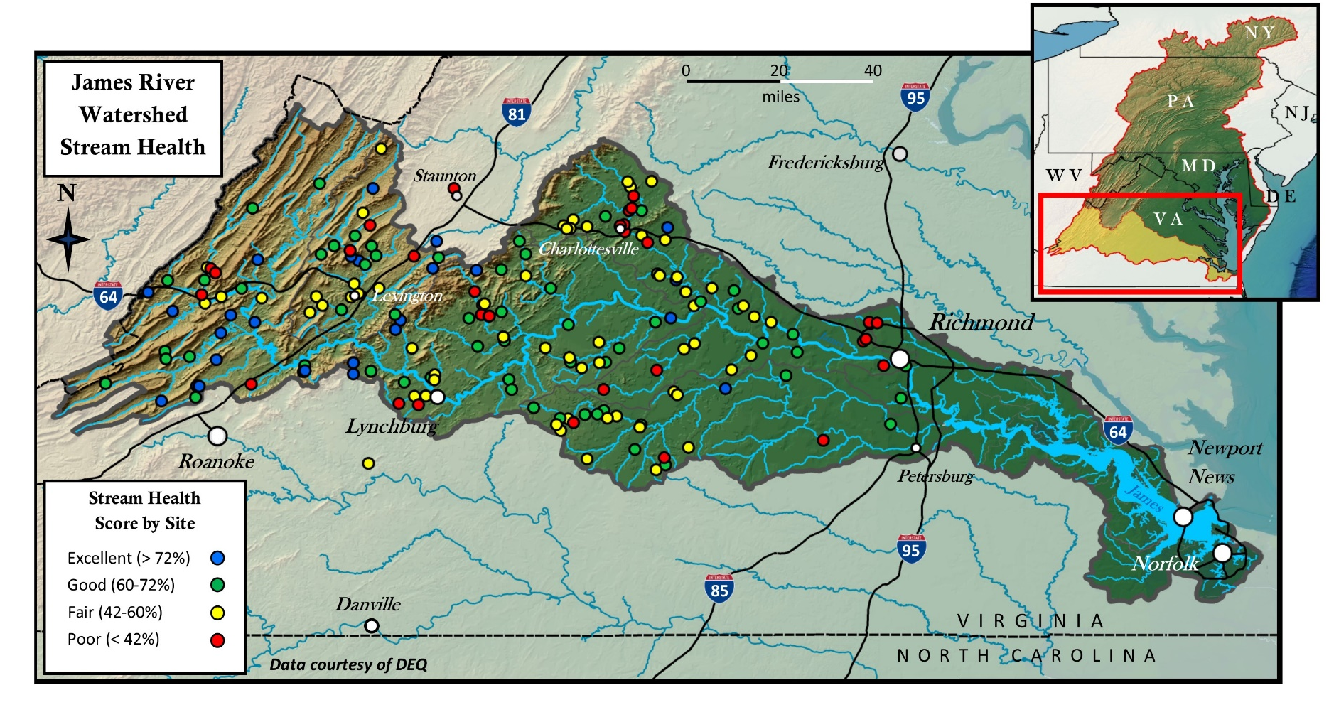
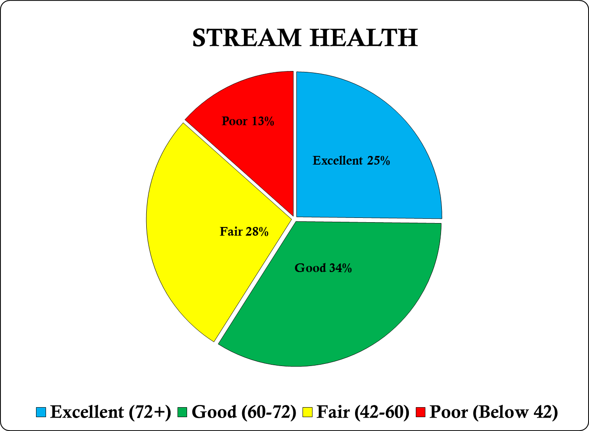
Habitat
STREAM HEALTH
59%
+6

Slide 11
Dissolved Oxygen 99%
Algae 69%
Overall Score 62%
Water Clarity 17%
62%
+11

Slide 12
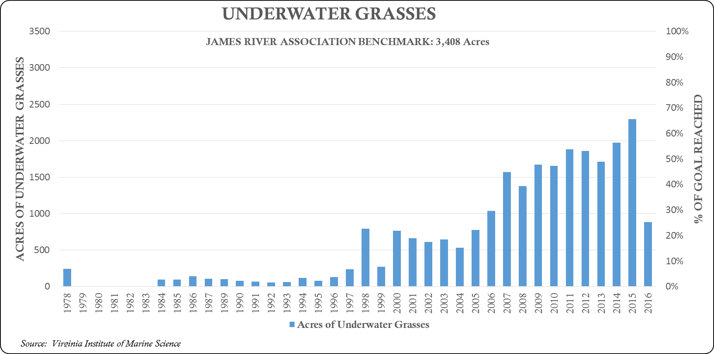
Habitat
26%
-32

Slide 13
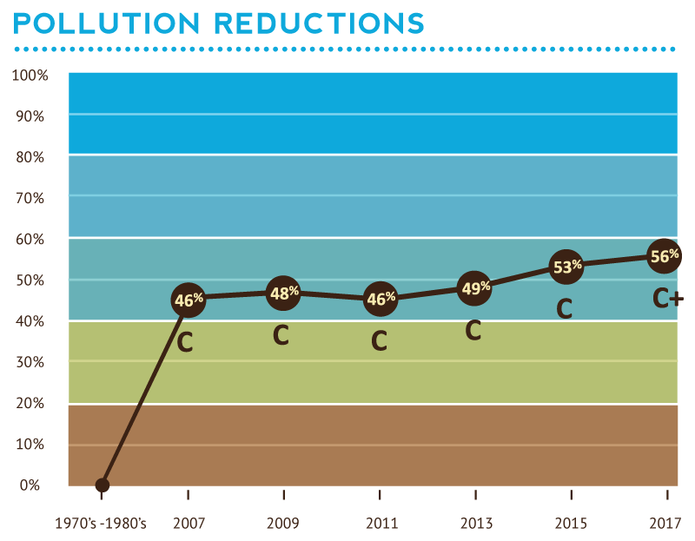
2017 Scores: 56%, C+
Nitrogen 52% +7
Phosphorus 77% +4
Sediment 46% +3
Bacteria 49% -2
POLLUTION REDUCTIONS

Slide 14
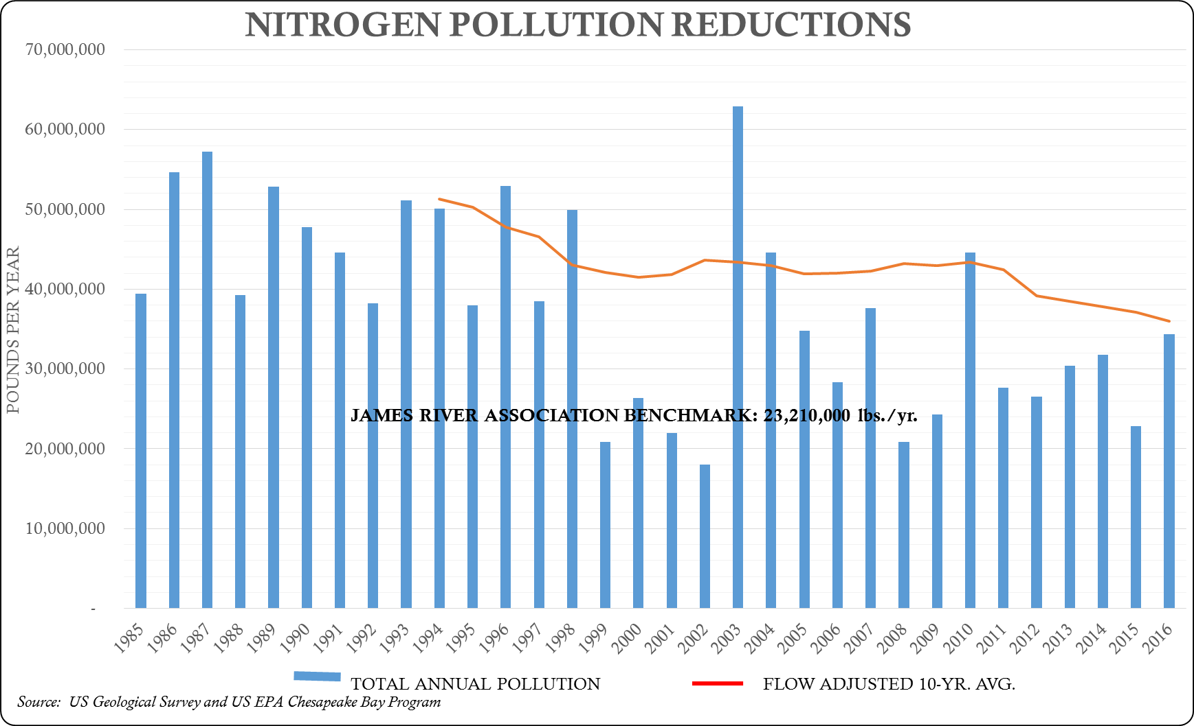
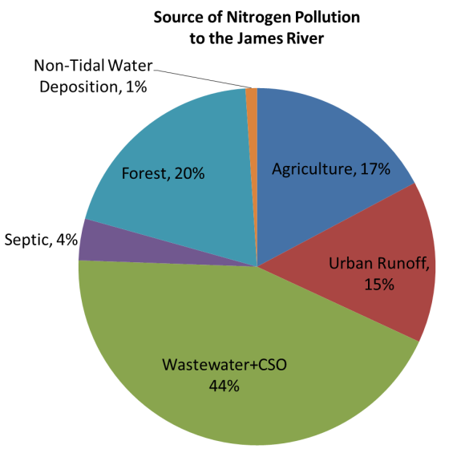
52%
+7

Slide 15
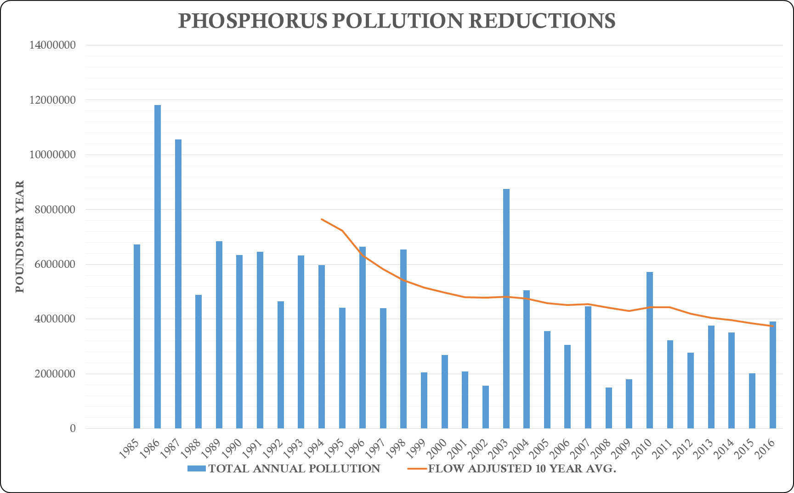
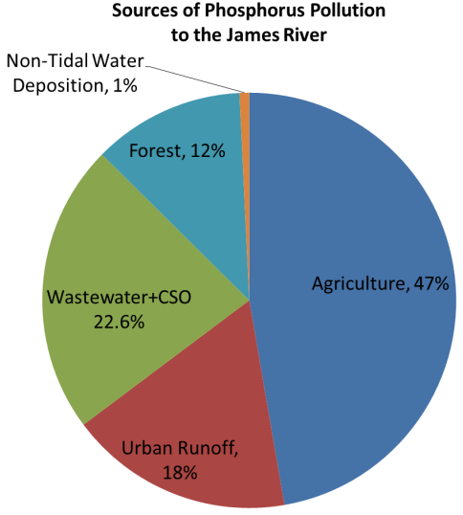
77%
+4

Slide 16
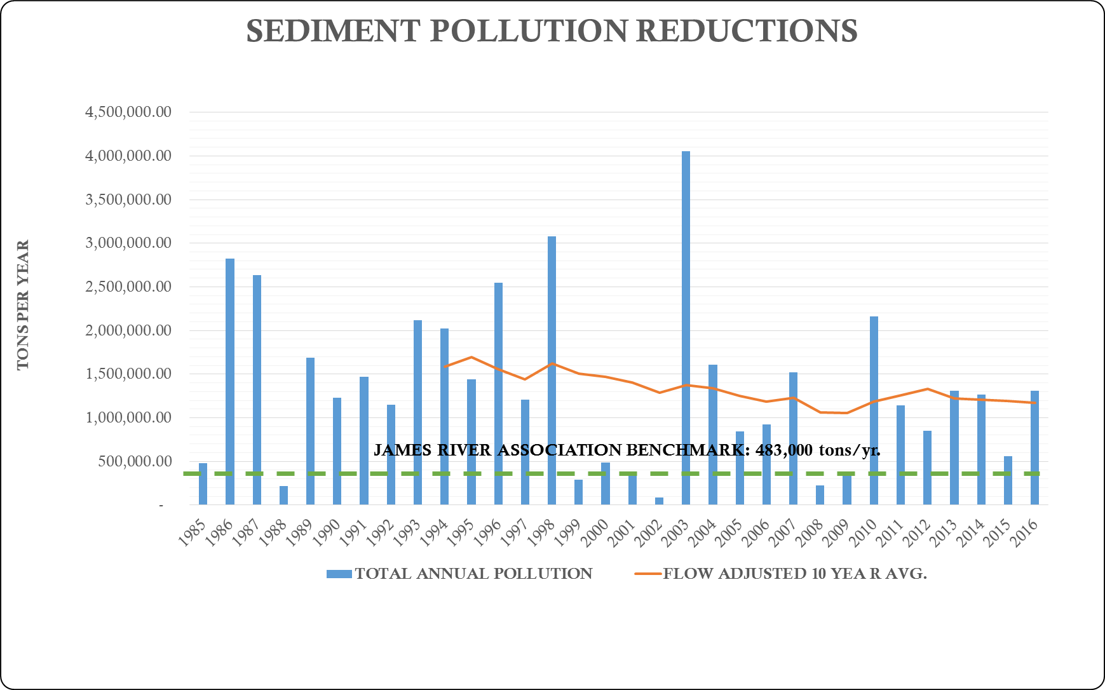
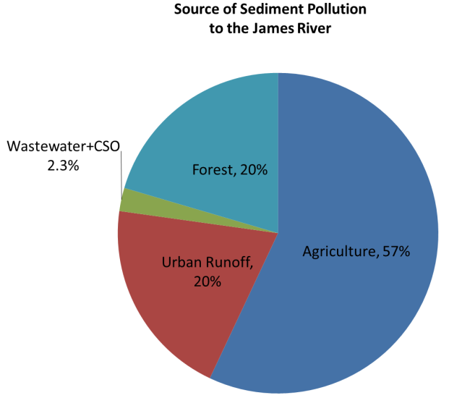
41%
+5

Slide 17
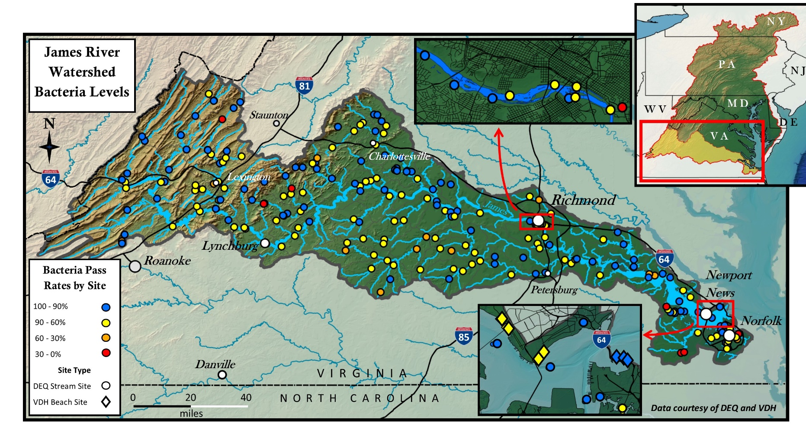
Pollution Reductions
BACTERIA
49%
-2

Slide 18
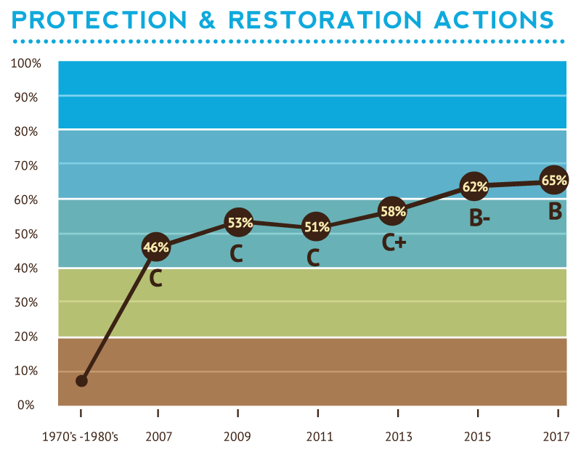
2017: 65%, B
Wastewater Pollution Reductions 118% +2
Agriculture Pollution Controls 48% +8
Stormwater Pollution Controls 41% +5
Vegetated Buffer Restoration 32% +2
Land Protection 88% +2
PROTECTION & RESTORATION ACTIONS

Slide 19
48%
+8
41%
+5
118%
+2

Slide 20
Virginia Water Quality Funding By Sector: 2002-2017, $1.35 Billion

Slide 21
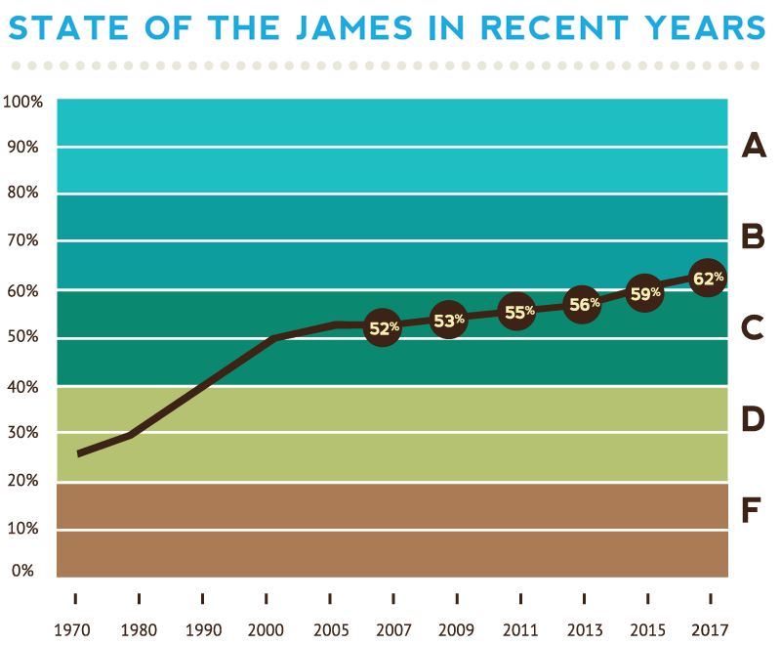
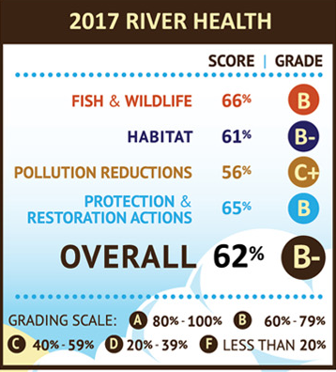

Slide 23
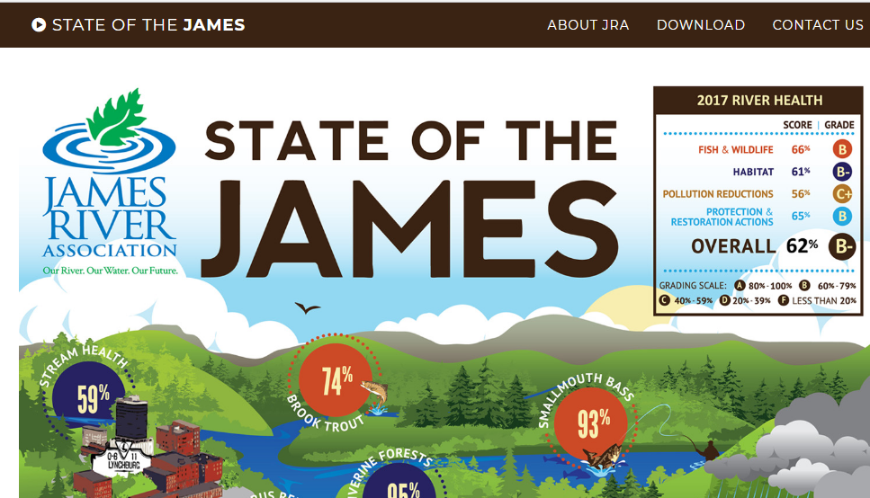
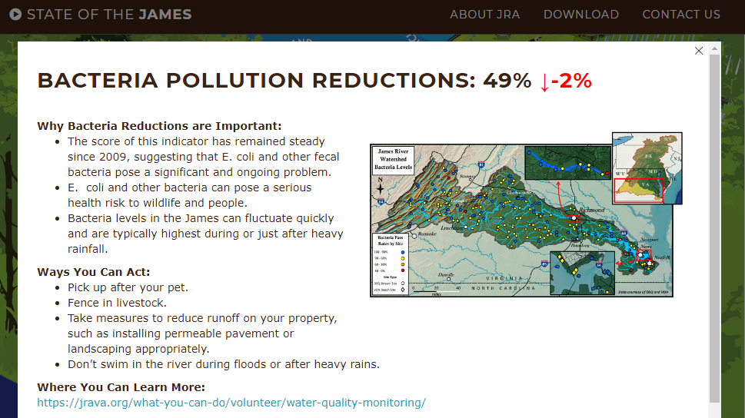
www.stateofthejames.org

Slide 24
