Slide 1
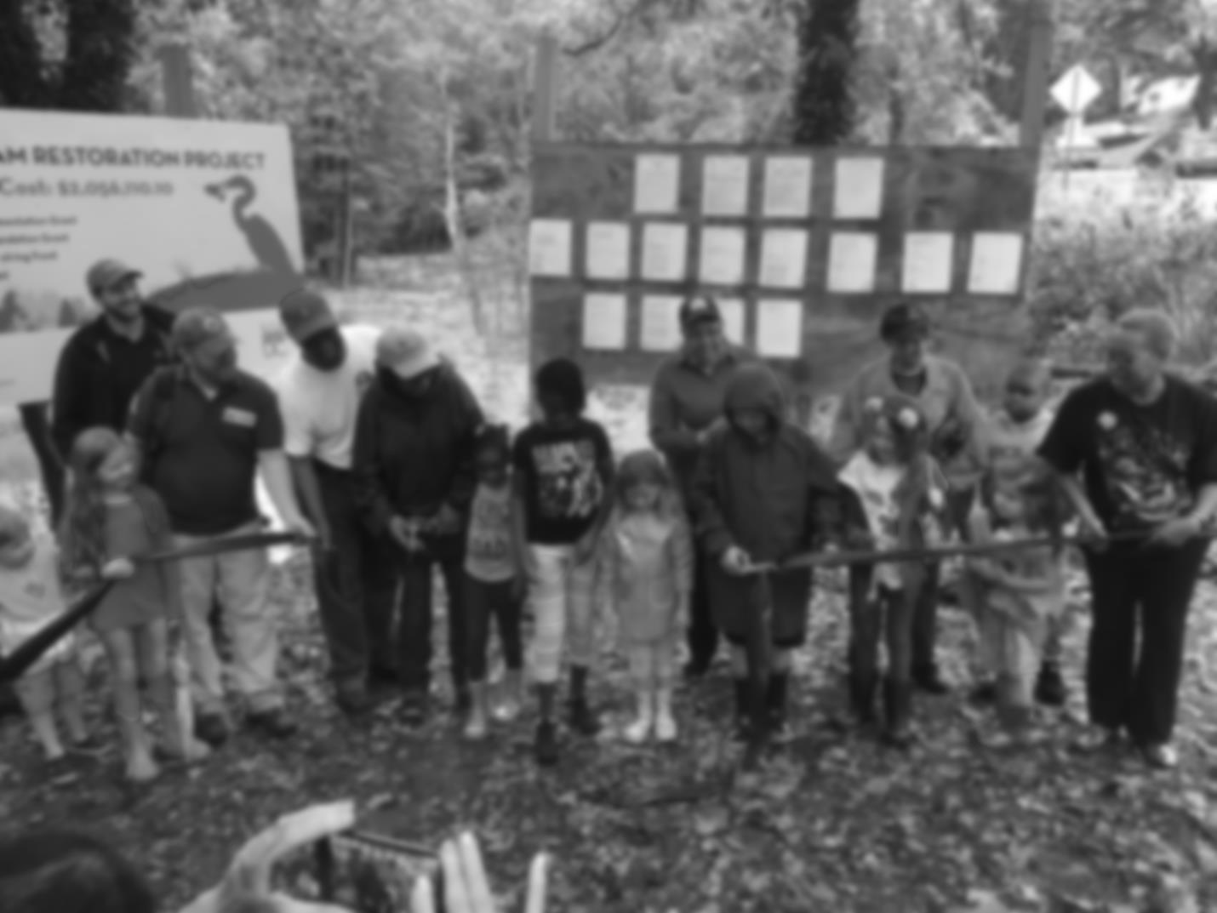

District of Columbia Updates: Phase III WIP and More
Katherine Antos, Branch Chief
Partnering & Environmental Conservation Branch
Department of Energy & Environment
Chesapeake Citizens Advisory Committee
November 29, 2018
@DOEE_DC

Slide 2

On Tap
District’s Phase III WIP
Climate resilience
Local engagement
Targeting
2018 Executive Council Directive and DC
Environmental Education
Conowingo WIP
@DOEE_DC

Slide 3
~90% pollution is from wastewater
Much progress already
Wastewater loads will increase with growth
Still more work to be done to reduce stormwater pollution
Increase implementation
BMP maintenance

Slide 4
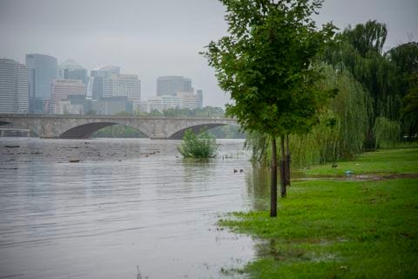
Climate Resilience
District leading by example in addressing climate
Qualitatively describing how integrating with other priorities:
ClimateReady DC
Resilient DC efforts
Quantitatively committing to additional pollutant reductions to address impacts of climate change
Photo Credit: Washington Post (2018)
@DOEE_DC

Slide 5
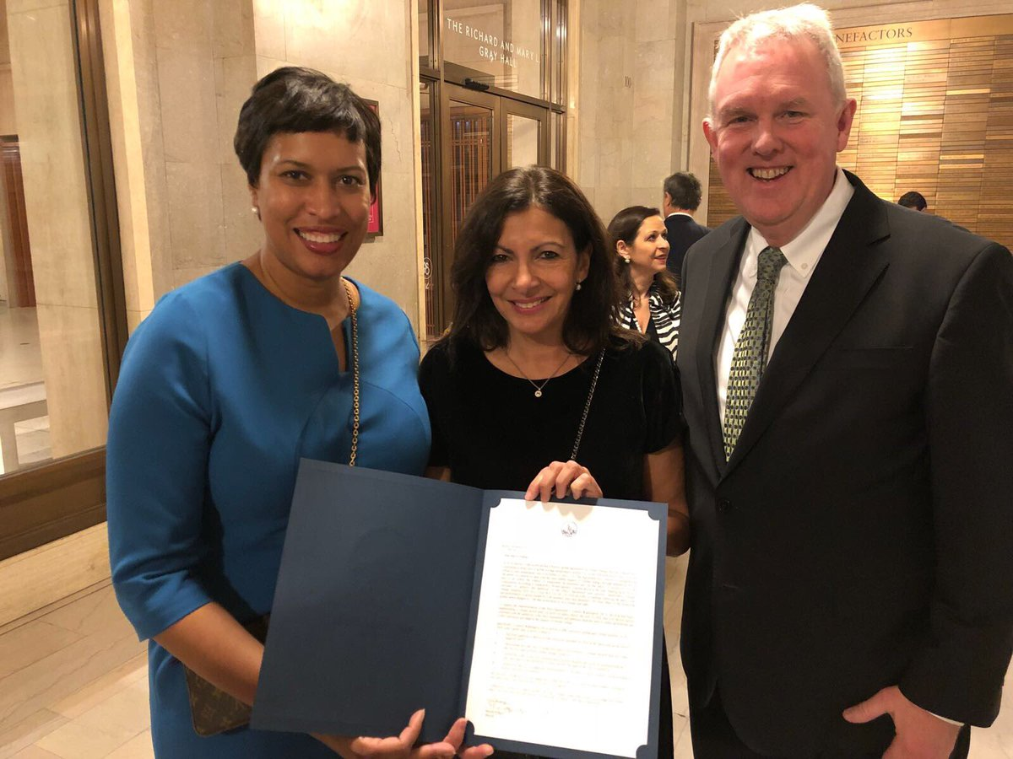
Leading on Climate Resilience
Forthcoming: Resilience Strategy
2018: Selected to participate in American Cities Climate Challenge; $2.5 mil worth of technical assistance
2017: Mayor Bowser committed District to be carbon neutral by 2050
2016: Climate Ready DC released
2013: Sustainable DC Plan established goals for 2032
@DOEE_DC

Slide 6
Local Engagement: DC Water
Ensure Phase III WIP consistent with Bay TMDL and wastewater permits
Evaluate flow and load projections
Improve reporting process to EPA
@DOEE_DC

Slide 7
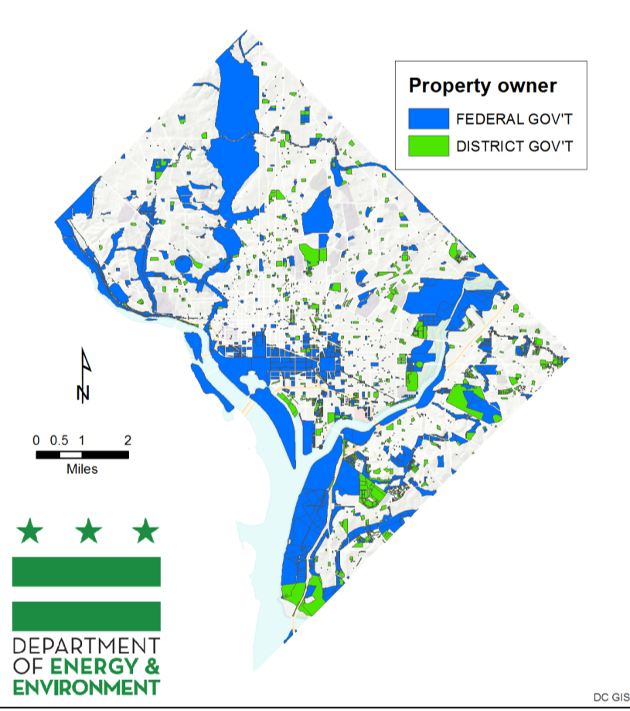
Local Engagement: Federal Facilities
Almost 30% land federal
District provided federal agencies with planning goals
Started training federal agencies in May 2018
Interim deadlines for scenario development

Slide 8
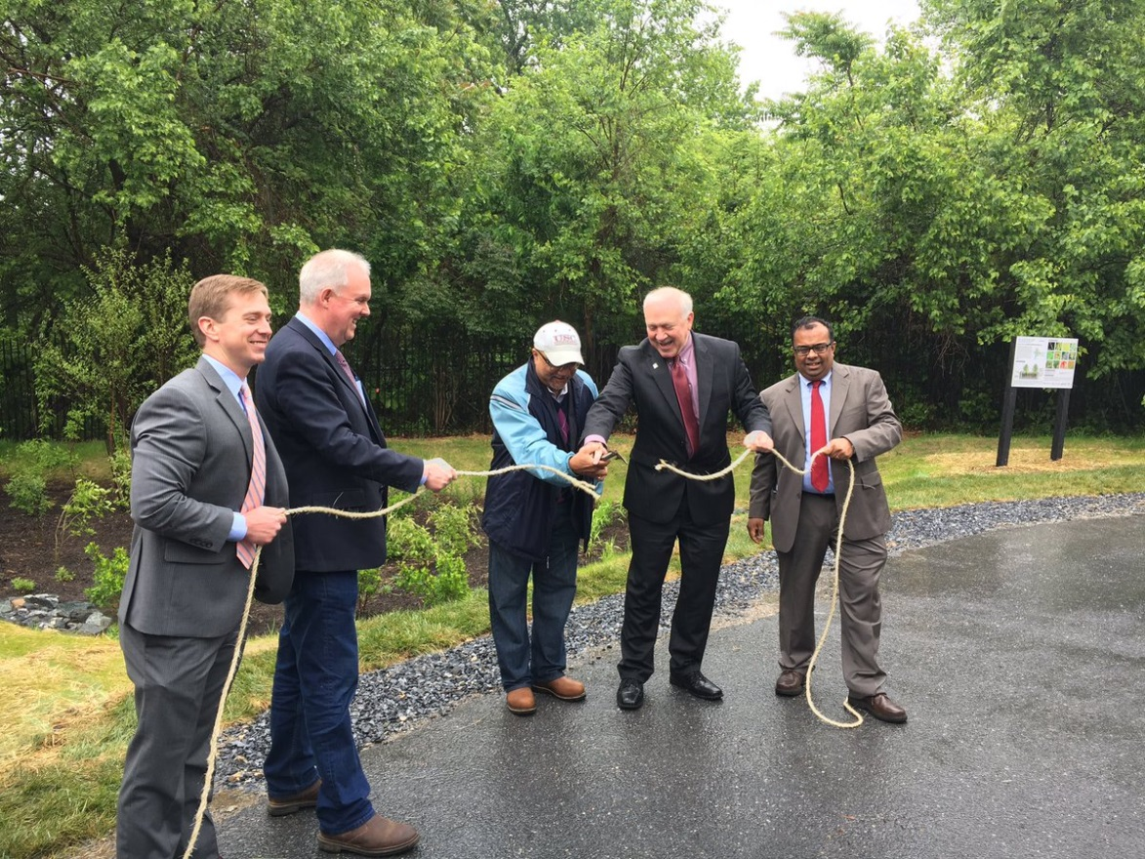
Local Engagement: Partner Organizations
Established Chesapeake Partner Advisory Group for organizations that help administer or are major participants in DOEE programs
Series of roundtables to gather feedback and advise
Input will inform Phase III WIP and DOEE programs
@DOEE_DC
Notes:
DDOT/UFD is the primary tree-planting and maintenance agency. We use the UFAC (Urban Forestry Advisory Council) to coordinate with UFD, other District gov agencies, Federal agencies (like NPS), non-profits, utilities, and District resident groups.
- Topics considered by UFAC include: overlap of solar policy and tree canopy; street tree maintenance; workforce training.

Slide 9
Chesapeake Partner Advisory Group Members
Alice Ferguson Foundation
Alliance for the Chesapeake Bay
Anacostia Coordinating Council
Anacostia Riverkeeper
Anacostia Waterfront Trust
Anacostia Watershed Society
Casey Trees
Center for Watershed Protection
Design Green
District Department of General Services
District Department of Parks and Recreation
District Department of Public Works
District Department of Transportation
Earth Conservation Corps
Latin American Youth Conservation Corps
Lenkin Company
Living Classrooms
Nspire Green
RainCredits
Rock Creek Conservancy
Solvitect LLC
The Nature Conservancy
University of the District of Columbia
Washington Parks and People
WC Smith
@DOEE_DC

Slide 10
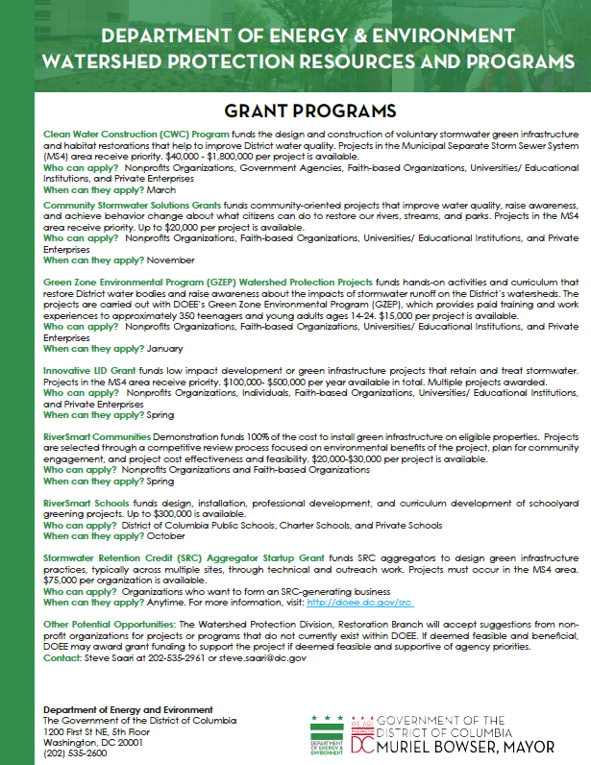
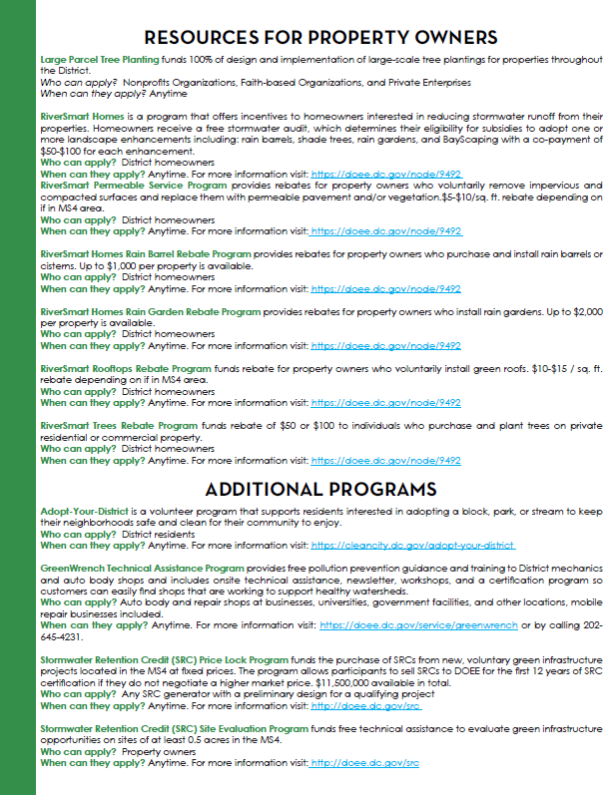
PRELIMINARY Partner Advisory Group Feedback
Create opportunities and resources to facilitate partnerships
Identify, cultivate and support local champions
Recognize value, time and resources for effective outreach
Make information available in advance of key decisions
Better communicate benefits and co-benefits of green infrastructure
@DOEE_DC

Slide 11
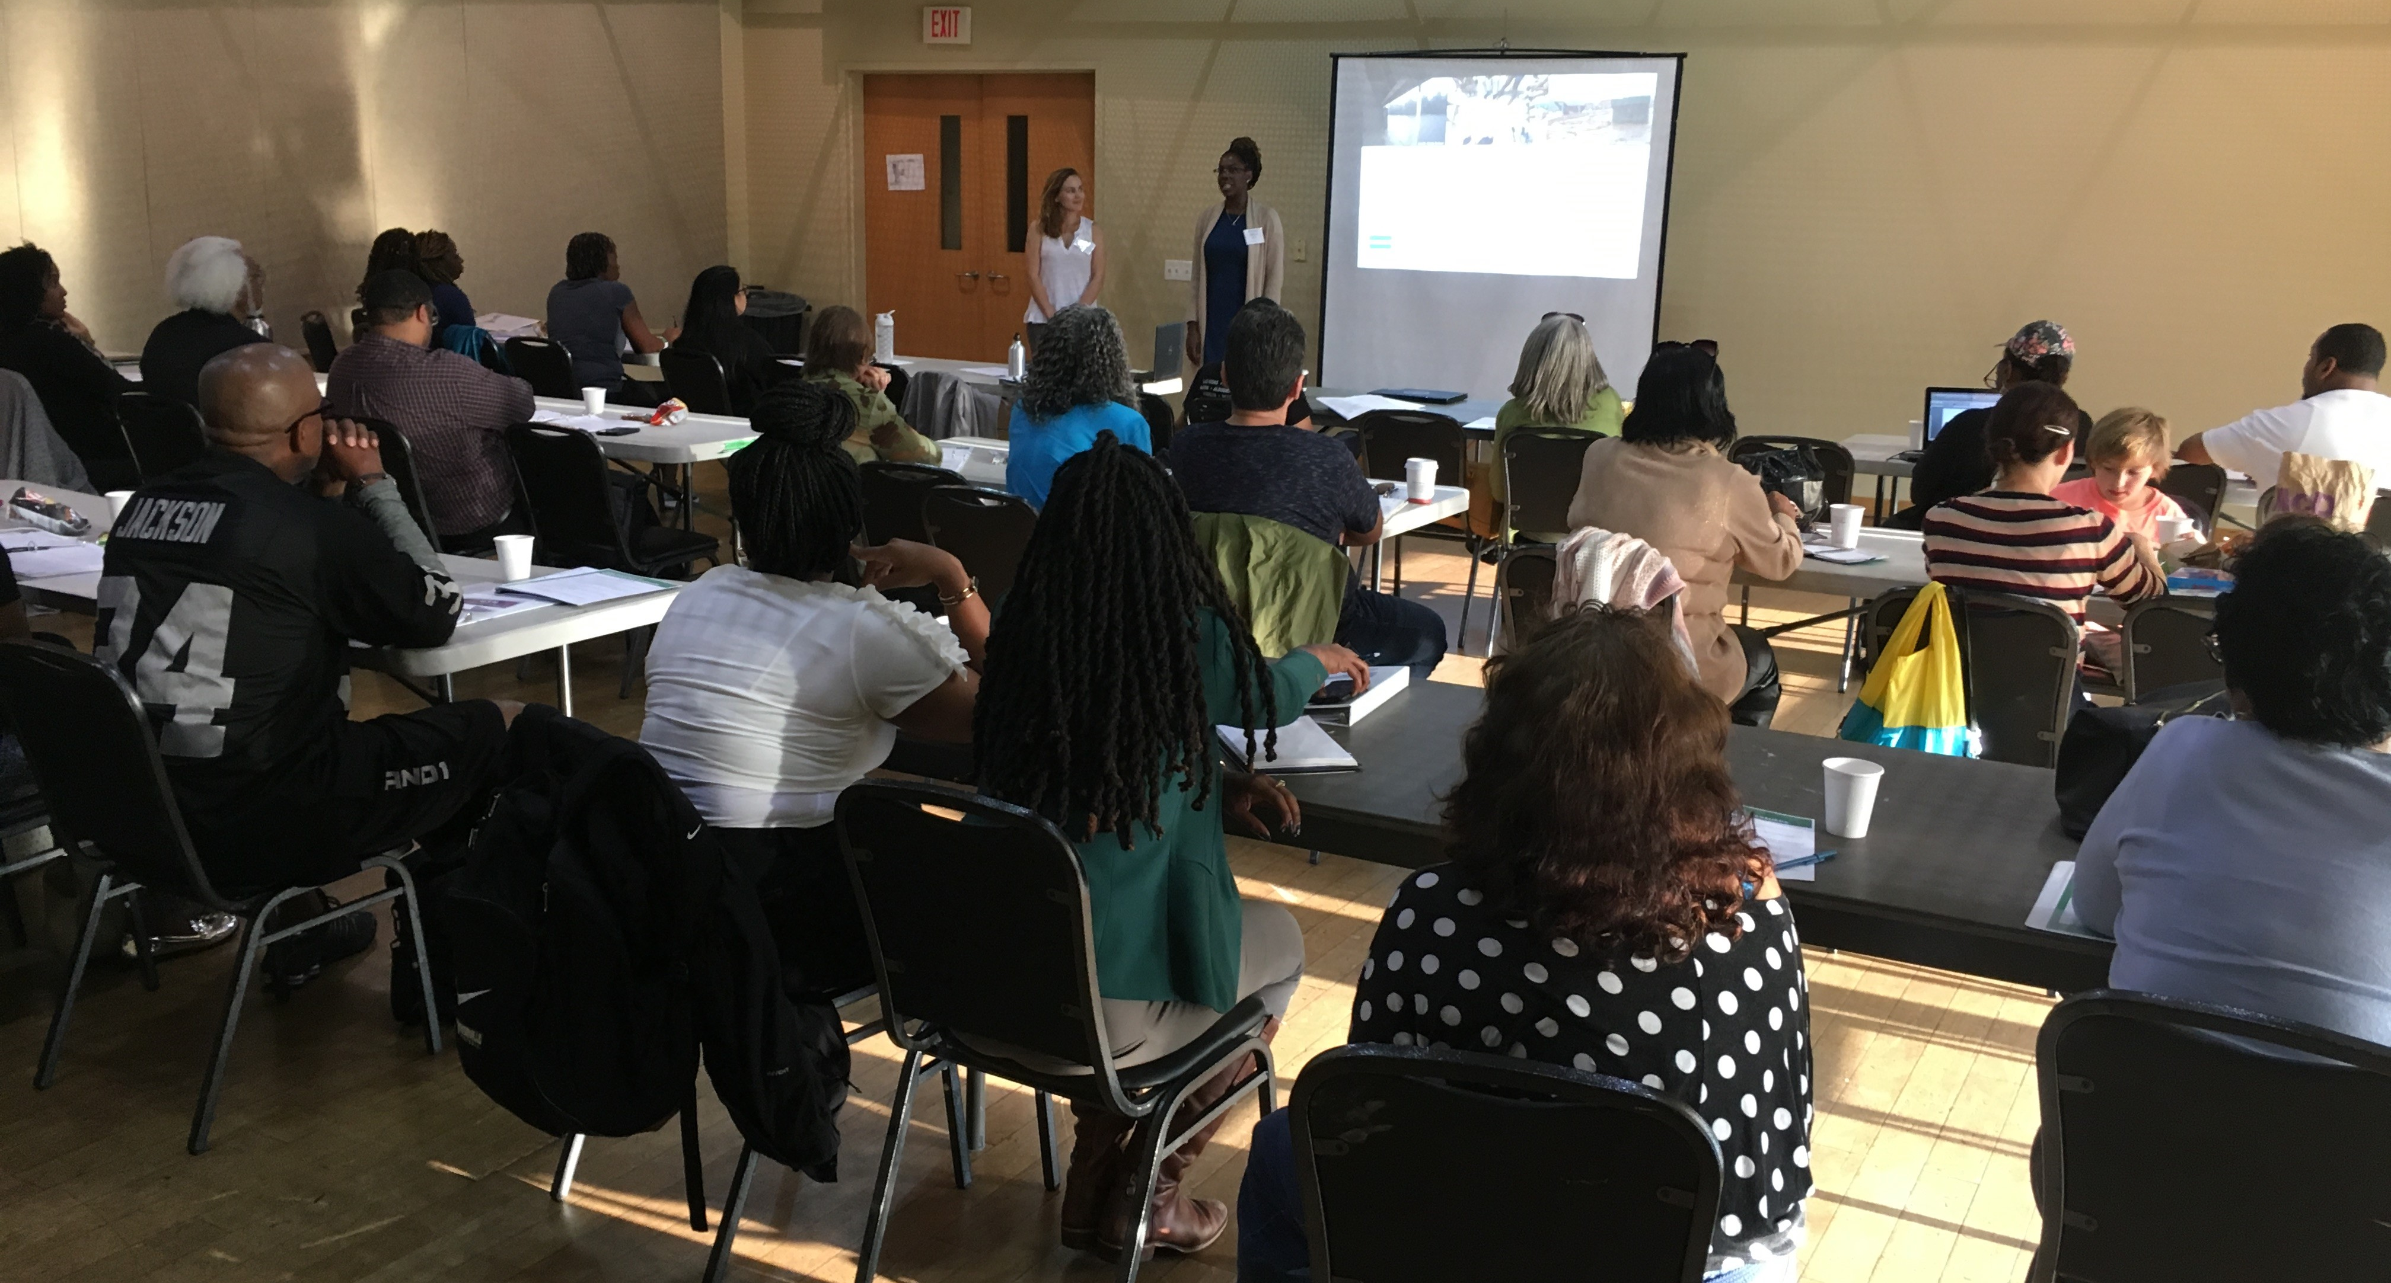
Local Engagement: Other Stakeholders
Utilize existing forums
Focus groups through new marketing contract
Potentially hold select stakeholder events
Public meetings in spring
@DOEE_DC

Slide 12
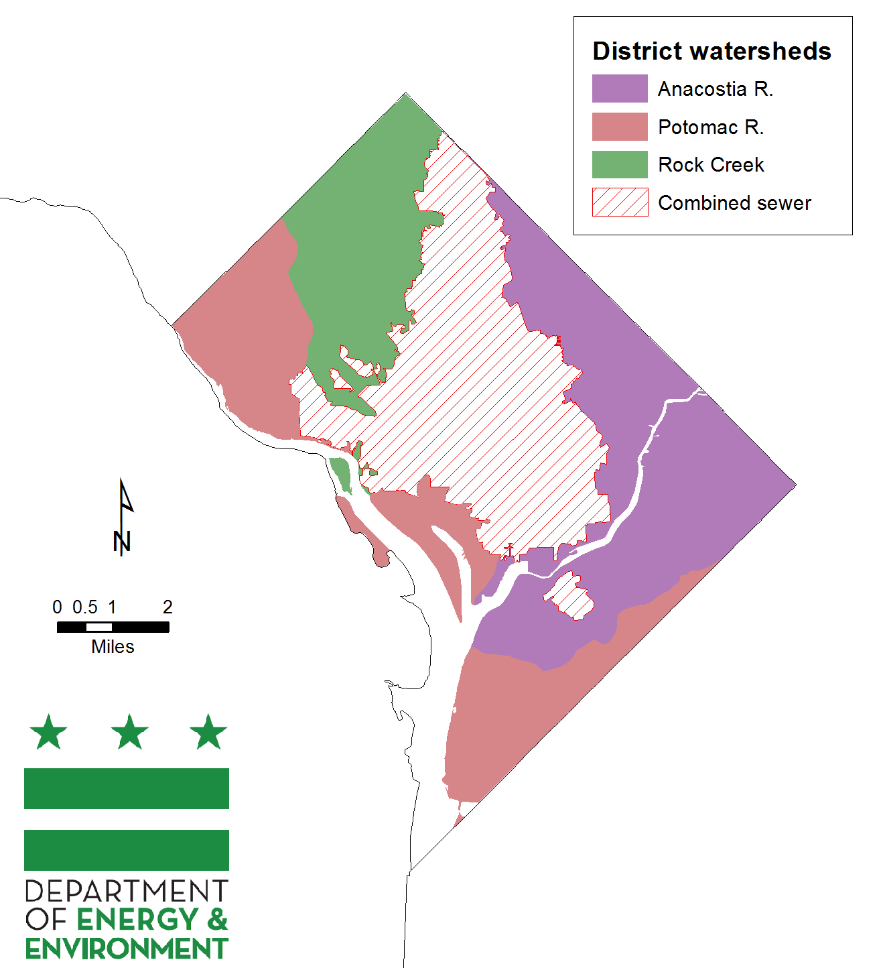
Where Does Stormwater Management Matter?
Here: Municipal Separate Storm Sewer System (MS4) and Direct Drainage

Slide 13
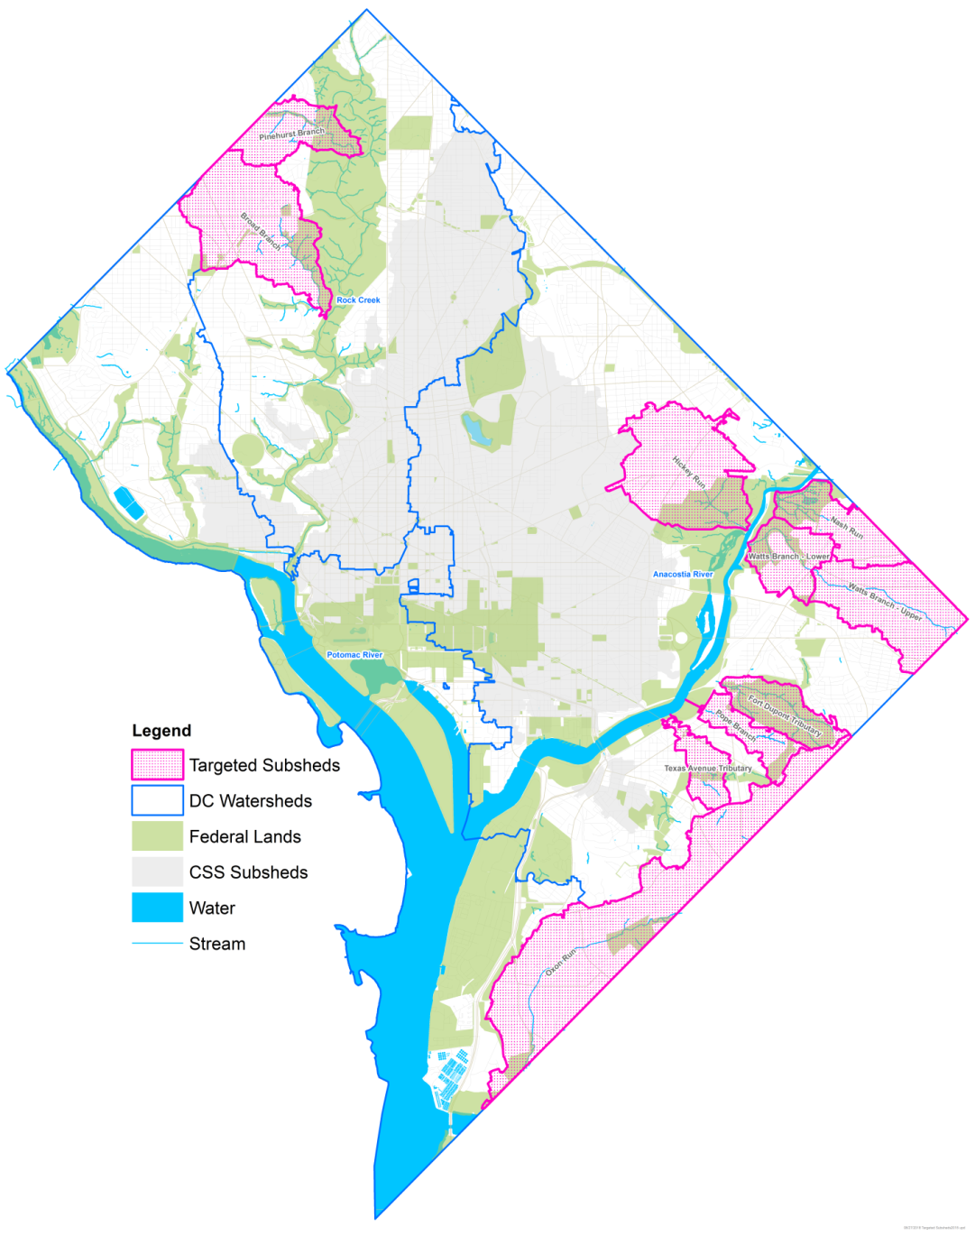
Targeted Areas for Local Benefits
Prioritize actions that:
Help meet local TMDLs
Protect existing or planned stream restoration sites
Support residents and community assets vulnerable to extreme weather events
@DOEE_DC

Slide 14
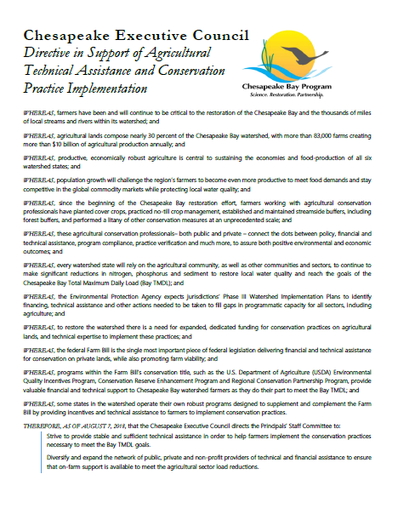
2018 Executive Council Directive
District benefits from reduced agriculture pollution
Element most relevant to DC: “Enhance the job climate for government technical assistance professionals by exploring how to make training and certification more streamlined and accessible, along with the development of two-year certification programs, innovative technology training forums and education loan assistance programs. ”
@DOEE_DC

Slide 15
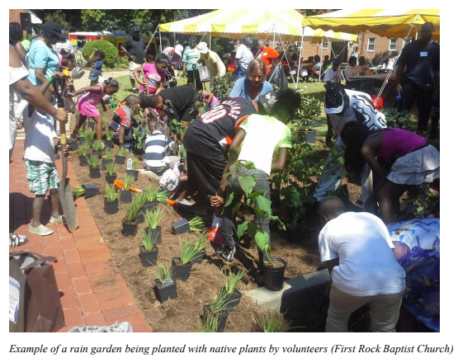
Environmental Education
Renewed DCPS collaboration
Seeking resources to expand environmental education opportunities
Increasing awareness of DOEE offerings and improving integration with curriculum
@DOEE_DC

Slide 16
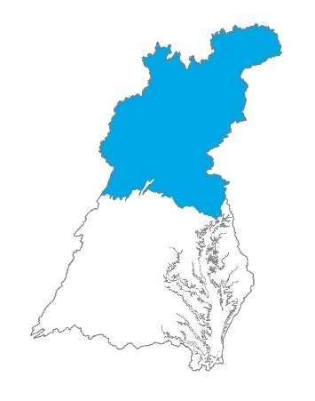
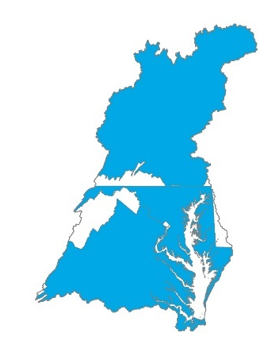
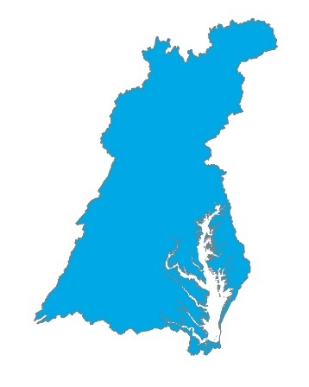
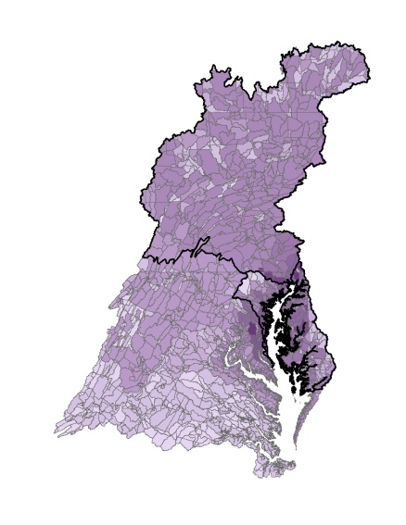
Conowingo
Support partnership approach to addressing Conowingo loads
Member of Conowingo WIP Steering Committee
District not within effective basins
Support CWIP deadline 3 months after state WIPs and not tapping into GIT assistance funds
@DOEE_DC

Slide 17
Katherine Antos
Branch Chief
Partnering & Environmental Conservation Branch
Department of Energy & Environment
Katherine.Antos@dc.gov
(202) 574-7606
https://doee.dc.gov/service/watershed-implementation-plans-chesapeake-bay

