Slide 1

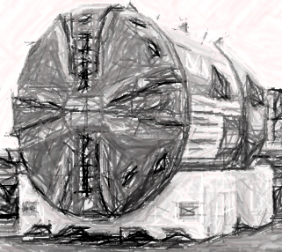
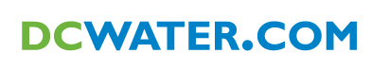
District of Columbia Water and Sewer Authority
David Gadis, General Manager
Briefing on:
DC Clean Rivers Project
Briefing for:
Chesapeake Bay Program
Citizens Advisory Committee
November 29, 2018

Slide 2
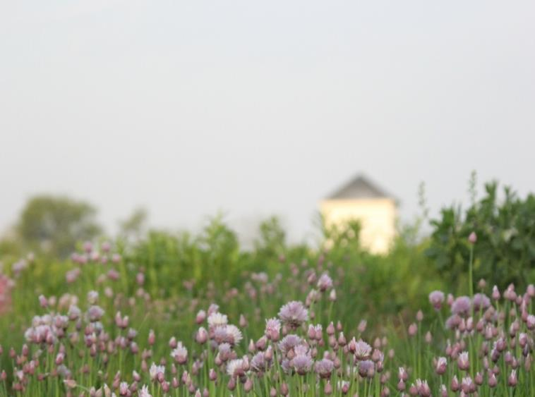
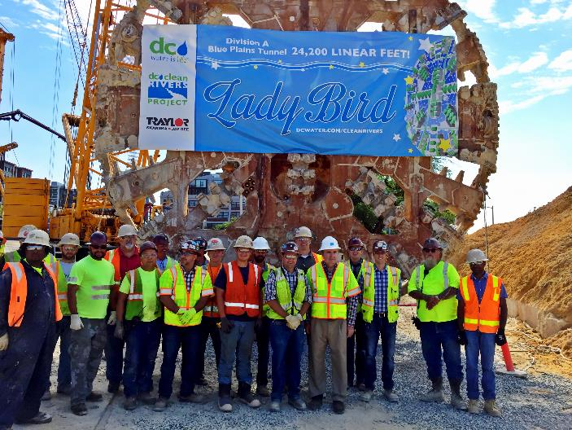
Agenda
Green Roof
at Fort Reno Reservoir
DCCR Overview
DCCR Status Update
Ongoing and Future Work
Questions
Anacostia River Tunnel Mining Completion
2

Slide 3
DC Clean Rivers Project Overview
3

Slide 4
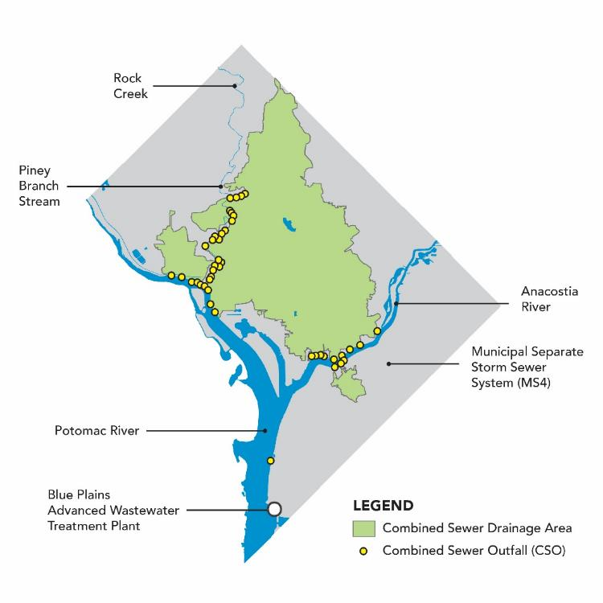
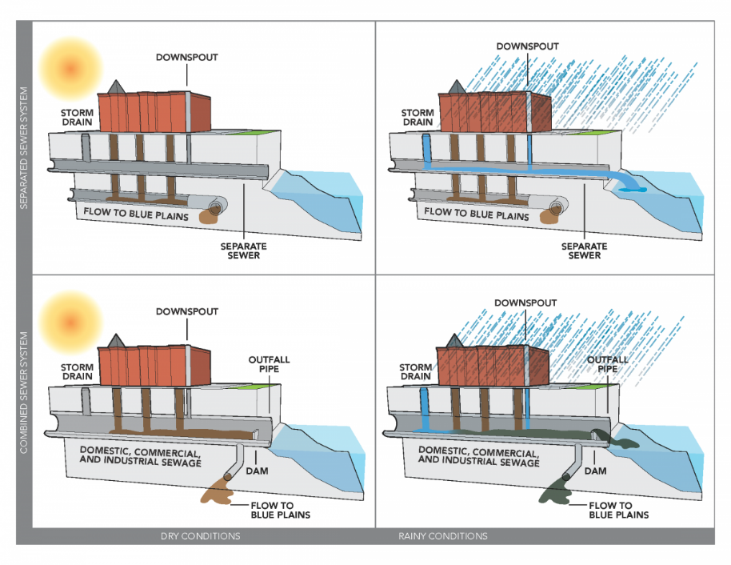
Separate and Combined Sewer Systems
1/3 area is combined sewer (12,478 acres)
47 Combined Sewer Overflow (CSO) outfalls
4

Slide 5
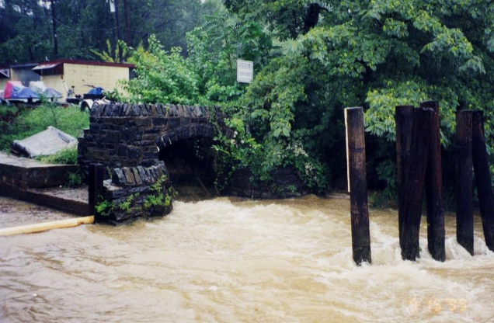
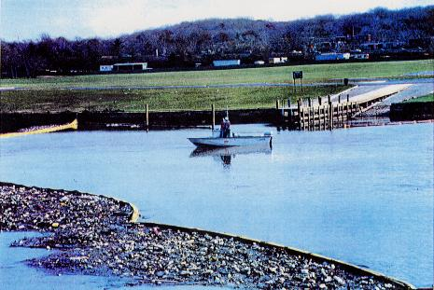
Magnitude of the Challenge: CSOs
CSO Discharge to Anacostia River
Trash in Anacostia River
5

Slide 6
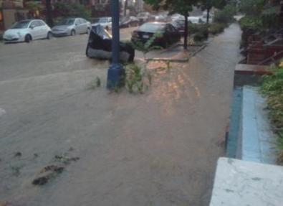
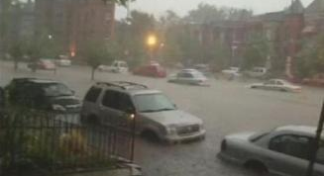
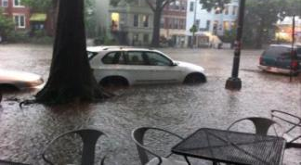
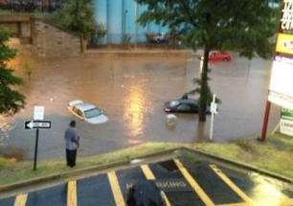
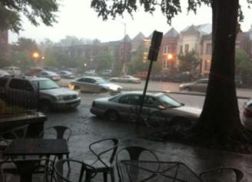
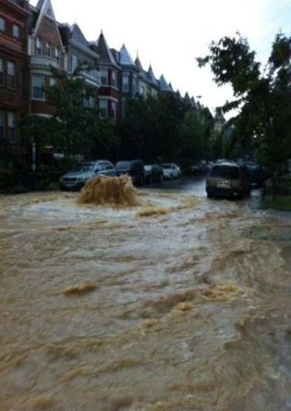
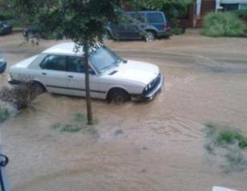
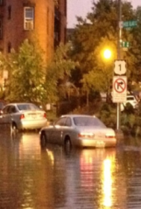
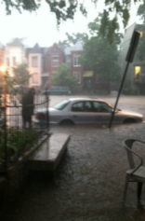
Magnitude of Challenge: Surface Flooding (Summer 2012)
Photo source unknown
Photo source unknown
Photo courtesy of: Greg Roberts
1st St NW
Rhode Island & T St NW
Rhode Island & 1st St NW
Photo source unknown
Photo courtesy of myfox.com
Photo source unknown
Rhode Island Metro
Rhode Island & T St NW
Photo courtesy of myfox.com
Photo source unknown
Photo courtesy of huffintonpost.com
Flagler St NW
Rhode Island Between 1st & 2nd St NW
1st & V St NW
6

Slide 7



What is our Purpose?
Control combined sewer overflows to the:
Potomac River
Anacostia River
Rock Creek
Relieve flooding in the Northeast Boundary Area
Implemented under a Federal Consent Decree among:
US Environmental Protection Agency (US EPA)/
US Department of Justice (US DOJ)
District of Columbia and
DC Water
7

Slide 8
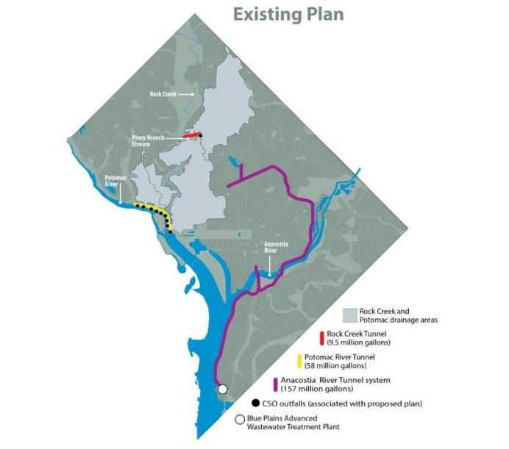
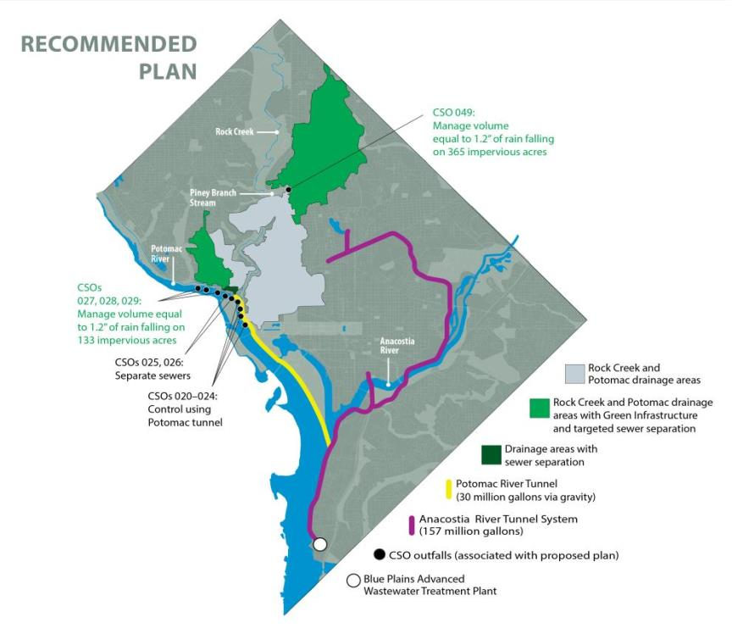
Program Development
January 14, 2016 – Consent Decree Modification Entered in Federal Court
2005 – Consent Decree Signed
2011 - DC Water Evaluates GI for Potomac River and Rock Creek
1998 - LTCP Started
2007 - New Nitrogen Limits Require Changing LTCP
2012 – Mayor’s
Task Force
2002 – Final LTCP
2003 – LTCP Meets WQS (EPA/DC)
Public Participation
Public Participation
8

Slide 9

DC Clean Rivers Project
DC CLEAN RIVERS PROJECT AND
NITROGEN REMOVAL PROGRAMS
DC Clean Rivers Project: $2.7 Billion
Nitrogen Removal: $950 Million
Total > $ 3.5 Billion
25 yr implementation (2005 – 2030)
96% reduction in CSOs & flood relief in Northeast Boundary
Approx 1 million lbs/yr nitrogen reduction predicted
9

Slide 10
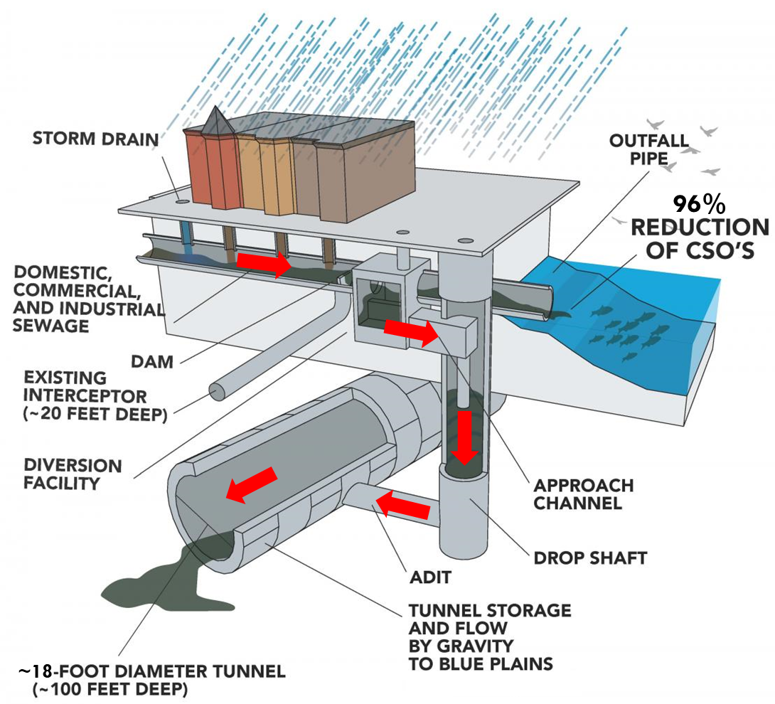
21st Century Sewer System
NEW FACILITIES CONSTRUCTED TO CONTROL CSOS
23
10

Slide 11
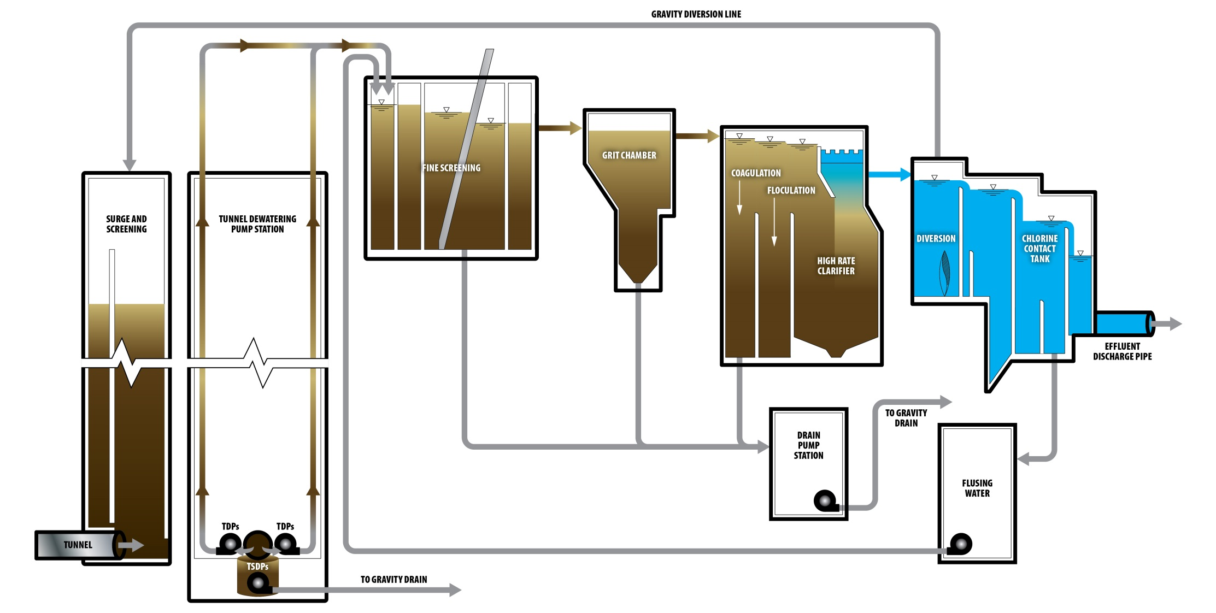
Tunnel Dewatering Pumping Station and Enhanced Clarification Facility
11

Slide 12
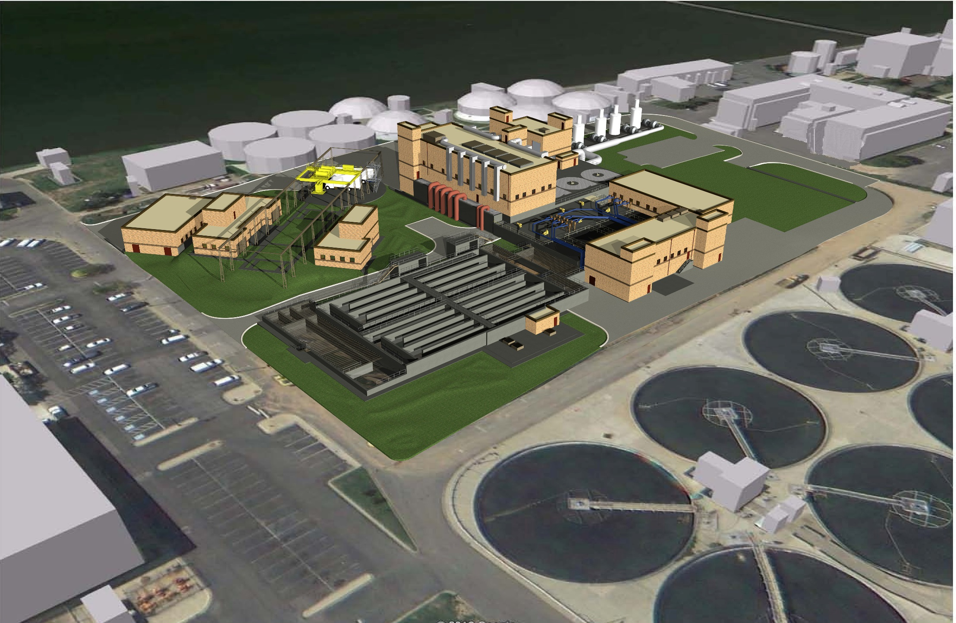
Tunnel Dewatering Pumping Station and Enhanced Clarification Facility
GANTRY SYSTEM ABOVE PS AND COARSE SCREENING SHAFTS
FINE SCREENS
GRIT REMOVAL
HIGH RATE CLARIFICATION
CHLORINE CONTACT TANK
12
12

Slide 13
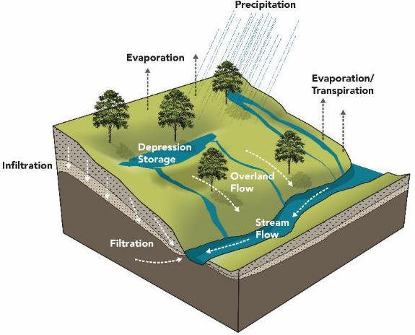
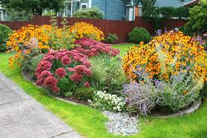
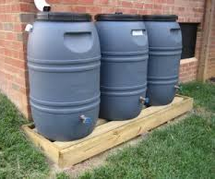
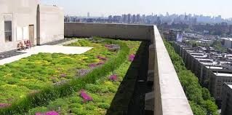
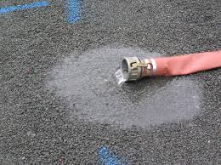
What is Green Infrastructure?
Mimics natural water processes:
Filtration, infiltration, slowing water, storage, and evapotranspiration
Reduces CSOs by slowly releasing stormwater to the sewer system
Rain Gardens and Bioretention
Downspout Disconnection and Rain Barrels
Green Roofs
Pervious Pavement
13

Slide 14
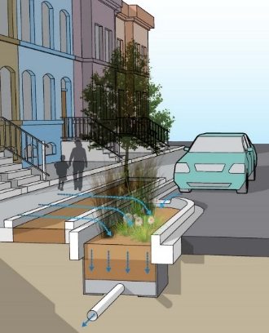
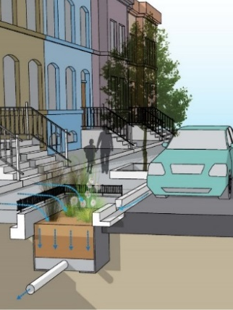
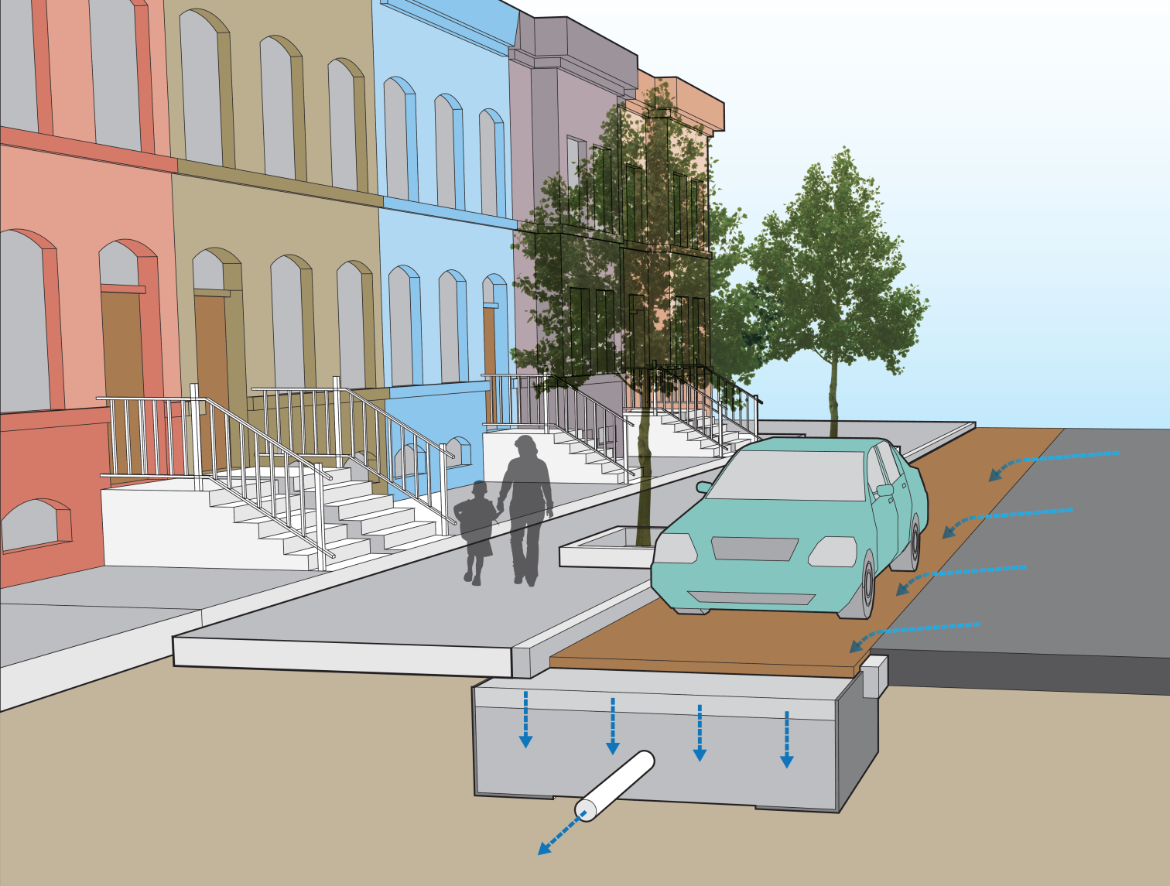
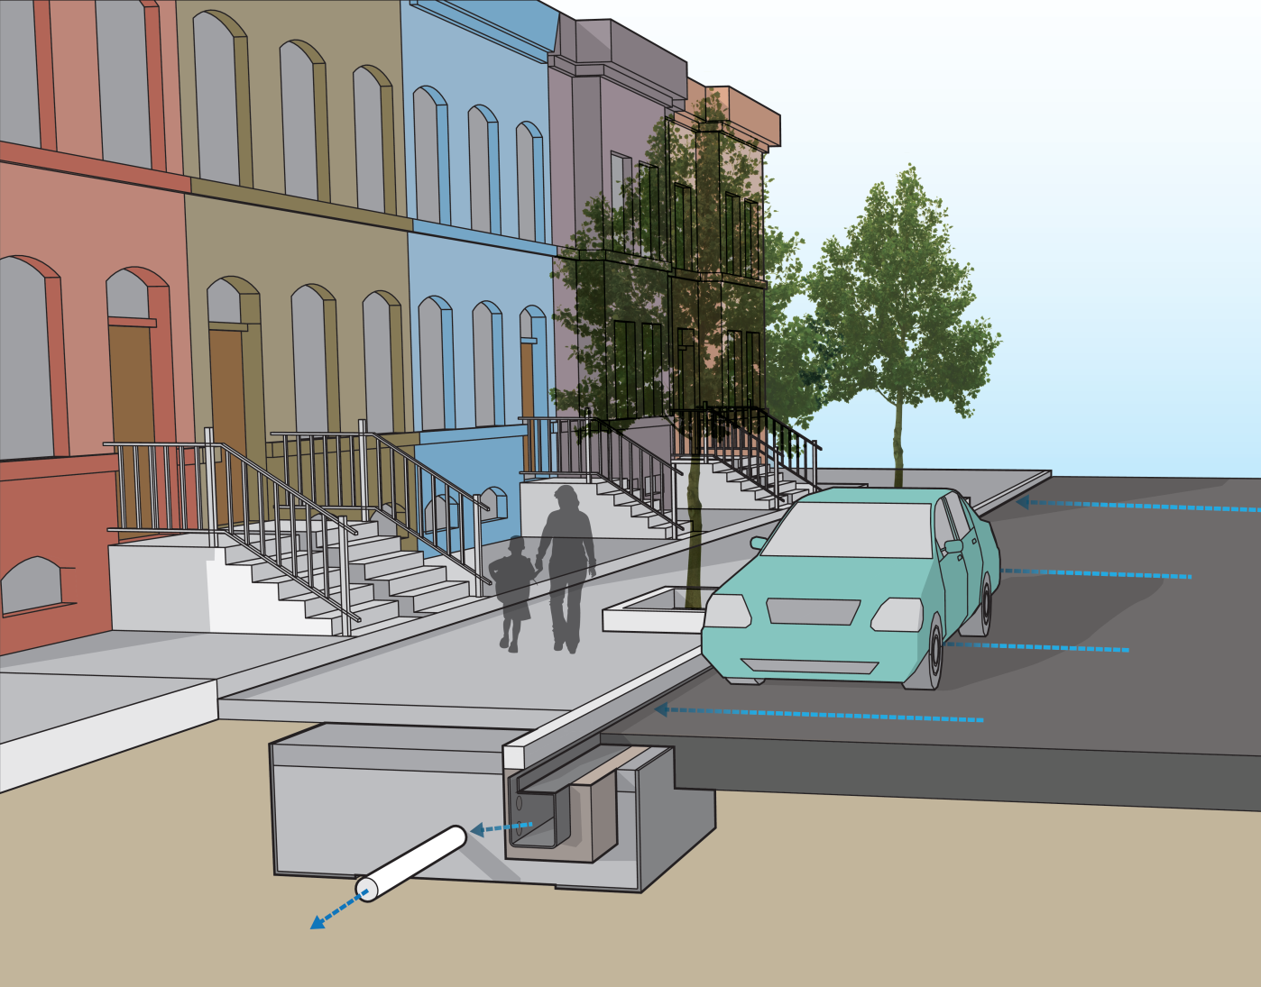
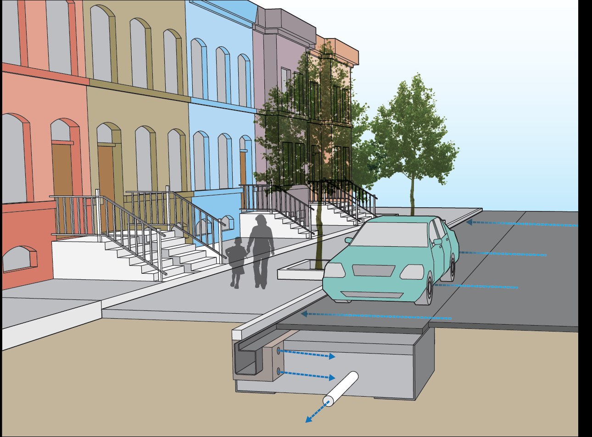
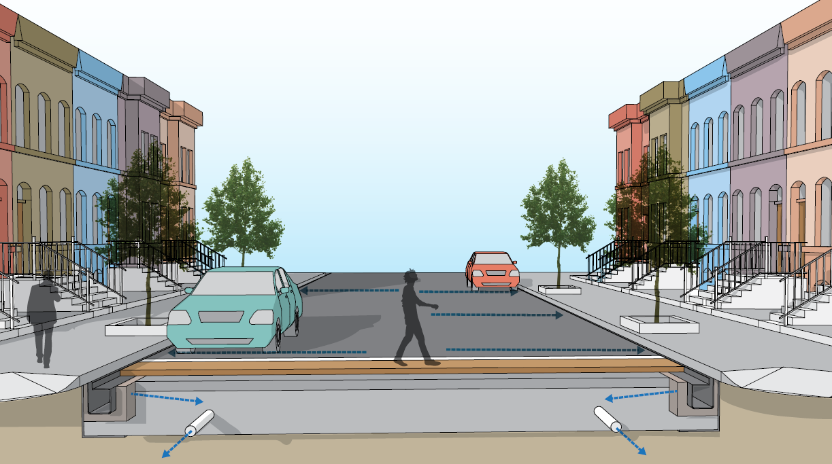
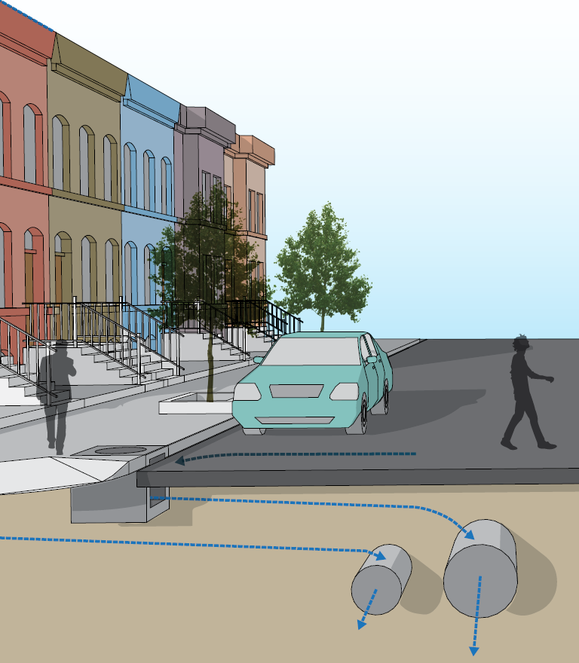
GI Technologies – Public Space
Siting and Design Goals:
Minimize temporary and long-term impacts to community
Match character and aesthetic of neighborhoods
Provide infrastructure upgrades by prioritizing areas for implementation
Provide ancillary benefits to community
Coordinate work with other entities (DDOT, other utilities, etc.)
Curb Extension
Bioretention
Planter
Bioretention
Permeable Alley
Permeable
Parking Lane
Sidewalk
Storage
Parking Lane
Storage
Crosswalk Storage
Sewer
Separation
14

Slide 15
DC Clean Rivers Project Status Update
16

Slide 16
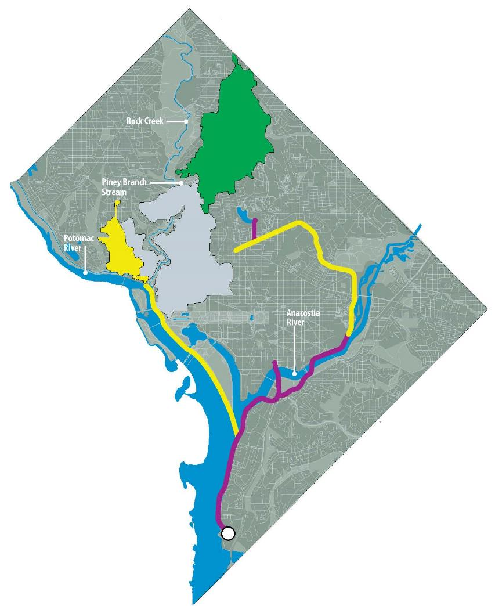
Project Status
Legend
In operation
Green Infrastructure for CSO 049
(Piney Branch)
Planning, design or construction
First Street Tunnel
Northeast Boundary Tunnel (under construction)
Green Infrastructure for CSO 027, 028, 029
Separate CSO 025, 026
Potomac Tunnel
Blue Plains and Anacostia River Tunnels
Tunnel Dewatering Pumping Station and 225 mgd Wet Weather Treatment facility
17

Slide 17
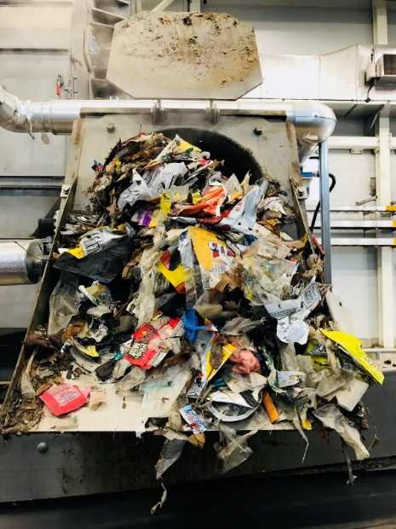
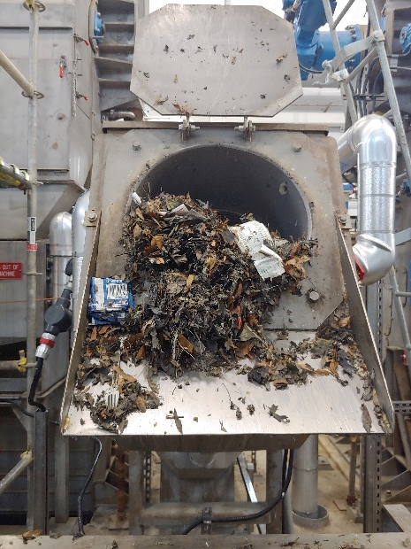
Anacostia River Tunnel System Performance
No. | Month | Rainfall, DCA Gauge (in) | Volume Captured by Tunnel (MG) | Measured Overflow (MG) | % captured | Solids Removed (tons)
1 | March 20 -31 2018 | 1.48 | 20 | 0 | 100% | 0
2 | April 2018 | 3.59 | 249 | 10 | 96% | 8
3 | May 2018 | 8.73 | 865 | 13 | 99% | 73
4 | June 2018 | 5.21 | 271 | 49 | 85% | 55
5 | July 2018 | 9.73 | 678 | 236 | 74% | 11
6 | August 2018 | 5.19 | 334 | 15 | 96% | 226
7 | September 2018 | 9.73 | 775 | 109 | 88% | 94
8 | October 2018 | 3.06 | 150 | 0 | 100% | 151
9 | November 1-28, 2018 | 7.56 | 780 | 6 | 99% | TBD
 | Total | 54.28 | 4122 | 438 | 90% | 616
November 20 marked 8 months in service
Exceeding predicted capture rate (90%>80%)
Volumes are high due to extremely rainy weather
6th wettest May on record
4th wettest July on record (all rain in second half of month)
5th wettest September on record
Wettest November on record (broke record from 1877)
<1” from wettest year on record (1889)
April 2018
November 2018
Trash and debris removed from CSO captured by tunnel at ECF Fine Screens
18

Slide 18
Dc clean rivers project ongoing and future work
19

Slide 19
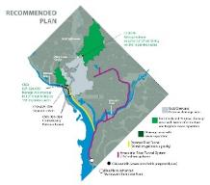
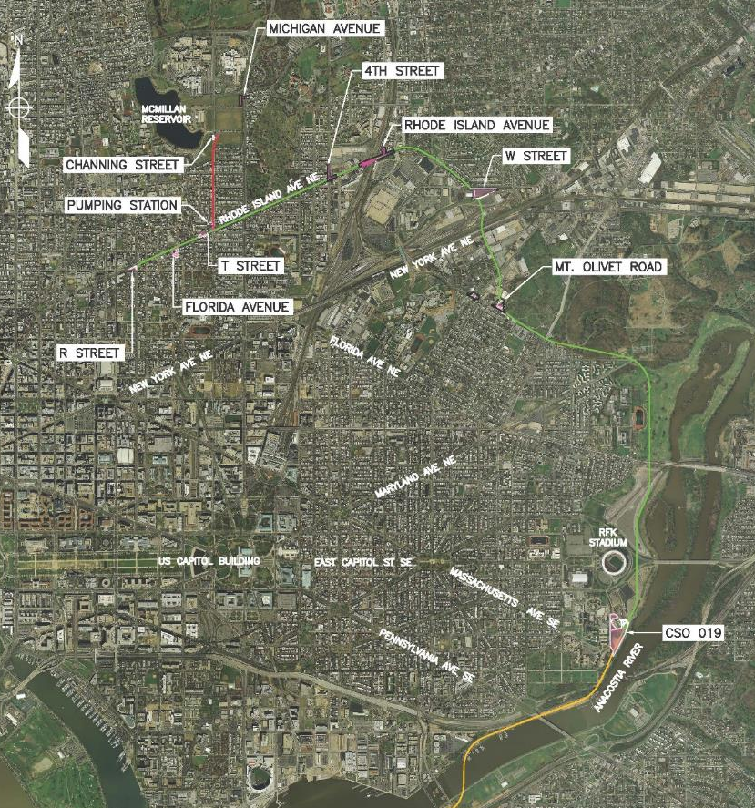
Division J – Northeast Boundary Tunnel
Key Map
Work is ongoing at the following locations:
CSO 19
Mt. Olivet Road
W Street
Rhode Island Ave
4th Street
TBM Machine is actively mining (Ring no 33 as of Nov 27, 2018) from CSO 19.
Mobilize to Florida Ave and Pumping Station site in late Dec 2018.
Milestone | Date
NTP | September 15, 2017
Construction Start | March 2018
Construction Complete | August 2023
111111111111111111111111111
20

Slide 20
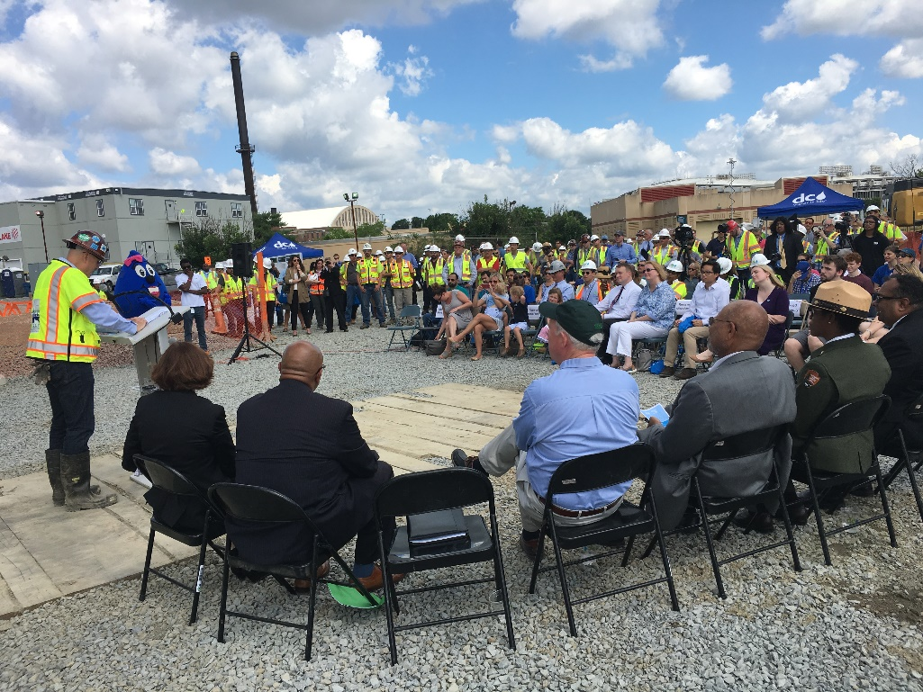
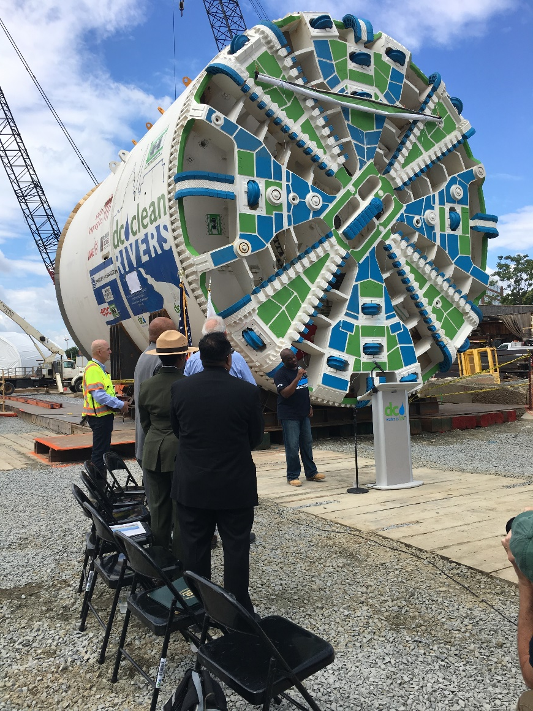
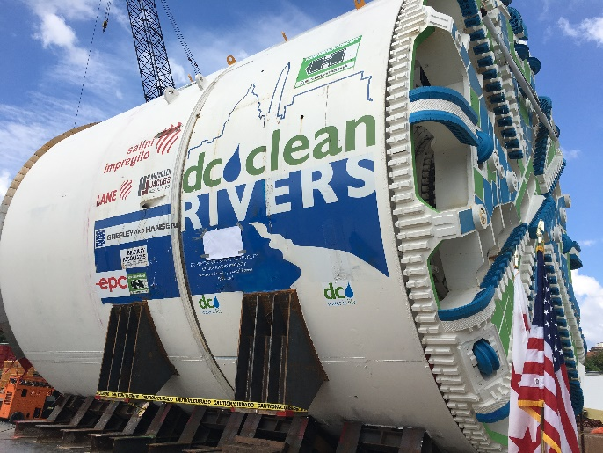
Northeast Boundary TBM Naming Ceremony
21

Slide 21
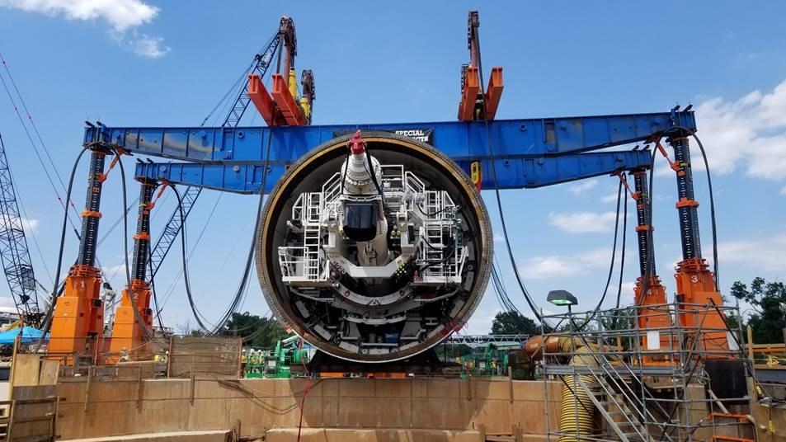
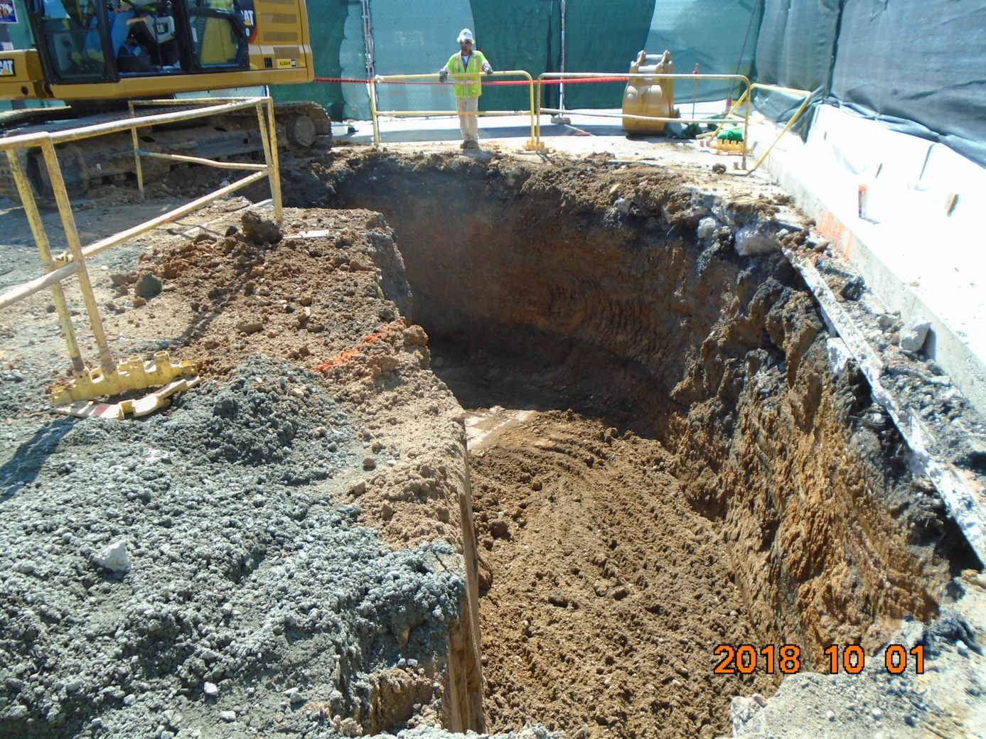
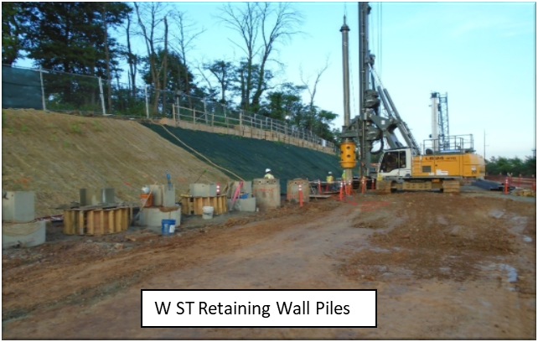
Division J – Northeast Boundary Tunnel
TBM Lowering
4th Street Pre-trench Excavation for Drop Shaft
444444444444444444
22

Slide 22
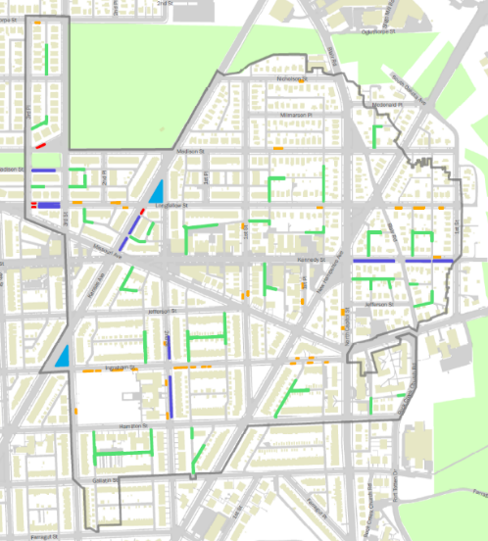
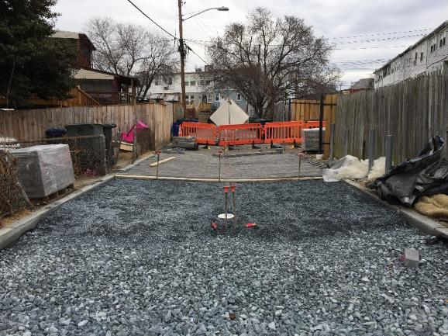
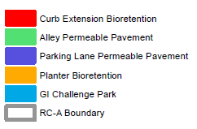
Division RC-A – Rock Creek GI Project A
Key Map
Project Boundary:
Project facilities were designed, permitted, and constructed in three phases:
Construction started in September 2017
Substantial Completion achieved October 9, 2018
Kansas Ave.
Missouri Ave.
New Hampshire Ave.
23

Slide 23
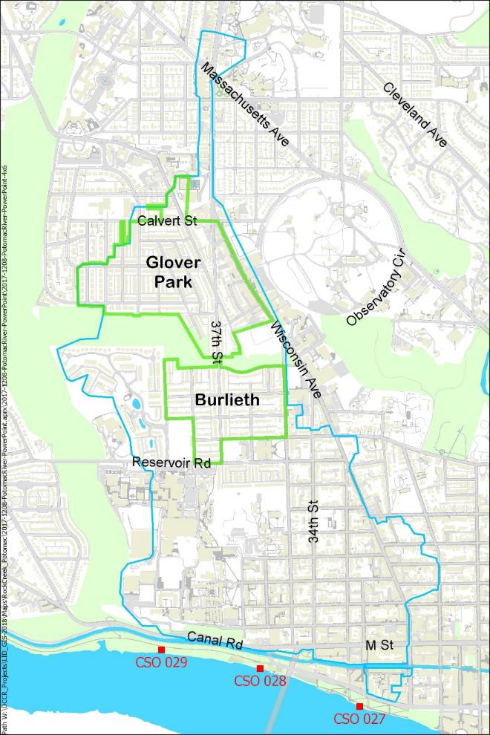
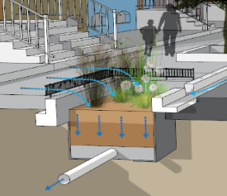

Division PR-A – Potomac River Project A
Key Map
Item | Status
Contract Award | April 9, 2018
Construction NTP | April 30, 2018
Place in Operation | CD Deadline June 23, 2019
Project Boundary:
Construction underway and tracking for on time completion.
Project includes:
Planter Bioretention
Alley Permeable Pavement
Parking Lane Permeable Pavement
11111111111111111111111111
24

Slide 24

Potomac River Tunnel
Tunnel connections for CSOs 027-029 contingent on Green Infrastructure practicability determination
Schedule Facility Planning/
Environmental Approvals: 2015-2018
Preliminary Design: 2019-2022
Procurement: 2022-2023
Final Design/Construction: 2023-2030
11111111111111111111111111
25

Slide 25

CSO 025 and 026 Sewer Separation
Separation of combined sewer system tributary to two Potomac River outfalls
Small, highly urbanized sewersheds in Georgetown Historic District
Construction contract to be awarded by March 2021
Placed in operation by March 2023
11111111111111111111111111
26

Slide 26





Questions and Answers
Brandon Flora, PE
brandon.flora@dcwater.com
202-787-4414

Slide 27

Blue Plains Nitrogen Removal
Blue Plains has consistently exceeded nitrogen removal requirements set by Chesapeake Bay Program and NPDES Permit

