Slide 1
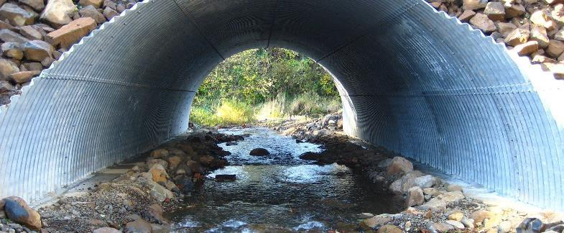
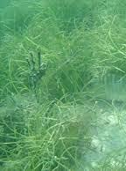
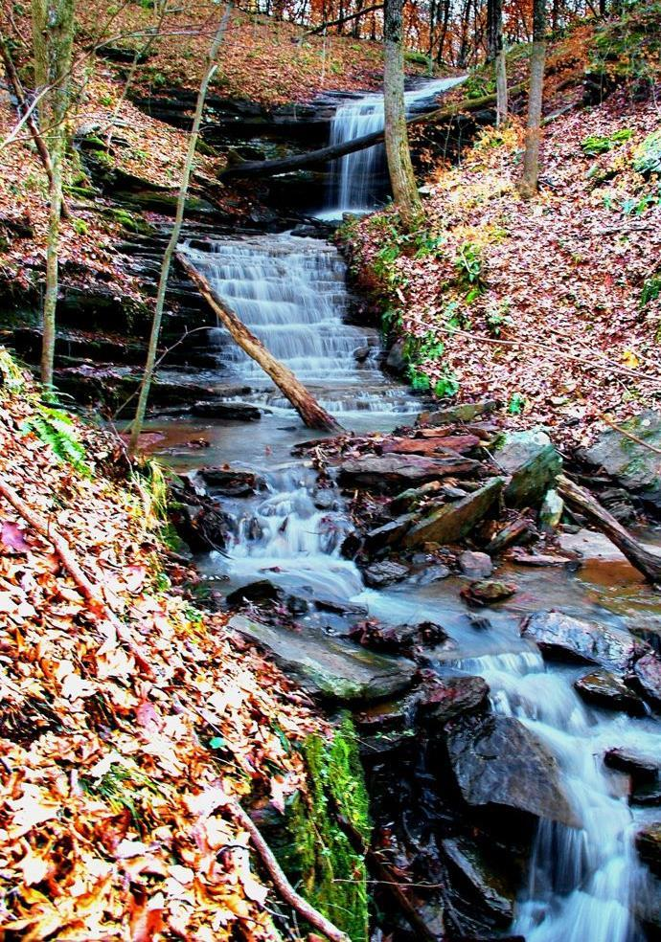
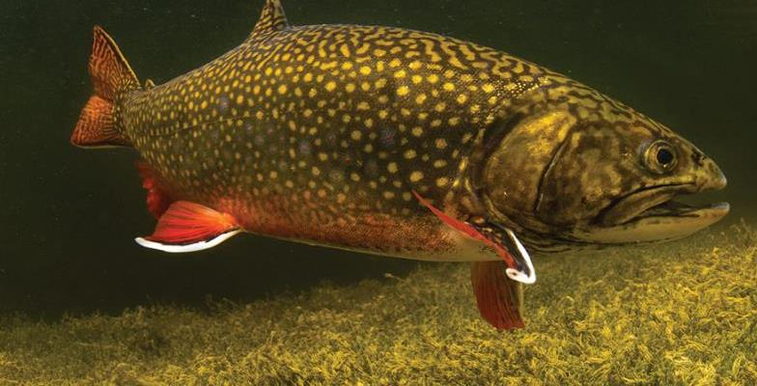
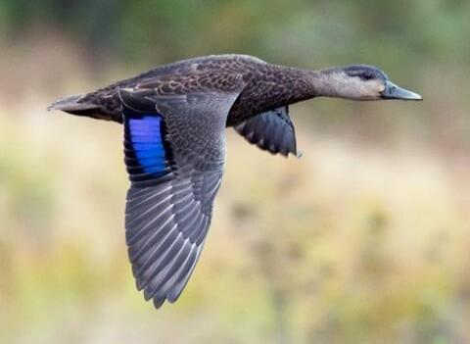
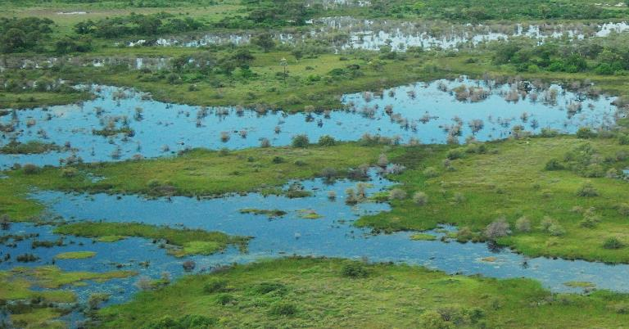
Habitat Goal Implementation Team and Workgroup Management Strategy

Slide 2
Indirect priorities
Infusing Social Science and Ecosystem Service valuation into our work
Ensuring that we have considered Diversity Equity Inclusion and Justice (DEIJ) considerations into workgroup and HGIT decisions
Coordinating and working across the six Goal Implementation Teams (GITs), STAR, and federal, state, and local groups/efforts to ensure we are leveraging resources towards common goals

Slide 3
Direct priorities
● Shallow water habitat conflicts
● Incorporating climate change into workgroup activities (e.g., thermal changes in streams, wetland impacts due to sea level rise)
● More focus on creating habitat in the urban portions of our watershed
● Improve outcome tracking and reporting for wetlands, black duck, and brook trout workgroups

Slide 4
HGIT Feedback Loop
Bay Program
Workgroup members
Update HGIT
Management Strategy
Workgroup chairs meeting
Fall Meeting
Spring Meeting
Workgroup chairs meeting
Update HGIT Management Strategy
Workgroup members
Bay Program

Slide 5
