Slide 1

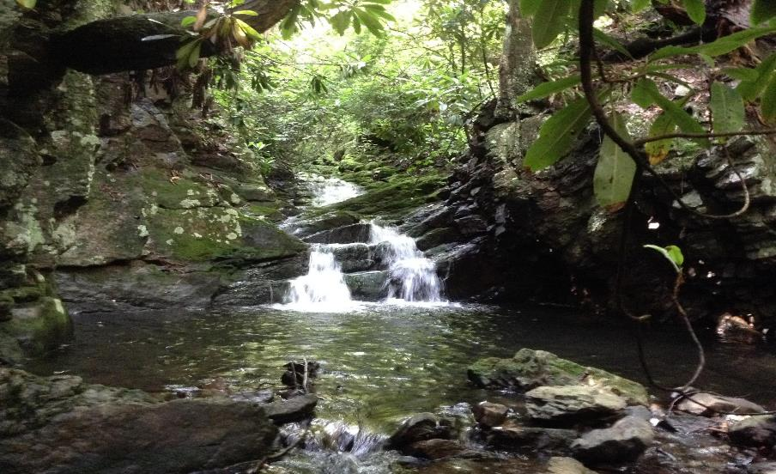
Habitat GIT Fall Meeting
May 4, 2022
Brook Trout
Stephen Faulkner
U.S. Geological Survey
Katie Ombalski
Woods and Waters Consulting, LLC
Co-Chairs, Brook Trout Workgroup

Slide 2
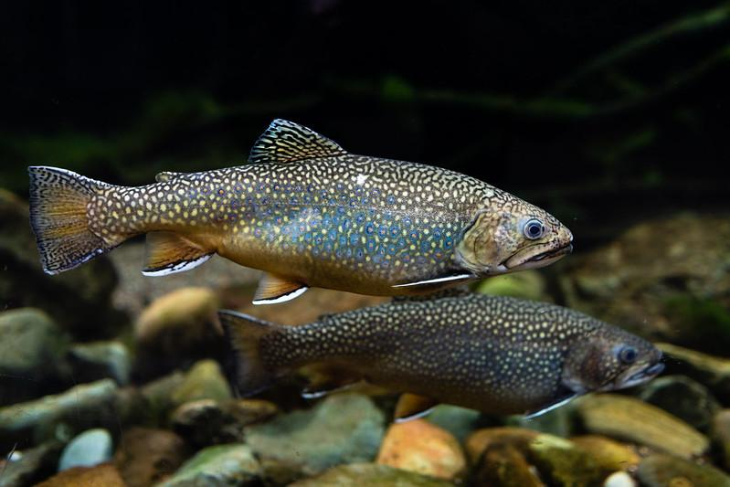
Brook Trout
Overview:
Finalized Logic and Action Plan
Focus is on primary barriers and compiling conservation/restoration actions
New GIT-funded project

Slide 3
Genetics Publications
    https://doi.org/10.1002/tafs.10337
https://doi.org/10.1002/nafm.10618

Slide 4
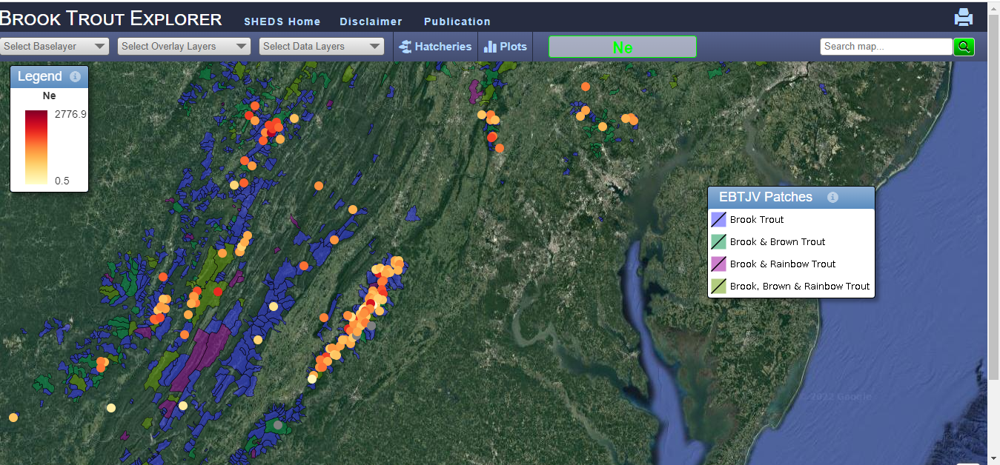
Publications
Genetics Web Viewer - https://bte.ecosheds.org/
    Genetics Web Tool

Slide 5
Other Publications
    Hydrology and Earth System Sciences. In Review

Slide 6
2022-23 Logic and Action Plan
Continue to engage BTWG members and stakeholder to identify large-scale priority action items with greatest impact
75% Riparian Forest Cover in all brook trout watersheds
Fencing livestock out of brook trout streams
Better private landowner engagement/incentives
Promote land stewardship

Slide 7
Challenges
    Need metrics to quantify conservation actions protecting current brook trout habitat
    Need to develop a reporting framework to collect and quantify all watershed restoration activities
    More capacity to engage and coordinate on large-scale priority action items with greatest impact

Slide 8
2022-23 Logic and Action Plan
    Large-scale actions necessary to achieve the Brook Trout outcome are connected to numerous other GITs (Healthy Watersheds, Fish Passage, Climate Resiliency, Forest Buffers, and Protected Lands) through common hydrological and ecological processes

Slide 9
2022-23 Logic and Action Plan
CBP GIT-funded Project: Facilitating Brook Trout Outcome Attainability through Coordination with CBP Jurisdictions and Partners
  Work with the CBP EPA Data Center Team to develop a tracking/reporting application that will support quality assurance (QA) procedures and a completed database.
  Build stronger collaborations with other CBP teams (Healthy Watersheds, Fish Passage, Riparian Buffers) on connected actions, e.g., reforestation, aquatic connectivity, land conservation

Slide 10
2022-23 Logic and Action Plan
CBP GIT-funded Project: Facilitating Brook Trout Outcome Attainability through Coordination with CBP Jurisdictions and Partners
  Identify opportunities for cross-GIT collaborations
  Strengthen communication and coordination with other stakeholders (e.g., Trout Unlimited, other NGOs)
  Collect and compile existing data from stakeholders and analyze monitoring and implementation data necessary to adequately track progress

Slide 11
2022-23 Logic and Action Plan
Development of a Rapid eDNA Tool to Detect Brook Trout Presence in the Field
  Apply existing qPCR eDNA brook trout assays in the CBW to evaluate various approaches (ddPCR, qPCR, commercial rapid field-testing platform)
  UMBC ICARE program - NSF-funded Master’s program committed to increasing the diversity of the environmental workforce
  UMBC Professor Dr. Tamra Mendelson, M.S. student
  USGS-EESC Geneticists Dr. Aaron Aunins and Dr. Cheryl Morrison

Slide 12
Priority Science Needs
Expand spatial-temporal groundwater model to rest of Chesapeake Bay Watershed to predict groundwater influence in headwater streams.
2. Determine how interactions between climate change and land use will affect brook trout.
3. Develop genetic metrics necessary to determine brook trout population health and resiliency

Slide 13
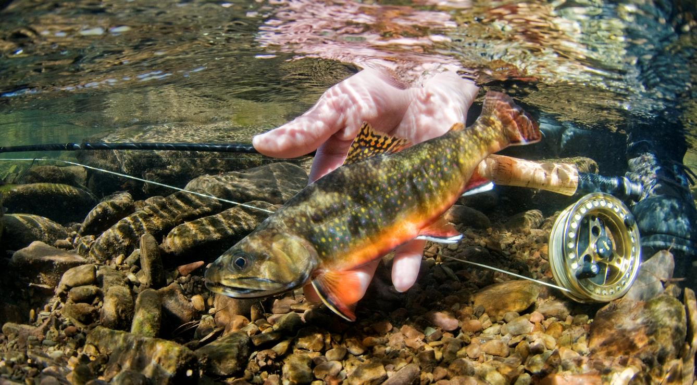
Questions?

