Slide 1

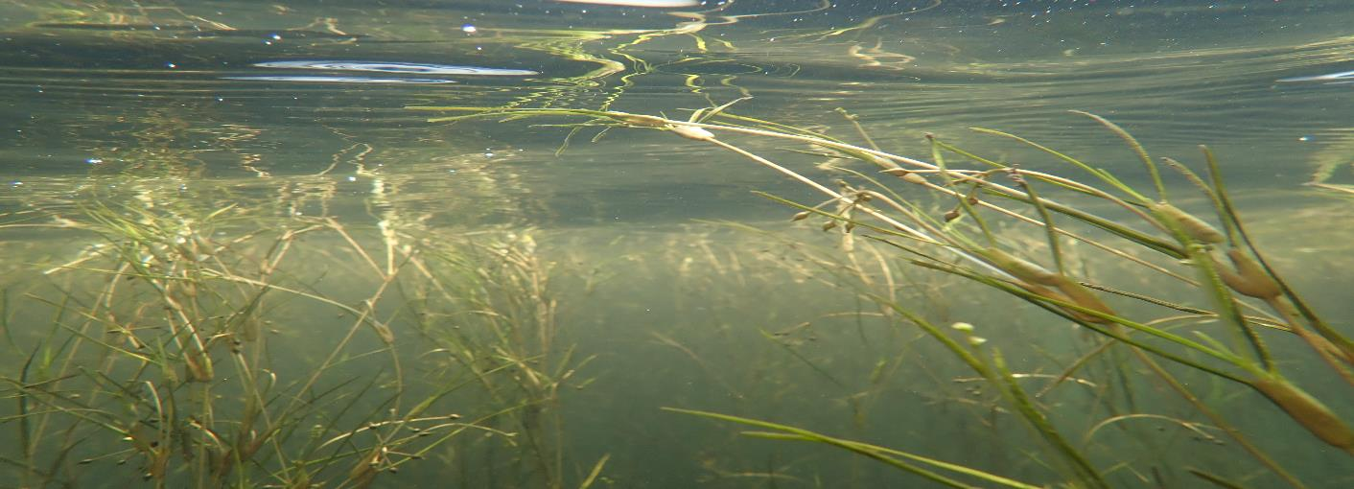
HGIT Spring Meeting – May 4th & 5th , 2022
Chesapeake Bay Program
SAV Workgroup Highlights
Brooke Landry
Maryland DNR and
Chair, SAV Workgroup

Slide 2
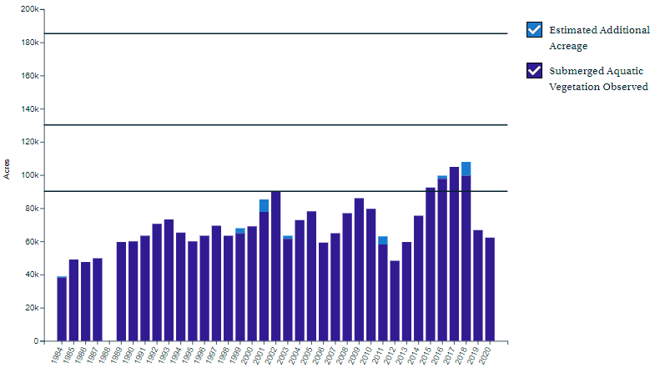
What is our Progress?
62,169 acres of SAV in 2020
48% of the 2025 target of 130,000 acres
34% of the ultimate 185,000-acre goal
******************************
The SAV Outcome is off course to achieving the target of 130,000 acres by 2025. Although the 62,169 acres mapped in 2020 is a 60% increase from the 38,958 acres observed during the first survey in 1984, it is a 20% decrease from the current 10-year average of 78,168 acres and a 7% decrease from 2019 when 66,684 acres of underwater grasses were mapped.
https://www.chesapeakeprogress.com/abundant-life/sav
Chesapeake Bay SAV Abundance 1984-2020

Slide 3
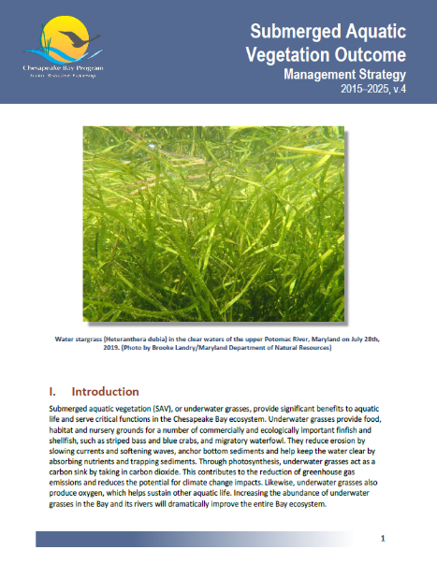
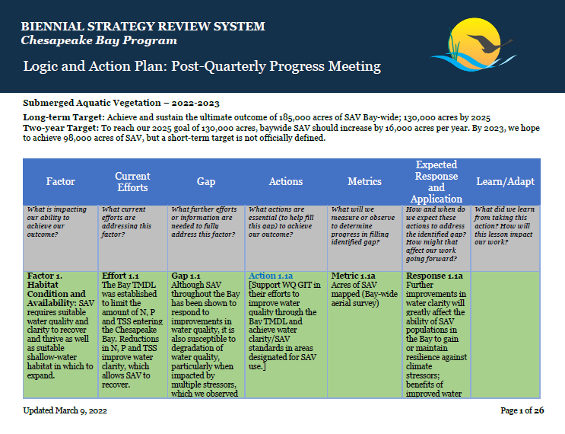
CBP Strategy Review System: Updated
SAV Management Strategy and Logic and Action Table/2-Year Workplan

Slide 4
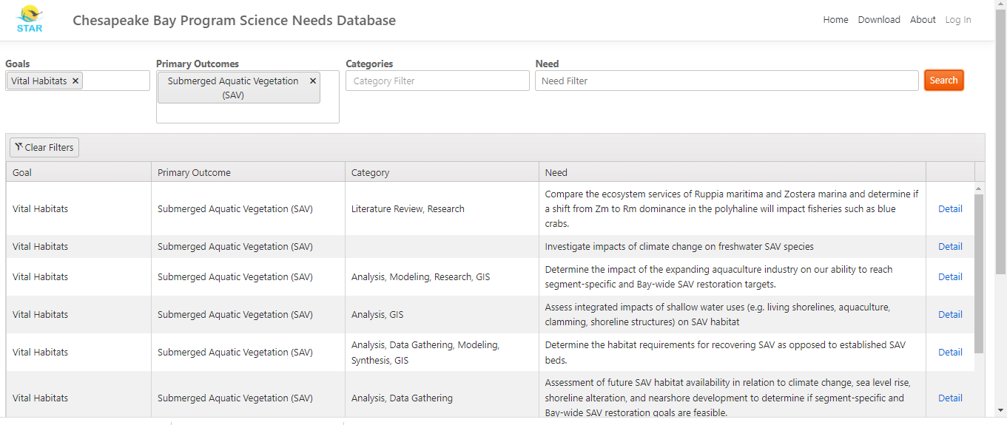
Science and Research Needs
https://star.chesapeakebay.net/#

Slide 5
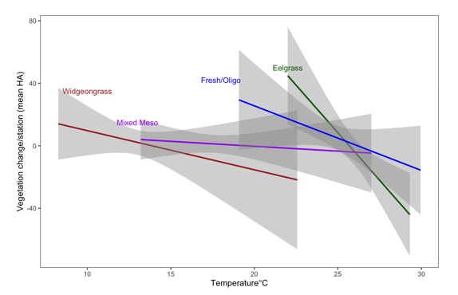
Modeling Climate Impacts on SAV in CB
2021 GIT-Funded Project
STAR/SAV Workgroup Collaboration
Contracted to VIMS (Chris Patrick’s team is lead) with sub-contract to Jon Lefcheck at SERC.
This project is addressing the role of climate stressors on Chesapeake Bay SAV, including warming temperatures, rising sea levels, chronic low oxygen concentrations, and increased runoff driven by greater precipitation and more frequent, intense storm activity.

Slide 6


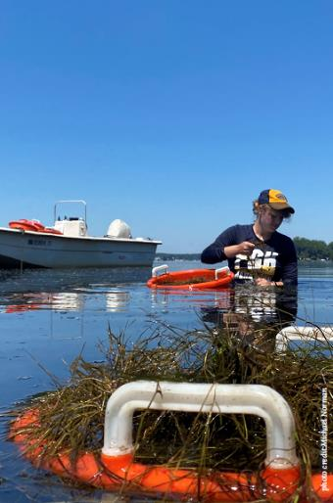
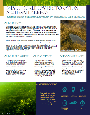
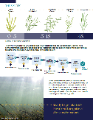
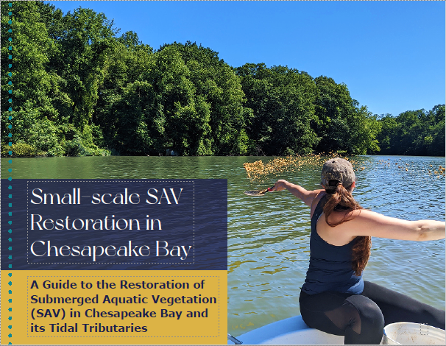
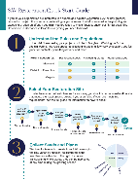
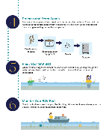
SAV Restoration Guide and associated outreach materials
2020 GIT-Funded Project
Completed December 2021
Contracted to Green Fin Studio (Dave Jasinski is lead) with SAV consultation by Cassie Gurbisz, SMCM.

Slide 7
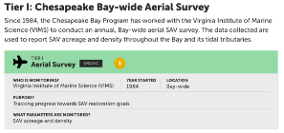
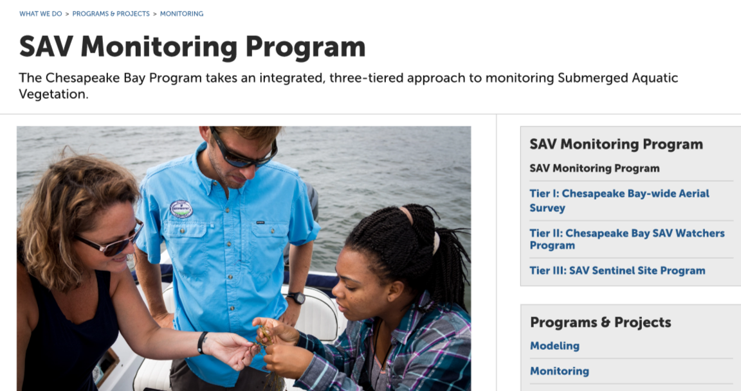
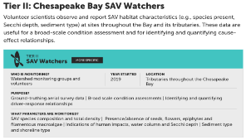
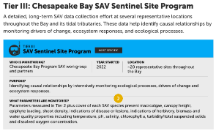
Chesapeake Bay SAV Monitoring webpages coming soon on www.chesapeakebay.net
Chesapeake Bay SAV Monitoring: A 3-Tiered Hierarchical, Integrated and Coordinated Monitoring Approach
1984

Slide 8
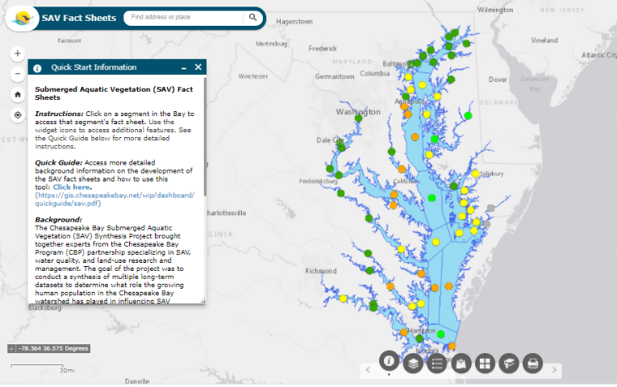
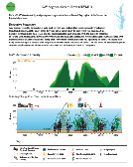
SAV Syn Segment Descriptions – working on automated updates
Data Dashboard: https://gis.chesapeakebay.net/sav/
VIMS maps: https://www.vims.edu/research/units/programs/sav/access/maps/index.php
CAST: https://cast.chesapeakebay.net/Home/TMDLTracking#SAVReportsSection

Slide 9
SAV Workgroup and
STAC Workshops
Rising Watershed and Bay Water Temperatures—Ecological Implications and Management Responses
Advancing Monitoring Approaches to Enhance Tidal Chesapeake Bay Habitat Assessment including Water Quality Standards for Chesapeake Bay Dissolved Oxygen, Water Clarity/SAV and Chlorophyll a Criteria
Evaluating a Systems Approach to Wetland Crediting

Slide 10
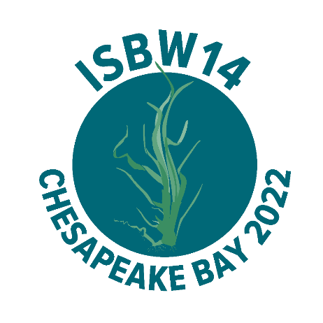
World Seagrass Conference 2022
&
International Seagrass Biology Workshop 14
The Graduate Annapolis
Annapolis, MD
August 7th – 12th, 2022
isbw14.org

Slide 11

HGIT Spring Meeting Chesapeake Bay Program
Questions?
Presentation template by SlidesCarnival.

