Slide 1


Diversity, Equity, Inclusion and Justice (DEIJ) at the Chesapeake Bay Program
Briana Yancy, EPA Life Scientist- Diversity Workgroup Coordinator, Chesapeake Bay Program
Bo Williams- EPA Environmental Protection Specialist & DEIJ Action Team Coordinator
Notes:
I think we only have 10-15 mins?

Slide 2

Agenda
DEIJ Implementation Plan
Implementation Ideas
Environmental Justice & Habitat
Resources
Questions
Notes:
Bo

Slide 3
DEIJ Strategy & Implementation Plan
Notes:
Bo

Slide 4
Partnership DEIJ Goals
Diversity Outcome: Identify stakeholder groups that are not currently represented in the leadership, decision making and implementation of conservation and restoration activities, and create meaningful opportunities and programs to recruit and engage them in the partnership’s efforts.
Environmental Justice Principle: Promote environmental justice through the meaningful involvement and fair treatment of all people, regardless of race, color, national origin or income in the implementation of this Agreement.
Notes:
Bo

Slide 5
CBP DEIJ Strategy and Implementation Plan Purpose
The CBP DEIJ Strategy, Restoration from the Inside Out, Provides recommendations to be used by CBP leadership, Goal Implementation Teams, Workgroups, and other components of CBP to:
                Inform the activities in Logic and Action Plans and
Integrate DEIJ in the implementation of management strategies
To help achieve the outcomes of the Chesapeake Bay Watershed Agreement
Notes:
Bo

Slide 6
What are we being asked to do?
Update Work Plans and Management Strategies to articulate the roles of DEIJ and to ensure inclusion of considerations for equitable distribution of benefits and improvements and considerations for reduction of disproportionate adverse environmental impacts in underrepresented communities.
Recruit and Retain: Seek opportunities to recruit, support and retain people from underrepresented groups, incorporating into decision making.
Participate and Discuss: Include discussion time regarding DEIJ into the agendas. Attend trainings and participate in EJ-led gatherings, tribal meetings and conferences, and other engagement opportunities.
Include: Underrepresented groups in the development and implementation of the Chesapeake Bay Watershed Agreement.
Reporting: Via SRS QPMs. Anytime you do something that involves DEIJ please feel free to share that with GITs/Workgroups and the diversity workgroup and be sure to include it in your SRS narrative
Notes:
Bo
Encourage you to look at the plan and take ownership of your actions and acivtely reach out to the Diversity workgroup when you need help. There are 21 actions relevant to the GITS and workgroups at the Chesapeake Bay Program

Slide 7
Implementation Ideas
Notes:
briana

Slide 8

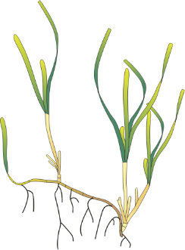
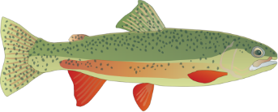
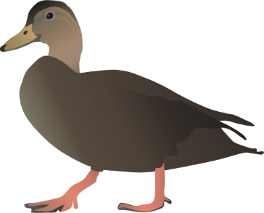


Update Work Plans and Management Strategies
Wetlands
Improve WetlandsWork.org by adding new success stories, implementing the marketing strategies that were developed to increase traffic of the site, and improving security and certifications to ensure site access to all by adding an accessibility widget & Assess risks to coastal habitats by forecasting vulnerability and resiliency of coastal systems to future change.
SAV
Continue SAV restoration efforts through direct plantings of seeds or propagules in hopes of establishing viable SAV beds where they are not recovering naturally with improvements in water quality or where diversity is low that where applicable correspond to locations on EJ Dash
Brook trout
Develop cache of outreach/communication products in English and Spanish for quick response to requests
Stream Health
Provide training and education to diversity of stakeholders on stream restoration and stream health by partnering with BIPOC organizations to reach new/diverse stakeholders .
Fish Passage
Conduct target species monitoring via community science of select dam removals in VA (+/- and relative abundance)
Black Duck
Improve methods of monitoring outcome progress – could partner with HBCU and other MSI to create monitoring programs
Notes:
Update Work Plans and Management Strategies to articulate the roles of DEIJ and to ensure inclusion of considerations for equitable distribution of benefits and improvements and considerations for reduction of disproportionate adverse environmental impacts in underrepresented.
this is a recap of when we went through your logic and action plans and pulled out some actions that could have a deij lens

Slide 9




Participate and Discuss
Notes:
It’s a constant commitment to others, growth and learning.
Include discussion time regarding DEIJ into the agendas. Attend trainings and participate in EJ-led gatherings, tribal meetings and conferences, and other engagement opportunities.
People have an opportunity to participate in decisions about activities that may affect their environment and/or health.
The public's contribution may influence the decision
Community concerns will be considered in the decision-making process
Decision makers will seek out and facilitate the involvement of those potentially affected

Slide 10

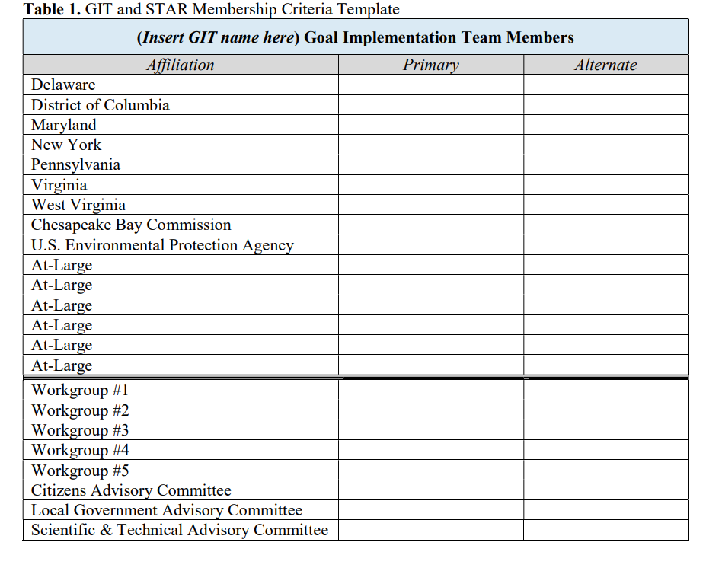

Recruit and Retain
Notes:
Recruit and Retain: Seek opportunities to recruit, support and retain people from underrepresented groups, incorporating into decision making.
Mentorship consider becoming a part of a mentoring organization or hosting an intern from an org that works hard to recruit underrepresented identities
Think about the membership of your GIT and workgroups do you have diverse perspectives from agencies. How can you include people in workgroup chair positions, at large membership at the least cost to them. How can you make sure ideas are included from those who its too difficult for them to be at the table

Slide 11

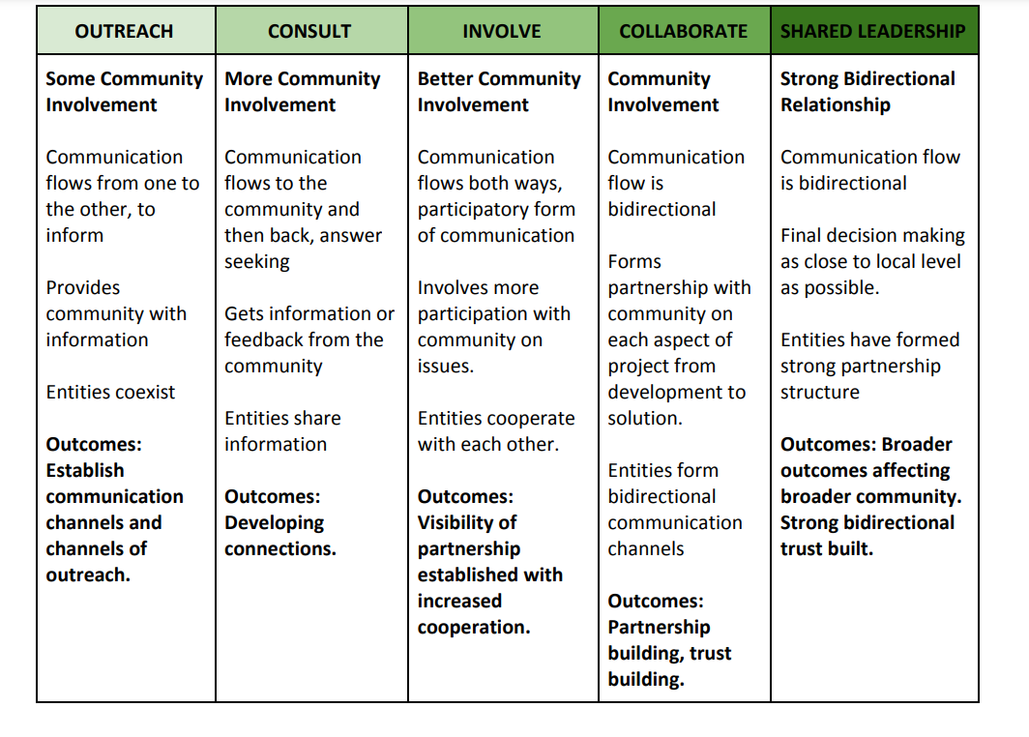
Include
Notes:
Include: Underrepresented groups in the development and implementation of the Chesapeake Bay Watershed Agreement. Thinking about your membership but also think about when you’re implementing projects and you need partners, contractors etc are you looking at women owned businesses, minority owned businesses, do you seek out diverse local partners before implementing something on the ground
How do we define “Meaningful Engagement/Involvement”?
People have an opportunity to participate in decisions about activities that may affect their environment and/or health.
The public's contribution may influence the decision
Community concerns will be considered in the decision-making process
Decision makers will seek out and facilitate the involvement of those potentially affected
People have an opportunity to participate in decisions about activities that may affect their environment and/or health.
The public's contribution may influence the decision
Community concerns will be considered in the decision-making process
Decision makers will seek out and facilitate the involvement of those potentially affected
The Spectrum of Community Engagement is a really useful framework. The DEIJ plan calls for GITs and workgroups to engage communities in developing logic and action plans, in decision making, and implementation work. But it doesn’t describe how those touch points will take place and to what degree—will community groups be part of the Goal Teams? Will they be consulted in an advisory fashion? Will there be public comment period

Slide 12
Environmental Justice & Habitat
Notes:
Briana

Slide 13
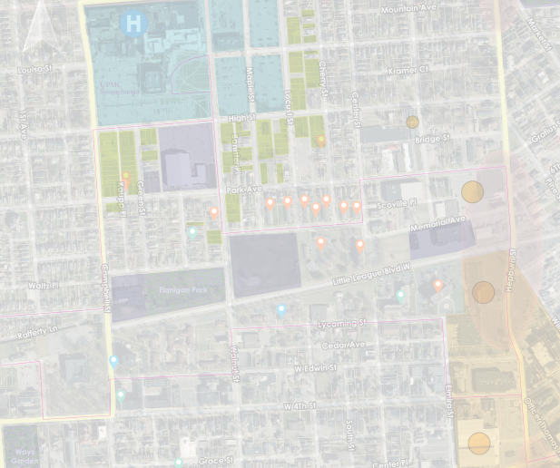

Building Capacity & Assisting Others
What can you do for others?
Provide support and technical assistance
Involve diverse groups & alleviate burdens
Notes:
What can we do for others? Investment in the growth, wealth and resource distribution of the most impacted groups, organizations and communities. Technical assistance, capacity building, funding, extra set of hands, more supplies etc. Involve groups early and often
-

Slide 14
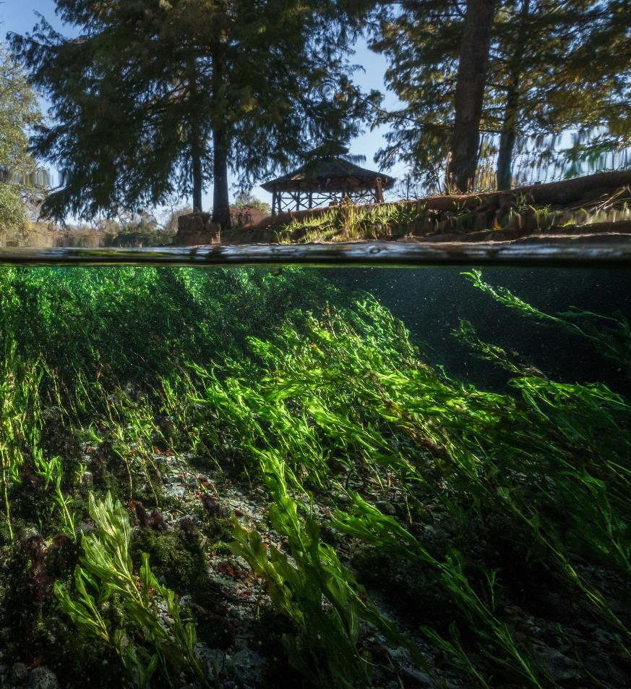
Protecting Species and Equitable Benefits for People
Increase endangered species & decrease in non-native species
Groundwater conservation of the Edwards Aquifer has also increased
Mitigate impact of water use restrictions & advance benefits of public access to overburdened groups
https://www.fondriest.com/news/managing-and-studying-texass-edwards-aquifer.htm
Notes:
Think more about how this developed that way, who did they talk to. Process for this
Expansion of the federally endangered Texas wild-rice, leading to a 125% increase in the plant’s coverage area.
decrease in non-native aquatic plant species
Groundwater conservation of the Edwards Aquifer has also increased
EAHCP developers considered how water use restrictions may impact the livelihood and economy of agricultural communities
The Regional Water Conservation Program partnered with municipal water providers to distribute low-flow toilets and promote other water-saving measuresEAHCP
The San Marcos River runs through the city of San Marcos, with a population of 43% Hispanic or Latino and an official Hispanic Serving Institution (Texas State University). The city has numerous public access sites and parks for people to enjoy the river for free during summer heat
https://www.fws.gov/story/2021-08/conservation-plan-texas-promotes-habitat-restoration-environment-justice

Slide 15
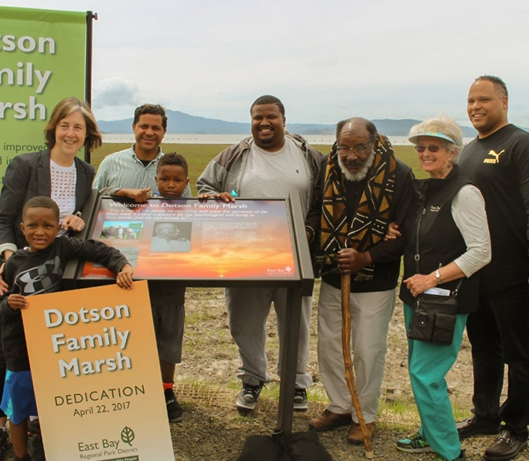
Access to Science: Voice & Choice
Richmond wetland restoration: Cullinan Ranch vs Breuner Marsh
Science choice can be bias choice
It is incumbent upon scientists to see the world through the lens of impacted people
https://bayday.org/environmentalist-dotson-earns-bay-hero-award/
Notes:
Research has a lot of power it impacts policy, project implantation and investment. Being included in science brings power to groups but also
There is a lot of unconscious bias in restoration and research. When you don’t have diverse perspectives, interests involved
Being able to access and understand science gives people more power and say in what happens to their communities.
In 2012 we began assessing damages to Castro Cove in San Pablo Bay near Richmond. It had been contaminated by oil, mercury, and lead associated with the adjacent Chevron refinery. To compensate for the injuries (in addition to cleaning up Castro Cove), we proposed to restore saltmarsh wetlands at Cullinan Ranch, part of San Pablo Bay National Wildlife Refuge, about ten miles to the north. We immediately met opposition from locals. They wanted the settlement funds to stay in Richmond; Cullinan Ranch was too far away.
We have project selection criteria set in federal regulations. Top of our list is always nexus— we aim to restore the same type of habitat and species that were injured
Building EJ into cost benefit analysis
https://thecottonwoodpost.net/2019/06/01/a-marsh-in-richmond-what-a-restoration-project-taught-me-about-racial-bias-white-privilege-and-environmental-justice/
https://gsa.confex.com/gsa/2021AM/meetingapp.cgi/Paper/369553
https://www.geosociety.org/GSA/News/pr/2021/21-59.aspx

Slide 16
Resources
Notes:
Bo

Slide 17
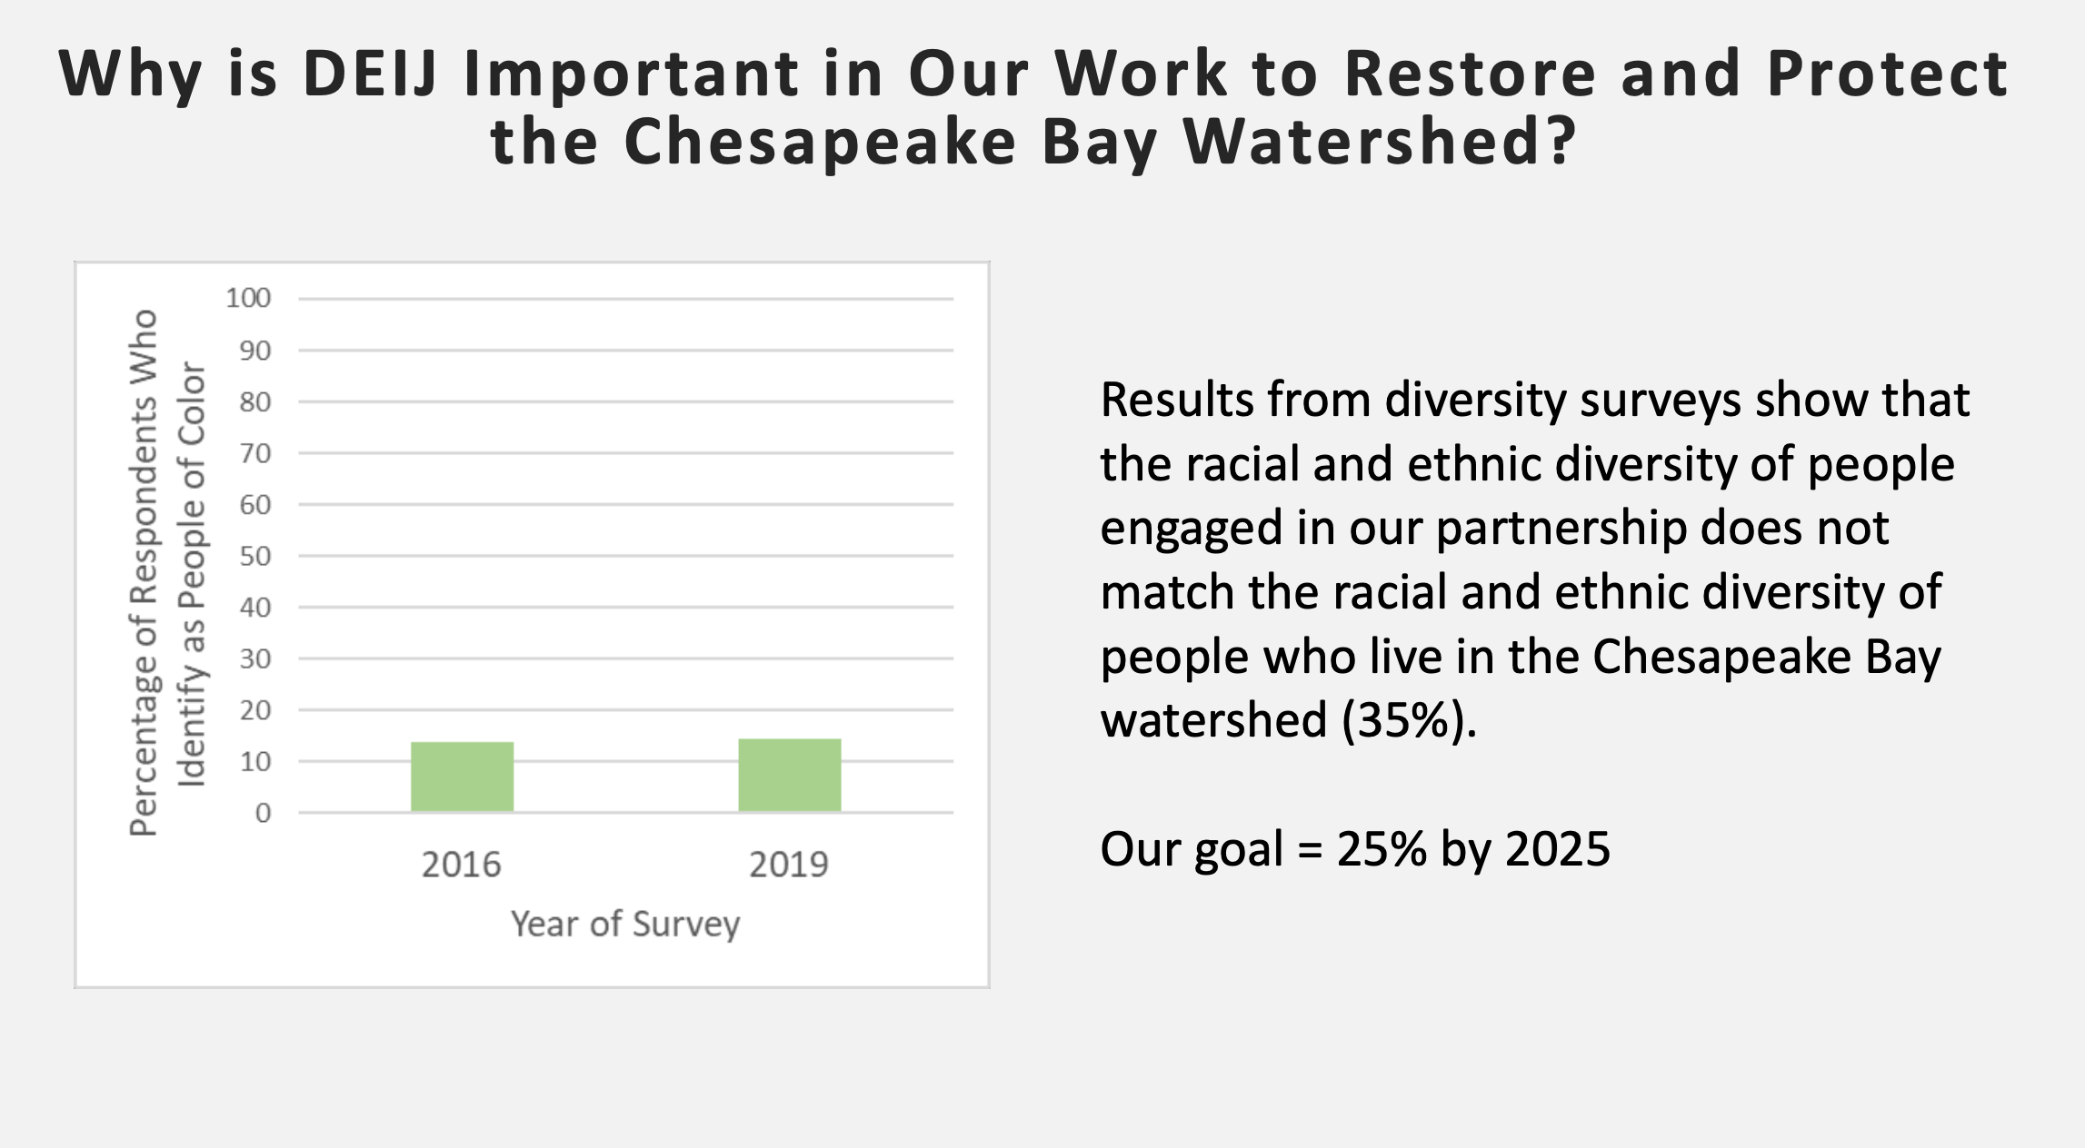
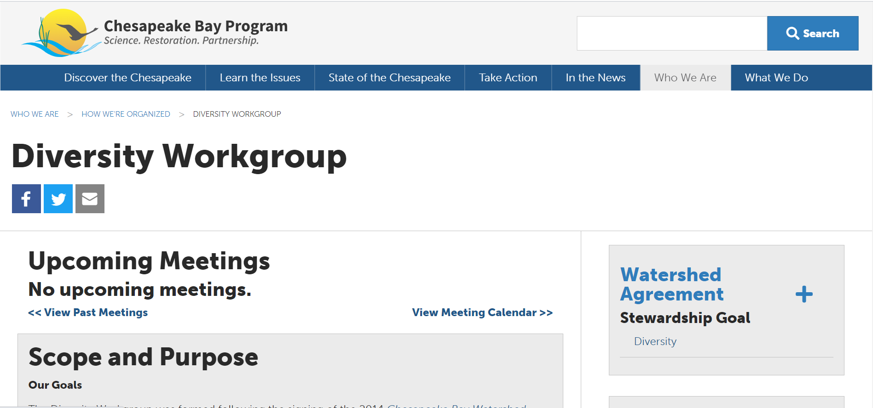
Notes:
Bo
Talk about the things we are doing and how they can be involved
Specifically highlight recruitment, document to help update workplans and reporting, ej dash for including Go to the website and highlight relevant resources….Just as the people in the Diversity Workgroup are here to help provide consultation, help or advice. We share all of our resources on the website and update it regularly.
https://chesapeake-deij2-chesbay.hub.arcgis.com/

Slide 18
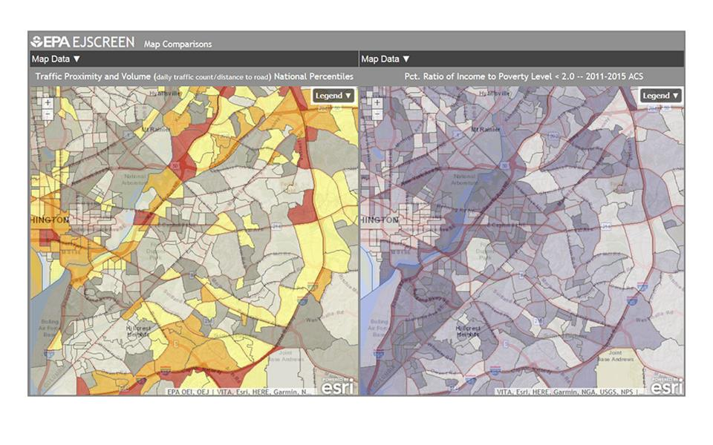
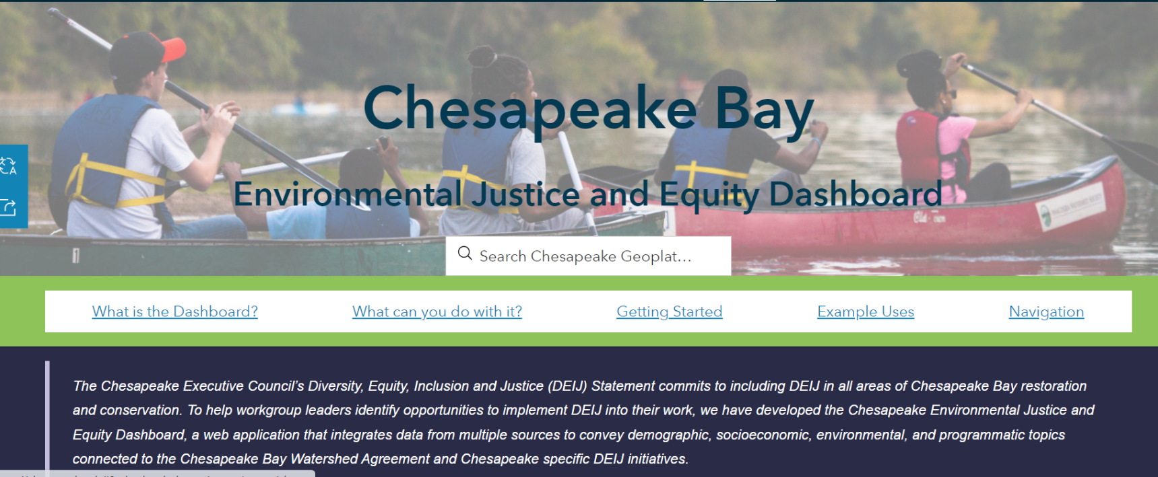

Slide 19
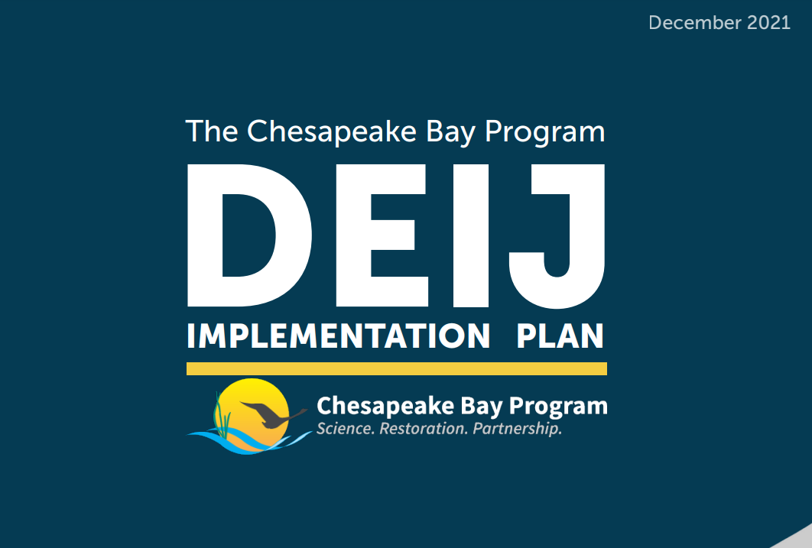
DEIJ Action Team: https://www.chesapeakebay.net/who/group/diversity_equity_inclusion_and_justice_action_team
Implementation Plan: https://www.chesapeakebay.net/documents/DEIJ-Final.pdf
Notes:
Bo

Slide 20


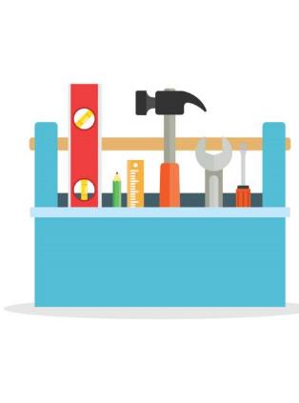
DEIJ Lens
Who
Where
What
Notes:
Bo
Remember the lens
Who are you working with, who are your partners, who is in the community, whose research are you citing,who are you inviting
Where is the work being done, where is there insersection between unrepresented communities and your work
What kind of work are you doing and how can you engage others, what kind of practices and tools are you using

Slide 21
Questions?
Notes:
Bo
If no one has questions start asking theses What questions do you have for us?
How can the Diversity Workgroup and Habitat GIT work together to achieve these goals?
What steps have you taken to incorporate DEIJ into your work?
What do you need moving forward?

Slide 22
Thank You!
Briana Yancy- EPA Life Scientist- Diversity Workgroup, Coordinator (yancy.briana@epa.gov)
Bo Williams- EPA Environmental Protection Specialist & DEIJ Action Team Coordinator (Williams.James@epa.gov)
Notes:
Figure out your why
Be okay with letting other be in charge

Slide 23
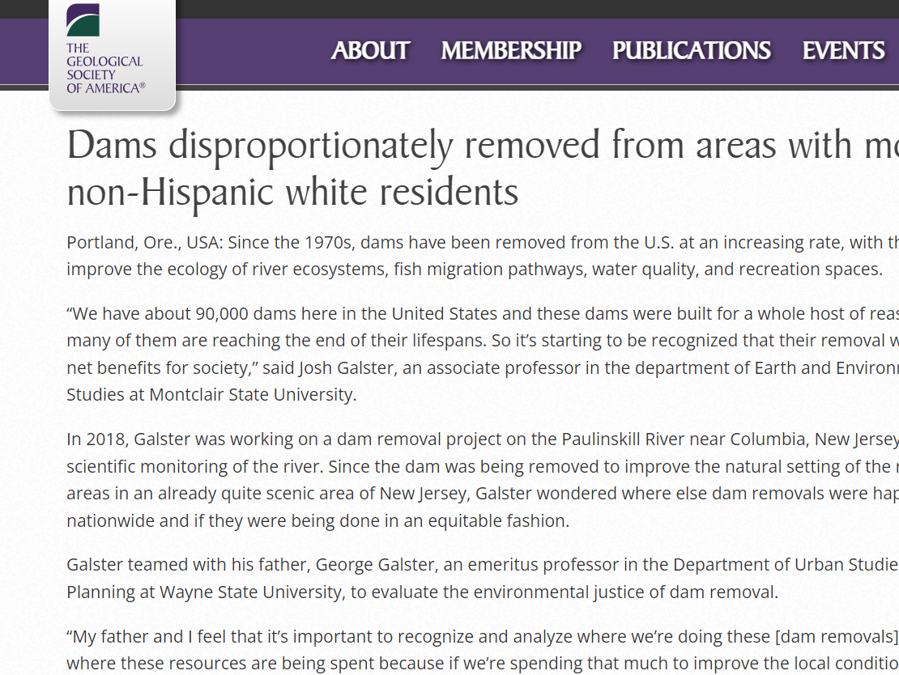
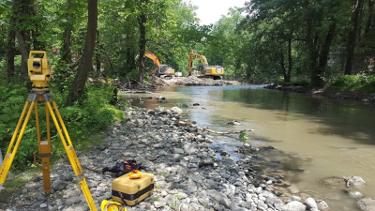
Additional Example 1 –Racial Bias in Dam Removal
https://www.geosociety.org/GSA/News/pr/2021/21-59.aspx
Notes:
.

Slide 24
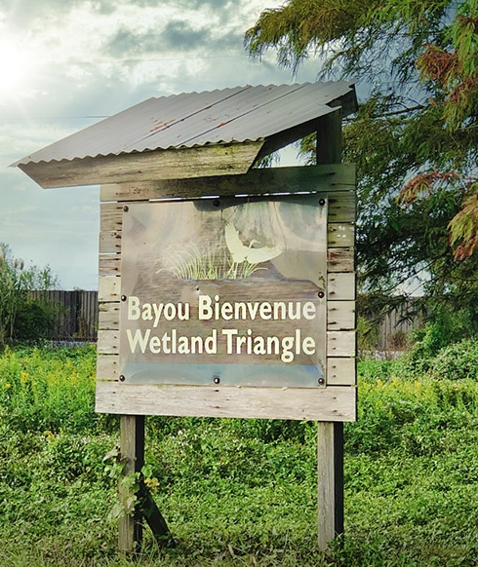
Additional Example 2 – Wetland Restoration, Environmental Justice & Food Security
Hurricane Katrina has led to degradation in the wetlands and quality of life in the Lower 9th Ward.
Community leaders are now engaged in a wetland restoration project
A healthy natural environmental is necessary for food justice in the Lower 9th
https://nolaplaces.com/place/bayou-bienvenue-wetlands/
Notes:
Hurricane Katrina has exacerbated problems of environmental conservation, environmental injustice and food insecurity in the Lower 9th Ward.
Community leaders are now engaged in a wetland restoration project that seeks to restore the BBWT to a cypress swamp for improved environmental protection
a healthy natural environmental is necessary for food justice in the Lower 9th
wetland degradation has diminished access to culturally relevant food that was traditionally procured from surrounding wetlands and grown within the neighborhood.
https://www.liebertpub.com/doi/full/10.1089/env.2010.0008

Slide 25
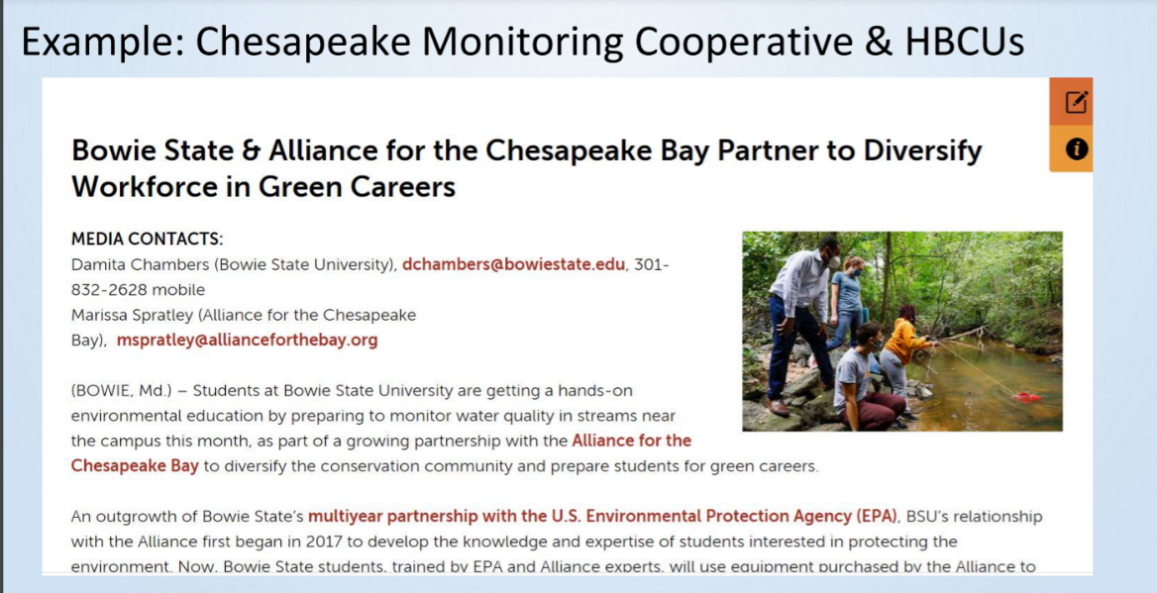
Additional Example 2 – Partnerships with HBCUs

Slide 26
DEIJ Defined

Slide 27
Definitions
Diversity- The demographic mix of a specific collection of people, taking into account elements of human difference. For example: racial and ethnic groups, income, spectrum of built environment settings (rural to urban), faith communities, LGBTQ+ populations, people with disabilities, gender, relationship to the natural environment. (Credit: Skeo, adapted from the D5 Coalition)
Inclusion- Refers to the degree to which diverse individuals are able to participate fully in the decision-making processes within an organization or group. While a truly “inclusive” group is necessarily diverse, a “diverse” group may or may not be “inclusive.” (Credit: D5 Coalition)
Equity - Improving equity is to promote justice, impartiality and fairness within the procedures, processes, and distribution of resources and rewards by institutions or systems. Tackling equity issues requires an understanding of the underlying or root causes of disparities within our society. (Credit: D5 Coalition)
Justice- The quality of being just, impartial, or fair. (Credit: Merriam Webster) Directly dismantling barriers to resources and opportunities in society so that all individuals in communities can live a full and dignified life. (Credit: Avarna Group)
Notes:
Talking point: Environmental justice vs. justice? We consider both in what we’re trying to do.

Slide 28
