Slide 1
Building and Maintaining Coastal Community Resilience through Blue Carbon Resources
5/5/2022
Habitat Goal Implementation Team
Spring Meeting

Slide 2
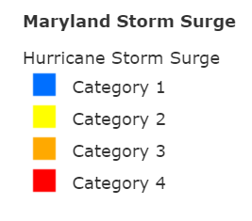
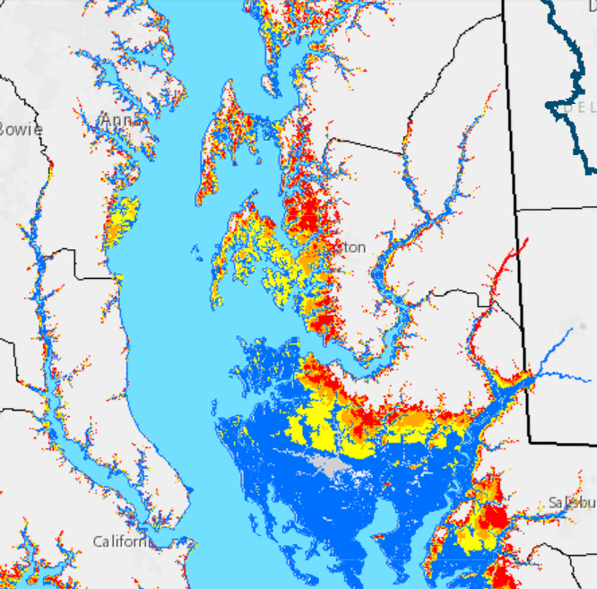
Tackling coastal resilience with communities
Example Coastal Resilience Issue:
Storm Surge Flooding
Goal: Work with a local Chesapeake Bay coastal community over multi-year effort to help solve its coastal resilience issues while benefiting other local priorities and mitigating climate change.
Process: Co-develop research by engaging community throughout, beginning with formulating the problems to be addressed. Partnering with existing networks/initiatives to identify and address current research gaps.
Focus: Hoping to incorporate/investigate natural infrastructure options, such as tidal wetlands, salt marshes, seagrass, and quantify associated ecosystem services and co-benefits (e.g., flooding mitigation, blue carbon sequestration, habitat creation, water quality improvement, community health).
Community: Aiming to work with under-served, under-represented, and/or vulnerable community.
Risk of storm tide flooding from hurricanes as predicted by NOAA SLOSH model. Obtained from Chesapeake Bay Program EJ and Equity Dashboard:
https://chesapeake-deij2-chesbay.hub.arcgis.com/

Slide 3
Solutions-Driven Research
Research that addresses real-world problems to make timely decisions based on science
Emphasizes stakeholder engagement and integration
Solutions-oriented outputs should drive development of research

Slide 4
Engagement and Input Thus Far
Timeline of engagements
Partners/Stakeholders
September: Meeting with EPA Region 3 and CBP to discuss coastal resilience and blue carbon research needs
October-November: Met with individual recommended stakeholders for input
November: 2nd meeting with EPA Region 3 and CBP for feedback on communities and potential project components
December: Met with MD DNR to discuss related project and interest in coordinating
January: Development of EPA ORD and Regional research funding components and proposals
February-April: Narrow down location
EPA: Region 3, Chesapeake Bay Program Office, Office of Air & Radiation, Water
Federal: NOAA, DOE, USACE
Chesapeake Bay Program
  Habitat GIT, SAV, Wetland, and Climate experts/coordinators
  Local Government coordinators
Academic: Virginia Institute of Marine Science, Duke, University of Maryland
Non-profits: The Nature Conservancy, The Conservation Fund, Chesapeake Bay Trust
Delmarva Restoration and Conservation Network
Maryland Department of Natural Resources

Slide 5

Community characteristics for consideration
Interested, willing, and motivated
Existing community relationships, coalitions, or networks
Clear understanding of what their problem(s) is/are that they are trying to solve
Potential to have meaningful impact in community
Prefer to work with under-served, vulnerable, or disproportionately impacted

Slide 6
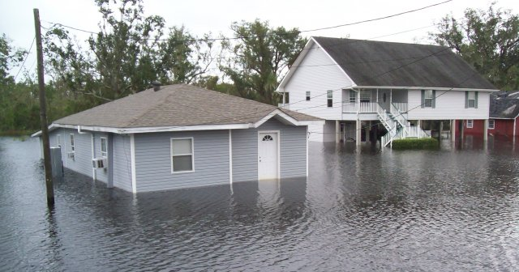
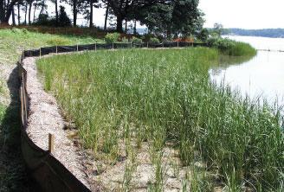
Potential project components
Exploring natural infrastructure options, including conservation, restoration, or new infrastructure
How and where to site coastal resilience solutions for the greatest impact
Economic, social, and/or ecosystem service benefits and tradeoffs of coastal resilience solutions
Impacts of climate change on natural infrastructure benefits
Blue carbon potential of natural infrastructure options
Gaps in blue carbon data needed for markets
Project components would ultimately be co-developed with the community.

Slide 7
Relevant ORD science and research skillsets
Community engagement
  Community engagement strategies and social science analysis
  Stakeholder analysis
Ecosystem services and benefits
  Natural infrastructure benefit quantification
  Social and community health benefits analysis
Siting and implementing coastal resilience solutions
  Climate-smart adaptation design planning
  Spatial overlap between natural infrastructure conservation/restoration opportunities and socio-economic vulnerability
  Integrate measures of spatially co-located ecosystem services, habitat ecological integrity, and predicted risks to integrity of natural infrastructure
Monitoring
  Remote sensing blue carbon habitat quantification and prediction of impacts of climate change on blue carbon resources spatial distribution
  Citizen science strategies and incorporation
Blue carbon assessment
  Chesapeake-relevant blue carbon sequestration information inventory and synthesis (existing models, soil core and land cover data, experimental results)
  Mesocosm experiments assessing impact of climate change on carbon sequestering capabilities of blue carbon resources
Future impacts
  Relate land cover changes to coastal resilience capabilities
  Interactions between oyster aquaculture and submerged aquatic vegetation

Slide 8
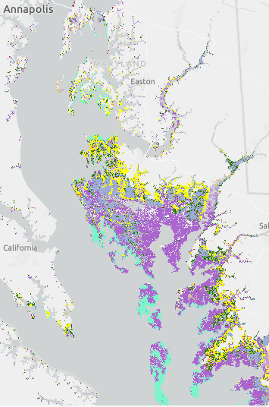
Potential Community:
Cambridge, MD
Cambridge, MD has historically under-served communities, flooding issues, interested in incorporating natural infrastructure options, CBP connections
Existing coalition through Envision the Choptank
Little Choptank River – part of Dorchester County – is area MD DNR is considering for Targeted Resiliency Area
TNC doing landowner engagement related to blue carbon in Dorchester
Existing blue carbon work and partners in Blackwater Wildlife Refuge
Cambridge
Dorchester County
Coastal marsh
Agriculture
Sea grass

Slide 9
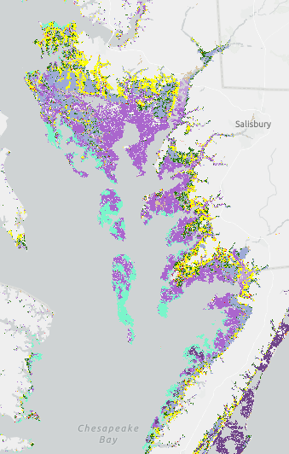
Potential Community:
Crisfield, MD
Crisfield, MD has historically under-served communities, coastal nuisance flooding, surrounded by salt marsh and SAV, American black duck habitat, CBP connections
Existing stakeholder advisory group through Nature Conservancy sea level rise adaptation NOAA grant project
Pocomoke corridor is area MD DNR is considering for Targeted Resiliency Area
Lower Shore Land Trust working with landowners in Somerset County
Blue carbon feasibility assessment transferability
Somerset County
Crisfield
Coastal marsh
Agriculture
Sea grass

Slide 10
Next steps
Gather partner (CBP, MD) feedback
Select community
Coordinate with ongoing work in community
Organize research capabilities within EPA and with partners
Engage community and identify community needs
Co-develop problem formulation
Co-design and scope research approach
Engage iteratively with community throughout

Slide 11
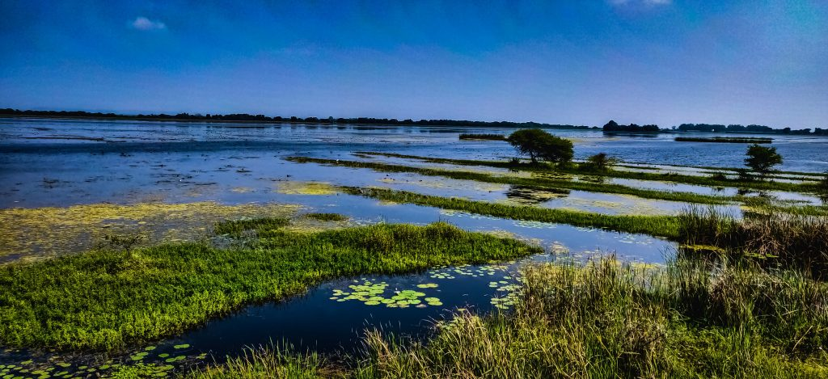
Thank you!
Questions?
Ideas?
Inputs?

