Slide 1


Rising Watershed and Chesapeake Bay Water Temperatures—Ecological Implications and Management Responses
STAC Workshop Draft Findings
Habitat GIT
May 5, 2022
Presented by Katie Brownson, USFS

Slide 2
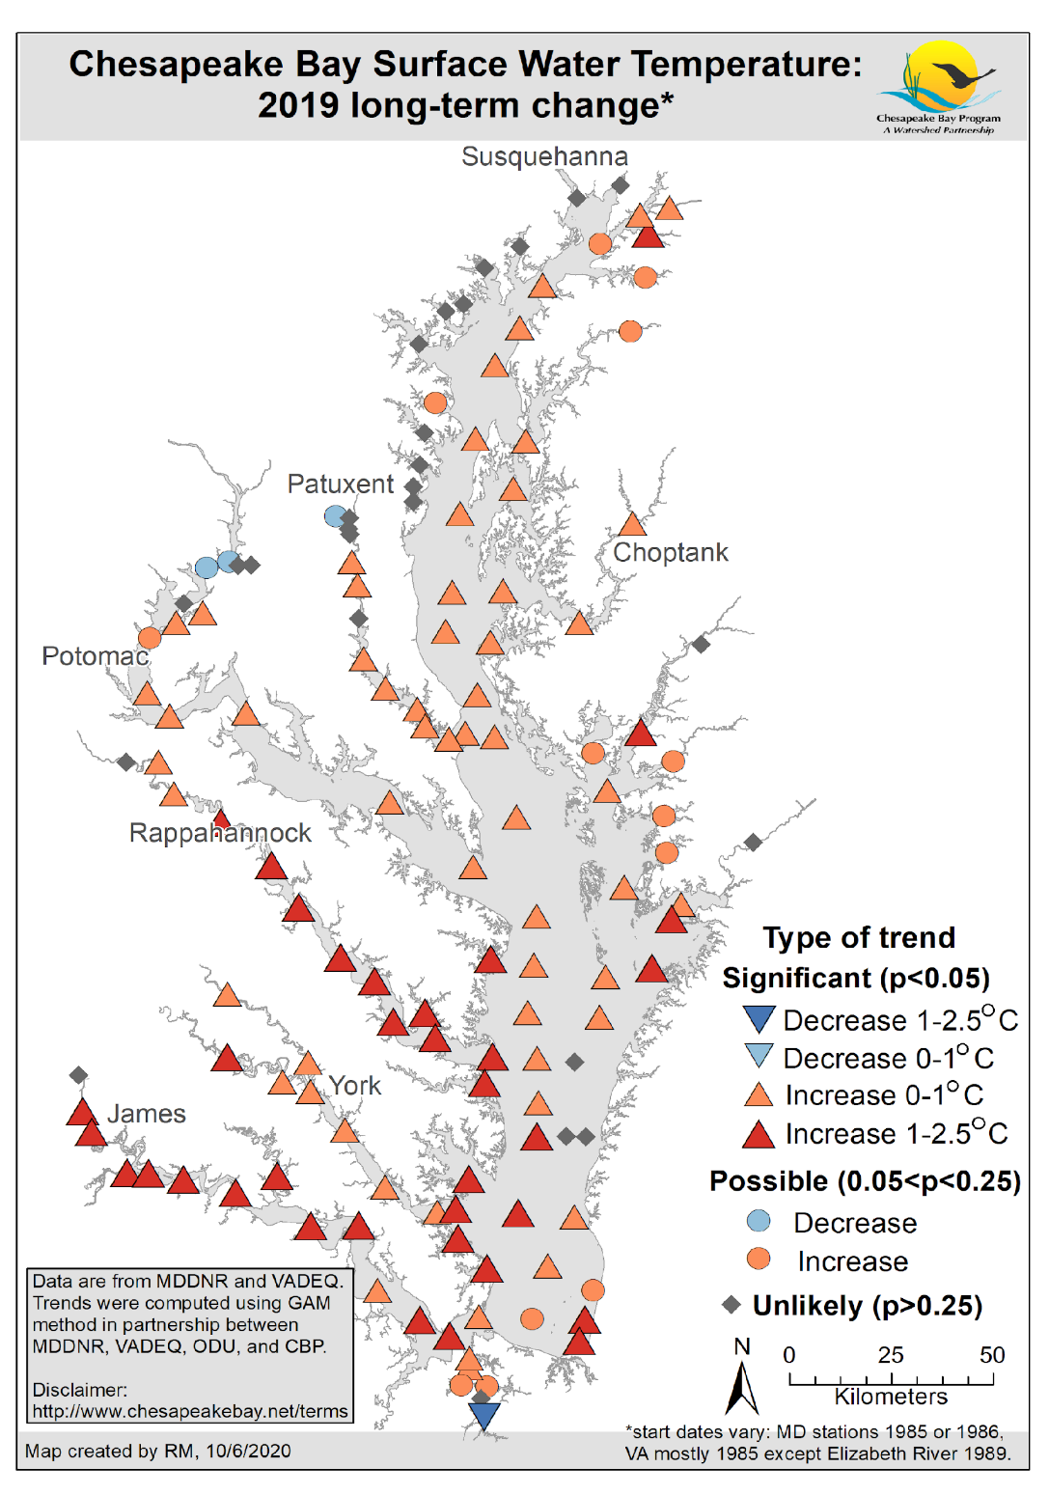
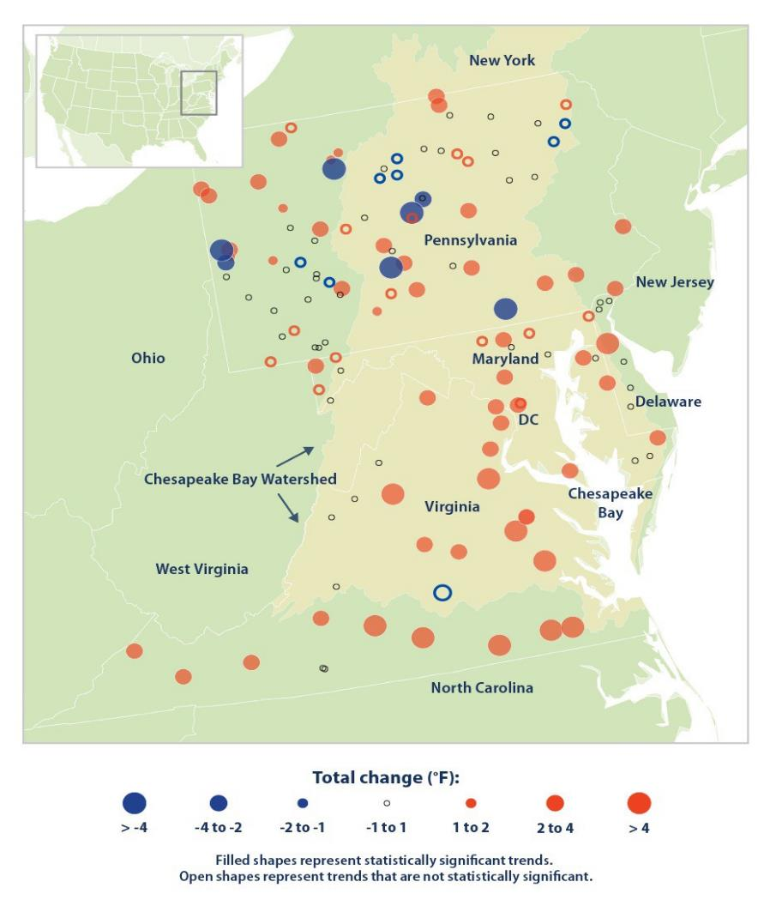
Chesapeake Bay tidal and non-tidal water temperatures have been increasing.
Rice and Jastram, 2015)

Slide 3
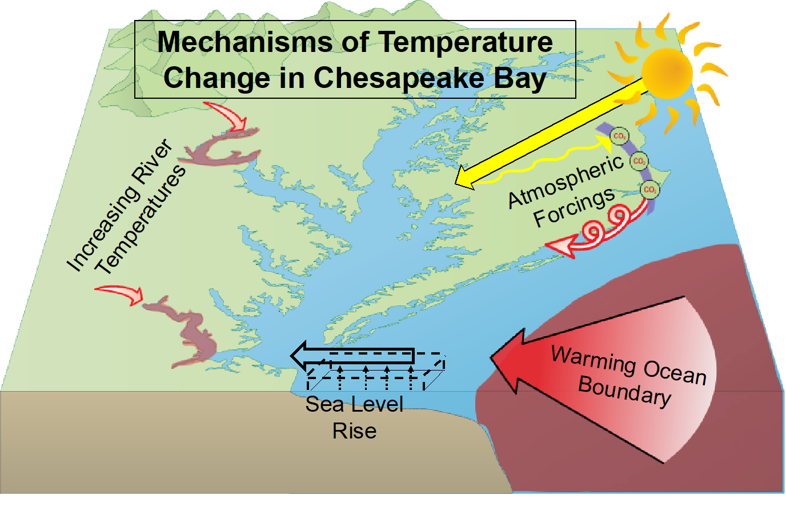
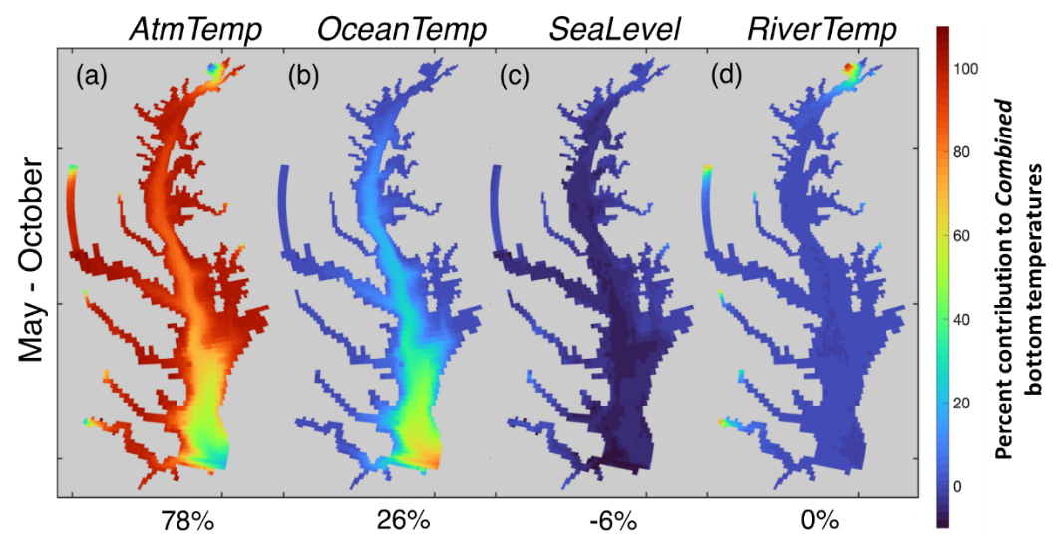
Increasing tidal water temperatures have been driven largely by atmospheric forcings
and the warming ocean boundary
Air temperatures
Ocean temperatures
Sea level rise
River temperatures
Source: Hinson at el. 2021

Slide 4
Increasing stream and river temperatures have been driven by rising air temperatures, but other drivers have a strong influence
Heat transfer from channel substrate
Substrate composition (bedrock vs. gravel)
Hyporheic exchange
Residence time in hyporheic zone
Groundwater inputs
Hyporheic exchange
Groundwater temperature
Degree of infiltration
Groundwater residence time
Legacy sediment
Underlying geology
Runoff temperature
Sources of water (farm ponds, municipal, mining and industrial discharge, snowmelt, etc.)
Upstream and riparian land use
Degree of infiltration
Channel temperature buffering capacity
Surface area: volume ratio
Channel form
Large woody debris
Instream vegetation
Water clarity
Stream size
Streamflow
Baseflow
Withdrawals (from surface or groundwater)
Local hydrology (presence of dams, floodplain connectivity, etc.)
Hydraulic resistance
Upstream and riparian land use
Groundwater inputs
Degree of infiltration
Rainfall
Non-tidal water temperature
Air temperature
Direct solar radiation
Canopy cover
Ambient air temperature

Slide 5
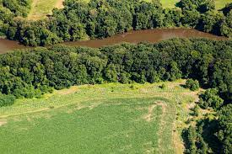
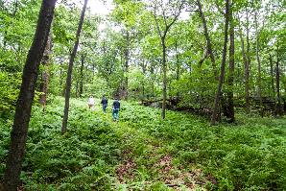
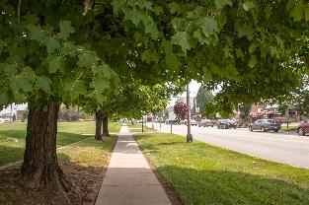
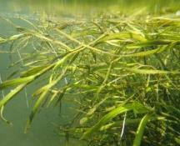
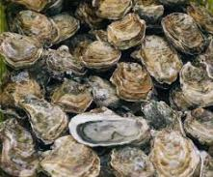
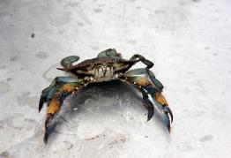
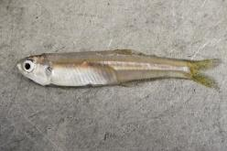
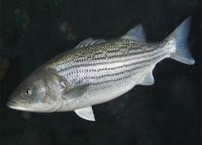
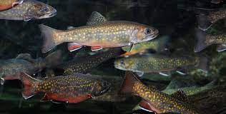
BMPs
Conservation
Land use practices
Mitigation
Lowering of Water Temps
Watershed
Tidal & Watershed
Adaptation
Minimize Impacts & Adjust
Submerged Aquatic Vegetation (SAV)
Oysters
Blue Crabs
Forage
Striped Bass
Brook Trout
(Menhaden, Bay anchovy, benthic invertebrates)

Slide 6
Watershed
Trends, Drivers, Ecological Impacts, Management Implications &
Draft Recommendations
Leads: Katie Brownson, U.S. Forest Service & Rebecca Hanmer, Forestry Workgroup Chair

Slide 7
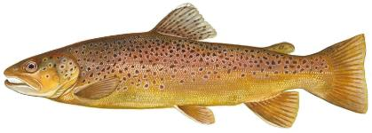
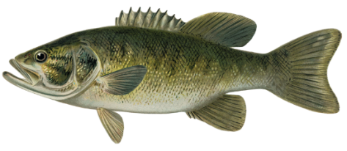
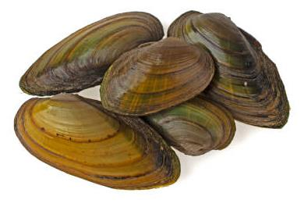
Ecological Impacts - Species
Strongest negative impacts on coldwater species (e.g., trout, sculpin) and their habitats (esp. where streams aren’t driven by groundwater )
Watershed-wide, warmwater aquatic species are most common. Although more tolerant to temperature increases, they are sensitive to extreme temperatures including rapid changes and to indirect effects (e.g., invasives, pathogens) from higher temps.
More study needed of temperature effects on lower foodweb
Algae, biofilms, zooplankton
Macroinvertebrates
Freshwater mussels & host species

Slide 8
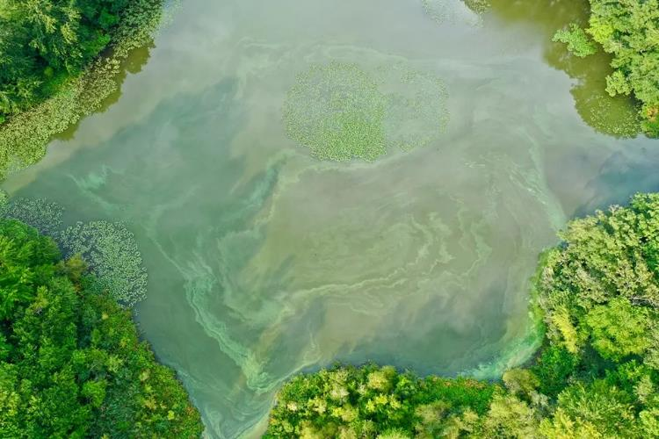
Ecological Impacts - Other Stressors
Co-occurring Stressors
Low dissolved oxygen
Invasive species
Algal blooms
Bacterial/viral outbreaks
Distribution & toxicity of other
pollutants (e.g., heavy metals,
pesticides, ammonia, etc.)
Expansion of invasives
Photo credit: Driscol Drones

Slide 9

Day 2 Themes for Discussion
Coldwater fisheries and habitats
Rural waters and habitats
Urban waters and habitats
Cross-watershed topics
State temperature water quality standards (WQS), monitoring and implementation
Monitoring and modeling
Photo credit: Joel Prince, NASF

Slide 10
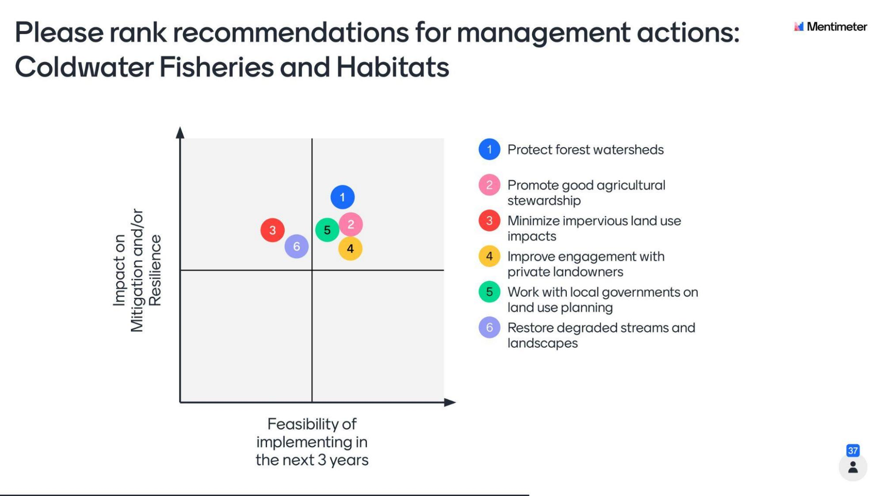

Slide 11
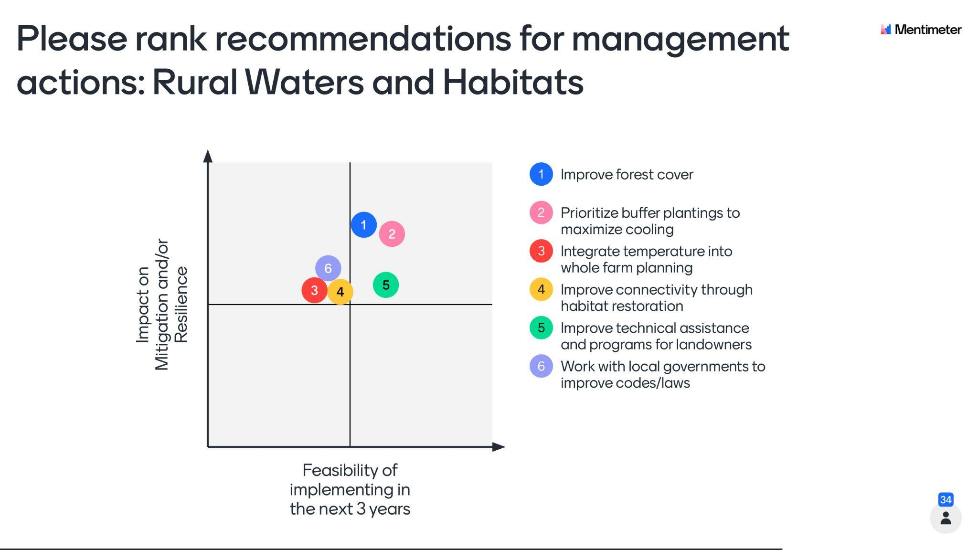

Slide 12
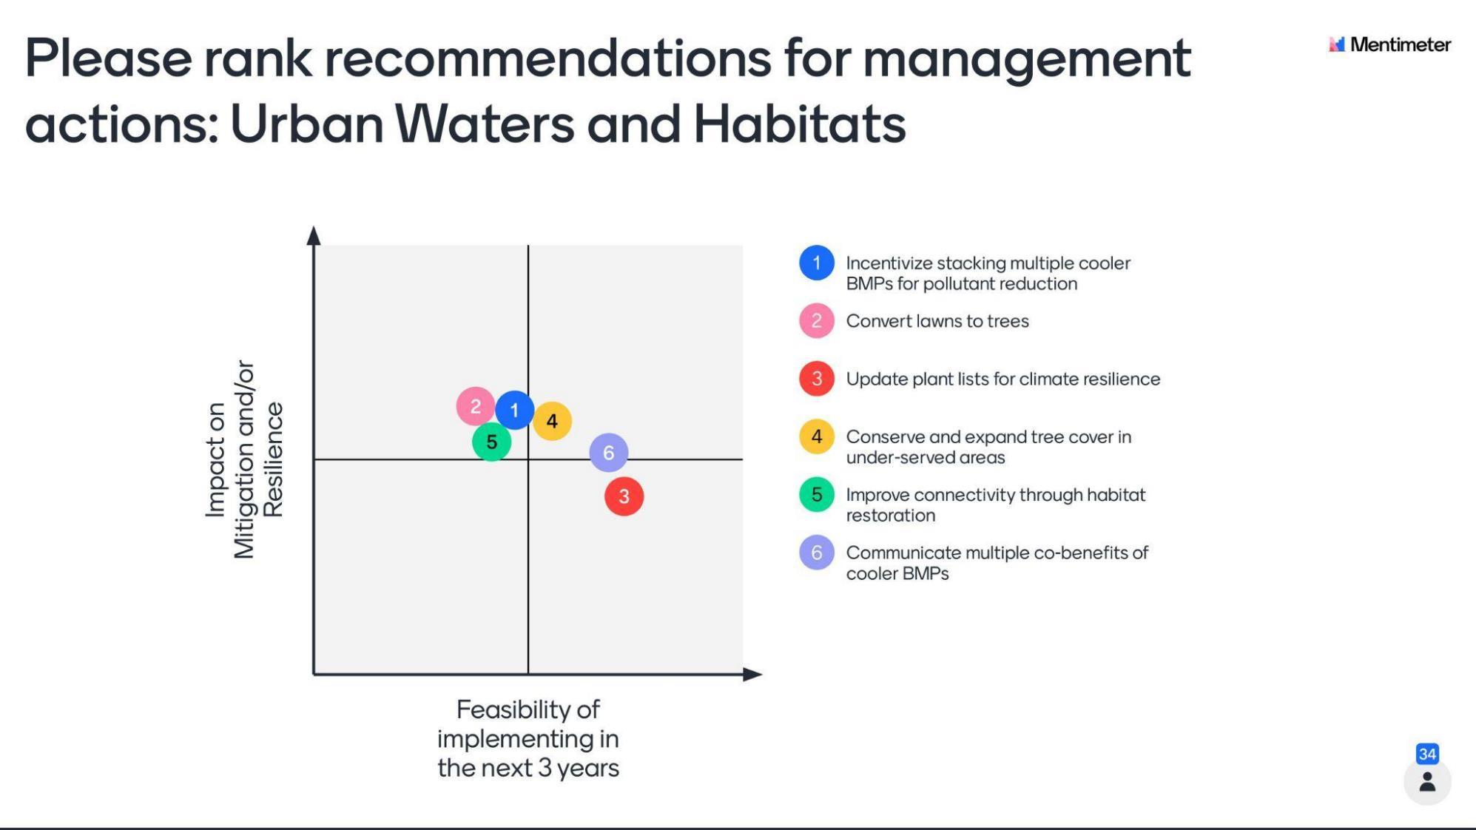

Slide 13
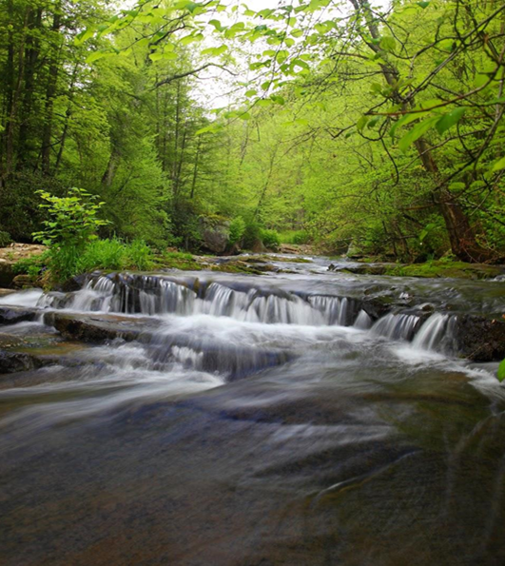
State Temperature Water Quality Standards (WQS)
Modernize WQS to make them more effective to combat rising water temperatures
Strengthen anti-degradation measures
Improve criteria to reflect a better understanding of thermal tolerances and ecology for a broader suite of species
Improve interstate cooperation through information-sharing, problem solving and monitoring-modeling support

Slide 14
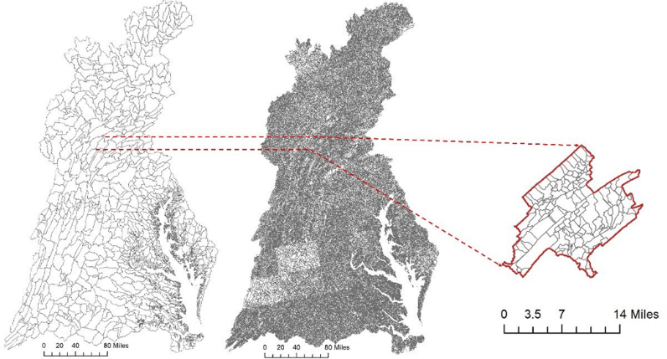
Monitoring, Modeling and Science Needs
Better use existing monitoring data and mapping tools
Improve monitoring networks to better include small streams and incorporate more continuous data collection
Evaluate the relative influence of BMPs and habitat restoration on water temperature, including cost-effectiveness
Develop models that better simulate land use and groundwater effects on local steam temperatures to better understand how stream temperature and living resources will respond to management
Establish multi-species prioritization tools and science-based targets for restoration and conservation to mitigate rising water temperatures

Slide 15
TIDAL
Trends, Drivers, Ecological Impacts, Management Implications &
Draft Recommendations
Leads: Julie Reichert-Nguyen & Bruce Vogt, NOAA and Rich Batiuk, CoastWise Partners

Slide 16
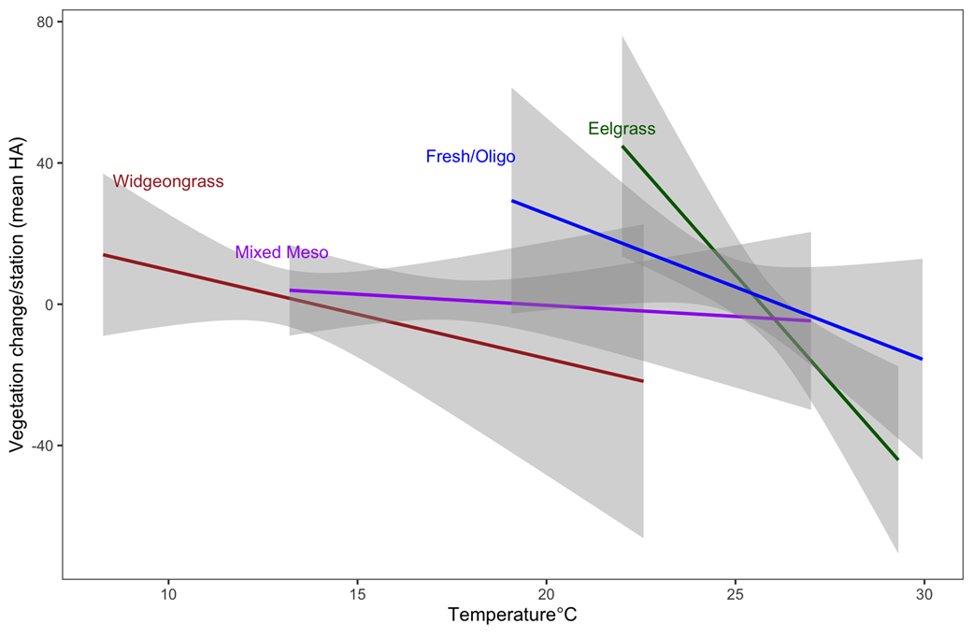
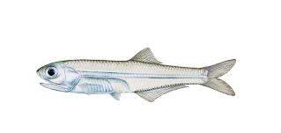
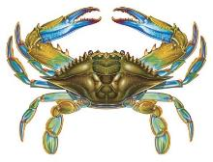
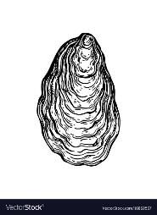
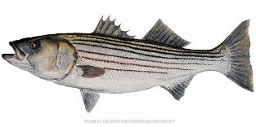
Varying Effects and Sensitivities to Rising Water Temps for Tidal Species
- biological / + ecosystem
+ biological / + ecosystem
+
Ecosystem
-
Biological
+
-
- biological / - ecosystem
+ biological / - ecosystem

Slide 17
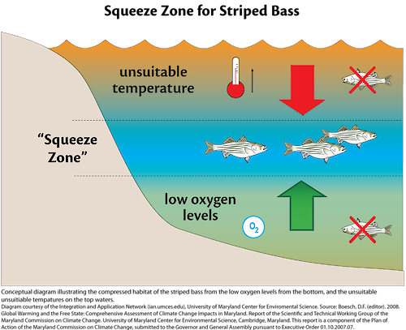
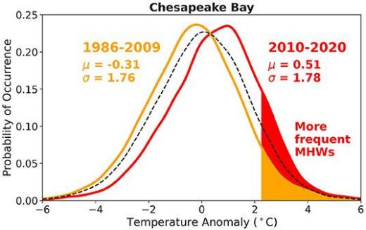
Science Needs – Better Understanding of Ecosystem-Level Effects, Multiple Stressors & Extreme Events on Survival & Habitat
Effects of reduced water clarity & salinity from increased precipitation and habitat loss/change on SAV & oysters
Effects of SAV community changes on habitat-use by fish and crabs
Lower oxygen solubility in water
Higher water temperature
Higher remineralization rate = more nutrients for algae growth
Changes in the intensity, duration, & frequency of marine heat wave events & effects on survival
More stratified water column
All combined = even lower dissolved oxygen
Source: Mazzini and Pianca 2022

Slide 18
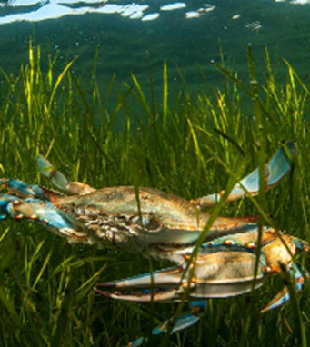
Day 2 Themes for Discussion
Ecosystem-based management
Multiple stressors
Nearshore habitats
New temperature regime

Slide 19
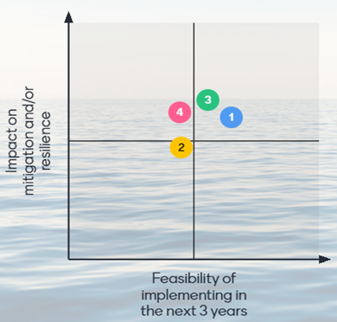
Management Recommendations (DRAFT)
Ecosystem-Based Management
(3) Continue water quality improvement to support SAV essential fish habitat
(1) Adjust within same season fisheries catch limits using two prong approach:
1) develop management triggers based on temperature thresholds for determining seasonal closures and
2) Incorporate an educational/human behavioral warming tool to communicate when fish are most stressed/vulnerable & how to modify fishing behavior outside of closures

Slide 20
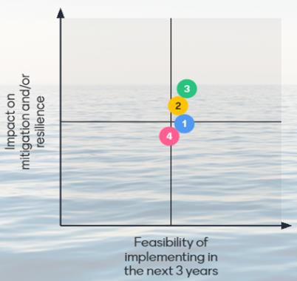
Management Recommendations (DRAFT)
Nearshore Habitats
(3) Target use of natural/green infrastructure where ecological & climate resilience benefits are highest
(2) Amplify the urgency to manage shoreline development & condition based on ecological thresholds already established for SAV, blue crab and fish

Slide 21
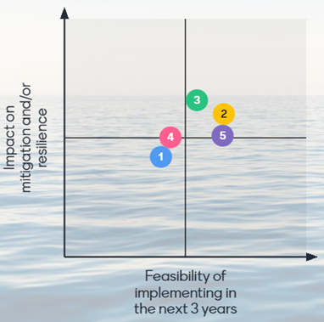
Management Recommendations (DRAFT)
Multiple Stressors
(3) Implement TMDL to its fullest potential & better connect to living resource outcomes
(2) Develop a public facing heat wave warning system that incorporates dissolved oxygen and is linked to habitat preferences of key species such as striped bass, blue crabs, oyster, and SAV

Slide 22
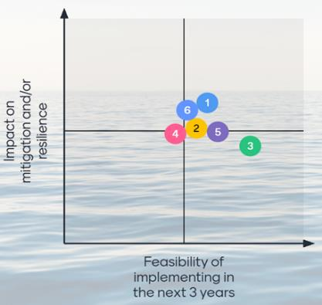
Management Recommendations (DRAFT)
New Temperature Regime
(1) Improve long-term monitoring networks to better connect to managing living resources
(6) Explore ways to support fisheries in the development of more strategic, long-term climate predictions for management

Slide 23
Next Steps
Steering Committee will review & synthesize information, including management recommendations and associated science needs, from synthesis papers and both workshop days and draft final report
Participant review of draft report (~May-June 2022 timeframe)
Release final report (~summer 2022 timeframe)
Conduct outreach with Bay Program and partners to discuss strategies to implement the report’s recommendations

Slide 24
Watershed Acknowledgements
Synthesis Element #1 Paper (Water Temperature Effects on Fisheries and Stream Health in Nontidal Waters): Stephen Faulkner, Kevin Krause, Rosemary Fanelli, Matthew Cashman, Than Hitt and Benjamin Letcher, USGS; Frank Borsuk and Greg Pond, EPA
Synthesis Element #1 Addendum (Temperature Criteria in CBP Jurisdictions' Water Quality Standards and Information on Warmwater Species): Rebecca Hanmer, EPA-retired; Jonathan Leiman, Maryland Department of the Environment; Daniel Goetz, Maryland Department of Natural Resources; Robert Breeding, Virginia Department of Environmental Quality; and Matthew Robinson, DC Department of Energy and Environment
Synthesis Element #4 Paper (Watershed Characteristics and Landscape Factors Influencing Vulnerability and Resilience to Rising Stream
Temperatures): Renee Thompson, USGS; Nora Jackson, CRC/CBP; Judy Okay, J&J Consulting; Nancy Roth, Tetra Tech; Sally Claggett, USFS
Synthesis Element #5 Paper (Trends): Rich Batiuk, CoastWise Partners; Nora Jackson, CRC/CBP; John Clune, USGS; Kyle Hinson, VIMS; Renee Karrh, Maryland Department of Natural Resources; Mike Lane, Old Dominion University; Rebecca Murphy, University of Maryland Center for Environmental Science/CBP; and Roger Stewart, Virginia Department of Environmental Quality
Synthesis Element #6 Paper (Model Projections): Rich Batiuk, CoastWise Partners; Gopal Bhatt, Pennsylvania State University/CBP; Lewis
Linker, U.S. EPA CBP; Gary Shenk, USGS/CBP; Richard Tian, University of Maryland Center for Environmental Sciences/CBP; and Guido Yactayo, Maryland Department of the Environment
Synthesis Element #7/8 Paper (Impacts of BMPs and Habitat Restoration on Water Temperatures): Katie Brownson and Sally Claggett, USFS; Tom Schueler, CSN; Anne Hairston-Strang and Iris Allen, Maryland Department of Natural Resources-Forestry; Frank Borsuk and Lucinda Power, EPA; Mark Dubin, UMD; Matt Ehrhart, Stroud; Stephen Faulkner, USGS; Jeremy Hanson, VT; Katie Ombalski, Woods & Waters
Consulting
Synthesis Element #10 Paper (Monitoring): Peter Tango, Breck Sullivan, John Clune, and Scott Phillips, USGS

Slide 25
Tidal Acknowledgements
Synthesis Element #2 Paper (Tidal Fisheries and Habitat Impacts): Bruce Vogt, Jay Lazar, and Emily Farr, NOAA; Mandy Bromilow, NOAA Affiliate; Justin Shapiro, CRC
Synthesis Element #3 Paper (SAV Impacts): Brooke Landry and Becky Golden, Maryland DNR; Marc Hensel and Chris Patrick, VIMS; Dick Zimmerman and Rhianne Cofer, Old Dominion University; Bob Murphy, TetraTech
Synthesis Element #5 Paper (Trends): Rich Batiuk, CoastWise Partners; Nora Jackson, CRC/CBP; John Clune, USGS; Kyle Hinson, VIMS; Renee Karrh, Maryland Department of Natural Resources; Mike Lane, Old Dominion University; Rebecca Murphy, University of Maryland Center for Environmental Science/CBP; and Roger Stewart, Virginia Department of Environmental Quality
Synthesis Element #6 Paper (Model Projections): Rich Batiuk, CoastWise Partners; Gopal Bhatt, Pennsylvania State University/CBP; Lewis Linker, U.S. EPA CBP; Gary Shenk, USGS/CBP; Richard Tian, University of Maryland Center for Environmental Sciences/CBP; and Guido Yactayo, Maryland Department of the Environment
Synthesis Element #9 Paper (Indicators): Julie Reichert-Nguyen and Bruce Vogt, NOAA; Mandy Bromilow, NOAA Affiliate; Ron Vogel, UMD for NOAA Satellite Service; Breck Sullivan, USGS; Anissa Foster, NOAA-CRC Internship Program
Synthesis Element #10 Paper (Monitoring): Peter Tango, Breck Sullivan, John Clune, and Scott Phillips, USGS

Slide 26

Thank you! Questions?

