Slide 1
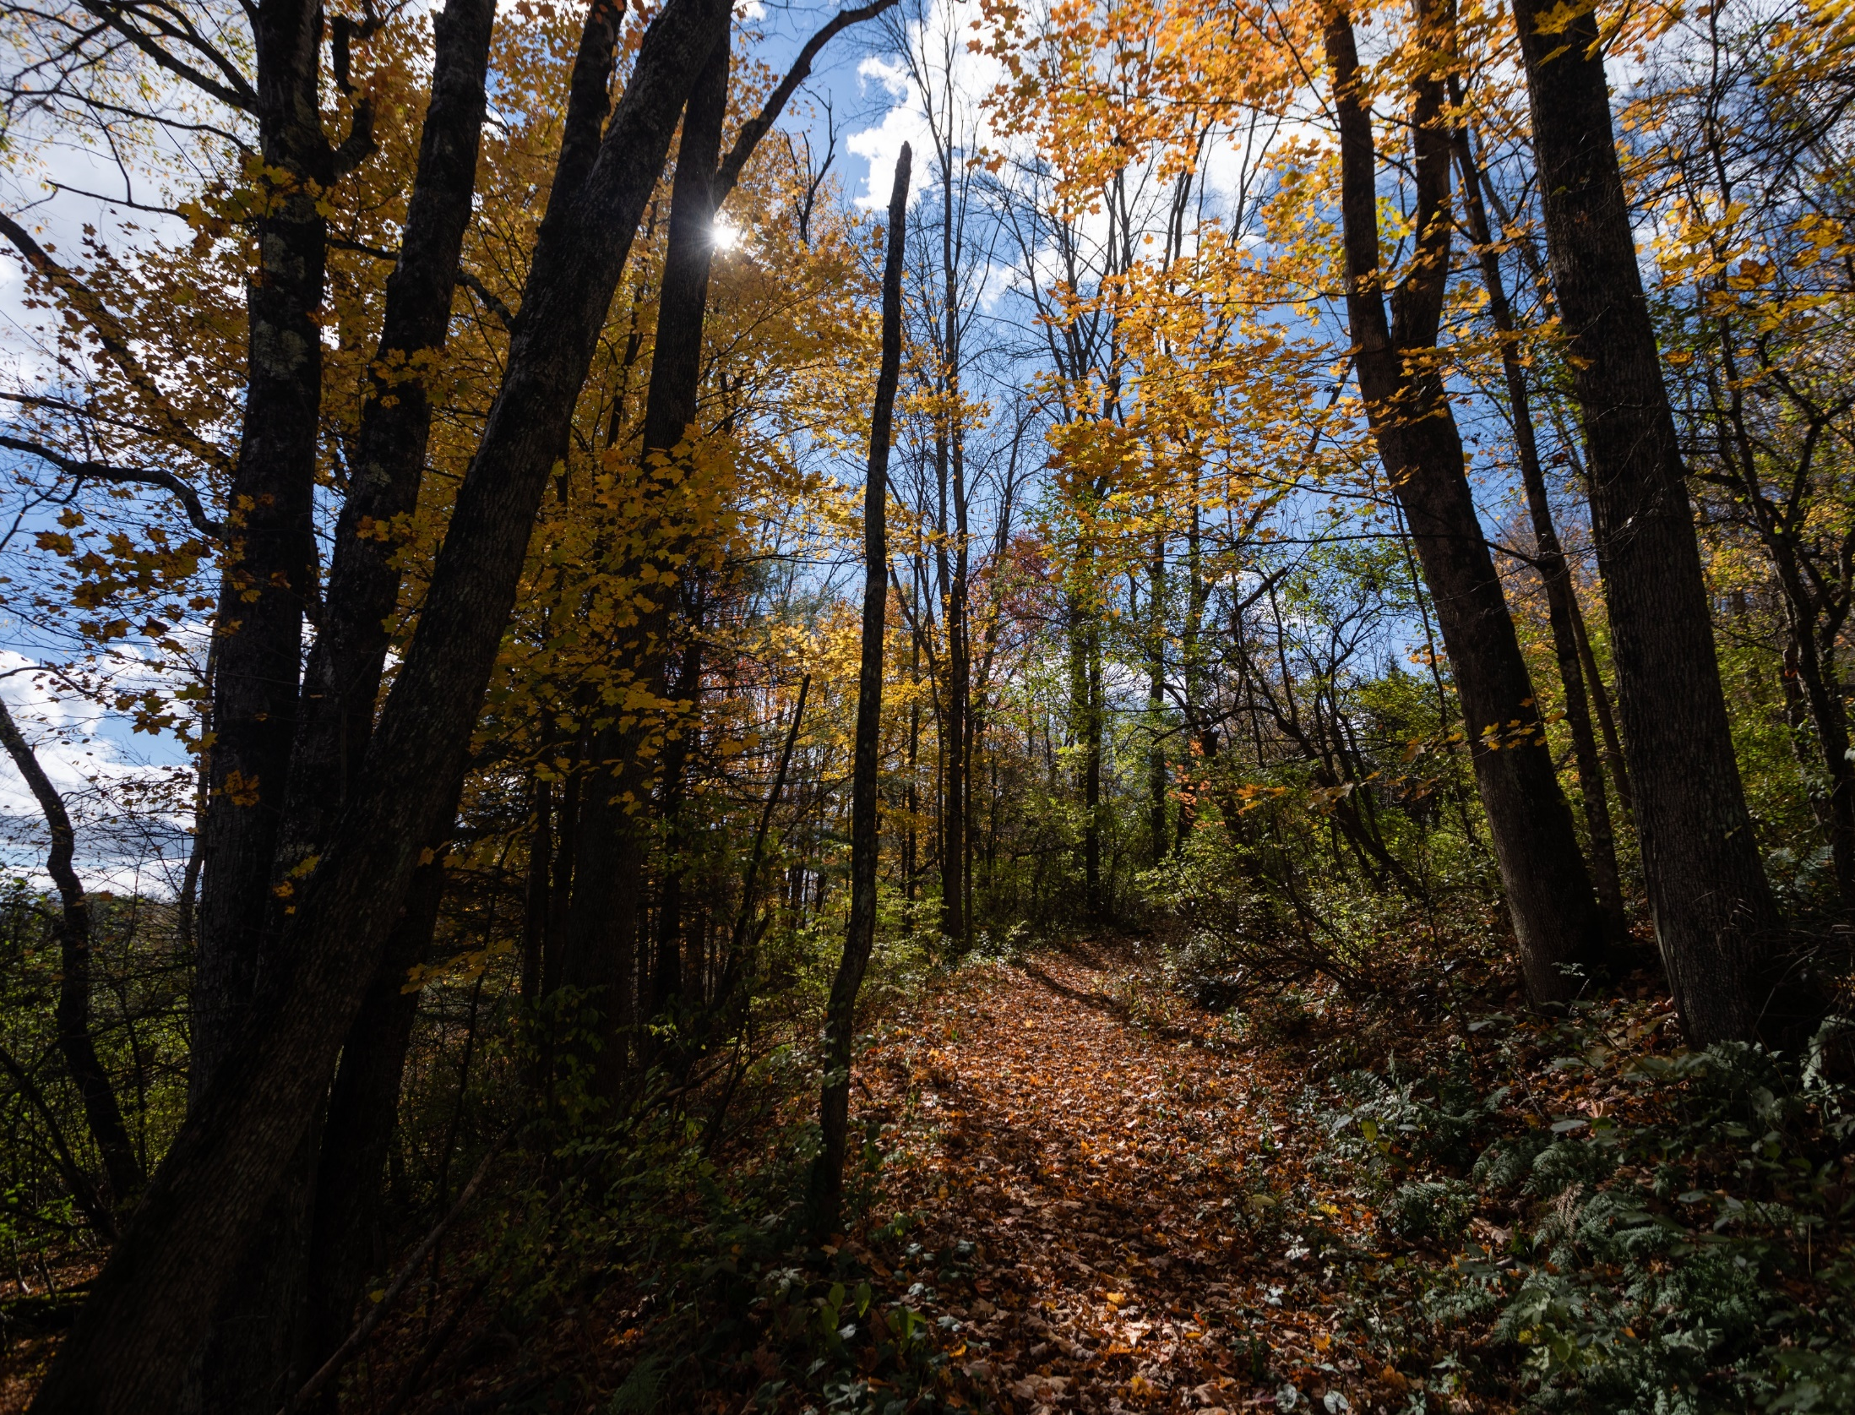




2022 Small Watershed Grants Program including
Chesapeake WILD Funding
Promoting voluntary, community-based efforts to
protect and restore the diverse and vital habitats of the Chesapeake Bay and its tributary rivers and streams
Will Parson, CBP

Slide 2
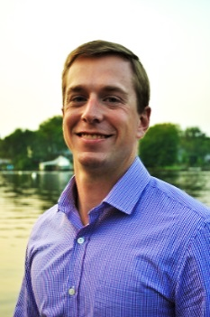
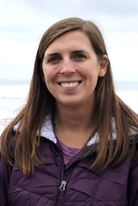
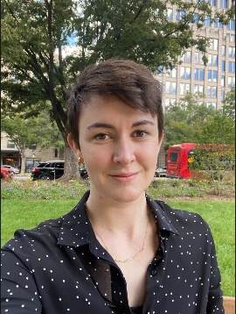


Today’s Discussion
Overview of Chesapeake Bay Stewardship Fund
Review of Reissued 2022 Small Watershed Grants RFP and C-WILD Funding Opportunities
Jake Reilly,
Program Director
Stephanie Heidbreder,
Program Manager
Nicole Thompson,
Program Coordinator
Notes:
2
Note for questions: For best use of time, questions about individual projects should be emailed to Elizabeth, or call her directly.

Slide 3
CHESAPEAKE BAY STEWARDSHIP FUND
Purpose and History
Accelerate local restoration actions and spur innovation in watershed restoration
Delivered in partnership with EPA and the Chesapeake Bay Program
New directed programming and partnership with U.S. FWS
1,200+ grants totaling roughly $200M and leveraging nearly $300M in additional local matching funds since 1999

Slide 4
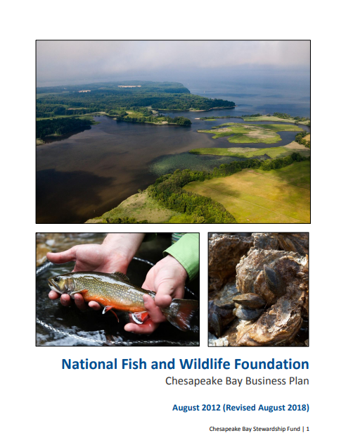
CHESAPEAKE BAY STEWARDSHIP FUND
Chesapeake Bay Business Plan
Provides a concise blueprint of NFWF’s targeted conservation outcomes for the Chesapeake Bay
Articulates NFWF’s measurable contributions to goals and outcomes of the Chesapeake Bay Program partnership and Chesapeake Bay Watershed Agreement

Slide 5
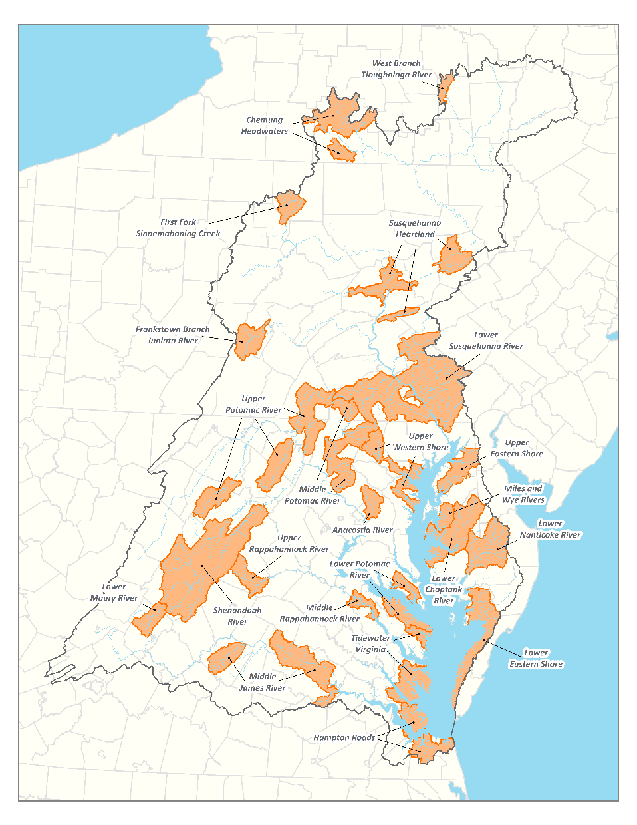
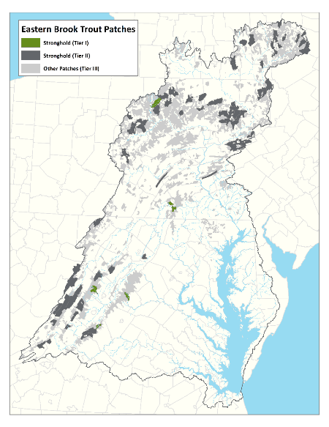
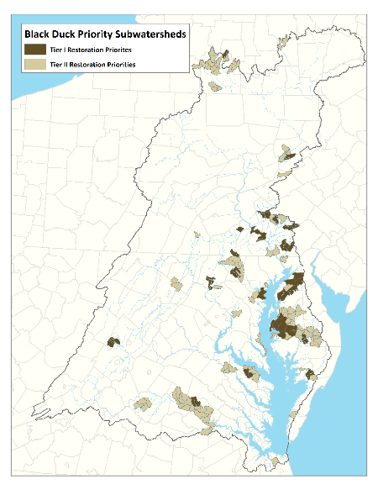
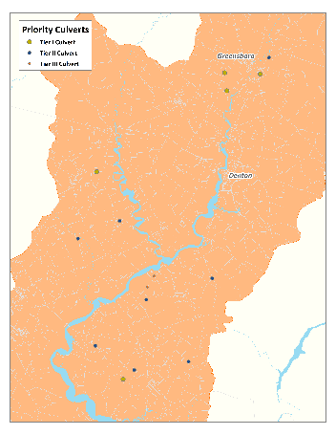
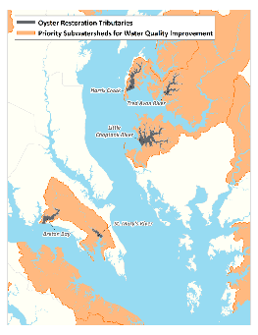
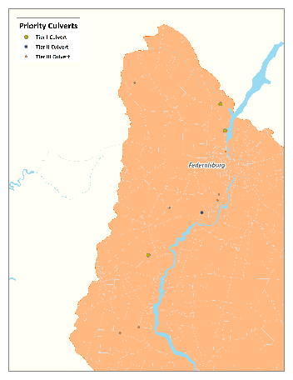
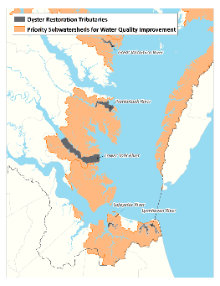
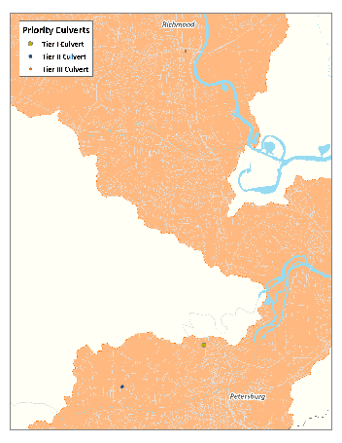
CHESAPEAKE BAY STEWARDSHIP FUND
Geographic Focus
Water Quality: Priority sub-watersheds with significant opportunity to reduce nutrient and sediment loading
Species and Habitat: Areas where species-specific interventions can help to improve habitat and restore populations for:
Eastern brook trout
Eastern oysters
American black duck
River herring
NFWF will continue to fund efforts outside of priority subwatersheds
Visit NFWF mapping portal for more info

Slide 6






FUNDING PARTNERS

Slide 7


SWG POOLED FUNDING AND 2022 C-WILD
2022 SWG Applications
2022 SWG Application Review
2022 SWG Funding Pool
2022 SWG Recommended Awards
2022 SWG Funding Pool
2022 SWG Awards
2022 SWG Awards w/ C-WILD Funding

Slide 8
REVIEW OF REISSUED 2022 SWG RFP
SWG – Implementation (SWG-I) | SWG – Planning and Technical Assistance (SWG-PTA)
Grant Size: Between $75,000 and $500,000 | Grant Size: Up to $75,000
Matching Funds: Match encouraged, not required* | Matching Funds: Match encouraged, not required*
Eligibility: Non-profit 501(c) organizations, community-based organizations, state government, local governments, municipal governments, Tribal governments and organizations, K-12 and post-secondary educational institutions | Eligibility: Non-profit 501(c) organizations, community-based organizations, state government agencies, local governments, municipal governments, Tribal governments and organizations, educational institutions, and for-profit technical service providers
Duration: ~2 years | Duration: <1 year
Outcome: On-the-ground implementation toward priority funding strategies and conservation outcomes | Outcome: Planning and technical assistance support to support future on-the-ground implementation efforts

Slide 9
PRIORITY OUTCOMES
Focus | Outcome | Activity | Geographic Focus
Water Quality | Reduce nitrogen, phosphorus, and sediment pollution to the Chesapeake Bay and its tributary rivers and streams | Improve water quality in agricultural areas by implementing best management practices to reduce polluted runoff | Priority Subwatersheds for Water Quality Improvement
 |  | Improve water quality in urban and suburban areas by implementing green stormwater infrastructure practices to treat, capture, and/or store stormwater runoff
 |  | Restore riparian forest buffer and associated riparian habitat in order to continually increase the capacity of forest buffers to provide water quality and habitat benefits throughout the watershed
 |  | Improving the health and function tributary rivers and streams
Eastern Brook Trout | Maintain and increase Eastern brook trout populations in stronghold patches | Increase habitat integrity in stronghold patches through protection and restoration of riparian areas, stream restoration, nonpoint source pollution controls and land use protections | Eastern Brook Trout Patches (Tier I and II)
American Black Duck | Increase wetland habitat and available food to support wintering black duck populations | Create, restore, or enhance the function of tidal and non-tidal wetlands to increase black duck carrying capacity through improved food resources | Black Duck Priority Subwatersheds (Tier I and II)
 |  | Increase available food resources
River Herring | Restore access and use of high quality migratory river and stream habitat | Implement high priority, cost-effective connectivity enhancement projects through culvert replacement, fish passage improvements, and dam removal | Priority Culverts for River Herring
Eastern Oyster | Restore oyster populations in priority Chesapeake Bay tributaries | Restore native oyster reefs in targeted tributaries through spat production and reef construction | Oyster Restoration Tributaries
Capacity and Planning | Motivate individuals in the watershed to adopt behaviors that benefit water quality, species, and habitats | Enlist individuals in local volunteer events to restore local natural resources and providing hands-on education and skill-building for individual action | N/A
 |  | Develop or improve conservation, watershed, or habitat management plans that provide guidance to landowners, organizations, or local governments on how to manage properties and communities for improved conservation outcomes
Notes:
All proposals MUST address at least one of these objectives of the Chesapeake Bay Watershed Agreement and NFWF’s Chesapeake Bay Business Plan - can address multiple outcomes

Slide 10
PRIORITY FUNDING STRATEGIES
UPDATED FOR 2022!
Managing Agricultural and Urban Runoff
Improving Water Quality and Stream Health Through Riparian Restoration and Conservation
Enhancing Freshwater Habitat
Protecting and Enhancing Terrestrial Habitat
Protecting and Enhancing Tidal and Estuarine Habitat
Enhancing Nature-Based Resilience for Human Communities and Critical Habitats
Building Capacity for Landscape-Scale Watershed and Habitat Planning, Design, and Implementation
Notes:
These are the things we want to fund, and all things being equal, priority will be given to proposals that address at least one of the “Priority Funding Strategies”. Note distinction between MUST and PRIORITY.

Slide 11
ADVANCING DIVERSITY, EQUITY, INCLUSION, AND JUSTICE
Program-wide priorities to enhance diversity*, equity*, inclusion*, and justice* in Chesapeake Bay habitat restoration and conservation efforts
Direct and meaningful engagement of impacted communities
Priority consideration for projects representing or resourcing underrepresented*, underserved*, and/or under-resourced* communities
New applicant demographic survey and communities impacted and engaged proposal narrative element

Slide 12
ADVANCING DIVERSITY, EQUITY, INCLUSION, AND JUSTICE
“Communities Engaged and Impacted: Describe the communities where the project will take place, who will specifically benefit from the project, and how they were or will be engaged in project development.
Provide demographic information on impacted communities, including but not limited to age, race and ethnicity, sexual orientation, and socioeconomic indicators.”

Slide 13
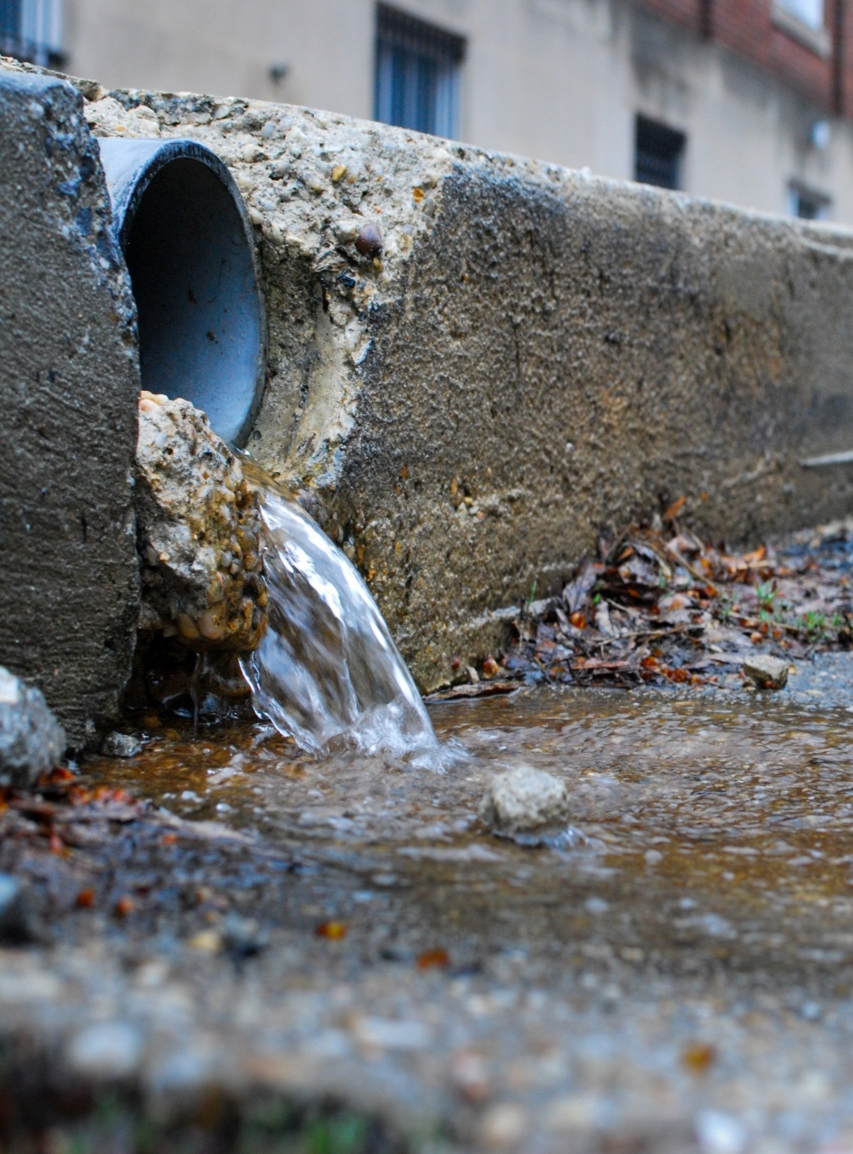
Strategy 1: MANAGING AGRICULTURAL AND URBAN RUNOFF
Managing upland agricultural runoff through farm-scale conservation systems and solutions
Managing upland urban runoff through Green Stormwater Infrastructure improvements (GSI)
Accelerating innovation in watershed management
Matt Rath, CBP

Slide 14
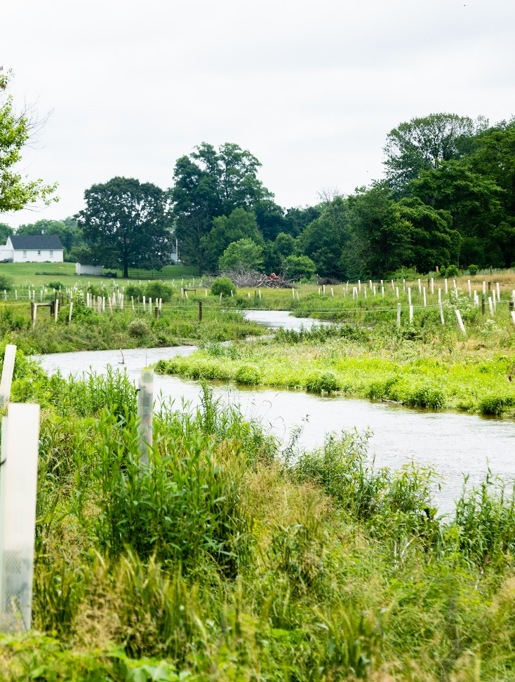
Strategy 2: RIPARIAN RESTORATION AND CONSERVATION
Forested buffers, livestock exclusion, and stream restoration*
Consistent with qualifying conditions and protocols established by the CBP partnership for creditable nutrient and sediment load reductions under the Chesapeake Bay TMDL
Additional narrative supplement
Conserving high-quality riparian corridors
Will Parson, CBP
Notes:
Note: stream restoration additional narrative upload

Slide 15
PROJECTS INCORPORATIONG STREAM RESTORATION
Long-term, watershed-based approaches to improving stream biological function can – and do – work, and can be competitive proposals for funding
Applicants for stream restoration projects creditable under the TMDL, consistent with CBP protocols, will need to demonstrate:
Realistic goals for improvement of specific stream functions
Watershed or catchment-level assessment of stressors, demonstrating efforts to address upland sources and stressors
Consideration of alternative design and restoration approaches to achieve functional improvements
Must submit the Stream Restoration Narrative Supplement” as a part of the application
Notes:
Proposed stream restoration and floodplain reconnection efforts must be consistent with qualifying conditions and protocols established by the Chesapeake Bay Program partnership for creditable nutrient and sediment load reductions under the Chesapeake Bay TMDL (see Recommendations of the Expert Panel to Define Removal Rates for Individual Stream Restoration Projects and associated protocol updates to determine project eligibility). In addition to standard proposal narratives required for the SWG program, proposals seeking funding for qualifying stream restoration and floodplain reconnection practices must complete and upload the accompanying “Stream Restoration Narrative Supplement” as a part of the application. Additional information is available in Appendix C.

Slide 16
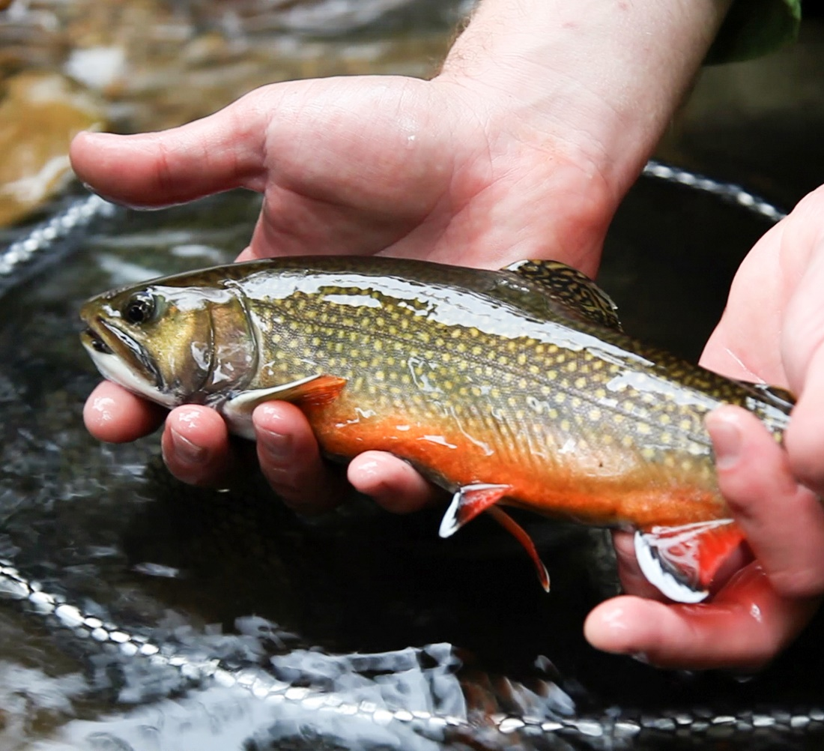
Strategy 3: ENHANCING FRESHWATER HABITAT
Increasing habitat integrity and population viability for Eastern Brook Trout
Increasing habitat connectivity and quality for at-risk species
Restoring river herring habitat connectivity
Will Parson, CBP
Notes:
Note: stream restoration additional narrative upload

Slide 17
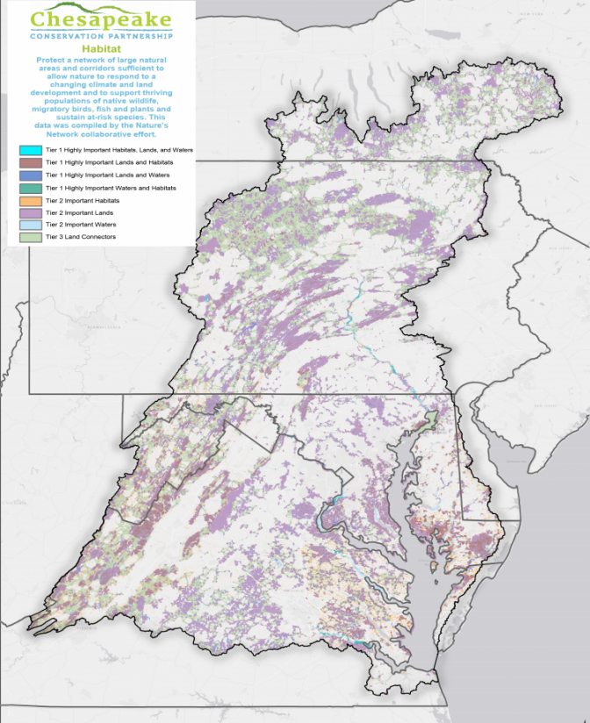
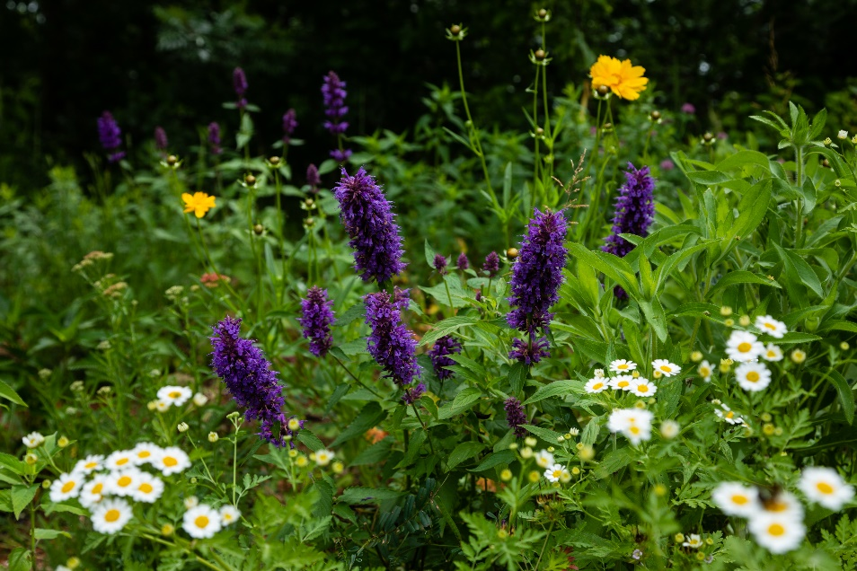
Strategy 4: PROTECTING AND ENHANCING TERRESTRIAL HABITAT
Maintain and enhance healthy watersheds and priority habitat corridors through land protection
Restoring pollinator habitat
Will Parson, CBP
Notes:
Note: stream restoration additional narrative upload

Slide 18
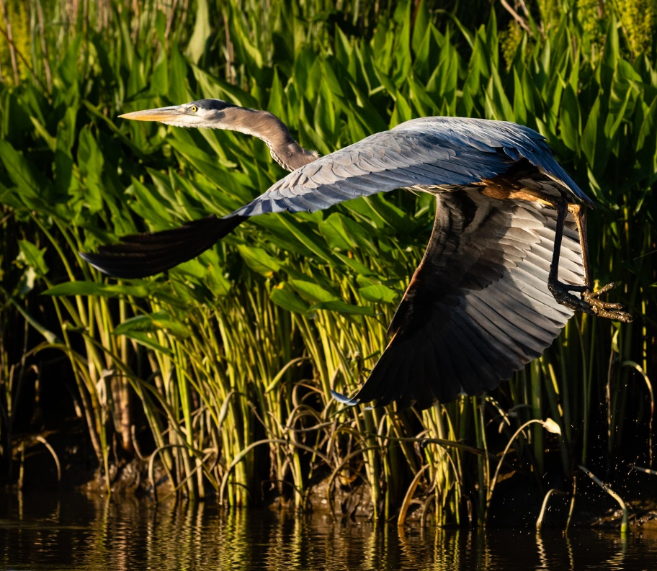
Strategy 5: PROTECTING AND ENHANCING TIDAL AND ESTUARINE HABITAT
Restoring and conserving wetland and tidal marsh habitat for black duck and at-risk marsh nesting birds
Managing shoreline erosion and marsh loss
Restoring large-scale oyster reefs
Will Parson, CBP

Slide 19
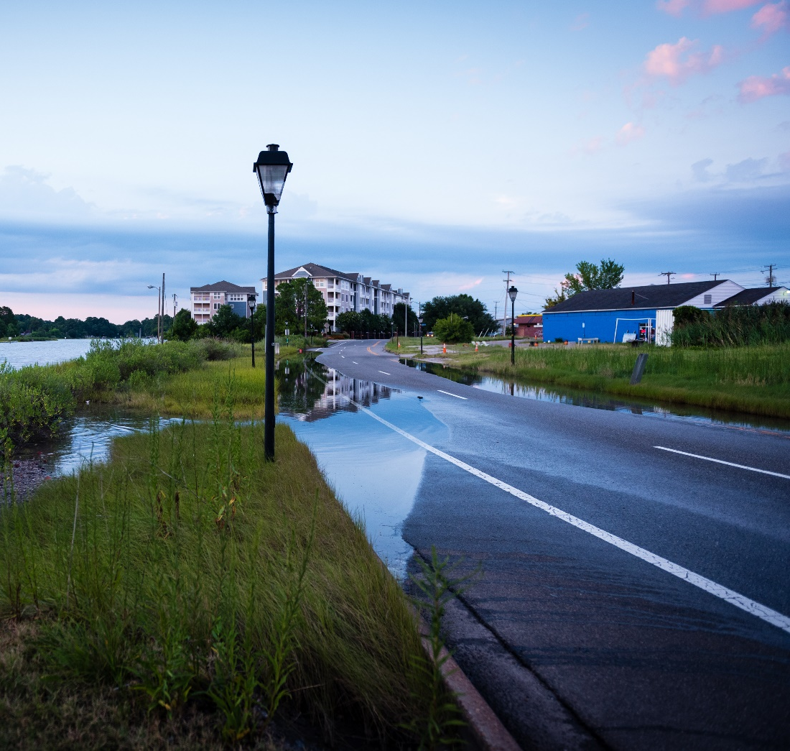
Strategy 6: ENHANCING NATURE-BASED RESILIENCE FOR COMMUNITIES AND CRITICAL HABITAT
Protecting and enhancing habitat to improve community resilience
Enhancing long-term resilience for critical species and habitats
Will Parson, CBP

Slide 20
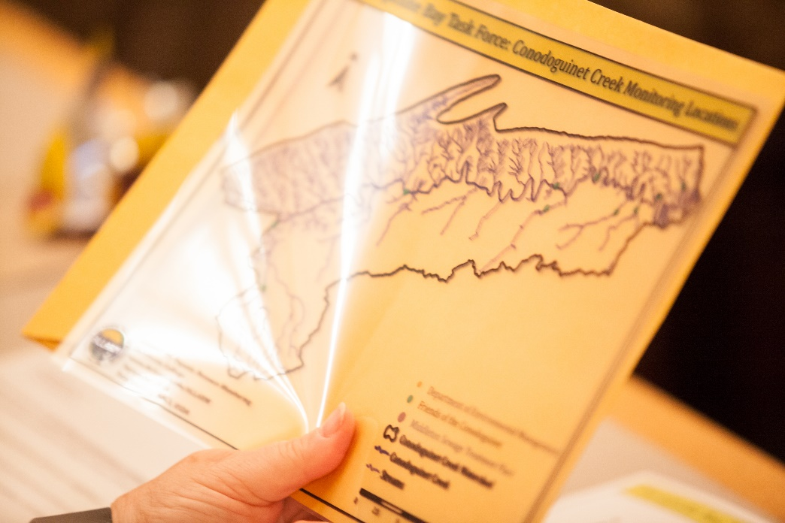
Strategy 7: BUILDING CAPACITY FOR LANDSCAPE-SCALE AND HABITAT PLANNING AND IMPLEMENTATION
Regional-scale partnership development
Improving delivery of outreach and technical assistance
Assessing local watershed and habitat restoration needs and opportunities
Designing and permitting watershed and habitat improvements
Leveraging social science to advance behavior change
Will Parson, CBP

Slide 21
Priority | Recommended Metric* | Metric Description/Instructions
Managing Agricultural and Urban Runoff (Required of water quality improvement proposals) | CBSF - BMP implementation for nutrient or sediment reduction - Lbs N/P/S avoided (annually) | Please use FieldDoc to develop estimates of the annual nitrogen, phosphorus, and/or sediment load reductions from your proposed project. Enter FieldDoc-generated pollutant load reduction totals in this field then upload your FieldDoc Project Summary in the "Uploads" section.
Managing Agricultural and Urban Runoff (Select all that apply) | CBSF - BMP implementation for nutrient or sediment reduction - Acres with BMPs | Enter the total number of acres under agricultural or non-urban BMPs to reduce nutrient or sediment loading. Do not double-count individual acres which have multiple BMPs. If you're implementing load reduction practices on urban lands, report associated outcomes instead under the "CBSF - BMP implementation for stormwater runoff - Acres with BMPs" metric. Do not include cover crops, conservation tillage, enhanced cropland nutrient management, or managed grazing.
 | CBSF - BMP implementation for nutrient or sediment reduction - Acres with cover crops | Enter the number of cropland acres with cover crops practices. Please describe the cover crop practices in the NOTES section.
 | CBSF - BMP implementation for nutrient or sediment reduction - Acres with conservation tillage | Enter the number of cropland acres with conservation tillage practices. Please describe conservation tillage practices in the NOTES section.
 | CBSF - BMP implementation for nutrient or sediment reduction - Acres with enhances nutrient management | Enter the number of cropland acres with enhanced nutrient management practices other than or in addition to conservation tillage or cover crops. Please describe the nutrient management practices in the NOTES section.
 | CBSF - BMP implementation for nutrient or sediment reduction - Acres with managed grazing | Enter the number of acres with managed grazing (i.e., promoting plant growth above and below ground, improving wildlife habitat, and maximizing soil carbon through a variety of grazing approaches). Please describe the grazing practices in the NOTES section.
 | CBSF - BMP implementation for stormwater runoff - Acres with BMPs | Enter total drainage area treated by stormwater BMPs. If you wish to also provide the extent of specific BMPs themselves (i.e. square feet of bioretention), please do so in the "Notes" section.
 | CBSF - BMP implementation for stormwater runoff - Volume stormwater prevented | Enter the number of gallons of stormwater runoff treated through stormwater BMPs (e.g. runoff treatment volume).
 | CBSF- Green Infrastructure - number of trees planted | Enter the number of trees planted for urban stormwater reduction. In the NOTES section, specify the specify the landcover type prior to planting (barren, cropland, grassland, shrubland), # of acres, and average # of trees per acre.
Improving Water Quality and Stream Health Through Riparian Restoration and Conservation (Select all that apply) | CBSF - Riparian restoration - Miles restored | Enter the number of miles of riparian habitat restored through the implementation of forest or grass buffers that are at least 35 feet wide. If you're implementing livestock exclusion, report associated outcomes instead under the "CBSF - BMP implementation for livestock exclusion -- miles of fencing installed" metric. In the NOTES section, specify the landcover type prior to planting (barren, cropland, grassland, shrubland), the % of vegetation on the pre-project site (0-20%, 21-40%, 41-60%, 61-80%, 81-100%), the dominant vegetation being planted (Broadleaf, Conifer, Shrub, Grass, Marsh, Swamp), the buffer width, and the acres.
 | CBSF - BMP implementation for livestock fencing - Miles of fencing installed | Enter the number of miles of livestock exclusion installed. Assume activities include exclusion fencing and a 35-foot forest or grass buffer, unless otherwise noted.
Priority | Recommended Metric* | Metric Description/Instructions
Improving Water Quality and Stream Health Through Riparian Restoration and Conservation (Select all that apply) | CBSF - Stream restoration - Miles restored | Enter the number of miles of stream restored for nutrient and sediment load reduction, consistent with qualifying conditions and restoration protocols established by the Chesapeake Bay Program.
 | CBSF - Floodplain restoration - Acres restored | Enter the number of acres of floodplain restored for nutrient and sediment load reduction, consistent with qualifying conditions and restoration protocols established by the Chesapeake Bay Program. Also report any associated linear stream restoration outcomes through the "CBSF - Stream restoration – Miles restored" metric.
 | CBSF - Wetland restoration - Acres restored | Enter the number of acres of wetland habitat restored, created, or enhanced. In the NOTES section, specify the dominant vegetation being planted (Marsh, Swamp).
Enhancing Freshwater Habitat (Select all that apply) | CBSF - Fish passage improvements - Miles of stream opened | Enter the number of miles of stream habitat opened to fish populations through dam removals, culvert replacement, or other fish passage improvements. A mile opened is defined as number of new miles that restoration makes accessible for aquatic species.
 | CBSF - Instream habitat restoration - Miles restored | Enter the number of miles of instream habitat restoration activities not otherwise creditable for nutrient and sediment load reduction. Projects implementing qualifying stream restoration practices for TMDL crediting should instead report those outcomes instead through the "CBSF - Stream restoration - Miles restored" metric.
Protecting and Enhancing Terrestrial Habitat (Select all that apply) | CBSF - Conservation easements - Acres protected under easement | Enter the number of acres protected under long-term easement (permanent or >30-yr).
 | CBSF - Land, wetland restoration - Number of trees planted | Enter the number of trees planted for all non-urban projects/practices.
Protecting and Enhancing Tidal and Estuarine Habitat (Select all that apply) | CBSF - American oyster - Marine habitat restoration - Acres restored | Enter the number of acres of native oyster reef restored.
 | CBSF - Wetland restoration - Acres restored | Enter the number of acres of wetland habitat restored, created, or enhanced.
 | CBSF - Fish passage improvements - Miles of stream opened | Enter the number of miles of stream habitat opened to fish populations through dam removals, culvert replacement, or other fish passage improvements. A mile opened is defined as # of new miles that restoration makes accessible for aquatic species.
 | CBSF - Erosion control - Miles restored | Enter the number of miles of tidal shoreline stabilized or restored through erosion control, including living shoreline restoration. Projects implementing qualifying stream restoration practices for TMDL crediting should instead report those outcomes instead through the "CBSF - Stream restoration - Miles restored" metric.
 | CBSF - Conservation easements - Acres protected under easement | Enter the number of acres protected under long-term easement (permanent or >30-yr). Assuming the specific parcel(s) has been identified, in the NOTES indicate what % of natural land cover would have been cleared in the absence of the easement(s).
Building Capacity for Landscape-Scale Watershed and Habitat Planning, Design, and Implementation (Select all that apply) | CBSF - Outreach/ Education/ Technical Assistance - # people reached | Enter the number of individuals reached by outreach, training, or technical assistance activities. In the "Notes" section, provide a summary of how individuals are reached (newsletter mailing list total, training attendance, etc.).
 | CBSF - Outreach/ Education/ Technical Assistance - # people with changed behavior | Enter the number of individuals measured as demonstrating changed behavior to benefit watershed restoration and protection. In the "Notes" section, provide a summary of how behavior change will be measured and tracked. If you have questions on whether your project contains behavior change activities, please contact NFWF staff.
 | CBSF - Volunteer participation - # volunteers participating | Enter the number of volunteers participating in project implementation, outreach, and education activities.
Priority | Recommended Metric* | Metric Description/Instructions
Building Capacity for Landscape-Scale Watershed and Habitat Planning, Design, and Implementation (Select all that apply) | CBSF - Management or Governance Planning - # plans developed | Enter the number of conservation, watershed, and/or habitat management plans developed or improved. In the "Notes" section, provide specific information on the aggregate areal extent of associated plans (e.g. acres, square miles), and the number and areal extent of contributing planning activities.
 | CBSF - Outreach/ Education/ Technical Assistance - # people reached | Enter the number of individuals reached by outreach, training, or technical assistance activities. In the "Notes" section, provide a summary of how individuals are reached (newsletter mailing list total, training attendance, etc.).
 | CBSF - Outreach/ Education/ Technical Assistance - # people with changed behavior | Enter the number of individuals measured as demonstrating changed behavior to benefit watershed restoration and protection. In the "Notes" section, provide a summary of how behavior change will be measured and tracked. If you have questions on whether your project contains behavior change activities, please contact NFWF staff.
* Easygrants metrics should be consistent with data entered into and/or derived from FieldDoc.org.
Notes:
Depending on strategy

Slide 22
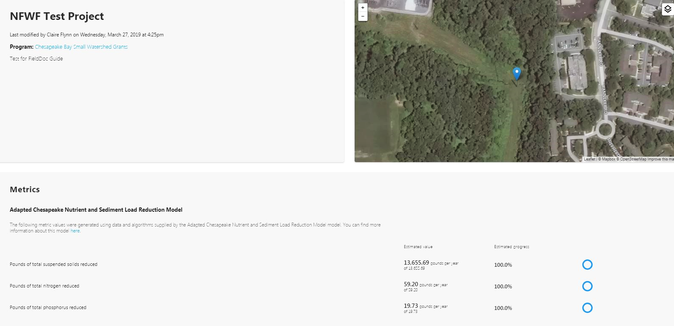
FIELDDOC
NFWF has partnered with Chesapeake Commons to develop FieldDoc, a user-friendly tool that allows consistent planning, tracking, and reporting of selected water quality improvement activities and associated load reductions
Future planned improvements will support capture and reporting of non-water quality outcomes via C-WILD
Notes:
Can use CAST as well

Slide 23
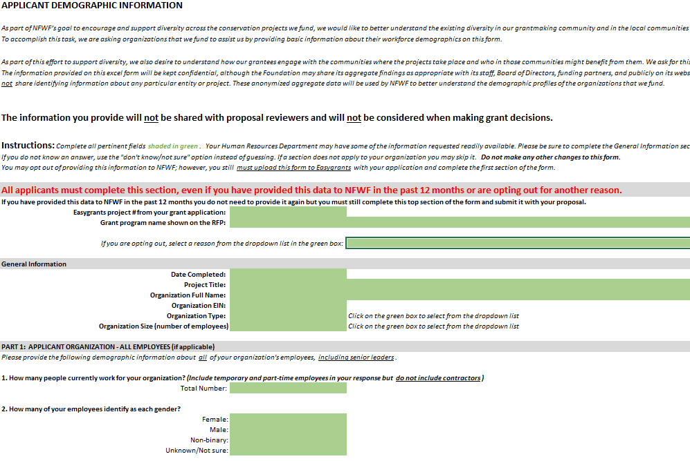
2022 UPLOADS – APPLICANT DEMOGRAPHIC FORM – NEW REQUIREMENT
The information you provide will not be shared with proposal reviewers and will not be considered when making grant decisions.
The Foundation will not share identifying information about any particular entity or project.
While the form is a required upload, applicants can opt out of providing the information within the form itself
If you have provided NFWF with this information in the last 12 months, you can opt out.
The information provided on this excel form will be kept confidential, the Foundation may share its anonymized aggregate findings as appropriate with its staff, Board of Directors, funding partners, and publicly on its website or through other media.
Notes:
Excel spreadsheet that is downloaded from the Uploads sections in the Easygrants application
- As part of NFWF’s goal to encourage and support diversity across the conservation projects we fund, we would like to better understand the existing diversity in our grantmaking community and in the local communities impacted by projects. We are asking organizations that we fund to assist us by providing basic information about their employees, senior leadership, and board members (as applicable) demographics on this form.
If your organization has provided this information to NFWF within the last 12 months, you can opt out. Please indicate this is the drop-down menu in the opting out section in the form.

Slide 24
2022 SWG FULL PROPOSAL NARRATIVE -
COMMUNITIES IMPACTED AND ENGAGED
Describe the community(ies) where the project will take place, who will benefit from the project, and how they were or will be engaged in project development and implementation. Provide demographic information on the community(ies), including but not limited to age, race and ethnicity, poverty rates.
Describe community characteristics of the project area and identify any communities impacted.
Describe outreach and community engagement activities.
Use demographic data to document (poverty statistics, school lunch data, demographic records to articulate high need or underserved communities).
This data can be found using Census data, School District data, State data centers, EJ Screen, and other sources
Notes:
- The demographic data for the community impacted by the project can be found using sources like Census data, School District data, State data centers, EJ Screen, and other sources. If you are having any difficulty with this portion of the question, please reach out to us.
Underserved - Populations who receive inadequate or inequitable environmental services and protection, who experience quality-of-life disparities, and who by design have little power or influence over outside decisions that impact their daily quality-of-life.
Note: Historically oppressed communities have been addressed with a wide array of terms (i.e. underserved, at-risk, vulnerable, underrepresented, marginalized, overburdened, overlooked, untapped, among many other terms). These terms each grew from different contexts and attempt to encompass the experiences of these communities, but they should not be used as a blanket term to address all the injustices these communities face. When using these terms, it is also important to acknowledge that specific communities may find this language pejorative and condescending regardless of our intent. Context and specificity and continuous learning is crucial.

Slide 25
ADDITIONAL CONSIDERATIONS –
COMPLIANCE REQUIREMENTS
Projects selected for C-WILD funding may be subject to requirements under the National Environmental Policy Act, Endangered Species Act (state and federal), and National Historic Preservation Act. Documentation of compliance with these regulations must be approved prior to initiating activities that disturb or alter habitat or other features of the project site(s).
Applicants should budget time and resources to obtain the needed approvals. As may be applicable, successful applicants may be required to comply with additional Federal, state, or local requirements and obtain all necessary permits and clearances.
Notes:
Note the question in the proposal about data collection
This includes any data collection activities described in the proposal as provided by match and partner activities.
NFWF uses a Project Evaluation Form to determine if a project requires a QAS in the grant agreement or if a project will need a QAPP. inserted into their grant agreements.
Primary data collection, secondary data usage, and data processing project activities funded by EPA are described and documented in QAPPs.
Reference tools available on the webpage, ensure they understand this can be a time consuming process, so start sooner rather than later

Slide 26
ADDITIONAL DETAILS
All projects must begin on or after September 1, 2022
All applicants with active grants from NFWF must be in good standing in terms of reporting requirements, expenditure of funds, and QAPPs (if required).
Applicants will be required to indicate the status of all permits required to comply with federal, state or local requirements.
When procuring goods and services, NFWF recipients must follow documented procurement procedures which reflect applicable laws and regulations.
Notes:
Note that the 25% match is more like 30% after following the Federal guidelines for match.

Slide 27
ELIGIBILITY
Small Watershed Grants – Implementation
Eligible applicants include non-profits, community-based organizations, state government, local governments, municipal governments, Tribal governments and organizations, and K-12 and post-secondary educational institutions.
Ineligible applicants include U.S. federal government agencies*, businesses, unincorporated individuals, and international organizations.
Small Watershed Grants – Planning and Technical Assistance
Eligible applicants include non-profits, community-based organizations, state government agencies, local governments, municipal governments, Tribal governments and organizations, educational institutions, and for-profit technical service providers.
Applications submitted by state governments agencies, post-secondary educational institutions, and for-profits must document support and/or request for proposed activities by appropriate non-profit organizations, local and municipal governments, Indian tribes and K-12 education institutions.
Ineligible applicants include U.S. federal government agencies*, unincorporated individuals, for-profit entities, and international organizations.

Slide 28
INELIGIBLE USE OF FUNDS
x Projects that seek funding for political advocacy, lobbying or litigation are NOT eligible.
x Ongoing efforts to comply with legal requirements (except to improve on baseline compliance, or develop cost-effective programs to implement MS4 permit requirements).
Grantees may only use grant funds for indirect costs if:
1) The grantee organization has a federally-approved indirect rate; OR
2) They can take the de minimus 10% indirect cost rate without an approved NICRA
Direct administrative expenses are allowed.

Slide 29
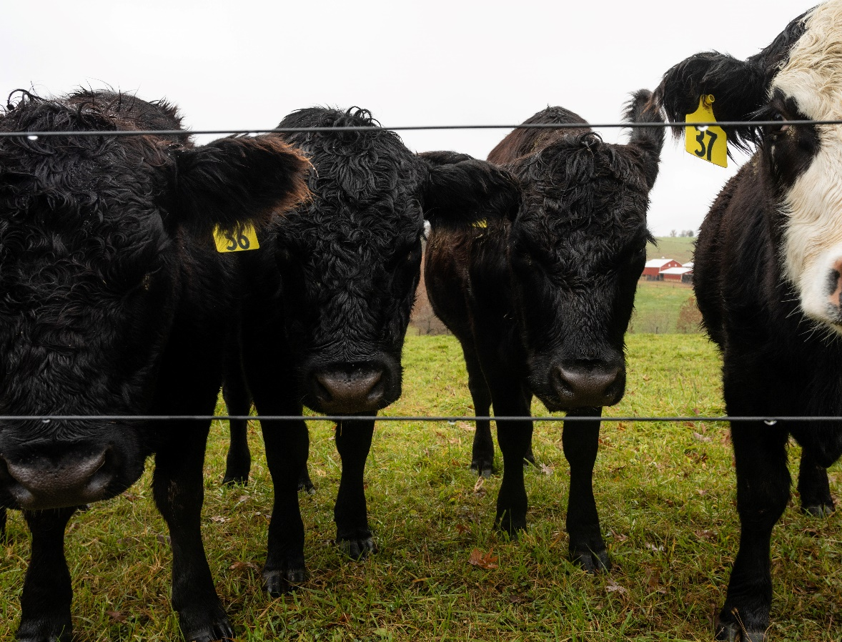
EVALUATION CRITERIA
NFWF and its external reviewers will utilize the following evaluation criteria in formally evaluating submitted proposals and making final award decisions:
Conservation Outcomes
Budget
Technical Merit
Will Parson, CBP
Notes:
Note that planning or modeling work, or purely educational work, would drop out of competition under the “results” score – we are looking for implementation.

Slide 30
CONSERVATION OUTCOMES
SWG-I: Project will clearly and demonstrably result in meaningful on-the-ground implementation of conservation and/or restoration actions that contribute to priority outcomes of CBSF and the Watershed Agreement, supporting multiple priority outcomes where possible.
SWG-PTA: Project will result in the delivery of planning and technical assistance products and services that meaningfully advance potential conservation or restoration implementation efforts.
All: Project supports new and existing partnerships working to advance conservation and restoration actions in the Chesapeake Bay watershed.
All: Project incorporates plans and approaches to implement, verify and sustain conservation and restoration actions and outcomes beyond the timeframe of the grant.
All: Project conveys a clear plan to transfer and disseminate project-related information to appropriate audiences and relevant stakeholders within the Chesapeake Bay watershed, with the goal of expanding adoption of successful approaches.
Notes:
Note that planning or modeling work, or purely educational work, would drop out of competition under the “results” score – we are looking for implementation.

Slide 31
BUDGET
The quality and level of detail in the budget and budget narrative provide a clear and detailed understanding of the proposed funding request.
Proposal demonstrates cost-effectiveness in achieving its proposed outcomes, considering both direct and indirect costs in the proposed budget.
Proposed costs are reasonable based on the work plan, local or regional costs for similar activities, and commensurate with project outcomes.
Budget clearly indicates the degree of partnership in conducting the proposed work.
Proposed funding request is well leveraged by the partners and other contributors through cash, in-kind, and other match.
Notes:
Note that planning or modeling work, or purely educational work, would drop out of competition under the “results” score – we are looking for implementation.

Slide 32
TECHNICAL
Proposal provides specific goals that correlate with a clear, logical, and achievable work plan, milestones, and timeline.
Proposed project team has the core competencies necessary to implement the proposed activities and achieve the proposed outcomes as well as the commitment to engage technical experts necessary to ensure activities are scientifically and technically sound and feasible.
Proposal demonstrates an understanding of necessary permitting and environmental compliance requirements and the ability to obtain necessary approvals consistent with the proposed work plan and timeline.
Applicant organization has demonstrated an ability to manage and implement similar projects on time and within budget.
Notes:
Note that planning or modeling work, or purely educational work, would drop out of competition under the “results” score – we are looking for implementation.

Slide 33

TIMELINE FOR 2022 SWG GRANTS
Proposals Due………………….11:59 PM, April 21st, 2022
Grants Announced……………..September
Grant Agreements Issued …….Likely starting in December
Will Parson CBP
Notes:
New for 2022- Projects should not have a start date prior to September 1, 2022 to facilitate necessary grant contracting and quality assurance activities.

