Slide 1

STAC Overview
Meg Cole (STAC Coordinator, crc)
November 2, 2023

Slide 2
Outline
STAC – Who we Are
Where does STAC fit in to the Chesapeake Bay Program?
What are STAC’s roles?
Proactive vs. Responsive
STAC – What we Do
Quarterly Meetings
Workshops
Reviews
Brief overview of STAC’s Budget
Looking Ahead
Upcoming Activities
Opportunities for involvement

Slide 3
STAC - Who we Are
Mission Statement: The Scientific and Technical Advisory Committee (STAC) provides scientific and technical advice and guidance to the Chesapeake Bay Program (CBP) Partnership on measures to restore and protect the Chesapeake Bay and its watershed.
Long Version: Since its creation in December 1984, STAC has worked to enhance scientific communication and outreach throughout the Chesapeake Bay watershed and beyond. STAC provides independent scientific and technical advice in various ways, such as (1) technical reports and white papers, (2) conducting reviews of CBP products, (3) technical workshops, and (4) interaction between STAC members and the CBP. STAC serves as a liaison between the scientific community and the CBP. Through professional and academic contacts and organizational networks of its members, STAC ensures close cooperation among and between the various research institutions and management agencies represented in the Chesapeake Bay watershed
Notes:
Now, on the slide in front of you, you will see the LONG version of who STAC is and what we do that comes directly from our bylaws.

Slide 4
Chesapeake Bay Program Organizational Structure
Citizens’ Advisory
Committee
Chesapeake Executive Council
Principals’ Staff Committee
Local Government
Advisory Committee
Management
Board
Scientific & Technical
Advisory Committee
Communications
Workgroup
Science, Technical
Analysis, and Reporting
Goal Implementation Teams
Sustainable
Fisheries
Protect &
Restore
Vital
Habitats
Protect &
Restore
Water
Quality
Maintain
Healthy
Watersheds
Foster
Chesapeake
Stewardship
Enhance
Partnering,
Leadership
& Management
Implementation
Workgroups
Implementation
Workgroups
Implementation
Workgroups
Implementation
Workgroups
Implementation
Workgroups
Implementation
Workgroups
Notes:
4

Slide 5
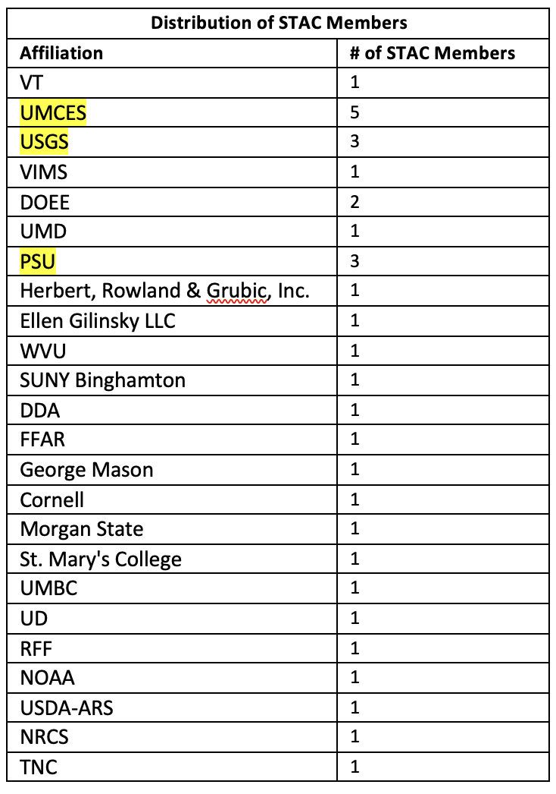
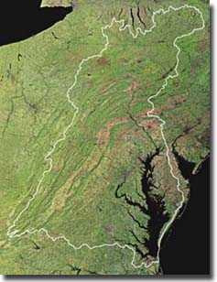
CBP’s connection to the regional & national scientific community

Slide 6
What is the role of a STAC member?
Provide expert opinion to the Chesapeake Bay Program (CBP) partners on any issue identified as important by the science community as well as management leadership. STAC acts to raise and review issues that members deem crucial to Chesapeake Bay restoration (proactive) or in providing scientific opinion when CBP partners solicit specific reviews or technical assistance (responsive).
Connecting your network – Representing your own and your colleagues expertise
Contribute to STAC-sponsored activities
Serve as liaison between STAC and other CBP entities (GITs, workgroups)

Slide 7
What about a Mayoral or Federal Appointee?
Each appointed mayoral or gubernatorial and federal representative from a jurisdiction serves as the continuous communication link between STAC and his/her member of the Management Board (MB), Principal’s Staff Committee (PSC) and/or the Executive Council (EC)
Mayoral or gubernatorial appointees assist STAC by maintaining active communication with the Chief Executive or staff in his/her jurisdiction or agency to ensure transfer of relevant STAC information and recommendations to the executive branch of the jurisdiction, as well as relaying issues of jurisdictional concern to the STAC

Slide 8
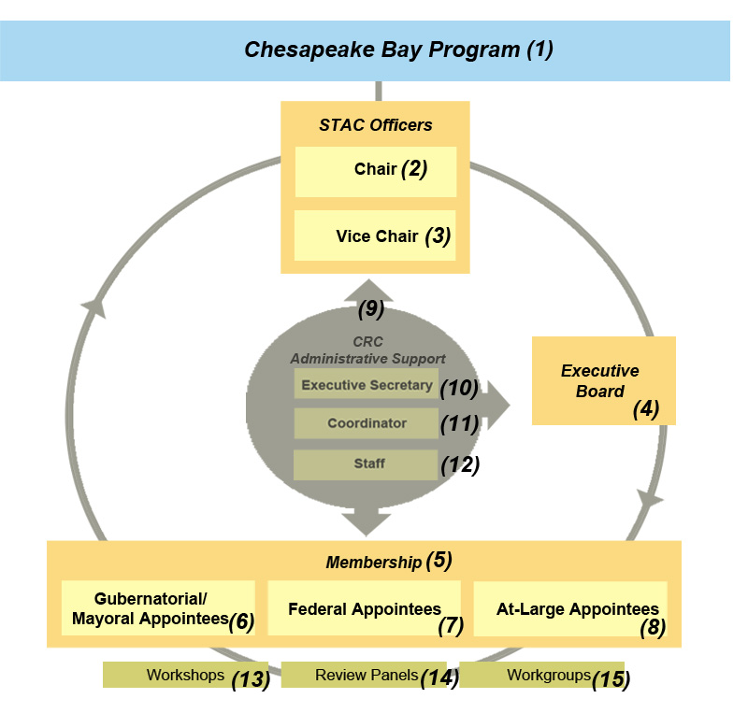
Notes:
Organizing structure – Tenure, chair, leadership

Slide 9

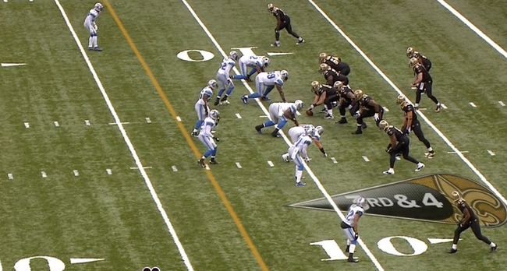
STAR vs. STAC
STAR
STAC
STAR is your on-the-ground, everyday technical assistance.
STAC is your avenue for evaluating broader questions.
Credit: Matt Johnston

Slide 10

STAC Budget Overview
The CBP provides STAC funding through a cooperative agreement with the Chesapeake Research Consortium (CRC)
Includes support for Staff, STAC member travel, and funding for STAC Meetings, Workshops, Reviews, Syntheses, etc.
STAC receives our budget annually: Budget cycle runs June 1 - May 31

Slide 11
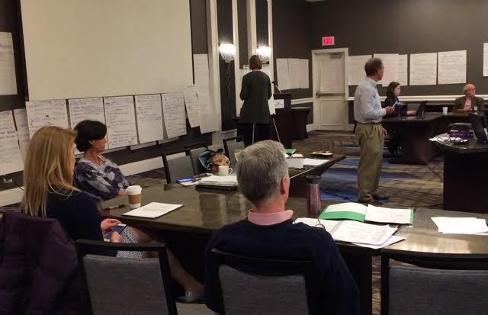
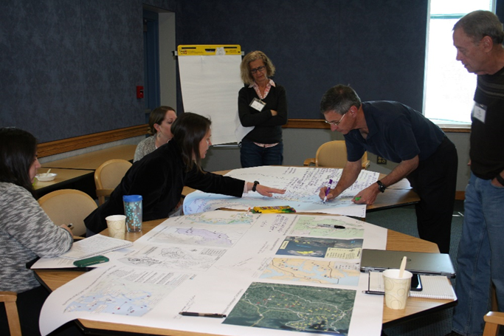
What we Do
Workshops
Explore scientific topics of interest – state of the science, problem-solving, foster collaboration
Reviews
Independently evaluate projects, policies and programs
Synthesis*
Analysis or synthesis of available data and previously published results to address gaps and inform future research

Slide 12
STAC Activities at a Glance
FY20
4 workshops
1 review
COVID impacts
FY21
5 workshops
FY22
5 workshops
1 review
FY23
1 workshop
CESR release
Synthesis funding
Review proposals for activities (workshops and reviews)
Serve on a review panel or workshop steering committee
Review and comment on final reports
Notes:
Show where STAC members plug in at each step in the process
Reviewing proposals
Serving on a review panel or steering committee
Reviewing and commenting on final reports

Slide 13
Quarterly Meetings
March, June, September, December
Dates are set each September for the coming calendar year
Typically Tuesday-Wednesday
Meeting duration may vary
2 in-person and 2 virtual
STAC members expected to attend at least 2 meetings per year
Call-in option will always be available
All meetings are open to the public – bring your colleagues!
Notes:
Our time to network and learn about the CBP’s ongoing work so that:
i. Science is directed toward management
ii. Projects are coordinated among institutions

Slide 14
Structuring STAC Meetings
Meeting Content
Mix of CBP programmatic updates and focusing on emerging science
Integrated presentations with group discussion and feedback
Concrete goals to come out of each meeting – ‘Action Item Trackers’
Continuing the conversation and linking back to GITs and workgroups
Previous Meeting Themes
Advancing LR and Habitat Management in the Bay’s T-Zone
Waterborne Health Risks in our Chesapeake Waters
Environmental Flows
Wetland Restoration
Soil Health 101 and the Connection to Bay Health
Notes:
Is this slide necessary??

Slide 15
Workshops
Workshops are the most common STAC activity. STAC funds about 4 to 6 workshops each year.
Workshops are opportunities for GITs, workgroups, advisory committees and other partners to investigate the science surrounding a topic related to restoration or conservation.
A primary mechanism by which STAC brings the broad expertise of the scientific and technical community to bear on critical and timely issues
STAC issues a Request for Proposals (RFP) each December, STAC members evaluate proposals, and determine funding at the March quarterly meeting
Notes:
For anyone interested and unfamiliar with typical STAC workshops, I have a whole separate presentation on the format, content, roles of the steering committee, budget, etc.

Slide 16
Reviews
STAC conducts independent peer review of technical reports, policy statements, and activities on behalf of CBP or other partners.
STAC usually emphasize reviews at the broad program level and development of advice on major issues.
Requests for STAC reviews may be received at any time.
If funded, STAC convenes a review panel of qualified experts, from within STAC membership and outside institutions.

Slide 17
Looking Ahead – Upcoming Activities
FY23 – Climate Change 3.0 is currently being planned. Convening in May 2024 in Northern VA.
STAC Subcommittees
CESR Communication and Outreach Team: CESR communications and outreach is ongoing and looking for partners within the CBP to help integrate learnings into the restoration effort.
Indigenous Traditional Ecological Knowledge
STAC Synthesis Projects
Notes:
disseminate the findings and implications of the CESR report in an accessible manner to
diverse audiences so that the learnings can be integrated into the restoration effort.; CESR Outreach Committee Responsibilities:
Oversee dissemination plans/efforts
Develop, review and approve CESR outreach products
Be a resource for CESR briefings/presentations

Slide 18
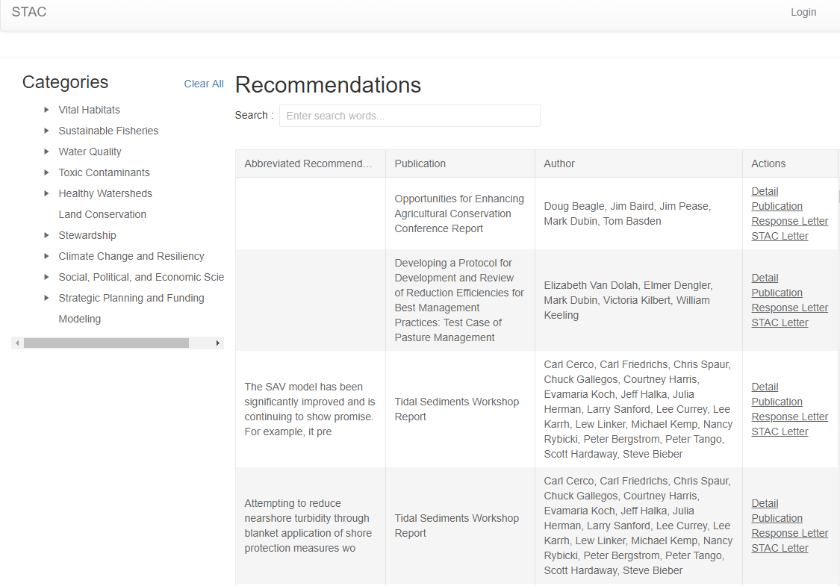
Recommendations Database

Slide 19
Denice Wardrop STAC Executive Secretary
dhw110@psu.edu
Meg Cole STAC Coordinator
colem@chesapeake.org
Tou Matthews STAC Projects Manager
matthewst@chesapeake.org
For more information on STAC, workshops, reviews, and upcoming meetings (including reports, as available), visit our webpage at:
http://www.chesapeake.org/stac/
Chesapeake Bay Program Website:
https://www.chesapeakebay.net/
CBP Newsletters (Daily, Weekly, Monthly)
https://www.chesapeakebay.net/action/newsletters

