Slide 1

Actions and Decisions from July 20 Coordination Quarterly
Action items completed
  STAR: Review Reaching 2025 report, with a focus on how to carry science and monitoring recommendations into beyond 2025.
  Integrated Trends Analysis Team (ITAT) and Climate Resiliency Workgroup (CRWG): have a conversation about utilizing trend analyses and integrating it into climate indicator development.
Action items in progress
  Bay Oxygen Research Group (BORG): Consider integration of climate science information, specifically marine heat waves, into the 4-Dimensional Interpolator development for application on the impact of heat waves on DO throughout the water column.
Action items not yet started
  BORG: Present at future CRWG meeting on 4-D Interpolator.

Slide 2

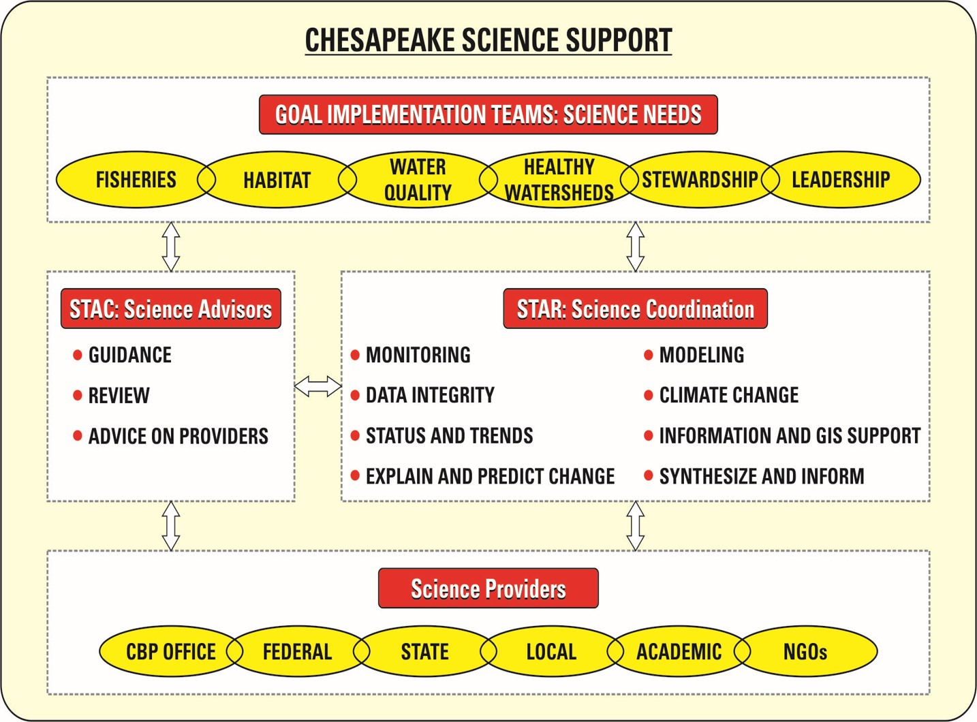
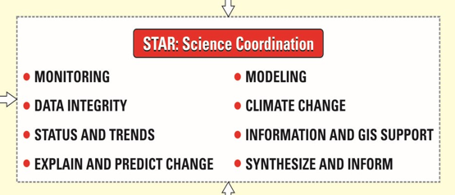
Scientific, Technical Assessment and Reporting (STAR)
Notes:
How does STAR fit in CBP science support?

Slide 3
Scientific, Technical Assessment and Reporting (STAR)
Purpose: Enhance Chesapeake Bay science and capacity by facilitating collaboration among science providers to provide monitoring, modeling, and analysis needed to update, explain, and communicate ecosystem condition and change to support the CBP GITs.
Notes:
What do we do?

Slide 4
Scientific, Technical Assessment and Reporting (STAR)
Manage and coordinate the Strategic Science and Research Framework (SSRF) to identify, track, and address the CBP science needs for the Watershed Agreement.​​
Interact with GITs to coordinate science partnerships and identify new opportunities to address science needs in SSRF and science capacity for Watershed Agreement outcomes.
Manage CBP-funded monitoring networks and collaborate with monitoring organizations to utilize and enhance additional networks to address the outcomes in the Watershed Agreement.
​​​​​​​​​​​Produce synthesis products and reports to better communicate scientific results and aid in science informed management decisions.
Notes:
How do we do it?

Slide 5
Scientific, Technical Assessment and Reporting (STAR)
Ensure data comparability, completeness, and integrity.
Conduct modeling to improve water-quality decision-making and better understand and predict ecosystem response.
Update, and deliver, the status and trends (indicators) of ecosystem conditions.
Coordinate science support of climate change activities.
Contribute to explaining ecosystem condition and change.
Enhance information management, access, and GIS support.
Notes:
How do we do it?

Slide 6
STAR Organizational Structure and Leadership 7/20/2023
Scientific, Technical Assessment
and Reporting (STAR) Team
Co-Chair – Ken Hyer, USGS
Co-Chair – Bill Dennison, UMCES
Vice-Chair – Kim Van Meter, Penn State
Coordinator – Breck Sullivan, USGS
Monitoring Coordinator – Peter Tango, USGS
Staffer – Alex Gunnerson, CRC
Staffer – August Goldfischer, CRC
EPA Science Branch –
Kaylyn Gootman, EPA
GIS Team Lead – John Wolf, USGS
Data Center – Brian Burch, EPA
Workgroups
Climate Resiliency
(CRWG)
Criteria
Assessment
Protocol (CAP)
Data Integrity
(DIWG)
Integrated
Monitoring
Networks (IMN)
Integrated Trends
Analysis Team
(ITAT)
Modeling Workgroup
(MWG)
Status &
Trends
(STWG)
Mark Bennet & Jackie
Specht
USGS & MD DNR
Julie Reichert-Nguyen
NOAA
Jamileh Soueidan
CRC
Peter Tango
USGS
August
Goldfischer
CRC
Cindy Johnson
VA DEQ
Durga Ghosh
EPA
August
Goldfischer
CRC
Peter Tango
USGS
August
Goldfischer
CRC
Breck Sullivan &
Kaylyn Gootman**
USGS & EPA
Alex Gunnerson
CRC
Mark Bennet & Dave
Montali
USGS & Tetra Tech
Lew Linker
EPA
Alex Gunnerson
CRC
Katheryn Barnhart
& Doug Bell**
EPA
Alex Gunnerson
CRC
Key:
Workgroup
Chair
Coordinator**
Staffer
**ITAT and STWG have two co-coordinators.
Bay Oxygen
Research Group
(BORG)
Hypoxia
Collaborative
Nontidal Network
(NTN)
Chesapeake Monitoring
Cooperative
(CMC)
Peter Tango
USGS
August Goldfischer
CRC
Peter Tango &
Bruce Vogt
USGS & NOAA
Bailey Robertory &
August Goldfischer
CRC
Peter Tango
USGS
August Goldfischer
CRC
Liz Chudoba
Alliance for the
Chesapeake Bay
Notes:
6
Who does what?

Slide 7
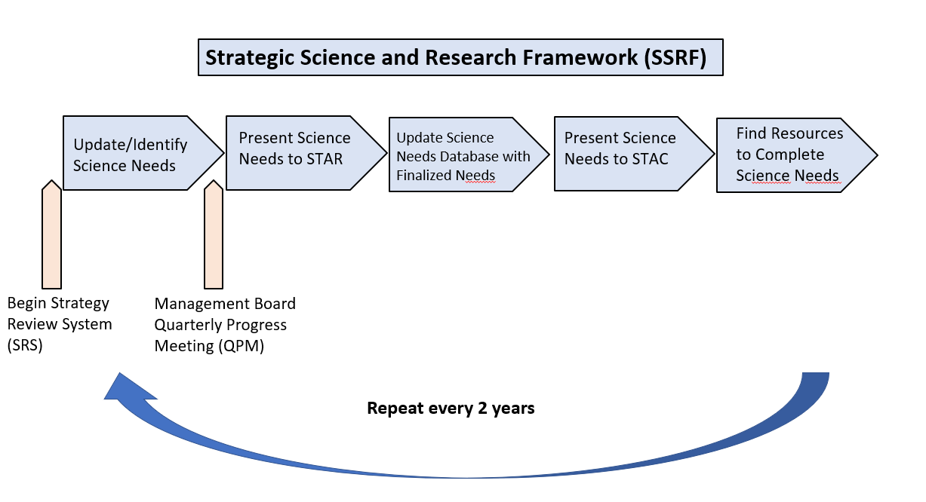
Science Needs Past
Notes:
This was our past…

Slide 8

Science Needs Future
STAR
Notes:
Where do we go from here? [I’m going to attempt a new diagram to show potential new options stac-star-srs interactions]

