Slide 1
Brook Trout Workgroup Special Session
For the purpose of reviewing the Outcome Assessment request from the Management Board
January 22, 2025

Slide 2
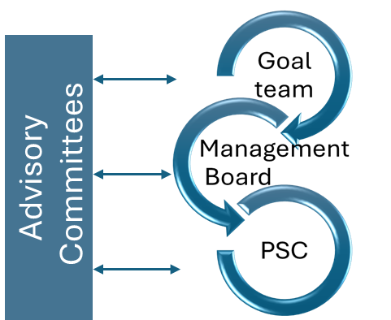
Draft Outcome Review Process
MB meeting on Second round GIT responses
Finalize outcome assessment.
Outcome consideration by PSC
MB meeting. Refine and approve process
MB Meeting. Further discussion of Outcome
13 Feb.
13 Mar.
10 Apr.
June
Jan 16
27 Feb.
27 Mar.
May
MB meeting on First round GIT responses
MB meeting on Third round GIT responses
MB Meeting. Further discussion of Outcome
Public Consideration
STAR and STAC meetings to discuss connections and collaboration.
Outcome Workgroup meetings and Office hours.
Notes:
Emphasize Feb 27 and March 13

Slide 3
Big Question: What advice do you have for the Management Board on how to consolidate, reduce, update, remove, replace or add new outcomes within your GIT?​ (More discussion to follow as part of this meeting)

Slide 4
A Simple Logic Model

Slide 5
Logic Model format (modified from Kellogg Foundation)
A logic model is a systematic and visual way to present and share your understanding of the relationships
among the resources you have to operate your program, the activities you plan,
and the changes or results you hope to achieve.
Baseline What is the condition of the things we care about? | :Stressors In order of importance what are the stressors and causes of stressors and where are they most prevalent? | Resources/Inputs In order to accomplish our set of activities we will need the following | Activities (Inputs) In order to address our problems or asset we will accomplish the following activities | Outputs We expect that once accomplished these activities will produce the following evidence or service delivery. | Short Term Outcomes We expect that if accomplished these activities will lead to the following changes in 1-5 years | Long Term Outcomes - Impacts We expect that if accomplished these activities will lead to the following changes in 6+ years
Indicator(s) | Indicator(s) | Indicator(s) | Indicator(s) | Indicator(s) | Indicator(s) | Indicator(s)
Data Source(s) | Data Source(s) | Data Source(s) | Data Source(s) | Data Source(s) | Data Source(s) | Data Source(s)
Use data to construct indicators

Slide 6
The main difference between an output and an outcome is that an output is what is produced or accomplished, while an outcome is the effect of that output on the desired result.
Measurable
More tangible
More complex
Long term effects of outputs
Drives
Inputs,
Outputs
and Outcomes
Outputs
Outcome
Goals
Outputs
The tangible or observable results of an action, project, or process (i.e. Inputs/activities). Outputs are more immediate deliverables that can be measured and assessed. Outcomes answer the question “So what?“
Outcomes
Outcomes are the results of the Inputs/activities and Outputs that help achieve the desired result.
Outcomes measure the long-term effects of a process, task or activity, such as a change in the environment or in people's behavior. Outcomes are often more complex and more difficult to measure than outputs, and can take a long time to manifest. Measures can be qualitative and overall trends.

Slide 7
Big Question: What advice do you have for the Management Board on how to consolidate, reduce, update, remove, replace or add new outcomes within your GIT?​
Guidelines:​ You do not have to answer all these questions, but the first two are necessary.
In reviewing your outcome, provide advice to the Management Board on whether "to consolidate, reduce, update, remove, replace or add new outcomes". ​
Don’t need to provide updated Outcome language at this point in the process.​
If consolidation is recommended, which outcome(s) do you advise combining with?​
Should the outcome be moved or restructured?
Consider if the Outcome is SMART, and specifically, whether the current outcome meets the definition of an outcome, as described in the 2014 Chesapeake Bay Watershed Agreement (“Agreement”), or if that outcome is an output or indicator.​
Review ERG’s Beyond 2025 Report for existing assessment of Specific, Measurement, and Timebound.
Consider the Secret Sauce
Consider the challenges to and opportunities for achieving the outcome. You are encouraged to leverage past documentation and learnings from the Strategy Review System process, as well as Charting a Course to 2025 report and Beyond 2025 Small Group recommendations as they pertain to the outcome.​
Consider how the outcome relates or could relate to the Bay Agreement mission, vision, and themes/pillars

Slide 8
Big Question: What advice do you have for the Management Board on how to consolidate, reduce, update, remove, replace or add new outcomes within your GIT?​
Guidelines:​ You do not have to answer all these questions, but the first two are necessary.
Consider the timescale for completing the outcome (5, 10, 15 years). Determine if achieving the outcome is an incremental step or is it a final outcome.​
Consider resource needs and availability (high, medium, low).​
Consider the risk or unintended consequences of removing the Outcome.
What value is added by having the Chesapeake Bay Program work on the outcome?
Consider how the Outcome, as written, benefits the public. Does the outcome reflect public input already received and have the potential to galvanize public support/engagement?
We will provide links to the supplemental information, including:
2014 Chesapeake Bay Watershed Agreement
Secret Sauce
Beyond 2025 Recommendations
Charting a Course to 2025 report

Slide 9
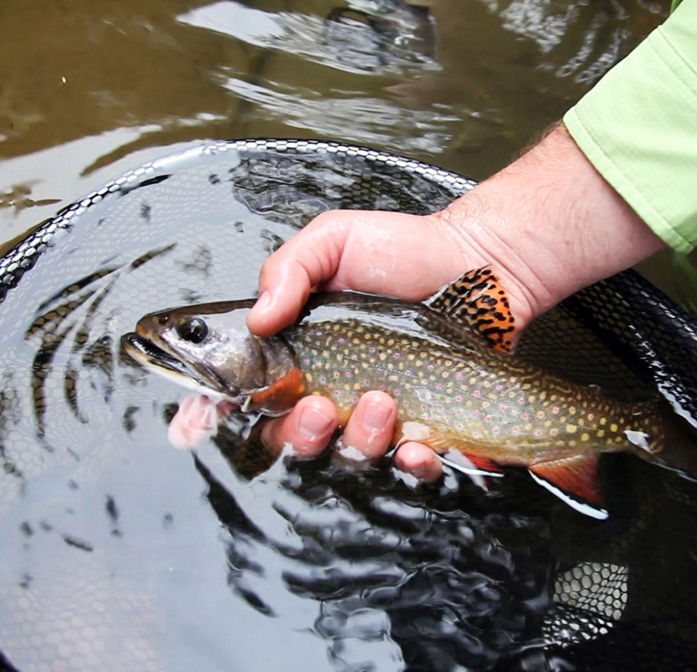
The secret sauce of a good outcome
Excerpt from Retrospective on Lessons Learned from the Chesapeake Bay Program Strategy Review System’s 3rd Cycle with Suggested Adaptations to Address the Issues
A good outcome is: (Secret Sauce)
Clear in its objective
Measurable
Has a monitoring program that supports and reinforces the outcome
Has partner commitment
Resources identified and/or available to support the efforts necessary to achieve the outcome.
Centering the work on benefits to people and living resources, not solely water quality.
Notes:
Outcome already has secret sauce – go through slide quickly
Add SAV pic

Slide 10
Brook Trout Workgroup Logic Model Example
Inputs
Outputs
Outcome
Identify priority barriers in collaboration with the fish passage workgroup, DOTs, etc.
Prioritize streams for AMD remediation
Identify ponds discharging warm water into brook trout streams
Propagate native brook trout
Plant Riparian Buffers
Research effects of 6ppdq on population health
Identify priority parcels in brook trout patches for conservation (acquisition or easement)
Identify brook trout streams where instream habitat improvements are needed (e.g. woody debris, pools, bank stabilization)
Survey state biologists to identify sentinel streams for long-term monitoring
Identify streams where competition with nonnative trout may be impacting brook trout
Remove physical barriers to brook trout migration to increase occupancy
Improve stream pH/water quality
Reduce surface runoff temperatures from ponds
Stock native brook trout
Increased forest cover
Decrease 6ppdq concentration in stormwater runoff
Increase conserved lands within brook trout patches
Improved habitat suitability index, and or IBI scores
Monitor sentinel brook trout populations to generate long-term trend analyses
Remove nonnative trout from sympatric populations
A good outcome is: (Secret Sauce)
Clear in its objective
Measurable
Has a monitoring program that supports and reinforces the outcome
Has partner commitment
Resources identified and/or available to support the efforts necessary to achieve the outcome.
Centering the work on benefits to people and living resources, not solely water quality.
UPDATE
Occupancy:
Restore and sustain naturally reproducing brook trout populations in Chesapeake Bay headwater streams, with an XX percent increase in occupied habitat by 2035.
ADD
Abundance:
Maintain or increase the abundance trend of adult fish in 50% or more of stronghold (or sentinel???) populations by 2035.
ADD
Resiliency:
Increase Ne above 50 in XX populations by 2035.
Connect XX number stream miles in stronghold populations by 2035.
Increase forest cover within riparian buffers above 75% in XX number patches by 2035.
Increase land enrolled in conservation easements by 20% by 2035.

