Slide 1
Stream Health Workgroup Special Session
For the purpose of reviewing the Outcome Assessment request from the Management Board
January 24, 2025

Slide 2
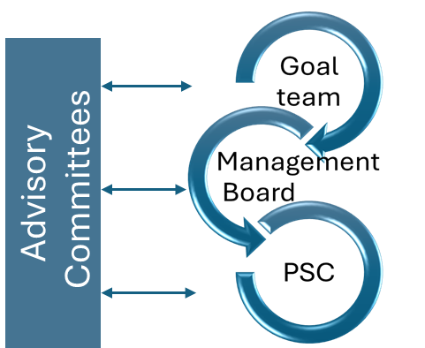
Draft Outcome Review Process
MB meeting on Second round GIT responses
Finalize outcome assessment.
Outcome consideration by PSC
MB meeting. Refine and approve process
MB Meeting. Further discussion of Outcome
13 Feb.
13 Mar.
10 Apr.
June
Jan 16
27 Feb.
27 Mar.
May
MB meeting on First round GIT responses
MB meeting on Third round GIT responses
MB Meeting. Further discussion of Outcome
Public Consideration
STAR and STAC meetings to discuss connections and collaboration.
Outcome Workgroup meetings and Office hours.
Notes:
Emphasize Feb 27 and March 13

Slide 3
Big Question: What advice do you have for the Management Board on how to consolidate, reduce, update, remove, replace or add new outcomes within your GIT?​ (More discussion to follow as part of this meeting)

Slide 4
A Simple Logic Model

Slide 5
Logic Model format (modified from Kellogg Foundation)
A logic model is a systematic and visual way to present and share your understanding of the relationships
among the resources you have to operate your program, the activities you plan,
and the changes or results you hope to achieve.
Baseline What is the condition of the things we care about? | :Stressors In order of importance what are the stressors and causes of stressors and where are they most prevalent? | Resources/Inputs In order to accomplish our set of activities we will need the following | Activities (Inputs) In order to address our problems or asset we will accomplish the following activities | Outputs We expect that once accomplished these activities will produce the following evidence or service delivery. | Short Term Outcomes We expect that if accomplished these activities will lead to the following changes in 1-5 years | Long Term Outcomes - Impacts We expect that if accomplished these activities will lead to the following changes in 6+ years
Indicator(s) | Indicator(s) | Indicator(s) | Indicator(s) | Indicator(s) | Indicator(s) | Indicator(s)
Data Source(s) | Data Source(s) | Data Source(s) | Data Source(s) | Data Source(s) | Data Source(s) | Data Source(s)
Use data to construct indicators

Slide 6
The main difference between an output and an outcome is that an output is what is produced or accomplished, while an outcome is the effect of that output on the desired result.
Measurable
More tangible
More complex
Long term effects of outputs
Drives
Inputs,
Outputs
and Outcomes
Outputs
Outcome
Goals
Outputs
The tangible or observable results of an action, project, or process (i.e. Inputs/activities). Outputs are more immediate deliverables that can be measured and assessed. Outcomes answer the question “So what?“
Outcomes
Outcomes are the results of the Inputs/activities and Outputs that help achieve the desired result.
Outcomes measure the long-term effects of a process, task or activity, such as a change in the environment or in people's behavior. Outcomes are often more complex and more difficult to measure than outputs, and can take a long time to manifest. Measures can be qualitative and overall trends.

Slide 7
Big Question: What advice do you have for the Management Board on how to consolidate, reduce, update, remove, replace or add new outcomes within your GIT?​
Guidelines:​ You do not have to answer all these questions, but the first two are necessary.
In reviewing your outcome, provide advice to the Management Board on whether "to consolidate, reduce, update, remove, replace or add new outcomes". ​
Don’t need to provide updated Outcome language at this point in the process.​
If consolidation is recommended, which outcome(s) do you advise combining with?​
Should the outcome be moved or restructured?
Consider if the Outcome is SMART, and specifically, whether the current outcome meets the definition of an outcome, as described in the 2014 Chesapeake Bay Watershed Agreement (“Agreement”), or if that outcome is an output or indicator.​
Review ERG’s Beyond 2025 Report for existing assessment of Specific, Measurement, and Timebound.
Consider the Secret Sauce
Consider the challenges to and opportunities for achieving the outcome. You are encouraged to leverage past documentation and learnings from the Strategy Review System process, as well as Charting a Course to 2025 report and Beyond 2025 Small Group recommendations as they pertain to the outcome.​
Consider how the outcome relates or could relate to the Bay Agreement mission, vision, and themes/pillars

Slide 8
Big Question: What advice do you have for the Management Board on how to consolidate, reduce, update, remove, replace or add new outcomes within your GIT?​
Guidelines:​ You do not have to answer all these questions, but the first two are necessary.
Consider the timescale for completing the outcome (5, 10, 15 years). Determine if achieving the outcome is an incremental step or is it a final outcome.​
Consider resource needs and availability (high, medium, low).​
Consider the risk or unintended consequences of removing the Outcome.
What value is added by having the Chesapeake Bay Program work on the outcome?
Consider how the Outcome, as written, benefits the public. Does the outcome reflect public input already received and have the potential to galvanize public support/engagement?
We will provide links to the supplemental information, including:
2014 Chesapeake Bay Watershed Agreement
Secret Sauce
Beyond 2025 Recommendations
Charting a Course to 2025 report

Slide 9
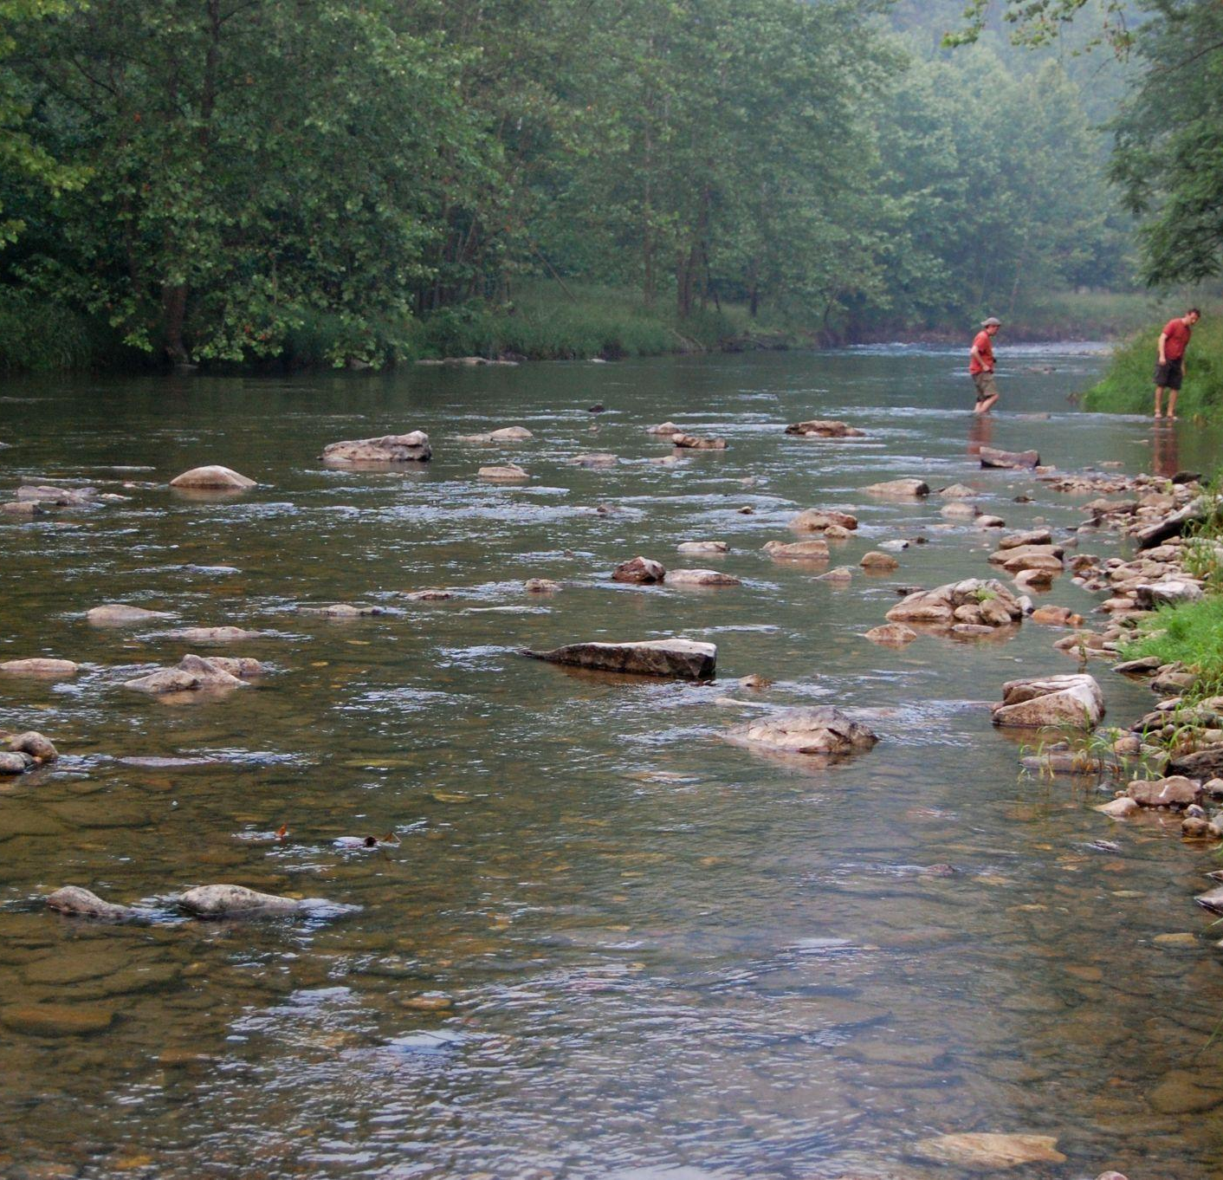
The secret sauce of a good outcome
Excerpt from Retrospective on Lessons Learned from the Chesapeake Bay Program Strategy Review System’s 3rd Cycle with Suggested Adaptations to Address the Issues
A good outcome is: (Secret Sauce)
Clear in its objective
Measurable
Has a monitoring program that supports and reinforces the outcome
Has partner commitment
Resources identified and/or available to support the efforts necessary to achieve the outcome.
Centering the work on benefits to people and living resources, not solely water quality.
Notes:
Outcome already has secret sauce – go through slide quickly
Add SAV pic

Slide 10
Stream Health Workgroup
Inputs
Outputs
Outcome
More granular timeline of stream conditions. Have a more robust suite of metrics that will create a clear picture of whether a stream can be classified as conducive for thriving shallow water living resources.
Establish more frequent and widely reported stream health metrics to complement Chessie BIBI.
ACTION 1.2: : Identify additional parameters/metrics to describe and quantify stream health and its stressors to complement, but not replace, existing biological indicators (e.g., Chessie BIBI).
Greater understanding of the state of streams within the watershed which can inform future management actions within jurisdictions and where to concentrate financial resources.
ACTION 2.1: Support pooled monitoring approach and other monitoring efforts throughout Chesapeake Bay watershed to inform watershed best management practices that demonstrate stream and riparian ecosystem improvement.
ACTION 2.2: Create an understanding of the effects and implications of population growth, land use change, and continued development of climate change.
Resource managers are more able to adapt implementation to specific conditions.
SMART goal - x% of watershed best management practices incorporate holistic practices
Current: Continually improve stream health and function throughout the watershed. Improve health and function of ten percent of stream miles above the 2008 baseline for the watershed.
Update: Continually improve stream health and function throughout the watershed.
Improve health and function of <X%> of stream miles for <Y timeframe> for the watershed.
Specific outcome language will be discussed in Feb SHWG meeting, due in April.

Slide 11
Stream Health Workgroup
Inputs
Outputs
Outcome
Foster a culture of inclusive responsibility for the watershed where all people can benefit from it’s resources.
ACTION 3.1: Engage with local communities and include targeted engagement with under-served, overburdened communities to increase participation in stream health concerns.
A space is created to share science and insights which would create clear understanding of cross-GIT/workgroup collaboration opportunities/challenges. The Stream Health Workgroup would share insights on stream restoration approaches and co-benefits of management approaches.
Action 4.1: Facilitate a series of meetings or workshops to summarize how different stream restoration approaches lead to different outcomes and tradeoffs associated with those approaches, as well as discuss ways to reduce unintended consequences.
Stream corridor improvements are completed in many different types of communities throughout the watershed.
SMART goal: X% of stream corridor improvements are completed in EJ identified communities.
SMART goal: X% of watershed improvements are completed in densely populated areas.
Current: Continually improve stream health and function throughout the watershed. Improve health and function of ten percent of stream miles above the 2008 baseline for the watershed.
ADD: Continually improve stream health and function throughout the watershed.
X% of stream health improvements occur in EJ identified communities and densely populated areas.
Specific outcome language will be discussed in Feb SHWG meeting, due in April.

