Slide 1


Can Seagrass Meadows Mitigate Ocean Acidification Thresholds for Eastern Oysters in the Chesapeake Bay?
Mark Brush, Sara Blachman, Emily Rivest, Richard Zimmerman, & Victoria Hill
Sustainable Fisheries GIT Fall 2023 Meeting

Slide 2
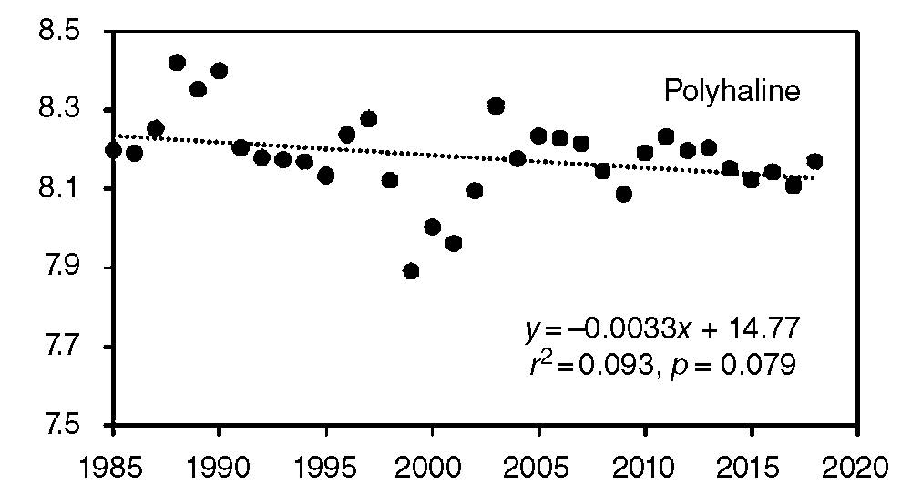
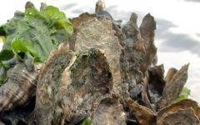
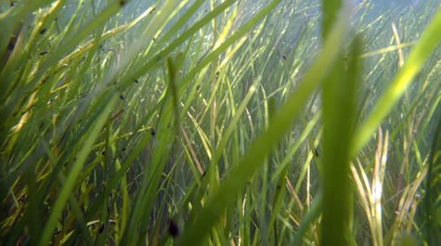
Introduction
Restored and cultured oysters in the Chesapeake are subject to ocean acidification (OA) and a myriad of co-stressors
Co-restoration of seagrasses has been proposed as a means of mitigating the negative impacts of OA on oysters
Brush et al. (2021)
Predictive models are required to quantify impacts of OA on oysters, the ability of SAV to mitigate those impacts, and reciprocal benefits to SAV
Photos: VIMS

Slide 3
Objectives
Expand an existing oyster bioenergetics model, EcoOyster, to include the impacts of pH and OA
Quantify the potential impacts of OA on oysters in the Chesapeake Bay, with a focus on multiple stressors and OA thresholds
(i.e., future values of pH below which oyster metrics such as shell growth slow or become negative)
Explore the potential for co-restoration of seagrasses to mitigate the negative impacts of OA on oysters, as well as reciprocal benefits

Slide 4
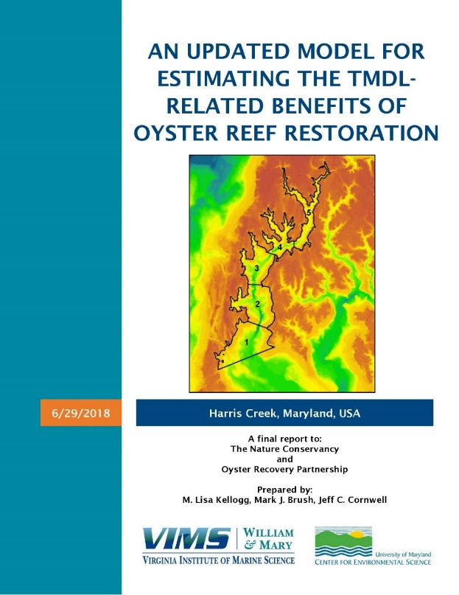
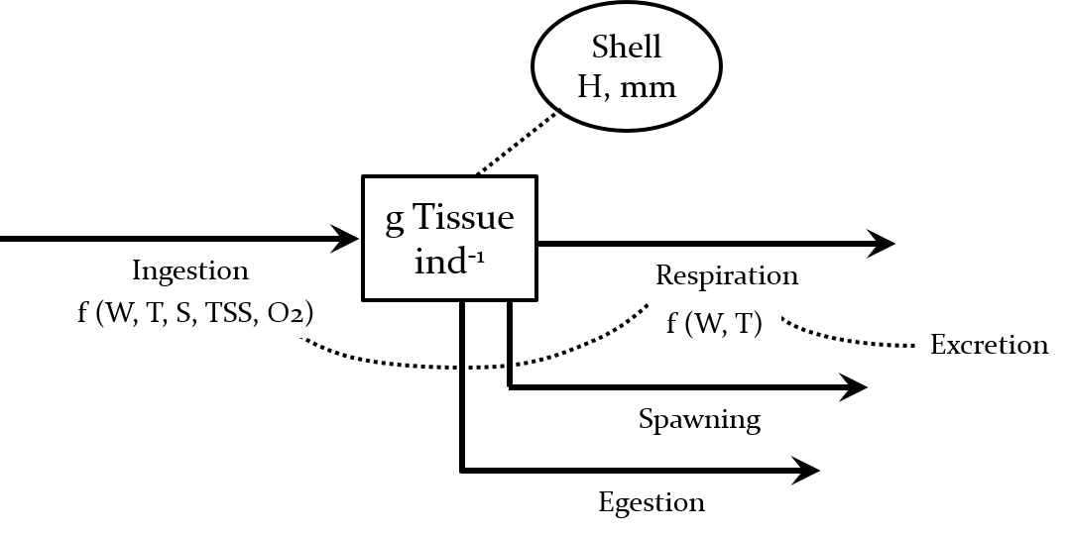
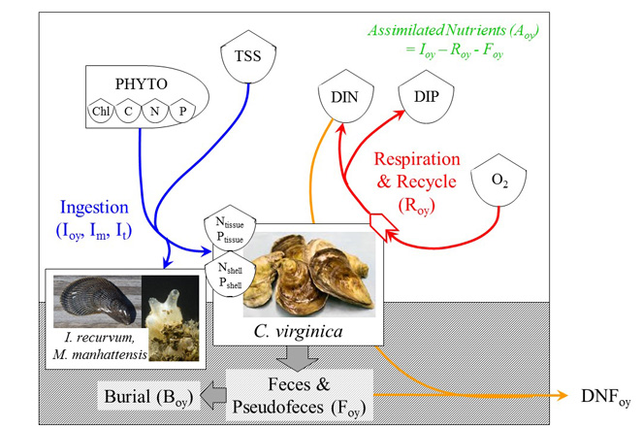
EcoOyster:
A model of individual oyster growth …
Brush & Kellogg (2018) Kellogg et al. (2018)

Slide 5
EcoOyster
… expanded to include the impacts of OA
Shell H, mm
Ω_{calcite}
Calcification
g Shell ind⁻¹
f (pH)
Dissolution
CI
f (pH)
g Tissue ind⁻¹
Ingestion
Respiration
f (W, T, S, TSS, O2)
f (W, T, O2)
Excretion
Spawning
Egestion

Slide 6
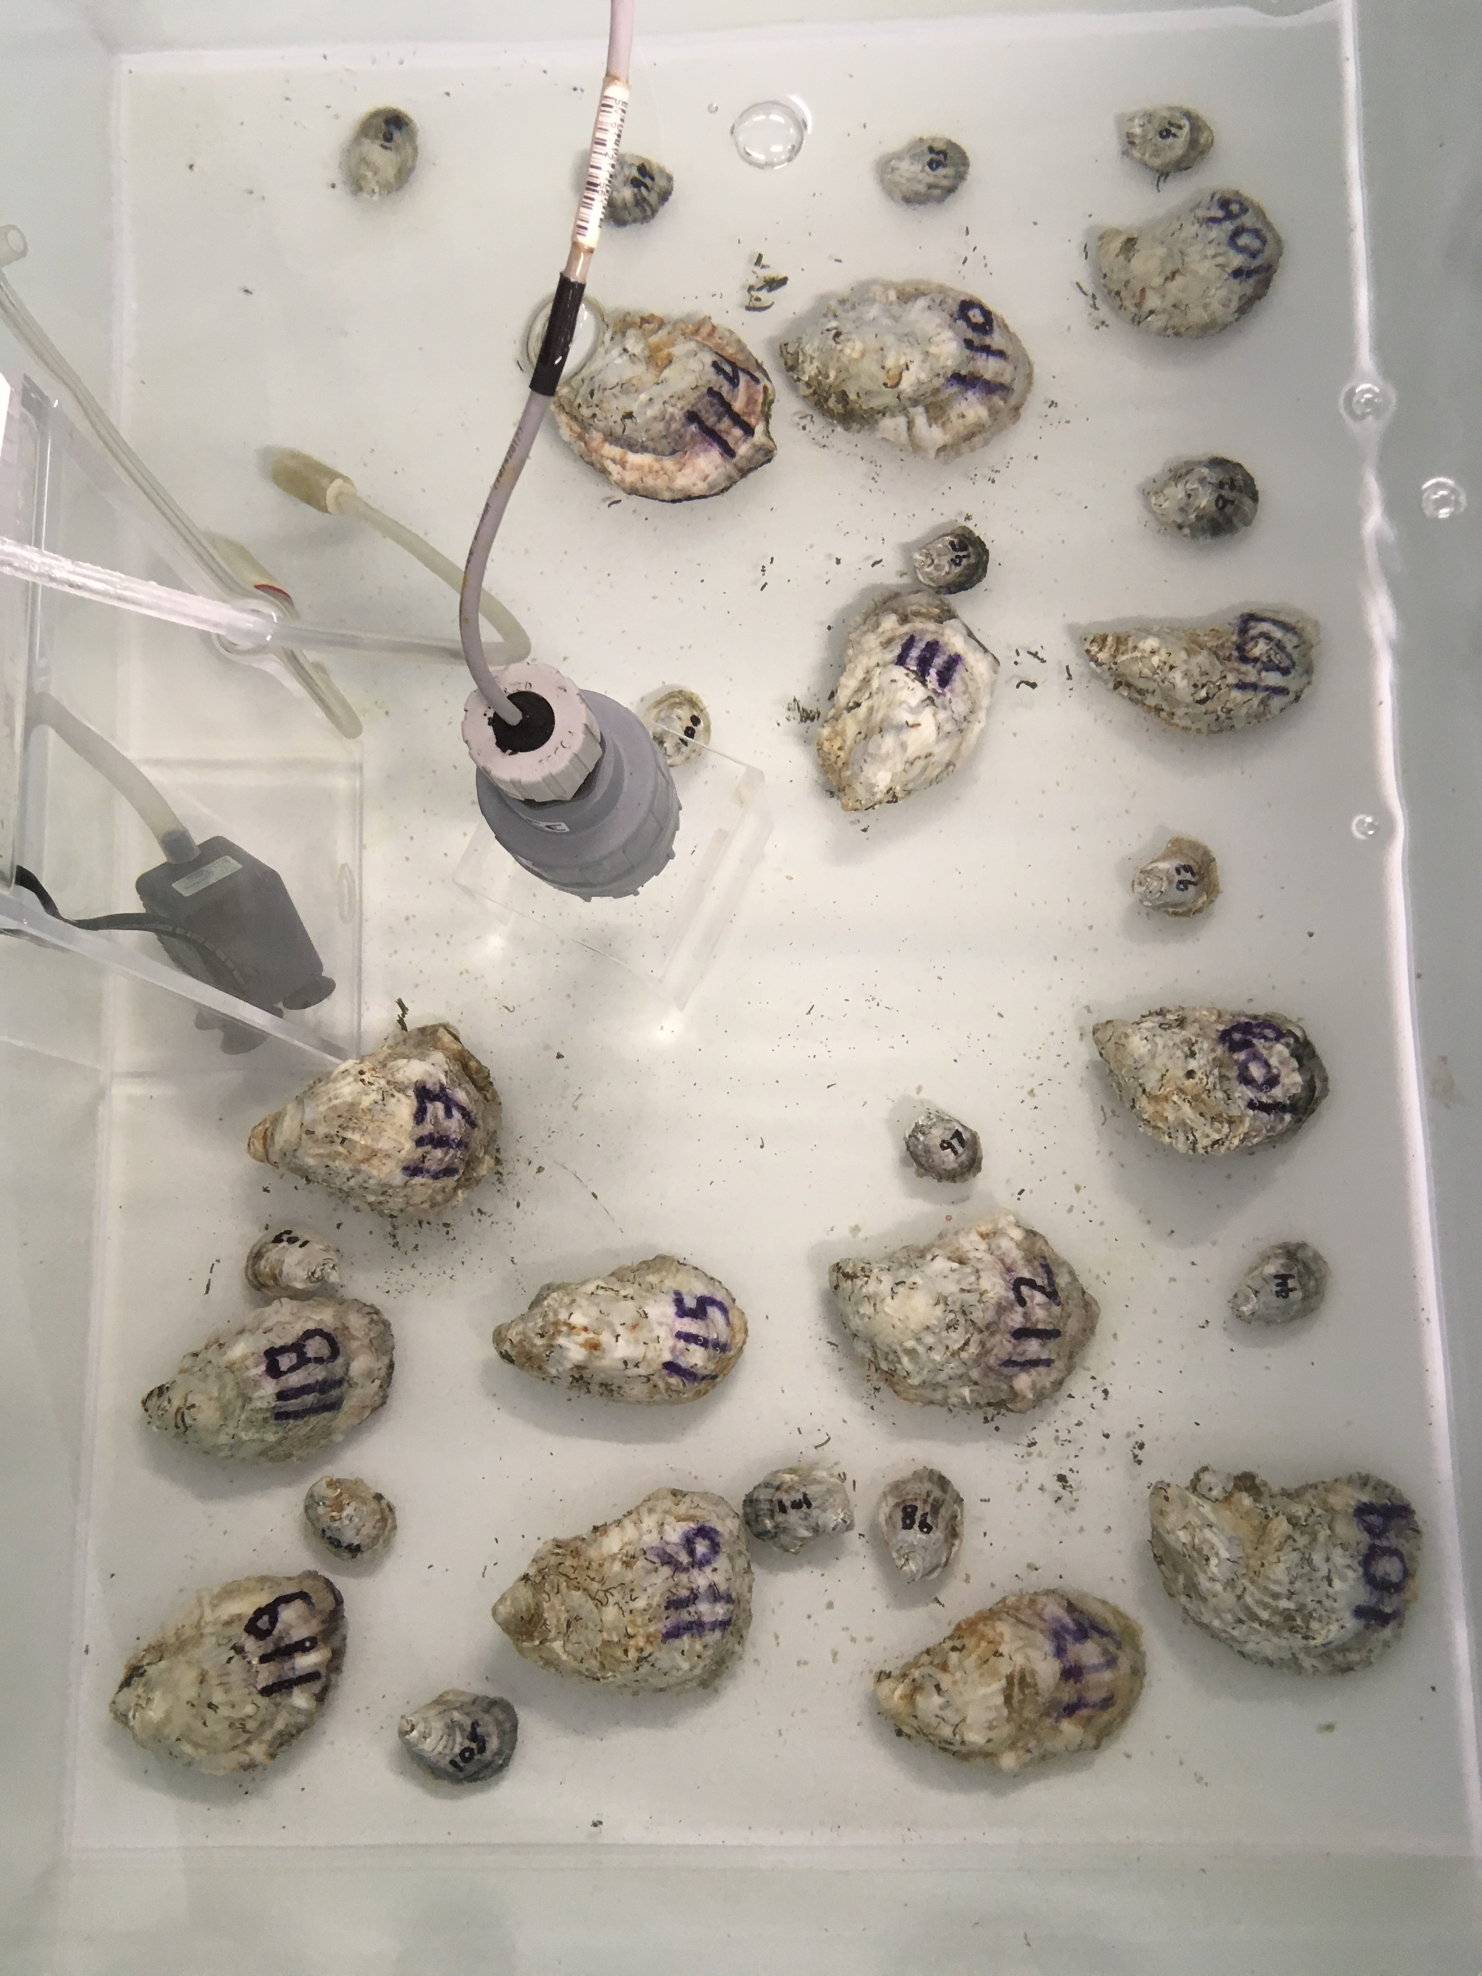
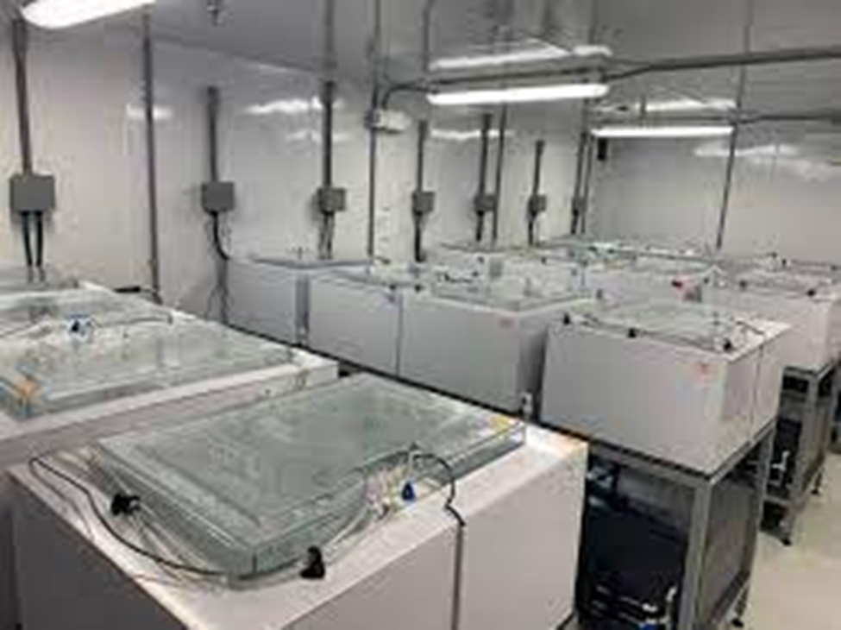
EcoOyster Expansion
Literature synthesis of existing data on:
Filtration
Respiration
Excretion
Calcification
Two-month controlled tank experiment with:
Two age/size classes (6 mo; 2 yr)
Four target pH treatments: 7.4, 7.6, 7.8, and 8.0
E. Rivest, VIMS

Slide 7
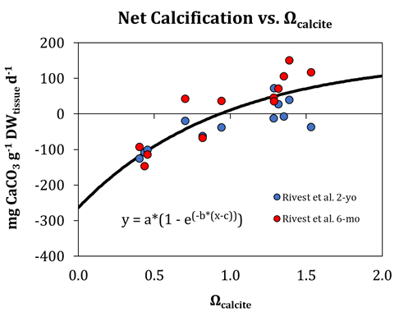
EcoOyster Expansion
No consistent, significant impacts of pH on filtration, respiration, or excretion
Significant impact on net calcification
Threshold Ω_{calcite} = 0.93

Slide 8
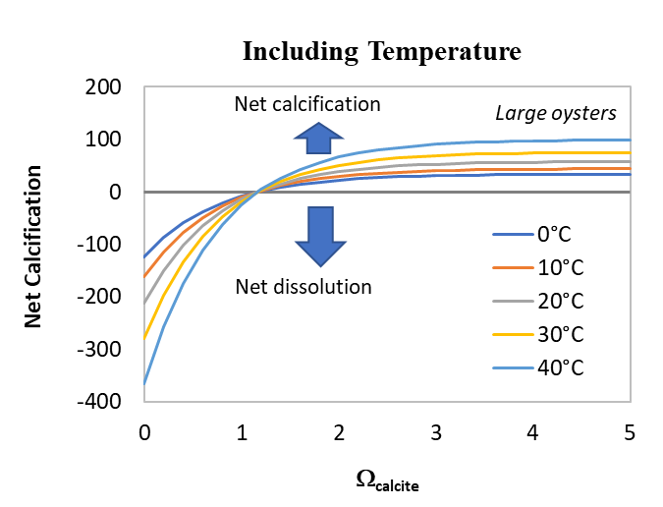
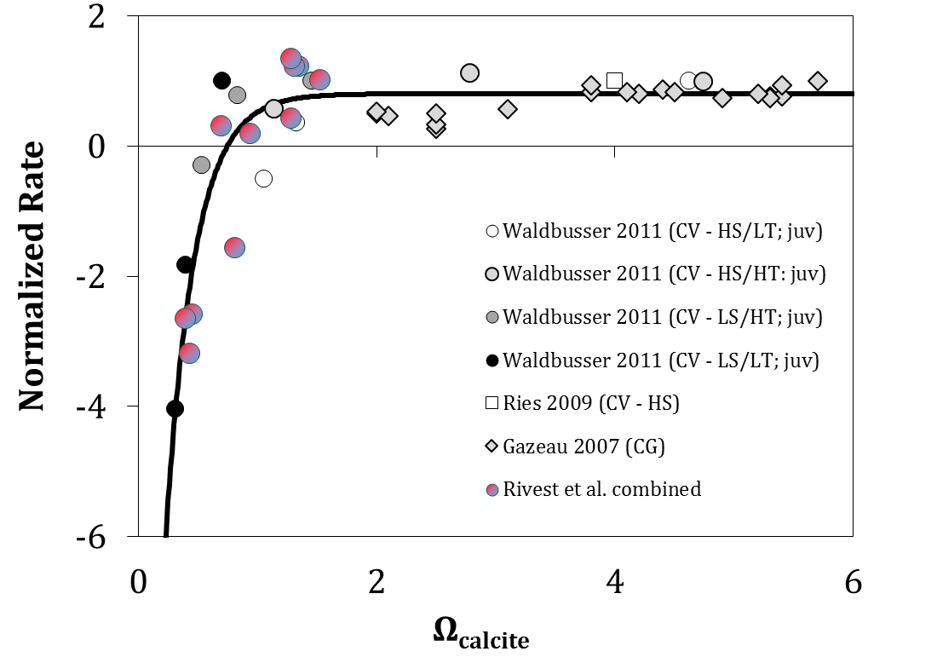
EcoOyster Expansion
Experimental results were consistent with literature synthesis
Net calcification was formulated as a function of tissue weight, Ω_{calcite}, and water temperature

Slide 9
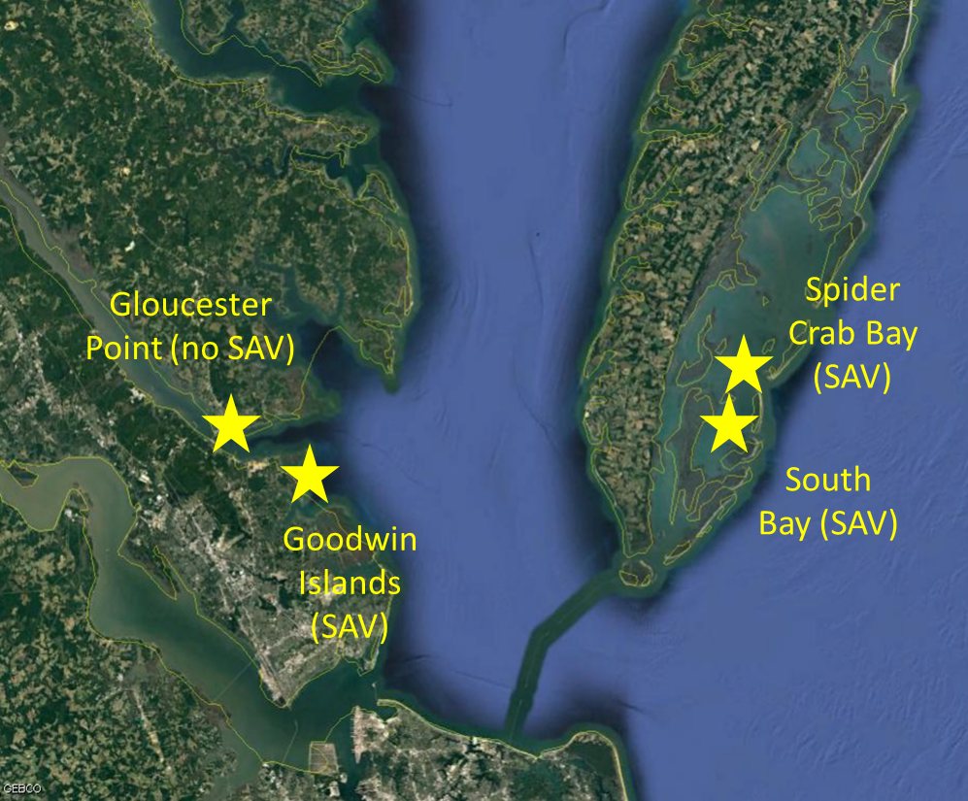
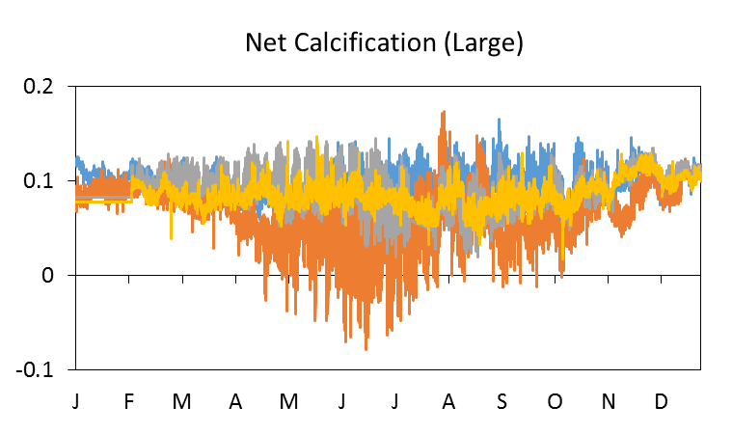
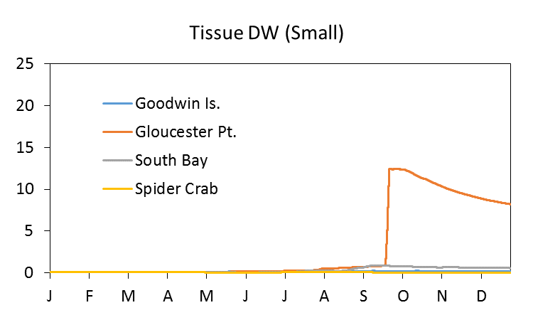
EcoOyster Application to Bay Time Series
g CaCO₃ g⁻¹ DW_{tissue} d⁻¹
2017

Slide 10
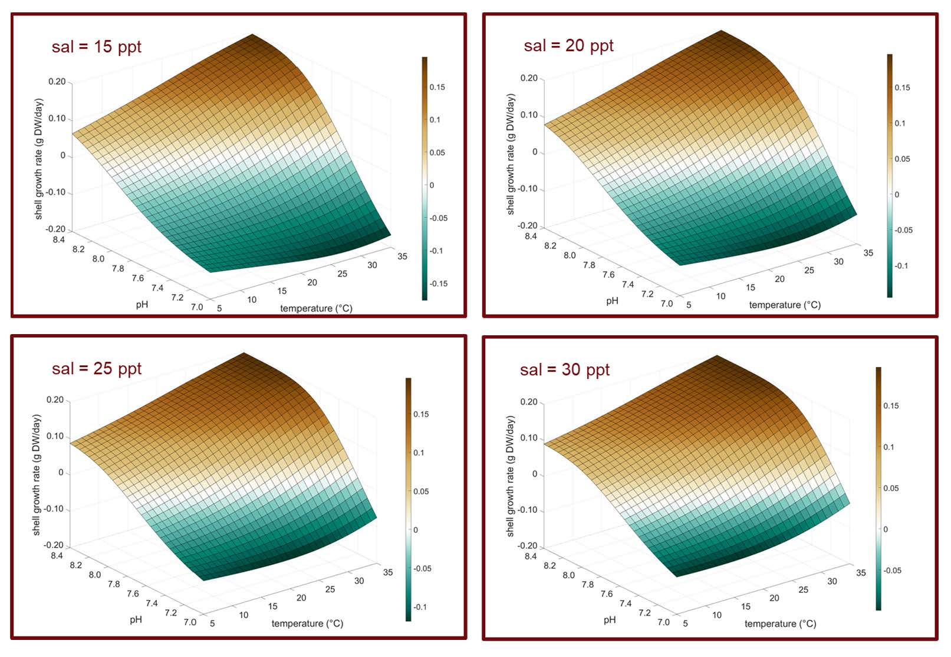
EcoOyster Simulation
Simulation of OA Thresholds for
Shell Growth (York River)
Zero growth is identified in white
Shell loss accelerates at low pH
Nonlinear interaction with temperature

Slide 11
EcoOyster Simulation
Simulation of OA Thresholds for
Shell Growth (York River)
Zero growth is identified in white
A greater range of conditions lead to shell loss as salinity decreases

Slide 12
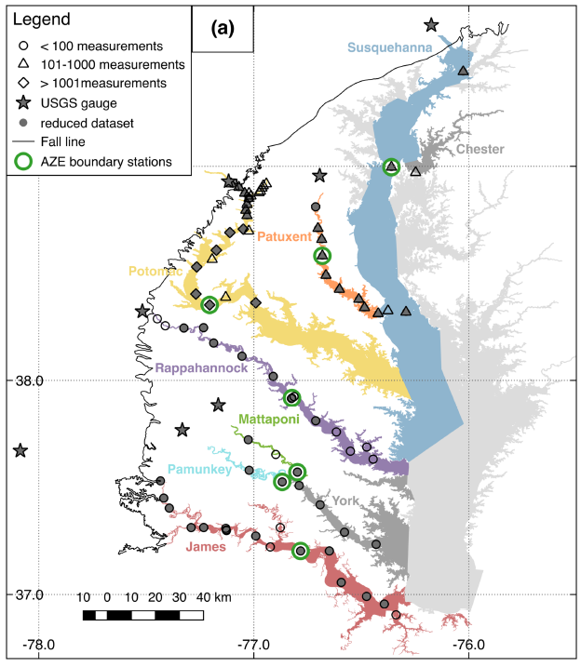
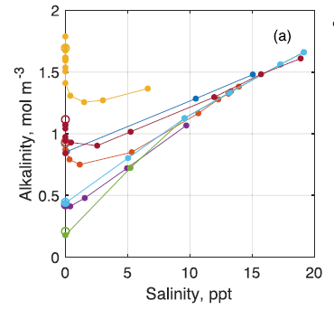
EcoOyster Simulation
Simulation of OA Thresholds for
all Bay systems and the E. Shore
EcoOyster was run across all possible combinations of …
Variable | Scenarios Analyzed
temperature | 0 - 35 °C (in 1°C increments)
salinity | 0 - 35 ppt (in 1 ppt increments)
pH | 7.00 - 8.40 (in 0.01 pH increments)
CO₂ constants | Cai & Wang, 1998
… using salinity–alkalinity relationships from Najjar et al. (2020) and E. Rivest (unpublished)

Slide 13
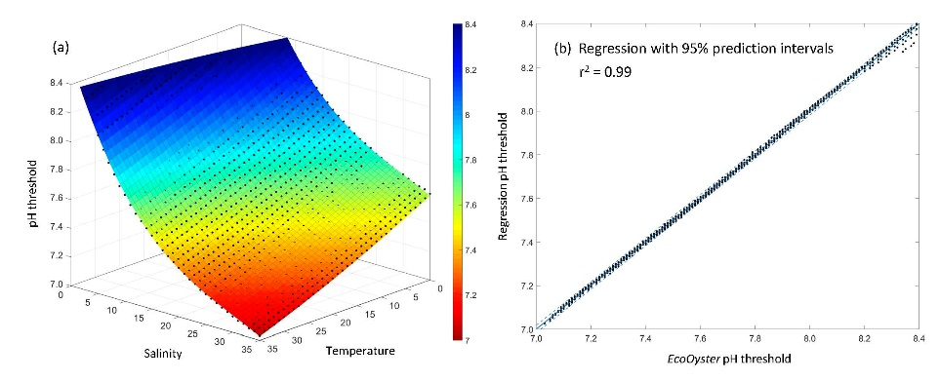
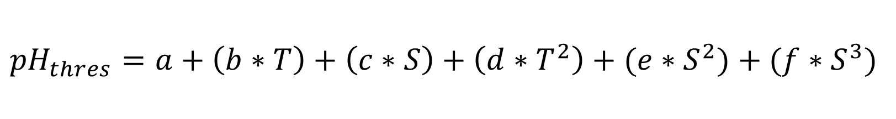
EcoOyster Simulation
Result: system-specific regressions to identify the threshold pH for shell growth:
$${pH}_{thres}=a+\left(b∗T\right)+\left(c∗S\right)+\left(d∗T^{2}\right)+(e∗S^{2})+(f∗S^{3})$$

Slide 14
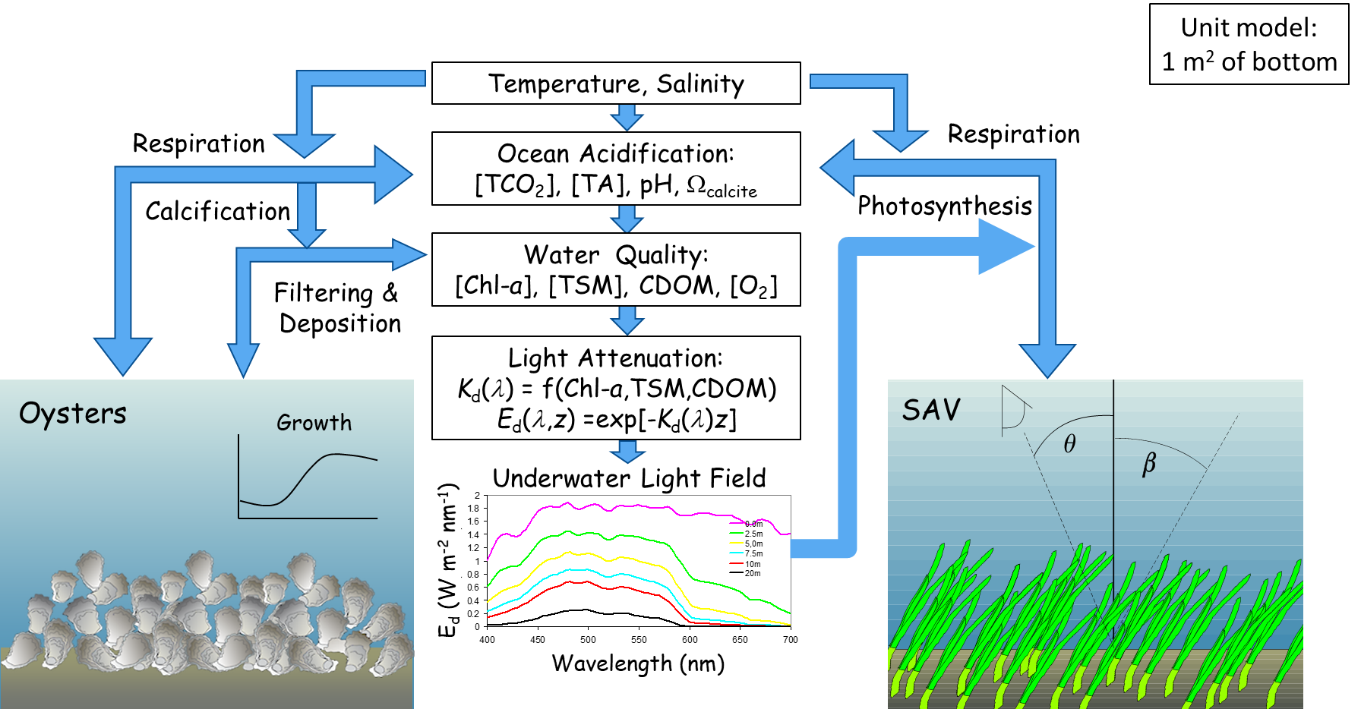
Potential of Seagrass to Mitigate OA Impacts
Coupling of EcoOyster & GrassLight:
GrassLight:
Zimmerman et al. (2015)

Slide 15
Coupled EcoOyster-GrassLight Model
Simulation Analysis
Variable | Scenarios Analyzed
Temperature | 15, 20, 25, 30 °C
Oyster density | 0, 15, 30, 50 m⁻²
Seagrass density | 0, 10, 25, 50, 100, 200, 300, 400, 500, 600, 700, 800, 900, 1000 shoots m⁻²
Initial pH | 7.0, 7.2, 7.4, 7.6, 7.8, 8.0
Flushing time | 1, 2.5, 5, 7.5, 10 days
Salinity, CHLA, TSM, CDOM | Fixed values per analysis
n = 6,720 simulations
Results for Salinity = 20, Oysters of 1 g tissue DW, and relatively clear water (CHLA = 3 ug/l, TSM = 10 mg/l, CDOM = 0.5 m⁻¹) …

Slide 16
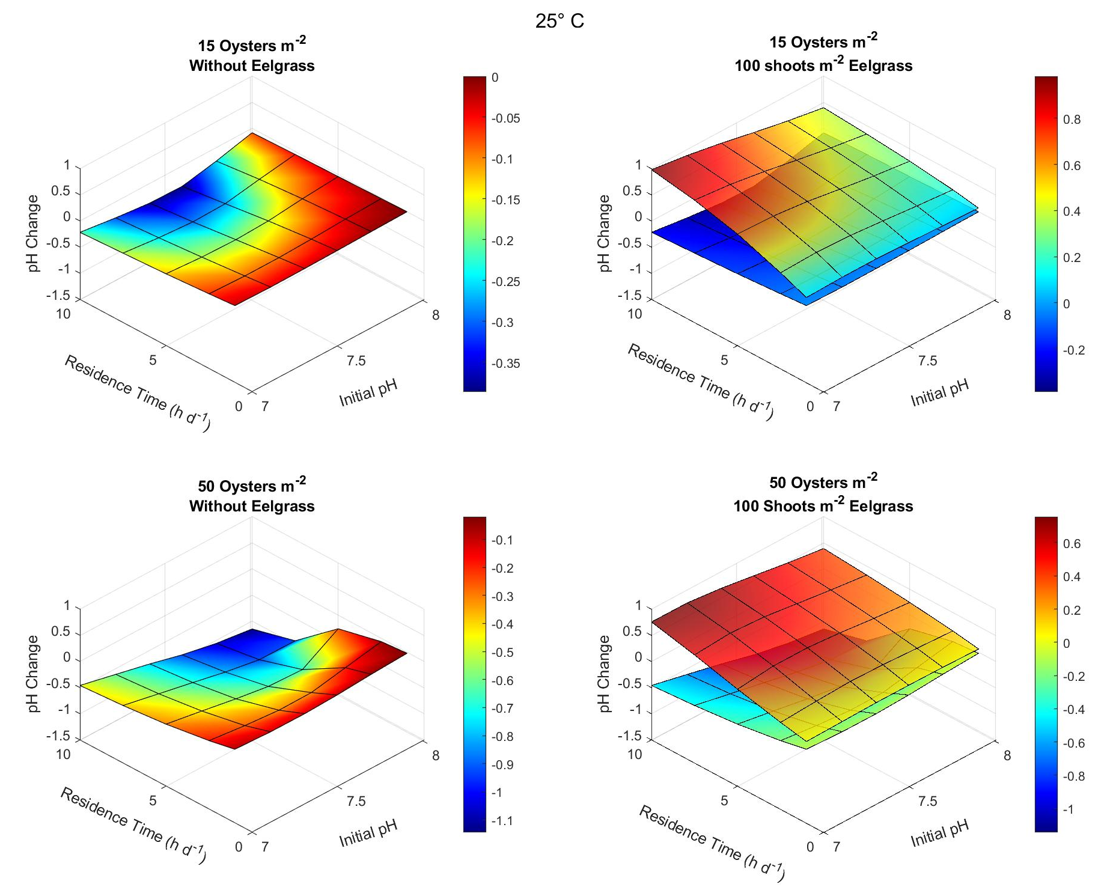
Coupled Model Output
Oyster metabolism lowers pH
Respiration increases [CO₂]
Calcification decreases alkalinity
pH drop depends on
pH (more calcification)
oyster density (more respiration & calcification)
Seagrass metabolism raises pH
Net photosynthesis decreases [CO₂]

Slide 17
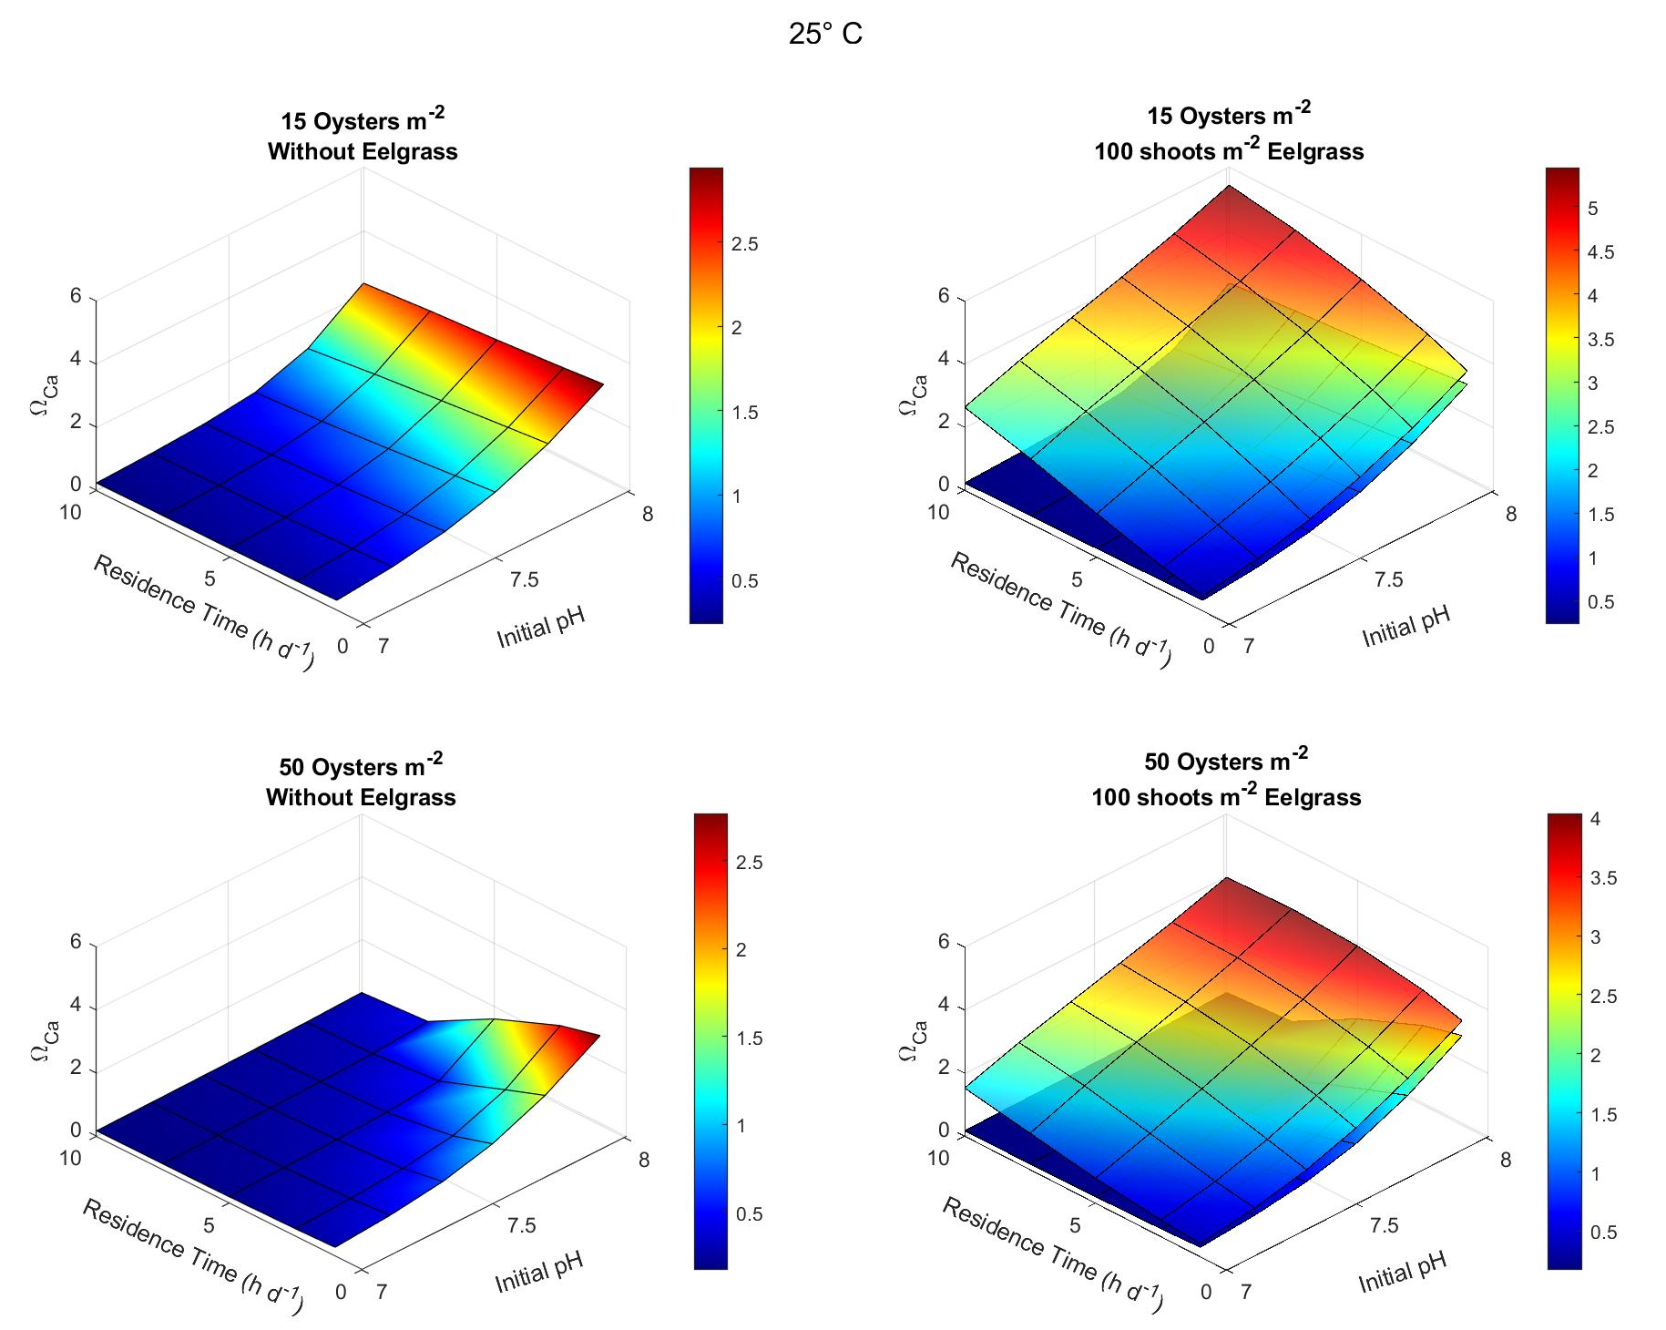
Coupled Model Output
Oyster metabolism without eelgrass
Lowers W_{Ca}
Effect is density-dependent
Eelgrass removal of CO₂
Raises W_{ca}
Reduces effects of Oyster density

Slide 18
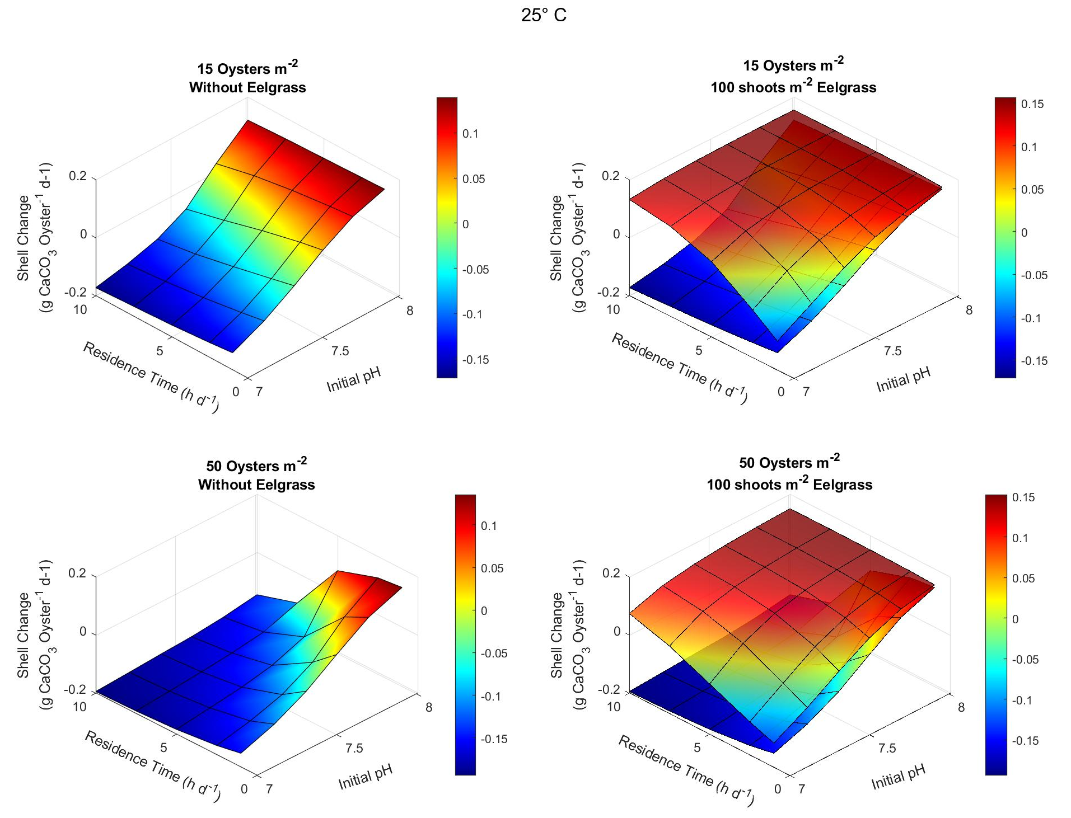
Coupled Model Output
Without Eelgrass
Oysters lose shell below initial pH 7.5
Loss increases with
Oyster density
Residence time
With Eelgrass
Oysters gain shell over most of the initial pH range
Reduced effects of oyster density & residence time

Slide 19
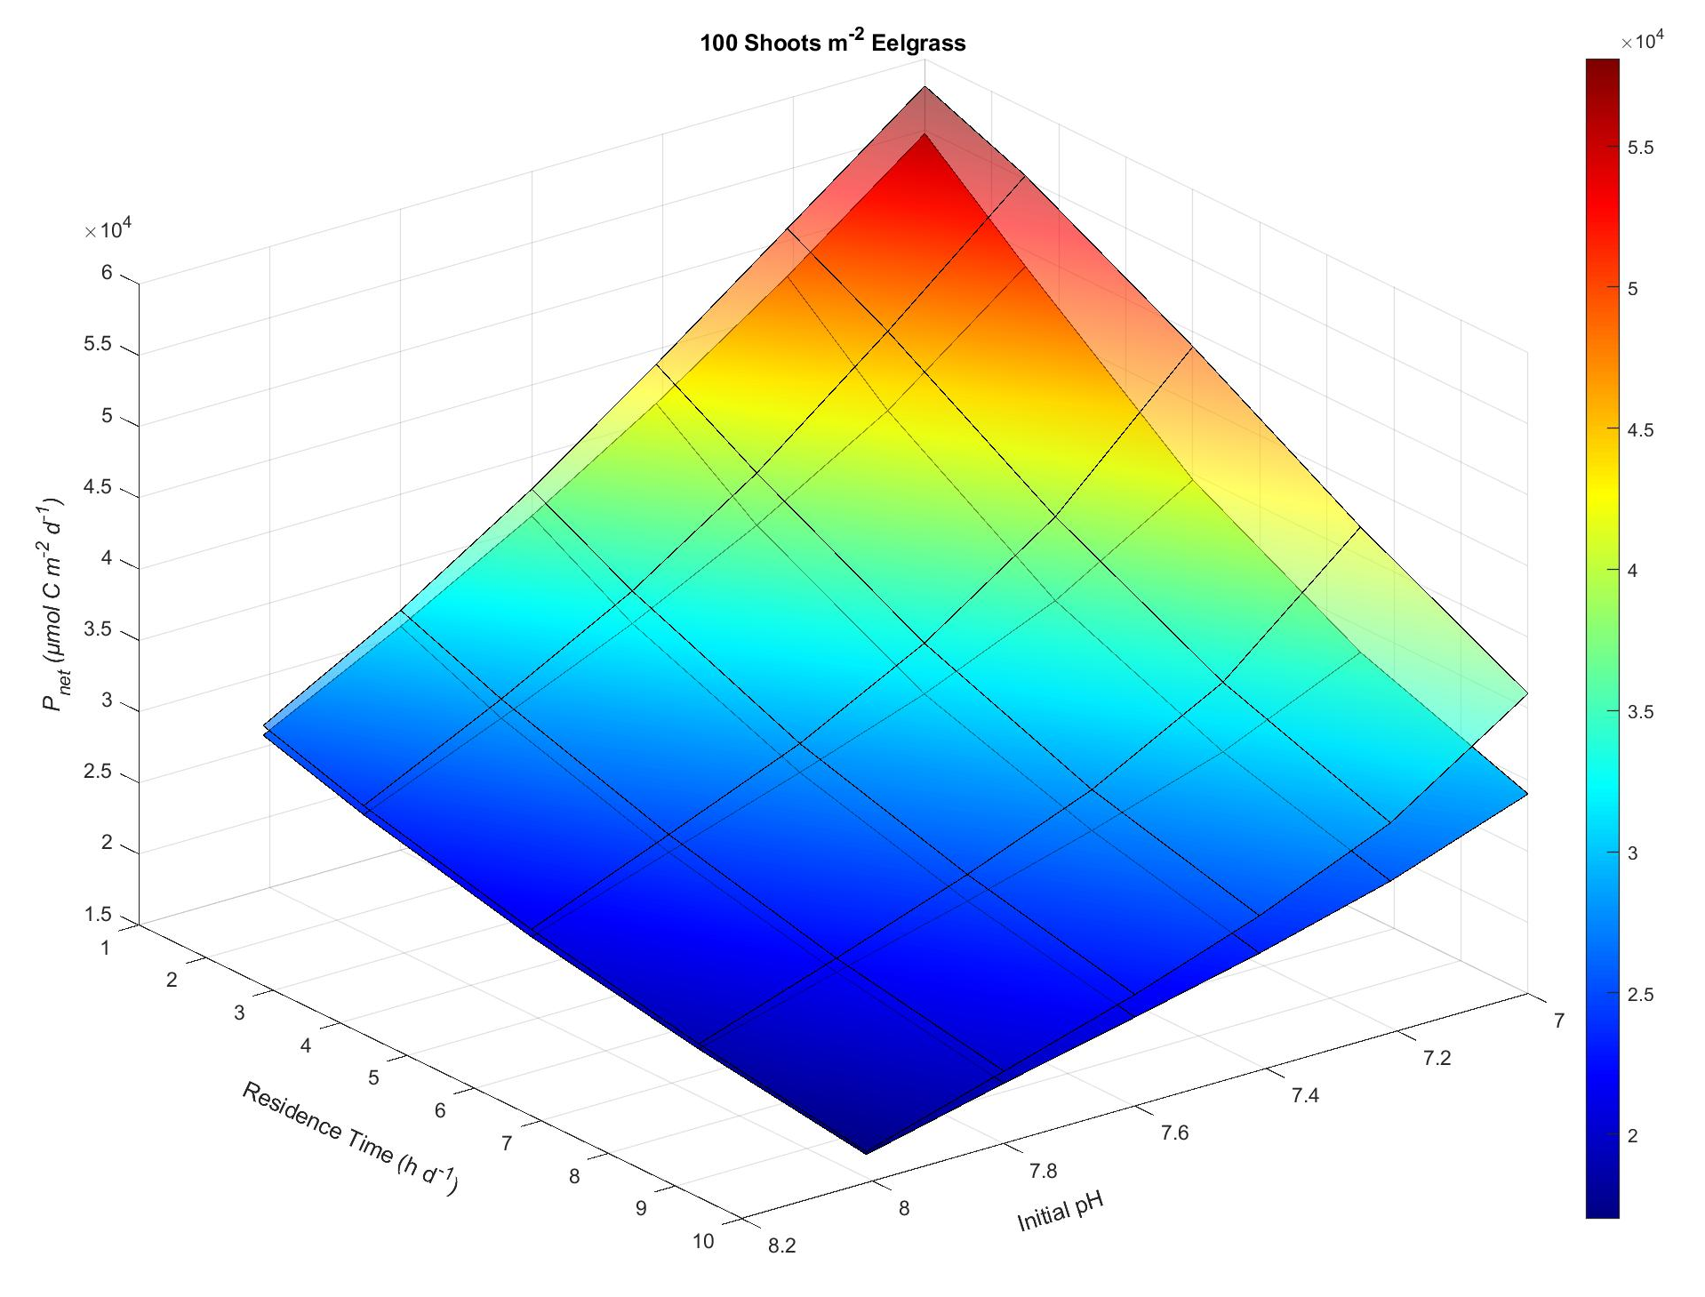
Coupled Model Output
Eelgrass P_{net} increases with oyster density
Oyster metabolism
Increases [CO₂]
Removes
Phytoplankton
Suspended matter
Improves water clarity for light penetration
50 Oysters m⁻²
15 Oysters m⁻²

Slide 20
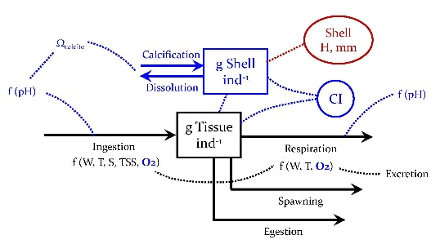
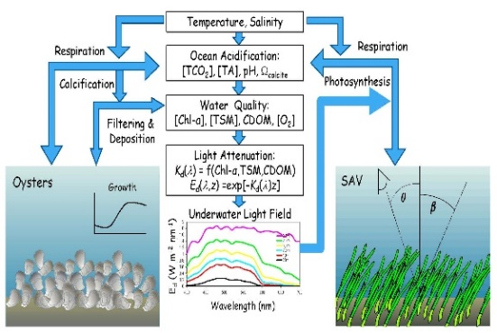
Conclusions
We expanded EcoOyster to include the impacts of OA on oysters, and coupled it to the seagrass model GrassLight.
OA has a strong effect on net calcification, and interacts strongly with environmental conditions including temperature and salinity.
OA thresholds (tipping points) for net shell growth are estuary-specific functions of temperature and salinity.
Seagrass restoration has the potential to offset the negative impacts of OA on oysters, with reciprocal benefits to seagrass.

Slide 21
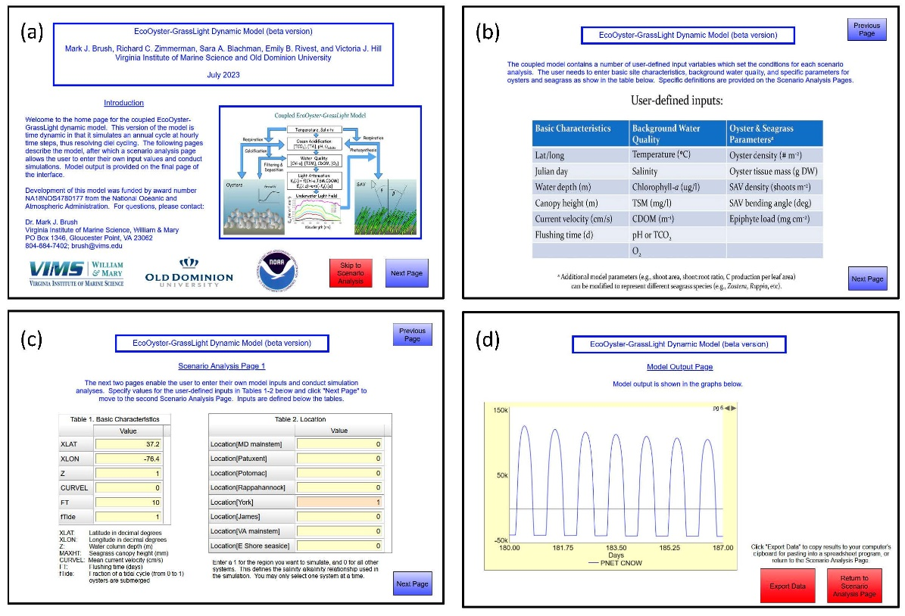
Stay Tuned …
Online Decision Support Model:

Slide 22
Thank you
Co-authors Sara Blachman, Emily Rivest, Richard Zimmerman, and Victoria Hill
Lab colleagues Christina Rarick, Abbey Sisti, Arien Widrick, and Megan Constidine
Our NOAA OAT Advisory Committee
NOAA CS-COR and OA Program funding

