Slide 1
Chesapeake Bay-specific abundance and mortality estimates for striped bass
September 18, 2023
Mike Wilberg, Samara Nehemiah (UMCES)
Rob Latour, Adena Schoenfeld (VIMS)

Slide 2
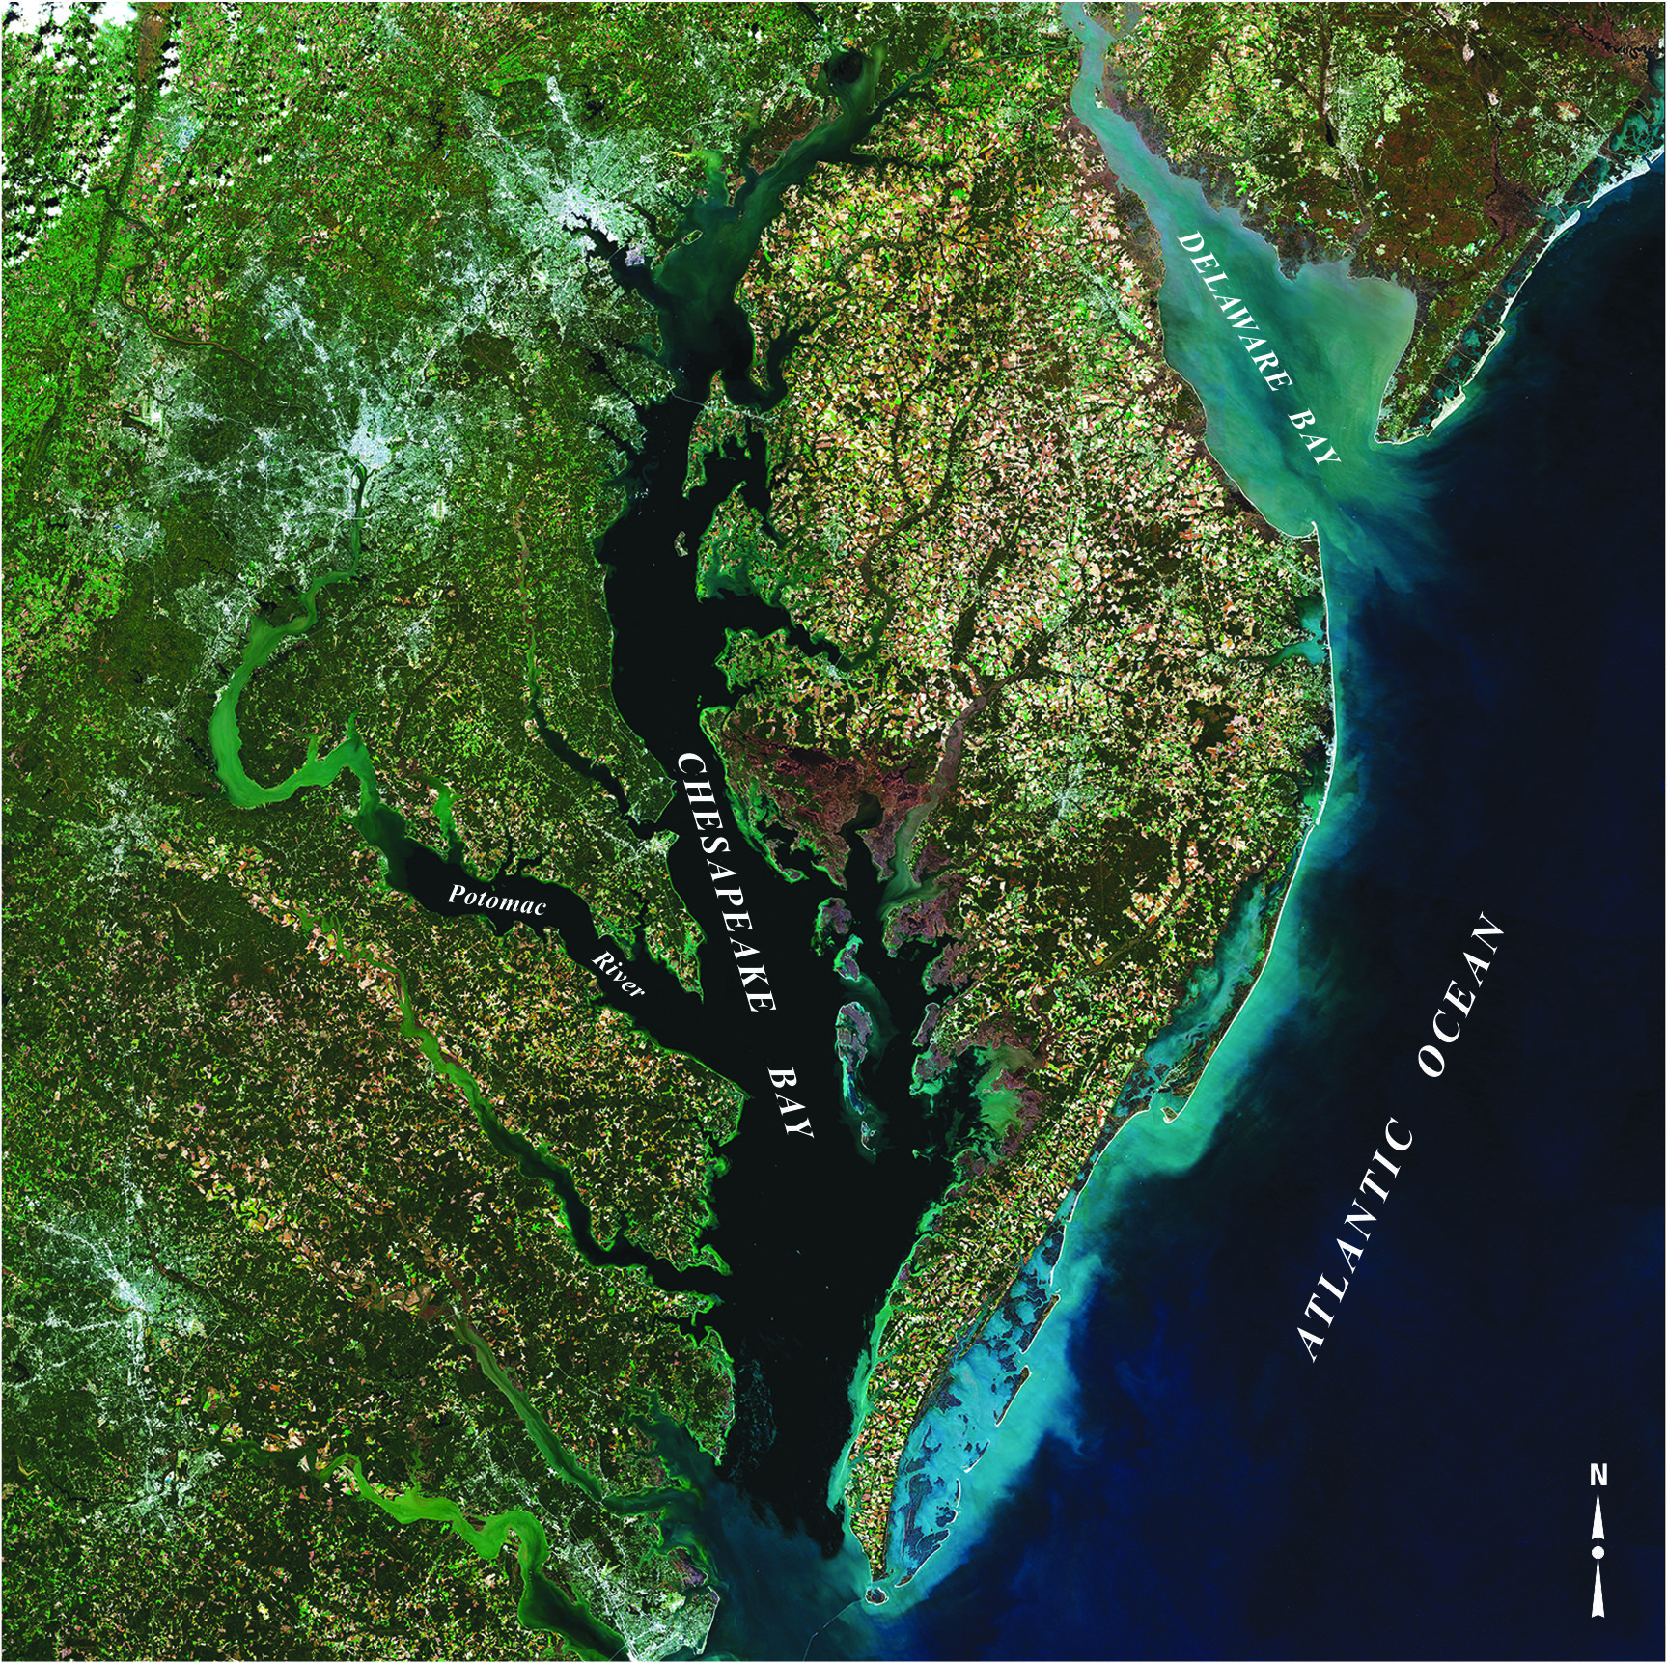
Background
Broad interest in understanding the effects of environmental changes on fish and shellfish populations in the Chesapeake Bay
Lack bay-wide abundance estimates for most species, which hampers our ability to determine causes of change in the community
USGS

Slide 3
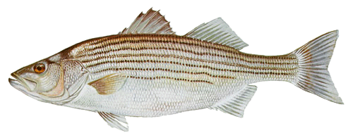
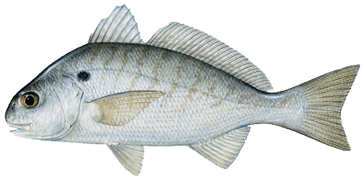
Objectives
Develop spatial modeling framework to estimate abundance and mortality rates for species in Chesapeake Bay
    Striped bass
    Spot
Estimate the effects of environmental drivers on population dynamics
Make the estimates publicly available to facilitate additional research
Photo: USGS

Slide 4
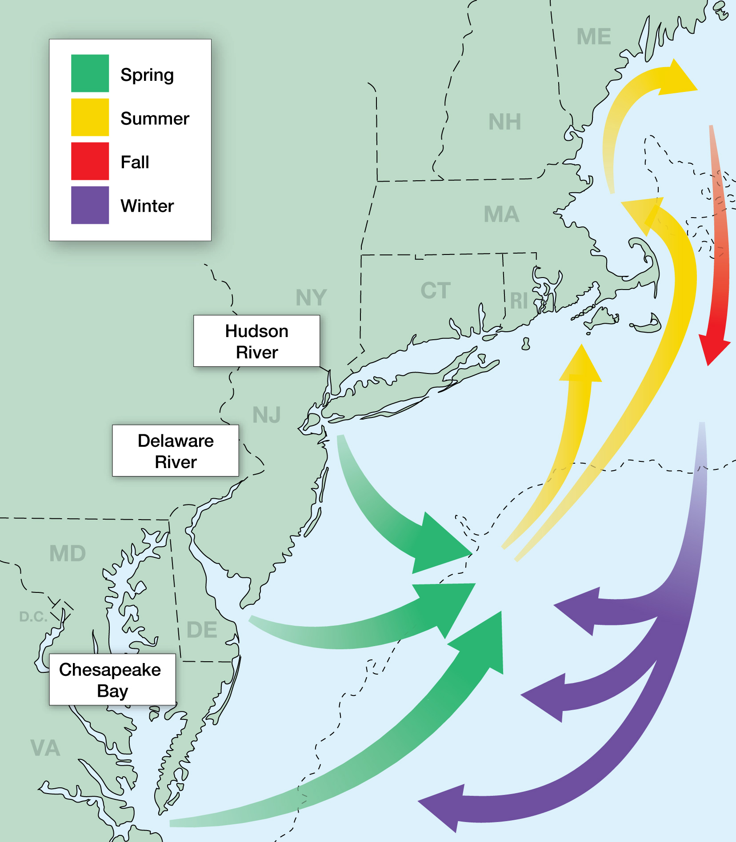
Striped bass
Important recreational and commercial fisheries
Assessed as a single coastwide stock
3 major spawning areas (> 60% from bay)
Data rich – long term data
Striped Bass Magic

Slide 5
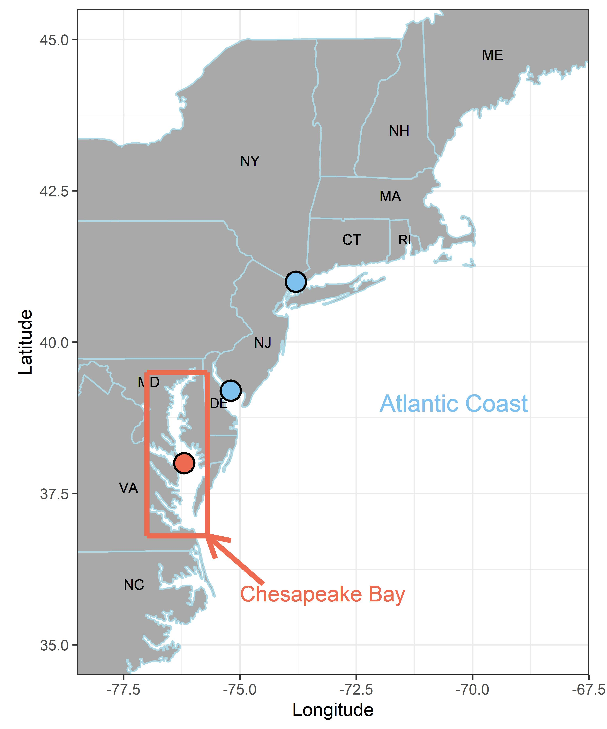
Model Structure
Age 1-15+
2 biological stocks
    Chesapeake Bay ( )
    Atlantic coast ( )
2 regions
    Chesapeake Bay ( )
    Atlantic coast
Years 1985 – 2017
    2 sub-annual time steps
      Jan – Jun
      Jul - Dec

Slide 6

Model Inputs
Surveys
  7 multi-age ( )
  2 age-1 ( )
  3 YOY ( )
Regional occupancy – tagging data
Aging error matrix
Years 1985 – 2017
    One fleet each spatial region and time step
    Catch = rec retained (MRIP) + com catch (states) + proportion discards

Slide 7
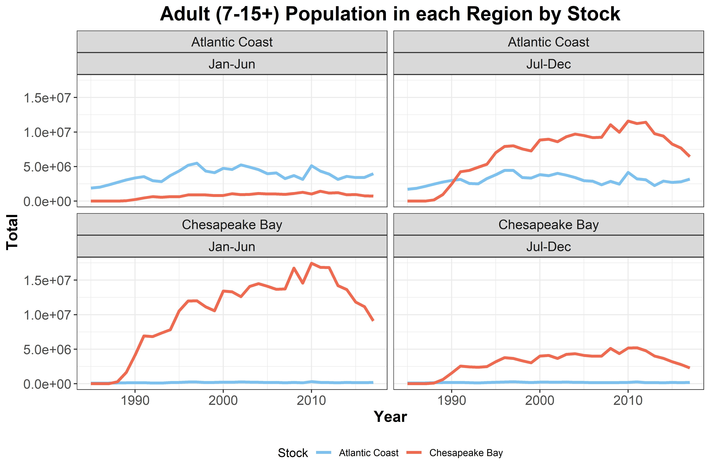
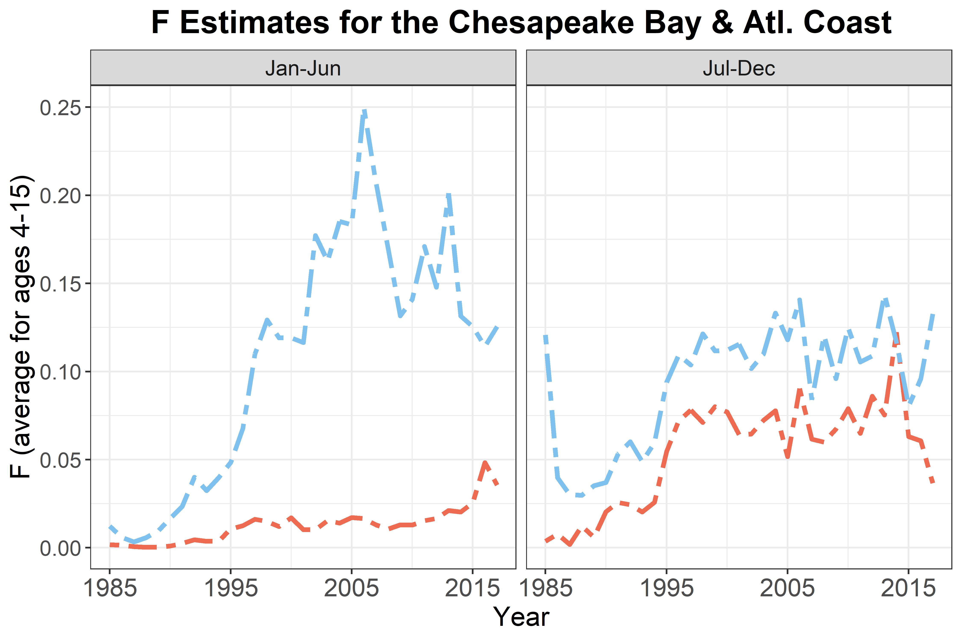
Model Output
Chesapeake Bay region
Atlantic coast region

Slide 8
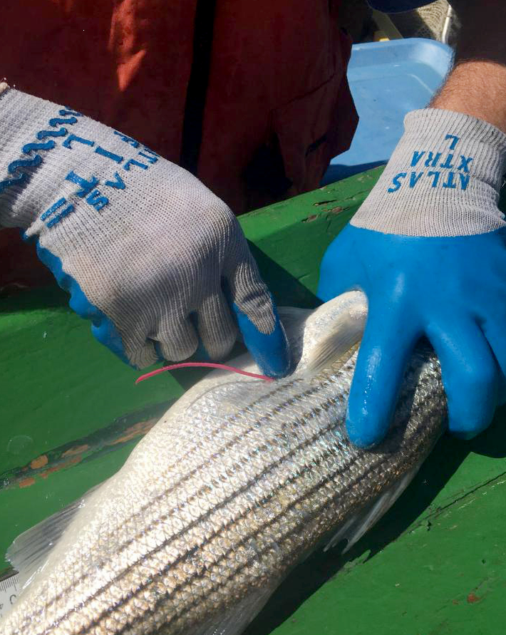
Coastwide Tagging
Model structure
    Tagging: Chesapeake Bay, Delaware River, Hudson River
    Recoveries: Chesapeake Bay, Atlantic coast
    1990-2020, ages 2-11+
    2 sub annual time steps (Jan-Jun, Jul-Dec)
    > 170,000 tagged fish & 28,000 recaptures
    Rec & Com fleets
Parameters
    Producer region-, time-, age-specific occupancy probabilities (φ_{p,t,a})
    Time-, region, age-based natural mortality (M_{t,r,a})
    Fleet-, disposition-, region-specific fishing mortality (F_{f,t,r})
    Fleet-specific selectivity
    Others….

Slide 9
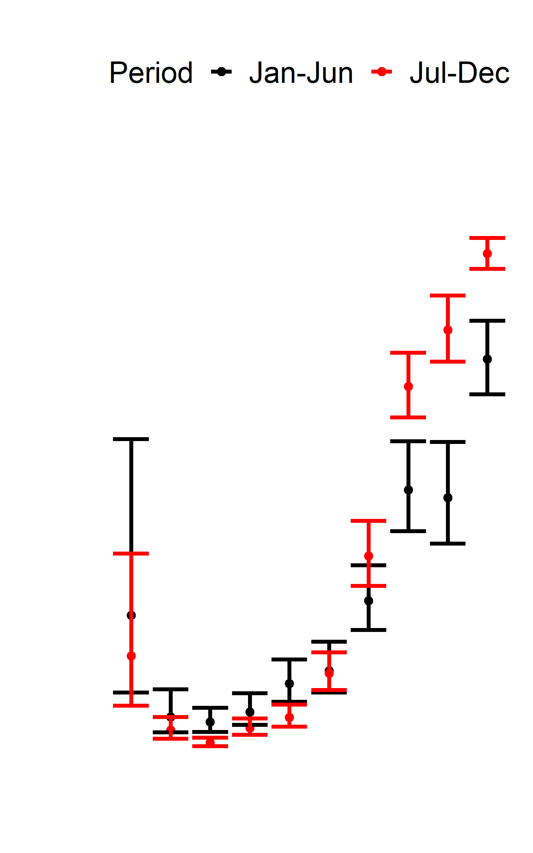
Occupancy probabilities
Incorporated into spatial catch-at-age model
Age-specific probabilities of Chesapeake Bay tagged fish in Atlantic coast

Slide 10
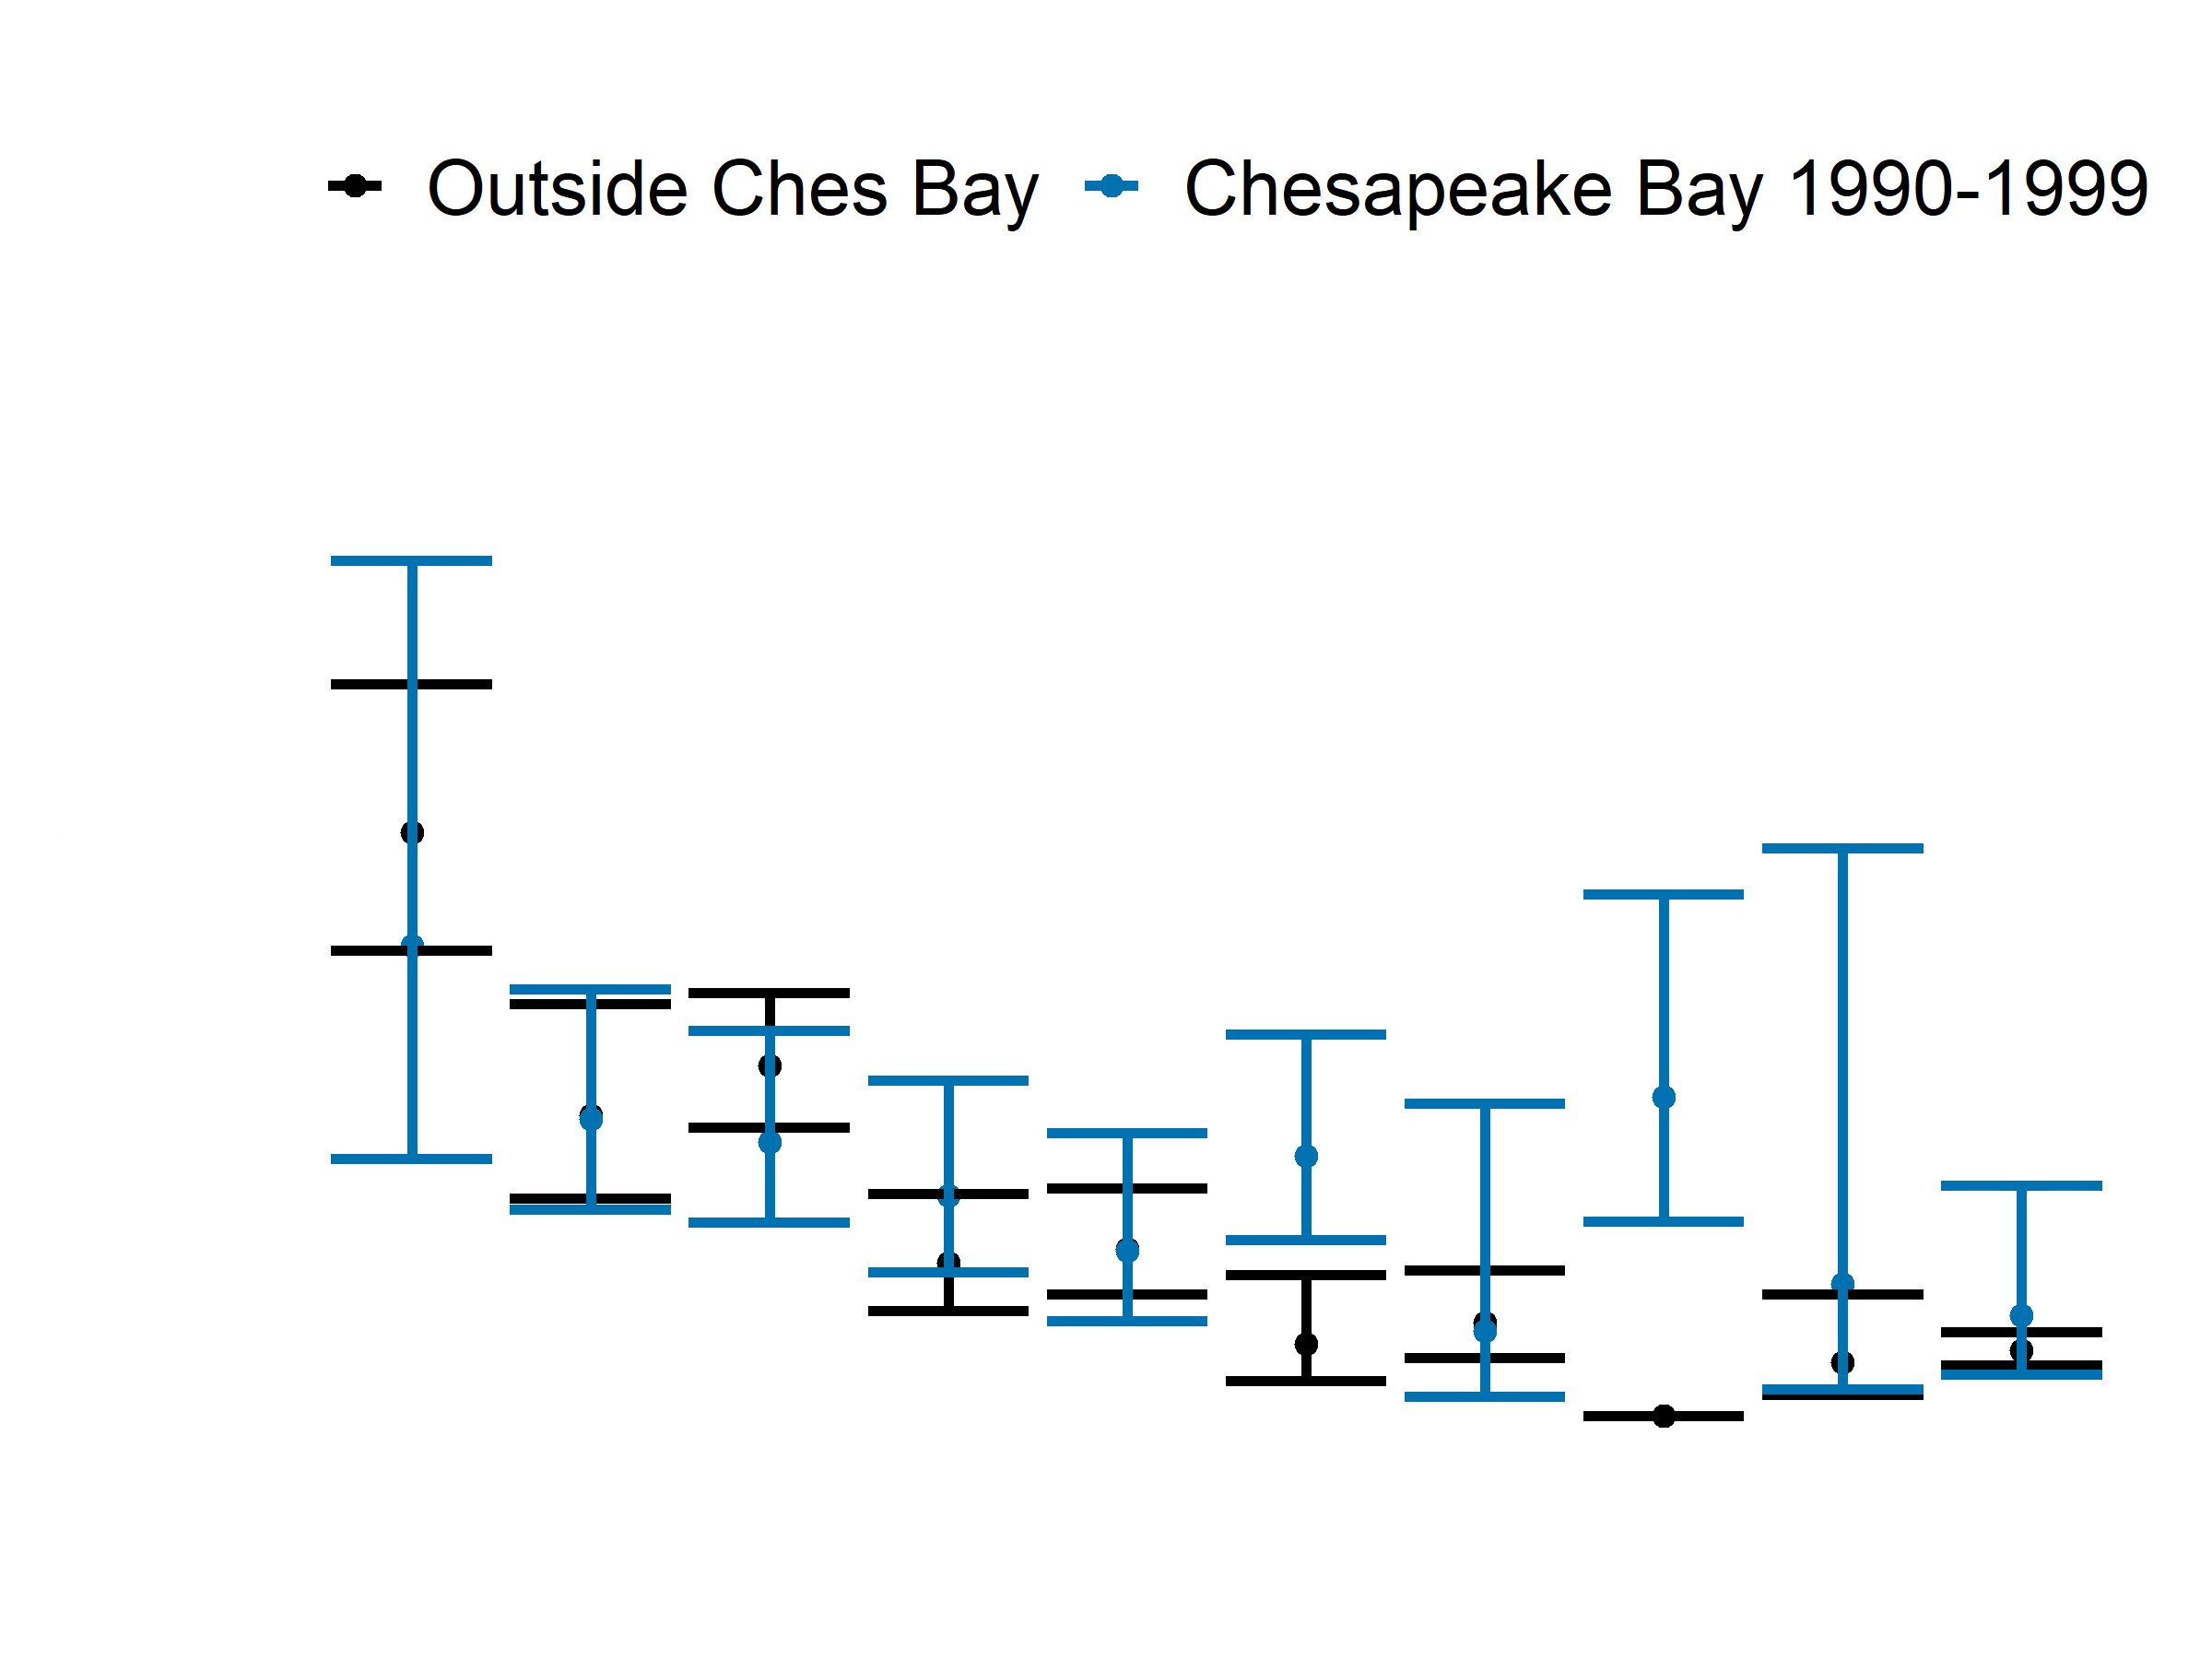
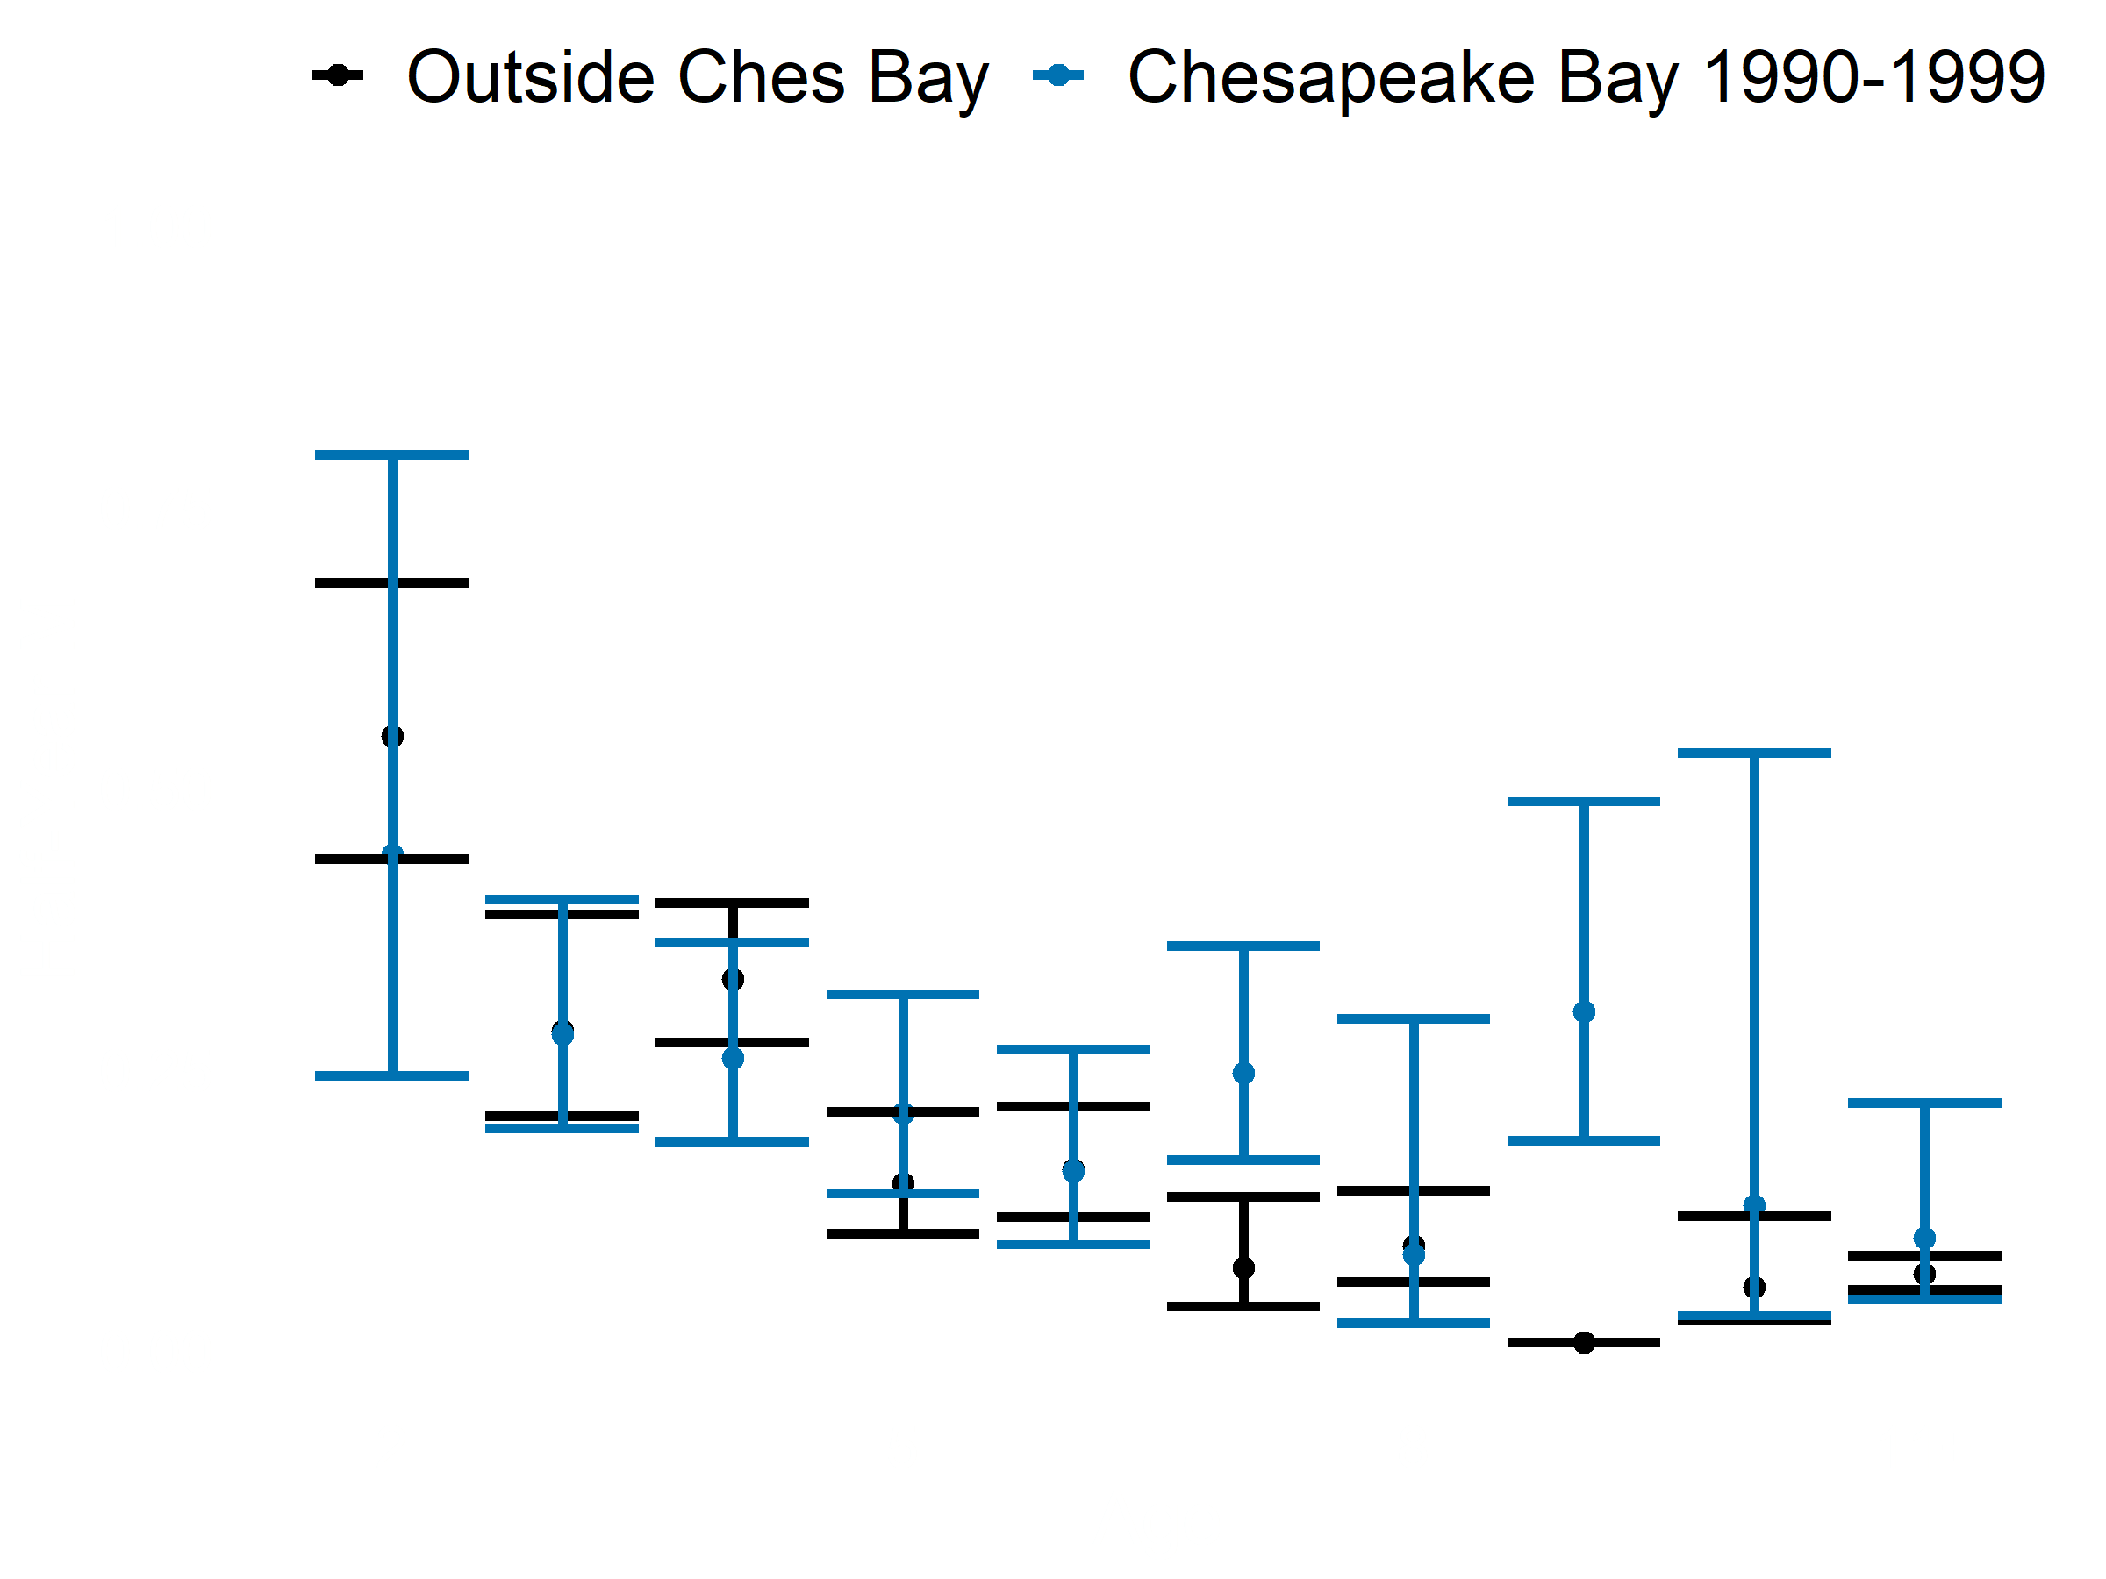
Natural Mortality
Model structure
    Time-invariant Atlantic coast
    Decadal within bay

Slide 11
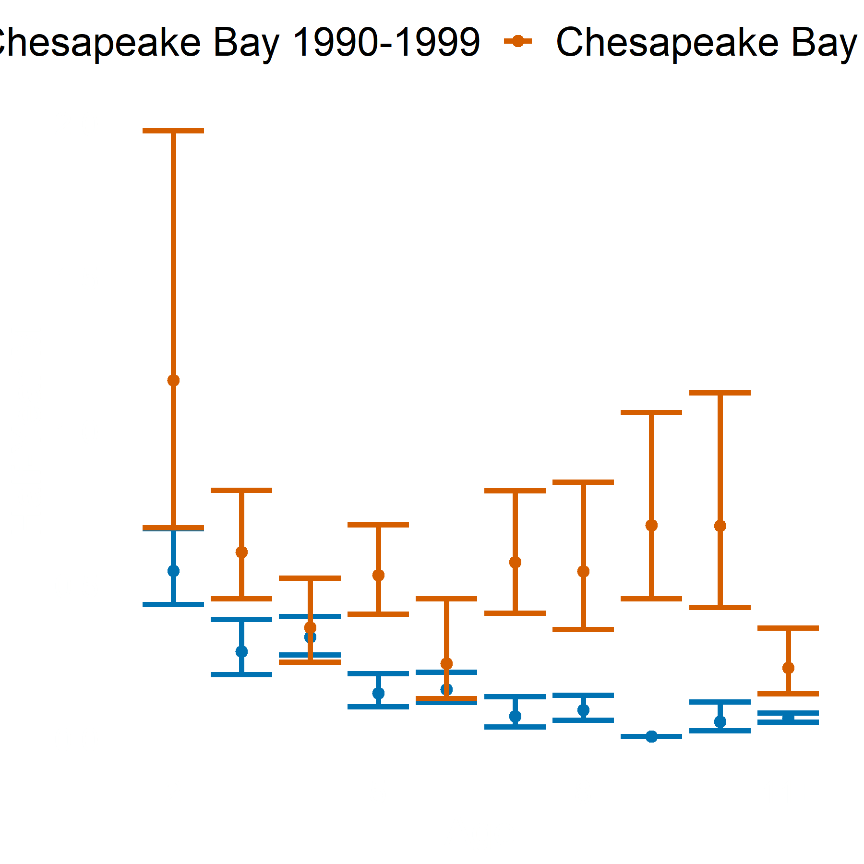
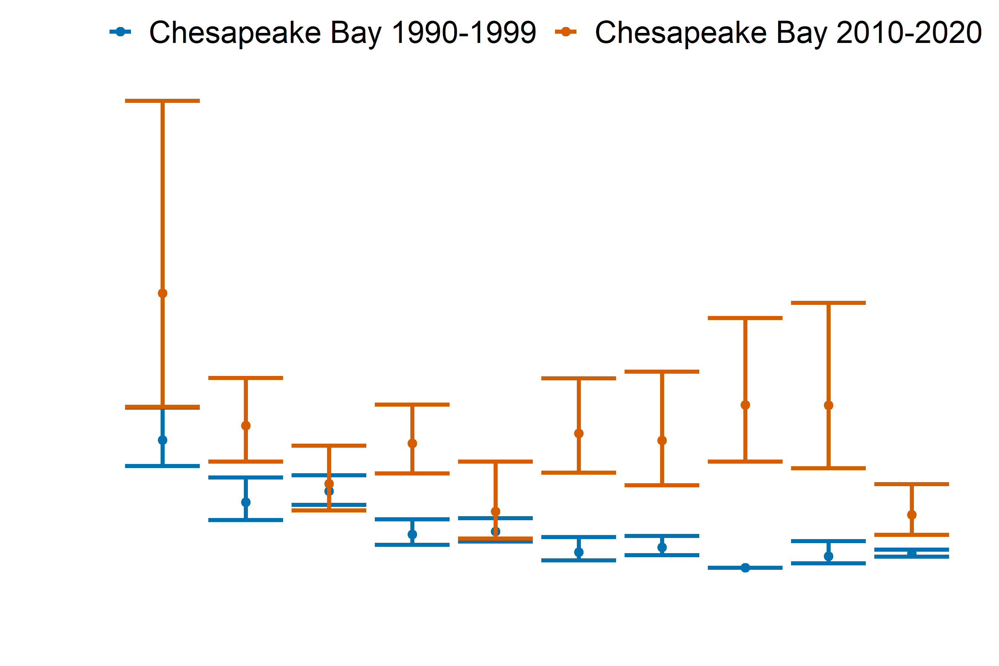
Natural Mortality

Slide 12
Natural Mortality
Mycobacteriosis?
Increased M through early 2000s tag recovery study (Jiang et al. 2007)
Survival of diseased fish 69% relative to healthy (Gauthier et al. 2008)
Overall M twice the accepted value (Hoenig et al. 2017)
80% annual mortality of severely diseased fish (Groner et al. 2018)
Higher M in bay residents than coastal migrants (Secor et al. 2020)
Notes:
Change figure size

Slide 13

Summary
Tagging analysis
  Completed – manuscript in progress
  Occupancy probabilities
  Spatially-explicit F & M estimates
Spatial modeling
  Nearly completed – final stages
  Spatially-explicit N & F estimates
virginia.org
Share with striped bass TC

Slide 14















Acknowledgements
Katie Drew
Gary Nelson
Spot TC members
Genny Nesslage
Dave Secor
Amy Schueller

