Slide 1
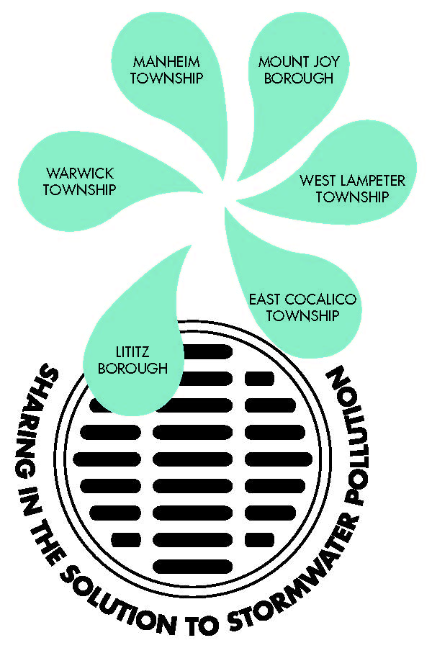
The Lancaster County Municipal Stormwater Financing Feasibility Study Sharing lessons learned
Monica Billig
Environmental Finance Center
University of Maryland
CAC/LGAC Meeting
December 5th, 2013

Slide 2
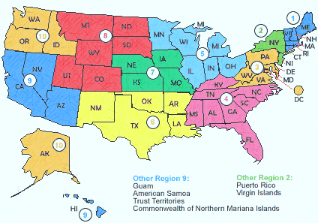
The EFC: Who are we?
Address the issue of “how to pay” by working across sectors
Help local and state organizations meet environmental mandates in fiscally-sound manner
Notes:
regional center, part of larger network – see examples from around the country; non-biased, non-partisan
we exist to provide the direct TA to communities

Slide 3
Project Background
Drivers:
MS4 permit compliance/enforcement
Need to develop baseline stormwater program cost estimates
Improve efficiency through collaboration
Sponsored by the Lancaster County Clean Water Consortium
Funded by the National Fish & Wildlife Foundation’s Local Government Capacity Building Initiative

Slide 4
Technical Analysis Methodology
Assess each individual stormwater program
Identify gaps in each existing program and evaluate future needs
Determine where current program fits into the desired level of service and evaluate costs
Develop and finalize proposed stormwater program budget
Develop a financing strategy to support budget
Identify opportunities to collaborate
COMMUNITY OUTREACH
Notes:
at EFC, we have done a variety of analyses – from a more basic analysis where we know that a utility fee is the way the community wants to go in and so we set up a pay-as-you-go system where the general fund and stormwater utility are the only sources (and grants)
Step 1: Evaluate existing program structure and current capacity & Identify trends in funding
Step 3: evaluate costs of future and existing activities
Step 4: year 1 and then project 5-10 years

Slide 5

Lessons learned early on
Greatest opportunity for collaboration is through education and outreach
Need to know the audience to frame message
Outreach is first step to putting long-term financing in place, projects on the ground

Slide 6
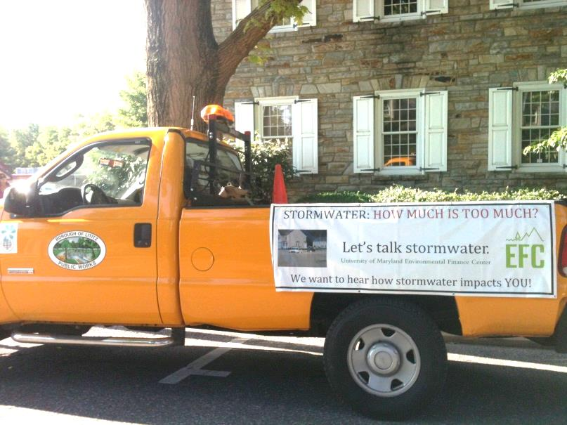
Initial Findings
Access to available information & resources
Relaying the importance of stormwater management to community
Limited understanding of program requirements
Municipal staff training
Tracking, documentation, and record keeping
Long term planning for implementing stormwater projects
Notes:
A lot of this improved by participating in the study

Slide 7
Most important element of study
Biggest challenge
Initial assumption:
Developing cost estimates
Initial assumption:
Unknown
Finding:
Peer-to-peer exchange and information sharing
Finding:
Existing data/baselines are unknown

Slide 8

What makes a stormwater program successful?
First hand observation reveals…
Leadership
Extensive targeted outreach
Collaboration
Sound fiscal planning

Slide 9
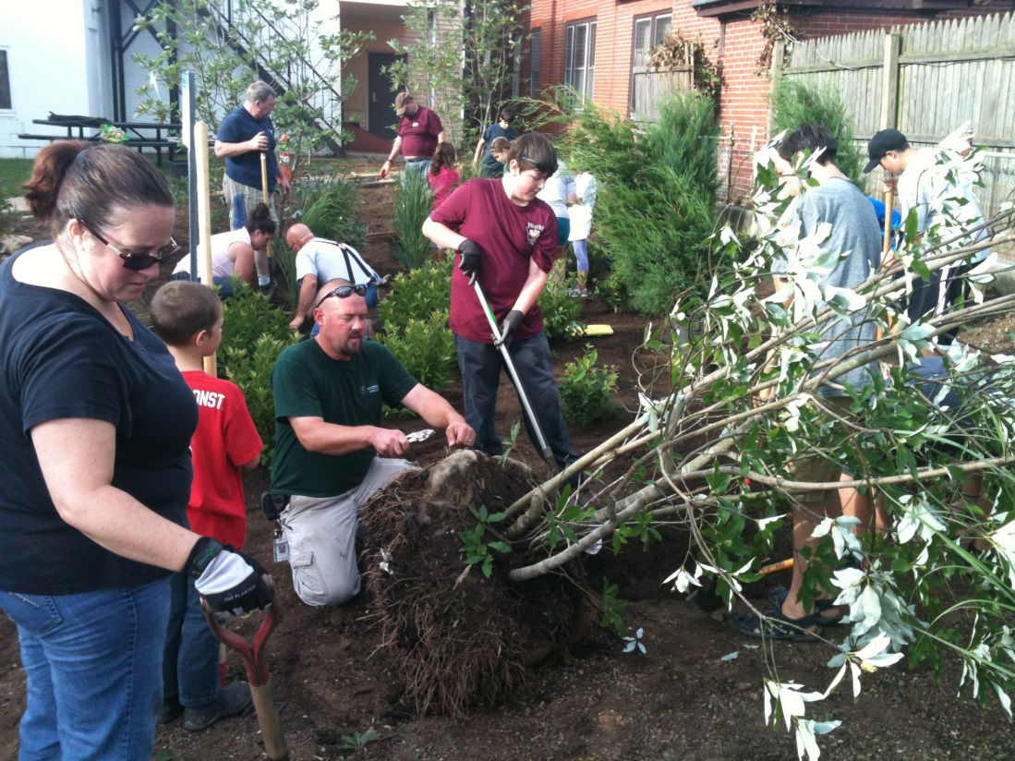
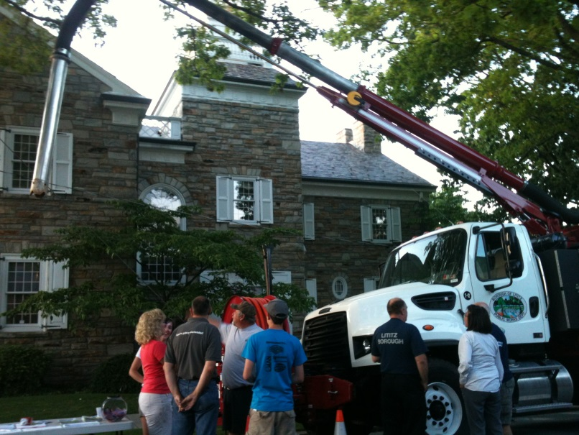
No two programs look the same…
…All have in common:
Creativity
Hard work

Slide 10
Thank you!
For further information:
Monica Billig
Environmental Finance Center
University of Maryland
240-786-8664
mbillig@umd.edu
http://efc.umd.edu/

