Slide 1
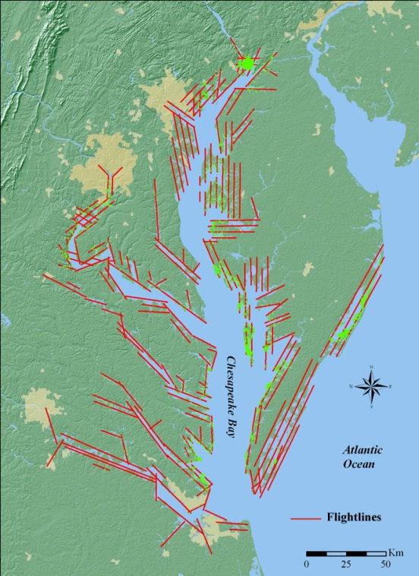
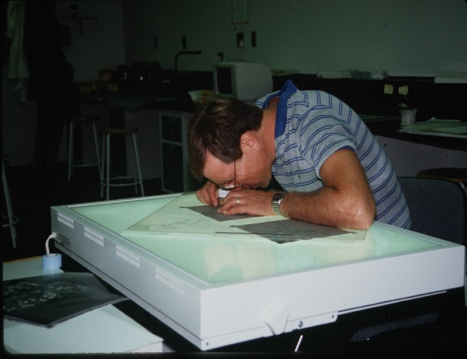
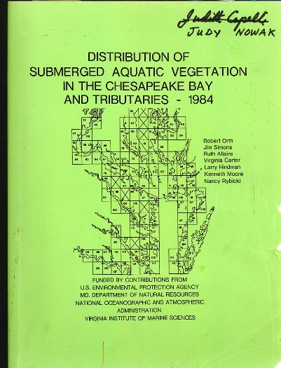
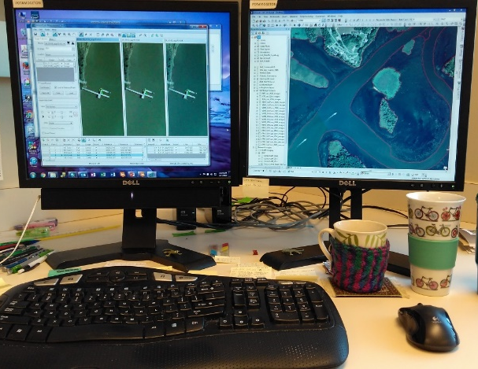
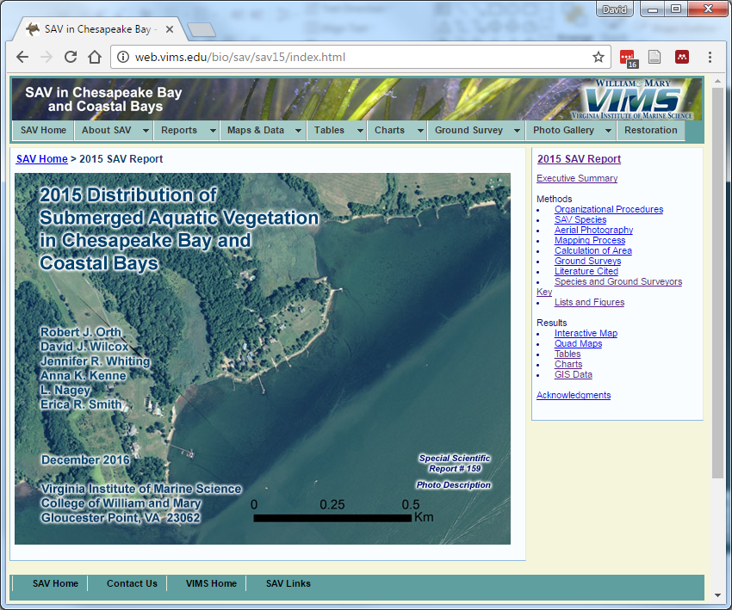

The Chesapeake Bay Annual SAV Monitoring Program:
Its Evolution – 1974 to 2016
Bob Orth, Dave Wilcox

Slide 2
Outline of Talk
  Significant Milestones
  Current SAV Survey Process
  Major Changes in the Process
  The Budget (Grants Supporting the Survey)
  Factors Influencing Costs Over Time
  Significance
  Conclusions

Slide 3
Significant Milestones
1974 First aerial survey of western shore Virginia tribs by VIMS
1978 First baywide survey of SAV. 2 groups: VIMS for VA; Aeroeco & American Univ. for MD.
2 separate reports
1979-1982 Various local surveys, primarily VA waters
1984-1986 Baywide survey of SAV: 2 groups- VIMS for VA, EPA-EPIC for MD; 1 report coordinated by VIMS
1987-2016 Baywide survey of SAV now coordinated by VIMS*
2006 SAIC external review of SAV Program
  2008 Comparison of Black and White vs Color Film
* No survey in 1988; same aerial contractor 1989-2016.

Slide 4
Current SAV Survey Process
Pre-Planning – VIMS coordinates with Air Photographics on timing, flightlines, and all elements of acquisition .
Acquisition – Air Photographics acquires imagery under correct conditions (monitored 24/7), and sends VIMS a digital copy. VIMS reviews imagery to ensure SAV is clearly captured. If not the area must be re-flown.
Orthorectification and mosaicking – All images with SAV are orthorectified and mosaicked by VIMS.
Photo-interpretation –SAV beds are delineated manually from the imagery into four density classes by experienced VIMS analysts.
Field Surveys – Volunteers and science groups collect field species data and submit their results to VIMS.
Data Submission and Press Release – SAV Survey data is analyzed by VIMS and released in coordination with EPA to spread the word.
Final Report – A final web-based report is produced, including all SAV aerial and field species data submitted to VIMS

Slide 5
Annual Survey Tasks by Month

Slide 6
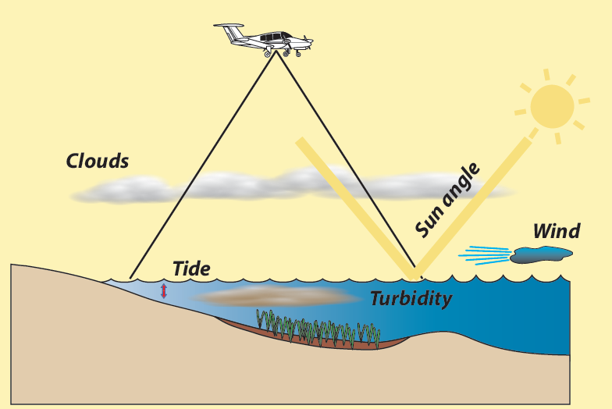
Acquisition of Aerial Imagery
Aerial multispectral digital imagery is acquired from flight lines flown over the entire bay
Flights require low wind, minimal cloud cover, low tide,
low turbidity, low sun angle.
VIMS and Air Photographics staff monitor these conditions 24/7

Slide 7
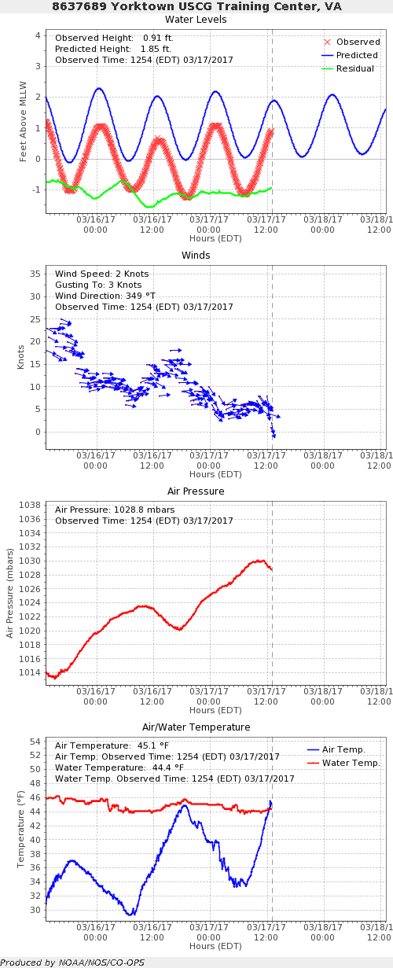
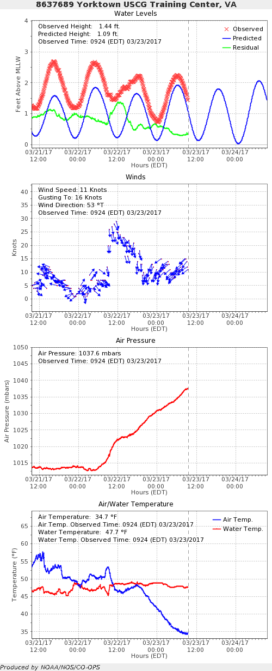
Wind and Tide = monitored daily for changes
NOAA Tides Online (https://tidesonline.nos.noaa.gov/geographic.html)

Slide 8
Other Acquisition Bottlenecks
Washington, DC
  Prior TSA approval (30 days in advance)
  Armed Police Officer in plane on day of flight
Aberdeen Proving Ground
  Prior approval (shooting live ammo on weekdays)
  APG personnel in plane on day of flight
  APG personnel preprocesses and censors all APG imagery
Patuxent Air Base
  Approval day before flight (Pax now doing drone work)
Dahlgren Navel Support Facility
  Approval day of flight (shooting live ammo)

Slide 9
Major Changes in The Process
  The Web Revolution
  Printed version of report to web-based report

Slide 10
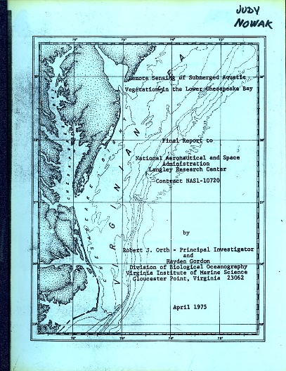
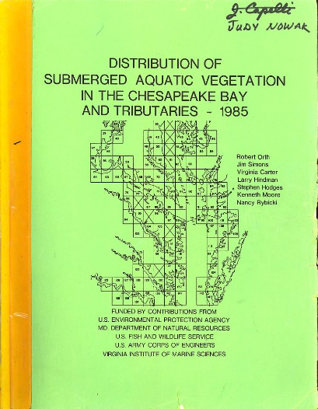
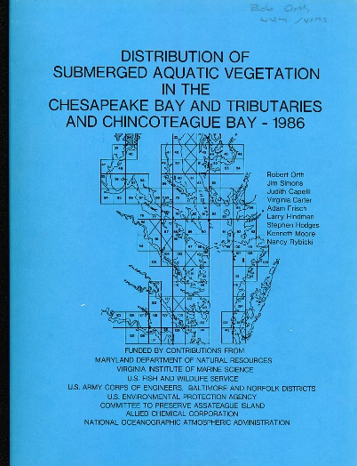
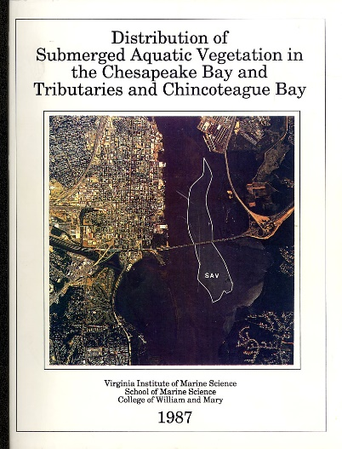
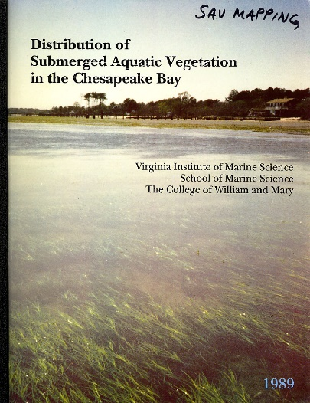

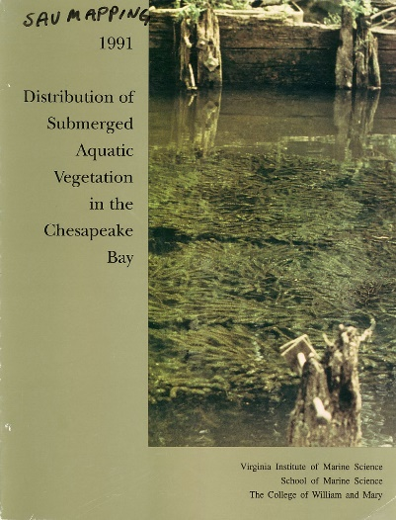
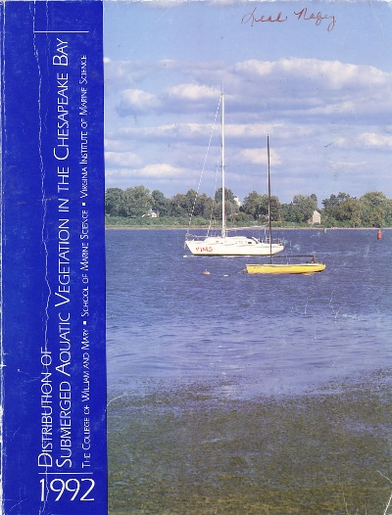
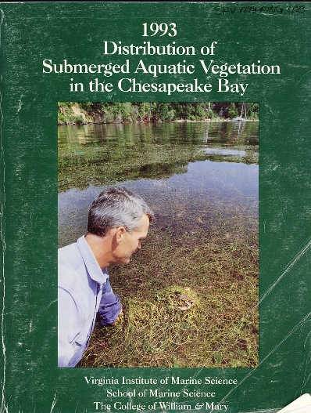


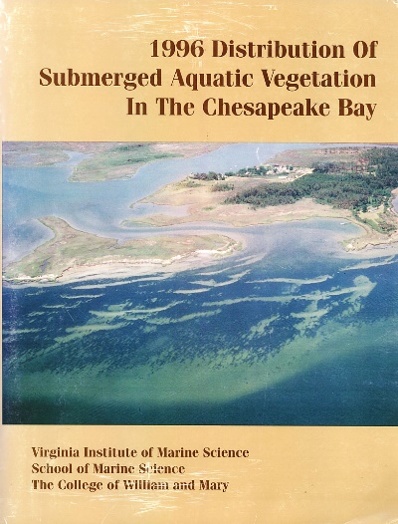

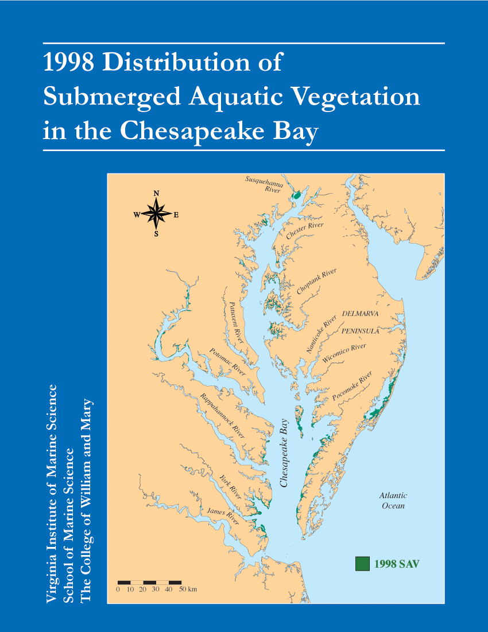
The Old Days – Printed Reports – through 1998

Slide 11
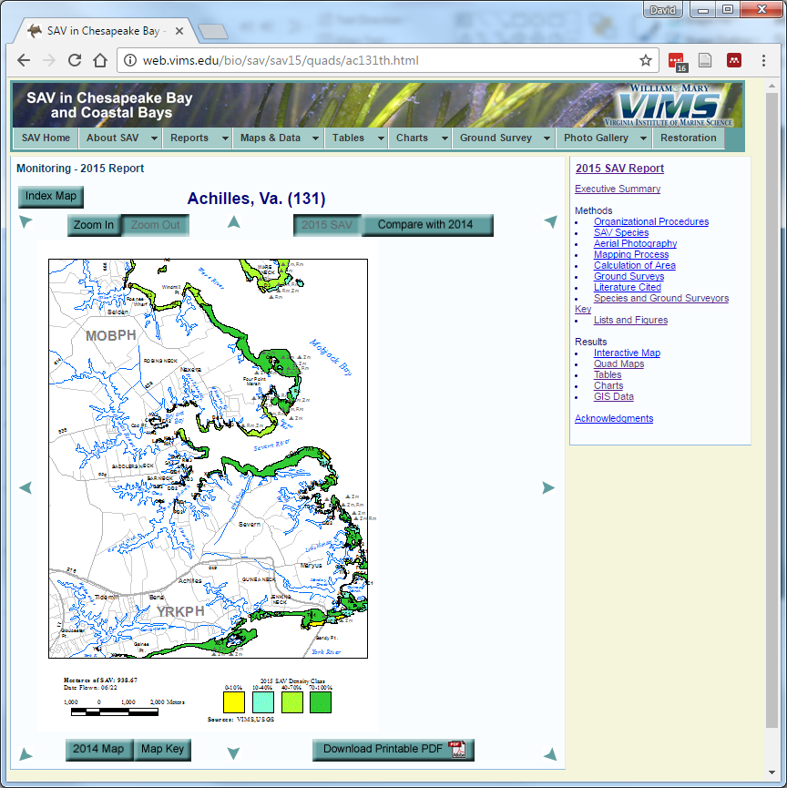
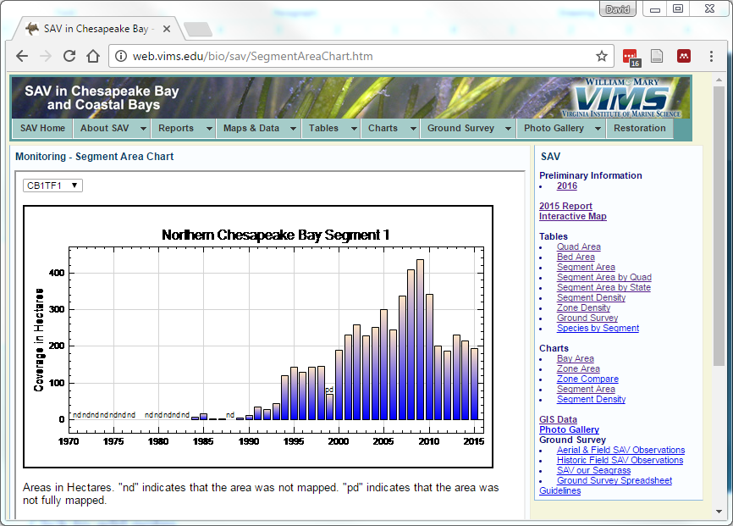
Web Based reports
1999- present

Slide 12
Major Changes in The Process
  The Web Revolution
  Printed version of report to web-based report
The GIS revolution
  Heads down (Manual) to on-screen Photo-interpretation
  Add GPS/IMU to acquisition of imagery

Slide 13

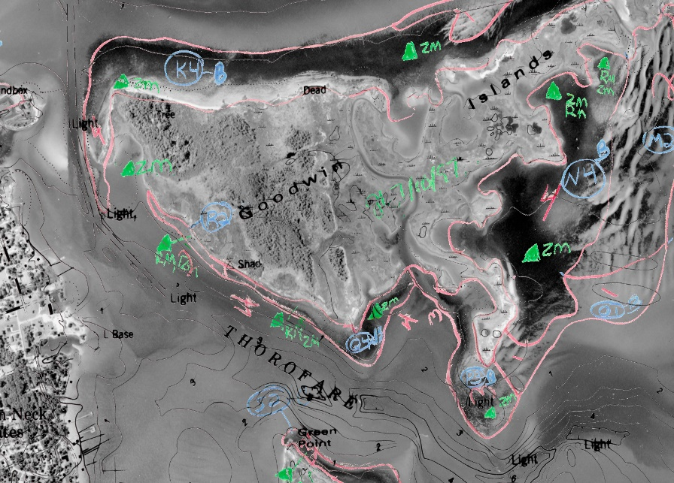
Old SAV Mapping Method
SAV Delineation
Mylar Overlay

Slide 14
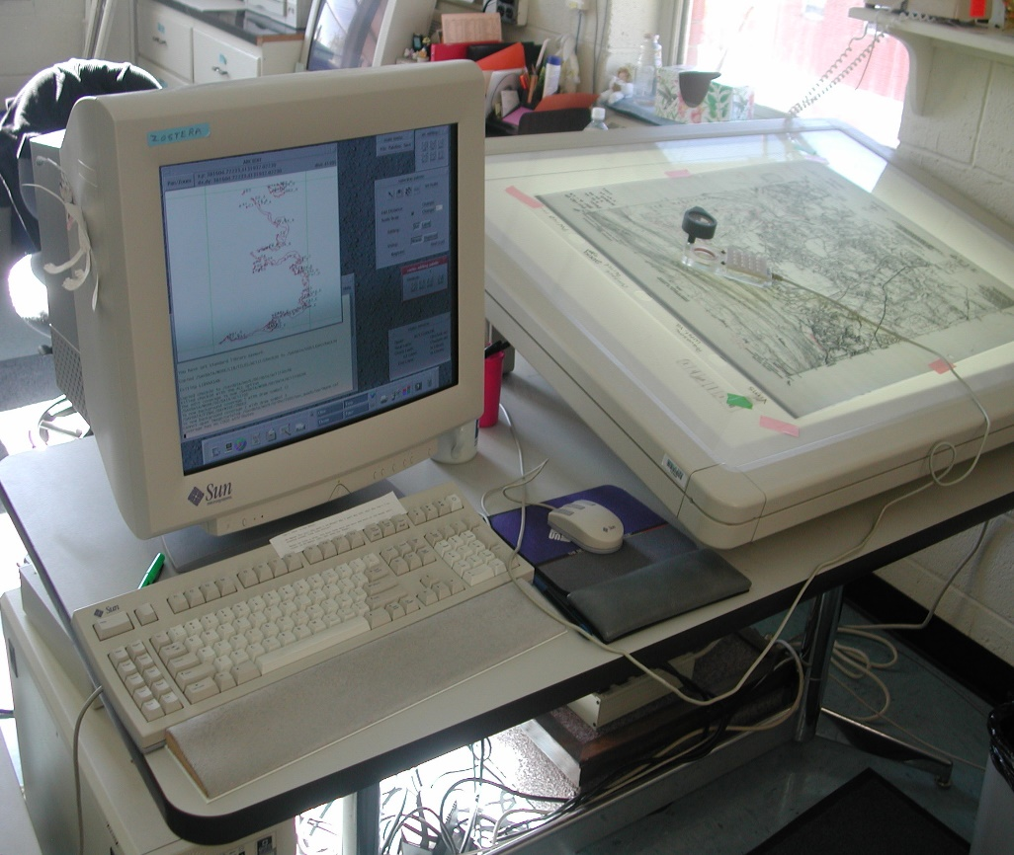
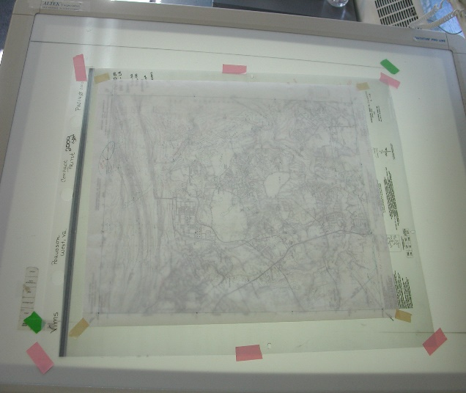
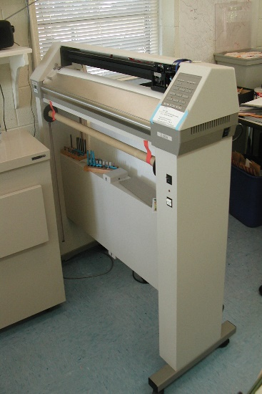
Old SAV Mapping Method
Plot and Proof
Digitize Beds

Slide 15

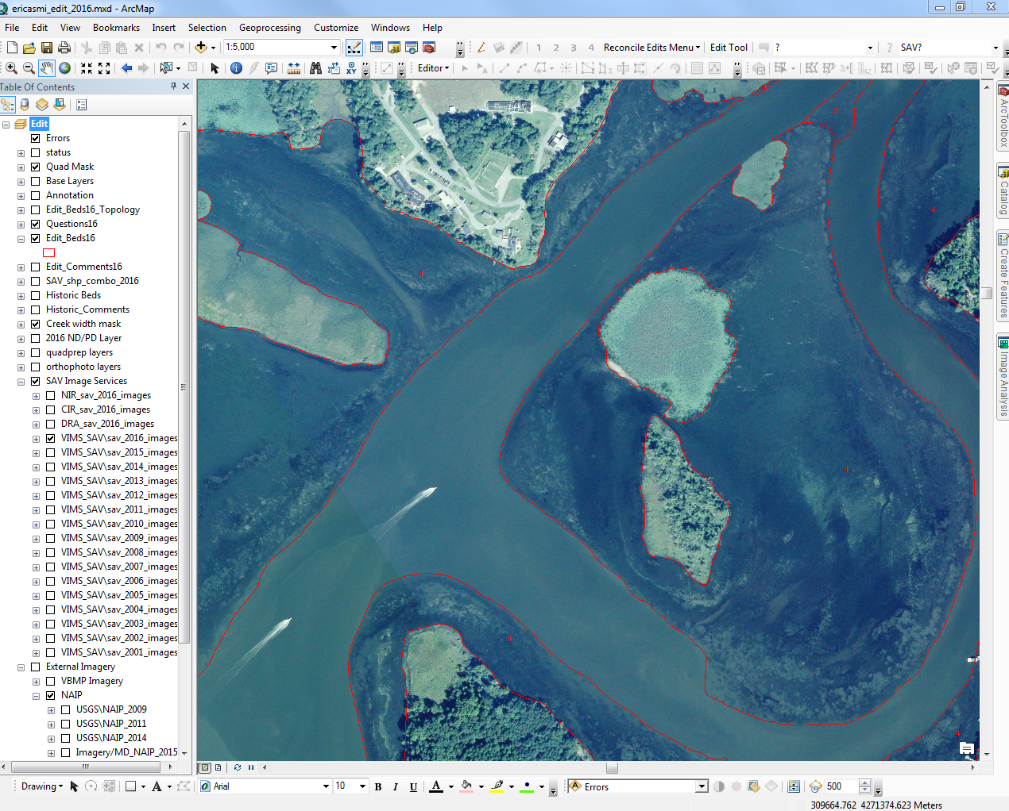
New SAV Mapping Method
Orthorectification, Mosaicking, Photo-interpretation
Requires knowledgeable and
very dedicated staff

Slide 16
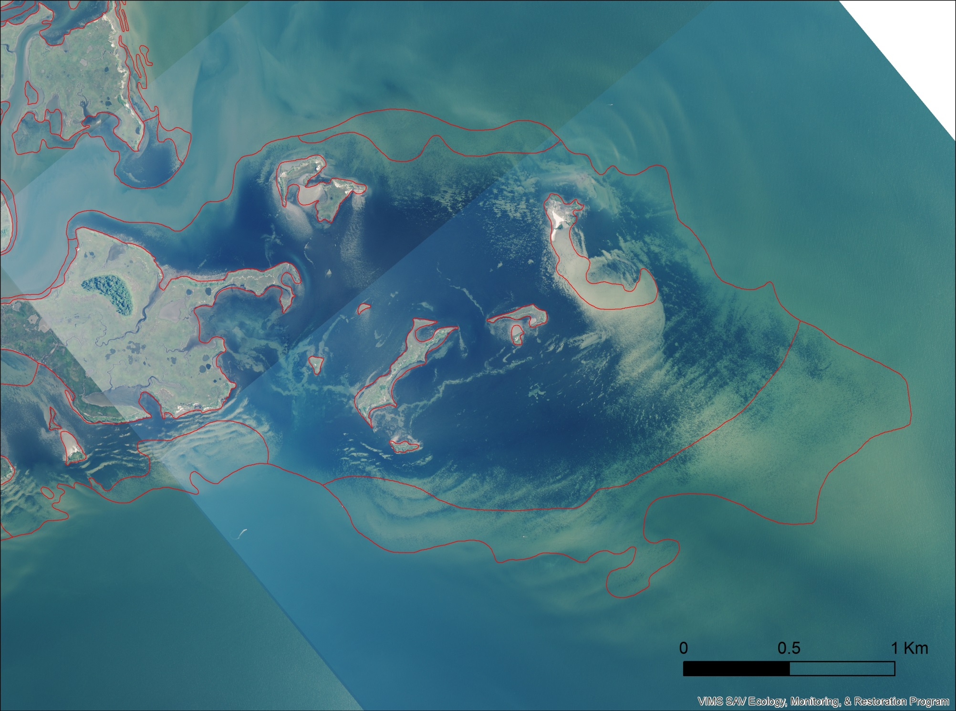
SAV beds outlined in red
and given density classes based on cover
2
1
4
4
4
1
1

Slide 17
Major Changes in The Process
  The Web Revolution
  Printed version of report to web-based report
The GIS revolution
  Heads down (Manual) to on-screen Photo-interpretation
  Add GPS/IMU to acquisition of imagery
  Interactive Map
  Switch from Film Prints to Digital Imagery

Slide 18
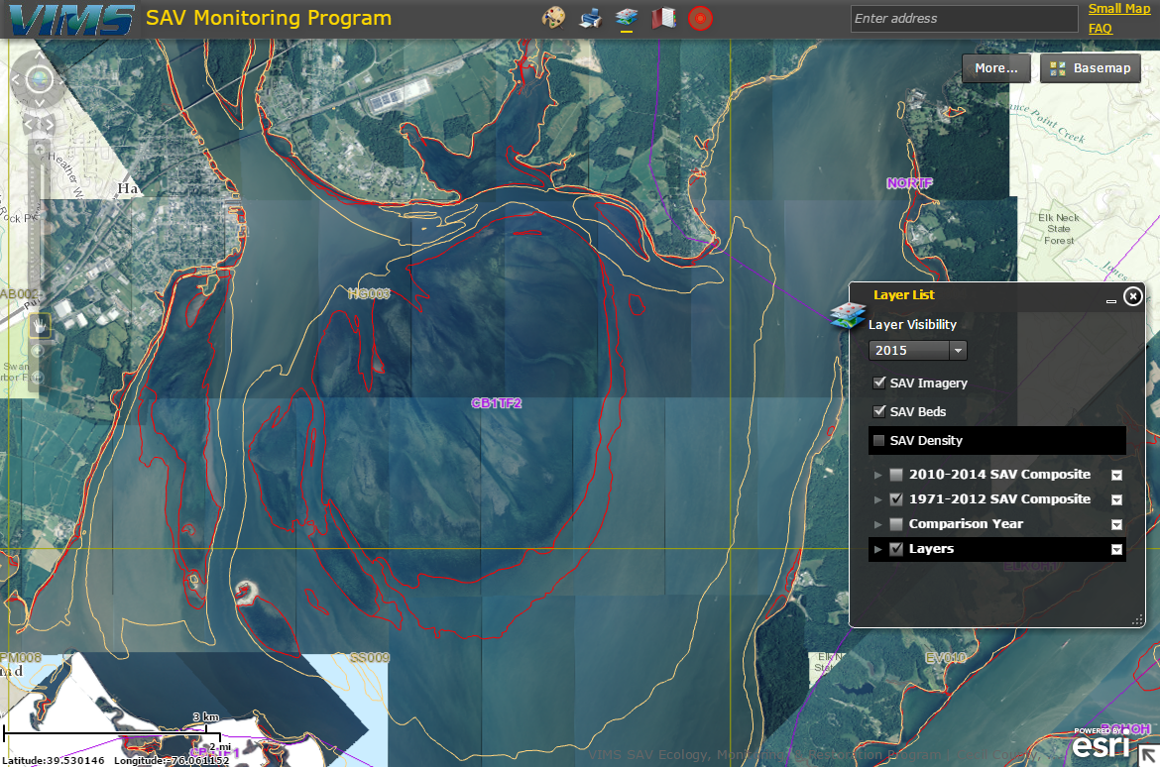
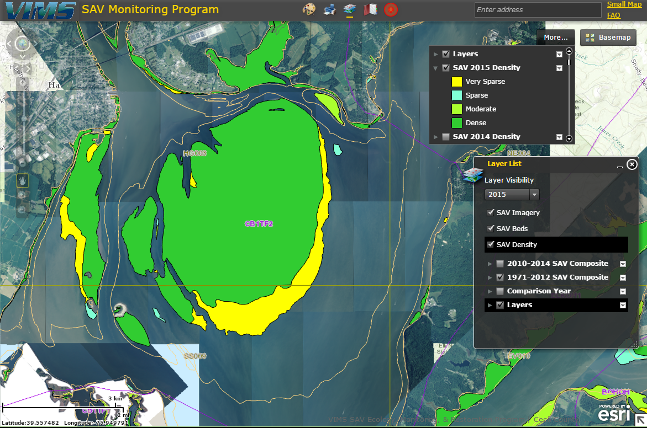
Interactive Map

Slide 19
Major Changes in The Process
  The Web Revolution
  Printed version of report to web-based report
The GIS revolution
  Heads down (Manual) to on-screen Photo-interpretation
  Add GPS/IMU to acquisition of imagery
  Interactive Map
  Switch from Film Prints to Digital Imagery. Ability to add imagery within days of obtaining it.

Slide 20
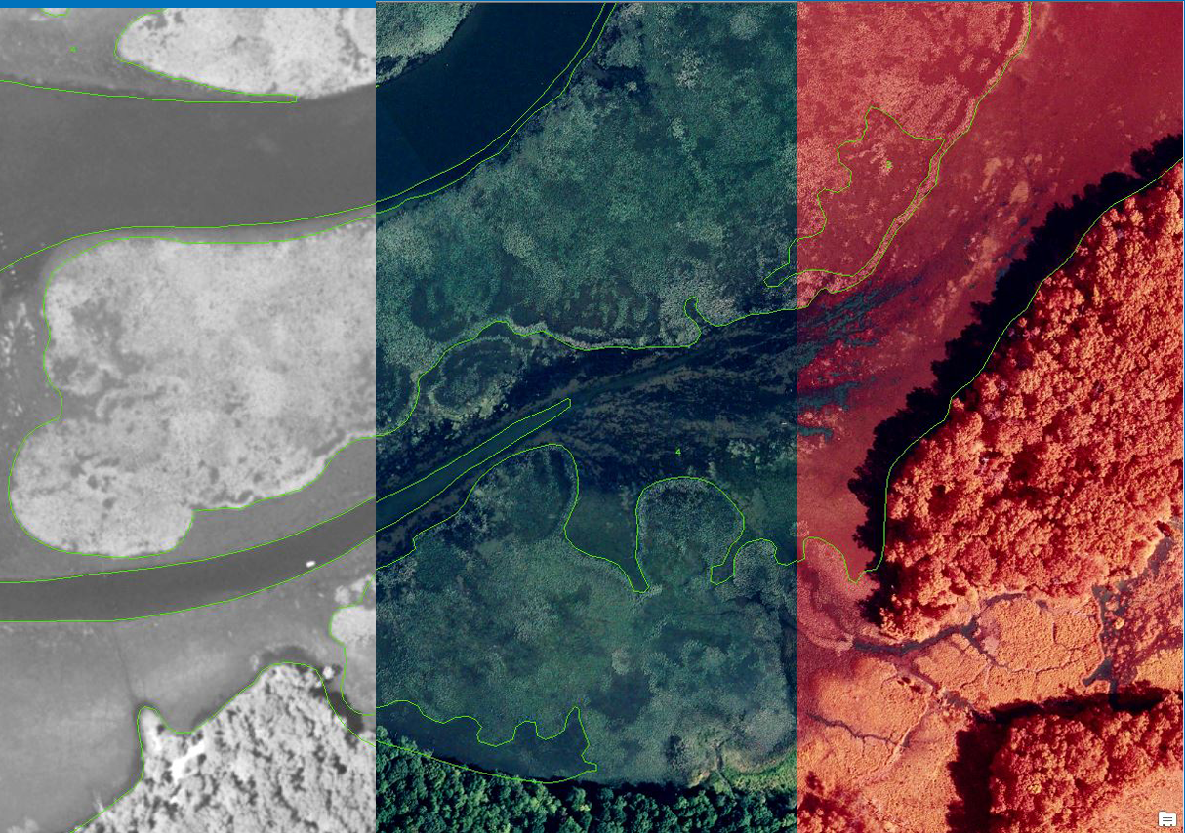
Emergent vegetation
Very dense SAV
Emergent vegetation
Very dense SAV
2014 Panchromatic
2015 Digital Imagery
2015 Color Infrared

Slide 21
SAV Ground Surveys
Transect Surveys
Ground Surveys
  Citizens
  Scientists

Slide 22
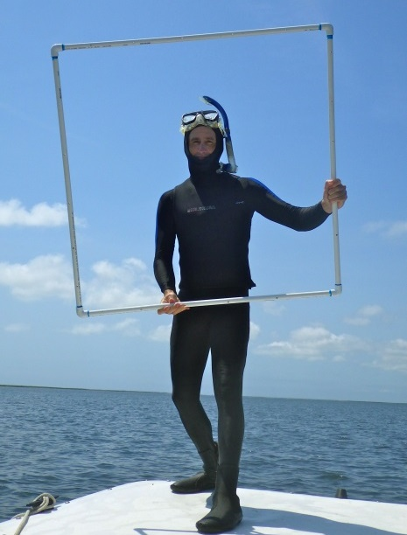
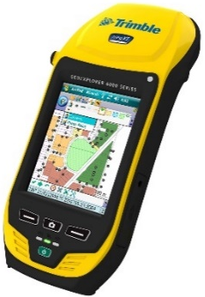
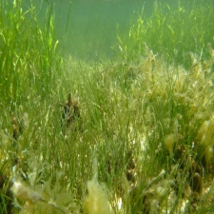
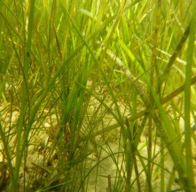
2008 – 2016
10580 observations!
GRASS BED
TRANSECT
…
10 m
SHORELINE
OFFSHORE EDGE
1m²
Transects – 200-1800 m
Notes:
Three years after first major die off.
Encompass 2010 die off
June/July 2008 – 2015
% cover of two SAVs (1m² quadrats)
N = 25 sites GPS checked
130 – 1500 meters in length
(n = 10580 observations!)

Slide 23
Poquoson Flats
2008-2016
Eelgrass
Widgeongrass

Slide 24
Back River Shoal
2008-2016
Eelgrass
Widgeongrass

Slide 25
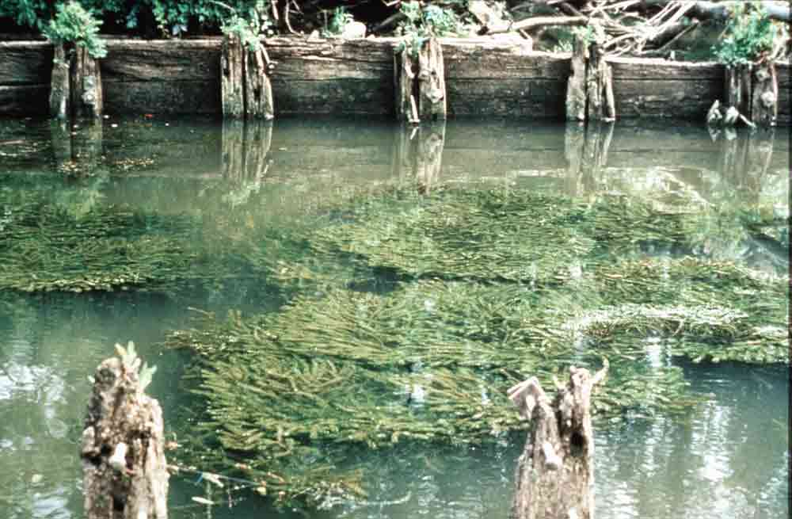
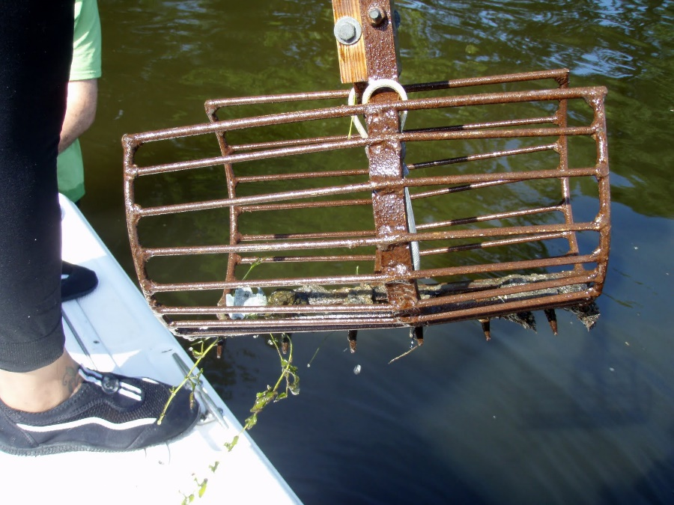
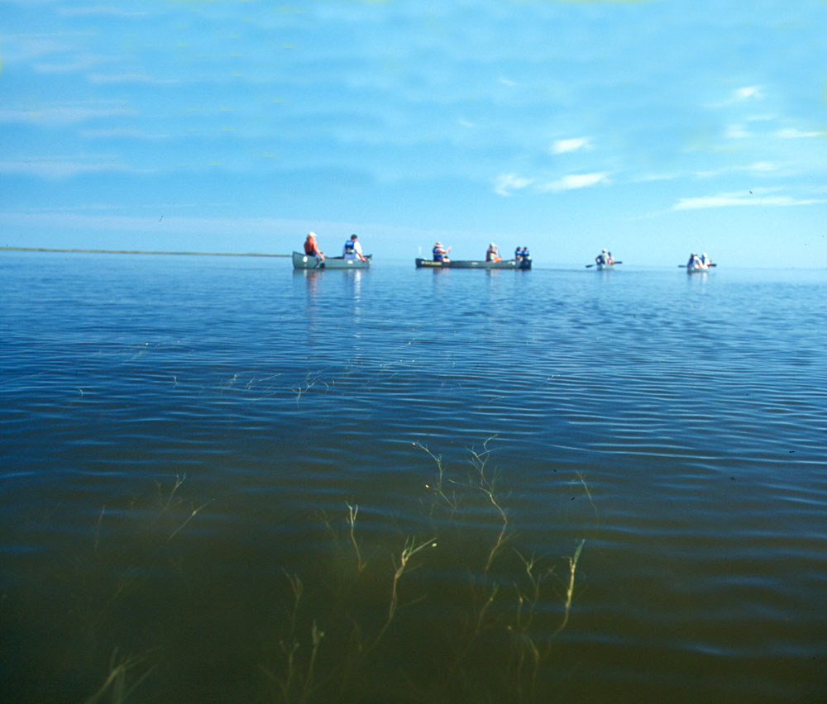
Ground Survey Point Data
Visual, Grab Samples
Notes:
Hi!
I’m David Wilcox from VIMS and this is Jill Bieri who works for CBF. With help from the Va. CRM program, we’re working on an project that we hope will get more people excited about monitoring SAV in Chesapeake Bay. Before I jump into that project, let me give you a just a little background on the current SAV monitoring program. So, to start, let’s leave the water’s surface and I’ll take you to more than two miles over the Bay in a small plane.

Slide 26
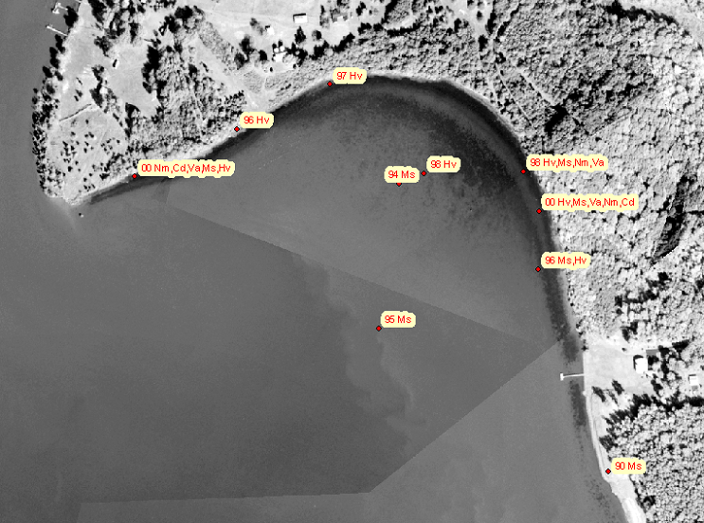
Notes:
So, while the bay is being photographed from the air, people are out on the bay recording what’s out there. For this little area in Aquia Creek, we’ve had observations dating back to 1990 reporting a variety of species from milfoil and hydrilla to coontail and wild celery.

Slide 27
Species data reported on
quadrangle maps

Slide 28
The Budget Information

Slide 29
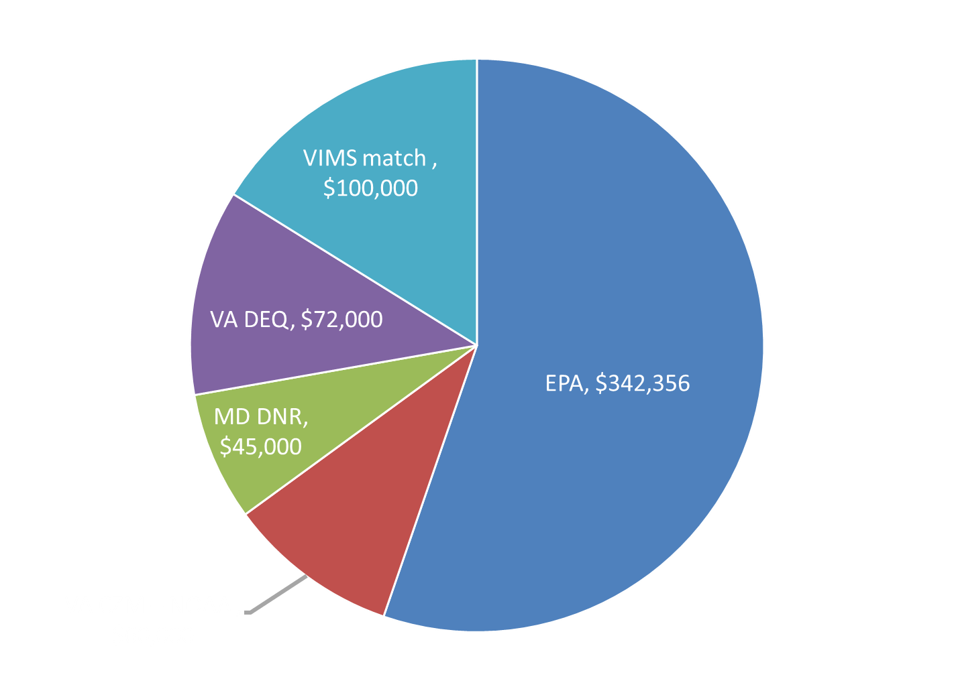
2016 SAV Survey Funding Sources
*
TOTAL = $619,356
* Preliminary Number

Slide 30
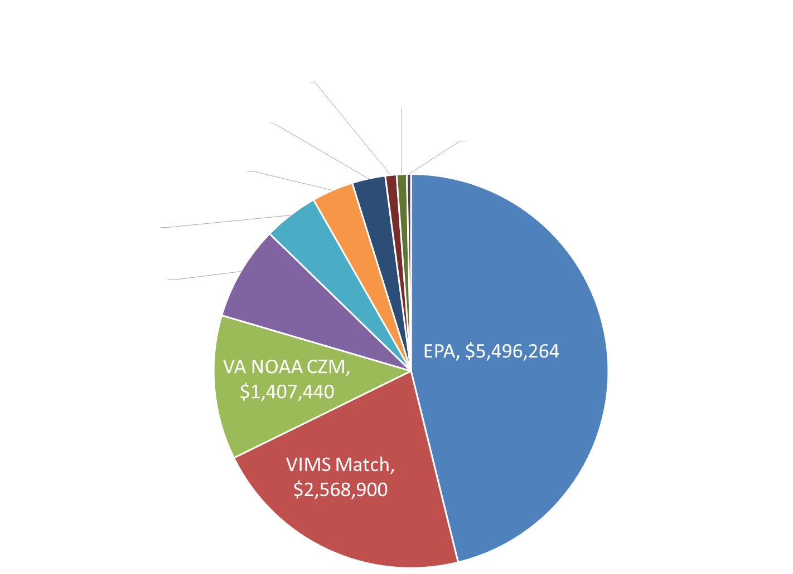
Grants Supporting the Survey 1989-2016
All MD sources = 12%
46%
12%
TOTAL = $11,906,452
21%

Slide 31
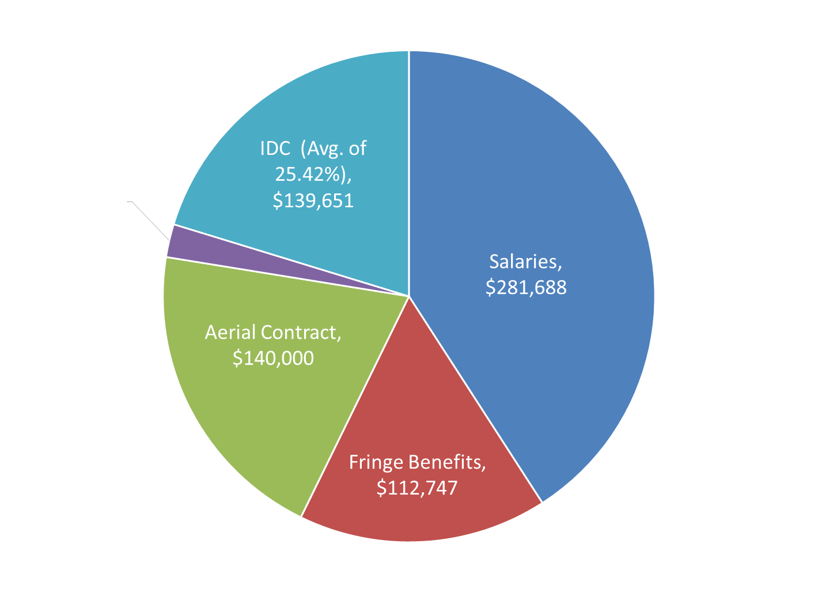
2017 Budget
TOTAL = $689,086

Slide 32
Factors Influencing the Budget
(+ = increases in budget; - = decreases in budget)
Inflation ($100,000 in 1984 = $233,489 in 2016)
Conversion of hourly staff to full time with benefits (+)
Addition of flight lines in Virginia tributaries, 1999 (+)
More SAV to map (+)
Printed report to web based report (-)
GPS/IMU added to imagery 2007 (+ $20-$30K)
Added 4th full time person early 2000’s (+)
Eliminated 4th full time person 2017 (-)
Digital Imagery requires more lines to cover SAV areas (+)
Aerial contract increases, 1989 to 2016 (+)
Personnel raises, reallocation of positions (+)

Slide 33
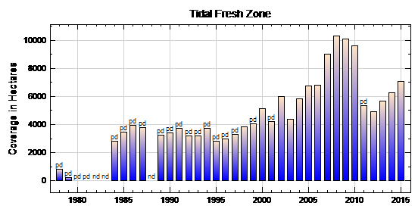
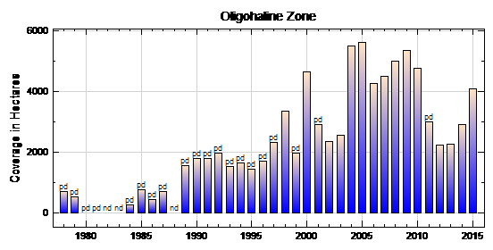
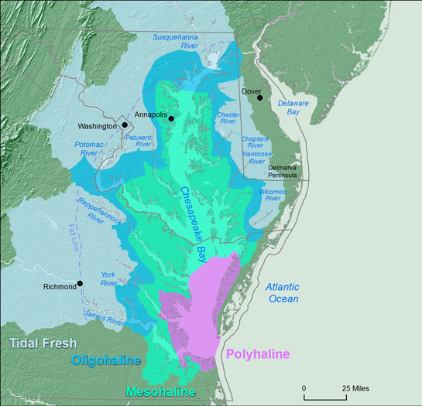
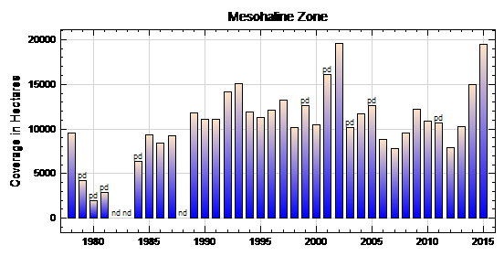
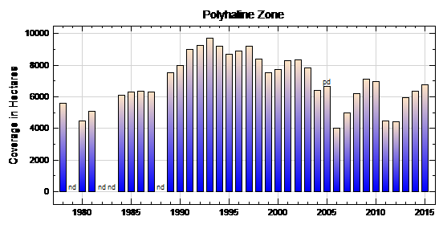
0-0.5
0.5-5
5-18
hot
18-30
More SAV – more beds to map!

Slide 34
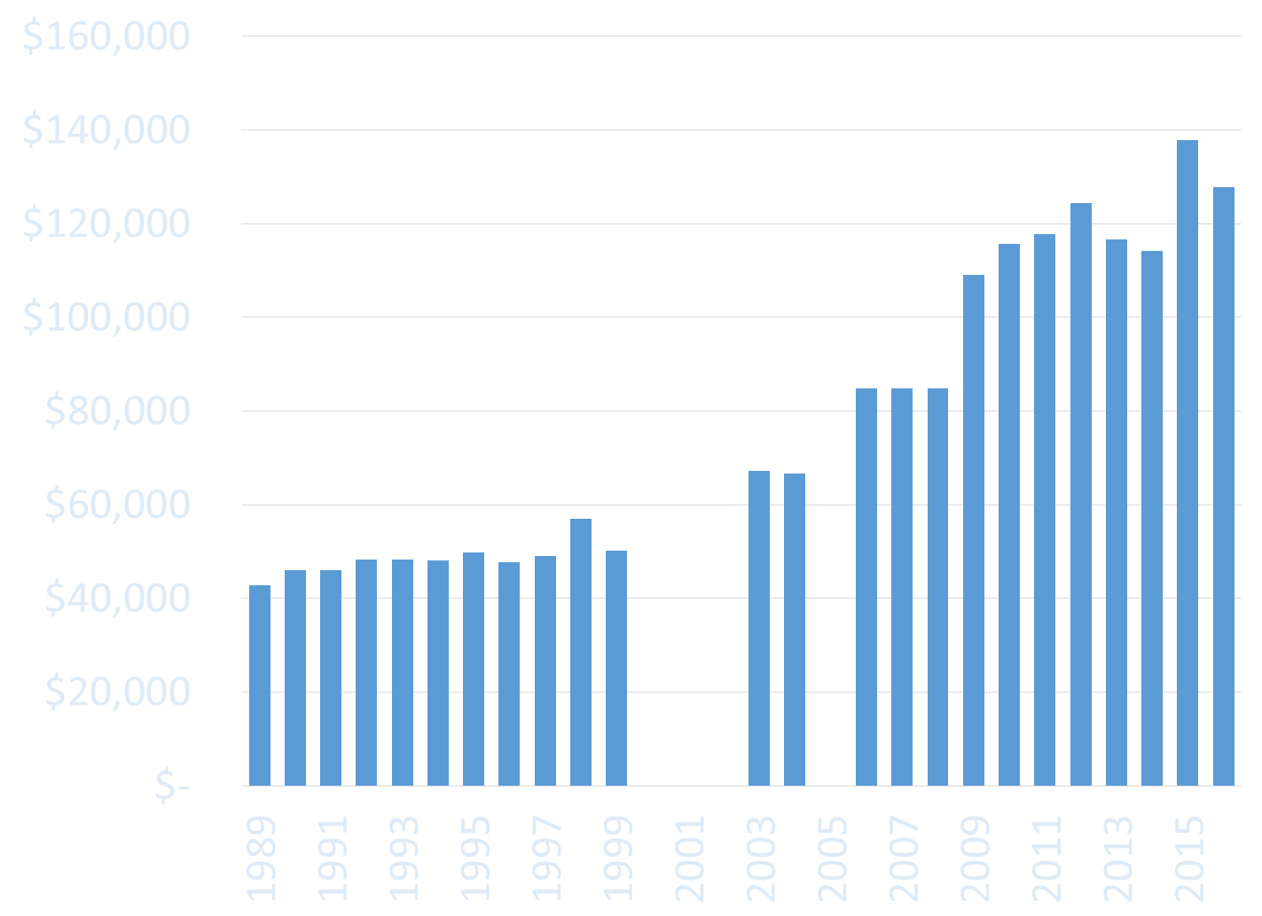
Aerial contract costs 1989-2016
Not adjusted for inflation
Digital
GPS/IMU
Scanning starts
NO COST DATA
NO COST DATA
NO COST DATA
NO COST DATA

Slide 35
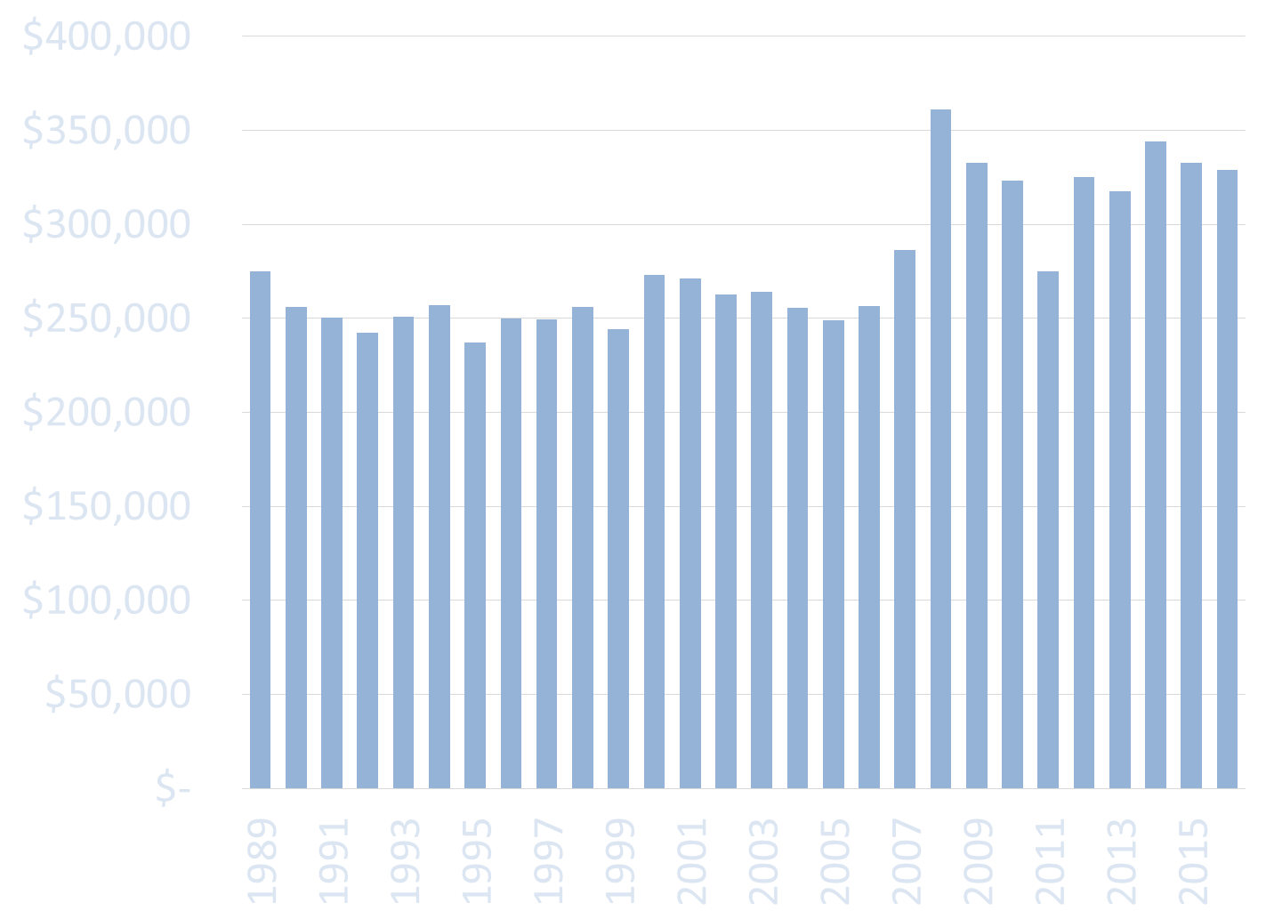
Survey Cost in 1989 Dollars

Slide 36
Significance of Annual Survey
State Water Quality criteria – Restoration targets

Slide 37
Virginia and Maryland’s
Water Quality Standards
(9 VAC 25-260
COMAR 26.08.02.03-3)
SAV acreage now included in determining attainment of Chesapeake Bay water clarity standards
EVERY ACRE COUNTS IN MEETING RESTORATION TARGETS!

Slide 38
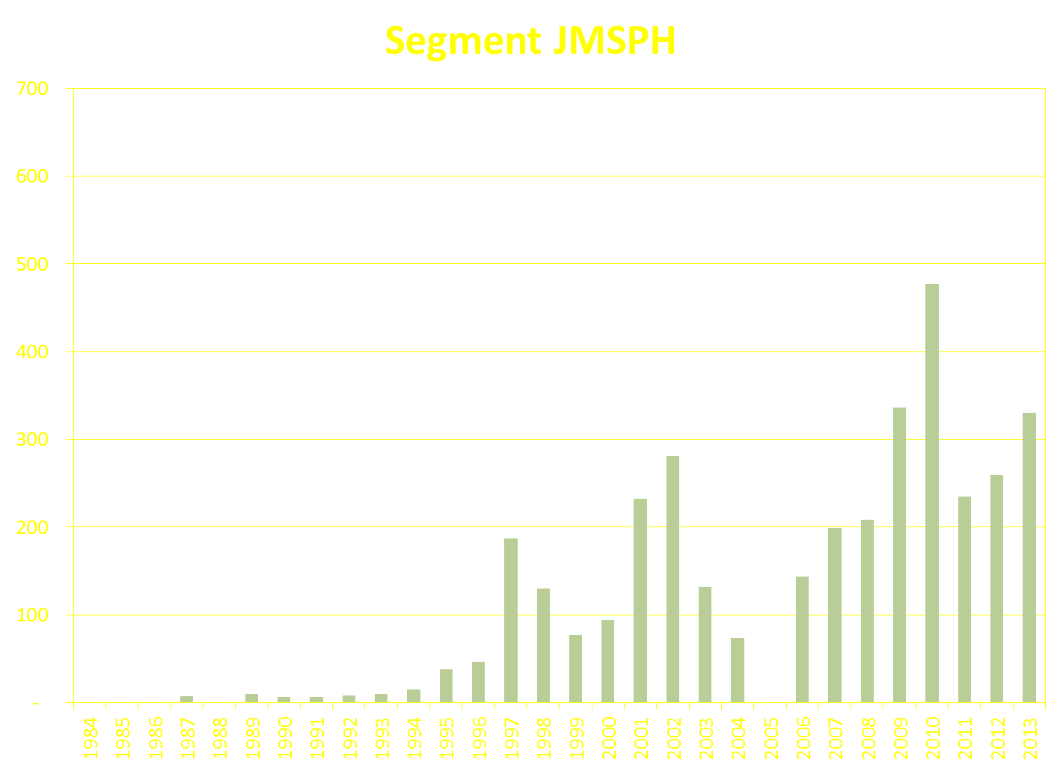
James River Polyhaline area
SAV Goal
604 acres
ND
PD

Slide 39
Significance of Annual Survey
State Water Quality criteria – Restoration targets
Necessary for Aquaculture Site Evaluations

Slide 40
State Regs Governing Aquaculture
VMRC 4 VAC 20335-10 (Jan. 1998) – On-bottom shellfish aquaculture activities requiring structures are now prohibited from being placed on existing SAV
Md. NATURAL RESOURCES Code Ann. § 4-11A-01 (2015) - SAV Protection Zone. -- "SAV Protection Zone" means an area of submerged aquatic vegetation as mapped in aerial surveys by the Virginia Institute of Marine Sciences in 1 or more of the 5 years preceding the designation of an Aquaculture Enterprise Zone or an application for a lease under this subtitle.

Slide 41
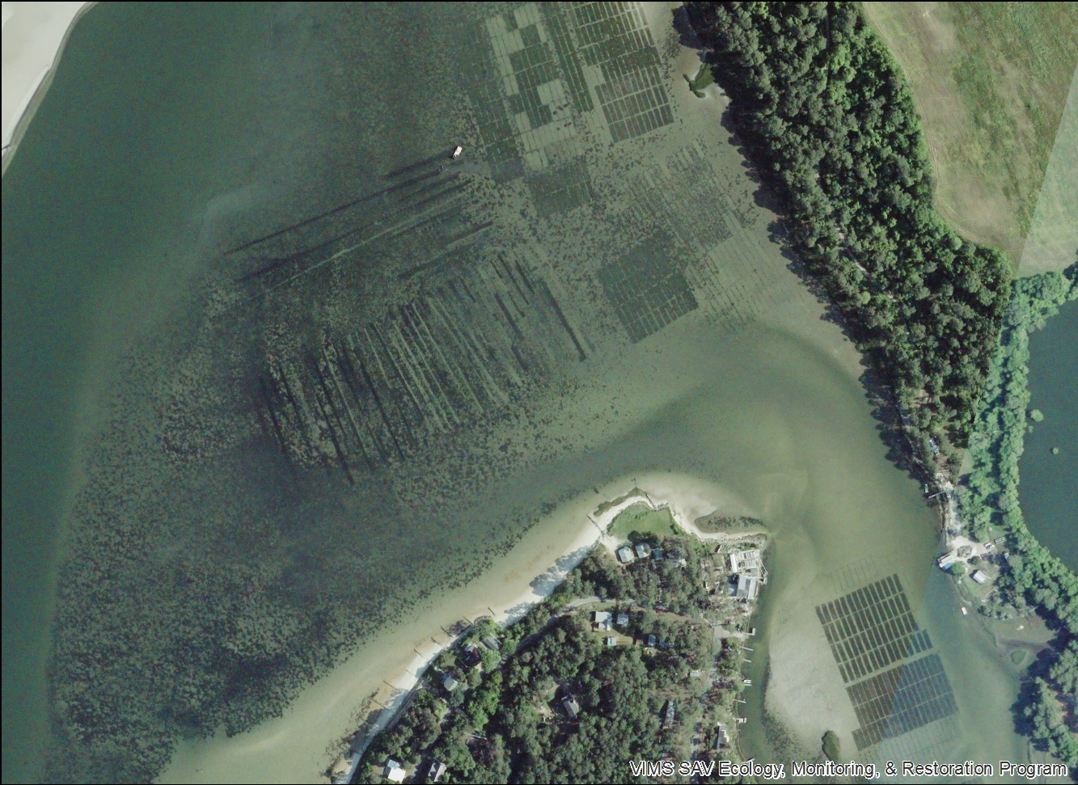
Oyster and Clam Aquaculture plots – The Gulf 2016

Slide 42
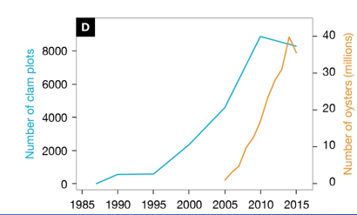
Aquaculture Expansion
Orth et al. just accepted Bioscience

Slide 43
Significance of Annual Survey
State Water Quality criteria – Restoration targets
Necessary for Aquaculture Site Evaluations
Monitor Propeller Scarring in VA

Slide 44

Brown’s Bay - 1997
Aerial photograph from
VIMS monitoring
showing extensive
scarring in grassbed in
Browns Bay located in
the Mobjack Bay

Slide 45
Boat Scars
Each point represents how much propeller scaring
we measured each year. Then we follow those scars
in subsequent years.
Orth et al. In Press

Slide 46
Significance of Annual Survey
State Water Quality criteria – Restoration targets
Necessary for Aquaculture Site Evaluations
Monitor Propeller Scarring in VA
Numerous Peer Reviewed Publications Requiring Annual data

Slide 47
Scientific Analysis
37 peer –reviewed papers in total

Slide 48
Eelgrass Changes 1984-2015
Lefcheck et al. 2017

Slide 49
Eelgrass Changes 1984-2015
Lefcheck et al. 2017

Slide 50
Conclusions
Survey has been responsive to technological changes while maintaining continuity of data collection
Survey has been responsive to management needs
Funding has just kept up with inflation
Annual Survey necessary for de-listing of Bay
Annual Survey necessary for understanding processes influencing Bay SAV

Slide 51





Thanks – SAV SYN Team/EPA
University of Maryland CES, EPA, SERC, VIMS, USGS, MD DNR Texas A&M, SESYNC

Slide 52


Submersed Aquatic Vegetation in Chesapeake Bay:
Sentinel Species in a Changing World
Just accepted to the journal BioScience!!

