Slide 1

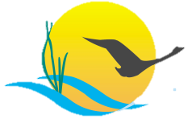
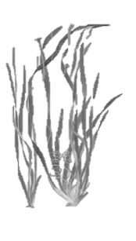

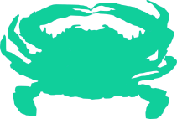

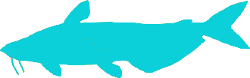

Sustainable Fisheries Goal Implementation Team
March 2017
Chesapeake Bay Program
Our Vision
The Fisheries GIT provides a forum to discuss fishery management issues that cross state and jurisdictional boundaries, connects science to management decisions and creates a framework for implementing ecosystem-based approaches to fisheries management.
Fish Habitat The Fish Habitat Action Team
(FHAT) is reviewing and
assessing workplan progress under their new coordinator, Gina Hunt (MD DNR). They will present progress, challenges, and future steps to the CBP Management Board in May.
The FHAT received STAC funding for a fish habitat workshop which will identify representative species for habitats in the Chesapeake Bay watershed. Using these representative species, experts will evaluate factors influencing habitat function and provide criteria to qualify factor significance.
Accomplishments
Blue Crabs The Chesapeake Bay Stock Assessment Committee is gearing up to draft the 2017 Blue Crab Advisory Report after analyzing the Winter Dredge Survey results.
The University of Maryland Center for Environmental Science Chesapeake Biological Laboratory (UMCES-CBL) was awarded EPA GIT funding to evaluate impacts of ecosystem factors on blue crab life cycle and population dynamics.
The Scientific and Technical Advisory Committee (STAC) is sponsoring a series of three workshops which will create a forum in which blue crab, oyster and SAV experts will work with climate experts to gain a better understanding of the likely impacts of climate change on blue crabs and develop recommended solutions which incorporate resiliency into blue crab management.
Oysters The Fisheries GIT worked with
stakeholders and CBP partners to
develop an oyster reef restoration progress dashboard and oyster indicator which measures in-water oyster reef restoration acreage. You can find these tools on Chesapeake Progress.
Restoration efforts are continuing in selected tributaries, including the U.S. Army Corps of Engineers – Norfolk innovative spatial design oyster restoration project in the Piankatank. Maryland and Virginia’s Oyster Interagency Teams continue to analyze data and stakeholder input to select the remaining 4 tributaries.
Oyster experts will meet with climate experts in April to participate in the STAC hosted oyster workshop to assess the impacts of climate change on oysters.
The Virginia Institute of Marine Science was awarded EPA GIT funding to investigate shell dynamics in oyster restoration and fishery management, addressing a key challenge in oyster restoration – the availability and sustainability of shell as oyster substrate.
Invasive Catfish The Invasive Catfish Task Force reconvened to review recent research on population diet and fish movement in the Bay. The Task Force is considering a future workshop which will summarize and communicate the latest research findings.
Forage CBP developed a forage video in their Bay 101 video series to inform the broader CBP community about the importance of forage and their role in the Chesapeake Bay ecosystem.
The Forage Action Team met to review recent research in striped bass indicator development by Maryland Department of Natural Resources (MD DNR) and factors driving forage population trends by UMCES-CBL. The Action Team discussed applications of this research and developed a strategy to guide actions moving forward.

Slide 2


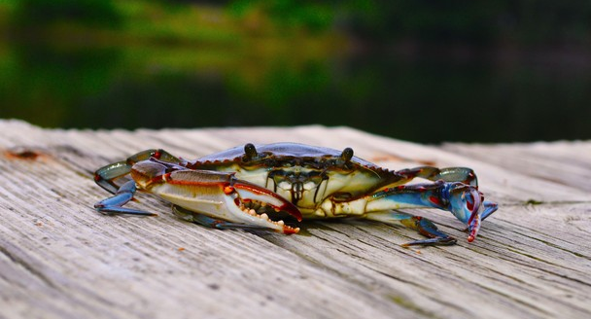
Sustainable Fisheries Goal Implementation Team
March 2017
Chesapeake Bay Program
Chesapeake Bay Program Updates
Executive Committee
Newly Funded Fisheries GIT Projects
The EPA/Chesapeake Bay Program (CBP) made funding available for the GITs for a third year to support key projects to advance progress on outcomes under the 2014 Chesapeake Watershed Agreement. The Fisheries GIT was awarded funding for an oyster shell/habitat loss study, evaluation of ecosystem factors affecting blue crab study, and a pilot study on benthic and forage sampling nearshore areas by local watershed groups.
What’s Happening in the Chesapeake Bay Program?
The CBP is initiating their Strategy Review System, which is a biennial review of the 31 outcomes under the 2014 Chesapeake Bay Watershed Agreement. Workgroups and Action Teams will present an overview of workplan progress at a designated meeting within the 2-year period. The Fish Habitat Outcome will present at the first meeting in May 2017, while the Oyster, Forage, and Blue Crab Outcomes will be presented in August 2017.
Sharing Our Oyster Restoration Success
Bruce Vogt (NOAA) presented the recent progress toward the oyster restoration outcome to the CBP’s Principals’ Staff Committee noting our successes, challenges and next steps. He noted the restoration efforts that have occurred in the past few years, our target restoration goals, and our newly established oyster indicator.
Executive Committee Meetings
Chesapeake Bay Scientists and policy administrators discuss various topics at monthly meetings of the Sustainable Fisheries GIT Executive Committee.
Jake Reilly from the National Fish and Wildlife Foundation (NFWF) provided a presentation to the Executive Committee to request priorities for NFWF’s upcoming Request for Proposals (RFP). Previously, NFWF RFPs have supported large scale oyster restoration. The Executive Committee agreed to prioritize tidal wetlands and oyster restoration.
Dave Goshorn, Chair of the Enhancing Partnering, Leadership, and Management GIT briefed the Executive Committee on the Strategy Review System, noting the purpose, timeline and requirements for each of the Outcomes under the Chesapeake Watershed Agreement (more details are provided on the right).
Next Meeting
Photo: Jennifer Baxter
June Full Fisheries GIT Meeting
June 19th – 20th, 2017
TBD, VA
SAVE THE DATE!
Find Meetings, presentations and other information at the Sustainable Fisheries Goal Implementation Team website

