Slide 1
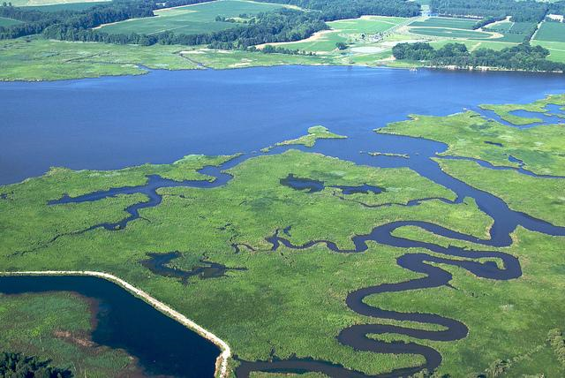
Chesapeake Bay Clean-Up and EPA Enforcement
Eric Schaeffer
Executive Director
Environmental Integrity Project
May 24, 2017

Slide 2
Enacted and proposed budgets adjusted for inflation using the GDP (chained) price index to FY 2016 dollars. Sources: EPA’s enacted budget from FY 1981-2016 (nominal dollars), EPA’s FY 2017 budget, FY 2018 Budget Blueprint

Slide 3
Sources: A New Foundation for American Greatness, FY2018. FY 2008-2016: FY 2017 EPA Budget in Brief, FY 2007-1999: FY 2011 EPA Budget in Brief,
FY 1998-1993: Summary of the 2000 Budget

Slide 4
HR 732: The “Stop Settlement Slush Fund” Act
“An official or agent of the Government may not enter into or enforce any settlement agreement on behalf of the United States directing or providing for payment of a loan to any person or entity other than the United States, other than a payment or loan that provides restitution for or otherwise directly remedies actual harm (including to the environment) directly and proximately caused by the party making the payment or loan…”

Slide 5
Volkswagen Settlement: Largest Beneficiaries of $2.7 billion Environmental Mitigation Trust Fund (Initial Allocations)
State | Initial Allocations ($) | Initial Allocations (%)
California | 381,280,175 | 14.12%
Texas | 191,941,816 | 7.11%
Florida | 152,379,151 | 5.64%
New York | 117,402,745 | 4.35%
Pennsylvania | 110,740,311 | 4.10%
Washington | 103,957,041 | 3.85%
Illinois | 97,701,054 | 3.62%
Virginia | 87,589,313 | 3.24%
North Carolina | 87,177,374 | 3.23%
Ohio | 71,419,317 | 2.65%
Other States and Administrative Costs | 1,298,411,704 | 50.73%
Total | 2,700,000,000 | 100.00%

Slide 6
2009 Manufacturing Sector Nominal Output = $4.59 Trillion
Sources:
Federal Reserve Bank of St. Louis, Manufacturing Sector: Real Output. https://fred.stlouisfed.org/series/OUTMS#0
U.S. Department of Labor, Bureau of Labor Statistics. Databases, Tables & Calculations by Subject. Manufacturing Sector. https://data.bls.gov/timeseries/CES3000000001

Slide 7
Shenandoah Valley: Phosphorus Imbalance
Table A. Estimated Manure and Phosphorus Output from Poultry and Cows, 2012
Type | Number of Animals | Manure Output | Phosphorus (pounds)
Chickens
Broilers | 157,380,630 | 196,726 tons | 4,485,348
Pullets | 1,286,348 | 32,101 tons | 251,545
Layers | 939,008 | 32,560 tons | 250,715
Turkeys | 16,534,511 | 148,811 tons | 3,258,961
Cows | 528,943 | 1.28 billion gallons | 5,056,038
Total | 176,669,440 animals | 410,198 tons/1.28 billion gallons | 13,302,607
Note: Manure generation and phosphorus content shown on a recoverable or as-is basis. Sources: USDA 2012 Agricultural Census, Virginia Department of Conservation and Recreation 2014 Nutrient Management Standards and Criteria, and the Chesapeake Bay Program.
Table B. Estimated Phosphorus Output v. Potential Crop Removal (pounds), 2012
Phosphorus Output (lbs) | Potential Phosphorus Removal by Crops (lbs) |  | Excess Phosphorus (lbs)
Livestock and Poultry Manure | Grain and Silage Crops | Pasture | Output - Removal
13,302,607 | -5,160,453 | -2,935,194 | 5,206,960
Note: Based on 2012 livestock production and harvest from the 2012 Census of Agriculture. Crop removal rates are from the Virginia Department of Conservation and Recreation’s (DCR) 2014 Nutrient Management Standards and Criteria.

Slide 8
Shenandoah Valley: Average Phosphorus Concentrations at Long-Term Trend Monitoring Stations
Stream Name (ID) | 2014 Benthic Impairment | 2014 | 2015 | 2016 | 3-year Average
Cedar Creek (1BCDR013.29) | No | 13.3 | 11.7 | 10.0 | 11.7
Linville Creek (1BLNV001.22) | Yes | 45.0 | 40.0 | 45 | 43.3
Muddy Creek (1BMDD005.81) | Yes | 409.5 | 168.2 | 198.4 | 258.7
Middle River (1BMDL001.83) | No | 34.0 | 103.3 | NA | 68.7
North Fork (1BNFS000.57) | No | 30.0 | 20.0 | 21.7 | 23.9
North Fork (1BNFS010.34) | No | 44.0 | 63.2 | 65.0 | 57.4
North Fork (1BNFS070.67) | No | 46.7 | 63.3 | 40.0 | 50.0
North Fork (1BNFS093.53) | No | 10.0 | 10.3 | 10.6 | 10.3
North River (1BNTH014.08) | Yes | 38.3 | 51.7 | 50.0 | 46.7
Passage Creek (1BPSG001.36) | No | 16.7 | 15.0 | 18.6 | 16.8
Shenandoah River (1BSHN022.63) | No | 21.7 | 23.3 | 30.0 | 25.0
Smith Creek (1BSMT004.60) | Yes | 191.1 | 145.7 | 148.9 | 161.9
South Fork (1BSSF003.56) | No | 59.5 | 61.7 | 92.9 | 71.4
South Fork (1BSSF054.20) | Yes | 145.0 | 71.7 | 160.0 | 125.6
South Fork (1BSSF100.10) | Yes | 128.3 | 133.6 | 197.5 | 153.1
South River (1BSTH007.80) | Yes | 23.3 | 35.0 | 40.0 | 32.8

Slide 9
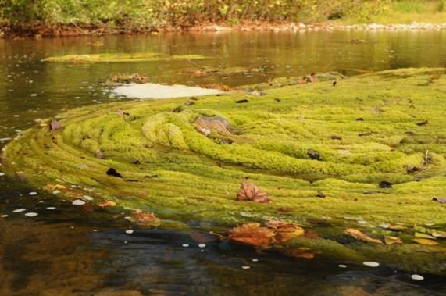
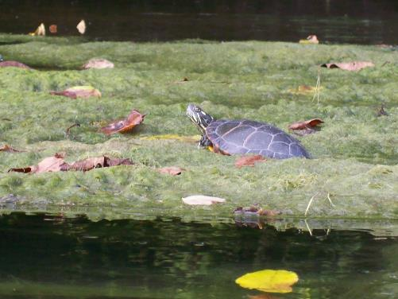
Citizens Complain about Algae
In 2015, the Shenandoah Riverkeeper and its parent organization, the Potomac Riverkeeper Network, sent a report to DEQ about persistent algae blooms in the Shenandoah River and tributaries.
126 people who used the river submitted written testimony and thousands of photographs and videos of algae in local waterways.
Algae interfere with the public’s ability to use the river for fishing, swimming, rafting, and boating.

Slide 10
Shenandoah Waters Exceeding Bacteria Standard for Recreation (235 cu/mL)
in 50% or More Samples, 2014-2016
Station ID | Map Key | Stream Name | Total Number of Samples | Number of Samples Over Standard | Percent of Samples Over Standard | Highest Value Measured (CFU/100 mL)
1BMDD005.81 | 36 | Muddy Creek | 60 | 49 | 82% | > 24,196
1BLNV006.49 | 32 | Linville Creek | 36 | 27 | 75% | 24,196
1BWSB000.22 | 1 | Wheat Spring Branch | 18 | 13 | 72% | 3,130
1BCST012.32 | 53 | Christians Creek | 24 | 17 | 71% | 1,670
1BBON000.60 | 37 | Boone Run | 18 | 12 | 67% | 3,654
1BLOM001.45 | 29 | Long Meadow | 12 | 8 | 67% | 12,033
1BMDL060.48 | 52 | Middle River | 36 | 24 | 67% | 8,664
1BNKD000.80 | 47 | Naked Creek | 24 | 16 | 67% | 7,701
1BDFK000.76 | 34 | Dry Fork | 36 | 23 | 64% | > 24,196
1BFNT002.16 | 17 | Flint Run | 36 | 23 | 64% | 6,867
1BSMT023.18 | 31 | Smith Creek | 36 | 23 | 64% | 3,255
1BCST021.76 | 57 | Christians Creek | 24 | 15 | 63% | 1,354
1BMDD000.40 | 38 | Muddy Creek | 18 | 10 | 56% | 15,531
1BPGE000.09 | 6 | Page Brook | 35 | 18 | 51% | 1,860
1BLNV001.22 | 30 | Linville Creek | 36 | 18 | 50% | 11,199
1BMLC000.40 | 24 | Mill Creek | 24 | 12 | 50% | 1,723
1BNPC000.02 | 18 | Narrow Passage Creek | 18 | 9 | 50% | 4,884
1BSTH041.68 | 58 | South River | 36 | 18 | 50% | 11,199
1BWAR003.88 | 33 | War Branch | 36 | 18 | 50% | 2,755
Note: A waterway exceeds Virginia’s recreational water quality standard for E. coli when more than 10 percent of samples in an assessment period exceed 235 “colony forming units” of E.coli per 100 milliliters of water (235 CFU/100 mL). The sampling stations listed in this table exceeded that standard more frequently, with 50 percent of samples or more containing at least 235 CFU/100 ml. Use the map key to find locations on the next page (Figure 4).

Slide 11
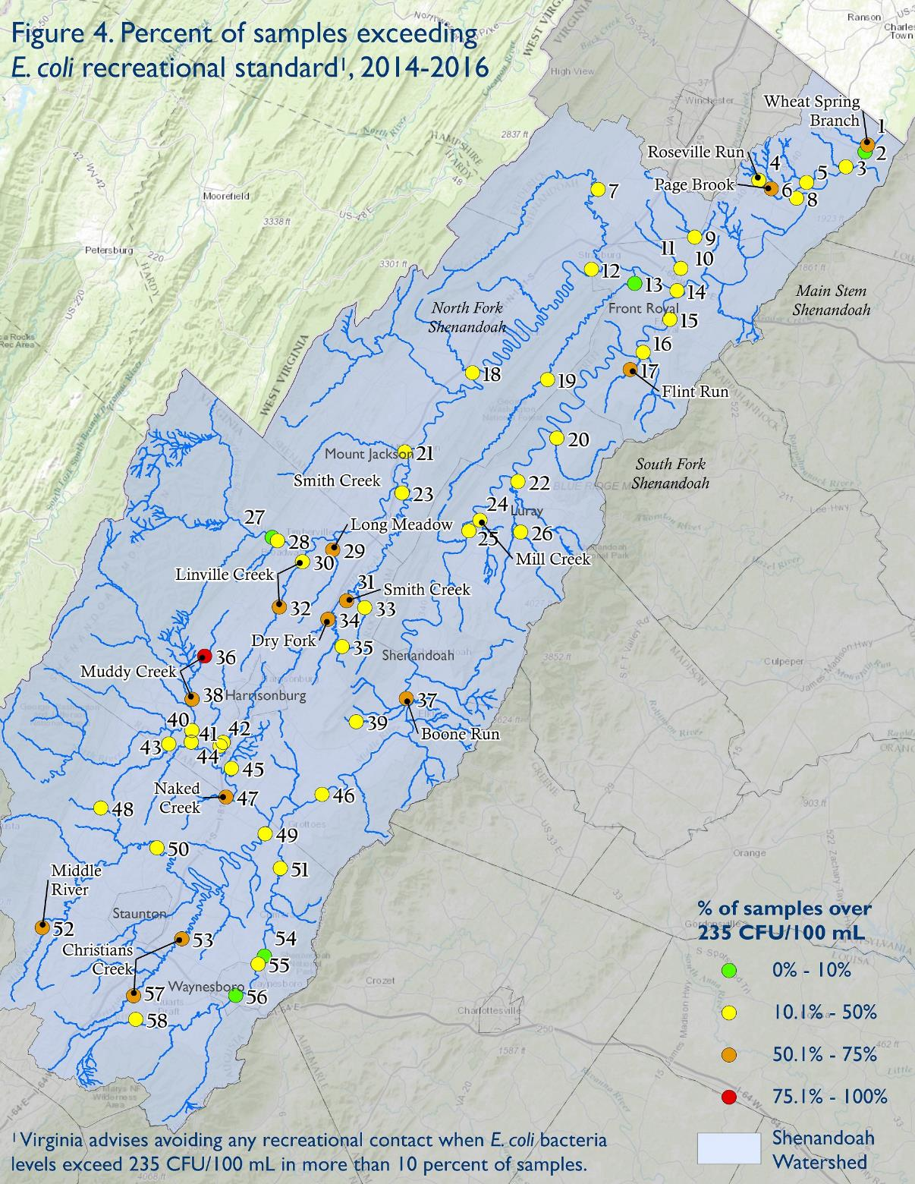
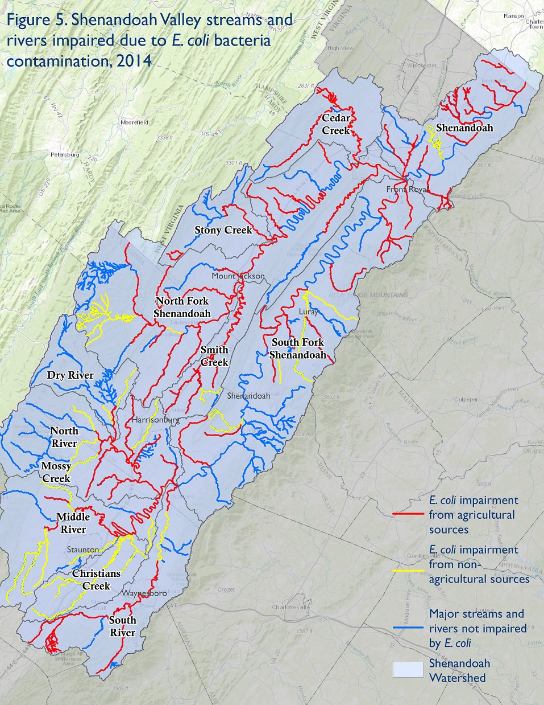

Slide 12
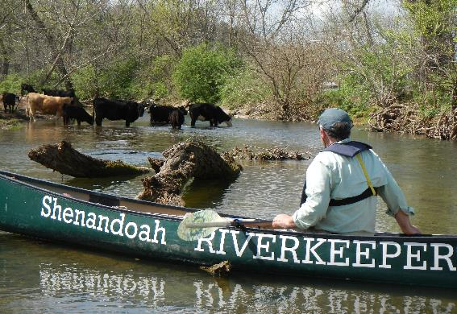
Unfenced Cattle Herds
Cattle roaming in streams can contribute to bacteria pollution
The State’s plan to clean up its waterways and restore the Chesapeake Bay includes fencing cattle out of waterways on 95 percent of the state’s farms.
State subsidies for fencing cattle out of waterways have dried up.
No statewide data are available about the percentage of farms that fence cattle out of streams.
Shenandoah Riverkeeper documented that in Rockingham County, only about 20 percent of the 841 farms with livestock near waterways actually fence their cows out of rivers and streams.

Slide 13
Where does exported manure go?
Poultry Waste Transferred Off-Site:
Augusta, Page, Rockingham, and Shenandoah Counties, 2013-2015
Waste Transfer Destination | Pounds of Phosphorus Transferred Off-Site | Percent of Total Transferred
Within the four-county area | 4,570,885 | 56.2%
Other counties in the Shenandoah watershed | 59,218 | 0.7%
Outside of Shenandoah Watershed but within Virginia | 566,865 | 7.0%
Out of state (West Virginia, Ohio, Kentucky) | 73,899 | 0.9%
To brokers or unknown destinations | 2,857,021 | 35.2%
Total Phosphorus from Poultry Litter Transferred between 2013 and 2015 | 8,127,887

Slide 14
NMP Phosphorus Limits By Crop Acreage
County | Total Crop and Pastureland (2012) | Acres Covered by Permitted Factory Farm NMPs | Permitted Acres with Phosphorus Limits | Percent of Crop and Pastureland with Phosphorus Limits
Augusta | 207,605 | 25,700.8 | 3,726 | 1.8%
Page | 55,795 | 6,904.1 | 1,425 | 2.6%
Rockingham | 176,917 | 28,436.9 | 12,707 | 7.2%
Shenandoah | 99,638 | 6,260.7 | 1,437 | 1.4%
Total | 539,955 | 67,302.5 | 19,295 | 3.6%
Source: Acres of crop and pastureland are from table 8 of the 2012 USDA Census of Agriculture. Acres with phosphorus limits are from a review of 316 nutrient management plans from large livestock operations.

Slide 15
Recommendations
Require NMPs for all farms that spread manure, not just large poultry or animal operations.
Document and verify actual yields and nutrient application rates.
Ship manure to regions with phosphorus-poor soil. Large integrators should share cost, but rely on public financing if needed.
Fence cattle out of waterways.
Increase bacteria monitoring and warn the public when levels make water unsafe for recreation.
List the Shenandoah as impaired by algae to accelerate work to curb nutrient pollution from agriculture and intensive livestock and poultry operations.

