Slide 1
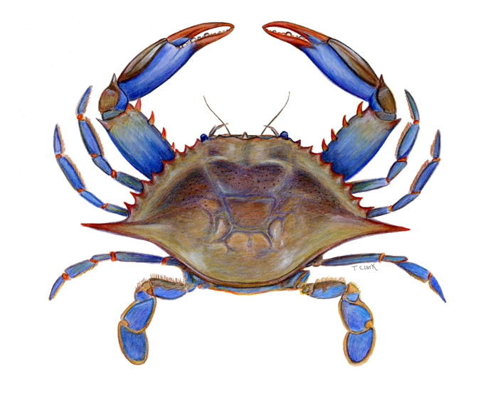

An Operating Model for Chesapeake Bay Blue Crabs
Michael Wilberg, Dong Liang, and Tom Miller
Chesapeake Biological Laboratory
University of Maryland Center for Environmental Science

Slide 2
Framework
Length-structured data generating model (operating model)
Stock assessment model (estimation model)
Operating
Model
Observation
Simulated
data
Estimation
Assessment
model
process
process
Known values
?
=
Estimated
values

Slide 3

Operating model: length-structured models
Many organisms are difficult to age – crustaceans, molluscs
Size- or stage-based models have been developed
  Including the most recent assessment model for blue crab
Stage-based models provide only a coarse description of the population (2-3 stages), and typically operate on annual time steps, which does not reflect the management tools used (small changes in minimum size and seasonal closures)
Length-structured models can track changes in small size classes (~5 mm), and at shorter time scales (months) to provide more resolved descriptions of the population dynamics.
These models can also be used to simulate population dynamics and data sets – serving as an operating model
Length-structured stock assessment approaches have been developed (Sullivan et al. 1990; Punt 2013; Cao et al. 2017)

Slide 4
Multiple survey and fisheries data to inform the operation model.
Maryland Department of Natural Resources
  Blue Crab Winter Dredge Survey
  Blue Crab Summer Trawl Survey
  Blue Crab Harvest Reports
Virginia Institute of Marine Science
  Blue Crab Winter Dredge Survey
  Juvenile Fish and Blue Crab Trawl Survey
  Chesapeake Bay Multispecies Monitoring and Assessment Program
Virginia Marine Resources Commission
  Blue Crab Harvest Reports
Potomac River Fisheries Commission
  Blue Crab Harvest Reports

Slide 5
Operating model processes
Growth
Maturation (for females)
Fishing mortality
Natural mortality
Recruitment

Slide 6
Operating model - Growth
Growth follows a stochastic increment von Bertalannfy growth model
K is proportional to the cumulative growing degree days (GDD) during a month (K_{m} = kp·GDD_{m})
L∞ constant over time and same for both sexes
Normally distributed growth increment with a variance calculated using variance of L ∞, K and their correlation (formulation from Cao et al. 2017)
Females stop growing when they mature

Slide 7
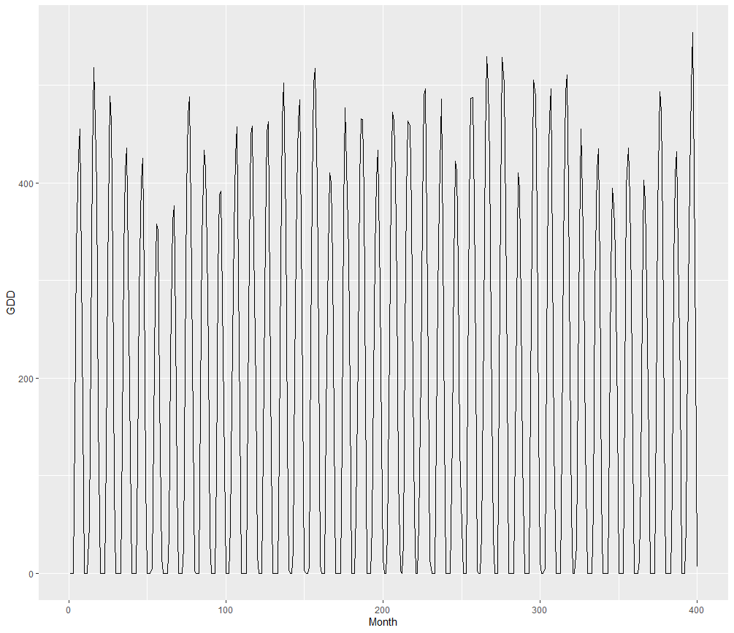
Operating model-Growing degree days
Temperature using a sin function with AR(1) errors

Slide 8
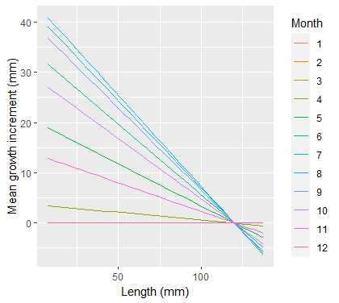
Operating model –
Mean growth
Stochastic von Bertalanffy growth model
Normally distributed growth increment with a variance calculated using variance of L ∞, K and their correlation (formulation from Cao et al. 2017)

Slide 9
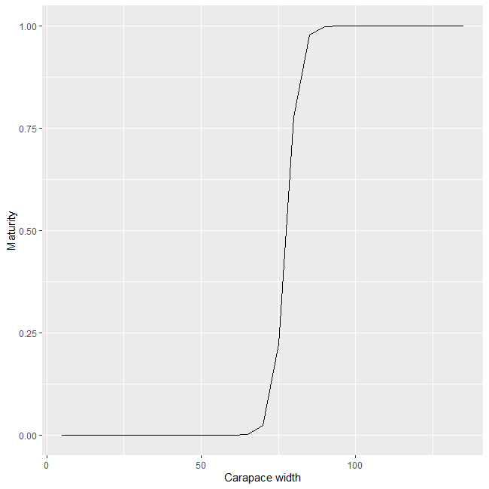
Operating model –
Female maturity
Female maturity follows a logistic function (Bunnell & Miller 2006)

Slide 10
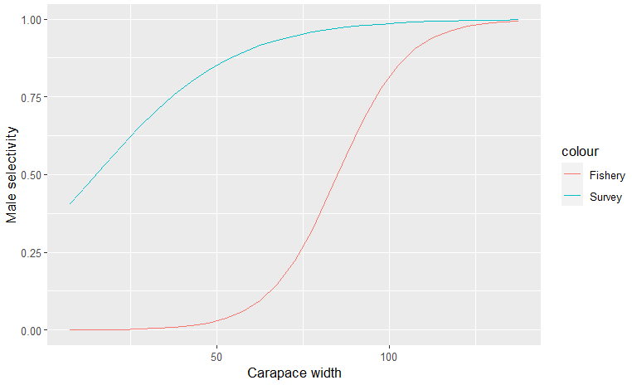
Operating model -
Recruitment and
Selectivity
Recruitment in months 5-10 (0 in other months)
  Lognormal recruitment each month with a median = 2000 and SD = 0.45
  Currently no stock-recruitment function
Logistic fishery and survey selectivity

Slide 11
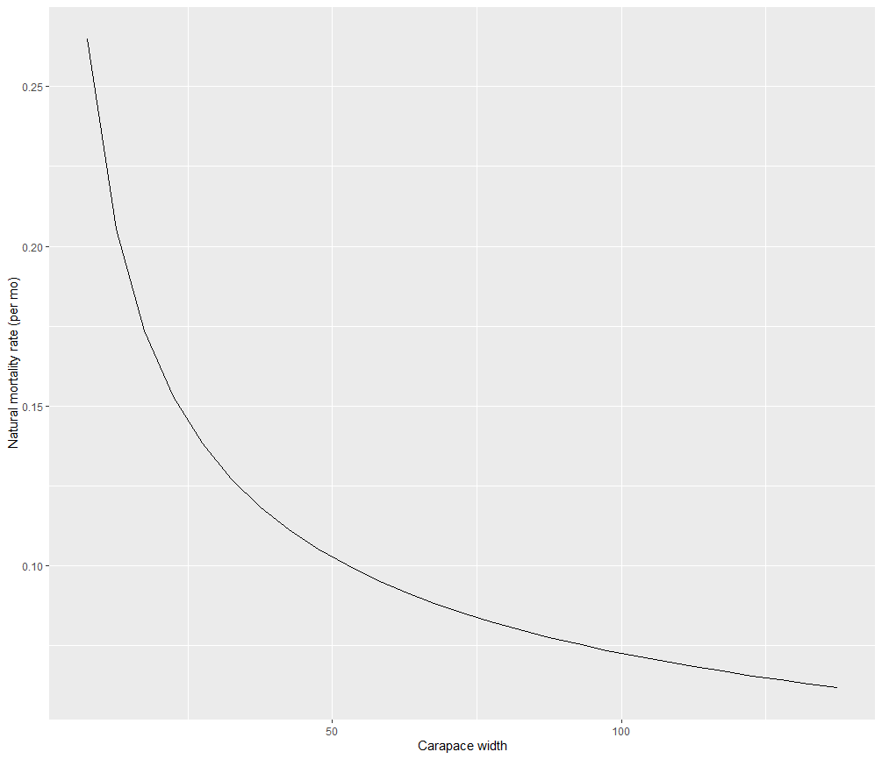
Operating model - Mortality
Natural mortality (0.075/mo) and fishing mortality (0.0875/mo)

Slide 12
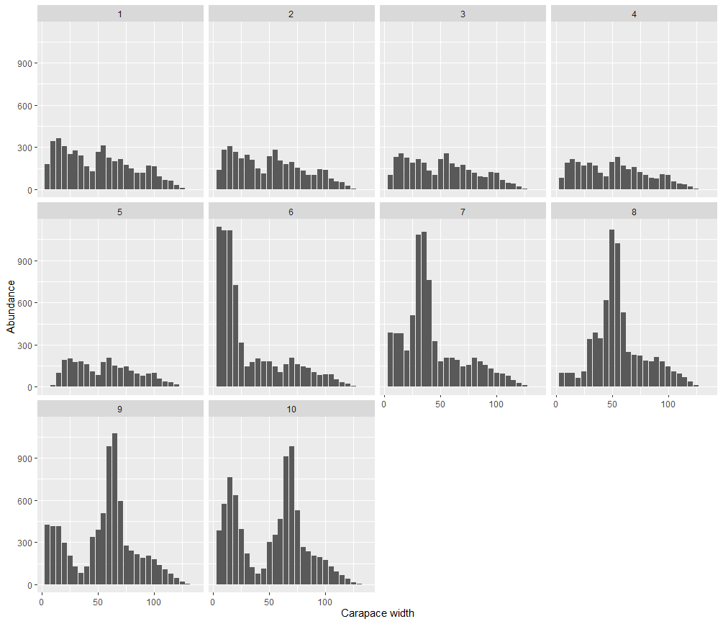
Population over time (males)

Slide 13
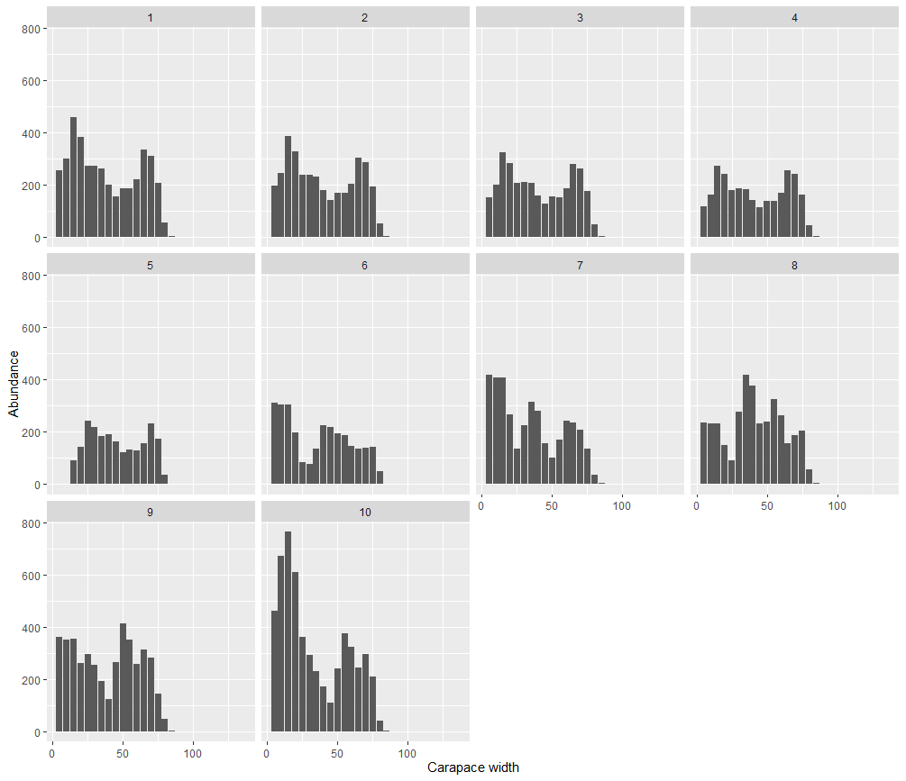
Population over time (immature females)

Slide 14
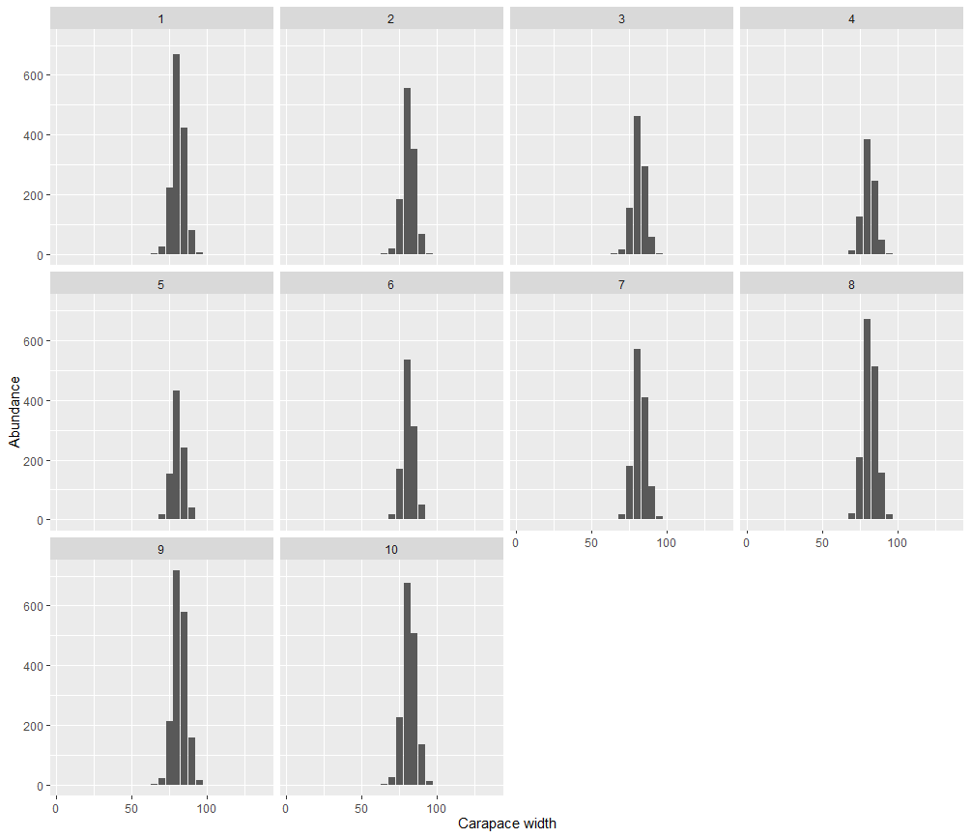
Population over time (mature females)

Slide 15
Observation process
Observation error was applied to the catch and index for each month and the catch and index proportions at length each month
Fishery catch- length composition
  Lognormal catch errors: CV = 10%
Surveys – length composition
  Lognormal index errors: CV = 30%
Multinomial proportions at length: effective sample size = 250
Simulated 20 data sets for 3 years with 10 months/year (30 time steps)

Slide 16
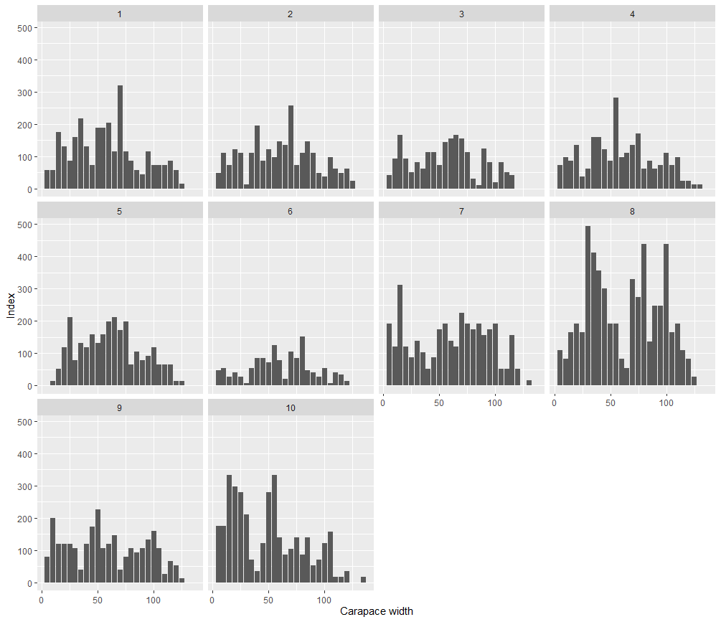
Simulation survey observations

Slide 17
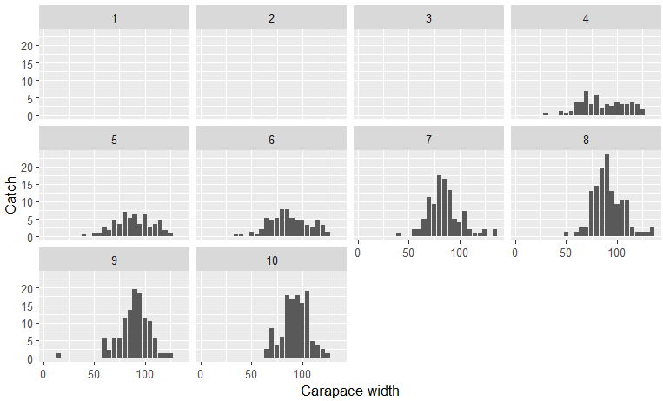
Catch over time (males)

Slide 18
Conclusions and next steps
When the estimation model is correctly specified, the estimates are approximately unbiased, which is promising for the upcoming assessment
  A population simulation model will be built based on the available data to ensure reasonable out-of-sample indices of abundance with reasonable prediction and accuracy.
Further development of the operating model
  Add spatial structure for blue crabs
  Add stock-recruitment function (and juvenile density dependent mortality?)
  Additional stochastic variation in growth and natural mortality
Conduct experiments with the operation model to test the current stock assessment model performance.

Slide 19
Acknowledgments
Funding
  Chesapeake Bay Trust
Collaborators
  Blue crab simulation model steering committee

