Slide 1
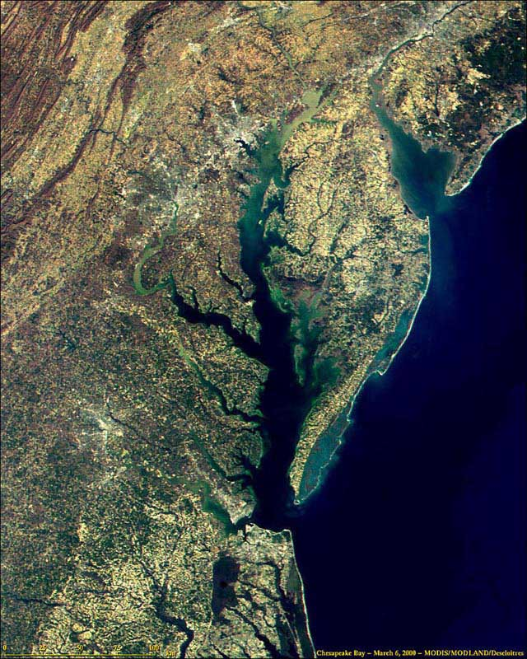
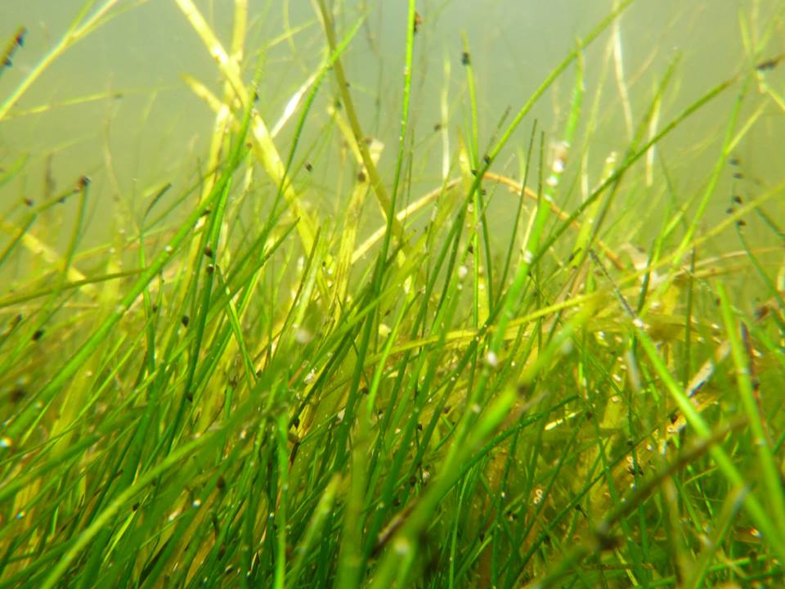

Chesapeake Bay
Alternative Strategies for Monitoring SAV in
David J. Wilcox, Robert J. Orth

Slide 2
Objectives
Annual distribution, abundance, & trends of SAV in:
  Chesapeake Bay
  Maryland
  Virginia
  Washington, DC
  Individual tributaries
  At local sites

Slide 3
SAV Survey Design Options
Continue monitoring program as is
As is + explore semi-automated classification
As is + explore fully-automated classification
Collect annual imagery, map every other year
Collect annual imagery, map large areas + subset
Collect annual imagery, map statistical subset
Collect annual imagery, map Bay in sections over 3-4 years
Collect selected imagery to support statistical sample
Use satellite imagery either for full or part of the Bay annually or every other year
Use drones and volunteers either for full or part of the Bay annually or every other year
Use ground survey only
Discontinue the SAV survey

Slide 4
1: Continue monitoring program as is
Pros: In addition to seamlessly continuing the long-term dataset, automation could result in cost savings due to reduced staff time.
Cons: The cost of aerial acquisition of the full Bay and technical staffing time would continue to need to be covered.
Feasibility: High with sufficient funding
Cost: $720K

Slide 5
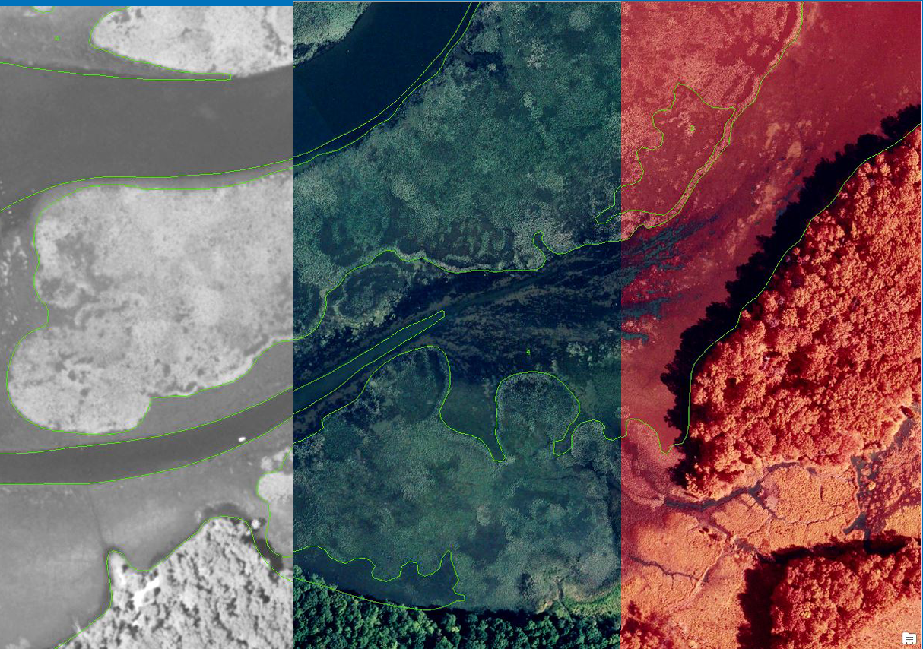
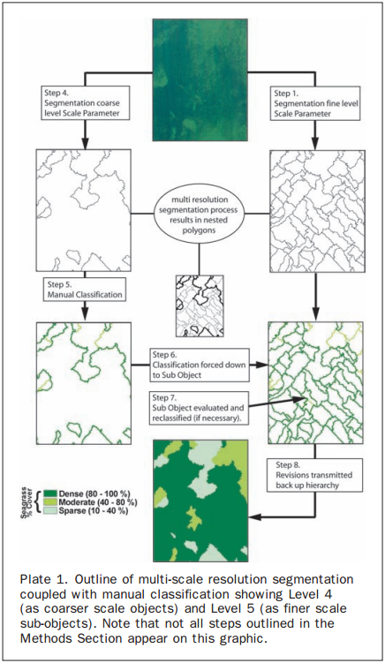
2: As is + explore semi-automated classification
Lathrop et all 2006

Slide 6
2: As is + explore semi-automated classification
Pros: In addition to seamlessly continuing the long-term dataset, automation could result in cost savings due to reduced staff time.
Cons: Would require an up-front investment to do the development work and set up all the classification routines.
Feasibility: Medium high with sufficient funding
Cost: $745K 1st year
$620K remaining years

Slide 7
3: As is + explore fully-automated classification
Pros: In addition to seamlessly continuing the long-term dataset, full automation could result in additional cost savings due to further reduced staff time.
Cons: Would require a larger up-front investment to do the development work and set up all the classification routines. There are no known programs using fully-automated classification at this point.
Feasibility: Medium low with sufficient funding
Cost: $770K 1st year
$520K remaining years

Slide 8

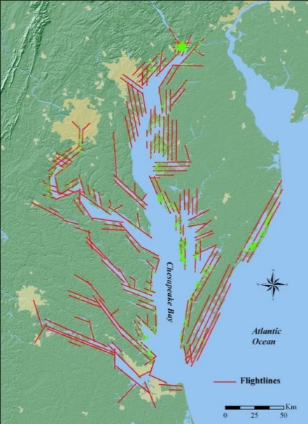
4: Collect annual imagery, map every other year
No SAV
Data
Mapped
No SAV
Data
Mapped
2017
2018
2019
2020

Slide 9
4: Collect annual imagery, map every other year
Pros: This scenario would allow for a reduction in staff or staff time, resulting in decreased expense. Annual imagery would still be collected, maintaining VIMS’ relationship with flight contractors (Air Photographics) and likelihood of maintaining reasonable rates for flight lines and imagery collection.
Cons: This scenario presents challenges with staffing as well as continuity of data availability. Review and permitting processes could be interrupted, delayed, or otherwise made more difficult.
Feasibility: High
Cost: $620k

Slide 10
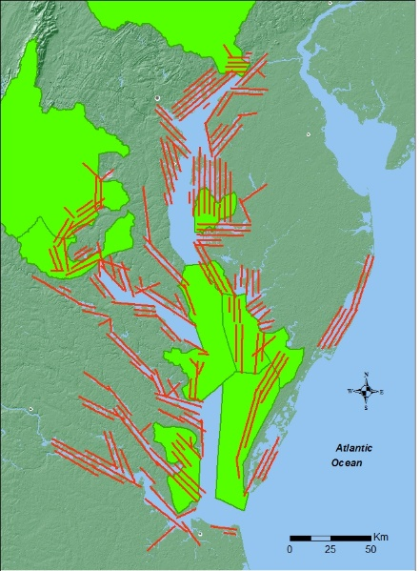
5: Collect annual imagery, map large areas + subset
2017
2018
2019
2020

Slide 11
5: Collect annual imagery, map large areas + subset
Pros: This scenario could potentially reduce staffing, save time, and decrease expenses.
Cons: There would be no actual bay-wide total or segment totals reported to determine how close we are to reaching our SAV acreage goals. Errors in the bay-wide total based on these areas could exceed the amount of annual change in SAV in the Bay.
Feasibility: High
Cost: $570K

Slide 12
6: Collect annual imagery, map statistical subset
Pros: By reducing the area that needs to be processed and analyzed, staff time and expense would be reduced. A sound statistical design should improve estimate accuracy.
Cons: There would be no actual bay-wide total or segment totals reported to determine how close we are to reaching our SAV acreage goals. The amount of area that would need to be mapped could be fairly large to achieve the desired accuracy.
Feasibility: High
Cost: $745K 1st year
$620K remaining years

Slide 13
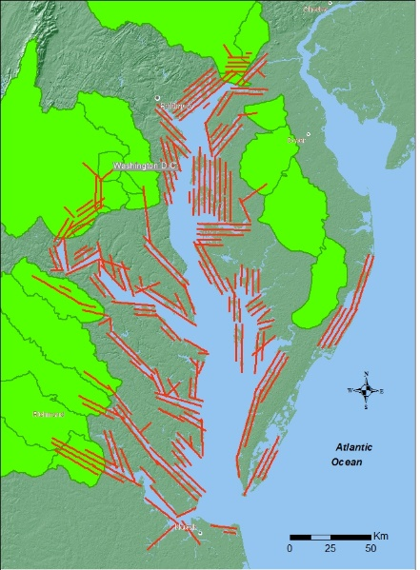
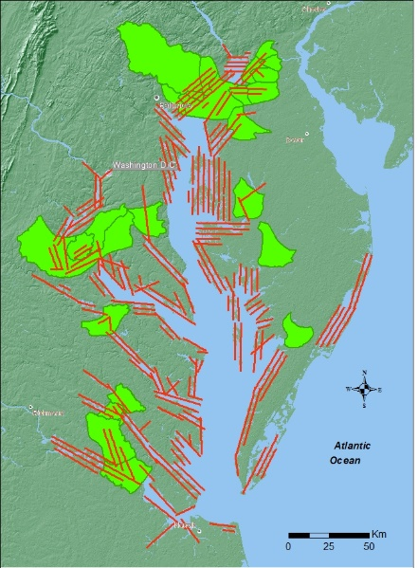
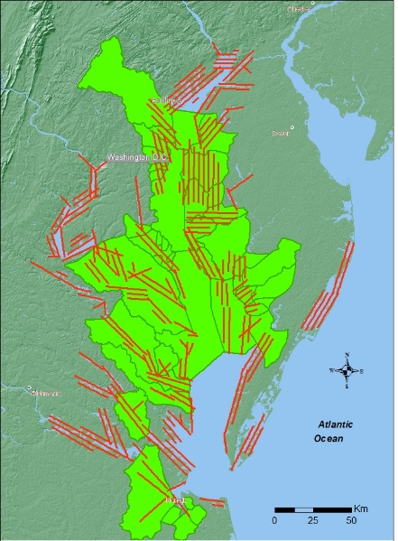
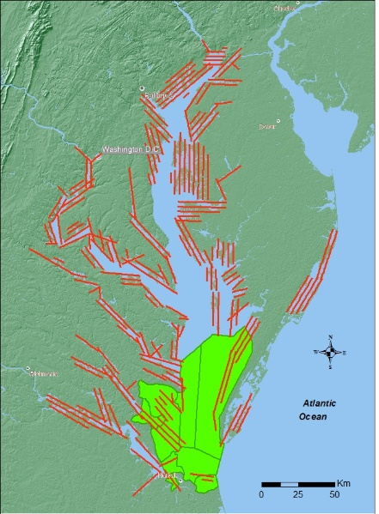
7: Collect annual imagery, map Bay in sections over 3-4 years
2017
2018
2019
2020

Slide 14
7: Collect annual imagery, map Bay in sections over 3-4 years
Pros: This maintains the bay-wide collection of annual imagery, but reduces staff time by decreasing the amount of imagery processed and analyzed. It also gives a complete picture of an entire salinity zone or region, rather than an estimate based on randomly selected sub-samples.
Cons: There would be no actual bay-wide total or segment totals reported to determine how close we are to reaching our SAV acreage goals. Annual detail would be lost sacrificing continuity.
Feasibility: High
Cost: $470K

Slide 15
8: Collect selected imagery to support statistical sample
Partial
Partial
Partial
Partial
2017
2018
2019
2020

Slide 16
8: Collect selected imagery to support statistical sample
Pros: Reduced cost for imagery collection and reduced staff time for processing.
Cons: There would be no actual bay-wide total or segment totals reported to determine how close we are to reaching our SAV acreage goals. A complete data set would not be available for future analysis should the need or opportunity arise.
Feasibility: High
Cost: $745K 1st year
$600K remaining years

Slide 17
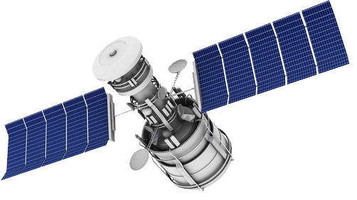
9: Use satellite imagery either for full or part of the Bay annually or every other year
Provider | Satellite | Pan Resolution | Mulispectral Resolution | Repeat cycle | Price per sq mile
GeoEye | GeoEye-1 | 0.46 | 1.84 | 8.3 days
DigitalGlobe | Worldview-2 | 0.46 | 1.84 | 4-5 days
DigitalGlobe | Worldview-3 | 0.31 | 1.24 | 4-5 days | $22.50
DigitalGlobe | Worldview-4 | 0.31 | 1.24 | 4-5 days
CNES | SPOT 6 | 1.5 | 6 | 26 days
CNES | SPOT 7 | 1.5 | 6 | 26 days
CNES | Pléiades 1A | 0.5 | 2 | 26 days
CNES | Pléiades 1B | 0.5 | 2 | 26 days
EROS | EROS A | 2 |  | 3-6 days | $0.50
EROS | EROS A | 0.7 |  | 3-6 days | $6.00
Planet Labs | RapidEye |  | 6.5 | 1 day | $1.28
5870 square miles to cover = $132,089 (Worldview-3) single attempt
ROUGH ESTIMATE

Slide 18
9: Use satellite imagery either for full or part of the Bay annually or every other year
Pros: This scenario eliminates the expense of the aerial contractor and produces a total SAV acreage annually.
Cons: Depending on the source, the satellite imagery could cost more than the aerial imagery. Additionally, existing high resolution satellite imagery is about a quarter of the resolution of current SAV aerial imagery. There may be additional unknown acquisition constraints.
Feasibility: Medium
Cost: $727K

Slide 19
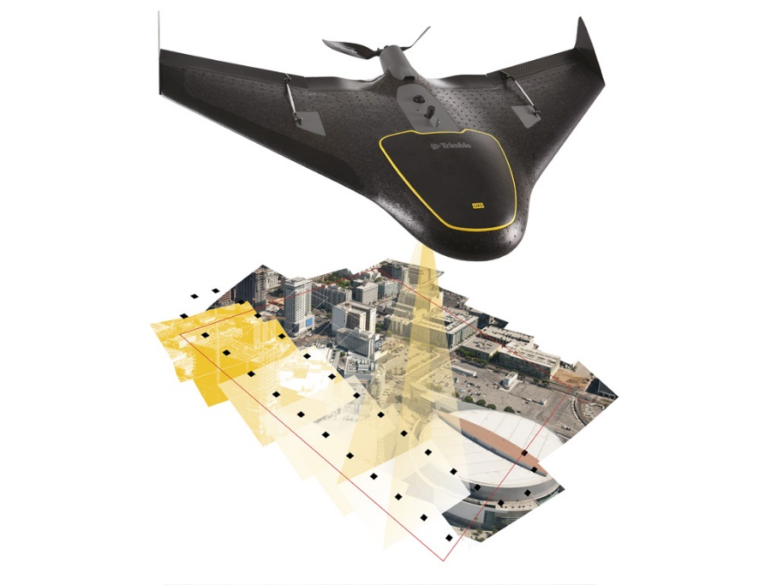
10: Use drones and volunteers either for full or part of the Bay annually or every other year
~3 mins per acre
5,870 sq. miles = 3.76 million acres
~ 21,000 hours
Tide and sun window is ~4 hours/day
~5,200 days to acquire the Bay

Slide 20
10: Use drones and volunteers either for full or part of the Bay annually or every other year
Pros: The use of drones permits acquisition of aerial imagery under a larger variety of conditions. A large number of volunteers would be engaged in monitoring the Bay.
Cons: This would require a tremendous coordination effort, training, and start up expense. Drones and drone operator training would be necessary. It is unlikely that the entire Bay and all its tributaries would be covered in a single season (requiring approximately 5000 days of flying); therefore determining how close we are to reaching our SAV acreage goals would be challenging.
Feasibility: Low
Cost: $680K

Slide 21
11: Use ground survey only
Pros: Species diversity data could be collected while mapping, which would improve our knowledge of SAV species distribution around the Bay.
Cons: This would require a tremendous coordination effort, start up expense, and training. The likelihood of creating a complete bay-wide SAV map would be minimal and therefore SAV goal tracking would be difficult.
Feasibility: Low
Cost: $300K

Slide 22
12: Discontinue the SAV survey
Pros: Potentially will save money if SAV monitoring by others is done on a significantly limited basis.
Cons: Bay-wide SAV data would no longer be available. Reaching our bay-wide SAV acreage goal of 185,000 acres would become impossible to determine, and consequently the Bay would never be de-listed. The burden would shift from VIMS to individual agencies, institutions, and organizations that do not have the financial, equipment, or staffing resources to collect their own data.
Feasibility: Low
Cost: Unknown

Slide 23
Ground Survey Design Options
Continue with the current design
Work with riverkeepers
Formal program with specific responsibilities
Discontinue current survey. Each organization collects just the data they need

Slide 24
1: Continue with the current design
Pros: There is a large network of individuals and organizations that currently contribute observations to the ground survey effort. They're familiar with the data requirements and logistics.
Cons: This "ad hoc" survey design lacks continuity from year to year and place to place. Some species are reported more frequently than others. There are spatially driven data gaps.
Feasibility: High
Cost: Unknown

Slide 25
2: Work with riverkeepers
Pros: This effort incorporates citizen scientists and volunteers into the SAV survey and monitoring process throughout the Bay, increasing environmental stewardship and SAV visibility as an essential habitat. It also provides more systematically collected species and abundance data as sampling strategies are designed uniquely for each tributary and organization participating.
Cons: Limited to participating organizations and funding availability, although some watershed groups are intitiating SAV Surveys without funding.
Feasibility: High
Cost: 10K/org setup
minimal to carry out

Slide 26
3: Formal program with specific responsibilities
Pros: This effort makes multiple types of groups responsible for the SAV survey and monitoring process throughout the Bay, increasing environmental stewardship and SAV visibility as an essential habitat. It also provides more systematically collected species and abundance data as sampling strategies are designed uniquely for each tributary and organization participating.
Cons: Limited to participating organizations and funding availability. Coordination of this scale of effort would also be difficult, but not impossible.
Feasibility: High, depending on
Outside participation
Cost: Cumulatively quite high but unknown - would vary by organization.

Slide 27
4: Discontinue current survey. Each organization collects just the data they need
Pros: Potentially will save money if SAV monitoring by others is done on a significantly limited basis.
Cons: Bay-wide SAV data would no longer be available. The burden would shift from VIMS to individual agencies, institutions, and organizations that do not have the financial, equipment, or staffing resources to collect their own data.
Feasibility: Low
Cost: Unknown

