Slide 1
Blue Crab Stock Assessment Status Update
Brooke Lowman
Sustainable Fisheries Goal Implementation Team
September 18, 2023
Annapolis, MD

Slide 2
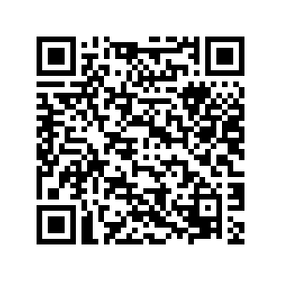
Progress
Fall 2022 – CBSAC Blue Crab Workshop (https://www.chesapeakebay.net/what/publications/2022-blue-crab-science-workshop-report)
Winter 2023 – subcommittee met to draft assessment Terms of Reference
Spring 2023 – subcommittee convened for preliminary assessment data workshop planning
Summer 2023 – jurisdictions drafted a Scope of Work document for the assessment team (funding from MD and VA administered as a contract through ASMFC)
Summer 2023 – solicitations for data to be presented at the fall 2023 assessment data workshop
Fall 2023 – contract awarded for lead assessment work group
Notes:
Scientists, managers, and stakeholders attended the blue crab workshop in fall 2022 to share insights, data streams, and hypotheses to help inform CBSAC’s research priorities.

Slide 3
Terms of Reference
TOR1: Critically review and estimate life history parameters and vital rates of blue crab in the Chesapeake Bay that are relevant to the stock assessment. In particular, the assessment should evaluate the extent and scale of interannual variation in life history parameters and vital rates of blue crab in the Chesapeake Bay.
TOR2: Describe and quantify patterns in fishery-independent surveys to develop indices of abundance and characterize the size composition of the population. Analyses should include:
A comprehensive evaluation of the utility of fishery-independent surveys to inform the stock assessment;
Consideration of index standardization which may include effects of environmental and abiotic factors on survey catches; and
Characterization of uncertainty in indices of abundance.

Slide 4
Terms of Reference
TOR3: Describe and quantify patterns in catch, effort, and CPUE. Analyses should include:
Estimation of catch and effort for each jurisdiction;
Evaluation of the utility of a commercial CPUE index in the assessment;
Examination of the impacts of reporting changes and trends in CPUE;
Evaluation and quantification of bycatch and/or discard mortality, and recreational harvest using available data from the jurisdictions; and
Characterization of uncertainty in the data.
TOR4: Evaluate the feasibility of, and if possible implement, blue crab stock assessment models that operate on sub-annual time steps and/or at spatial resolutions lower than that of the entire Chesapeake Bay to better represent population dynamics.

Slide 5
Terms of Reference
TOR 5: Characterize uncertainty in assessment estimates (mortality and abundance).
TOR 6: Update the sex-specific catch survey models used in the 2011 benchmark stock assessment with relevant new data. Characterize major changes in assumptions between the 2011 assessment model and the 2023 model.
TOR 7: Based on assessment model results recommend appropriate biological reference points for management. To extent possible, evaluate the appropriateness and utility of
Aggregate bay wide reference points
Sex specific reference points
Recruitment reference points

Slide 6
Terms of Reference
TOR 8: Evaluate stock status relative to recommended reference points.
TOR 9: Identify relevant ecosystem and climate influences (such as habitat, environmental drivers, prey availability, and predation/cannibalism) on the population dynamics and fisheries and, to the extent possible, explore other analyses that support the assessment.
TOR 10: Identify existing data sources and gaps, and, to the extent possible, characterize the uncertainty in the relevant sources of data.
TOR 11: Report on the status of research recommendations from the most recent benchmark assessment. Identify and prioritize research recommendations for future work.

Slide 7
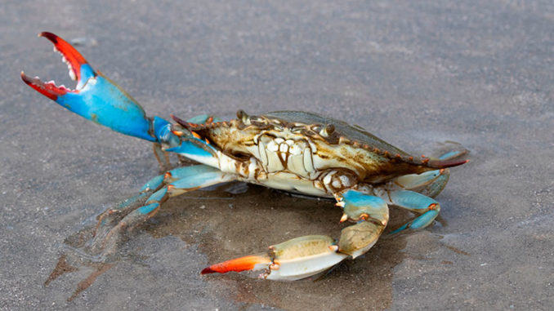
Looking forward…
Data Workshop - late fall 2023
Presentation of available data sources
Identification of potential uses
Methods Workshop – spring 2024
Assessment Workshop – winter 2025
Peer Review – early summer 2025
Final Report – late summer 2025
https://www.shutterstock.com/image-photo/blue-crab-callinectes-sapidus-close-texas-1718076880

