Slide 1
Integrating Marine Heatwave Information to Indicate Potential Impacts to Fisheries
Sustainable Fisheries Goal Implementation Team Summer Meeting September 18th, 2023
Jamileh Soueidan, CRC
jamileh.soueidan@noaa.gov
Acknowledgements: Julie Reichert-Nguyen, NOAA Chesapeake Bay Office, and Emily O’Keefe, CRC-NOAA Intern
Notes:
Hello all! My name is Jamileh Soueidan. I am an environmental management staffer with the Chesapeake Research Consortium and I support the Climate Resiliency Workgroup at the Chesapeake Bay Program. Today I will be sharing with you recent efforts by our team at the NOAA Chesapeake Bay Office, which have focused on how we can integrate fisheries and fish habitat considerations into marine heatwave analyses to better understand how these extreme events are impacting fisheries in the Bay. These efforts have included interviews with marine heatwave and fisheries researchers and scoping out a methodology for detecting marine heatwaves in the data from our Chesapeake Bay Interpretive Buoy System (or CBIBS for short). I do want to acknowledge Julie Reichert-Nguyen with NCBO and Emily O’Keefe who was our summer intern; both have been integral to moving this effort forward.

Slide 2
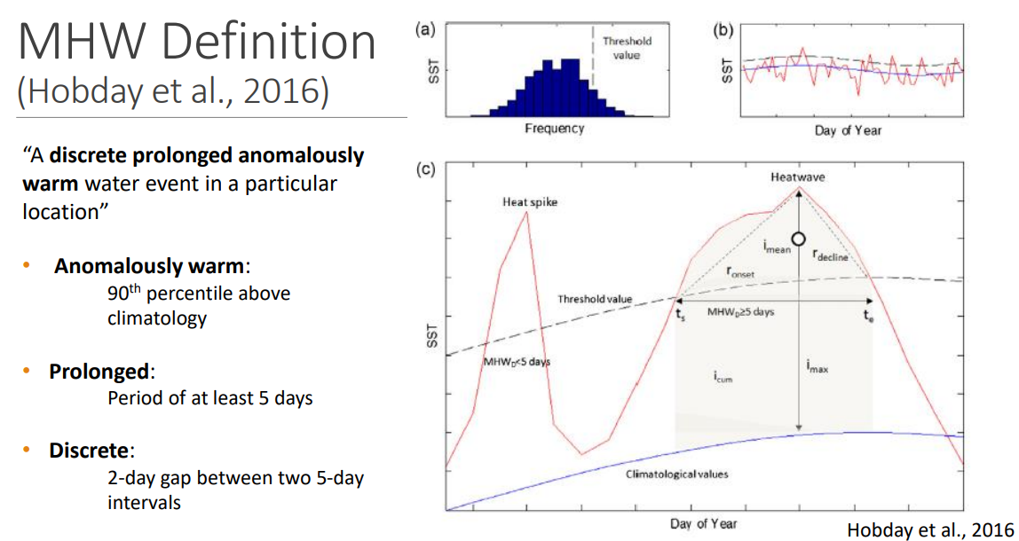
Common Definition in Scientific Literature
(slide from Shunk et al. presentation)
Notes:
So first I would like to start with “what is a marine heatwave.” The common definition states that it is a discrete prolonged anomalously warm water event in a particular location. More specifically, the Hobday et al. definition, which is defines anomalously warm as at or above the 90th percentile for the climatology of the region, prolonged as at last 5 days, and discrete meaning there must be more than two days between the events to count as separate heatwaves.
Shunk Presentation: https://d18lev1ok5leia.cloudfront.net/chesapeakebay/documents/impact_of_marine_heatwaves_on_subsurface_hydrography_and.pdf

Slide 3
Common Marine Heatwave Descriptive Characteristics
Frequency: the number of marine heatwave events that occur every year.
Duration: the length of each individual marine heatwave, in days.
Intensity: how hot it is during the marine heatwave event (expressed as the maximum or average)
Cumulative Intensity: Integral of marine heatwave intensities over a time period (℃ x days) – combines magnitude and duration of heat anomalies
  Good indicator of thermal stress to ecosystem
Notes:
There are four main characteristics of marine heatwaves that we look at when examining these events. Frequency, or the number of marine heatwave events that occur every year, duration, or the length of individual events, intensity, or how hot it is during the event, and cumulative intensity, which is an integral of marine heatwave intensities over a period of time and combines the magnitude and duration of heat anomalies.
(integral of MHW intensities over a year, in °C × days), which is an index that combines both magnitude and duration of heat anomalies and perhaps one of the best indicators for thermal stress on many ecosystems

Slide 4
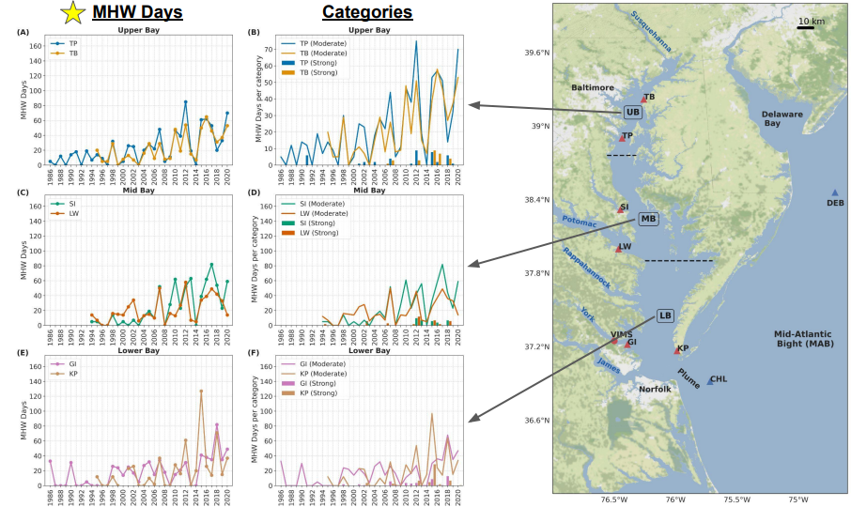
Chesapeake Bay Marine Heatwave Research: In situ data (Mazzini & Pianca 2022)
Significant long-term trends (1986-2020) were detected for MHW frequency, MHW days, and yearly cumulative intensity
If trends persist, by the end of the century the Chesapeake Bay will reach a semi-permanent MHW state, when extreme temperatures will be present over half of the year.
Notes:
Now there has been some really great research conducted recently in the Bay to characterize surface heatwaves in the Bay using the common definition that I reviewed earlier. This study, published in 2022, found that there are significant increasing trends from 1986 to 2020 for marine heatwave frequency, number of days, and yearly cumulative intensity. They concluded in the paper that if these trends persist, that the Bay will reach a semi permanent marine heatwave state, with extreme temperatures present for over half of the year.
Mazzini presentation:https://d18lev1ok5leia.cloudfront.net/chesapeakebay/documents/marine_heatwaves_in_the_chesapeake_bay_-_piero_mazzini_vims_and.pdf
Mazzini & Pianca 2022: Marine Heatwaves in Chesapeake Bay https://www.frontiersin.org/articles/10.3389/fmars.2021.750265/full
According to Hobday et al. (2018), multiples of the 90th percentile difference from the mean climatology define each of the following categories: 1-2x: Moderate; 2-3x: Strong; 3-4x: Severe, and >4x: Extreme. In the present work no Extreme MHW days were detected, and only a single Severe day was found at CHL and DEB, thus when referring to categories, we will only report the Moderate and Strong days.

Slide 5
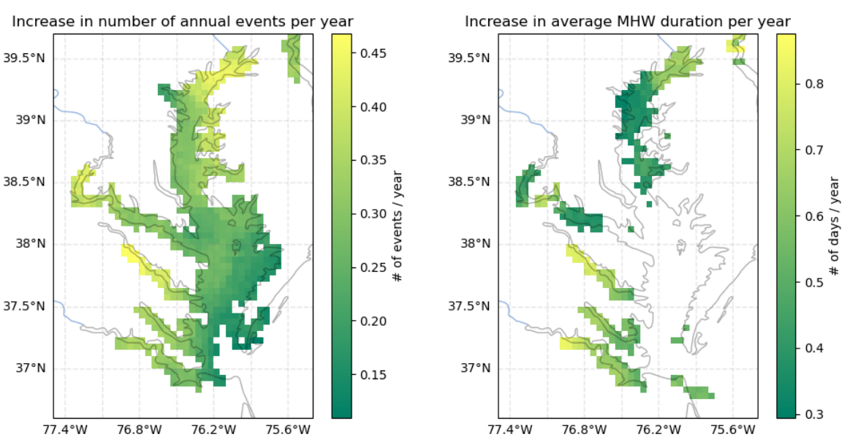
Chesapeake Bay Marine Heatwave Research: Satellite data (Wegener 2022)
Almost entire Bay has significant increases in the number of annual marine heatwave events (2002-2020).
Spatial structure indicates marine heatwave cumulative intensity driven by increases in duration (not max intensity).
Marine heatwave characteristic maps show significant spatial variation.
Satellite analysis consistent with buoy-wide analysis.
Notes:
This next study was conducted by Rachel Wegener as a part of her graduate research. This study identified marine heatwaves in the Bay using satellite data and found similar results as Mazzini and Pianca, where the Bay has experienced significant increases in the number of annual heatwave events over the past 20 years or so. She found that marine heatwave cumulative intensity was driven by increases in duration and maximum intensity. She also found that these characteristics maps of the events, show significant spatial variation throughout the Bay. Lastly, she found that the satellite analysis was consistent with the buoy-wide analysis.

Slide 6
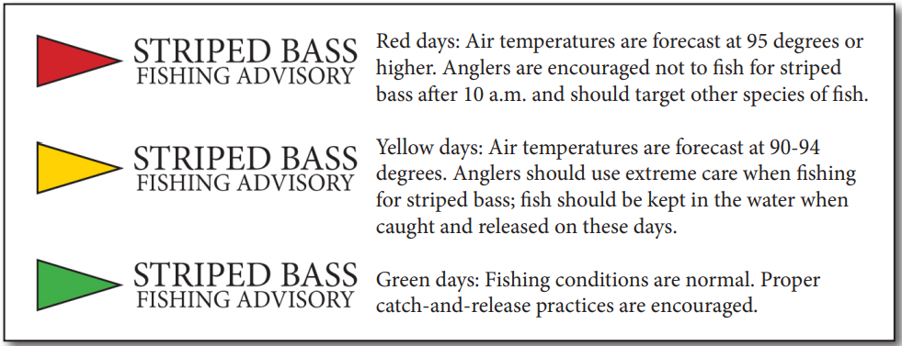
Stakeholder Interest - Recommendation from Rising Water Temperature Workshop
Convene an interdisciplinary team of scientists, resource managers, meteorologists, and communicators to design and create a publicly available marine heat wavealert system.
Connect alert system with habitat preferences of key species and guidance on fishing behavior. Consider incorporation of other key parameters (e.g., dissolved oxygen, salinity).
Example from Maryland Department of Natural Resources
Notes:
So, I wanted to touch quickly on the main driver behind this work. I presented on the STAC Rising Water Temperature Workshop at the last Fisheries GIT meeting; in this effort, participants developed five recommendations addressing four main themes, including Extreme Stressors. The recommendation that focused on extreme stressors stated that stakeholders were interested in convening an interdisciplinary team of scientists, resource managers, meteorologists, and communicators to design and create a publicly available marine heatwave alert system. They were interested in connecting this alert system with the habitat preferences and environmental thresholds of key species to inform fishing behavior, or when there might be tipping points for key species.
STAC Report: https://www.chesapeake.org/stac/document-library/rising-watershed-and-bay-water-temperatures-ecological-implications-and-management-responses/

Slide 7
Marine Heatwave Products
Marine Heatwave Analyses
Decide which Marine Heatwave Definition to utilize through meeting with experts
Determine and conduct analysis with available data
Address data limitations
Communication Products
Incorporation into NCBO Seasonal Summaries
Development of Marine Heatwave Fisheries Impact Indicator(s) - assess use on Chesapeake Progress
Roadmap
Incorporation of Marine Heatwave Forecasting
Incorporation of marine heatwave forecasting data and modeling into analyses
Development of Marine Heatwave Alert System
Building from the analyses and products, create a publicly available marine heatwave alert system linked to fisheries impacts
Notes:
So what have we been focusing on… our team has been creating building blocks or steps towards running marine heatwave analyses using our CBIBS data and determining how best to relate these analyses to fisheries impacts. This summer we have
And recently, we have been testing different marine heatwave analyses using the data from our CBIBS buoys as well as connecting with our satellite office to potentially tap into their data sources as well.
Finish script here

Slide 8
Marine Heatwave Analyses - Summer 2023 Efforts
Marine Heatwave Researchers | Fish Habitat / Environmental Condition Researchers
Vince Saba, Ryan Rykaczewski, Dillion Amaya, and Andrew Ross (NOAA) | Rachel Dixon, Mary Fabrizio, and Troy Tuckey (VIMS)
Ron Vogel (NOAA) and Rachel Wegener (UMD) – Satellite | Tom Parham and Jim Uphoff (MDNR)
Piero Mazzini, Nathan Shunk, Cassia Pianca (VIMS) | Yang Jiao (Virginia Tech)
Reviewed different marine heatwave definitions to inform analysis.
Conducted interviews with researchers to determine which marine heatwave characteristics would be most useful to connect with fish impacts.
Presented current efforts during Climate Resiliency Workgroup meeting with Fish Habitat Action Team for feedback and discussion.
Testing marine heatwave analysis with available continuous data
  NOAA Chesapeake Bay buoy and satellite data
Notes:
Over the summer at NCBO, we conducted an in depth review of the different definitions of marine heatwaves (one of which was the common definition I reviewed earlier), and then we held interviews with marine heatwave, environmental condition, and fish habitat researchers to understand how best to characterize marine heatwaves in connection with fish impacts. The folks we met with (listed on the right) work at different NOAA line offices, our NCBO satellite folks, as well as researchers from VIMS, Virginia Tech, University of Maryland and MD DNR. These conversations gave important insights and perspectives into how these different definitions could be used and how to connect this marine heatwave information to fishery impacts, either through utilizing environmental thresholds or habitat condition.
Ron: Warming climate, warming temps - living resources adapting or not being there - what do we hope to do from a management perspective. How will they use it? Example of Management - catch and release of striped bass; what other questions? - use intern; get input from stakeholders who use
Build information into seasonal summaries - retrospectively - what we know about marine heat waves this year; how good are the projections? - look at historical record to see what happened to the fisheries (review for different species)
DO monitoring - connections here

Slide 9
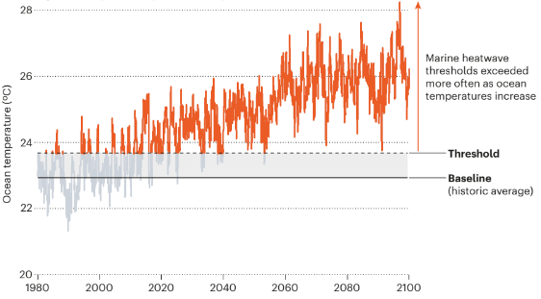
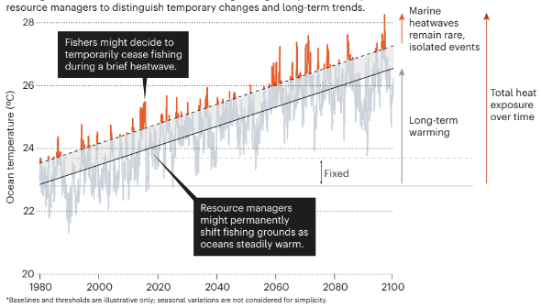
Marine Heatwave Definitions
(Amaya et al. 2023)
Fixed baseline - defining heat relative to historical temperature (includes long-term warming trend; currently used by climatology research community)
Shifting baseline - defining heat relative to increasing average temperatures (removes long-term warming trend; definition now being used in 2023 State of Ecosystem Report)
Notes:
So, as I mentioned on the last slide, there is more than one definition for marine heatwaves. The common definition I reviewed previously is this fixed baseline definition, which defined heatwaves relative to historical temperatures and it includes the long-term warming trend. Typically the fixed baseline threshold is set to include at least 30 years of data. As these trends continue, this is where we will see those constant or semi permanent marine heatwave conditions.
The next definition was developed by folks at NOAA’s Physical Sciences Laboratory and Northeast fishery science center. This definition utilizes a shifting baseline to define heatwaves relative to increasing average temperatures. They remove the long-term warming trend in the data, to truly examine the extremes of the extremes. They posit that this definition might provide management utility when trying to make short term decisions about certain species.

Slide 10
Feedback Highlights
Ideally, want 30-100 years to establish climatological trend, but can potentially use 15 years.
Both marine heatwave definitions have value depending on the fish impact question:
  Fixed baseline could indicate shifts in community structure – e.g., decrease in striped bass and increase in species from the south (e.g., red drum).
  Shifting baseline could indicate acute stress on present species in Bay (periods of higher vulnerability).
Indicator needs to be relatable to audience – plan more meetings with stakeholders to review and provide input during development process.
  E.g., communicating geographic location for MHW events
Marine heatwaves can happen throughout the year; this could have implications depending on the life stage of fish being evaluated.
Consideration of other extremes (e.g., cold snaps), which could have species-level impacts
Notes:
So, now I will just touch on a few key points we have heard through these interviews and through other conversations we have had with experts and the Climate Resiliency workgroup. Ideally, we would like ~30 to 100 years to establish a climatological trend. The CBIBS data that I mentioned earlier only has around 13 years of data. We heard from the interviews that both marine heatwave definitions have value in informing fisheries management depending on the question; the fixed baseline analysis could indicate long-term shifts in community structure, while the shifting baseline analysis could indicate acute stress on species present in the Bay. When considering indicator development, we discussed meeting with stakeholders to solicit input and insights (like this meeting today), to ensure they are relatable to target audiences and provide management utility. We heard at the Climate Resiliency Workgroup meeting that communicating geographic information about the marine heatwave events would have greater utility as communications directed at species specific fishing behavior is difficult in habitats where multiple species exist. Furthermore, it would be helpful to integrate information on future climatology from climate change scenarios to inform tipping points where Chesapeake Bay habitats will likely not be tolerable for a species of fish.
Ron: Warming climate, warming temps - living resources adapting or not being there - what do we hope to do from a management perspective. How will they use it? Example of Management - catch and release of striped bass; what other questions? - use intern; get input from stakeholders who use
Build information into seasonal summaries - retrospectively - what we know about marine heat waves this year; how good are the projections? - look at historical record to see what happened to the fisheries (review for different species)
DO monitoring - connections here

Slide 11
Feedback Highlights (continued)
Engage with physiologists to increase understanding of fish response to warming temperatures and extreme events; fill data gap on the adaptive response.
  E.g., understanding impacts of back to back MHW events above temperature threshold
Consideration for different types of thresholds that can be utilized; can be based on species physiology or habitat condition or a combination:
  Potential refinement of marine heatwave definition to relate better to fish – will likely vary by species.
  E.g., MDNR’s habitat suitability categories as proxy thresholds indicating habitat condition for striped bass.
Consider unintended consequences of effort:
  E.g., sharing habitat suitability preferences during extreme events shifting fishing behavior
Integrate information on future climatology from climate change scenarios to inform tipping points where Chesapeake Bay habitats will likely not be tolerable for a species of fish.
Exploring how efforts can inform resilience work, especially in targeting multi-tiered nature-based strategies to provide thermal refugia
Notes:
Continuing from the last slide, here are some more highlights from the discussions we have had over the past few months. First, we heard that we need to engage with physiologists to increase our understanding of the species specific response to these warming temperatures and extreme events; an example of this being the potential for cumulative stress on fish species caused by back-to-back MHW events. These conversations we had with these experts and during the CRWG meeting also highlighted the point that thresholds can be based on specific species physiology or habitat condition or even both and we can decide based on what would have the best management utility for decision-makers, an example of these thresholds could be the ones that Tom Parham presented on earlier for striped bass habitat condition. We should also re-evaluate whether the common definition of 90th percentile for 5 days captures the actual fish impacts. Other points we heard from these discussion include the fact that we need to be aware of these extreme events throughout the year (not just in the summer). Heatwaves or cold snaps during other seasons has the potential to impact these key species depending on their life stage. We also heard a word of caution from these discussions to consider the unintended consequences; how we communicate information on habitat condition and preferences of these key species has the potential to influence where anglers or fishing, potentially resulting in a more targeted fishing efforts. And lastly, there were robust discussions around how this work can inform resilience-building efforts, especially in how we can target multi-tiered nature-based strategies to provide thermal refugia.
Potentially not use 90th percentile method; use tercile method (below average, average, above average); use same script method (66th %tile or 33rd %tile)

Slide 12
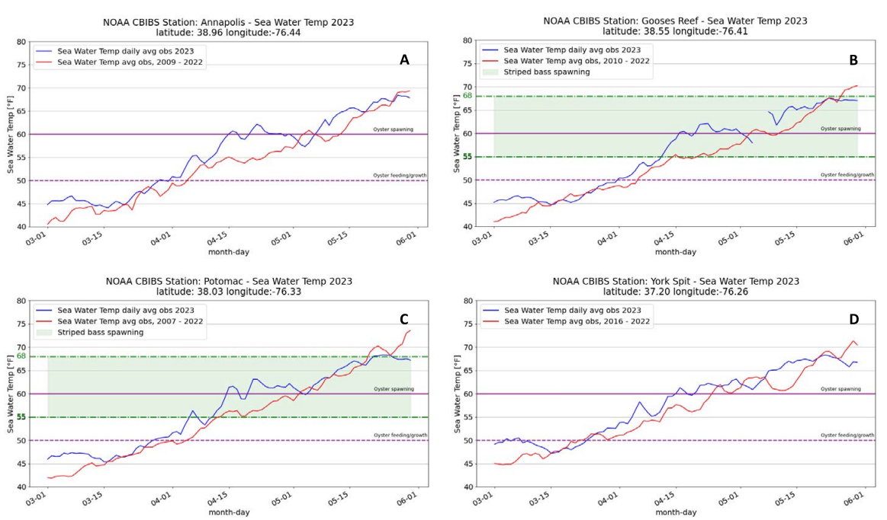
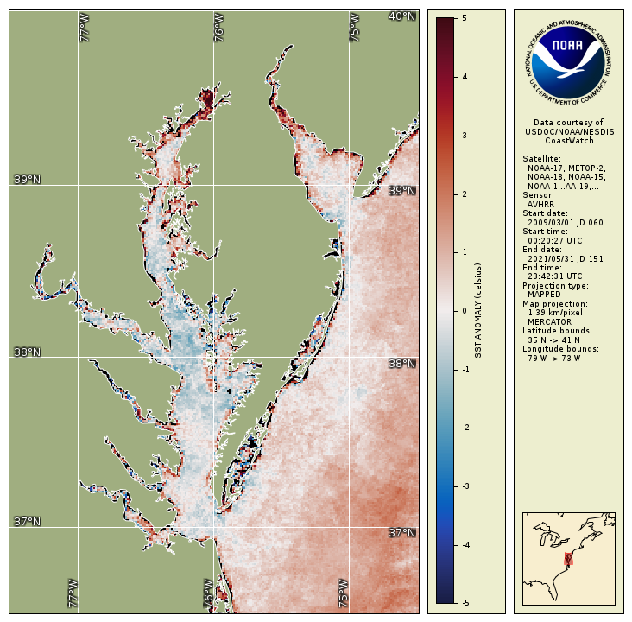
NOAA Chesapeake Bay Seasonal Summaries
Quarterly reports using existing environmental observational data to craft narratives about impacts on living resources (e.g., water temperature/SST anomalies, salinity, flow)
Notes:
So how are we connecting this to our work at the NOAA Chesapeake Bay Office? Currently, the office has been producing quarterly reports, in partnership with the NOAA satellite office, using our existing environmental observational data from our buoys and the satellite data to assess trends and craft narratives about how these trends could have affected key fisheries. These analyses incorporate information on water temperature, including sea surface anomalies, salinity, and flow. We are planning to expand this product to include more observational data from fisheries research, including new studies that result from the 2023 funding opportunity. We are also looking into incorporating species-specific risk assessments to increase the utility of these reports for Bay and regional managers. Structuring the environmental condition data in formats that relate to fish impacts will help support ecosystem-based fisheries management.
NCBO is planning to expand this product to include:
More observational data and insights from fisheries research
New research from 2023 funding opportunity
Species-specific risk assessment to increase utility for Bay/regional managers

Slide 13
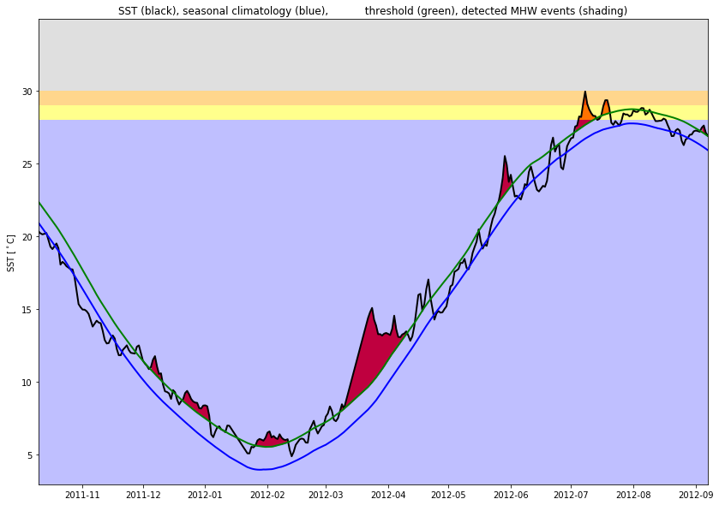
NOAA Chesapeake Bay Seasonal Summaries - Integration of Marine Heatwave Information
Goal: Characterize marine heat waves (e.g., intensity, duration, and frequency) related to living resource thresholds in seasonal summaries.
Feedback included that it would be beneficial to have marine heatwave information in communications to start raising awareness.
Can refine and make more robust as more data and research findings become available.
Example
Adult Striped Bass Habitat Condition Threshold
Habitat Condition
Suitable
(<28ºC)
Tolerable
(28ºC- 29ºC)
Marginal
(29ºC- 30ºC)
Unsuitable
(> 30ºC)
Surface Sea Temperature
Notes:
So, we are thinking about how to we integrate our MHW analyses into these seasonal summaries and relate the information to living resource impacts for specific species. Right now we are starting with a simple approach, which includes visualizing a species or habitat threshold along with a figure depicting the marine heatwave information. The figure on the right shows the SST in black, the 90th percentile threshold in green, and the climatology in blue; the red shaded peaks are marine heatwave events, while the shaded background depicts habitat condition thresholds for striped bass, based on the research we heard earlier from Tom Parham. Suitable habitat, in blue, is below 28C, the yellow shade from 28-29C indicates tolerable habitat, the orange shade from 29-30C indicates marginal suitability, while the grey/black shading above 30C indicates unsuitable habitat for adult striped bass. As we can see, we have marine heatwave events exceeding what would be considered either suitable or tolerable for habitat conditions. We do want to refine this and make it more robust as more data and research finding become available.

Slide 14
Next Steps
Marine Heatwave Analyses – testing with NOAA Chesapeake Bay Interpretive Buoy System and satellite data:
  NOAA could potentially become the data provider for an indicator and run analyses; staff available.
  Build in fish habitat considerations and relevant thresholds.
Communication Products –create conceptual data visualizations using both marine heatwave definitions and get stakeholder feedback on what would be most valuable for fish impacts:
Future Considerations:
  Consider new descriptive characteristics: spatial (e.g., % of total habitat affected by extreme marine heat waves) and temporal (e.g., length in between consecutive marine heatwave events).
  Integrate research on subsurface DO and temperature trends during marine heatwave events.
  Explore use of marine heatwave forecasts.
Notes:
Multi-stressor index
Mention Fish GIT meeting

Slide 15
Thank you!
Please feel free to reach out at:
Jamileh.Soueidan@noaa.gov

