Slide 1
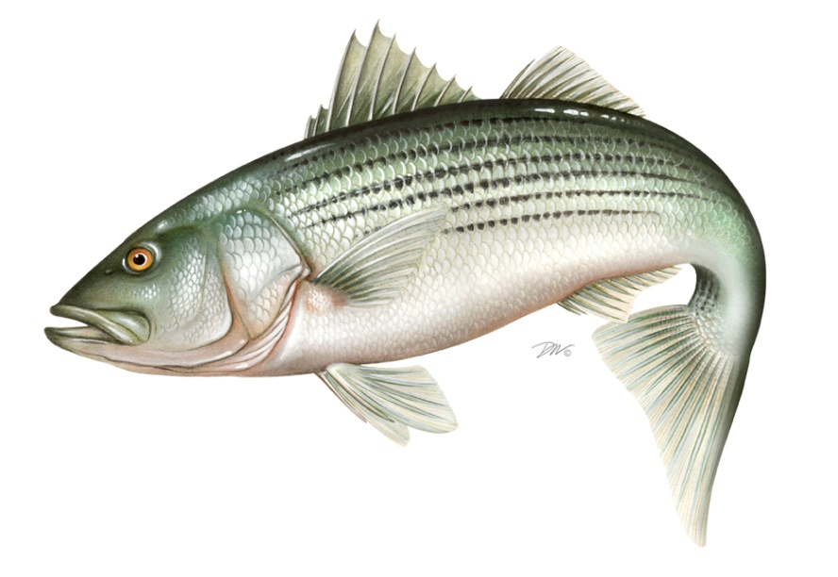
ASMFC Striped Bass Science and Management
Katie Drew, ASMFC
Sept. 18, 2023

Slide 2
Outline
Current assessment and stock status
Striped bass management
Past and Present
History of management
2023 Emergency Action and Addendum II
The future of striped bass management

Slide 3
Striped Bass Stock Assessment

Slide 4
Striped Bass Stock Assessment
Conducted by the ASMFC Striped Bass Technical Committee and Stock Assessment Subcommittee
Peer reviewed through the NEFSC SAW/SARC process
Most recent benchmark: 2019
Most recent update: 2022 (terminal year 2021)
Next update: 2024 (terminal year 2023)

Slide 5
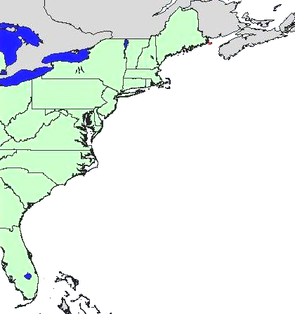
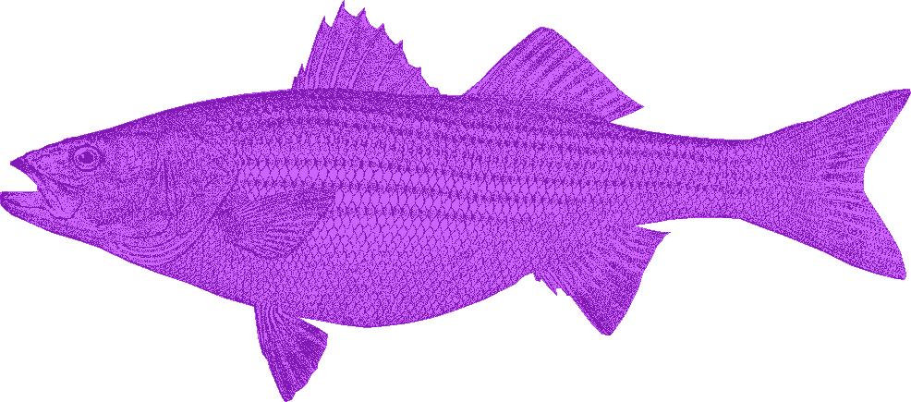
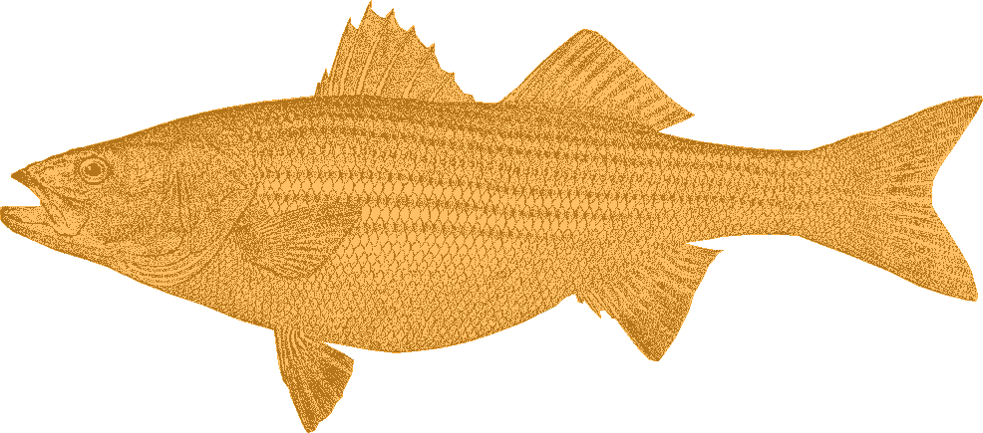
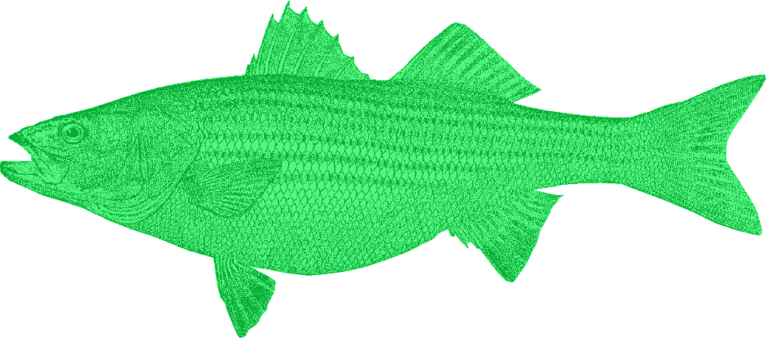
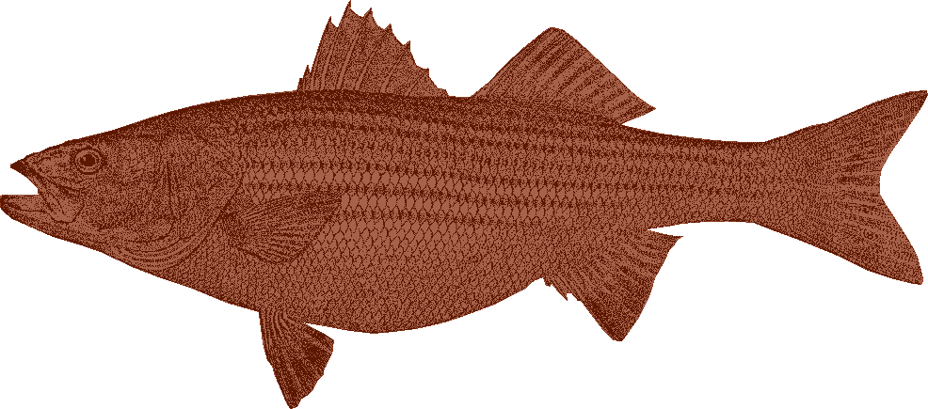
Stock Assessment Model
We know there are biologically distinct stocks in the major bays and estuaries along the coast.
Hudson River
Delaware Bay
Chesapeake Bay
Albemarle Sound – Roanoke River

Slide 6
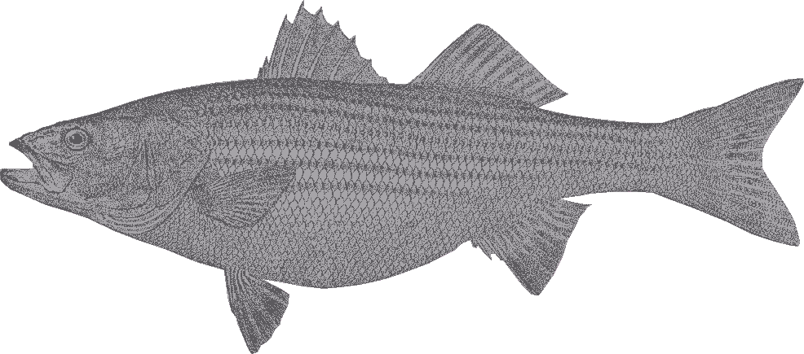
Stock Assessment Model
We know there are biologically distinct stocks in the major bays and estuaries along the coast.
However, we can’t tell the fish apart when we catch them without genotyping them, so we don’t know how many from each stock we are removing each year.
The Albemarle-Roanoke stock is treated separately and data from inland NC is not included in the coastwide assessment.
So we treat all the sub-stocks as a single mixed population in the assessment model.

Slide 7
Stock Status
Spawning stock biomass reference points
SSB threshold: estimate of female SSB from 1995, when the stock was declared rebuilt (188 million pounds)
SSB target: 125% SSB threshold (235 million pounds)
Fishing mortality reference points
F threshold: the F value that will allow median female SSB to stabilize at the SSB threshold in the long-term, under current recruitment conditions
F target: the F value that will allow median female SSB to stabilize at the SSB target in the long-term, under current recruitment conditions

Slide 8
Stock Status
What are “current recruitment conditions”?
Prior to the 2022 assessment, it was observed recruitment from 1994 to the present
In 2021, the recruitment trigger was tripped: the MD Juvenile Abundance Index was below the threshold for 3 consecutive years, so the “low recruitment regime” was used to calculate the F reference points and generate future stock size projections

Slide 9
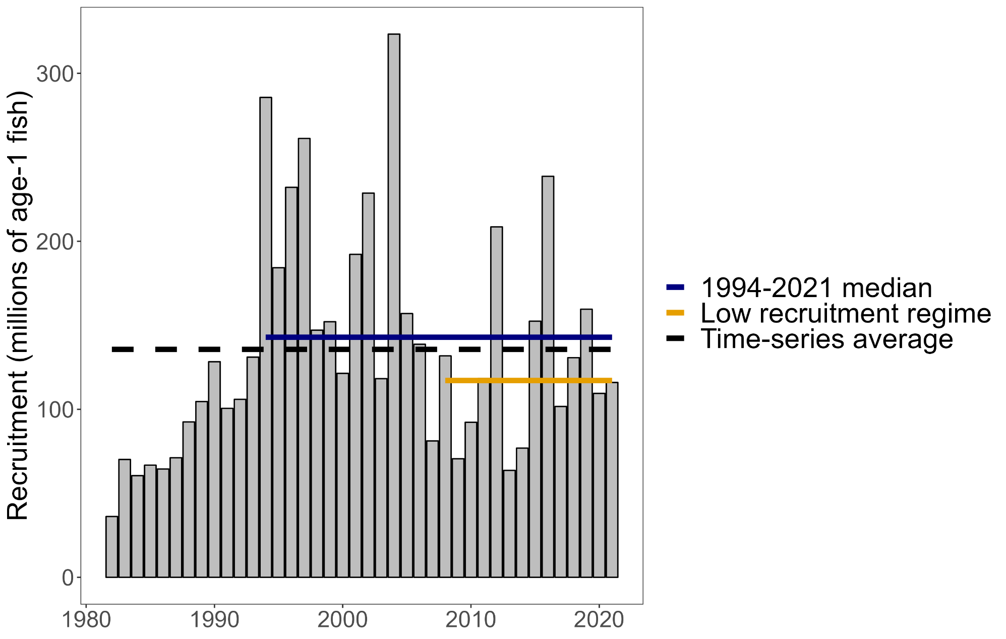
Stock Status
What are “current recruitment conditions”?

Slide 10
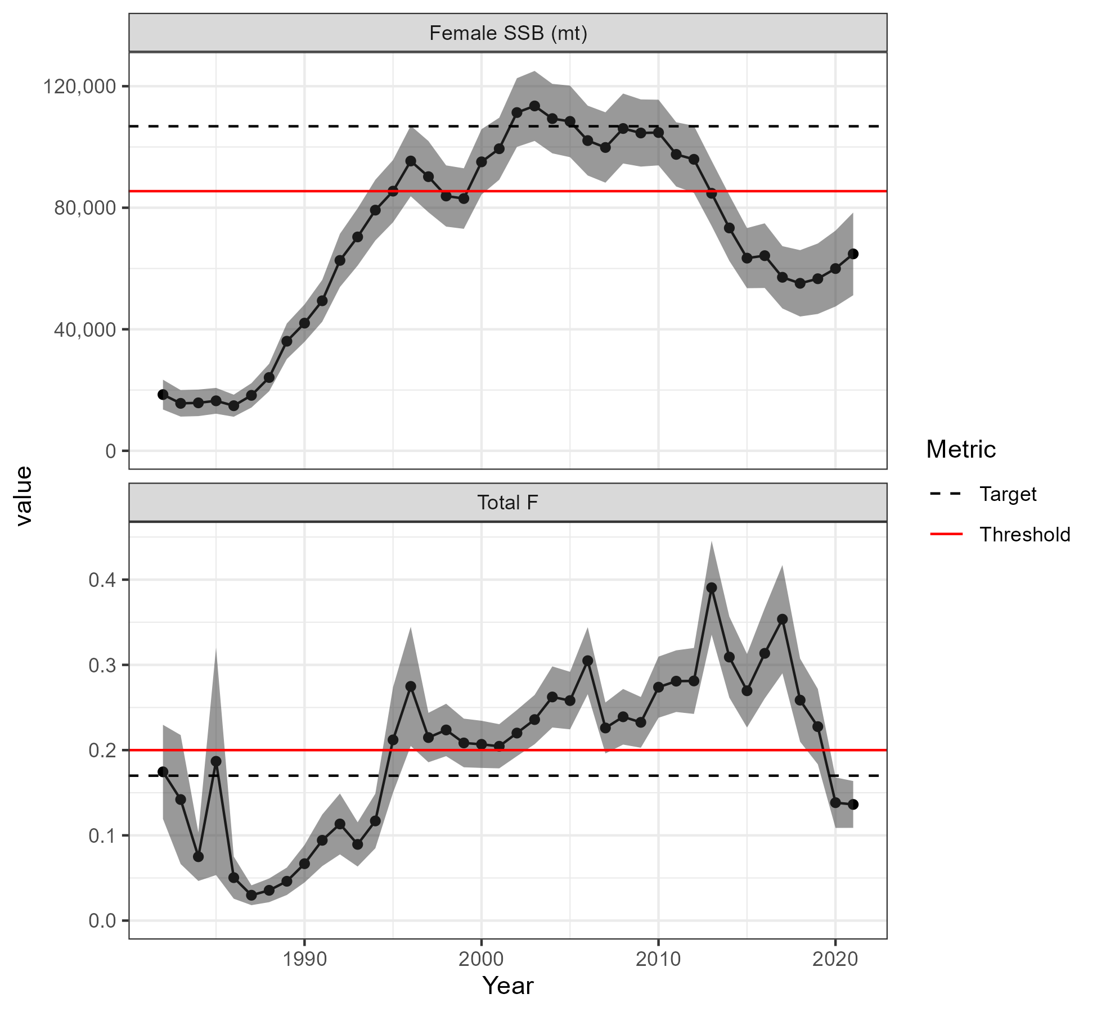
Stock Status
In 2021, the stock was overfished, but not experiencing overfishing

Slide 11
Future Work for Assessments
Continue to develop a spatial/stock-specific model
First attempt did not pass peer review
Collaborating with other researchers on alternative models
Continue to improve our understanding of striped bass productivity & model it quantitatively
Environmental drivers of recruitment and climate change impacts
Natural mortality (ecosystem impacts, myco, etc.)

Slide 12
Striped Bass Management

Slide 13
Striped Bass Management History
Striped bass are managed by ASMFC
1981: The first Fishery Management Plan for striped bass was implemented because of stock declines
1984: compliance became mandatory with the Atlantic Striped Bass Conservation Act

Slide 14
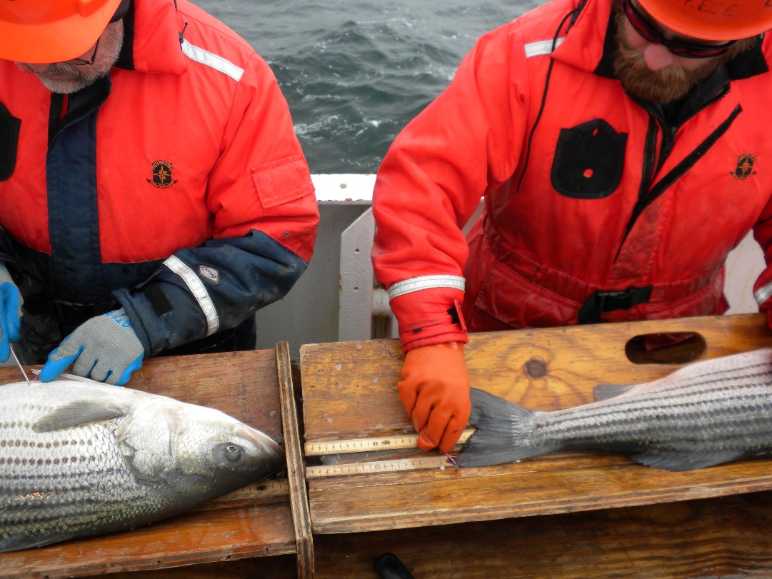
Striped Bass Management History
1985 – 1990: series of management actions to protect the 1982 year class & rebuild the resource: increased size limits, moratoria in several states, recreational trip limits
1990: NOAA prohibited fishing for or possessing striped bass in the EEZ
1995: Stock was declared rebuilt; management was relaxed and the target F was increased; EEZ moratorium remains in place

Slide 15
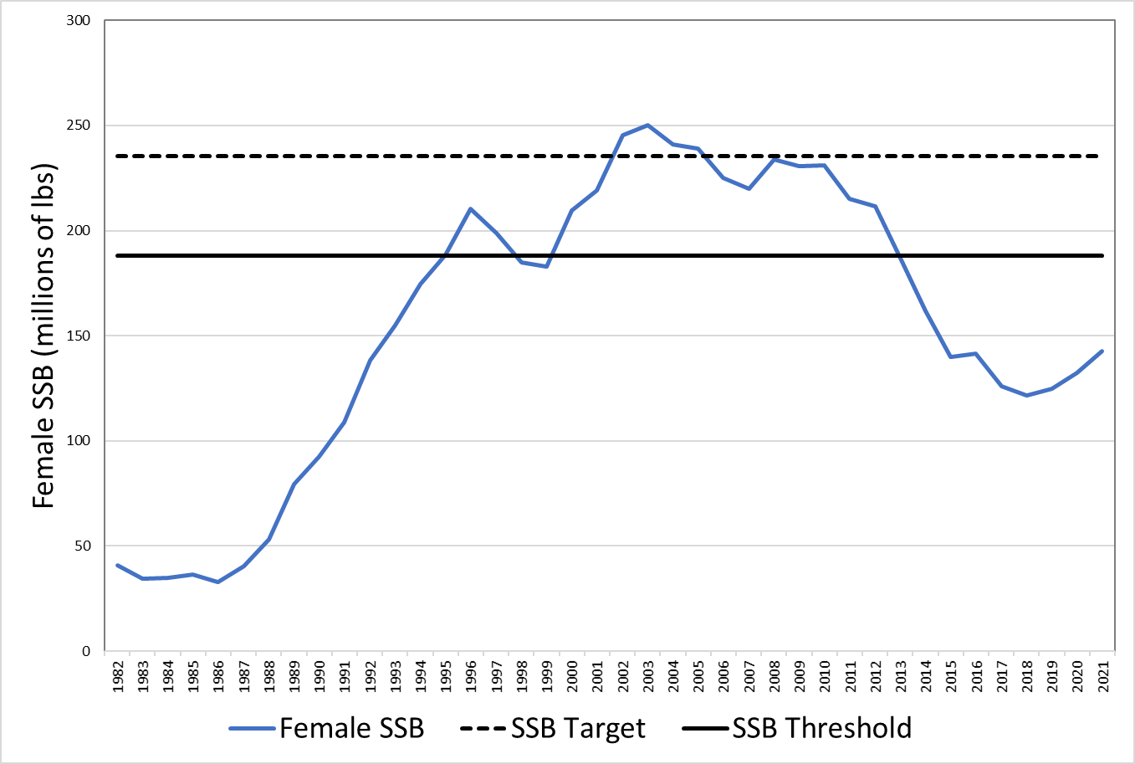
Striped Bass Management History
Amendment 6 to the FMP (2003)
Addendum I (2007)
Addendum II (2010)
Addendum III (2012)
Addendum IV (2014)
Addressed overfishing: 1 fish bag limit, quota reductions
Addendum VI (2019)
Addressed overfishing & overfished status: slot limit (28”-35” ocean fisheries), circle hook requirement, quota reduction
2014: Add IV
2003: Amendment 6
1995: Stock rebuilt
2019: Add. VI

Slide 16
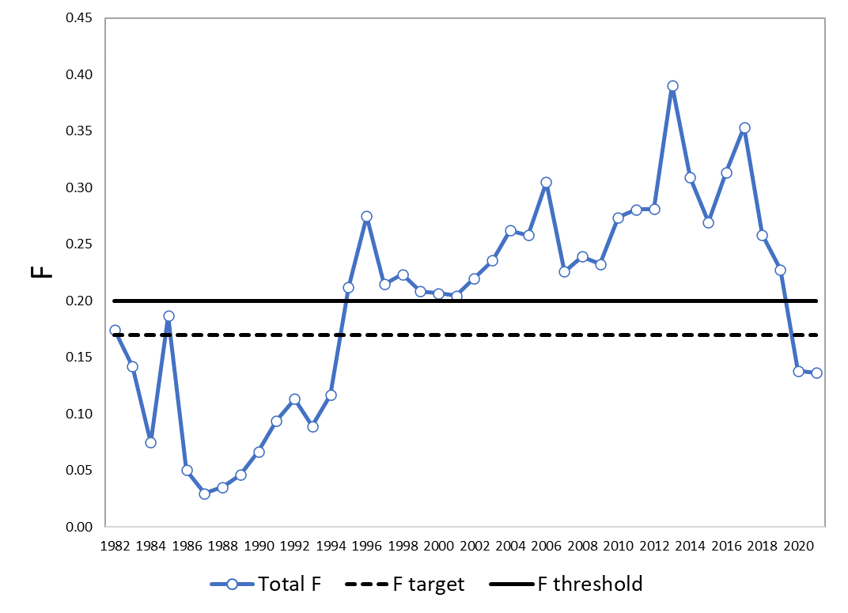
Striped Bass Management History
Amendment 6 to the FMP (2003)
Addendum I (2007)
Addendum II (2010)
Addendum III (2012)
Addendum IV (2014)
Addressed overfishing: 1 fish bag limit, quota reductions
Addendum VI (2019)
Addressed overfishing & overfished status: slot limit (28”-35” ocean fisheries), circle hook requirement, quota reduction
2014: Add IV
2003: Amendment 6
1995: Stock rebuilt
2019: Add. VI

Slide 17
Striped Bass Management History
Amendment 7 to the FMP (2022): Re-evaluated objectives and management triggers, further gear restrictions to reduce release mortality, conservation equivalency, etc.
Addendum I (2023) – commercial quota transfers
Emergency Action (2023)
Addendum II (in-progress)

Slide 18
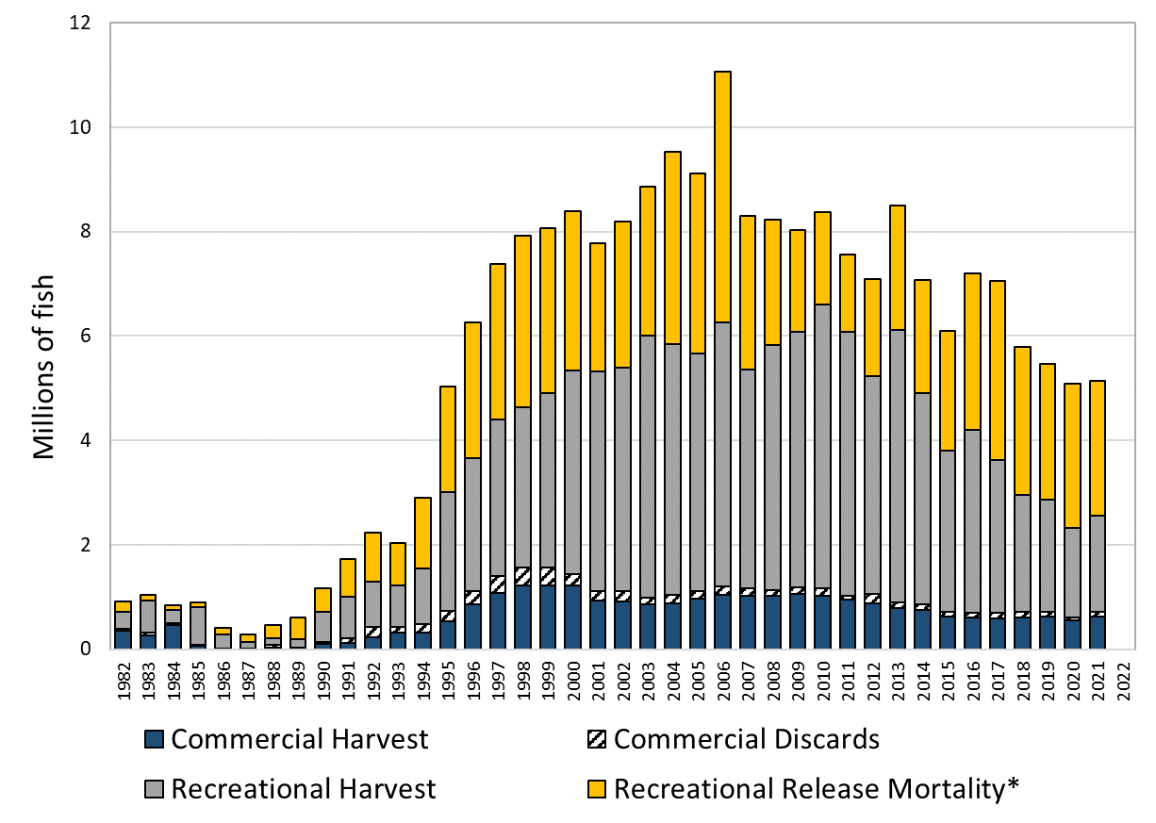
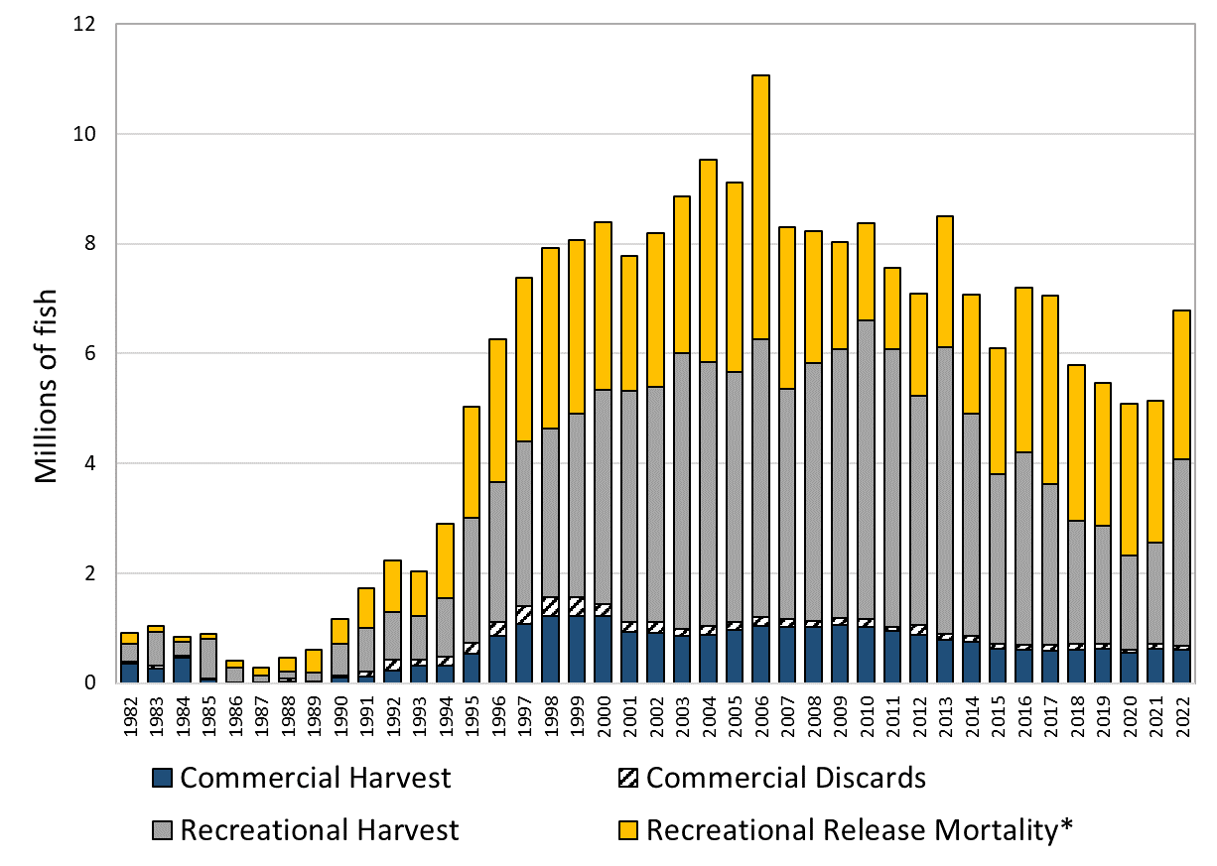
2023 Emergency Action
Assessment: stock has a high probability of rebuilding if the 2021 F is maintained through 2029
2022 removals:
32% increase in total removals
88% increase in recreational harvest

Slide 19
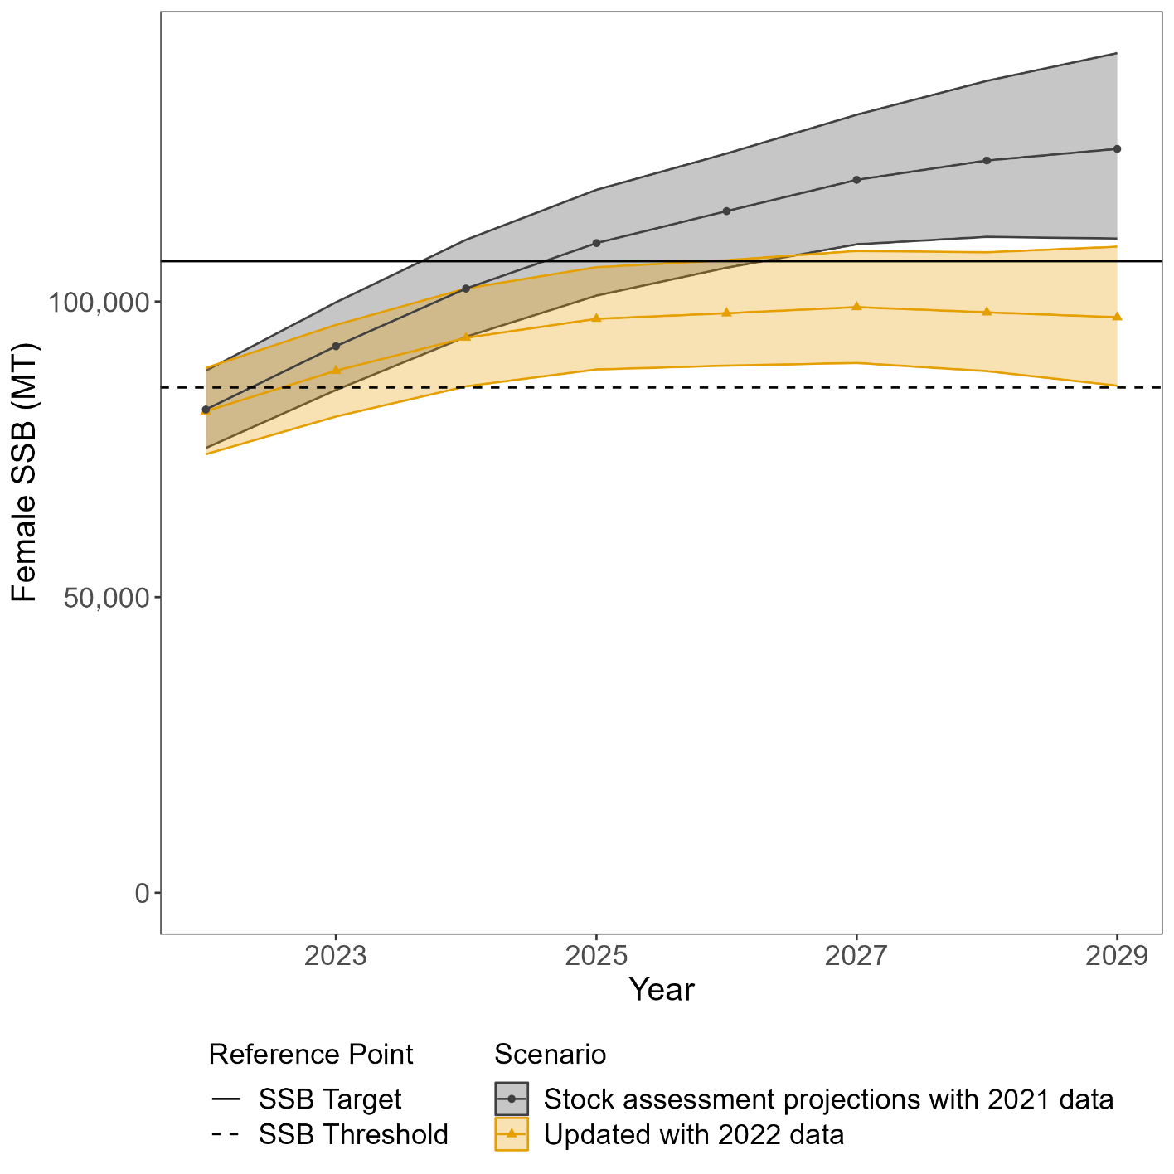
2023 Emergency Action
Probability of rebuilding by 2029 extremely small if 2022 F rates are maintained
Board took emergency action to reduce removals, narrowing the ocean slot limit from 28”-35” to 28”-31”

Slide 20
Addendum II
Initiated Addendum II to Am. 7 to bring F to the F target in 2024
Looking at options to reduce removals in the ocean and Bay commercial and rec fisheries
Send out for public comment in Oct. 2023, final approval in Feb. 2024
Stock assessment update in Oct. 2024: reevaluate progress towards rebuilding, consider additional changes to management

Slide 21
Future of Management
Better handle recreational release mortality/catch-and-release fishery
Better handle conflicting stakeholder needs (sector, region)
Be more adaptable/responsive to climate change and shifting stocks
More holistically incorporate ecosystem considerations

Slide 22
Ecosystem Considerations
Striped bass managed using single-species reference points
Key prey species use reference points or harvest control rules that take into account predator needs
NOAA: Atlantic herring harvest control rule
ASMFC: Atlantic menhaden ecological reference points
→ Manage striped bass and menhaden together instead of as separate Boards? Manage ecosystem as a whole?

Slide 23
Questions
Katie Drew, kdrew@asmfc.org

