Slide 1
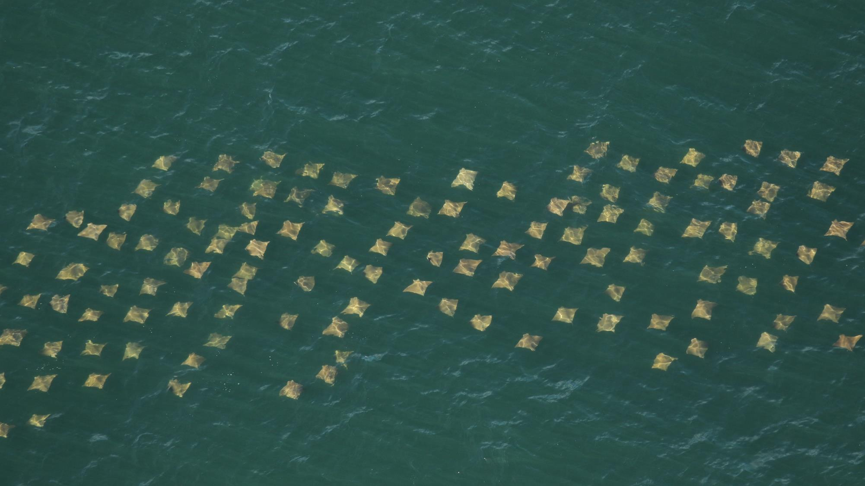


Movements of Chesapeake Bay fishes reveal multi-scale habitat use, migrations, and implications for fishery management
Mariah C. Livernois
Matthew B. Ogburn, Henry D. Legett, Kimberly D. Richie, Nathan B. Furey
Sustainable Fisheries Goal Implementation Team Meeting
September 18, 2023
Photo: FWC

Slide 2



Thank you to our funding support & collaborators!
Keira Heggie, Robert Aguilar, Dr. Chuck Bangley
Dr. Wilmelie Cruz Marrero
ACT Members
Metadata contributors:
Dr. David Secor, Mike O’Brien (UMCES)
Drs. Kevin Weng &
Patrick McGrath (VIMS)
Dr. Samir Patel (CFF)
Chuck Stence (MD DNR)
June 2022 Stakeholder Meeting Attendees:
NOAA, Mid-Atlantic Fisheries Management Council, Virginia Institute of Marine Science, Virginia Marine Resources Commission

Slide 3
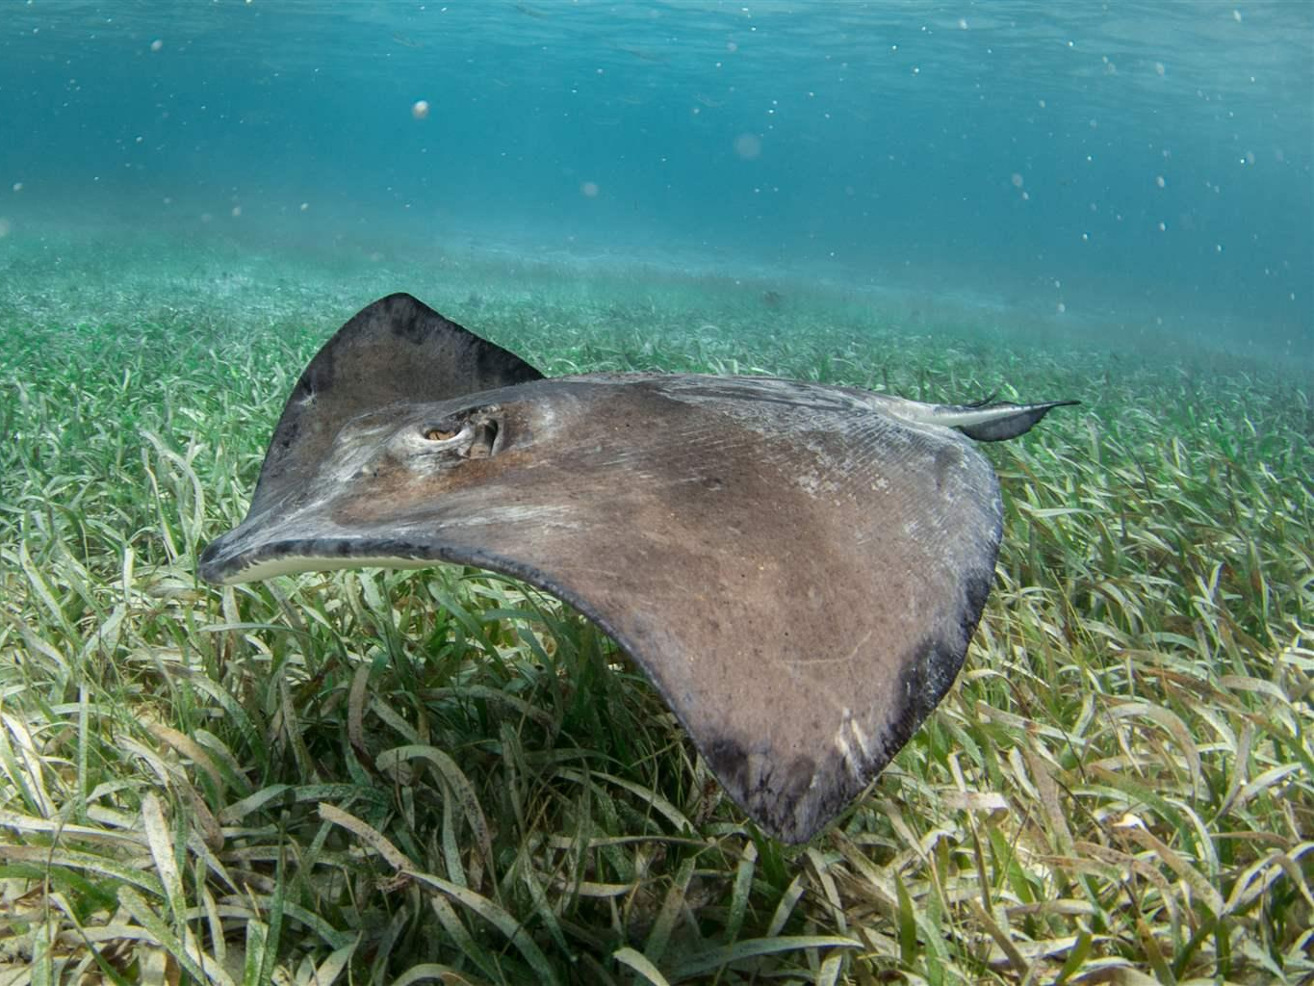
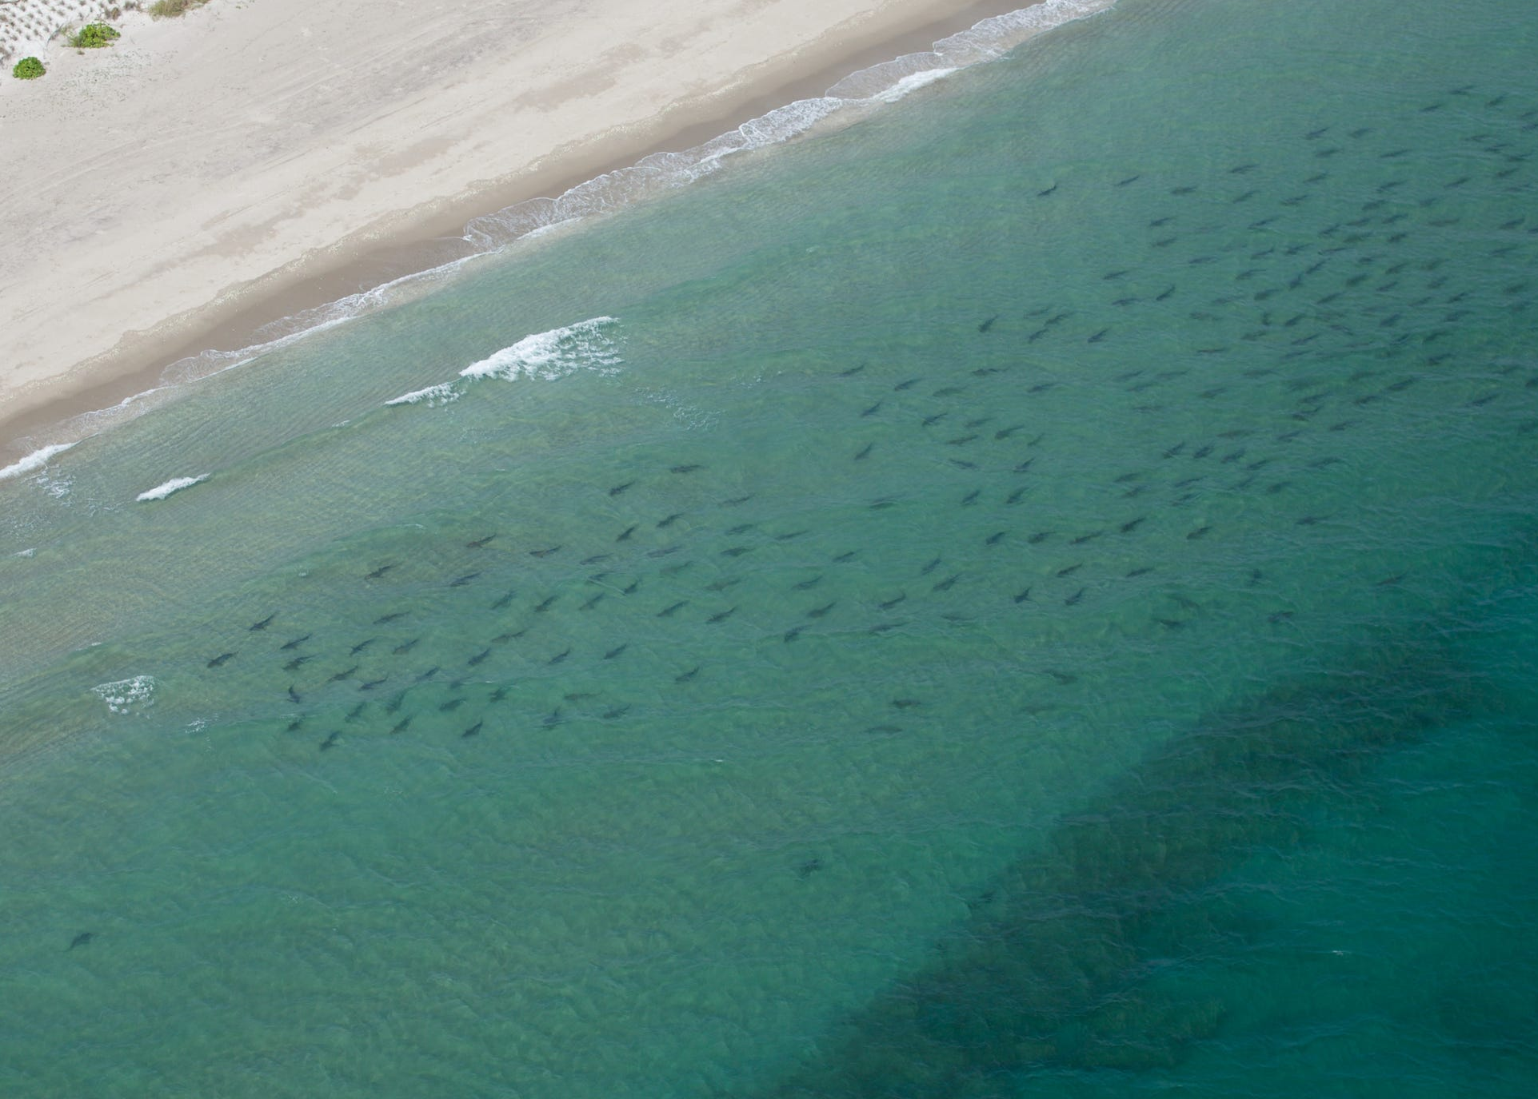




Animal movement – what can it tell us?
Identify important habitats
Determine migration pathways
Assess timing of habitat use
All (and more) can inform fishery management
Exs: marine protected areas, interjurisdictional cooperation, etc.

Slide 4
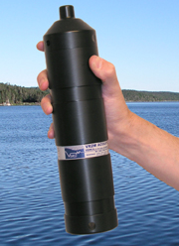
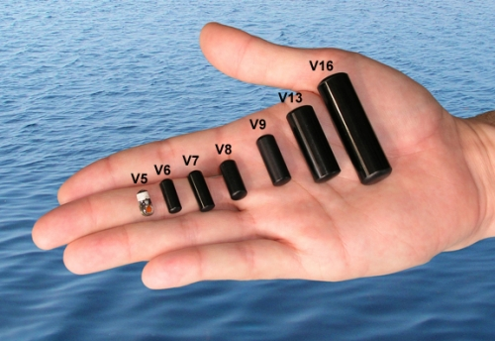
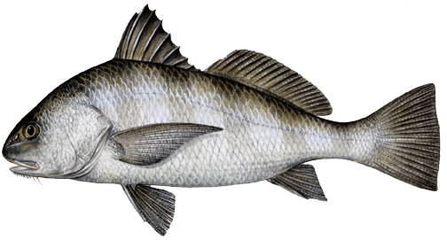
How can we track animals underwater? Acoustic Telemetry
Acoustic telemetry tags emit a “ping” at a specific frequency, rate, pattern
Acoustic receivers (hydrophones) “hear” the signal, and record the date, time, and ID
Acoustic Transmitter
Tagged Animal
Hydrophone
Internal Acoustic Tag
(unique ID)

Slide 5
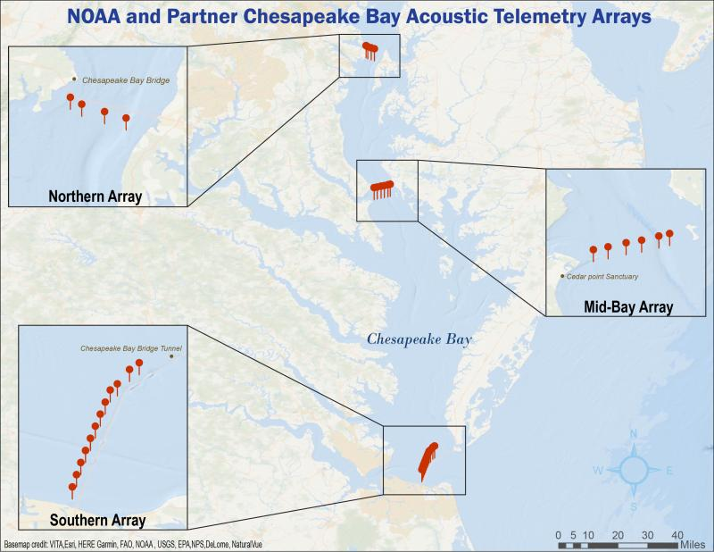
How do we track animals in the Chesapeake Bay?
Receiver arrays in Chesapeake Bay, Delaware Bay, offshore & coastal
Backbone Array

Slide 6
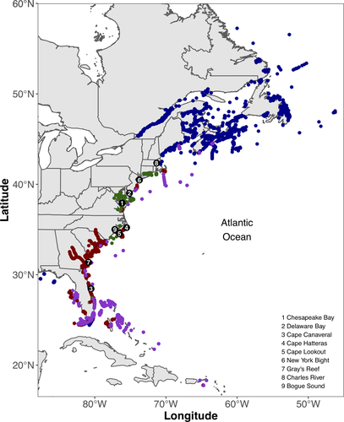
Can we do this over large spatial scales?
Have to download data from the hydrophone, so it’s labor intensive
Luckily, lots of researchers use the same type of hydrophones and tags
Bangley et al. 2020
Data sharing occurs through cooperative telemetry networks
(ex: ACT)

Slide 7
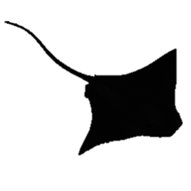
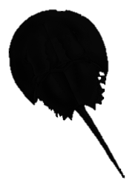
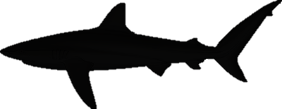
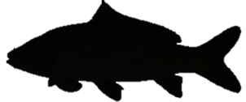

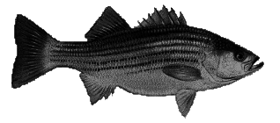
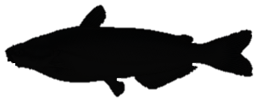
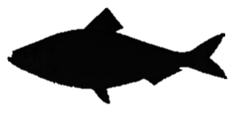
When and how do animals use the Chesapeake Bay?
Eight species tagged by the Smithsonian 2014-2021
Highly migratory
Coastal/oceans
Highly migratory
Euryhaline
Resident
Euryhaline
Resident
Freshwater
Dusky Shark
n = 29; 16,168 detections
Cownose Ray
n = 82; 79,620 detections
Horseshoe Crab
n = 16; 91,743 detections
Common Carp
n = 15; 90,784 detections
Smooth Dogfish
n = 21; 11,360 detections
Striped Bass
n = 40; 831,594 detections
Blue Catfish
n = 47; 2,095,717 detections
Alewife
n = 50; 6,743 detections

Slide 8
We are using telemetry data to:
Identify migration pathways, habitat use patterns, and timing of use of Chesapeake Bay
Highlight the utility of acoustic telemetry data for fishery management applications

Slide 9
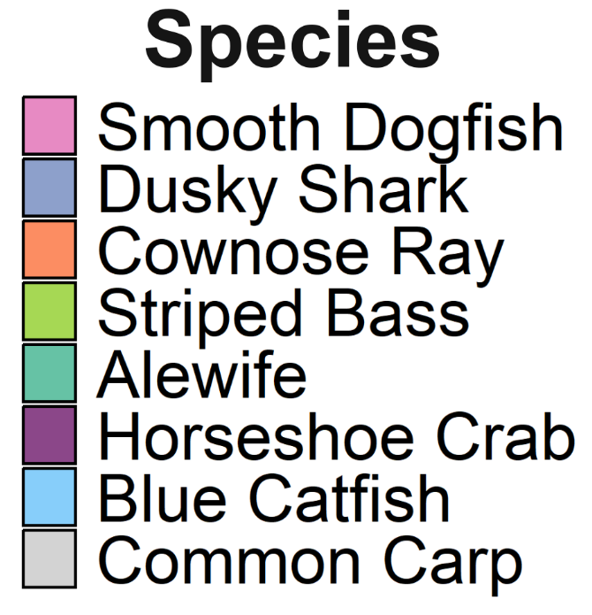
Migratory species link the Chesapeake Bay to the rest of the East Coast

Slide 10
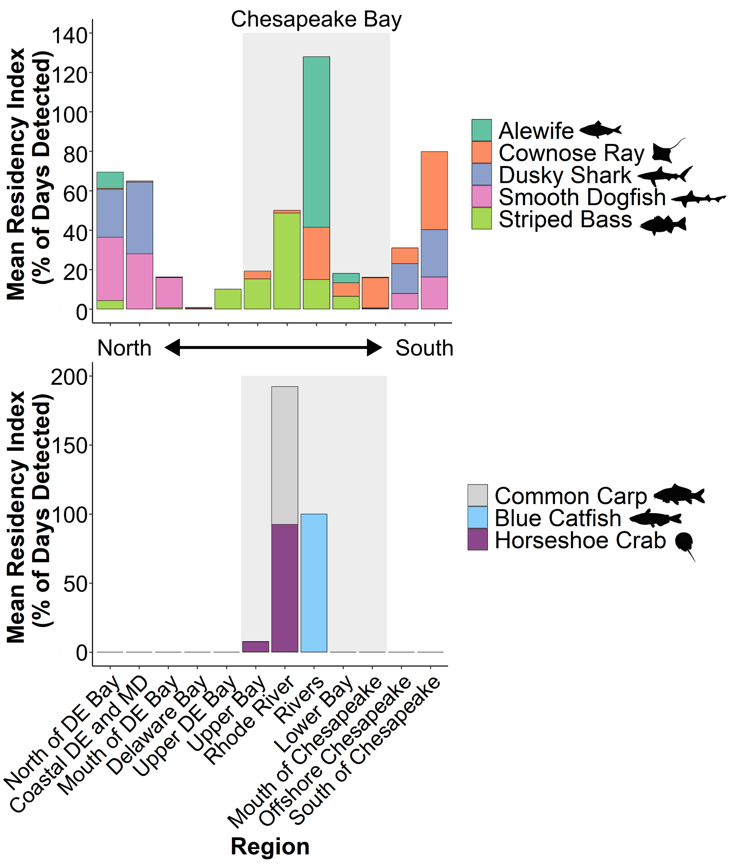
What metrics define habitat use for all species?
Residency index
How much time does a species spend in a habitat/region?
General description of habitat use
Identifies species groups (resident vs. migratory)
A couple of case studies…
Notes:
Region labels?

Slide 11
Partial & complex migration of juvenile Striped Bass
Length: ~0.3 m (1 ft)
Migration out of estuary for some (but not all) via 2 pathways
Movement into DE Bay through C&D canal
Some movement into lower estuary
Notes:
Size and silhouetee

Slide 12
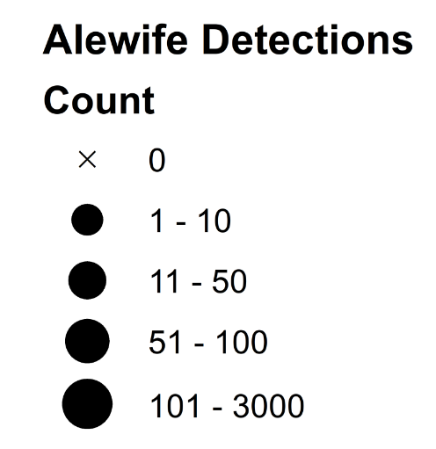
Alewife migration Spring 2022
Backbone array & CBIBS important for documenting migration

Slide 13
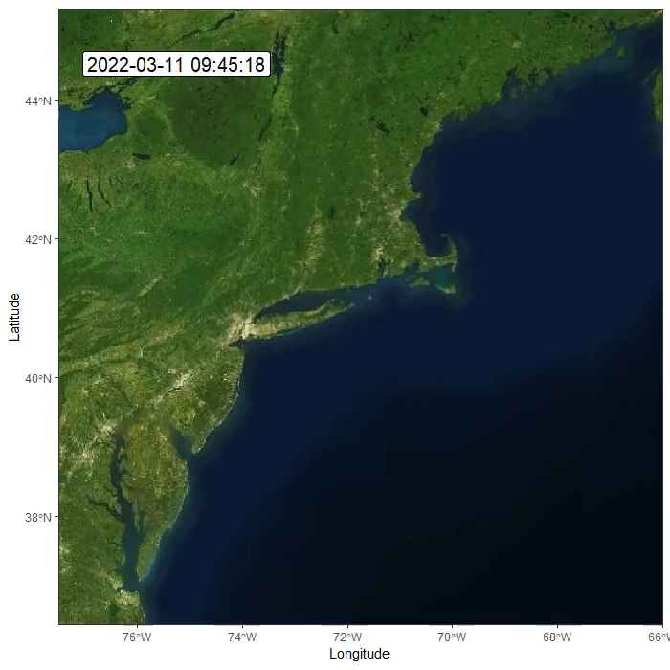
Full migratory cycle of Alewife to Gulf of Maine
Can also determine:
Seasonality of residency
Entry/exit dates
Environmental conditions
Many other metrics
Alewife
Can we use this data to inform fishery management?

Slide 14
Can we address fishery management with telemetry?
Yes! Ex: Network Analysis
Each receiver located within a specific fishery management jurisdiction
Relate detections to movement between jurisdictions via networks

Slide 15
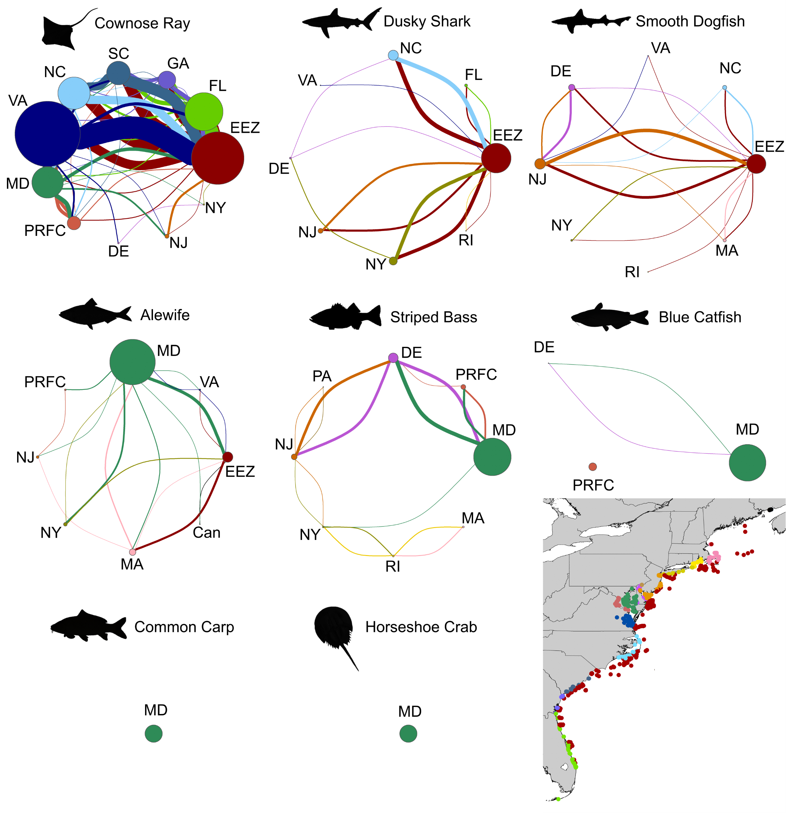
Can we address fishery management with telemetry?
Bubble size = # individuals detected in a jurisdiction
Line width = # individuals detected moving between jurisdictions
Both managed cooperatively (ASMFC)

Slide 16
Can we address fishery management with telemetry?
Bubble size = # individuals detected in a jurisdiction
Line width = # individuals detected moving between jurisdictions
Opportunity for cooperative management, both state & federal

Slide 17


Take-home Messages
Acoustic telemetry can define movement and habitat use patterns, including residency, migration, timing of entry/exit, etc. across diverse species
Chesapeake Bay backbone array critical to detecting movements & migration pathways
Acoustic telemetry data can be used to develop and enhance fishery management strategies
Mariah.livernois@unh.edu
Questions?
@mariahlivernois
Photo: FWC

