Slide 1
Accounting for Agricultural Nutrients - Overview of Current Methods and Data Sources
Tom Butler, EPA
8/28/2025

Slide 2
Todays Objective:
Gain a general understanding about the assumptions used in the generation and application of agricultural nutrients in Chesapeake Bay Program modeling efforts.

Slide 3
Outline
Bay Total Maximum Daily Load (TMDL) Summary
Background on Watershed Model
Data sources
Organic Nutrients
Inorganic Fertilizer nutrients
Nutrient Applications
Ag acres
Crop Yields
Data ideals
Consistency > Accuracy

Slide 4
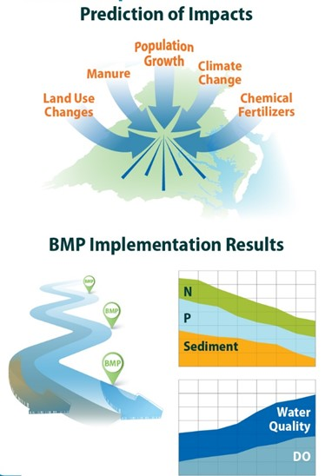
Total Maximum Daily Load
(TMDL) summary
What management practices…
…. will reduce nitrogen and phosphorus to levels …
…. that will achieve appropriate dissolved oxygen, clarity, and chlorophyll in the Bay?

Slide 5
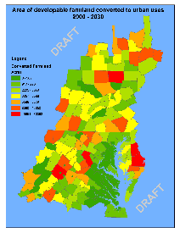
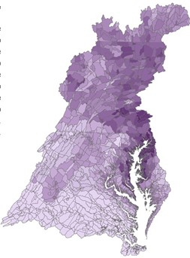
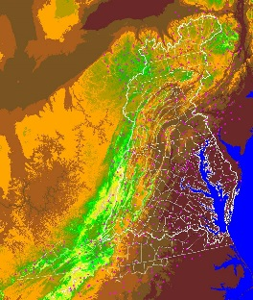
Chesapeake Bay Program (CBP) Decision Support System
Land Use
Change Model
Bay
Model
Criteria
Assessment
Procedures
Watershed
Model
*You are here*
Data
Airshed
Model

Slide 6
Primary use of the CBP Watershed Model
Represent anthropogenic changes in load
Set and track reduction goals
Ideally:
Include all load sources
Treat all jurisdictions equally
Track management actions that change loads
Factor out the variability of weather over time

Slide 7
Data sources
State reporting
Census of Agriculture
Industry
Research values
Aerial Imagery

Slide 8
Data source tree
Nutrients
Organic
Inorganic
Biosolids
Manure
State supplied
Animal population
Sales Tonnage
Crop Yields
Ag inputs
USDA yields
Acres
Aerial Imagery
Census of Agriculture
Manure or litter generated
Manure or litter nutrient concentration
Literature Values

Slide 9
Data source tree
Nutrients
Organic
Inorganic
Biosolids
Manure
State supplied
Animal population
Sales Tonnage
Crop Yields
Ag inputs
USDA yields
Acres
Aerial Imagery
Census of Agriculture
Manure or litter generated
Manure or litter nutrient concentration
Literature Values
Not all data sources provide the full picture
Calculations are required to get model inputs
Ex. Manure nutrients = Animal populations (X) Waste generation (X) Waste concentration

Slide 10
Assumptions
Expected Crop yield (best three of five) directs nutrient application
Inorganic nutrients are available for distribution across the entire watershed
Farmers will not sacrifice potential yields

Slide 11
Agricultural acres
Initial Land Use
High resolution Land Cover
2013-2014 USDA’s National Agricultural Imagery Program aerial imagery
State and county agency leaf‐off imagery
LiDAR imagery
Proportions of Initial Land Use are Revised
Census of Agriculture
Percentage of acres for each crop group
Notes:
The initial land use is made from LRseg acreage of developed and natural from Peter and county acreage of ag from ag census, proportionally split into LRsegs based on the Peter’s fraction of county crop and pasture in each LRseg.
When you add up the initial land use, it never exactly matches the total available space in the LRseg. That’s where the springs come in.

Slide 12
Crop Yields
National Agricultural Statistics Service Information (NASS)
Annual Surveys
Five Year Census of Agriculture
County scale
State Scale
County Scale
Literature Values
Used if no yield data is supplied
small percentage of acres or nutrients
Notes:
Ag census = Over 100 crops
Annual Survey = 11 major crops

Slide 13
Organic Nutrients
(Animal population)
(Manure/Litter tons)
(Manure/Litter nutrient concentration)
Census of Agriculture
American Society of Agricultural and Biological Engineers (ASABE)
Poultry Litter Subcommittee (PLS)
Swine characterization report
American Society of Agricultural and Biological Engineers (ASABE)
Poultry Litter Subcommittee (PLS)
Swine characterization report
Turkey Characterization Report
Turkey Characterization Report
Production surveys
Inventories
Sales
Notes:
Poultry – new and more accurate sources of publicly available production data are required to more accurately represent commercial Brooder/Poultry production in the CBP partnership's decision support tools.
Swine – report focuses on the mass generation rate and nutrient content of manure from commercial swine production systems in Pennsylvania and Virginia.

Slide 14
Inorganic Nutrients
Fertilizer Sales tonnage data
American Association of Plant Food Control Officials (AAPFCO)
Direct reported state data (Departments of Ag)
1985-2016
2017-2020

Slide 15
Example application
Inorganic nutrients are calculated and applied – may be more or less than need
Manure transport removes manure nutrients
Inorganic nutrients are used to replace transported manure
Crop A has calculated nutrient need
All available manure nutrients are applied
35%
inorganic
35%
inorganic
60%
inorganic
Crop A
Crop A
Crop A
Crop A
Crop A
25% inorganic
75% manure
75% manure
75% manure
25%
manure Transported
BMP
RESULT
50% organic

Slide 16

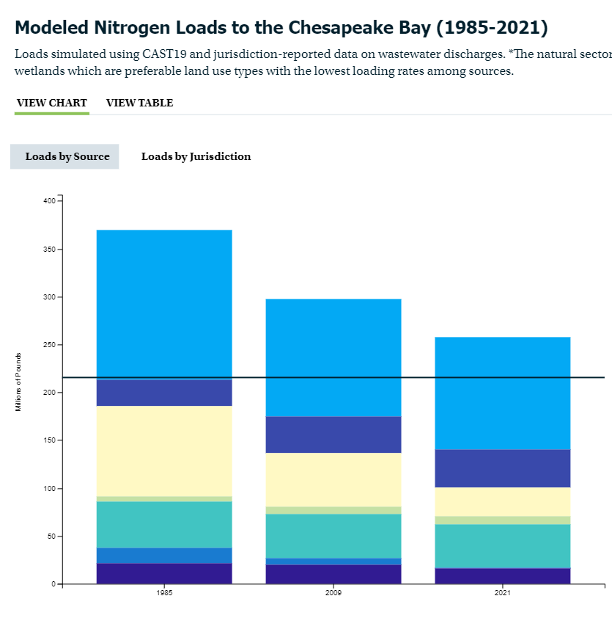
Consistency > Accuracy
Space and time trends are more important than the absolute value
Space - Model used to allocate responsibility between jurisdictions
Time - Model used to track TMDL, based on changes since 1995

Slide 17
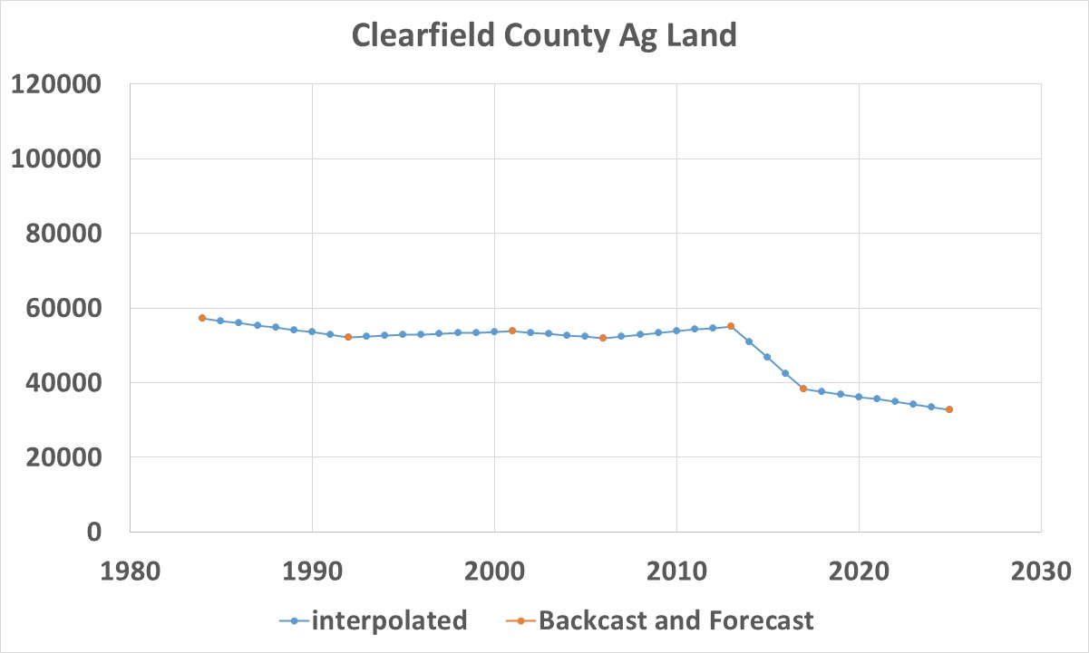
Consistency example
NOTE* This is an example only
Current Phase 6

Slide 18
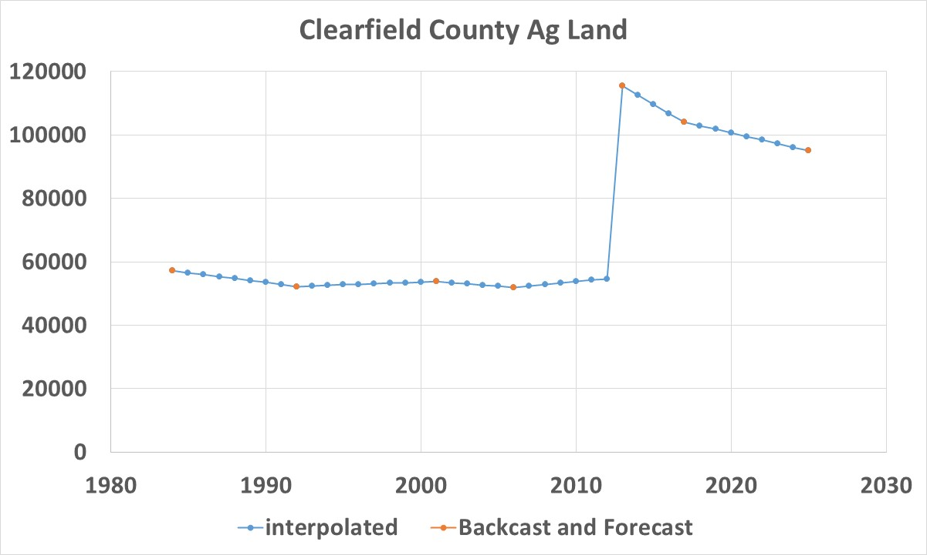
Consistency example
Incorporate hi-res land use
Not likely that ag increased between 2012 and 2013
Not likely that ag increased relative to 1995
2013 is current development number
2017 and 2025 just for illustration

Slide 19
Consistency example
Current Phase 6 with “Change Product”

Slide 20

A few additional notes
Models have historically been updated at intervals
New data can be accommodated during these periodic updates
Process referred to as a change product (see previous example)
Cannot move the goal posts when people are planning based off a set expectation
https://www.flickr.com/photos/niallkennedy/74353767

Slide 21
Summary
The Chesapeake Bay Program uses models to examine how management practices will reduce nitrogen and phosphorus
Multiple sources of data are used to feed these tools
Data limitations require assumptions to be made
New lines of evidence are essential to improving the representation of agriculture in modeling tools
AND
BUT
THEREFORE

Slide 22
Questions?

