Slide 1

Stewardship Workgroup
Quarter 3 Meeting – August 21, 2025

Slide 2
Agenda
1:00
Welcome/ Introductions
1:10
Beyond 2025 Outcome and Target Process
1:20
Discussion: public feedback received so far
1:30
Implementing Stewardship Work in 2025 – Action Teams
1:45
Other Announcements & Rapid Coordination
2:00
Adjourn

Slide 3
What’s your favorite
summertime treat or activity?
01
Icebreaker
in the Chat

Slide 4
Beyond 2025 Outcome Assessment Process
Dec 2024: GIT 5 Outcome Assessment Survey & ask for workgroup feedback
Feb 2025: Workgroup meeting feedback finalizes recommendation to update Outcome
Feb-May 2025: Language drafting and revision process
May 8, 2025: Report out to Management Board + Management Board feedback
May 8-13, 2025: Language revisions with Leila Duman and Anna Killius
May 13, 2025: New revised language submission
May 2025: MB & PSC approved revised outcomes for public comment
July 1 - Sept 1: 60 Day Public Comment period

Slide 5
2014 Chesapeake Bay Watershed Agreement Outcome Language
Stewardship Outcome:
Increase the number and diversity of trained and mobilized volunteers who have the knowledge and skills needed to enhance the health of their local watersheds.
https://www.chesapeakeprogress.com/engaged-communities/stewardship

Slide 6
What needed to be updated with this outcome?
2014 Watershed Agreement Language: Increase the number and diversity of trained and mobilized volunteers who have the knowledge and skills needed to enhance the health of their local watersheds.
Challenges with 2014 Watershed Agreement Language:
Not very Specific, Measurable, Achievable, Relevant, or Time-bound (SMART)
Overemphasizes training and mobilizing volunteers which:
    Is not the direct role/responsibility of the Chesapeake Bay Program, thus making the outcome difficult to achieve;
    Does not fully capture stewardship actions beyond volunteer-based programs, i.e., individual and community-scale stewardship actions.
Notes:
How did your outcome need to be revised? Did language need to be deleted because of new science or policy? Did new targets need to be set? Why are these changes happening? What was the process to change—with your workgroup, MB and PSC? (Use as many slides as needed)

Slide 7
Draft Outcome and Targets for Revised Watershed Agreement
Revised Stewardship Outcome:
Increase public participation in stewardship actions that contribute positively to the lands, waters, living resources and communities throughout the Chesapeake Bay watershed.
New Target:
Through 2040, better equip practitioners with the social science data, technical assistance and support needed to develop, improve and carry out individual and community-level stewardship programs, including those that will help advance Agreement goals.

Slide 8
How do the revisions address the challenges?
Revised Stewardship Outcome: Increase public participation in stewardship actions that contribute positively to the lands, waters, living resources and communities throughout the Chesapeake Bay watershed.
Revisions:
Replaces reference to training and mobilizing volunteers with the more inclusive phrase, “increase public participation in stewardship actions” to better reflect the breadth of stewardship activities represented across the Mid-Atlantic region.
Outcome language remains simple, accessible to the public, and inspirational based on Management Board feedback from the March retreat.
Acknowledges stewardship of lands, waters, living resources and communities.
Target language incorporates SMART factors.

Slide 9
The Stewardship Target incorporates SMART factors.
New Target: Through 2040, better equip practitioners with the social science data, technical assistance and support needed to develop, improve and carry out individual and community-level stewardship programs, including those that will help advance Agreement goals.
Specific, Relevant, Achievable:
The target language describes specific activities – providing “social science data, technical assistance, and support” – that are relevant to the role of the Chesapeake Bay Program.
          These activities are achievable by the Chesapeake Bay Program.
Target language focuses on stewardship programs that are specific and relevant to Agreement goal and outcome areas, e.g., Water Quality, Tree Canopy, etc.
Time-bound:
“Through 2040” sets a year to assess target progress while acknowledging that increasing and normalizing public participation in environmental stewardship will take ongoing, long-term effort.
Measurable:
Metrics to measure the success and progress of the target will need to be set.

Slide 10
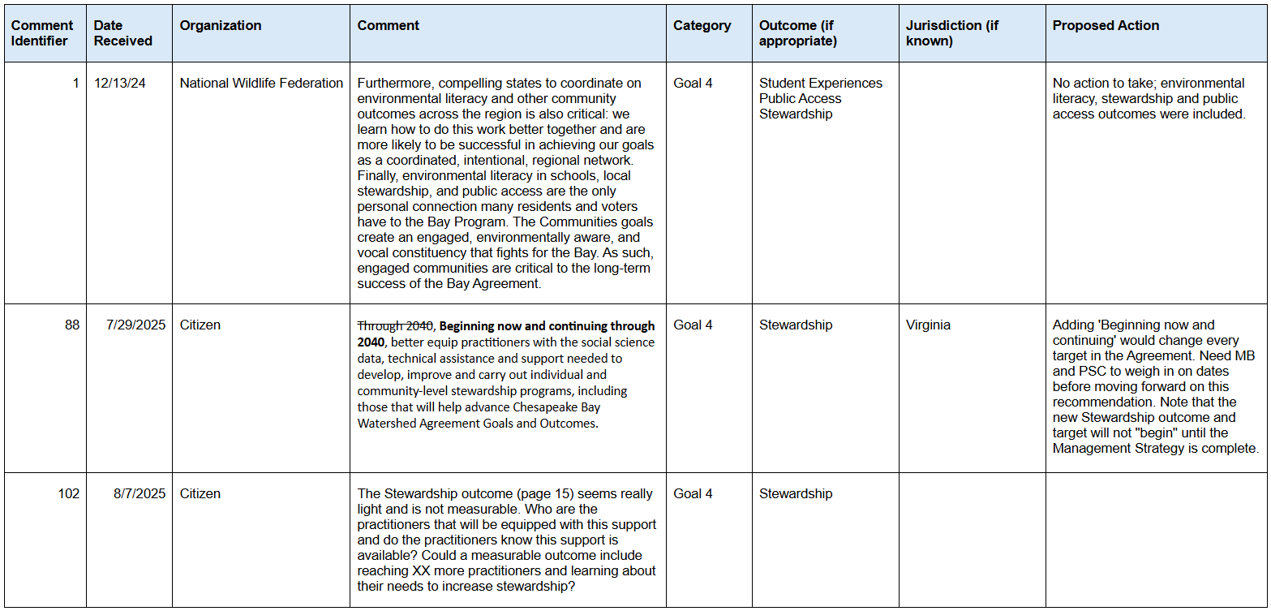

Slide 11
Future Management Strategies and Potential Measures
(How to Get it Done)
  Continue the Stewardship Survey, and use it to inform practitioners
    along with other data/social science
  Use additional datasets that demonstrate success – some things partners may already be tracking and reporting (for grants, other commitments):
    # of volunteers that participate in projects
    amount of pet waste kept out of the water through localities’ efforts
    capture larger-scale, collective efforts / community-scale stewardship
  Work with other Watershed Agreement outcomes
    Identify targeted stewardship engagement that contributes to achieving outcomes
    Help them plan “how to” promote those actions using social science practices (informed by the stewardship survey)
    EXAMPLE: “By 2040, XX number of trees planted by individuals or communities in areas lacking tree canopy.”
  Connect with the professional community (partners and regional practitioners) – self-assess their capacity to instigate and measure stewardship, and growth over time.

Slide 12
REVISED STEWARDSHIP OUTCOME
STEWARDSHIP GIT (GIT 5)
Stewardship Workgroup
Outcome’s ultimate intent:
  Increase and normalize public participation in stewardship actions that contribute to achieving environmental results.
What’s new?
  Build capacity: equip partners and stewardship practitioners with data, tools, technical assistance, support; work through the network to engage with the public.
  Expand the scope of stewardship actions promoted to better align with and help achieve more of the outcomes in the Watershed Agreement.
  More emphasis on collective, community-scale efforts as well as individual (greater impact).
Challenges:
  Need more time to identify targets, numeric metrics and means to measure. Stewardship results take a long time to realize. We need small bites.
  If the on the ground metrics live under other outcomes, then the Stewardship WG would assist the other WGs with data, tools, social science best practices guidance, and partnerships to support implementation; and help with tracking the metrics.
  Effective stewardship methods and strategies for partners would be informed by data collected through an updated Stewardship Index (survey) and analysis.

Slide 13
Implementing Stewardship Work in 2025
Opportunities for engagement: Action Teams!
Steward Map Ambassadors
Stewardship Resource Library
Community-Level Stewardship

Slide 14
2025 Action Teams
Steward Map Ambassadors
Stewardship
Resource Library
Community-Level Stewardship
Assist with outreach and promotion of the map.
Help brainstorm new map uses and map design improvements.
View the map here.
Determine the key audience(s) and their resource needs/wants.
Help design, gather resources for, and eventually share an online stewardship resource hub for practitioners.
Develop a plan/methodology to identify what community-scale stewardship actions already exist across the watershed.
Help establish a baseline for future measurement.

Slide 15
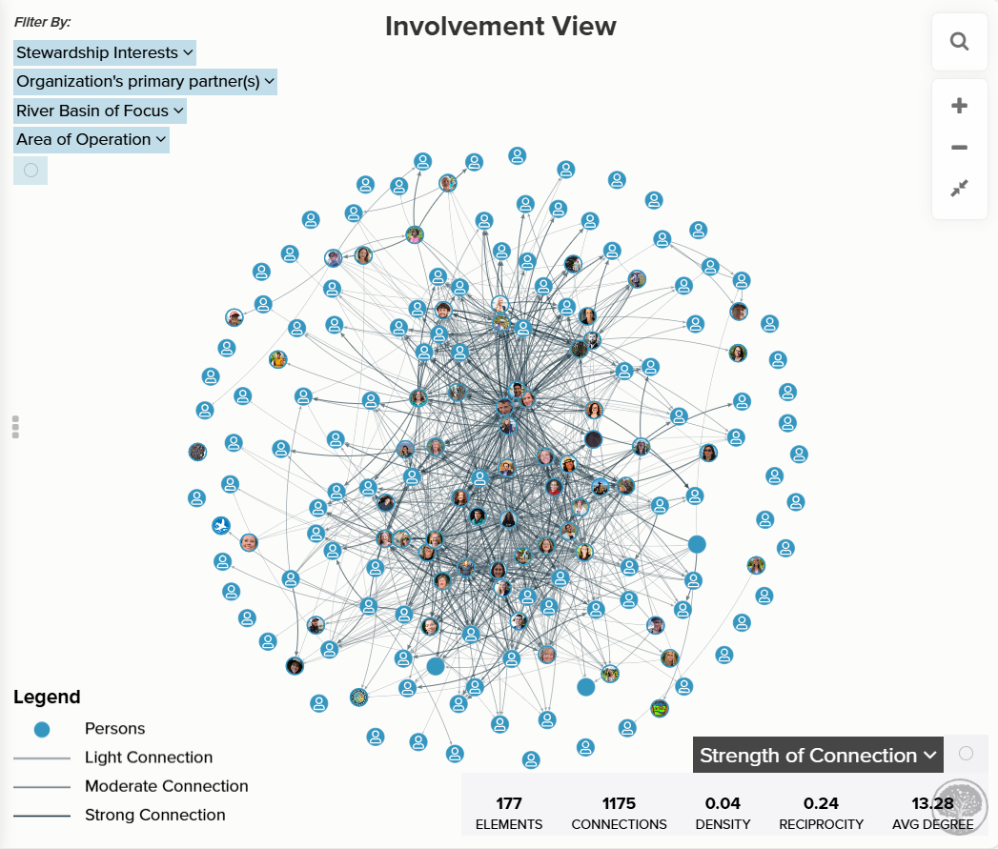
Implementing Stewardship Work in 2025
Ongoing Efforts:
Chesapeake Steward Map
Map Stewards: 191
  150 added in 2024
  11 added in 2025
1,444 Connections
Notes:
https://embed.kumu.io/8bee687ffdbfb36e078453bbe61838bd#home/involvement

Slide 16


Closing Announcements
Reach out to Meredith if you
are interested in guiding the work
of the Stewardship Workgroup in
an informal steering committee
or as a co-chair!
Let Meredith know if you’d like to join an Action Team!
Meredith Lemke, lemkem@chesapeake.org

Slide 17

Thank
You

