Slide 1
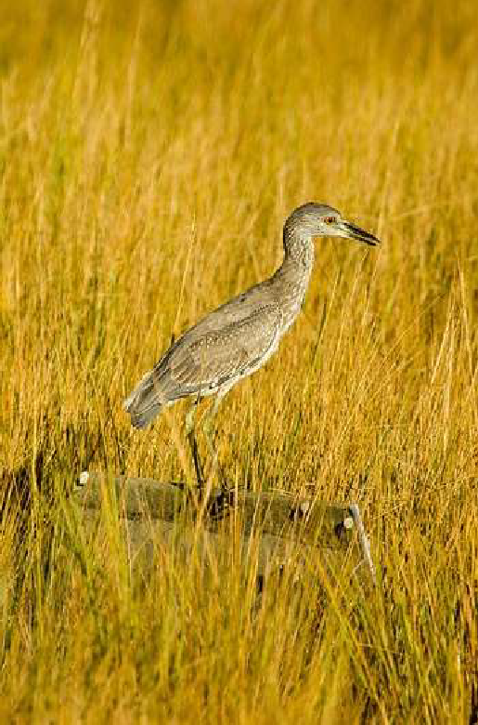
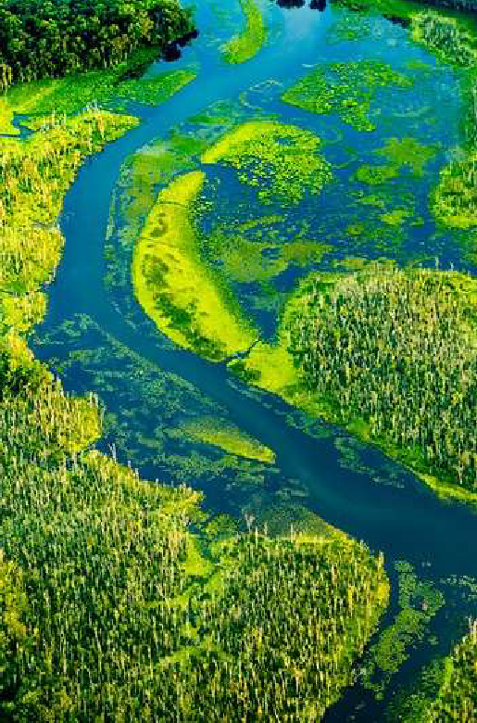
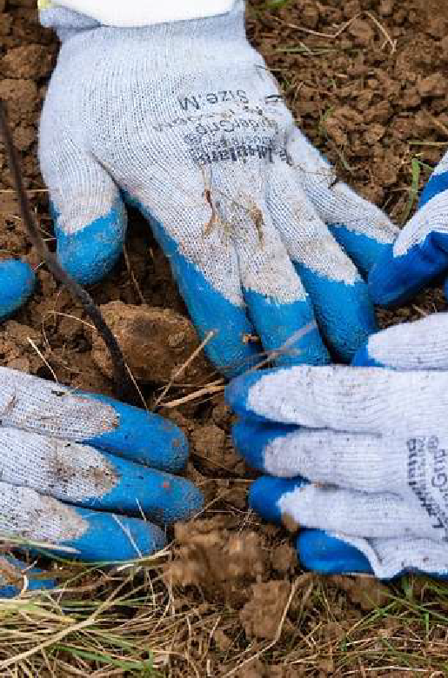



Beyond 2025 Update
Notes:
An update from the Beyond 2025 Steering Committee- this is the group that is convening to develop recommendations for what the Bay Program should do after 2025.

Slide 2
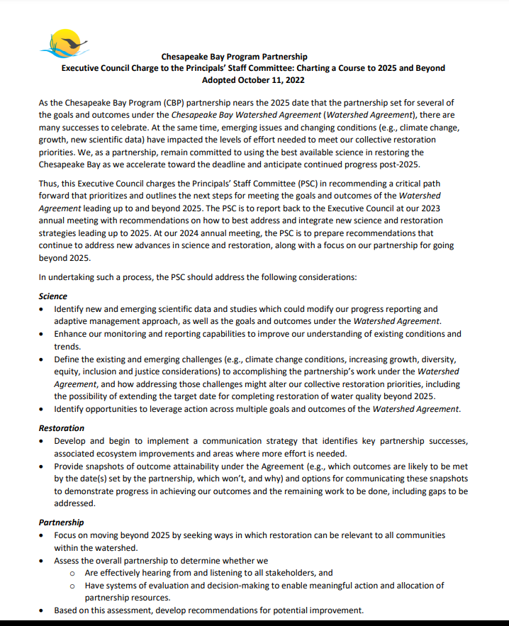
Notes:
This is in response to an Executive Council charge from 2022 – Charting a Course to 2025 and Beyond. The final Reaching 2025 report should be released any day now, so the focus is really shifting to what should happen beyond 2025

Slide 3
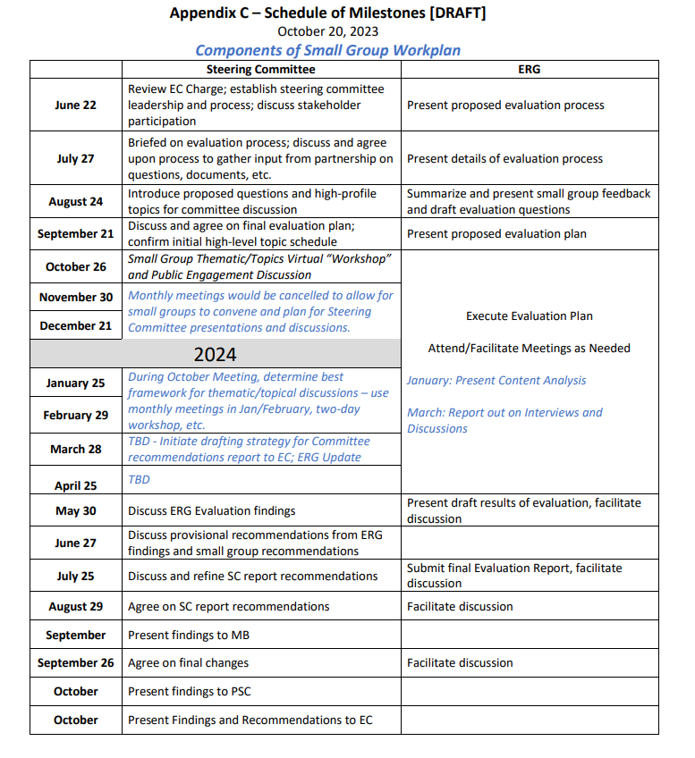
Notes:
The EC charged the Program with providing recommendations at the 2024 meeting, so this is an overview of the timeline for the work. We have been meeting as a Steering Committee since June and the meetings so far have been very process-oriented. So I am going to give a bit more detail on what that process is going to look like and what the plan is for digging into the substance.
ERG is a contractor that is helping with this work- they are conducting a program evaluation to help support the recommendations so this shows how their work will be running in parallel with the steering committee work. We approved their evaluation plan at the September meeting and they will likely be reaching out to get input from GITS and Workgroups as they go along their work.

Slide 4

STEERING COMMITTEE PROPOSED PRODUCT BY EC2024
Summary of where we are with the 2014 Watershed Agreement
Reaching 2025 Report
CESR, Rising Temperatures, Forest Buffers & Wetlands Conference Reports, SRS meeting report, report, Advisory Committee Recommendations, and more. Crosswalk of common themes.
Where we are
Where do we want to be
Vision
Current Partnership Vision – Reaffirm? Refine?
Impact assessment
What is the ability of our Partnership to positively impact each goal and outcome?
Do we have the right outcomes for our goals and the right goals for our vision?
What we do
Assessment of our overall partnership
Partnership Structure
Governance and Adaptive Management
How we work
Path Forward
Recommendation on what to do with the Watershed Agreement post-2025
Recommendations on the Partnership
Notes:
Big picture what the SC is trying to do – evaluate where we are, where do we want to be, what we do, how we work and then based on that, start charting a path forward.
The evaluation of where we are is going to pull in the reaching 2025 report, but also the rising temps workshop report that many of us worked on as well as the forest buffer action strategies you all developed last year .

Slide 5
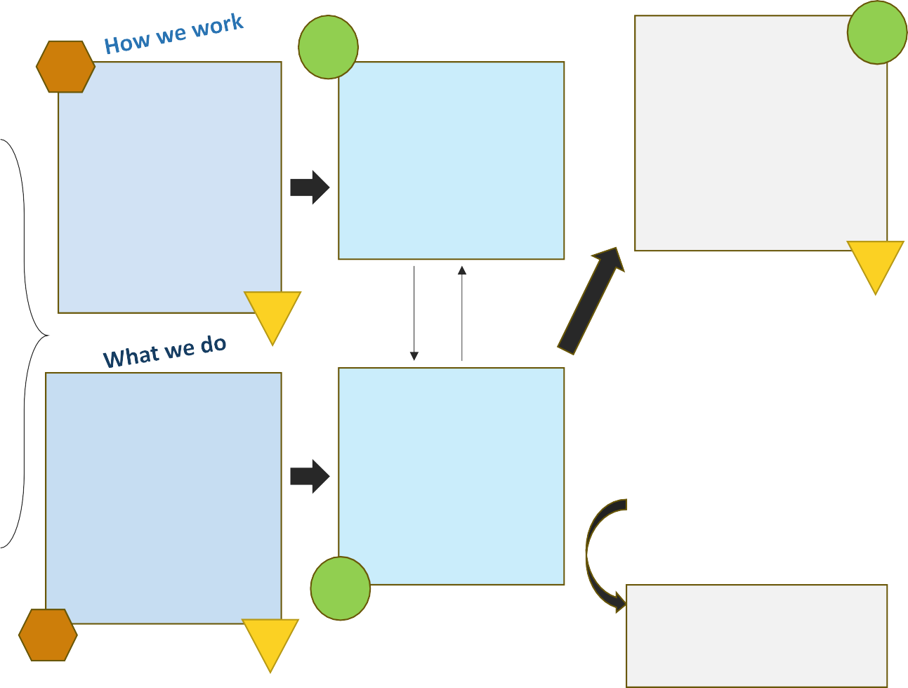




PROCESS
SC
Draft SC Recommendations
SC
^{ERG} Organizational/
Governance Assessment
Recommendations on Org. Structure, Gov. & Adapt Mgmt
Agreement, Structure, Governance, Adapt Mgmt
Next Steps Post EC2024
GIT Involvement in Review process
G+
Vision Exercise
SC
CBP Structures
CBP Processes
Adaptive Management
Stakeholder/NGO
engagement
Findings, strengths, weaknesses
Identify and/or assess
options
Reaching 2025 Report
Outcome Attainment
Assessment and Recommendations
Future watershed will be different
Reaffirm or refine
vision?
G+
informs
MB
PSC
High Profile Topics
Steering Committee discussions about priority issues like climate change, shallow waters, DEIJ, NPS, etc. that are coordinated by SC and GIT+ small groups
Science and Policy Reports
CESR, Rising Temps, Dartmouth, Biennial Mtg Report, Adv. Committees Recommendations
Impact Assessment of Goals & Outcomes
Recommendations on Agreement
Do we have the right goals / outcomes and can the partnership have an impact on them?
What to do with met
goals? Unmet goals?
Amend and extend?
Reform and rewrite?
**Any proposed changes cannot be fully scripted in 1yr.**
Final Recommendations to EC in 2024
G+
SC
Post EC2024
PHASE II: Execute Recommended Path Forward
SC
G+ GIT Involvement + WG
ERG
G+
⁼ chairs and/or SMEs)
Notes:
After many hours of meeting, this is the process that is outlined. Some components of the work will be led by the steering committee (green circle with SC), some components of the work will be led by ERG (orange hexagon), and there are multiple check points for GIT + WG involvement (yellow G triangle)
ERG’s program evaluation is going to focus on that organization/governance assessment and an impact assessment of goals and outcomes
The SC will be doing some visioning and delving into what they are calling “high profile topics” to help inform recommendations on the organizational structure, governance, adaptive management, and the Agreement

Slide 6
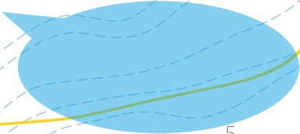
SMALL GROUPS: PURPOSE
Guide the Beyond 2025 Steering Committee in thinking about, discussing, and ultimately forming recommendations around cross- cutting, high-level topics that have arisen in the EC Charge and partnership reports.
Draft recommendations, based on full Steering Committee feedback, for integration into the Steering Committee’s final product.
Considerations:
Small and nimble enough for meeting and planning; inclusive enough to reach experts outside of SC, like GIT and AC members.
Overall makeup should encourage silo-breaking and diversity of viewpoint.
Need for a lead or point person. Lack of staffing support.
Breakout Discussion!
5
Notes:
Are dividing up into Small Groups to delve into those ‘high profile topics”. At the meeting last week we more or less coalesced around what those topics will be

Slide 7
HIGH LEVEL TOPICS
Breakout Discussion!
Climate
Healthy Watersheds
Clean Water
People
Shallow Water Habitats
Notes:
We tried to move towards having a fewer number of groups to discourage siloing and reduce the logistical burden of organizing these groups. They are meant to be sticky topics that we really need to grapple with as we think about the next phase of the partnership
“healthy watersheds” originally started off a “lands” group that would focus more on land conservation and restoration and more terrestrial living resources

Slide 8
GUIDING QUESTIONS FOR EACH TOPIC
Breakout Discussion!
3 Vs
VISION: What does success look like? What do we hand to the next generation?
VALUE: What are we doing that works? What could be improved? What learnings can we draw from?
VANGUARD IDEAS: What idea would be transformative?
Cross-Cutting Considerations
CLIMATE: How does climate change interact with your topic?
PEOPLE: How can we better center people in our efforts on this topic?
LIVING RESOURCES: How can your topic maximize living resource impacts?
Notes:
These might get modified slightly based on input from the last meeting, but the idea is that each group will address the 3 Vs as well as a set of cross-cutting considerations.
Some of the extra sticky topics (like climate and people) will be both focal topics and cross cutting considerations that each group will need to consider

Slide 9
PROPOSED WORKPLAN
November-December
Small groups convene to guide full committee discussion.
Recruit experts outside of the steering committee to participate.
Consider guiding questions and cross-cutting considerations
Review and develop presentations, questions, resources, strawman recommendations to
guide full committee discussion of topic.
January
Full committee discussion on topic, led by small group
Two-day workshop; planning support would be of interest
February
Provisional Recommendations (drafted/revised from January discussion) presented to
Steering Committee.
Final Recommendations integrated into SC Final Product
Notes:
This is the proposed workplan- allegedly initial work in the small groups is going to happen quickly to help organize full steering committee discussions in January. May be reaching out to some of you for input or involvement once we start getting organized within our healthy watersheds group.

