Slide 1
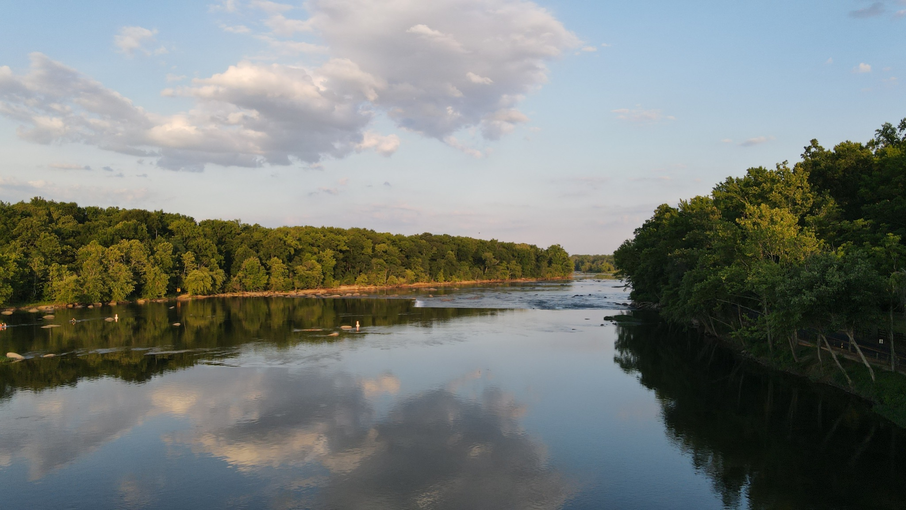

Refresher Reel: Achieving Water Quality Goals in the Chesapeake Bay: Comprehensive Evaluation of System Response (CESR):
Denice Wardrop (CRC) and Kurt Stephenson (VT)
August 24, 2023
Presentation to STAR

Slide 2
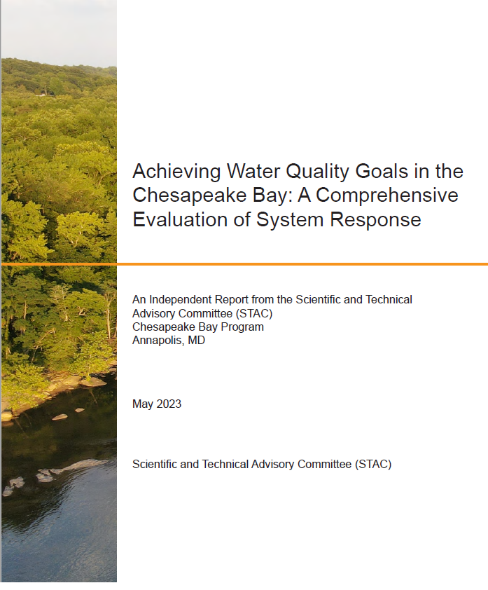
CESR Report
Self-initiated
Inclusive of STAC Membership
Multiple levels of internal and agency review
Over 50 contributors with unanimous STAC inclusion
Main report (Co-editors and Steering Committee) plus 3 “Resource Documents”

Slide 3
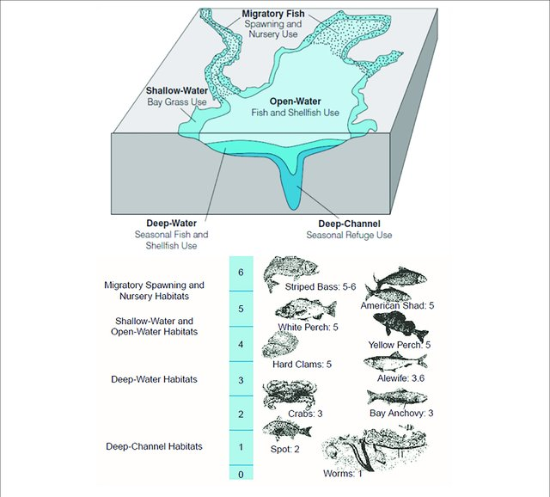
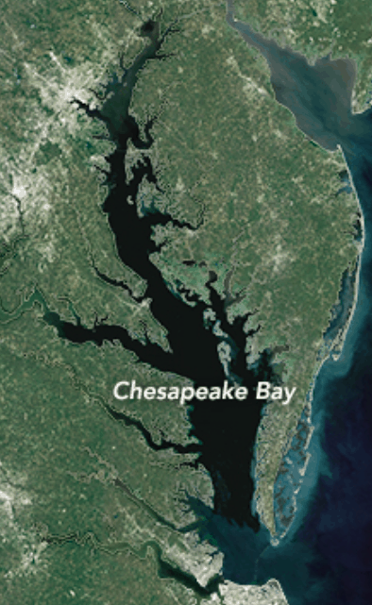
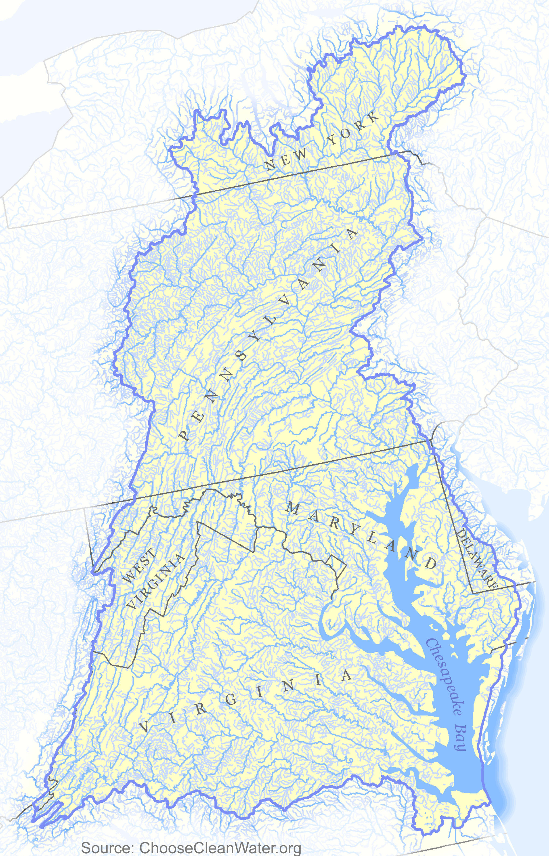
Public Policy
Chesapeake Bay Agreement: Restoration Goals
Sustainable Fisheries
Vital Habitat
Water Quality
Toxic Contaminants
Heathy Watershed
Climate Resiliency
Land Conservation
Stewardship
Public Access
Environmental Literacy
Water Quality Standards
TMDL: Stressor Reduction Goals
Targets: Nitrogen, phosphorus, sediment
TN: 214.6 m/lbs/yr TP: 13.4m lb/yr TSS: 18,587m lb/yr
Implementation Policies
Designated Uses
Federal permitting
Fed/State nonpoint programs
Funding
Water Quality Criteria
Dissolved Oxygen, Water clarity/SAV,
& Chl-a
across 5 habitats
TMDL accounting & accountability
Biological, Physical, and Social System Response
Living Resource Response
How are living resources responding to changing water quality conditions?
Achieving Water Quality Standards
Are nutrient & sediment reductions producing expected water quality response?
Achieving TMDL:
Are implementation policies and management actions sufficient to achieve nitrogen, phosphorus and sediment goals in the TMDL?

Slide 4
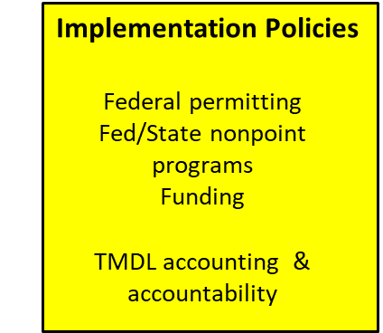
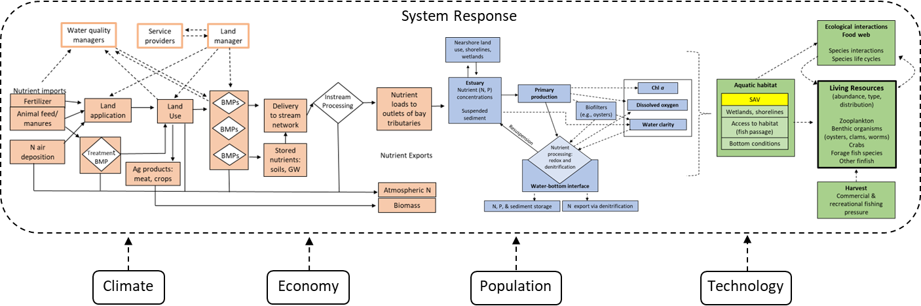
System Response to Meeting Bay Water Quality Standards
Designated Use
WQ Criteria & Assessment
TMDL
SAV wetlands, shorelines
Access to habitat (fish passage) Bottom conditions
External Factors

Slide 5
Summary of CESR Findings and Implications
Living Resource Response
Achieving Water Quality Standards
Achieving TMDL
Findings: The impact of WQ improvements on living resources depends on where WQ improvements occurs, antecedent conditions, & impact varies across species.
Implications: Potential to increase the impact on living resources from our WQ and restoration investments.
Findings: Bay water quality is improving, but the magnitude of the improvement appears to be lagging behind expectations
Implications: Full (100%) achievement of Bay water quality standards is a distant and doubtful.
Findings: Nonpoint source programs are not generating the scale of reductions needed to achieve TMDL
Implications: To substantially improve nonpoint source outcomes will require new programs and approaches
Overarching Finding: Complex problem with tradeoffs, uncertain outcomes, and no single “silver bullet” answer
Overarching Implication: Experiment, learn, and adapt

Slide 6
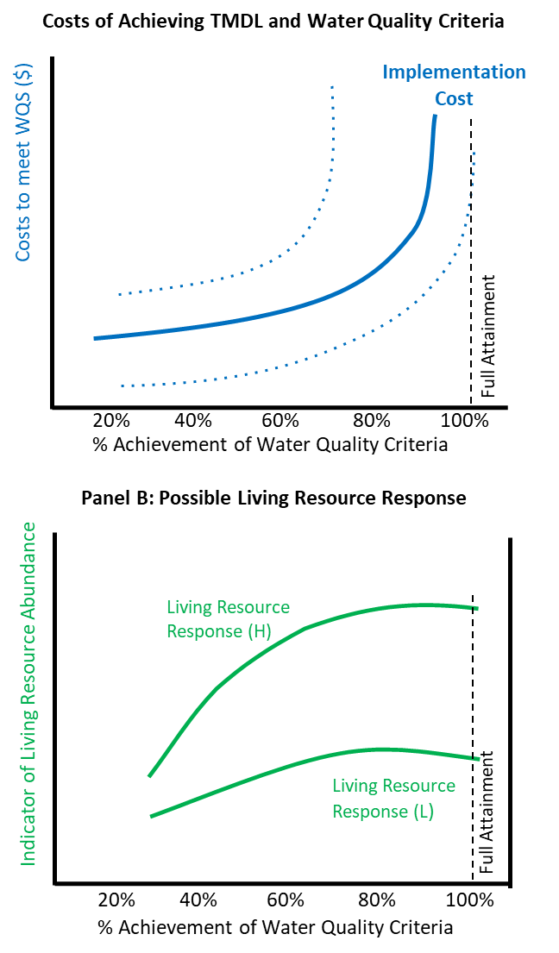
Implications
Full attainment may not be necessary to improve and support living resources goals
Notes:
Gaps are shifting the cost of attainment curve
Costs expected to increase rapidly
May never intersect full attainment.

Slide 7


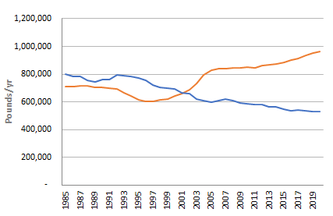
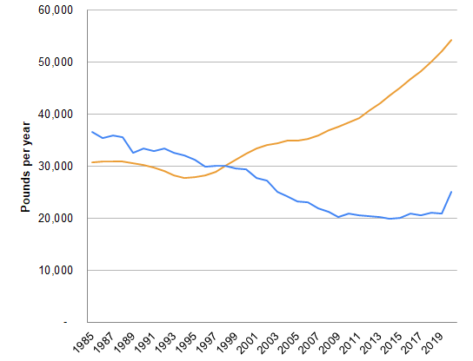
Difference between expected and observed outcomes
Flow normalized Load
Flow normalized Load
Response gap
CAST
CAST
Notes:
There is a disconnect….
Many in the CBP believe that CAST under credits BMPs. Adding more BMPs to CAST will only make the response gap larger… Adding more BMPs to CAST will make it easier on paper to meet TMDL and further from achieving outcomes in the real world.

Slide 8
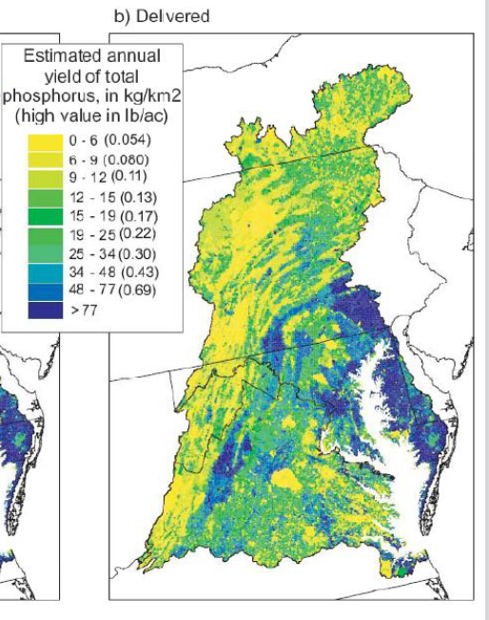
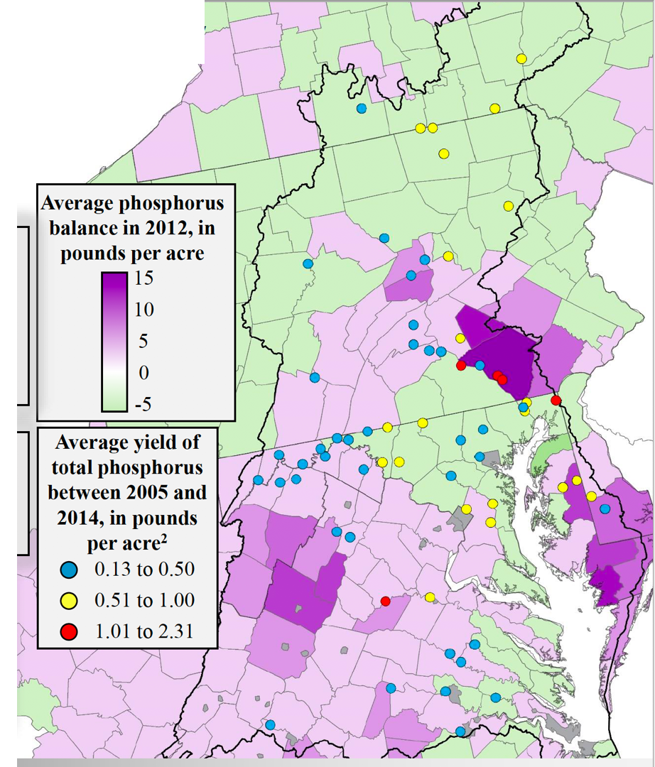
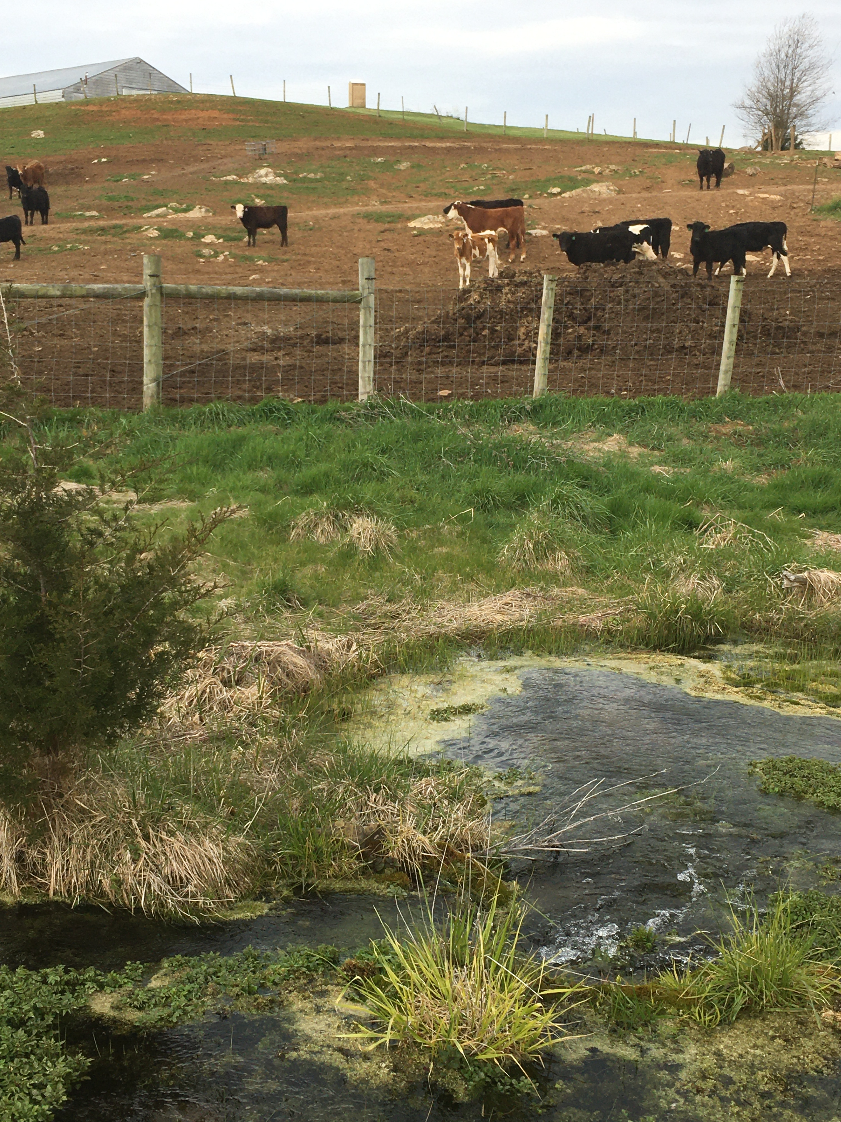
Nutrient Mass Balance
Moyer et al. 2107, Webber, 2017
Source: USGS Sparrow Model Output

Slide 9
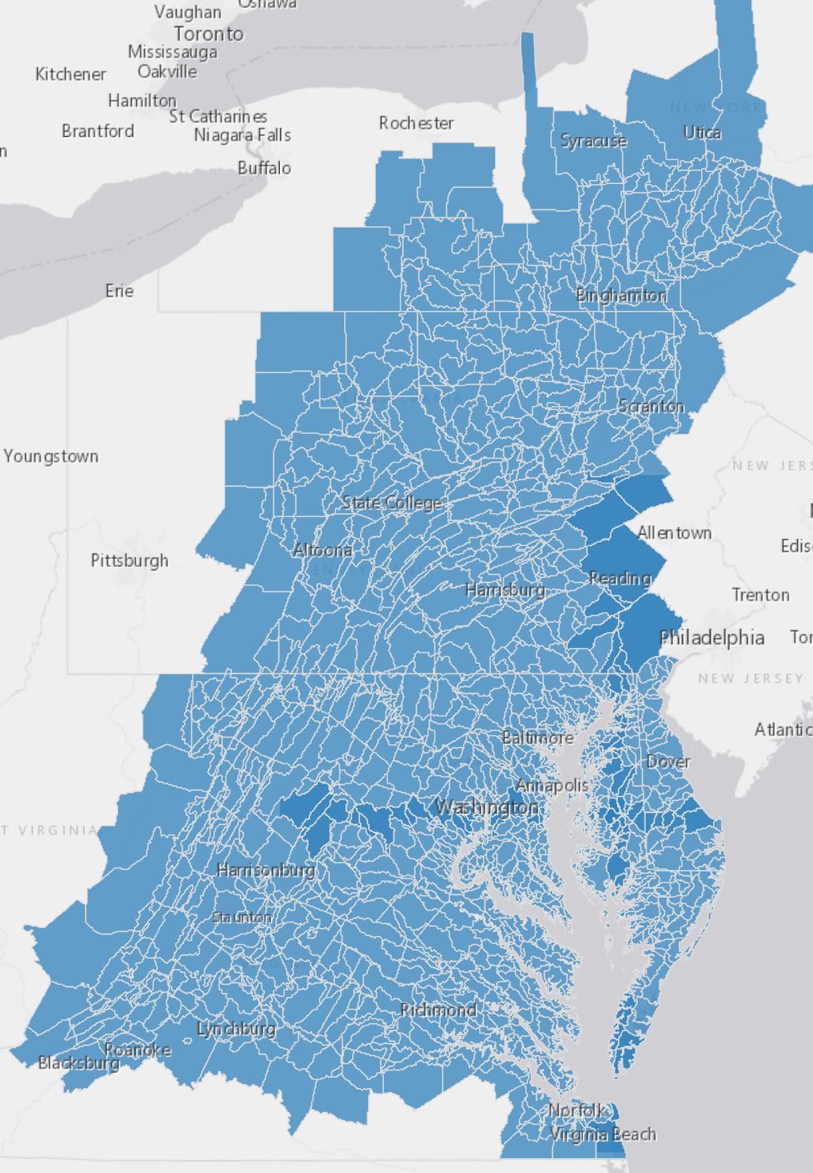
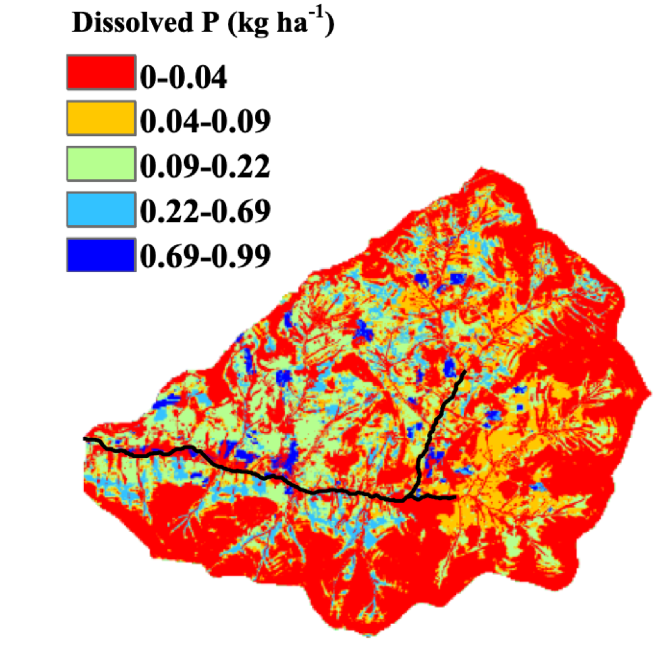
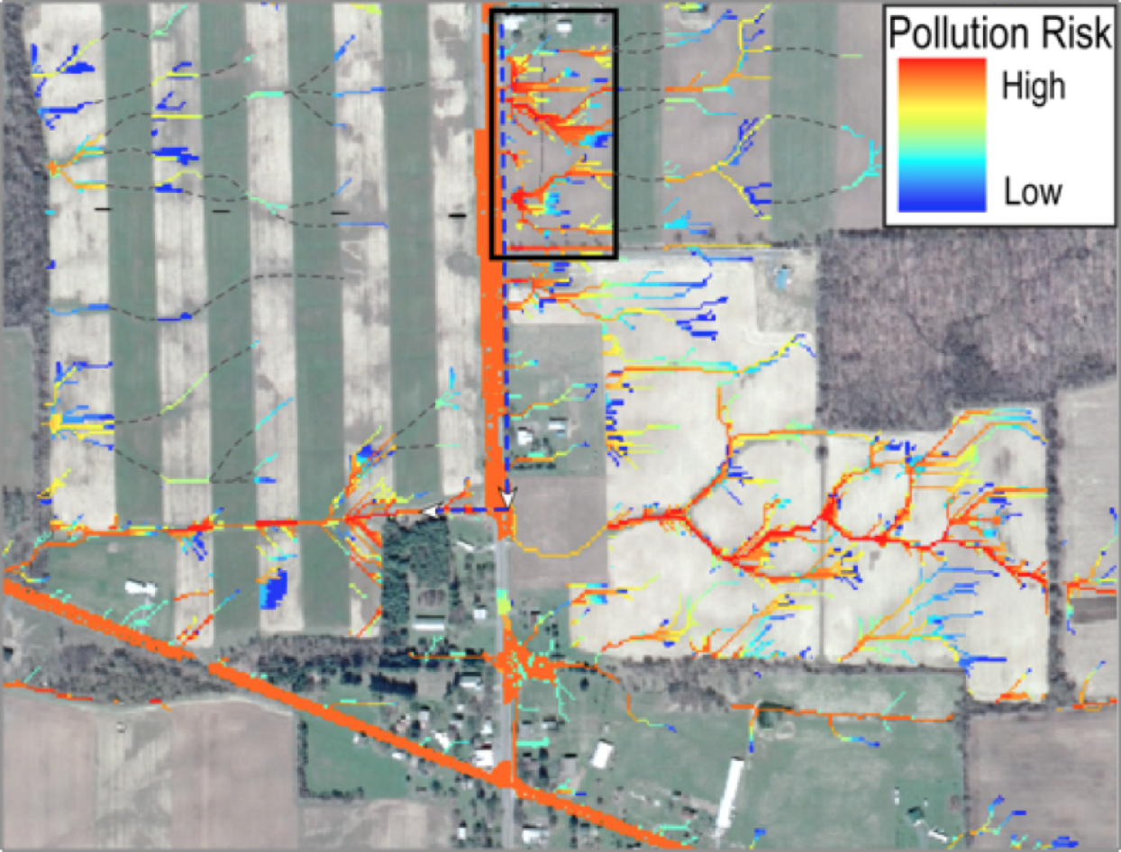
Basin
9,000 acre sub-watershed
Improve tools and incentives for targeting
Nutrient loads are highly variable across the landscape across multiple scales (including across land managers).
Total phosphorus balance across 58 dairy farms in Shenandoah Valley Virginia, 2018
25 acre parcel
Quartile | Total P balance (kg/ha)
Minimum | -30.9
1st Quartile | 1.5
Median | 12.4
3rd Quartile | 18.7
Maximum | 97.6
(Source: Pearce & Maguire 2020)
Notes:
Studies suggest 5-20% of the land area generates 50-90% or more of runoff and nonpoint source loads
Within fields, nutrient losses may be confined to relatively small areas that with the correct targeting and incentives may be easily treated.
Others have found that targeting BMPs to sites with higher pollution potential can improve cost effectiveness of pollution reduction efforts

Slide 10
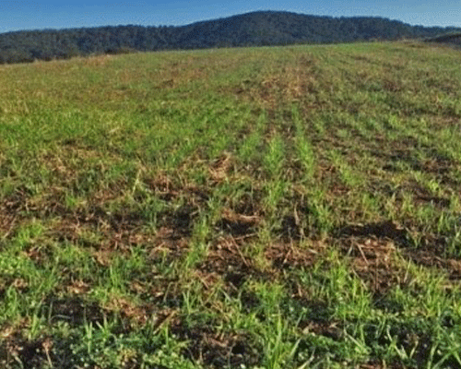
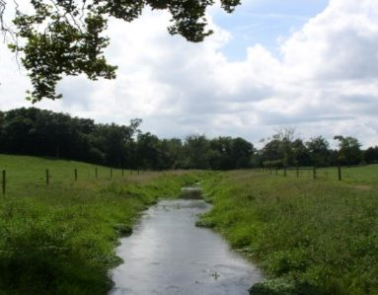
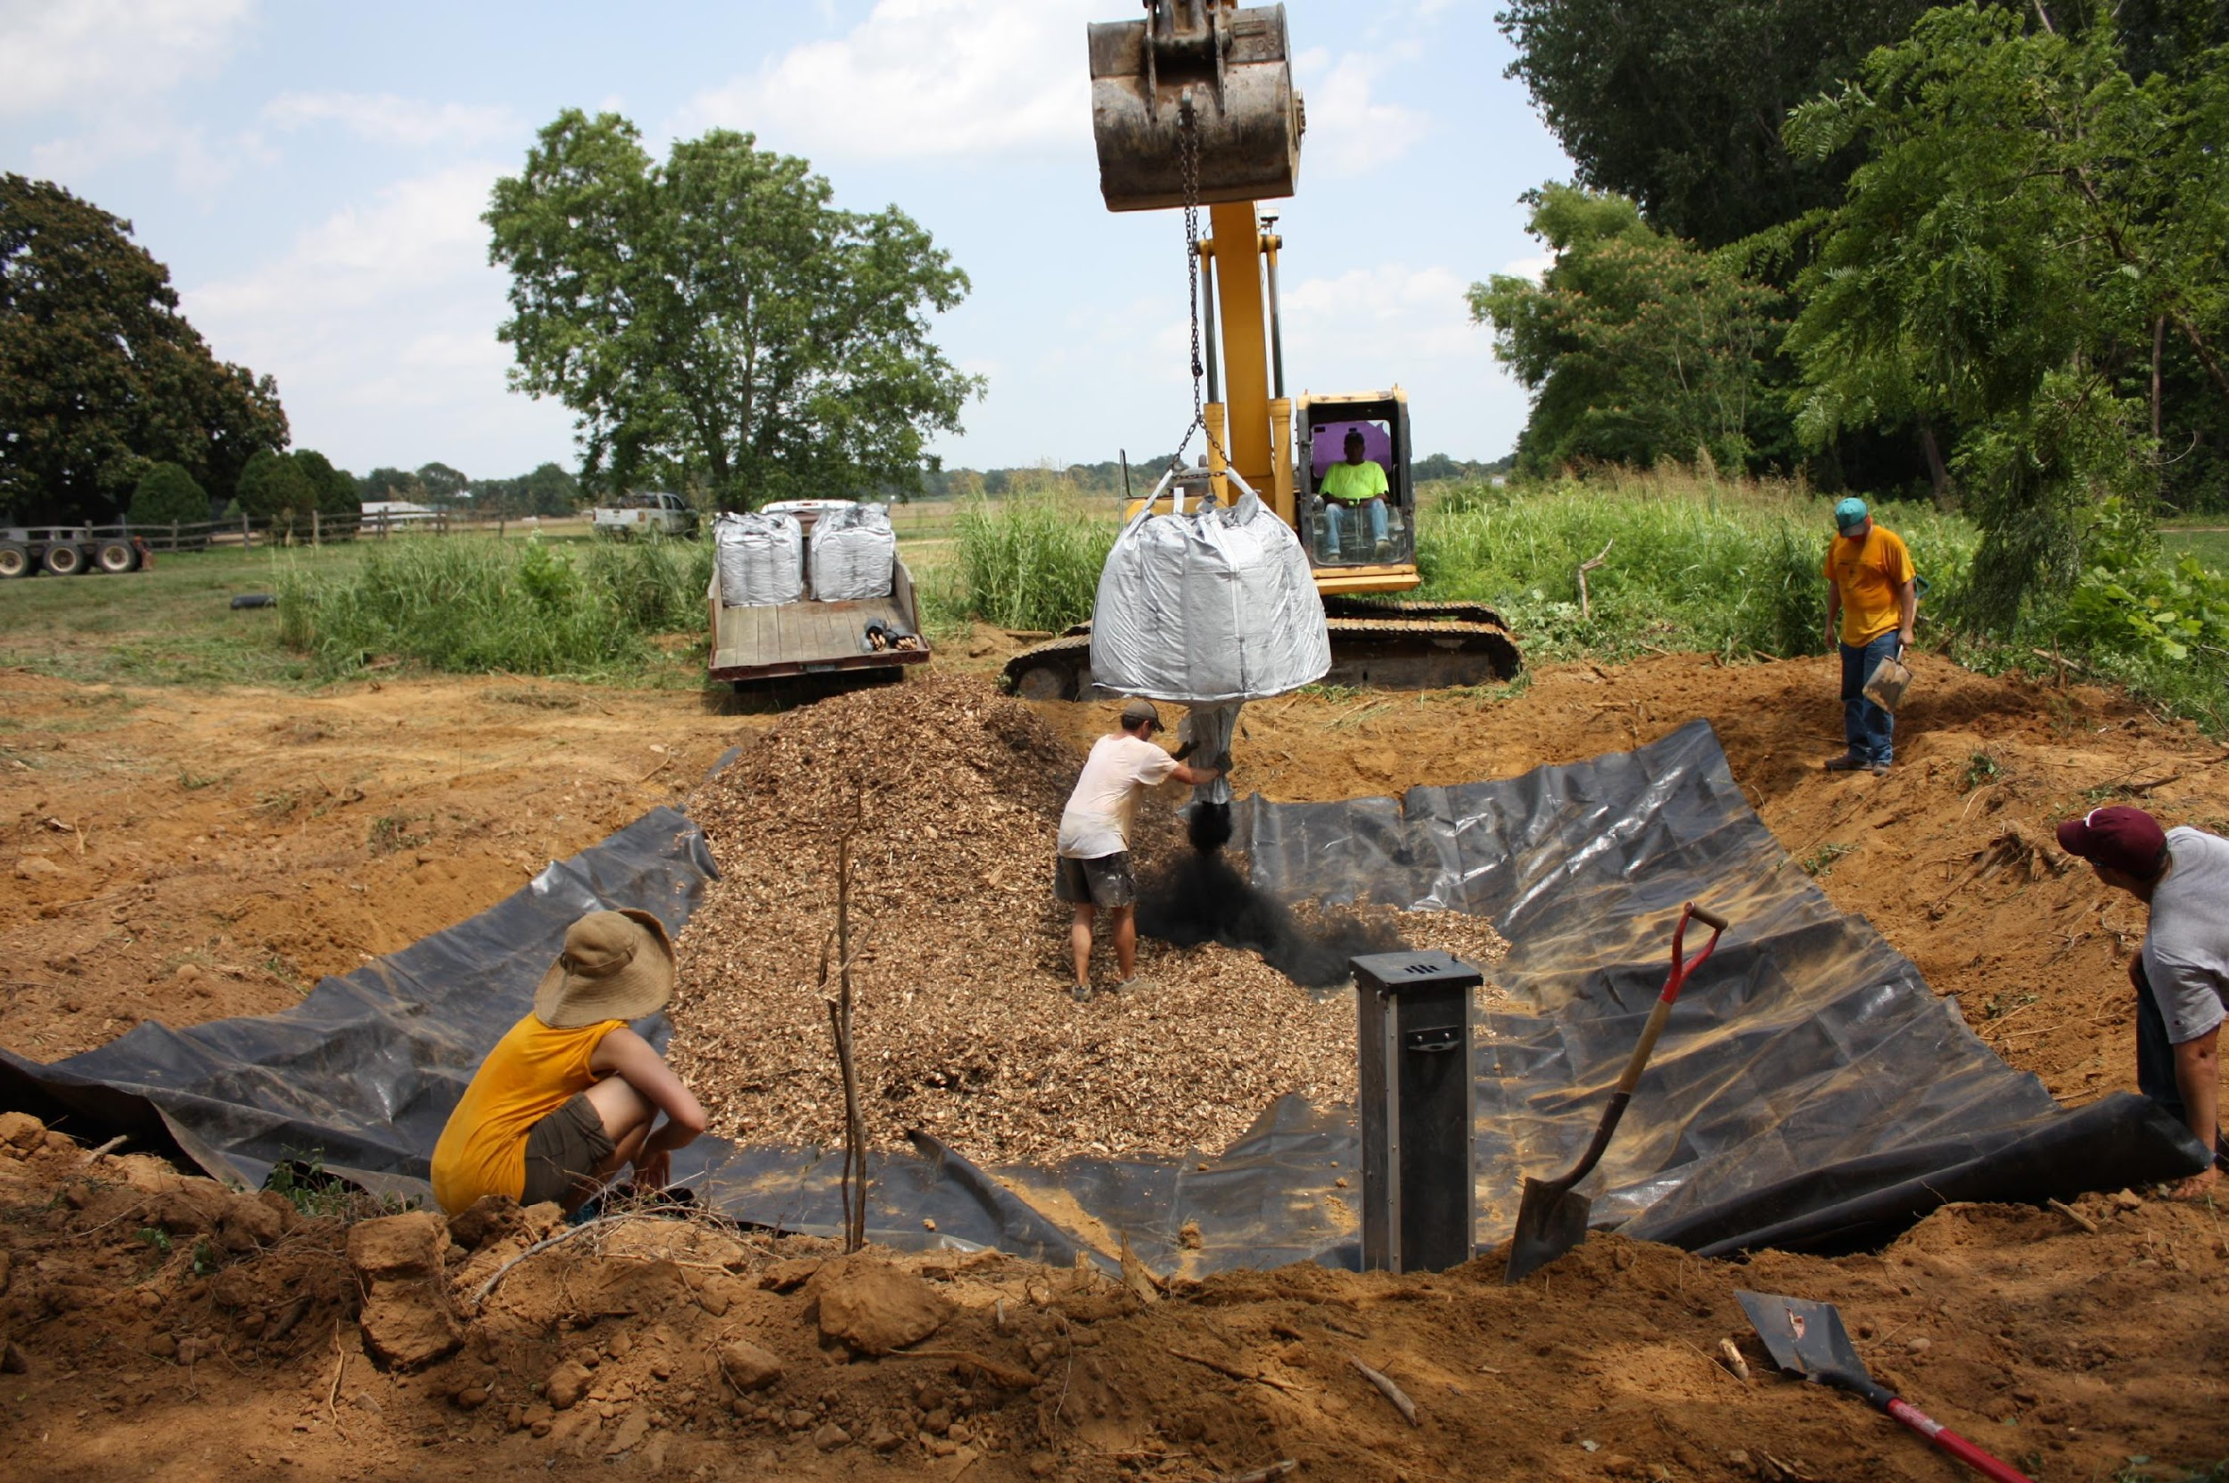
Incentivize Outcomes
Cover crops
Livestock Exclusion Fencing
Denitrifying Bioreactor
Low upfront installation costs Private benefits
High up front installation costs
No private benefits

Slide 11
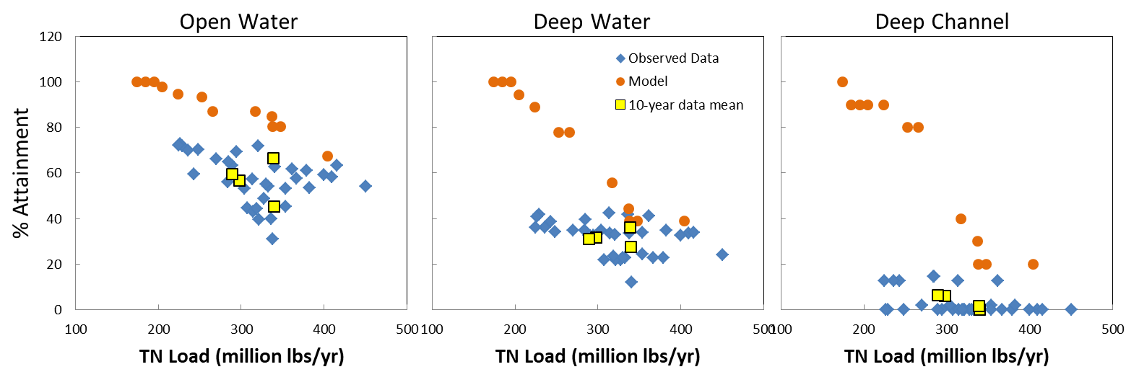
Finding: DO Response across Habitats
Response gap
Response gap
Expected and realized relationships between TN loads and DO criteria attainment for open water, deep water, and deep channel habitat, calculated as 3-year running mean observed values (blue diamonds) and expected responses from estuary model (orange dots) for the same time periods. Yellow squares are 10-year means of the observed data.

Slide 12
Trajectories of Response
Possible Recovery Trajectories
Degradation
Hypoxia Intensity
Trajectory unable to return to initial state
Climate change
Tipping points
Biotic communities
Land use/land cover
Attainment of WQS
Increasing Nutrient Loads
Nutrient loading at which system will reach attainment
Nutrient loading at which system fell short of attainment
Notes:
Here is my thinking on a variant of your graphic… including a return to neverland idea.

Slide 13
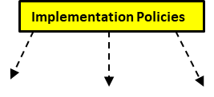
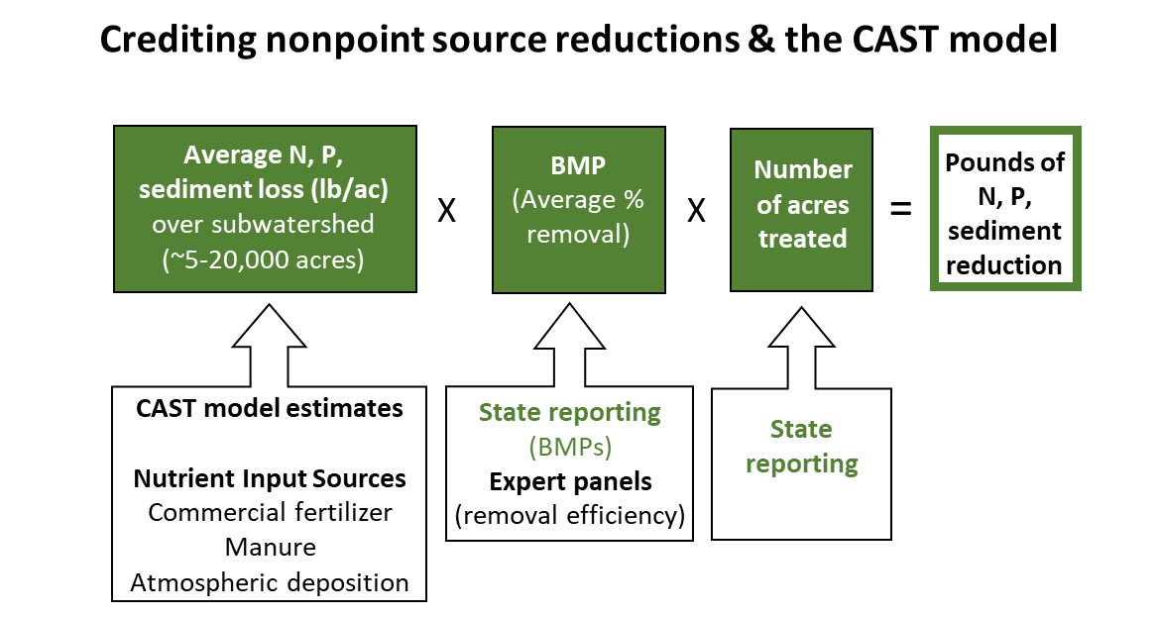
Nonpoint Source Implementation Policy
Voluntary Financial Assistance: Cost-Share
Offer $ based on portion of installation cost of a practice
$
Land Manager
Cost
BMP

Slide 14
Achieving TMDL: Finding: Nonpoint source programs are not generating the scale of reductions needed to achieve TMDL
Two Challenges
1) Nonpoint source programs not generating sufficient levels of adoption/behavior change
2) The actions/practices being implemented may not be as effective as expected in producing pollutant reductions

Slide 15
Nonpoint source programs are not generating enough adoption/change (“implementation gap”)
Controllable N Loads to the Chesapeake Bay, 2021 (estimated by CAST Model)
Total nonpoint source reduction achieved from 2009-2021
Urban
Millions of lbs/yr
Ag
+50 million lb/yr N reduction needed

Slide 16
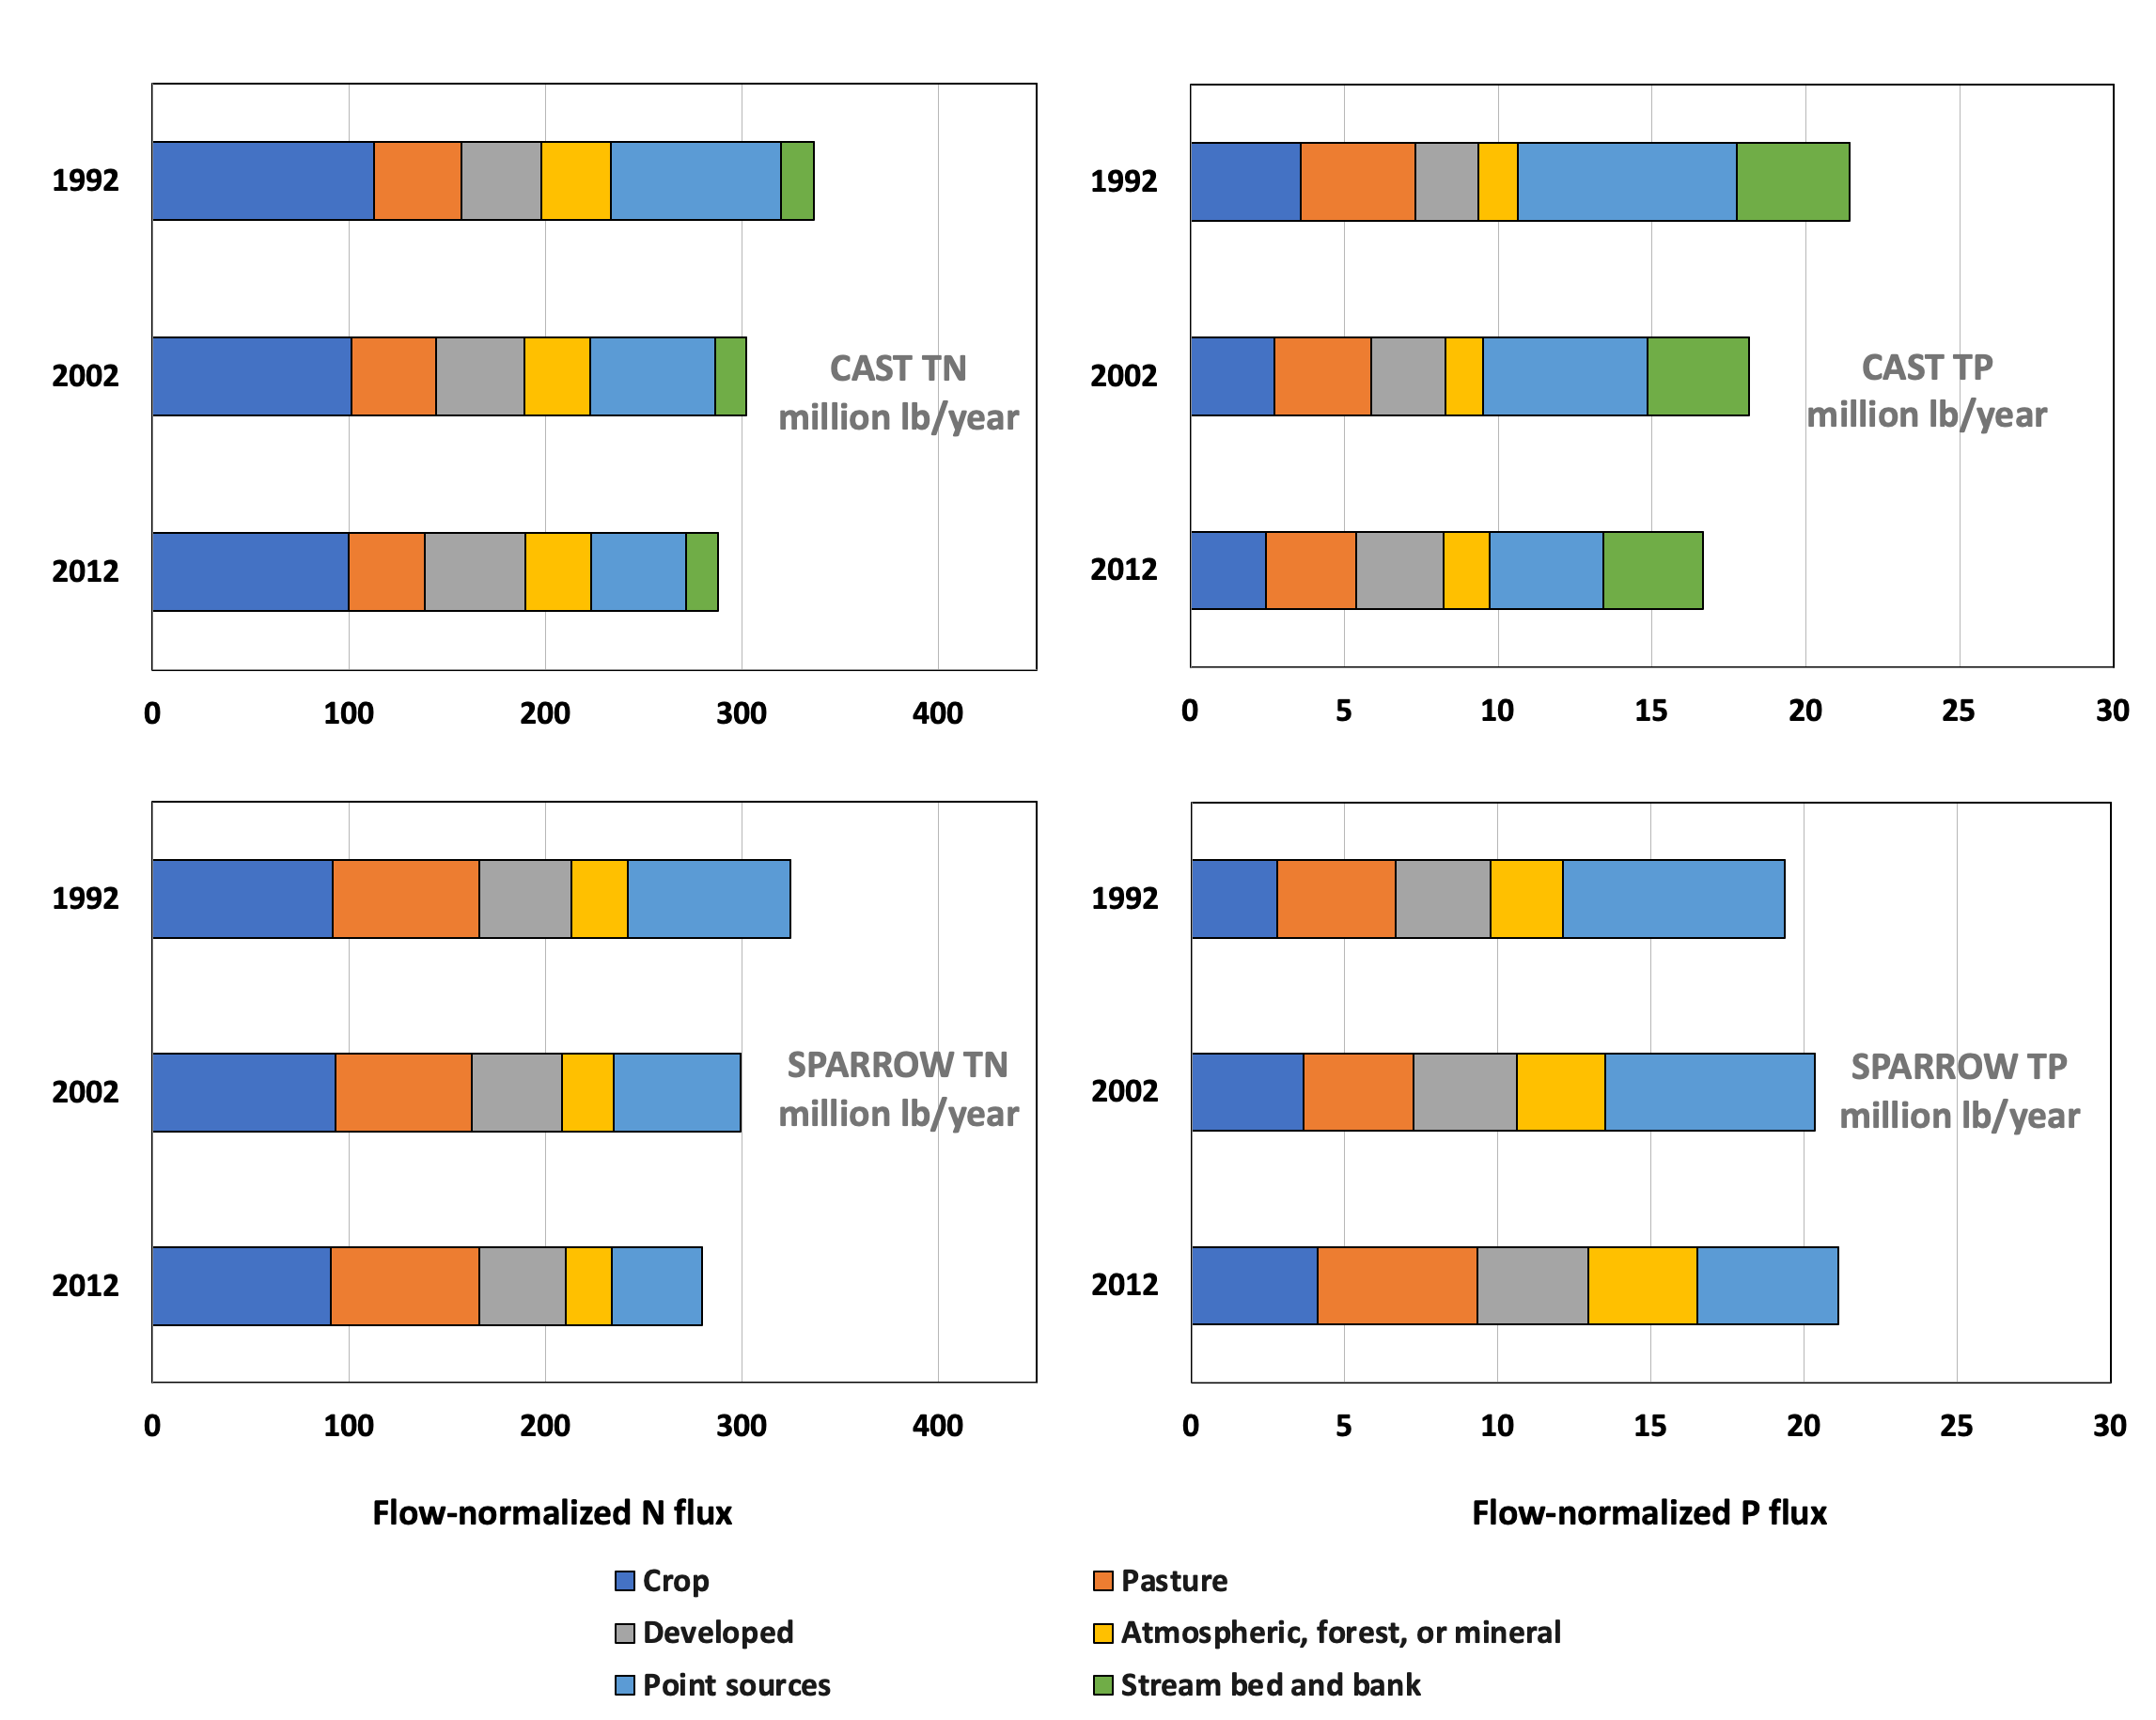
Nitrogen
Phosphorus
Nonpoint source programs may not be as effective as expected
Estimated flow-normalized total and source sector TN and TP fluxes to the Chesapeake Bay for the CAST and SPARROW models
Ator et al. 2020
Notes:
The nonpoint source challenge NPS control efforts (BMPs) are effective, but response has not (yet) been detected i) Legacy Nutrients and Lag Times Mask BMP effectiveness ii) NPS BMPs and NPS policies are not as effective as predicted a) BMP Performance Effectiveness Estimates b) Spatial distribution of BMPs with respect to pollutant sources c) Uncertainty both in behavioral response to nonpoint source control measures and in BMP effectiveness

Slide 17
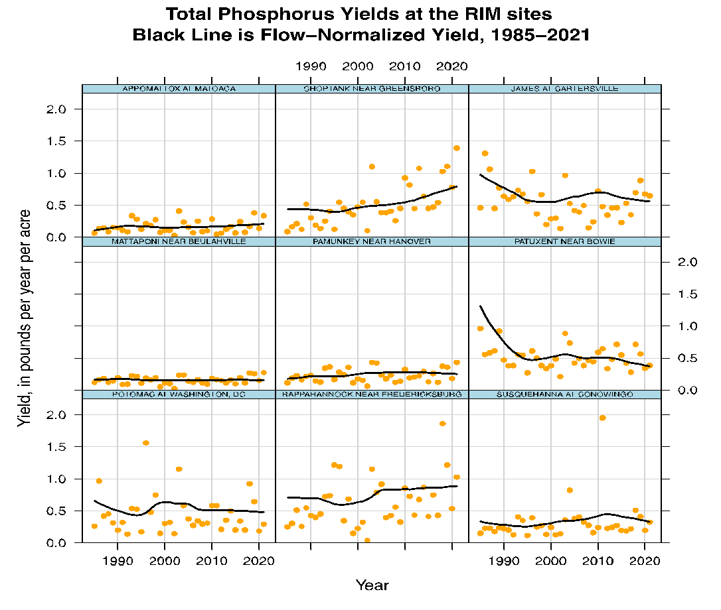
Total Phosphorus Yields at the RIM sites
Black Line is flow Normalized Yield, 1985-2021
Source: Mason and Soroka, 2022
Notes:
Progress? Maybe in the light of climate change, population growth, agricultural intensification, etc

Slide 18
Achieving TMDL: Implication: To substantially improve nonpoint source outcomes will require new programs and approaches
Ideas to improve nonpoint source program effectiveness

Slide 19
Incentive Programs
Voluntary Financial Assistance: Cost-Share
Offer $ based on portion of installation cost of a practice
$
Land Manager
Cost
BMP
Payment for outcomes/success
Offer $ based on producing an outcome
Revenue $
Land Manager
Cost
Behavior change
Outcome

Slide 20
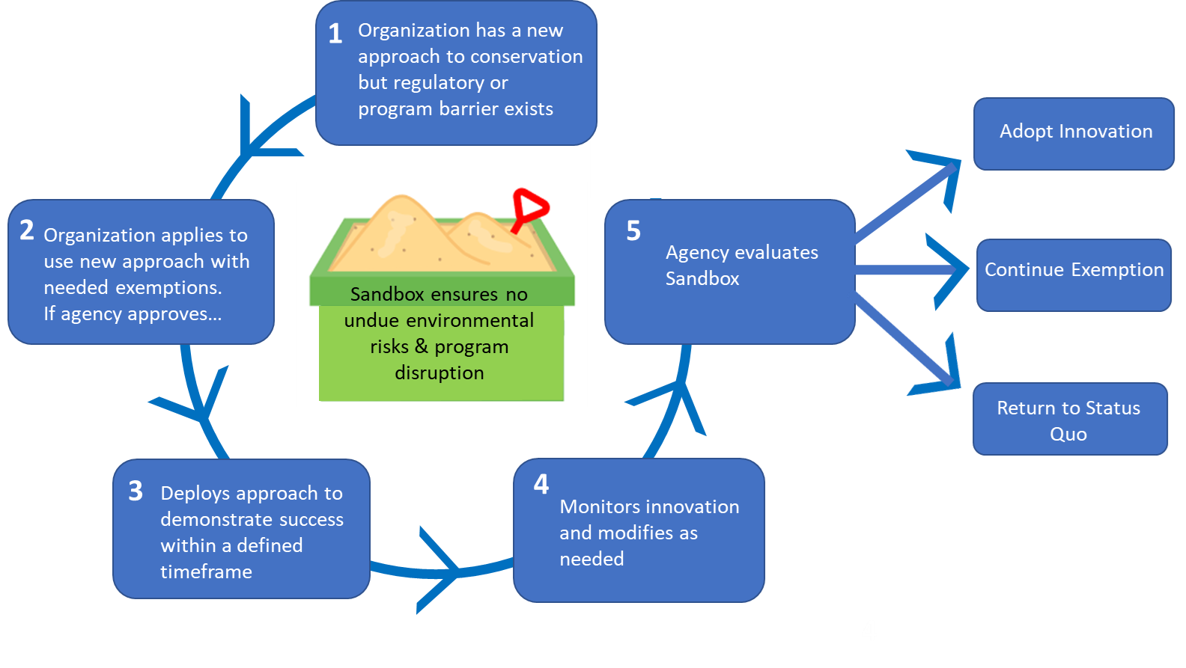
Encourage Institutional/policy Innovation
Sandboxing
Ideas for what to “Sandbox”
TMDL accounting & accountability (alternative to CAST)
Types of outcome-based incentive programs
Alternative regulatory programs
The Sandboxing Process (Figure adapted from Higgins and Male, 2019)

Slide 21
Achieving Water Quality Standards:
Findings: Bay water quality is improving, but the magnitude of the improvement appears to be lagging behind expectations

Slide 22
Achieving Water Quality Standards:
Costs of Achieving TMDL and Water Quality Criteria
Implementation Cost (w response gaps)
Implementation Cost (expectations)
Costs to meet WQS ($)
Implications: Full (100%) achievement of Bay water quality standards is a distant and doubtful.
Full Attainment
20% 40% 60% 80% 100%
% Achievement of Water Quality Standard

Slide 23
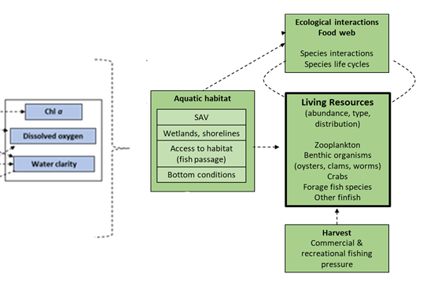
Living Resource Response

Slide 24
Living Resource Response
Living resource response to attainment of water quality standards
Findings: The impact of WQ improvements on living resources depends on where WQ improvements occurs, antecedent conditions, & impact varies across species.
Indicator of living resource abundance
Full attainment
20% 40% 60% 80% 100%
% Attainment of WQS

Slide 25
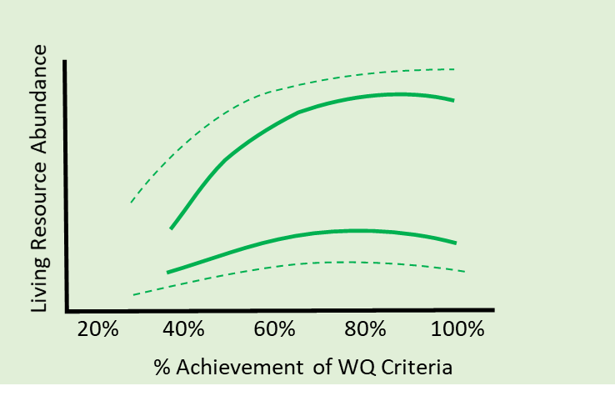
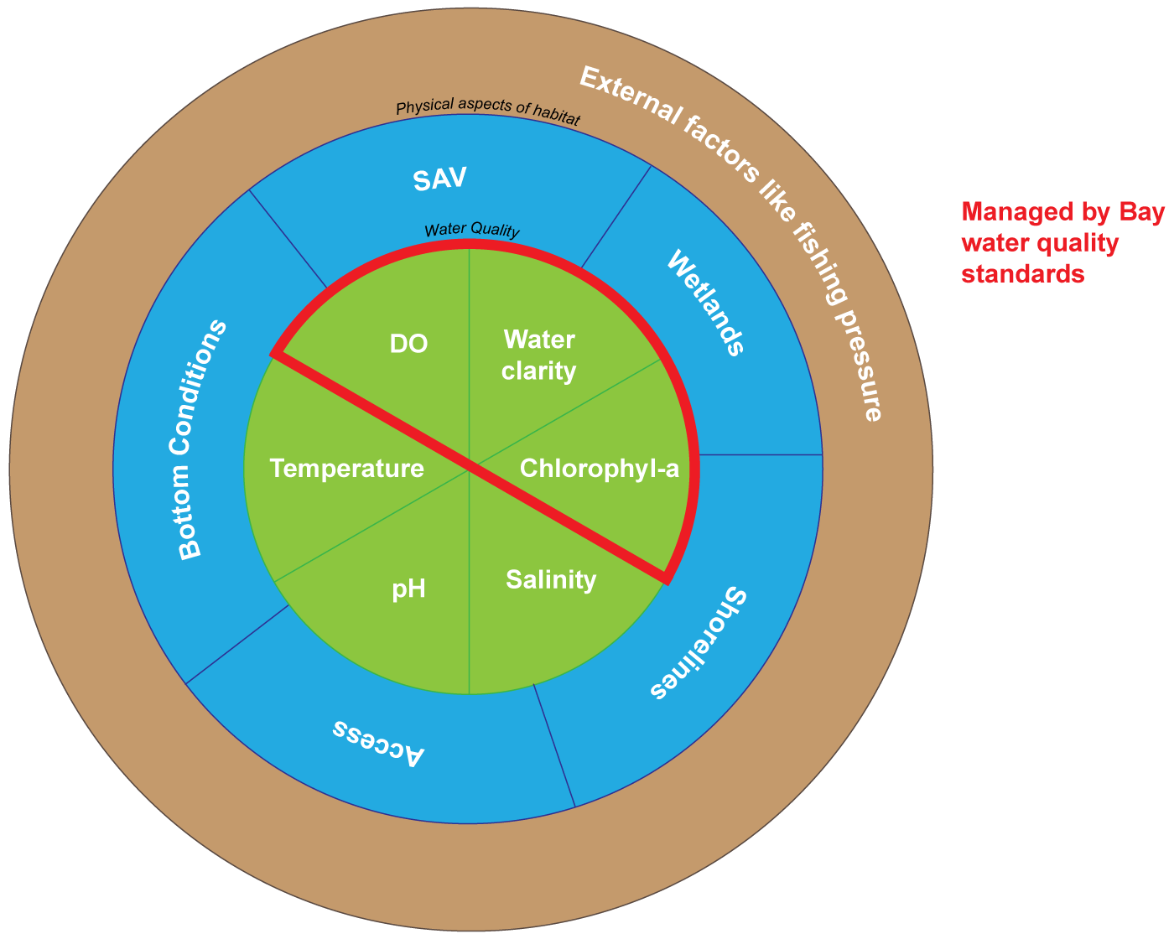
Boosting Living Resource Response

Slide 26
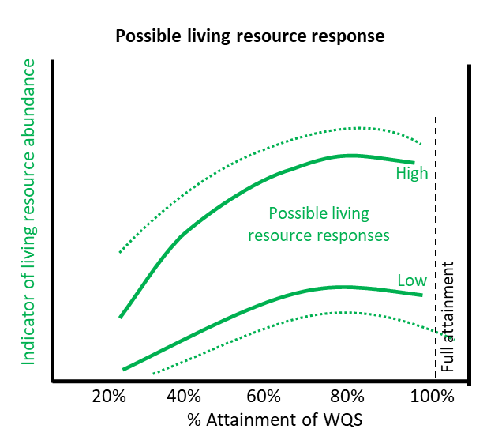
Living Resource Response
Implications: Potential to increase the impact on living resources from our WQ and restoration investments

Slide 27
Implications
Full attainment may not be necessary to improve and support living resources goals
Notes:
Gaps are shifting the cost of attainment curve
Costs expected to increase rapidly
May never intersect full attainment.

