Slide 1
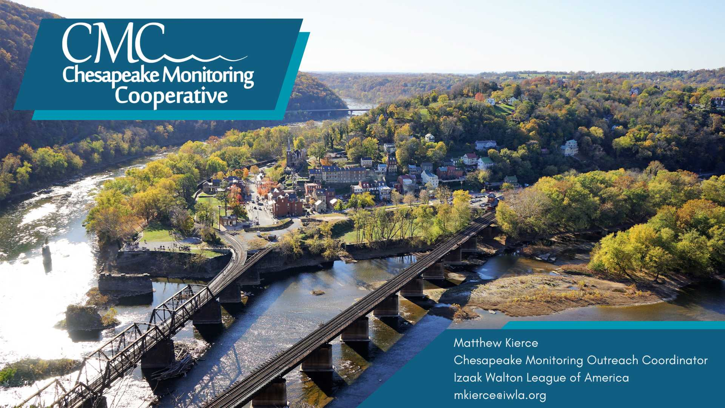
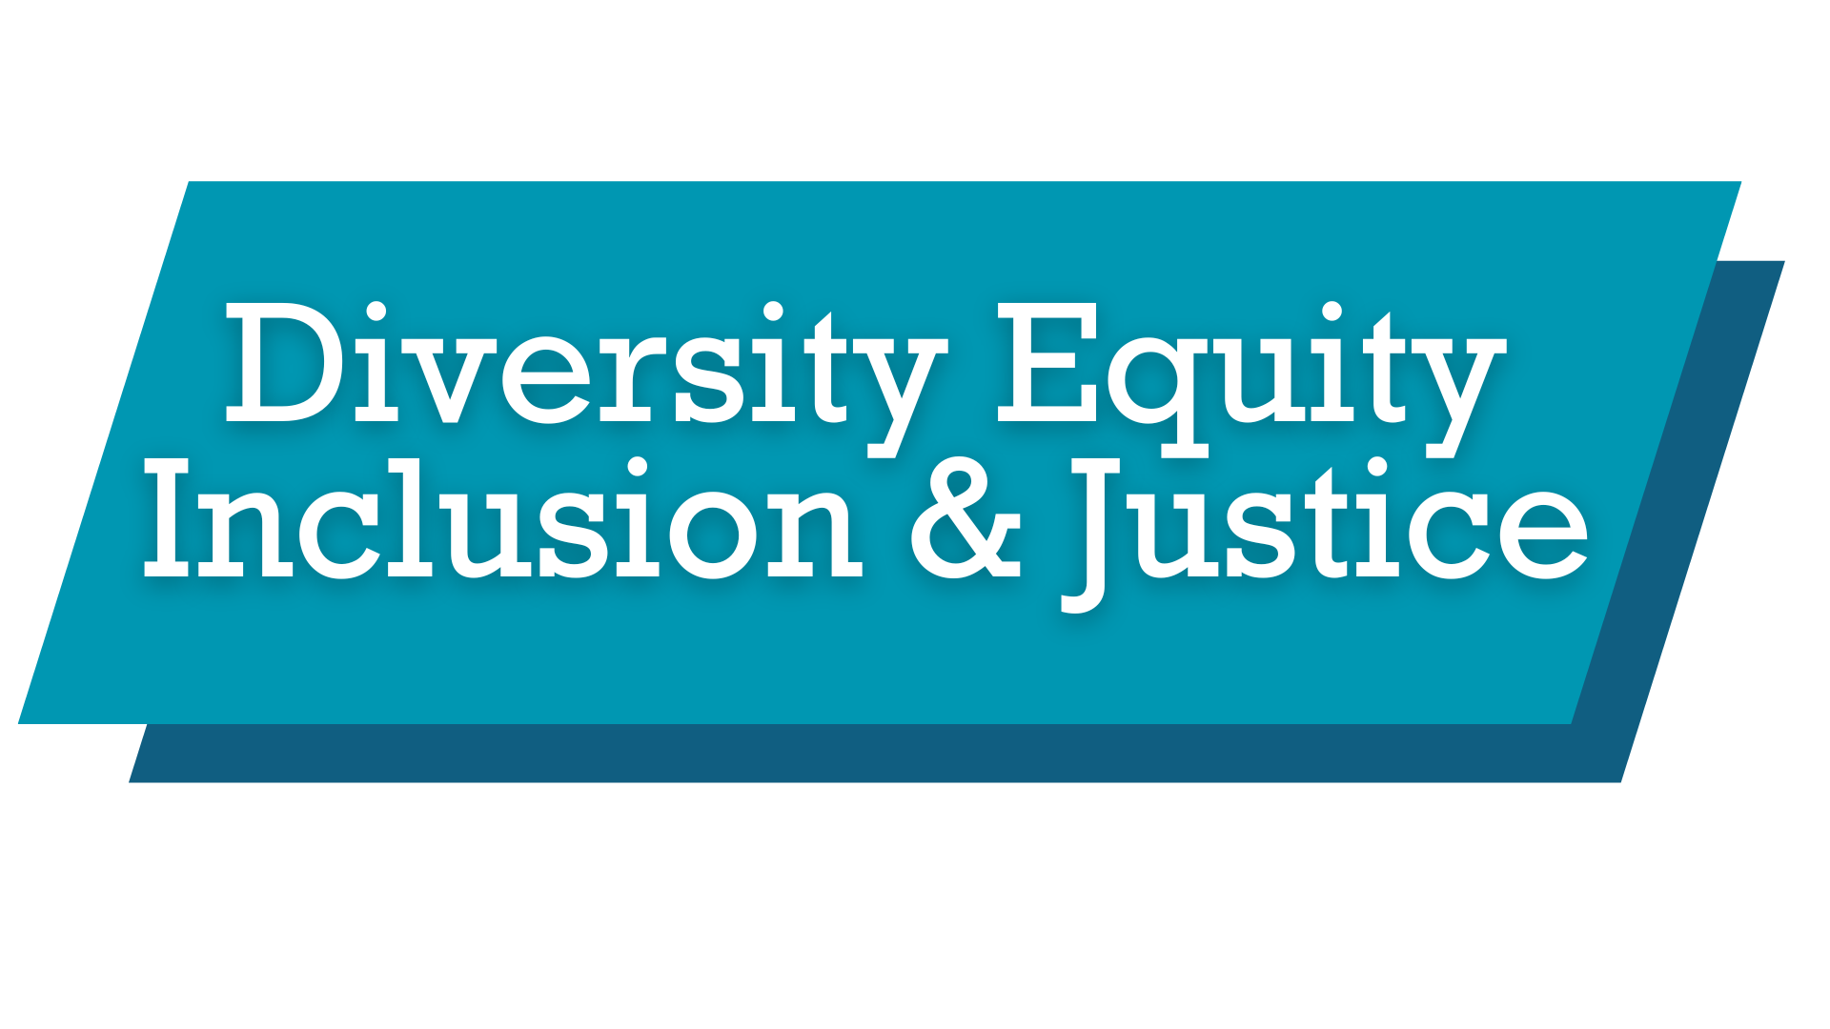

Slide 2
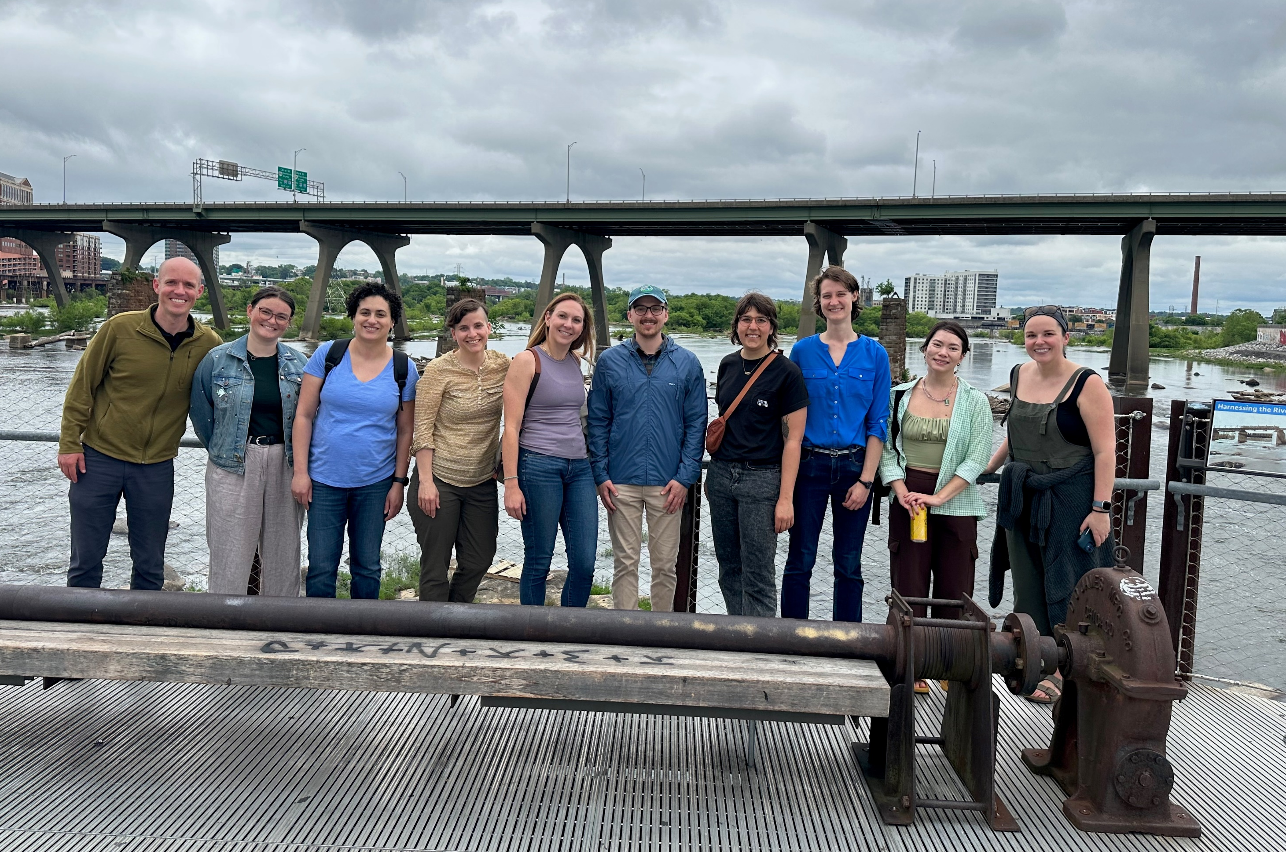

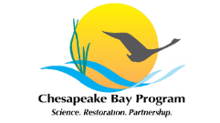

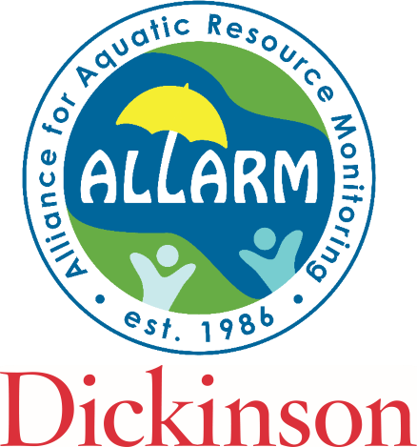


CMC Background
We aim to provide technical, logistical, and outreach support for the integration of volunteer-based and nontraditional water quality and benthic macroinvertebrate monitoring data into the Chesapeake Bay Program (CBP) partnership.
CMC development team partners & service providers:

Slide 3

Disclaimer
While this presentation covers our efforts to enhance DEIJ at the CMC I want to acknowledge:
  I am not an expert and do not share the lived experiences of underrepresented communities.
  My aim is to share our initiatives, and I am open to learning from those with lived experiences to better guide our work and to continue to increase the accessibility of water monitoring.

Slide 4


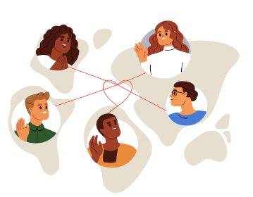
DEIJ - What?
Volunteer water monitoring is crucial but can be limited by systemic barriers and privileges
The Chesapeake Monitoring Cooperative (CMC) is focused on democratizing access to water monitoring & data
Dedicated to increasing engagement of underrepresented communities

Slide 5
DEIJ - Why?
Our Mission:
The CMC commits to supporting all partners, communities, and individuals who want to collect, share, interpret, and use water quality data to increase understanding of the Chesapeake Bay watershed health.
Our Vision:
The CMC envisions equitable access to water quality data for all communities. We envision communities use data of known quality to advocate for local change, inform regional watershed management decisions, and improve restoration efforts.

Slide 6
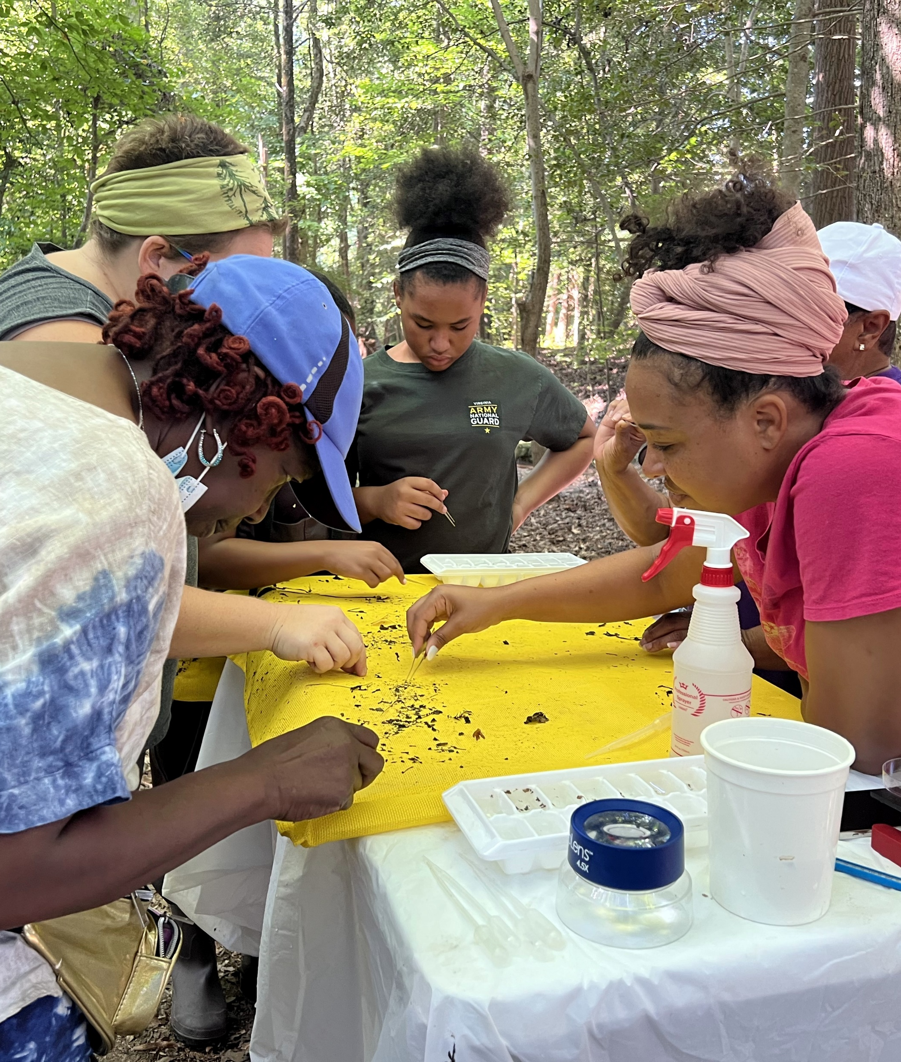
DEIJ - How?
Worked with community and monitoring groups to identify barriers and tailor solutions to community needs.
Created the Community Connection Chart to help new individuals & communities
Developed case studies to highlight successes and impacts

Slide 7
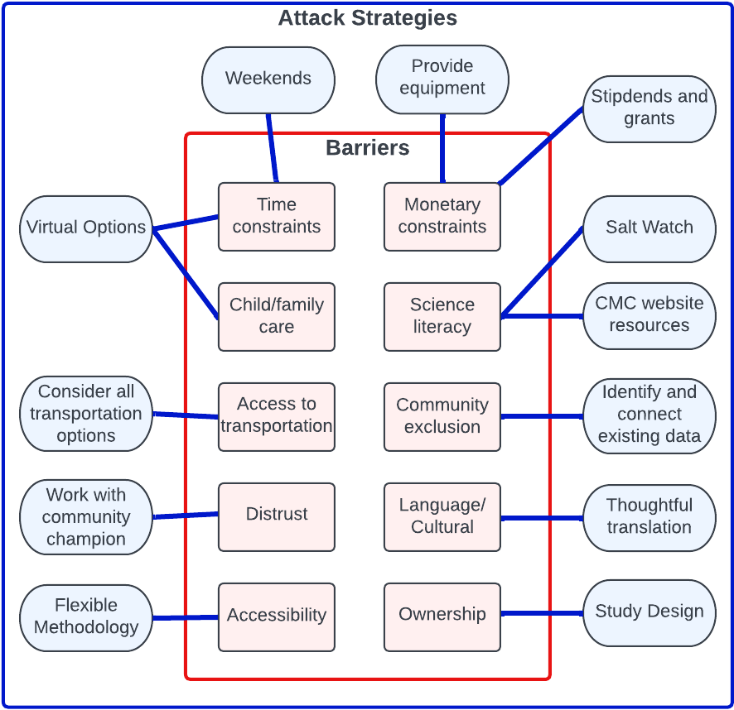
Attacking Barriers
Identify barriers to monitoring & strategies to overcome them
Expand community involvement and foster relationships for new monitoring programs
Next steps: Enhance toolkits and resources to break down these barriers

Slide 8
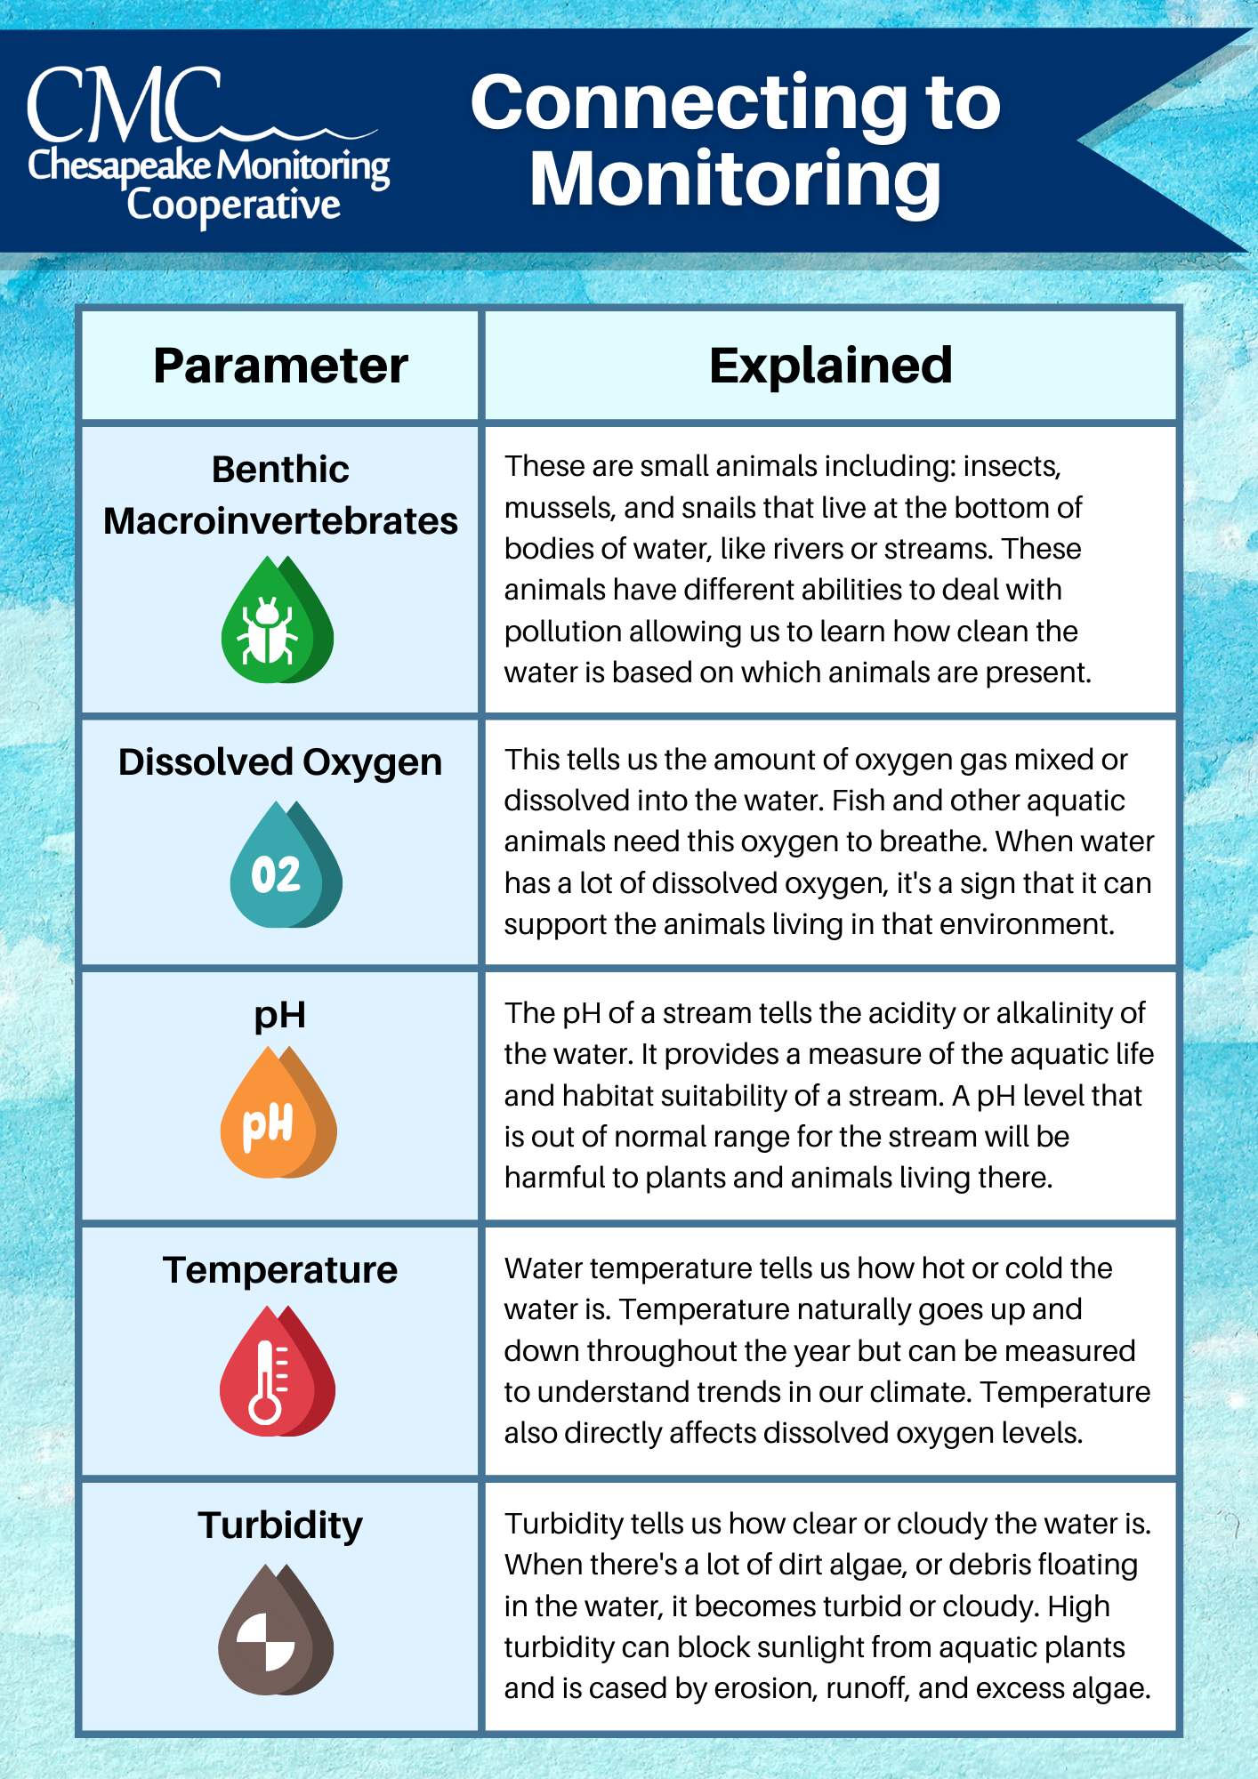
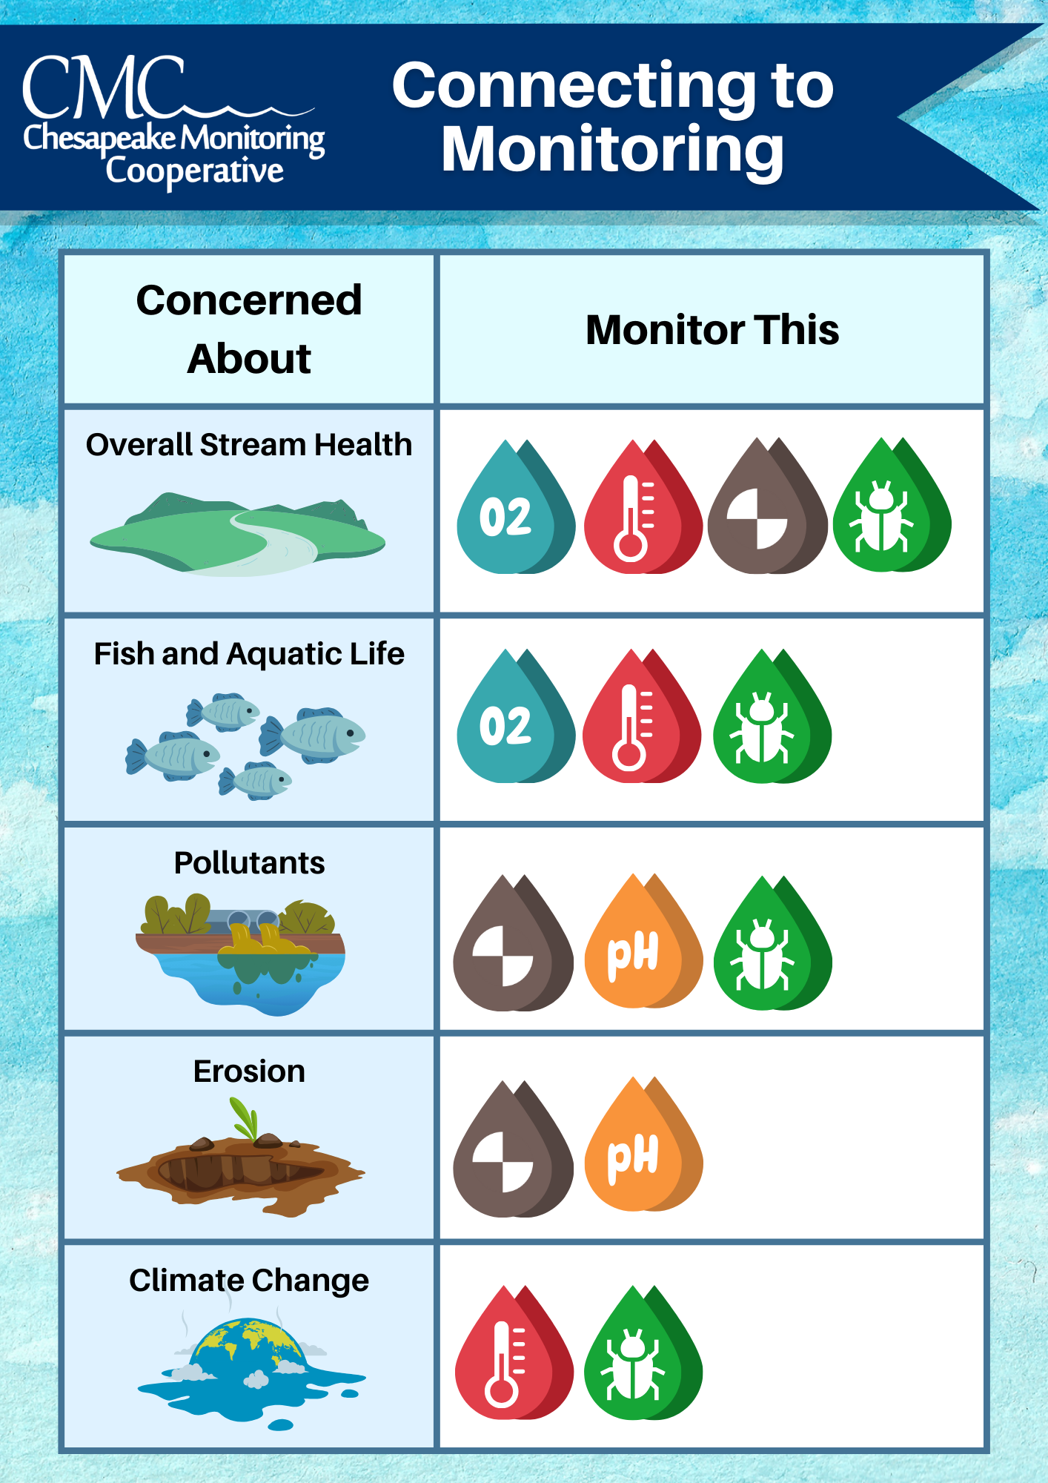
The Community
Connection Chart
Give communities the control
Ownership of monitoring process & the data
Reduce science literacy barriers
Enhance advocacy goals

Slide 9
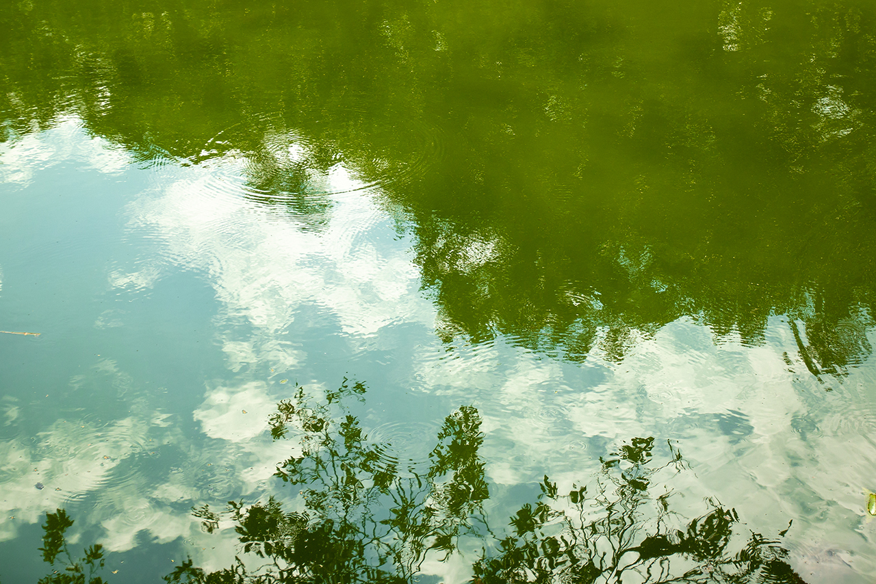
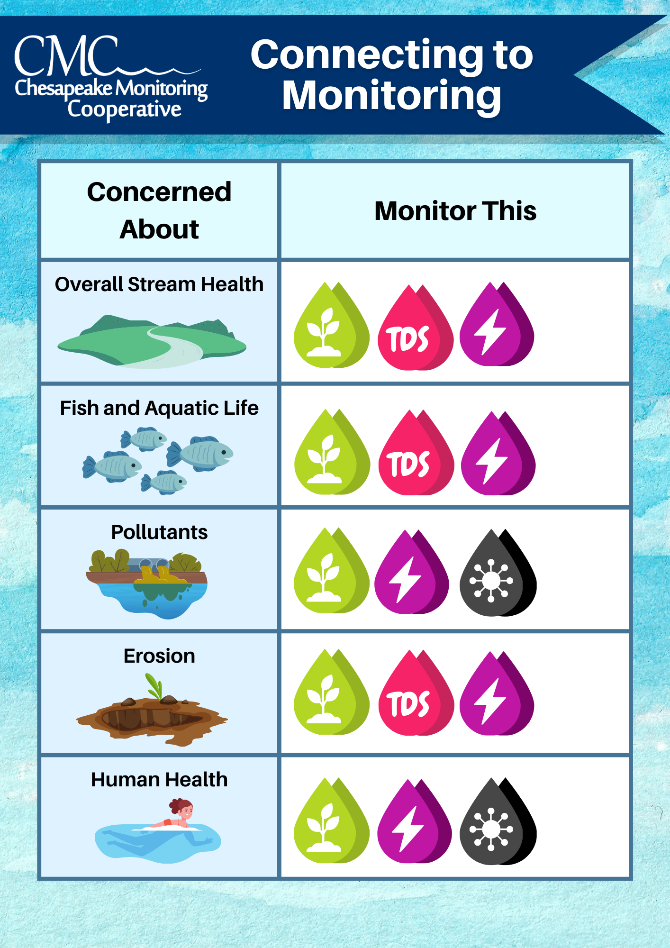
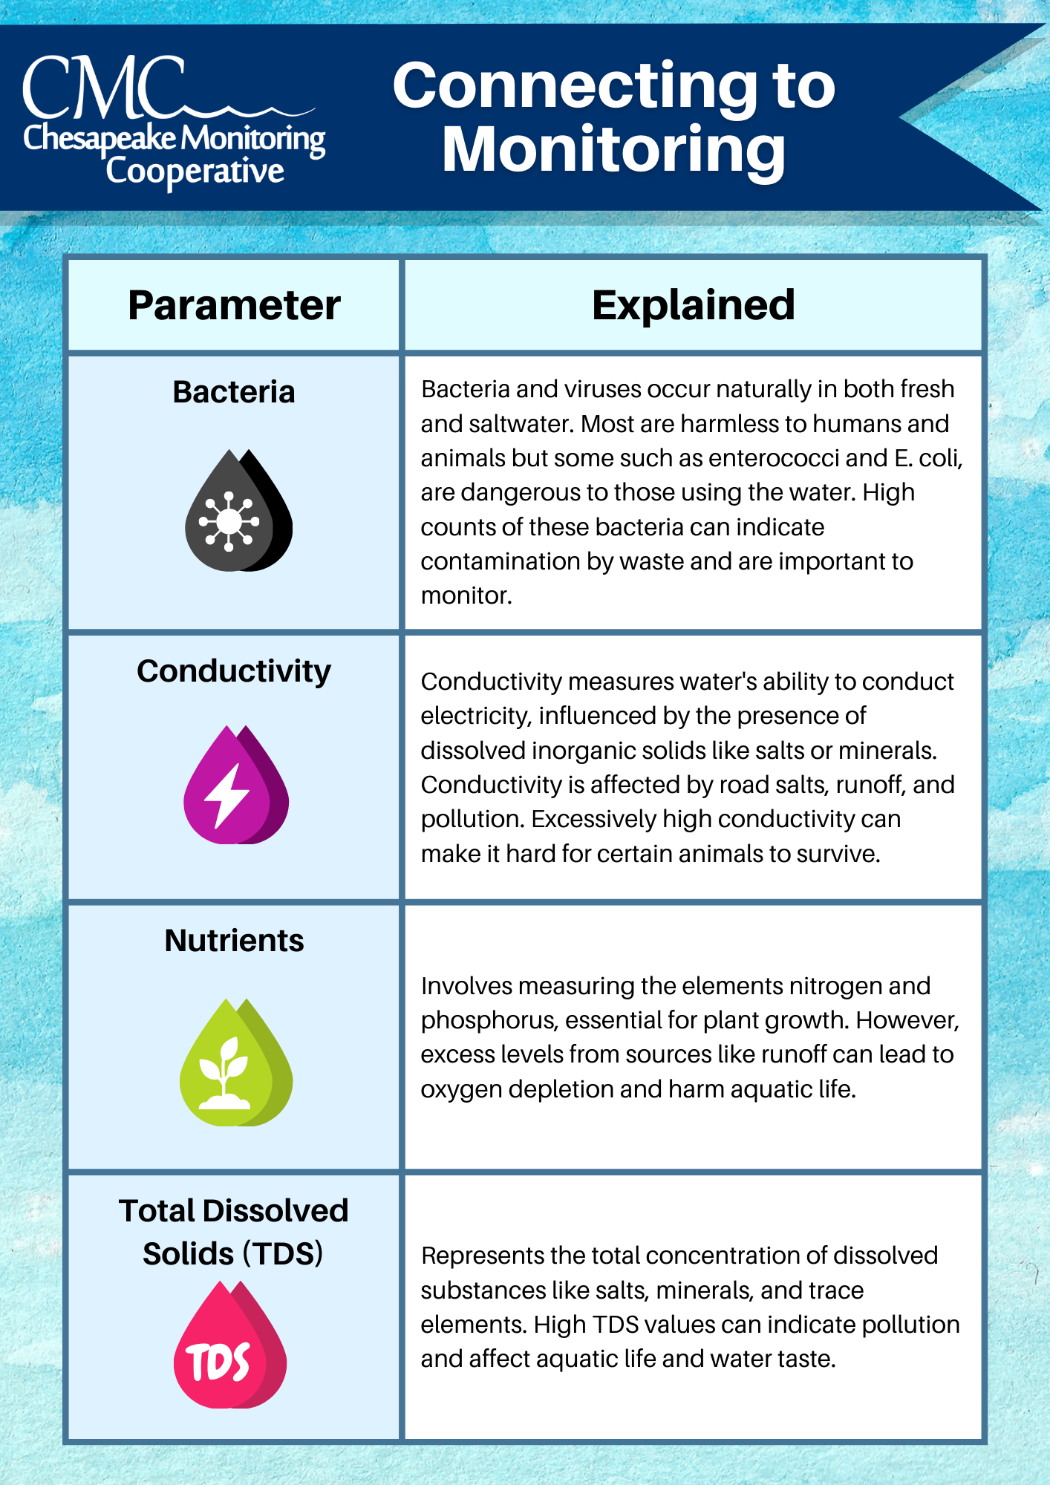

Slide 10
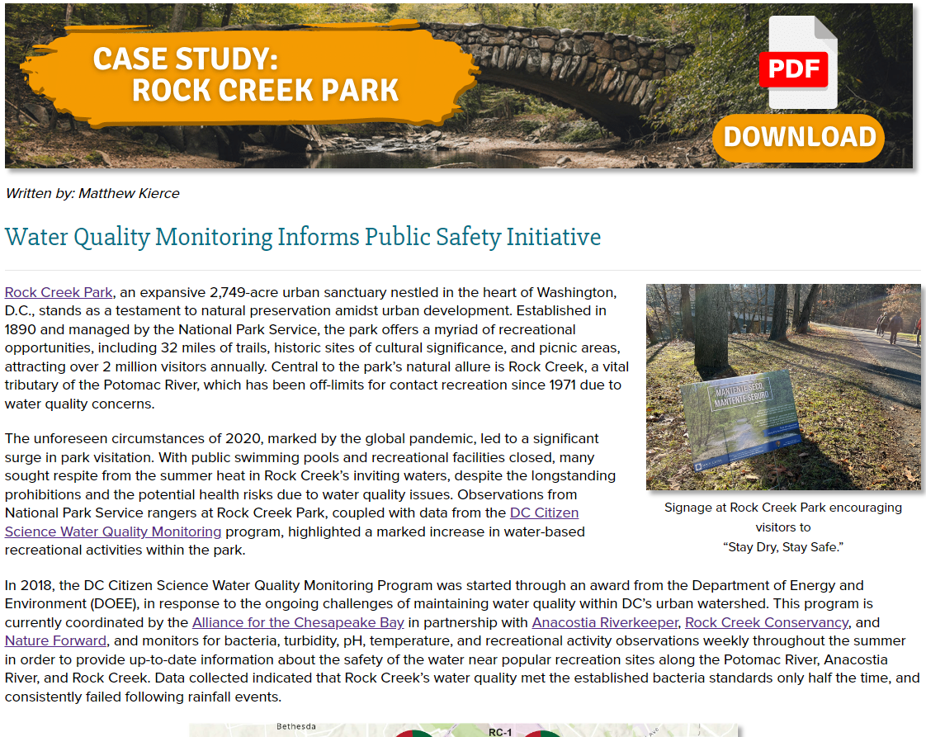
Rock Creek Park, DC
The DC Citizen Science Water Quality Monitoring Program, coordinated by the Alliance for the Chesapeake Bay, provided data on Rock Creek’s poor water quality
Bilingual signs discouraged unsafe water activities, leading to 80% reduction in water-based recreation within weeks
The #RecreateResponsibly campaign effectively raised awareness of water quality risks, promoting safer park usage

Slide 11
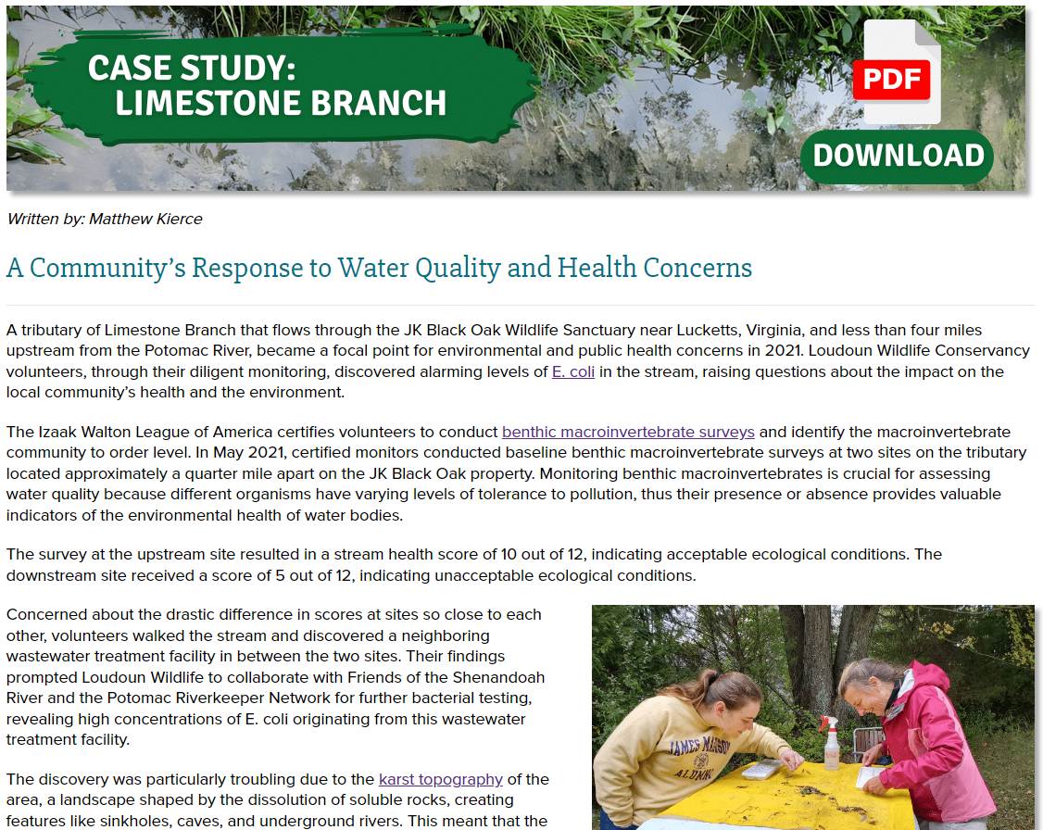
Limestone Branch, VA
IWLA Save Our Streams volunteers discovered low macroinvertebrate scores, leading to identification of E. coli contamination
Loudoun Wildlife Conservancy secured funding to conduct further testing, raise awareness, and provide resources to residents, particularly underserved communities
EPA-mandated actions to address the wastewater issues, and the installation of water filtration systems for 17 Hispanic families, saving the community nearly $250,000 over four years

Slide 12

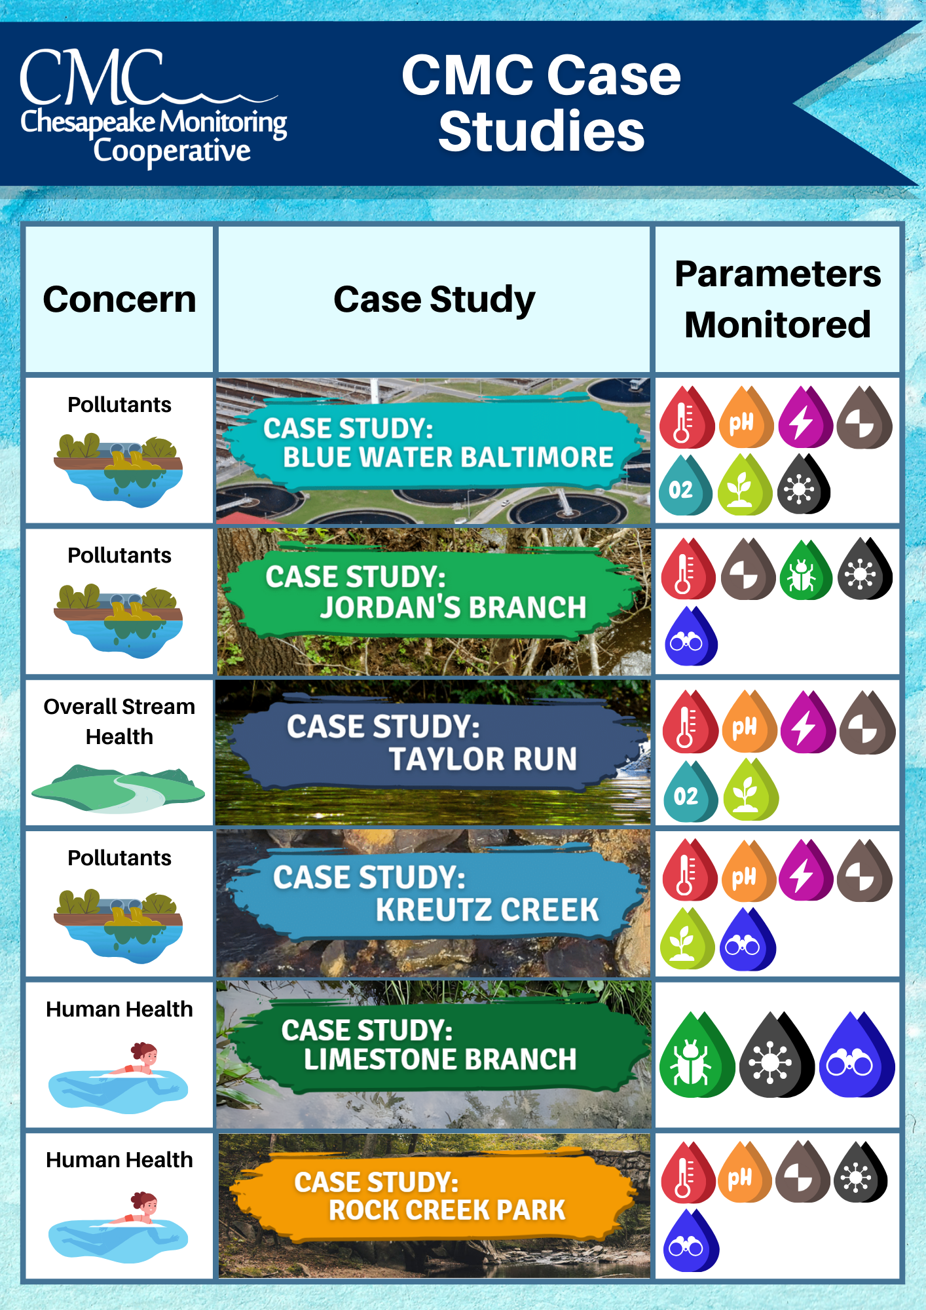
Making Connections
Communities
Connection Chart
Case Studies

Slide 13
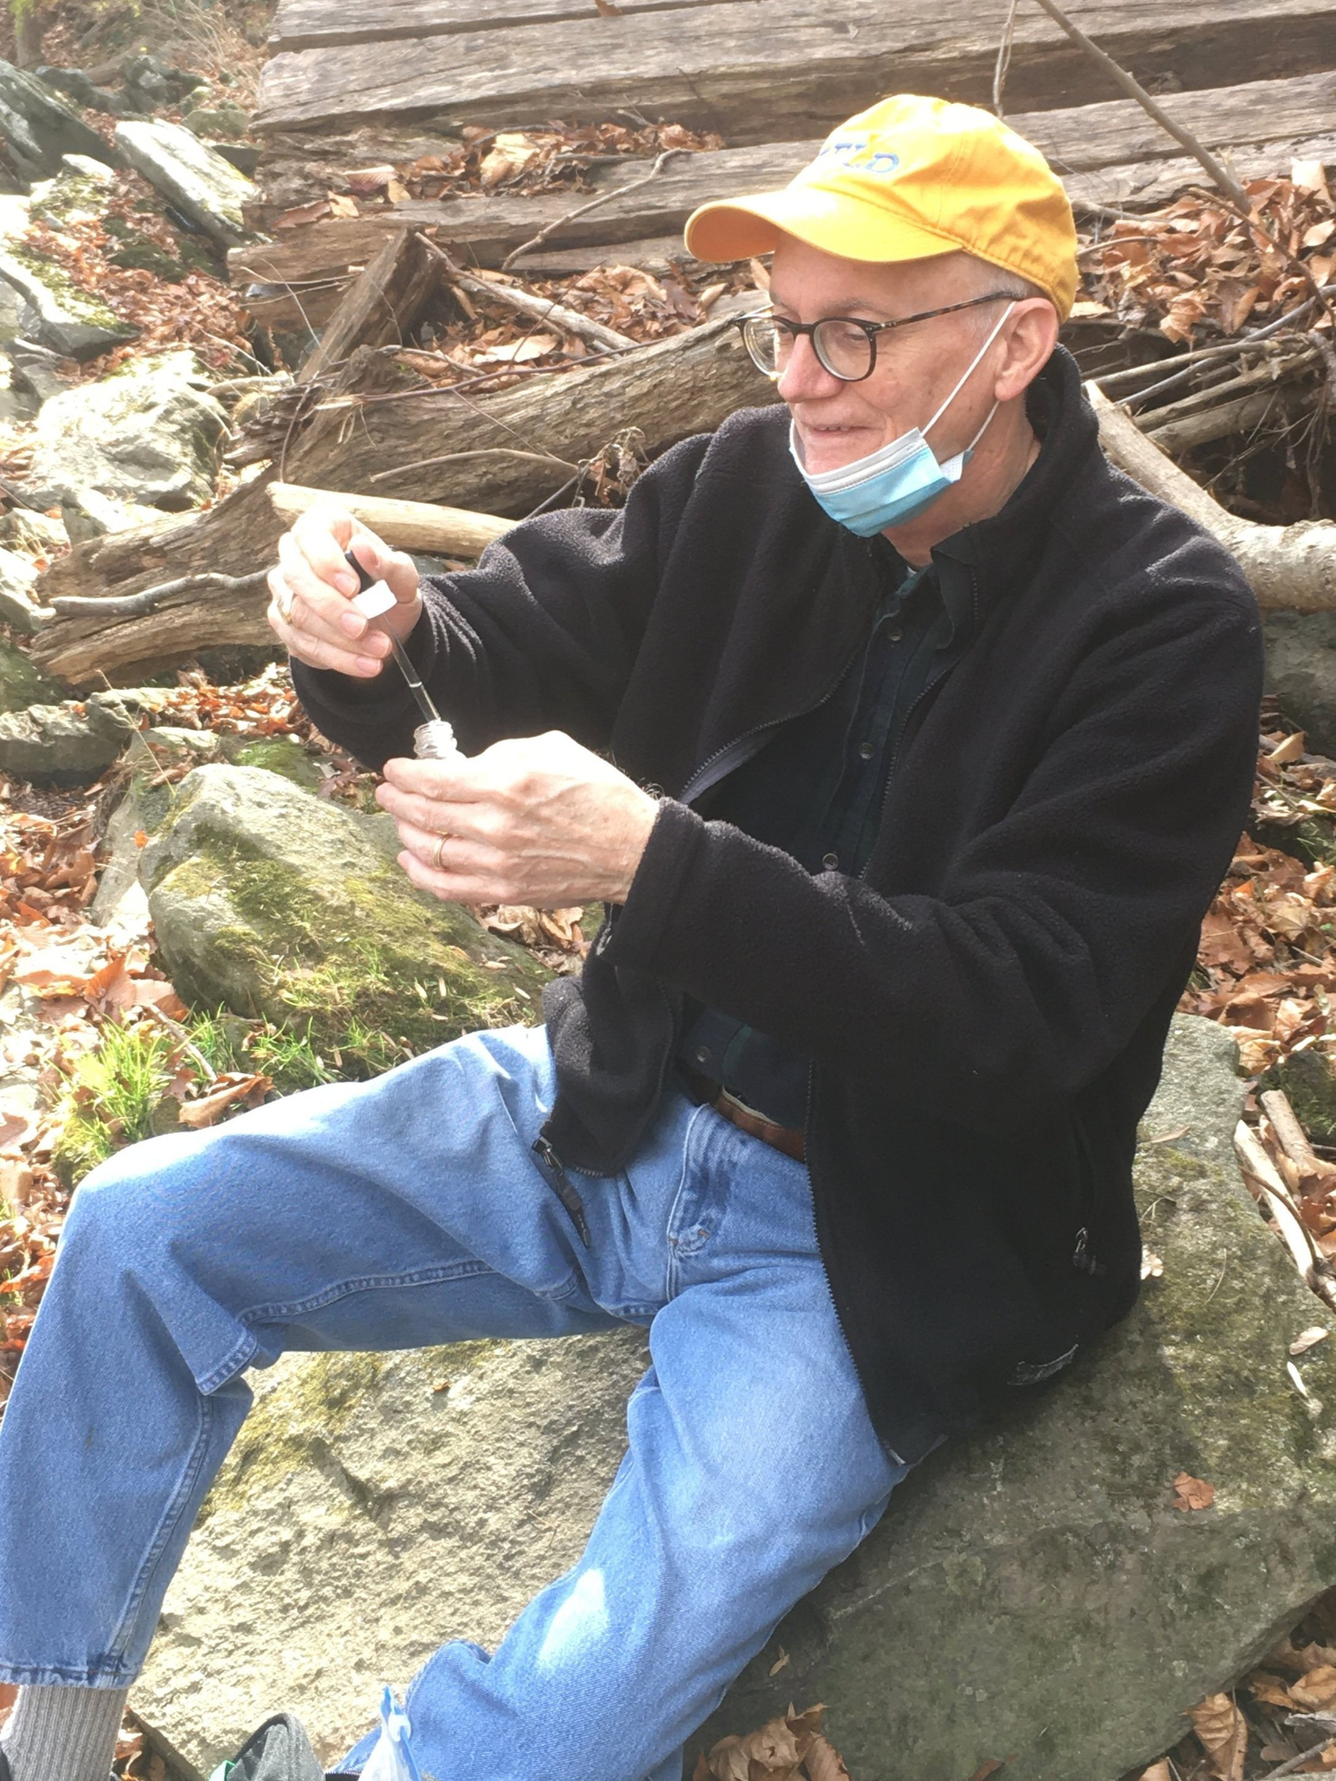
Next Steps
Moving Forward:
Identifying service provider specific projects (i.e., Integrating Salt Watch to provide accessible monitoring & datasets)
Continue building relationships with underrepresented groups, including HBCUs and Virginia Indian Tribes
Remaining committed to an inclusive environment, empowering all communities in the Chesapeake Bay watershed.

Slide 14
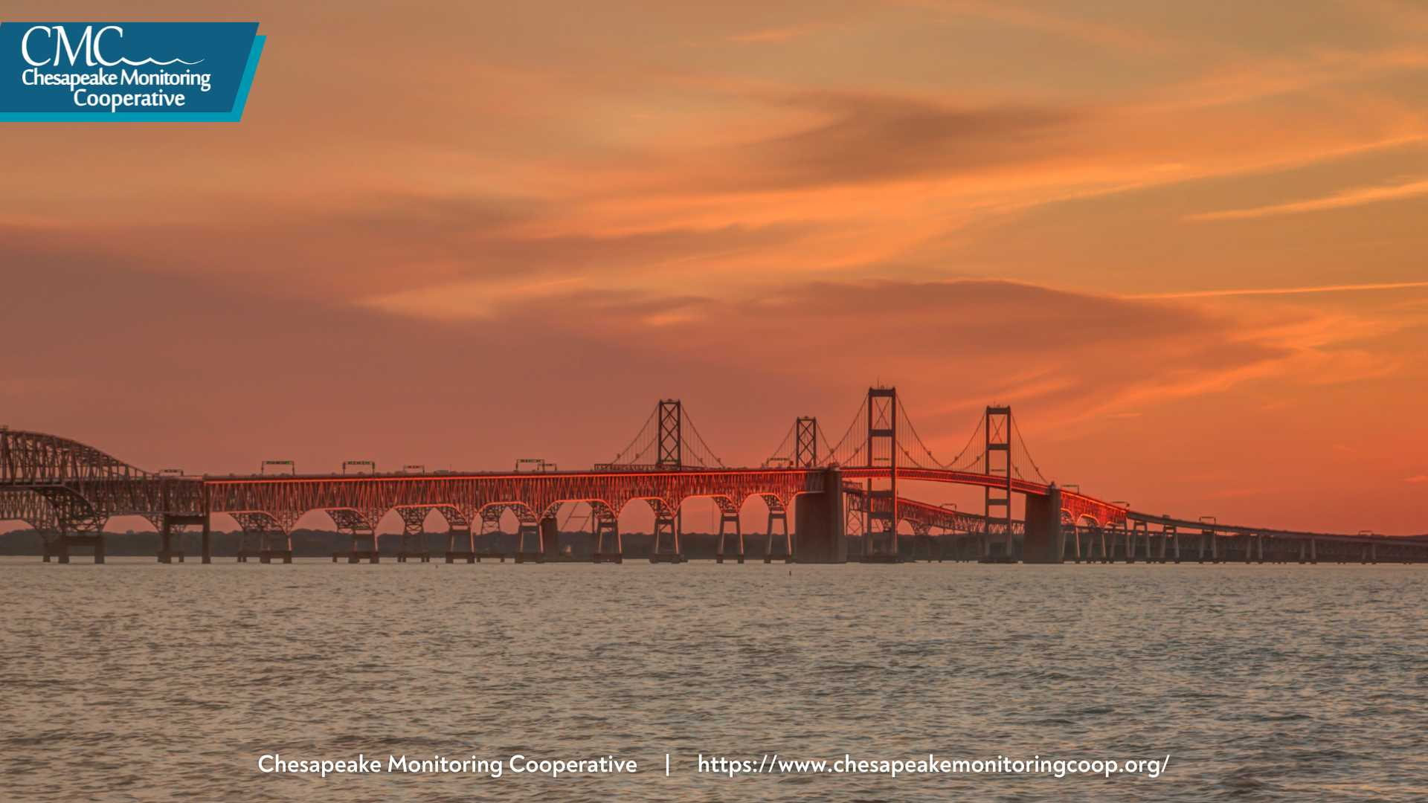
Thank you!
Matthew Kierce
Chesapeake Monitoring Outreach Coordinator
Izaak Walton League of America
mkierce@iwla.org

